Slide 1
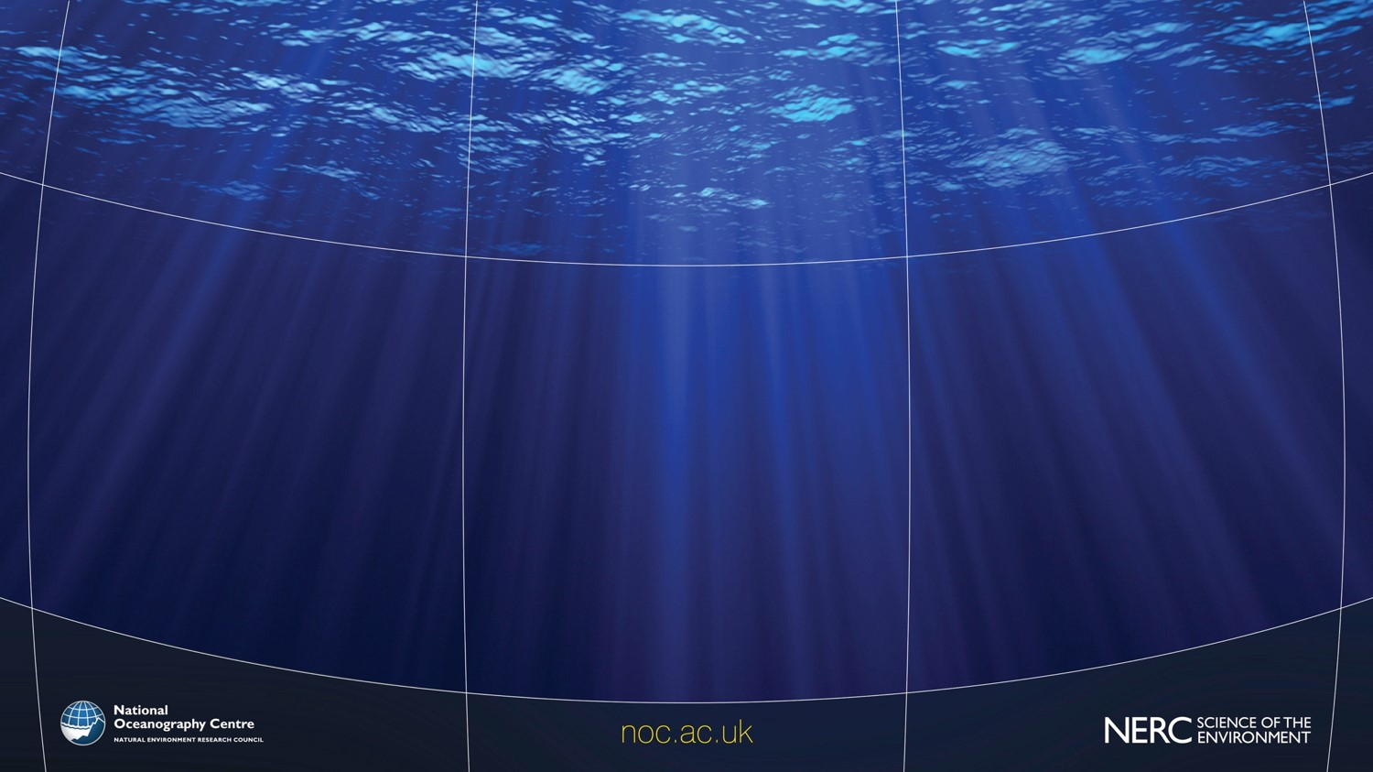

The role of science in planning for coastal protection
Amani Becker

Slide 2
Structure of Talk
Introduction
  Coastal hazards and vulnerability
  About NOC
Measurement
  GNSS tide gauge
  C-RISe: Coastal Risk Information Service
  Nearshore monitoring using radar
  Wirewall
Modelling for adaptive coastal management
  ARCoES Decision Support Tool
Notes:
how research can assist planners in understanding and addressing challenges of protecting the coastal environment whilst developing the blue economy; carrying out coastal urban regeneration; and in light of climate change.

Slide 3
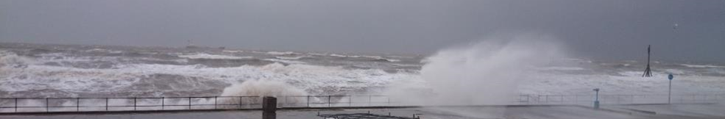
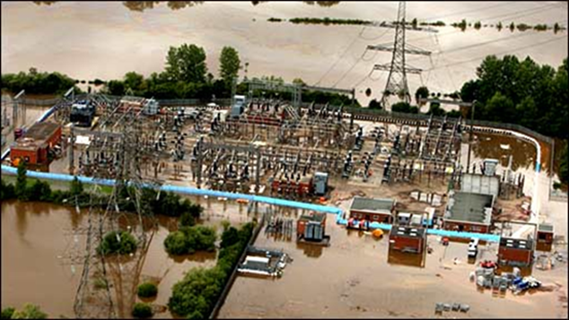
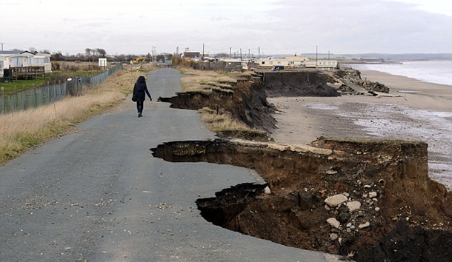
Coastal Hazards and Vulnerability
Climate Change, Sea-level Rise, Storms, Flooding, Erosion
Increasing coastal population, infrastructure

Slide 4
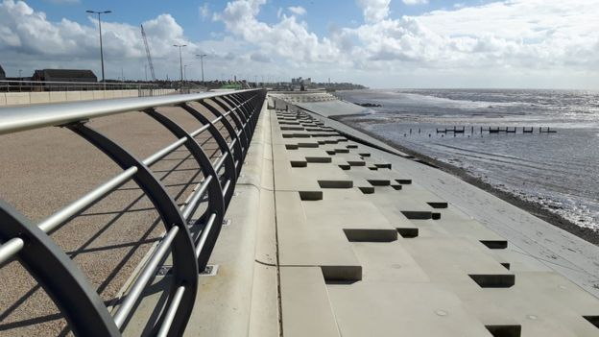
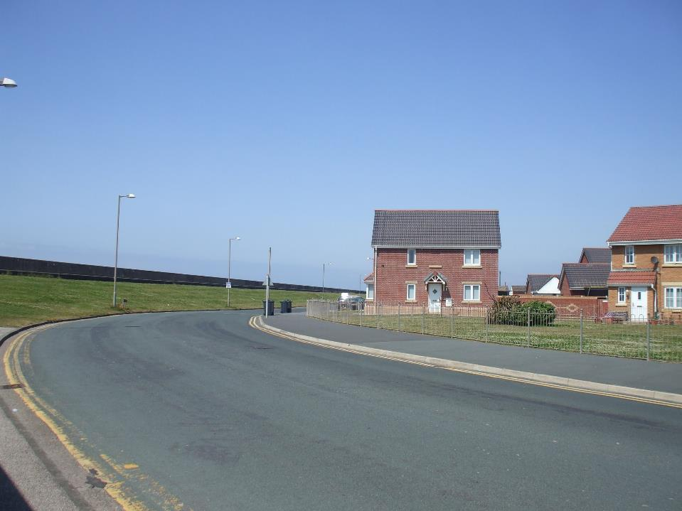
Coastal Hazards and Vulnerability
In the UK £150bn of assets and 4 million people are at risk from coastal flooding.
3,200 kilometres of defended coastline.

Slide 5
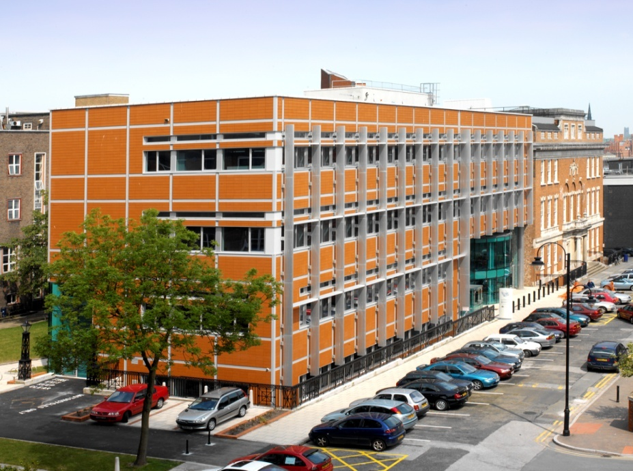
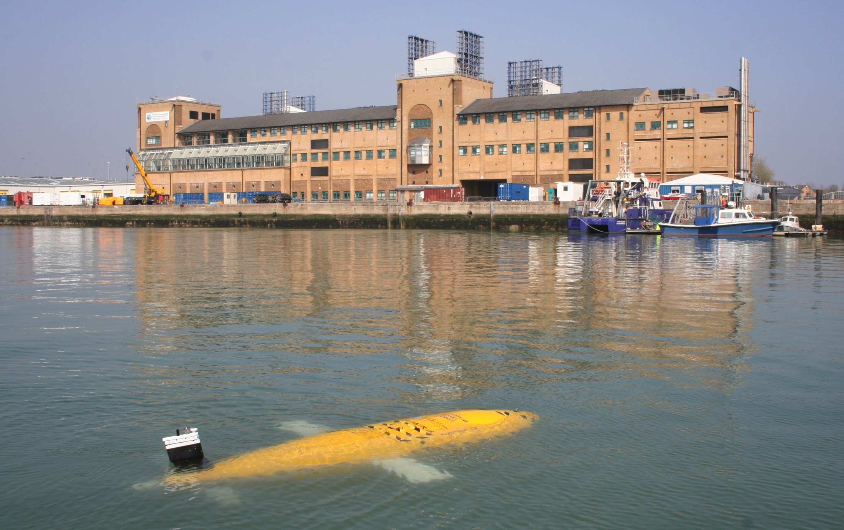
The National Oceanography Centre
Based across two sites, Southampton and Liverpool
Both co-located with Universities
>600 staff (~200 scientists and technologists)
Funded by UKRI/NERC, EU, Industry, Government Departments and Agencies

Slide 6
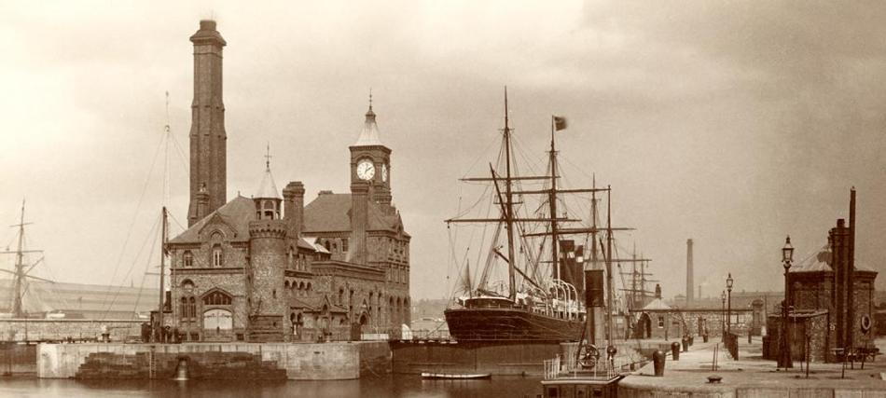
The National Oceanography Centre
Long history of tidal and sea level science
1845 Liverpool Observatory was created to support the shipping industry
From 1920s to 1950s two thirds of the world’s tides were calculated in Liverpool

Slide 7
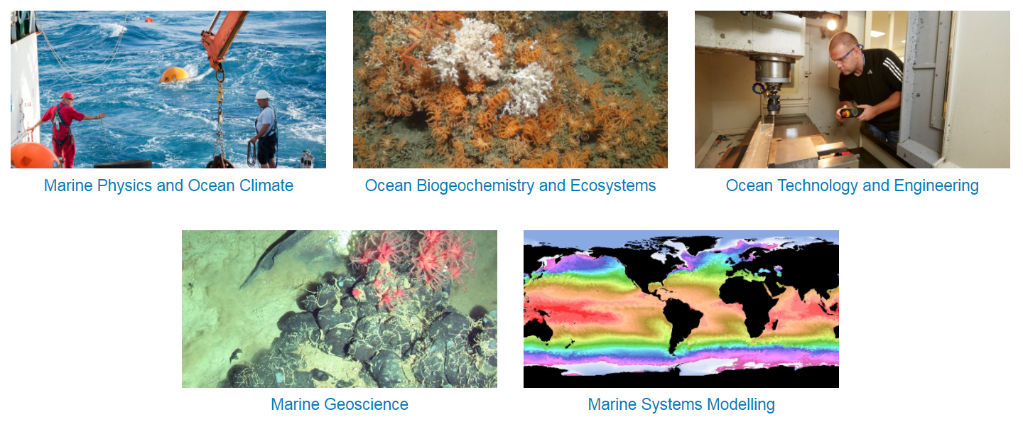
The National Oceanography Centre
Notes:
Science delivered around 5 themes

Slide 8
Marine Spatial Planning
Making decisions about the competing uses of limited coastal space
Planning theory and practice
Marine realities (science and policy)
Planning at the coast must be based on good understanding of the environment and coastal processes
Spatial theory (cultural geography)
Stephen Jay,
University of Liverpool
Notes:
Any good plan will consider all actors

Slide 9
Monitoring and Modelling at the Coast
Decision support tools
Characterising the coastline
Understanding coastal dynamics
Necessary for design
Validating models
Predicting impact of proposed interventions
Tracking impact of any intervention
Modelling
Measurement

Slide 10

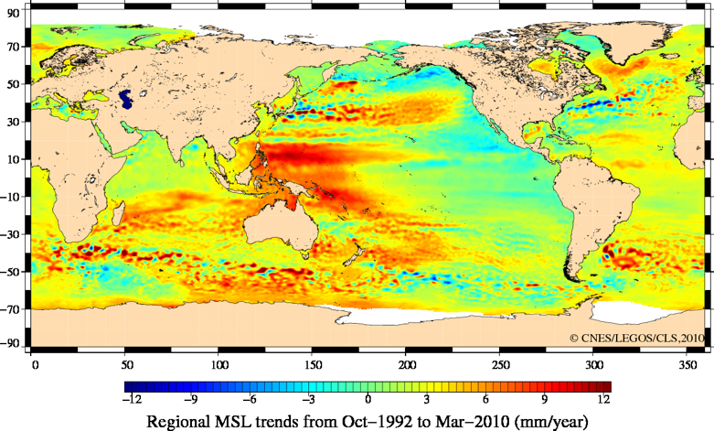

C-RISe: Coastal Risk Information Service
Few long term records from tide gauges
Vulnerable populations and infrastructure
Improved regional information enables planning
Notes:
C-RISe provides satellite derived data on sea level, winds, waves and currents to partners in Mauritius, Mozambique and Madagascar, supplementing climate projections with seasonal and regional information, to help understand and address a wide range of issues from coastal erosion and impacts on ecosystems to port design and navigation.

Slide 11









C-RISe: Coastal Risk Information Service
Improve resilience in vulnerable coastal areas by ensuring that C-RISe data are used:
in decision making processes
in climate adaptation strategy documents or management plans
to mitigate and prevent impacts from coastal inundation
to reduce risks to marine traffic and offshore activities
Notes:
C-RISe provides satellite derived data on sea level, winds, waves and currents to partners in Mauritius, Mozambique and Madagascar, supplementing climate projections with seasonal and regional information, to help understand and address a wide range of issues from coastal erosion and impacts on ecosystems to port design and navigation.

Slide 12
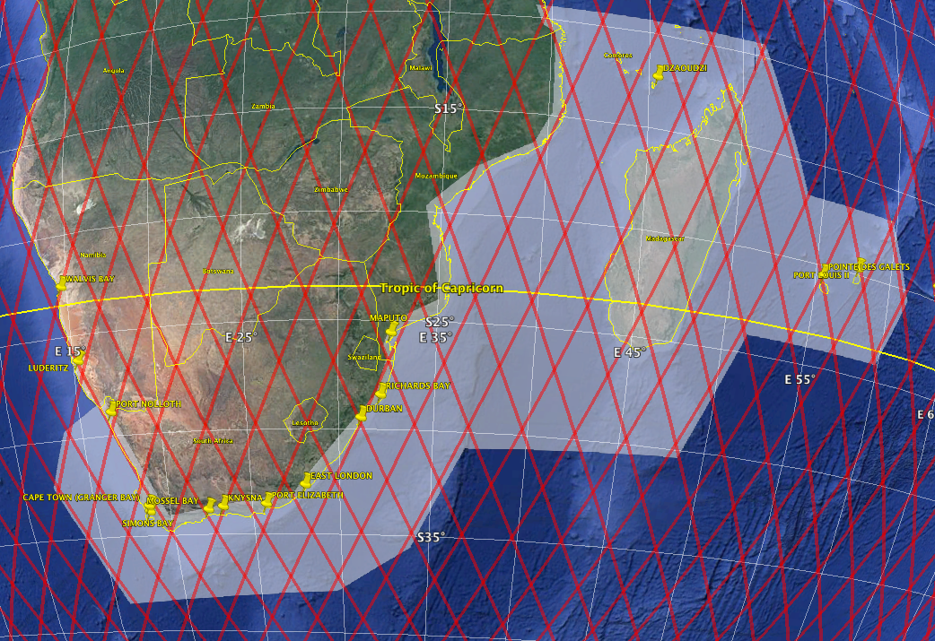
C-RISe Satellite data
Along-track satellite data reprocessed with the NOC Coastal Processor. 2002-2019. Parameters include total water sea level and sea level anomaly
Sea state (significant wave height) and wind speed climatologies, 1992-2019.
Surface current climatologies.
Near Real Time satellite wind and wave data, overlaid on model forecasts.

Slide 13
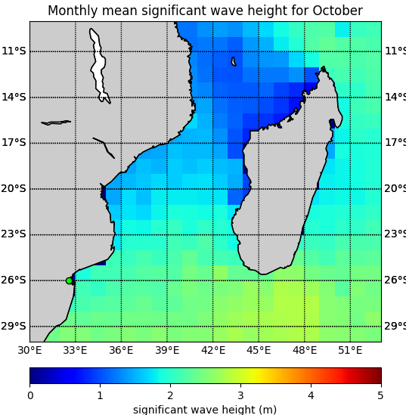
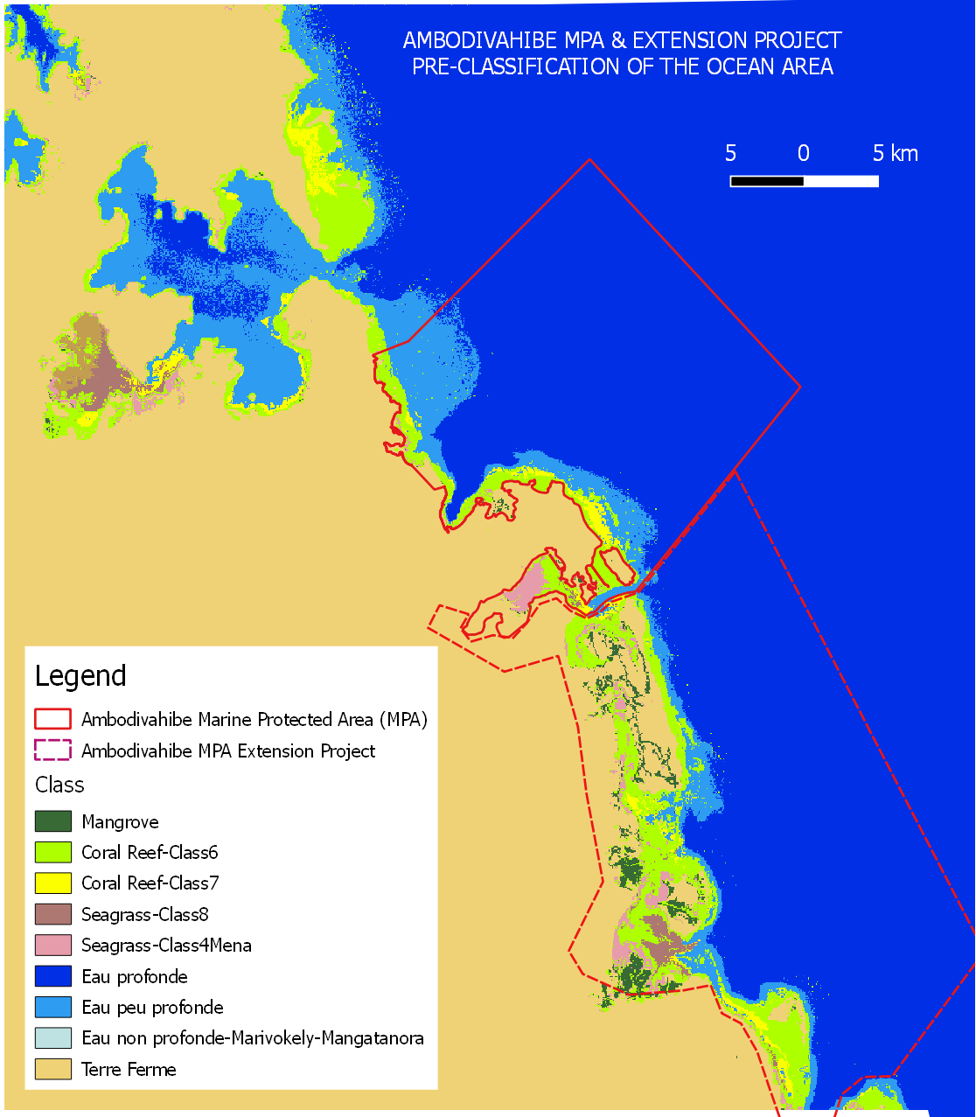
C-RISe Use Cases
Partners in Madagascar and Mozambique have so far delivered 25 Use Cases including:
Tidal analysis for Nacala, Mozambique
Analysis of regional variability in sea level change
Effect on mangroves (Bons Sinai, Mozambique and Menabe and Melaky, Madagascar)
Support for Management of Ambodivahibe Marine Protected Area (MPA)
Coral reef resilience
Effects on shrimp fisheries

Slide 14
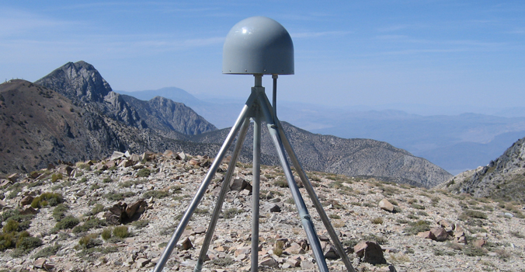
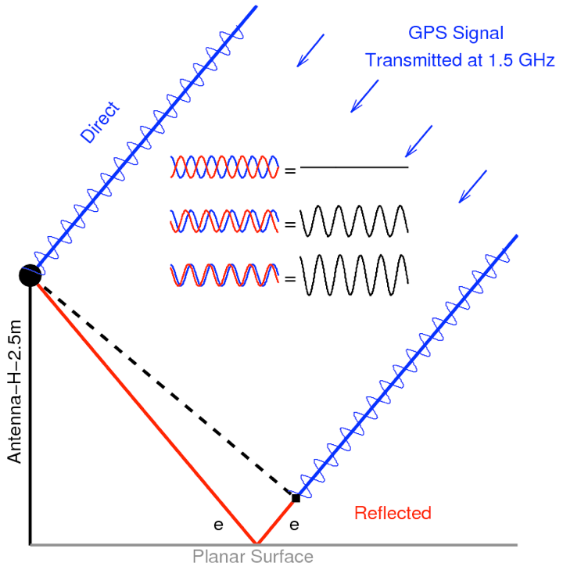
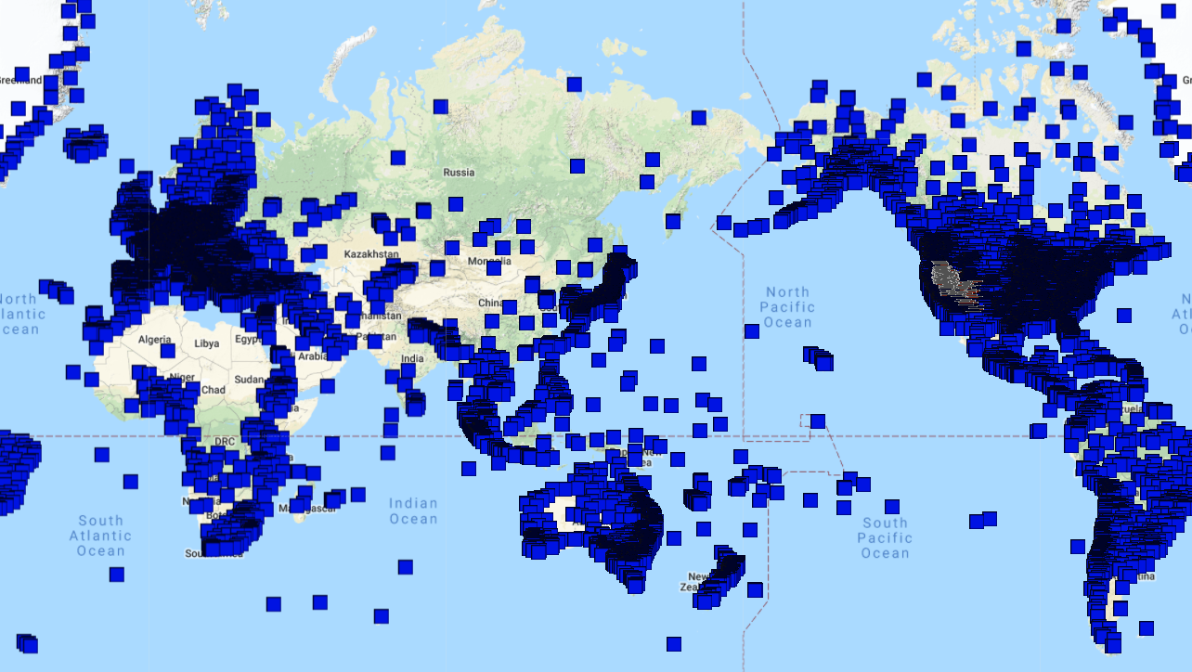

Measuring Tides Without Getting Your Feet Wet
GPS antenna
over 15000 permanent continuously operating GNSS sites
RH = reflector height
Notes:
Uses multipath – sensor picks up reflected and refracted signals as well as the direct ones

Slide 15
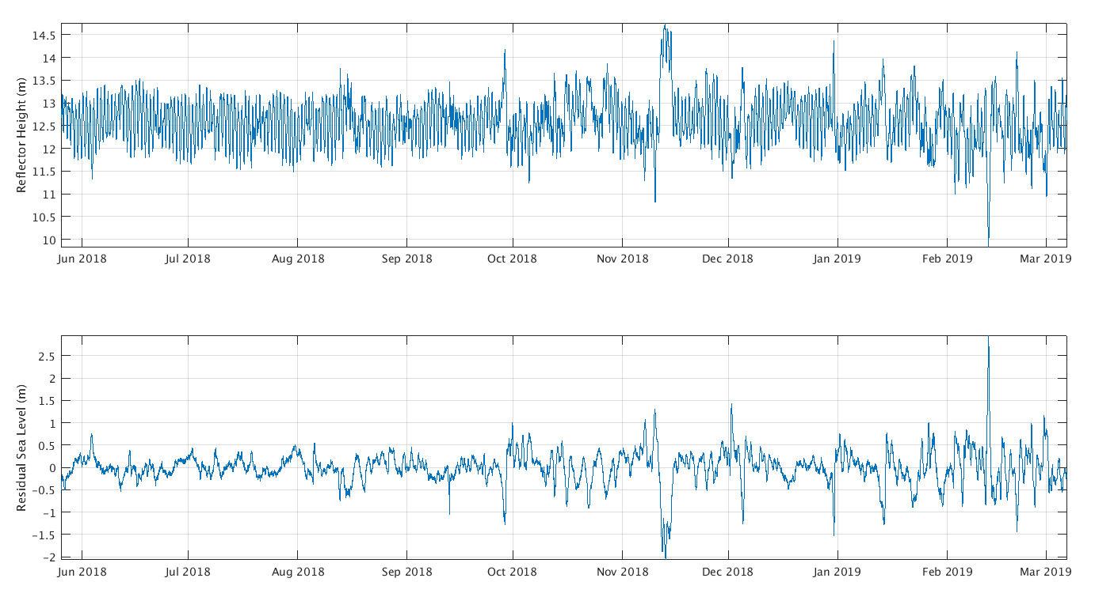
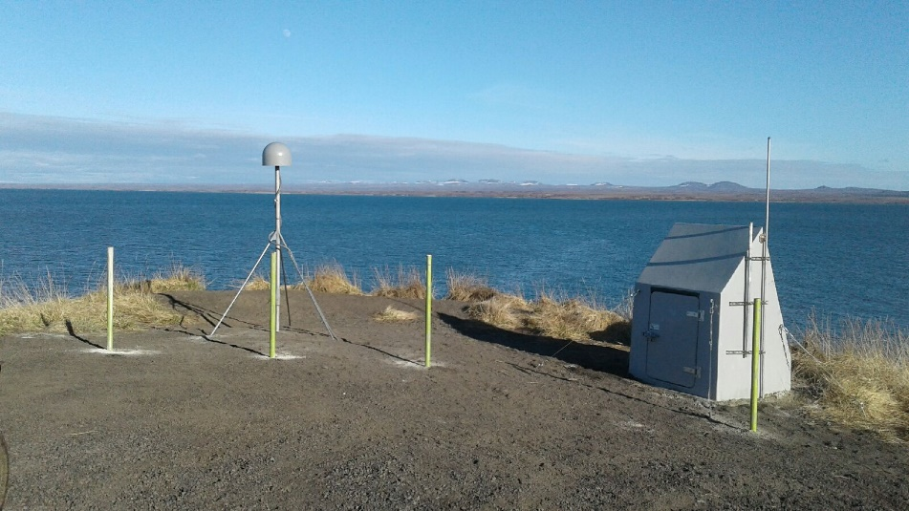
AT01 : Saint Michael Bay Alaska

Slide 16
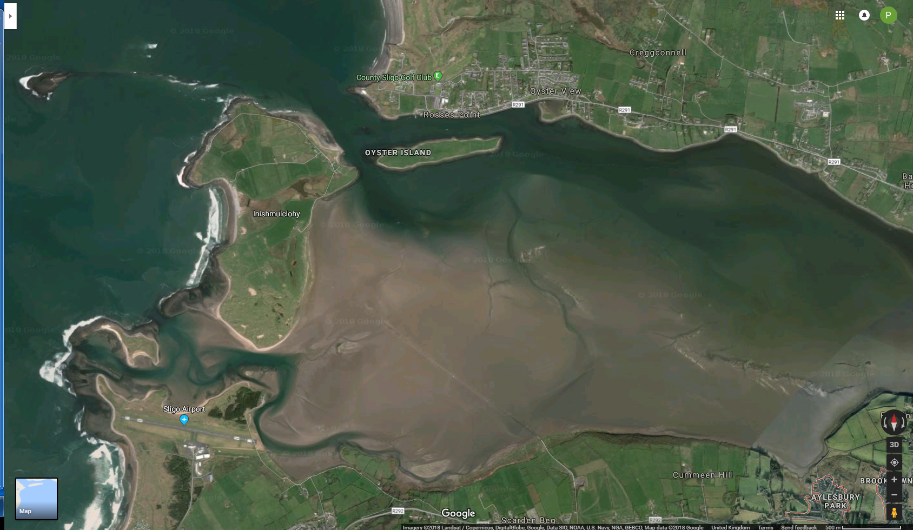
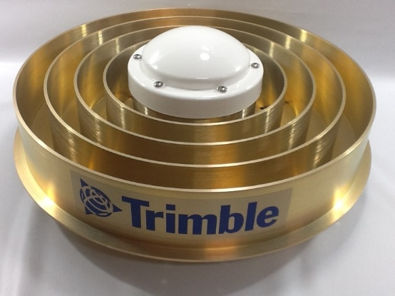
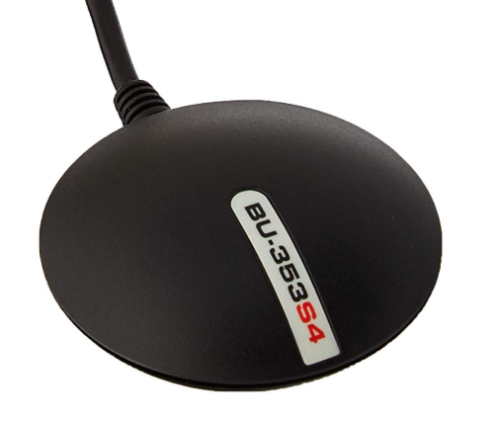
LOCTIPS: NERC innovation award to test low cost GPS receiver to measure sea level
Collaboration with the RNLI to provide tidal information for predicting when people can safely travel to and from Coney Island over the strand
Notes:
Installing an affordable version just for tides
GNSS receiver was installed to measure land movement using a geodetic quality instrument (~£10k) with an antenna designed to reduce multipath
But what if we can get away with a cheap £100 receiver and antenna and point the antenna towards the sea?

Slide 17
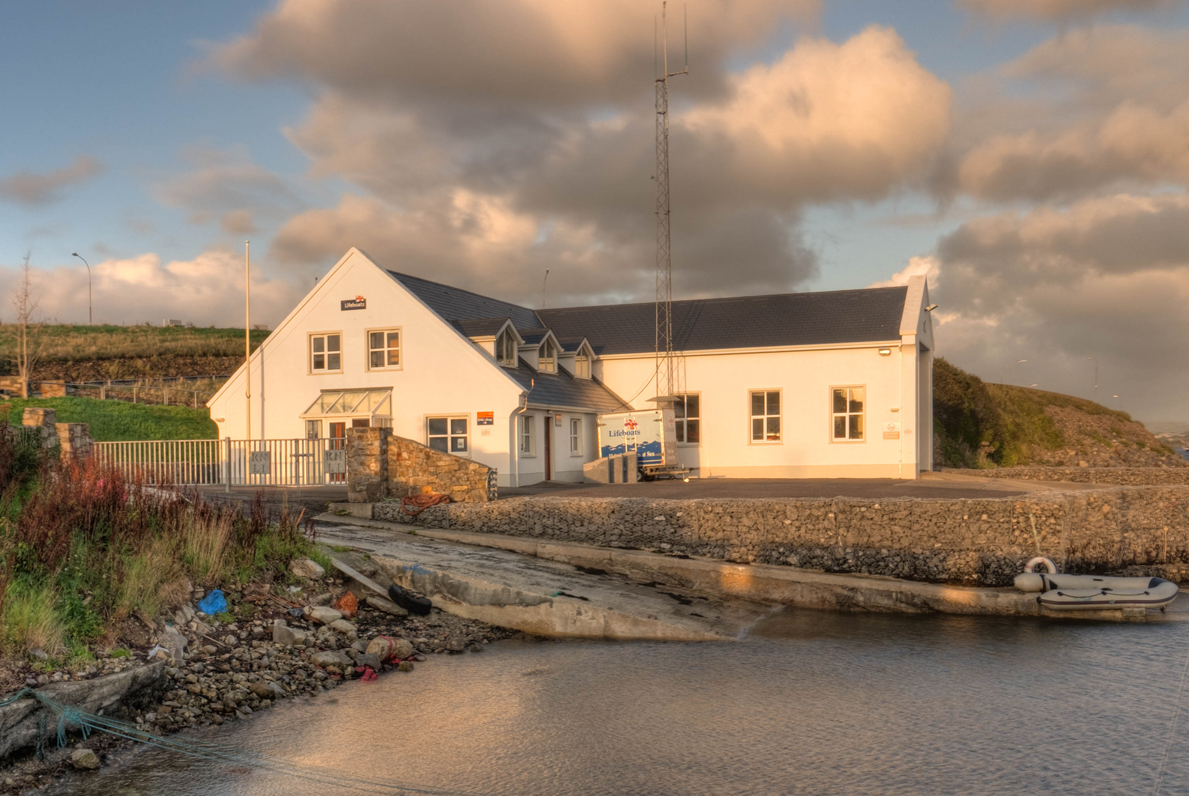
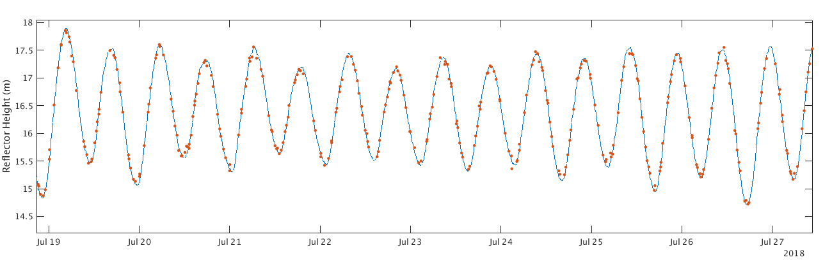
Comparison to tide gauge
Orange dots : GPS
Blue Line : tide gauge

Slide 18
± of the GPS Tide Gauge
+ The tide gauge is defined in an International Terrestrial Reference Frame (ITRF).
+ Straight-forward to operate.
+ No moving parts in (salty or frozen) water.
+ Could be attached to buildings.
+ Easily relocatable (used for temporary applications).
+ Could be niche tide gauge for polar regions.
+ Not just for tides.

Slide 19
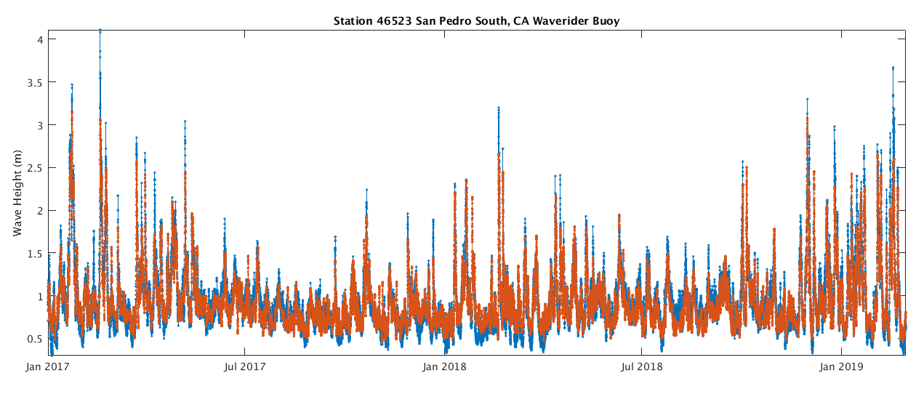
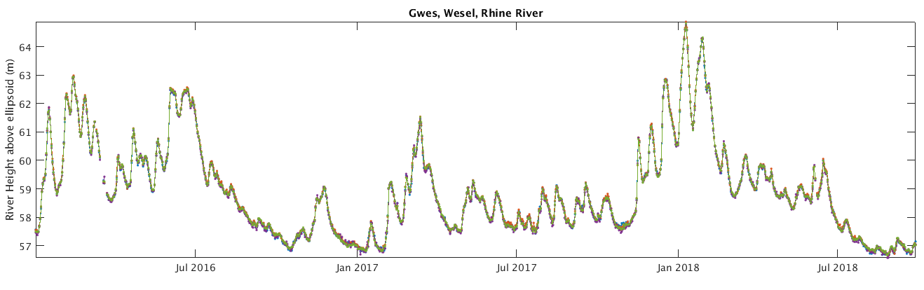
Not just for tides…
Blue: Waverider Buoy
Orange: GNSS Derived Wave Heights
Waves
River levels

Slide 20
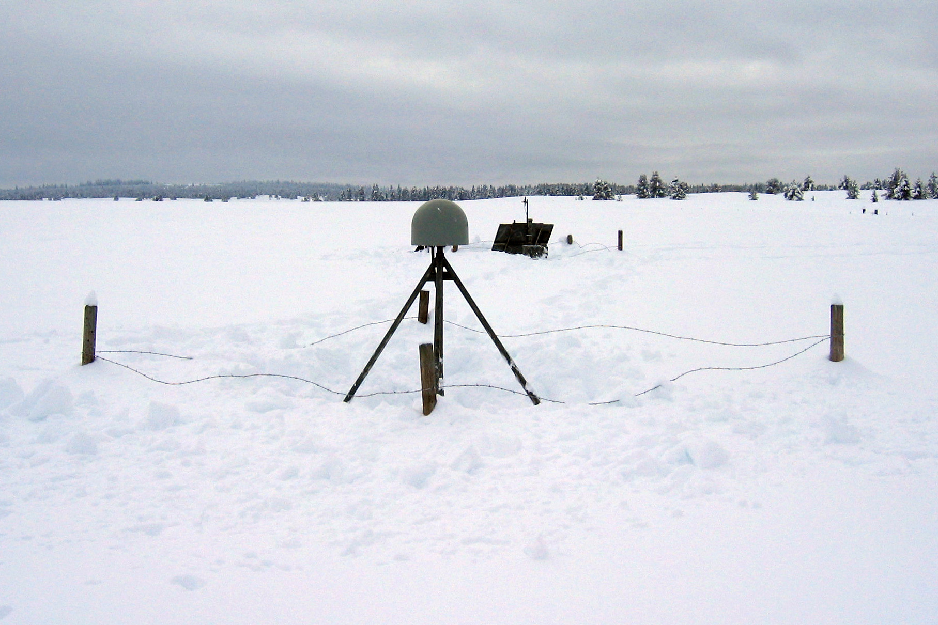
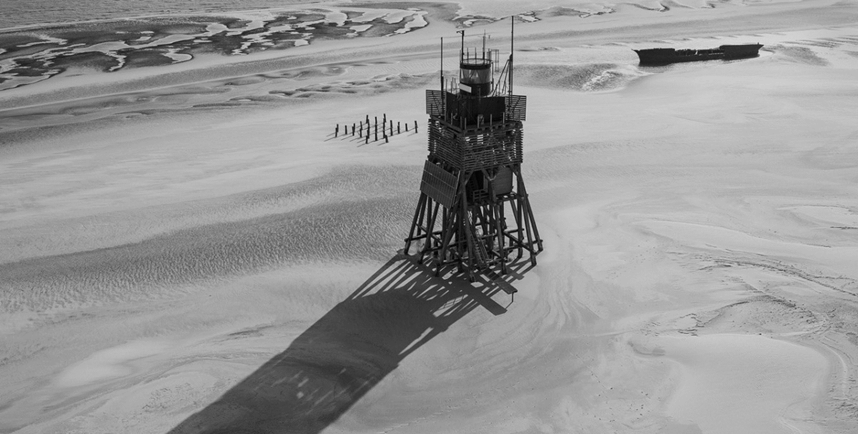
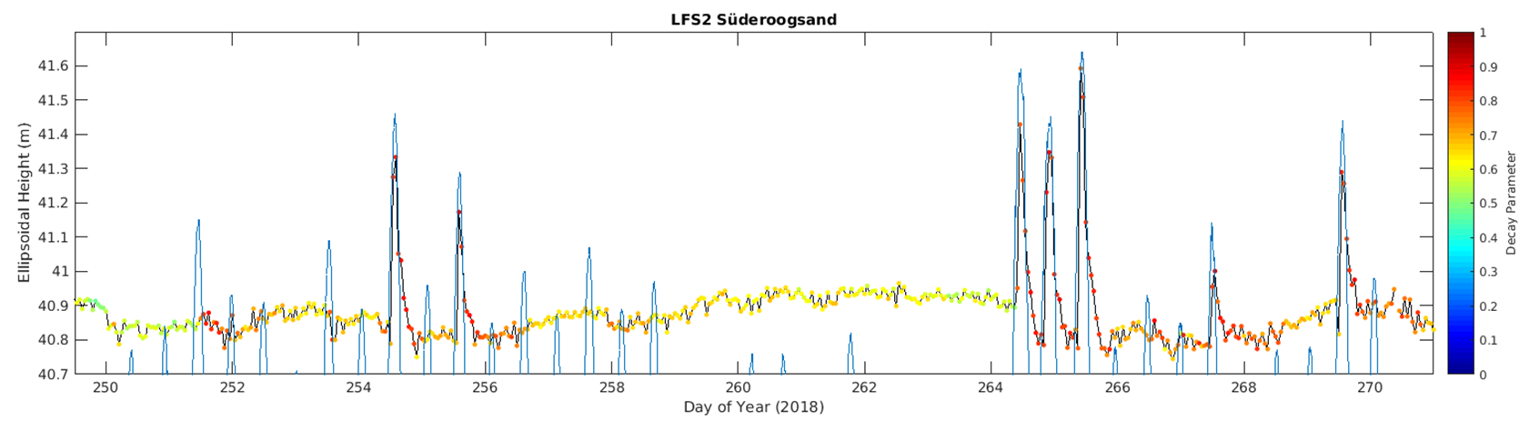
Not just for tides…
Snow level
Süderoogsand
Intertidal sediment

Slide 21
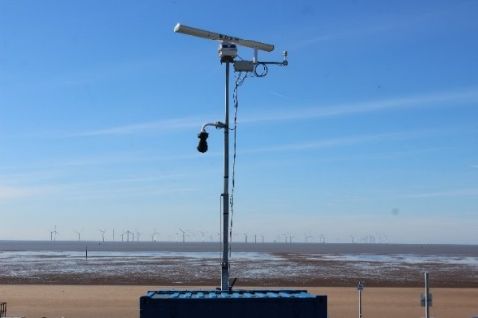
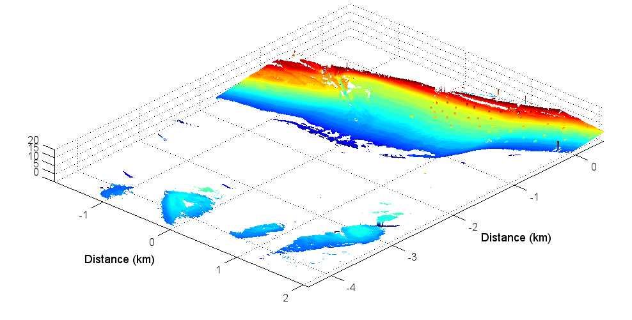

Radar-based nearshore monitoring
What does radar deliver?
Enables large coastal areas to be imaged within 4 km of the antenna.
Intertidal topography at 3 m resolution – every 2 weeks.
Bathymetry down to ~30 m – weekly.
Estimates of current speed and direction with ~200 m resolution – every 15 minutes.
Wave direction and period – every 15 minutes.
Supplementary radar imagery showing wave patterns, tidal flows and ships – every 15 minutes.
Automated, cost-effective, long term coastal monitoring.
Notes:
Overview of different data products that can be produced by a radar system
METHOD At each site Marlan Maritime Technologies deployed a radar survey platform with an 8m extendible tower. The radar produces an image every 2.5 seconds. Time exposure images like those shown below are created every 15 minutes and analysed over a 2-week period

Slide 22
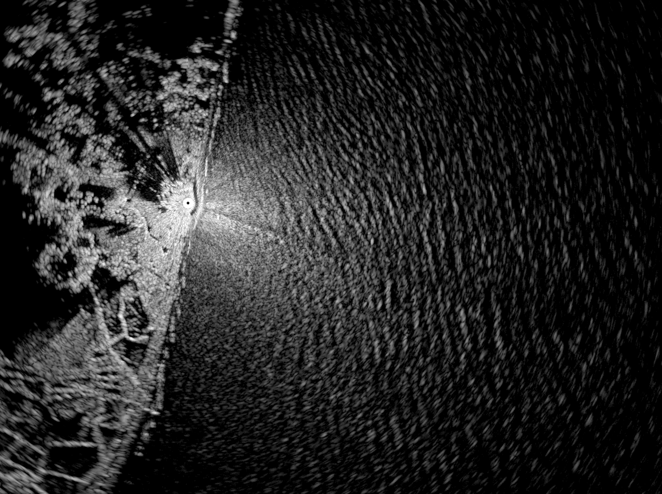
Radar-based nearshore monitoring - Minsmere
Monitoring storms and recovery
Assessing resilience of the offshore bank
Raw radar data show waves coming from the south east and the east during storm events in January 2018
Data are processed to derive bathymetry and surface currents
Notes:
Radar deployed at Minsmere over winter 2017/18
Information on direction and speed of waves from the breaking waves

Slide 23
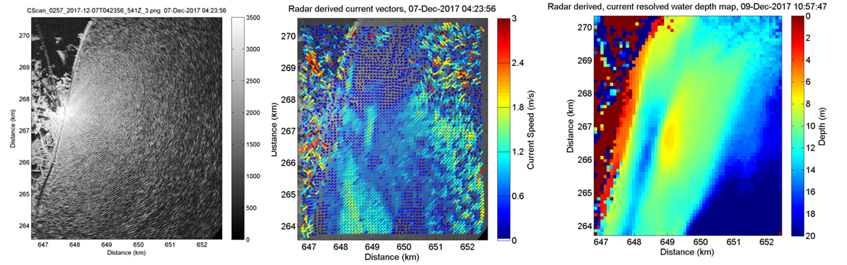
Radar-based nearshore monitoring - Minsmere
Notes:
On the left can be seen the raw radar data showing waves with very short wavelengths and a subtle but distinct change in wave propagation over the Dunwich sand bank ~1.5km offshore
Central panel shows vectors describing the radar-derived surface currents – operationally these vectors are updated every 15 minutes. Noise is present in the top right.
Currents are faster in the channel and to the south.
Where the waves are transformed (change speed and direction) the water is shallow, in areas where they are not the water is deep. Surface currents are therefore used to derive bathymetry (image on the right), through a process of wave inversion.
The right hand panel shows radar-derived bathymetry around Minsmere, the sandbank at Dunwich is clear with the deep channel running shore parallel
All of this information is used to analyse the response of the system to storms and assess the overall stability of the system prior to any potential nourishment or coastal defence intervention.

Slide 24
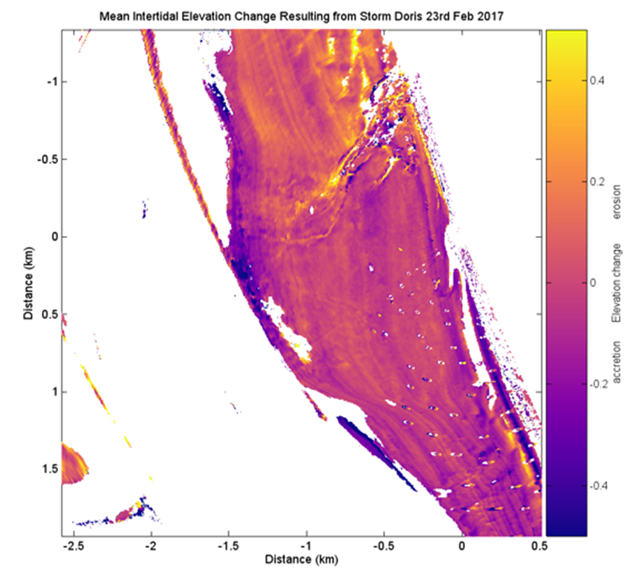
Response to storms
Continuous observation during storm events.
A survey is generated leading up to a storm and another following the storm.
Image shows the residuals between surveys generated before and after storm Doris 23rd February 2017.
~30 cm elevation changes in various regions of the beach and around the Alt river training bank to the north of the radar location.
Notes:
Radar monitoring provides continuous observation during storm events. Data can be processed such that a survey is generated leading up to a storm and another survey generated following the storm. The image shows the residuals between surveys generated before and after storm Doris 23rd February 2017.
There were significant ~30 cm elevation changes in various regions of the beach and around the Alt river training bank to the north of the radar location.
Can see that the area north of the training bank is accreting and south is eroding

Slide 25
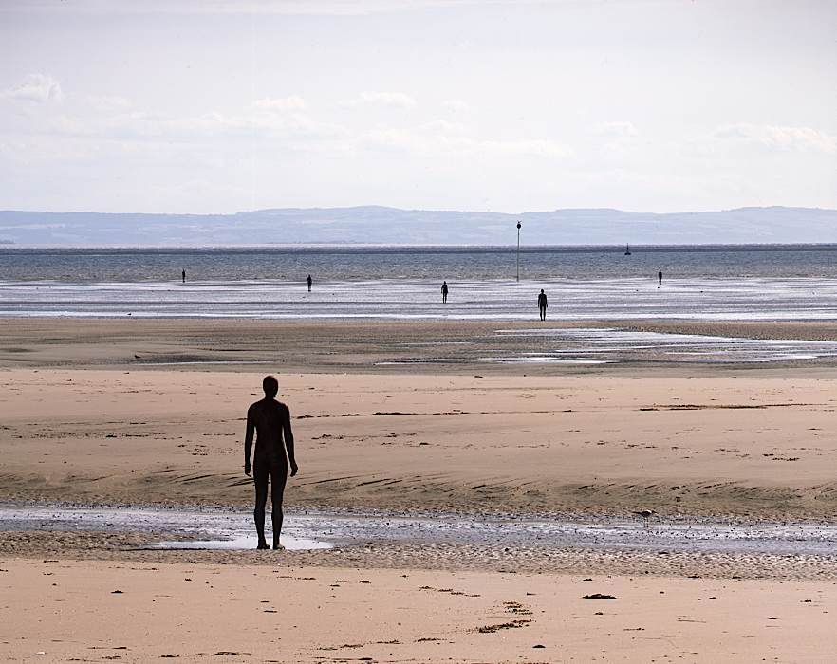
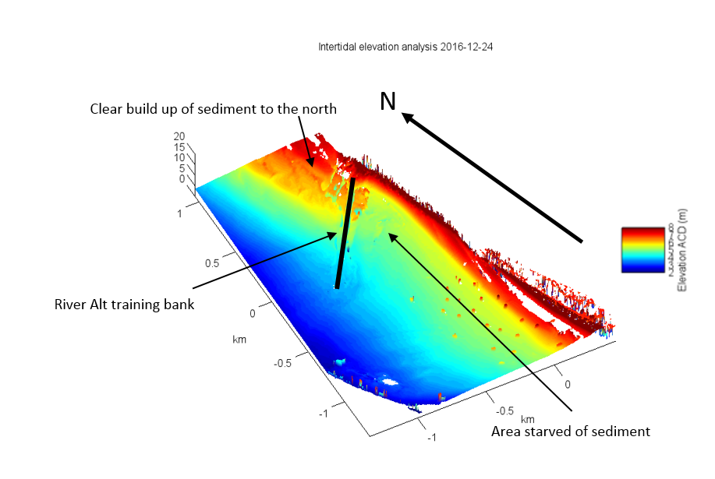
Potential beach nourishment site - Crosby
Volumetric assessment of sediment starvation around the River Alt training bank
Foot path at risk of erosion, along with waste water infrastructure
High spatial and temporal resolution data assisted decision making in regards to volume of nourishment required and potential placement locations

Slide 26

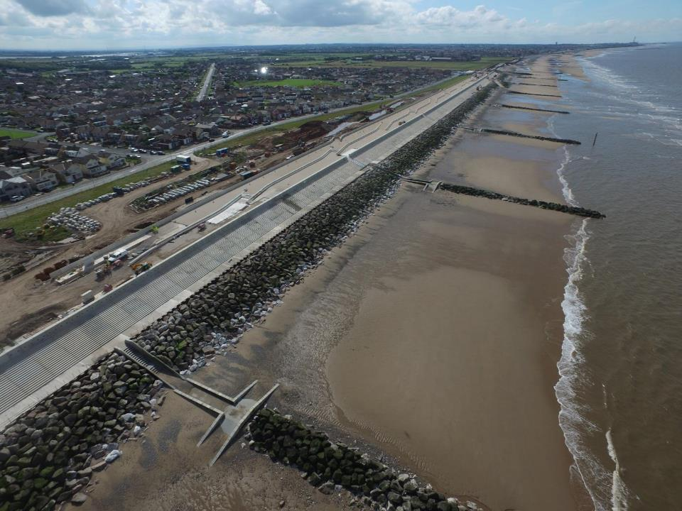
Construction of basic sea wall typically cost £12k-13k per linear meter.
Higher quality schemes cost £23k-24k per linear meter.
In addition to building a sea wall there are also other costs associated with reshaping the coastal frontage to enhance its aesthetics as an amenity.
Rossall (nr. Blackpool) is larger than anything previously in the UK.
The new 1.9 km scheme protects 7,500 properties from flooding & cost £63m.

Slide 27
Great uncertainty in overtopping estimates
Overtopping estimates are at best within a factor of 3
3 orders of magnitude in uncertainty in safety thresholds developed from numerical estimates
Large safety margins being factored into the design of new schemes
Costly overdesign of sea defences
Notes:
As stated earlier:
In the UK £150bn of assets and 4 million people are at risk from coastal flooding.
3,200 kilometres of defended coastline.

Slide 28
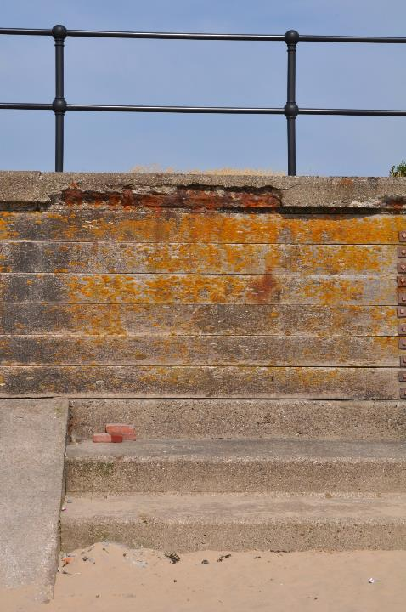
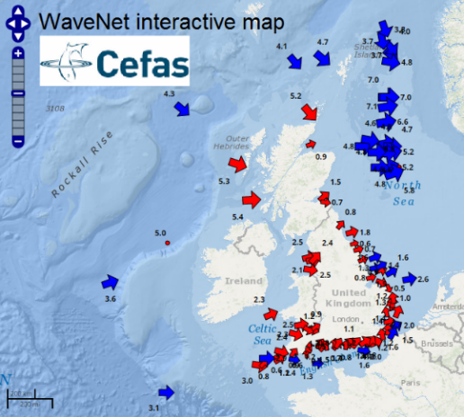
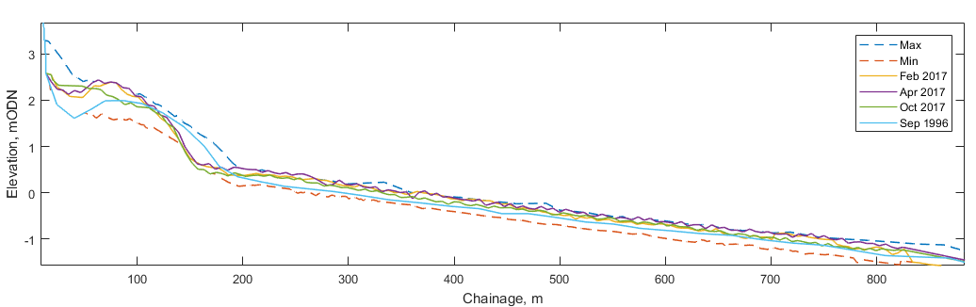
Crosby Case Study
New coastal scheme in planning
Large tidal range (>10 m springs)
Fetch limited waves (< 5.5 m, W-NW)
Available coastal monitoring data
Notes:
Biannual beach surveys + additional pre/post storm surveys collected when we deploy WireWall.
Weather
Water levels
Waves offshore

Slide 29

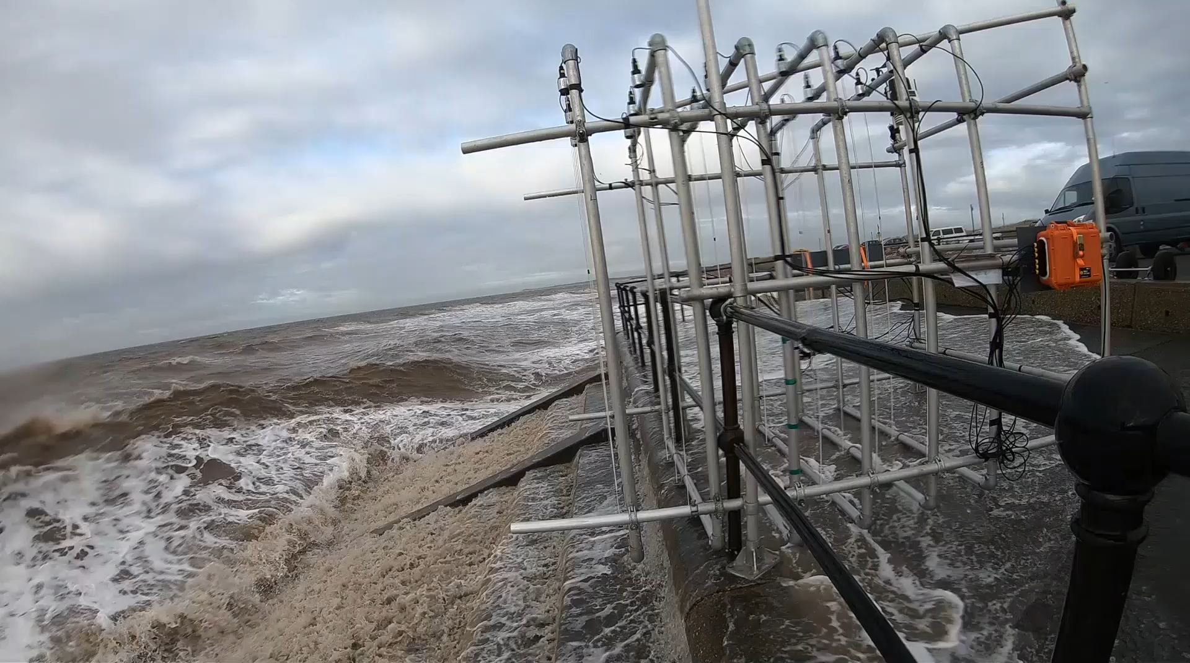
Notes:
An award winning relocatable overtopping measuring system, used to collect field observations of wave-by-wave overtopping velocity and volumes. It can provide site-specific data and calibrate overtopping tools to inform the design of cost-effective sea defences, which will provide protection from changing storm patterns and rising sea levels

Slide 30
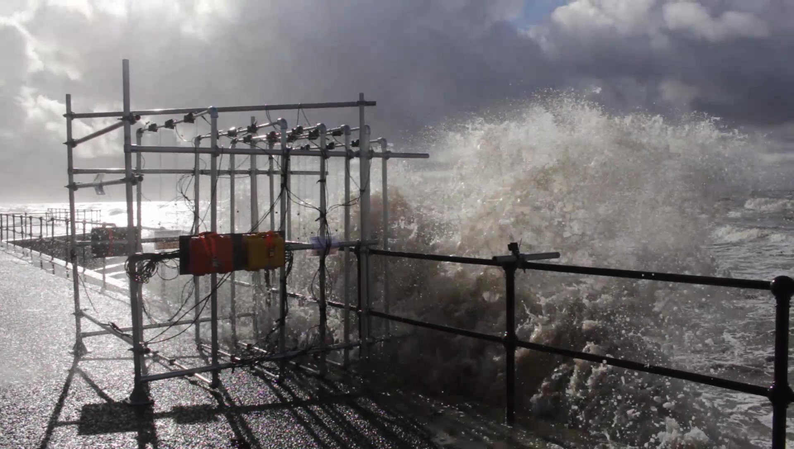
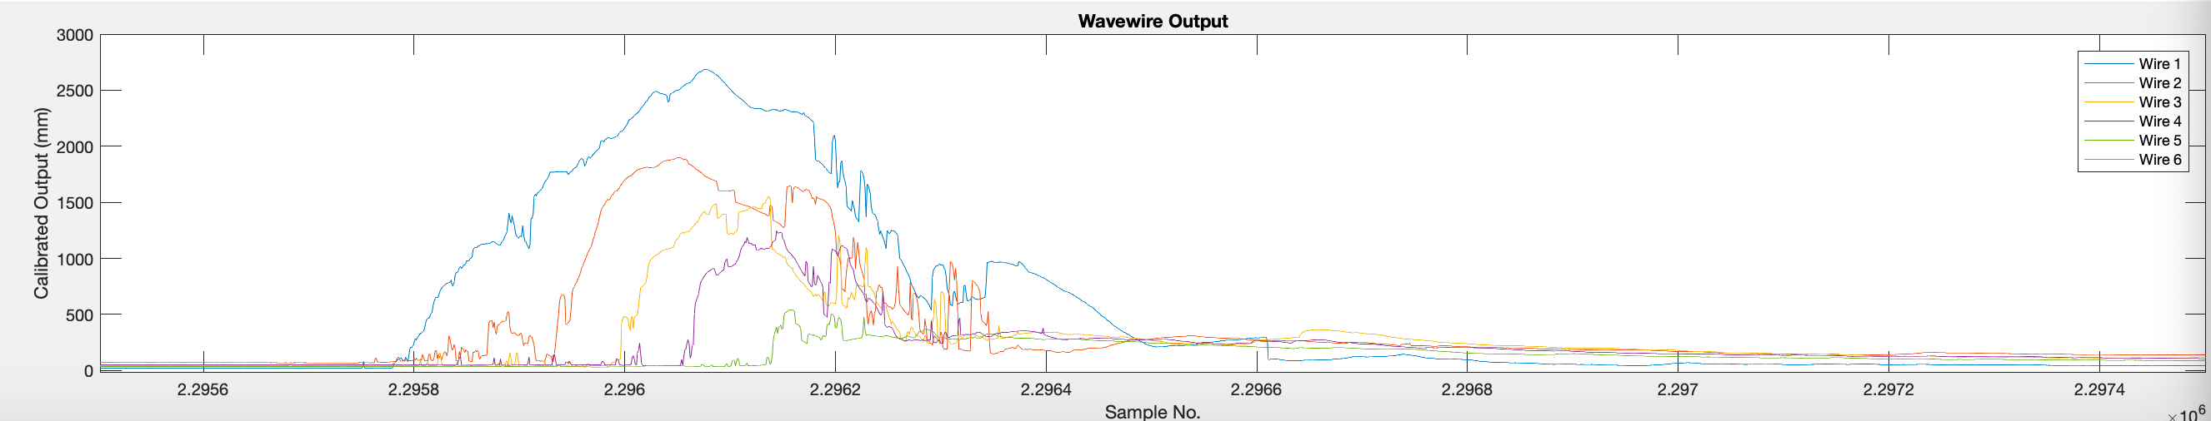
Wave-by-wave measurement
6
5
4
3
2
1
Sea WireWall Land
Notes:
This plot shows what the wave-by-wave data looks like.
3 rows of wires going from sea on the left to land on the right.
Over topping plume passing through the wires. Each line is the length of wire being wet. The time of the signal shows the water nicely passing through the wire, with a rapid increase in wet length and a slower return signal and the back of the plume comes through. As we go inland the max height of the plum is lower as it falls to land. Then after the plume there is a low elevated signal that’s slow to decay, which is the water slosh on the prom. Clever processing means we can separate the back ground slosh fromt eh plume and look at both components of the overtopping hazard.

Slide 31
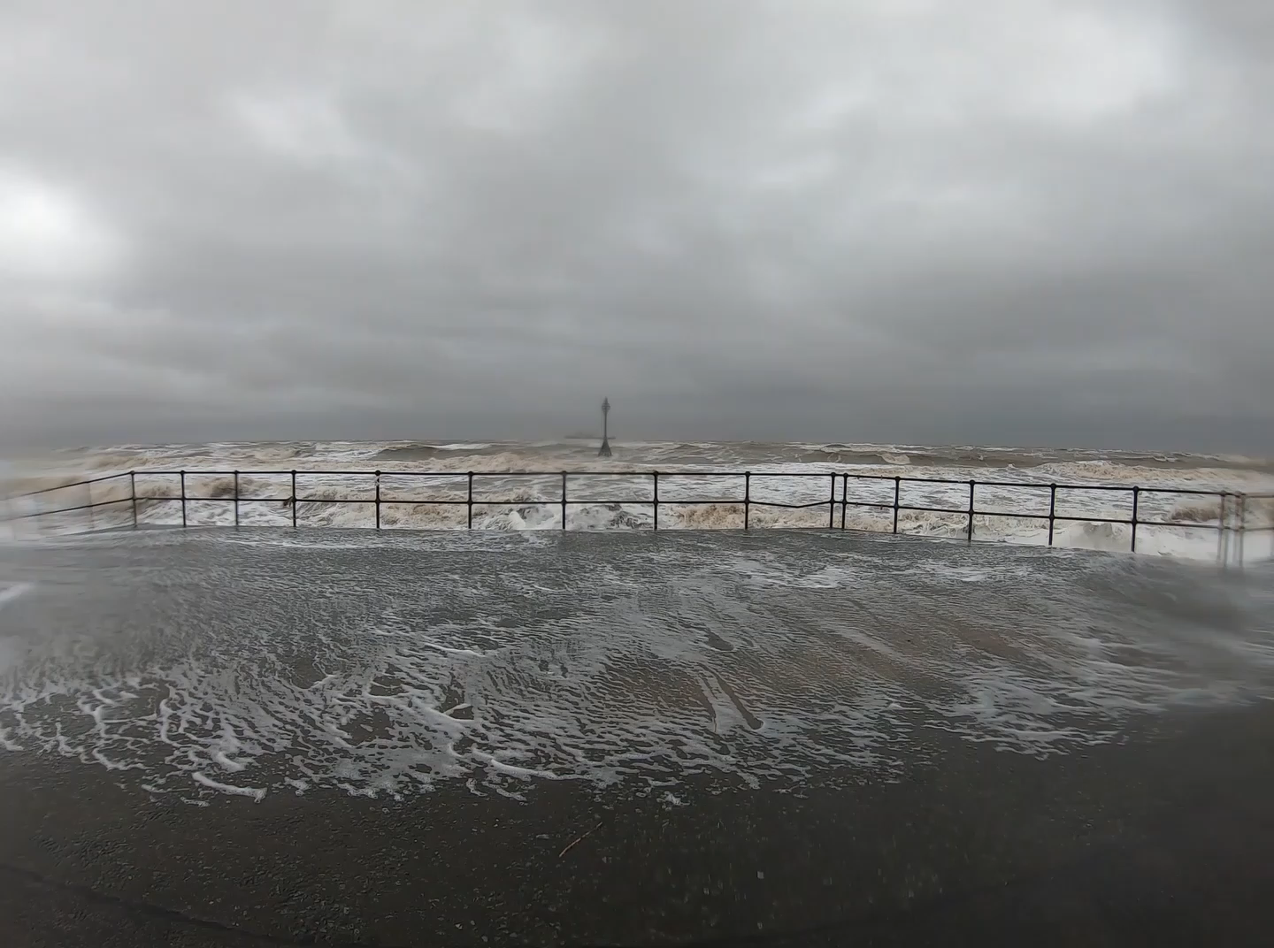
No alert from the EA this winter, but plenty of overtopping
Under prediction of the overtopping forecast
Notes:
Collected data (volumes, velocity and camera footage) to recalibrate the EA’s flood forecasting system for our site and validate the safety thresholds applied.

Slide 32
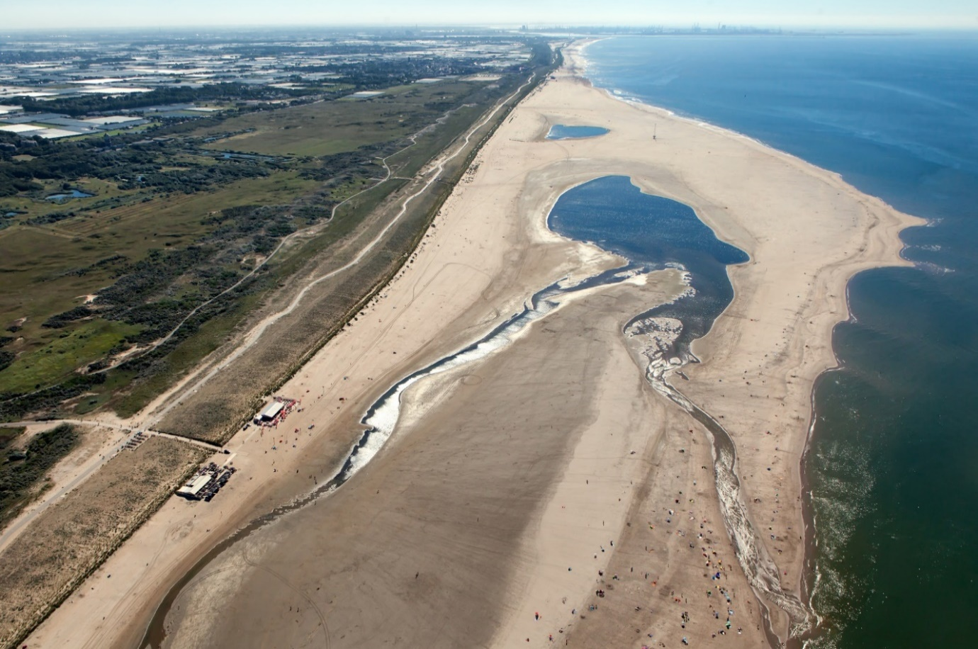
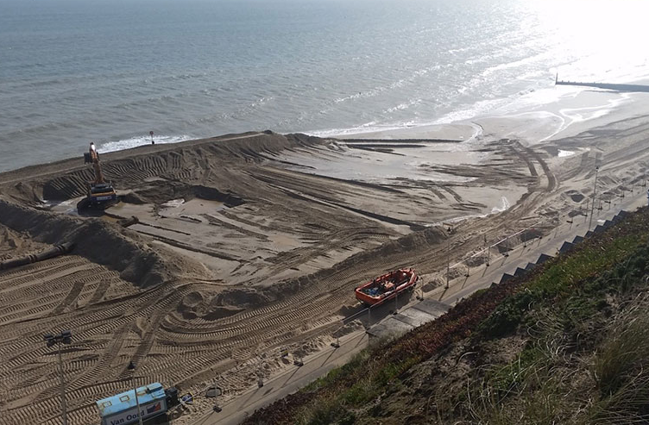
Modelling for adaptive coastal management
Mega-recharge
Beach recharge
Main points
20 million m³ sand
2-3 million m³ sand
http://www.dezandmotor.nl/en/the-sand-motor/photos-and-pictures/
https://poolebay.net/project/bournemouth-beach-replenishment-winter-201516/
Notes:
Coastal managers are looking to use softer schemes at the coastline to break up the hard engineered landscape and also provide space for habitat & recreation. Here we will be using exploratory modelling to access the potential impacts of using mega beach nourishment as a management option at a UK case study site.

Slide 33
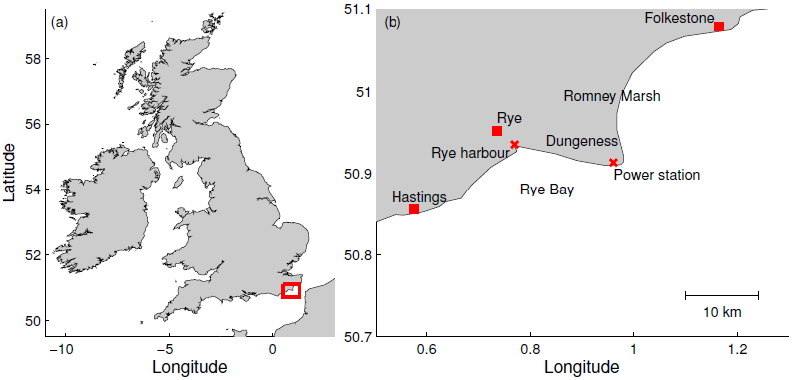
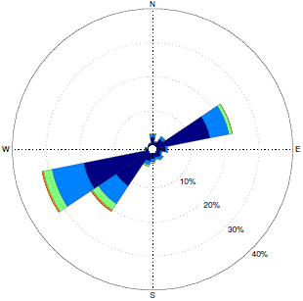
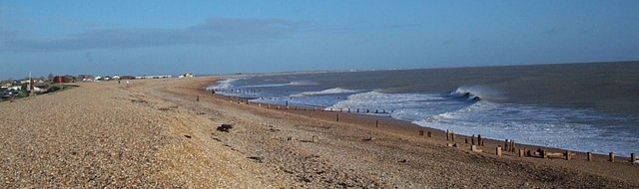
Dungeness (Rye Bay) – Advance the Line
© Copyright Elliott Simpson and licensed for reuse under this Creative Commons Licence, http://www.geograph.org.uk/
Notes:
Our case study site is Rye Bay in the SE of the UK. The shoreline is influenced by a macro-tidal regime with a mean range of 8.6 m, waves come from 2 main directions SW & NE to the region but only SW have impact for this shoreline orientation. The highest predicted tide 4.48 m ODN.
The bay is protected by a natural gravel barrier, which sits on top of a steep gravel beach. At either end there is infrastructure due to the power station and harbour. The bay is also part of the SSSI and forms the ranges for the ministry of defence to practice. The Environment agency current policy is to ‘do nothing or retreat the line’. So better understanding of the flood hazard is therefore of interested in the current level of defence provided by this natural system and its vulnerability.
Many of coastlines include mixed sediments and interactive geomorphic features, such as muddy estuaries, rock headland so the longshore transport of nourished material need to be understood. This leads to our exploratory modelling study. Which uses a Coastal evolution model to evolve the shoreline in response to longshore transport of sediment.

Slide 34
S1: Single small recurved spit
Notes:
All the following simulations then use a CEM as developed by BGS. This is used to indicate how an intervention may evolve. This model has been calibrated to represent evolution of the gravel beach-barrier system. Developed by Ashton & Murray.
Our initial scenario is a single small recurved spit positioned close to the western hard defence (black) to see how it supports the natural coastline and the engineered structures. It is positioned so the natural drift moves the sediment towards the second stretch a of maintained defence in the east (black)
1st 10 years – formation of lagoon & sheltered water for recreation / habitats.
Then the feature collapses maintaining a wider beach, with greatest width in front of the sea wall in the west.
This is 55ha so just more than 1/3 of the Dutch intervention.

Slide 35
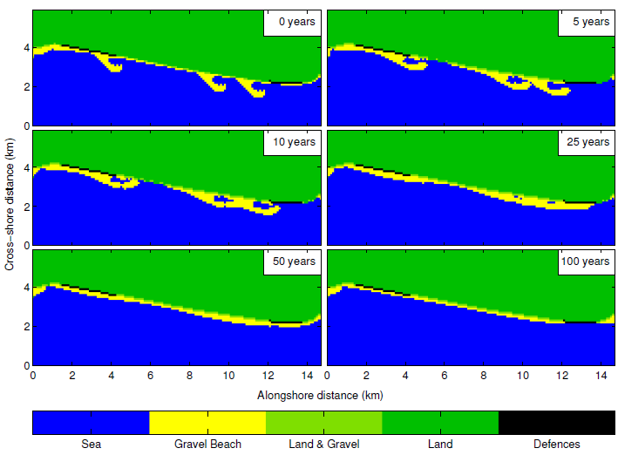
M: Multiple small recurved spit
Notes:
In this scenario we have all the smaller recurved spits positioned close to the engineered defences, with 2 spits in the east where erosion rates are higher in the baseline scenario.
Within 10 years multiple small lagoons have formed potentially supporting the natural habitat in locations at risk of erosion. Where there are 2 spits the western spit supports the eastern one prolonging the existence of the feature. Still a small lagoon after 25 years. The beach is widened for 50 years, with the largest widening in front of the engineered structures. By 100 years the beach is still present, but starting to thin.
SS Simultaneous recurved spits 1 to 3 165ha (each single spit 55ha), Total slightly larger than the Dutch intervention.

Slide 36

L: Single large recurved spit
Notes:
Our last scenario is a large single recurved spit positioned between 2 hard defence (black) to see how it supports the natural coastline and the engineered structures. In the most beneficial position of the small interventions (S2).
25yrs – sediment is redistributed to the west supporting the seawall and the recurve extends to the east providing shelter from waves. After 50 years it forms a lagoon and after 100 it is starting to collapse, but the beach width has been increased along the frontage.

Slide 37
Dungeness (Rye Bay) - Summary
Advance the line options need careful consideration. Size & position have varied impact on: coastline evolution & the creation of space for habitat & recreation.
Small interventions are more cost-effective within 20 years. Larger interventions have greater benefit beyond 20 years.
Multiple interventions allow positive impact across a full frontage over the long-term & require a smaller initial deposit to achieve the same impact as a single large intervention.
The size of these features reduces the natural littoral drift increasing erosion immediately down drift of the intervention in the short-term.

Slide 38



Sea level rise: plausible high-end projections to 2500 AD (Jevrejeva et al., 2012)
Adaptation and Resilience of Coastal Energy Supply
RCP8.5
RCP6
RCP4.5
RCP3PD
upper 95% and low 5% confidence level
Challenges facing the future security of:
nuclear energy sector (national)
coastal energy supply (NW region)
...as a result of changing patterns of temperature and rainfall, sea-level rise and storms.
The research determined threats posed to future energy generation and the distribution network by:
Flooding
Erosion
Changing patterns of: coastal sedimentation; water temperature and quality; distribution of plants and animals in the coastal zone

Slide 39

Supporting Decision Making
Projections of potential future flooding to 2500 AD = NNB lifetime
Online map viewer for exploring potential future flooding (SLR & storms) developed for NW region and selected nuclear case studies.
* Sizewell (mixed beach)
* Hinkley Point (rocky shore and cliff)
* Bradwell (estuary)
* Sellafield (sand beach/dune)
* Fleetwood: SLR, storms, wave overtopping, high river discharge
IAA
ERIIP

Slide 40



Decision tool development
560 Simulations
Storm return periods from 1:1 year up to 1:10,000 year
SLR from present to +5.5 m
The sea defences across the domain are re-digitised back into to the domain
Fleetwood case study includes high river flow and wave overtopping
Dungeness case study includes joint probability analysis of EWL and wave height combinations modelled on morphological evolution for gravel or mixed beaches (XBeach-G).

Slide 41


Slide 42


Slide 43


Slide 44






Impacts are:
Sectoral - National Grid, EnergyNW, OfGEM, EDF, ONR, NDA, Sellafield, CEFAS
Coastal - e.g. Sefton, Wyre, NE, EA
Civic – Liverpool City Region (LCR) and LEP

Slide 45
Summary
  ARCoES - https://arcoes-dst.liverpool.ac.uk/
  Modelling for adaptive coastal management
  Wirewall - @Wirewall_NOC
  Nearshore monitoring using radar
  C-RISe: Coastal Risk Information Service – www.c-rise.info
  GNSS tide gauge
Decision making tools
Modelling
Measurement

Slide 46

Acknowledgements
Jenny Brown, Simon Williams, Cai Bird, David Cotton, Andy Plater

Slide 47
Thanks for listening
abeck@noc.ac.uk
@amanibee

