Slide 1
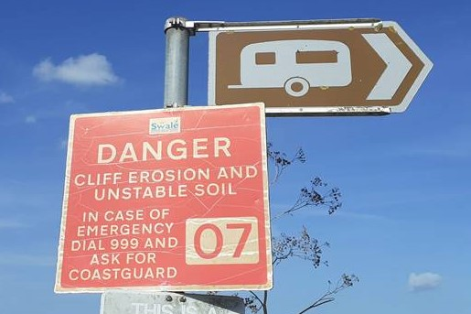
Long term resilience on the coast
The adequacy of Shoreline
Management Plans and
spatial planning in England
Andrew Coleman MRTPI FRGS
Senior Lecturer
MSc Town Planning
Michael Tucker
Planner
Brighton and Hove City Council

Slide 2
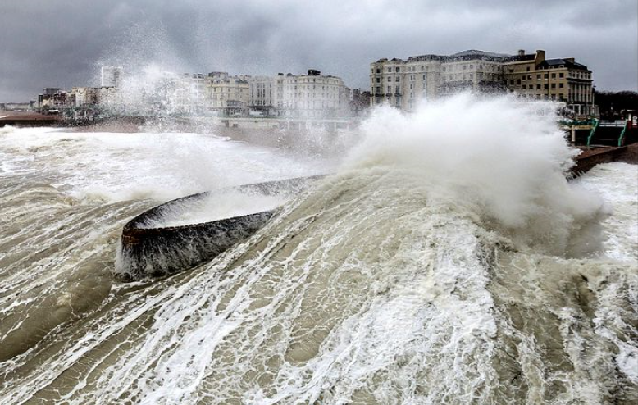
Content
About us
Methodology and terminology
SMPs and national planning policy
Coastal Challenges
Spatial planning on the coast
Main Findings and Recommendations
Questions
References
Source: pinterest

Slide 3



About us
Andrew Coleman – Senior Lecturer, University of Brighton, MSc Town Planning
  Royal Town Planning Institute and Royal Institution of Chartered Surveyors accredited
  Specialism in coastal planning and climate adaptation
  New Graduate Apprenticeship route
  T @theplanorak
Michael Tucker
  MSc graduate (Distinction)
  Planner at Brighton and Hove City Council
  [views do not represent those of our employers]

Slide 4
Methodology and Terminology
Literature Review
Recent research into application of national policy and SMPs into spatial plans
  Committee on Climate Change
  Environment Agency
  University of Brighton
Shoreline Management Plans – SMPs – non-statutory long term (~100 year) coastal change and flooding strategies
Local Plans – statutory medium term (~15 year) land use plans
Environment Agency – EA – government agency with strategic overview of coastal flood risk and capital and maintenance responsibilities
Committee on Climate Change – CCC - independent statutory organisation advising UK Governments and reporting to Parliament
Notes:
10 year

Slide 5
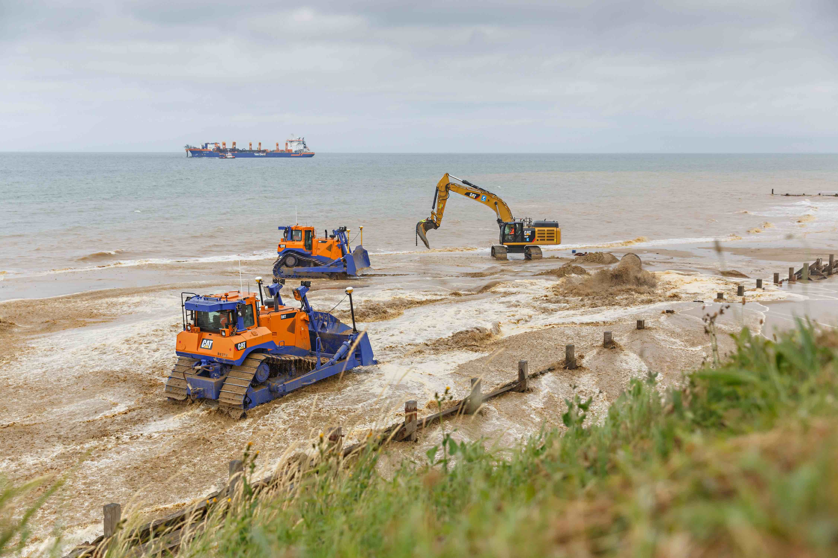
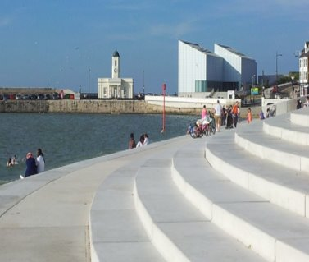
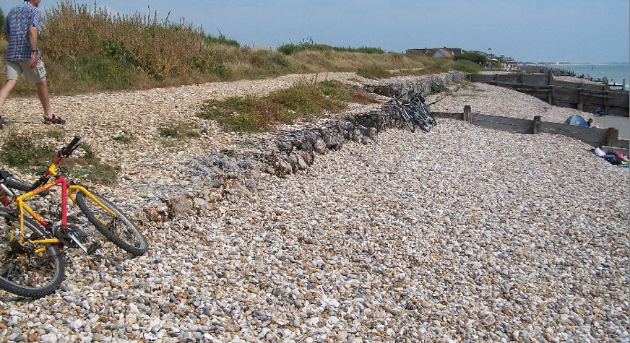
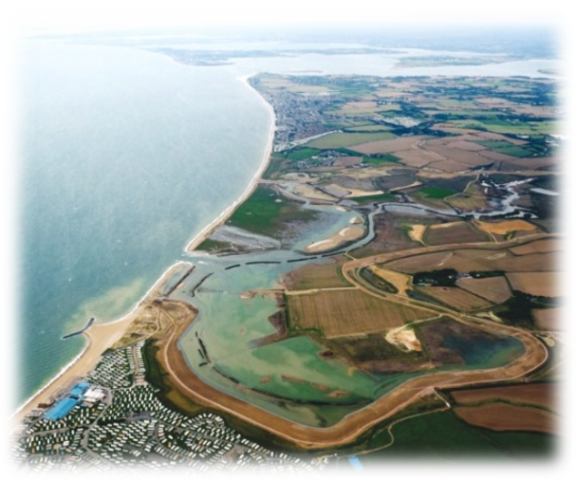
Shoreline Management Plans
Non-statutory
Prepared by local authorities (and sometimes EA)
Policy Options:
Advance the Line (ATL)
Hold the line
(HTL)
No Active Intervention (NAI)
Managed Realignment (MR)
Time epochs:
up to 2025, 2055 and 2100
Source: Ballinger and Dodds, 2017

Slide 6
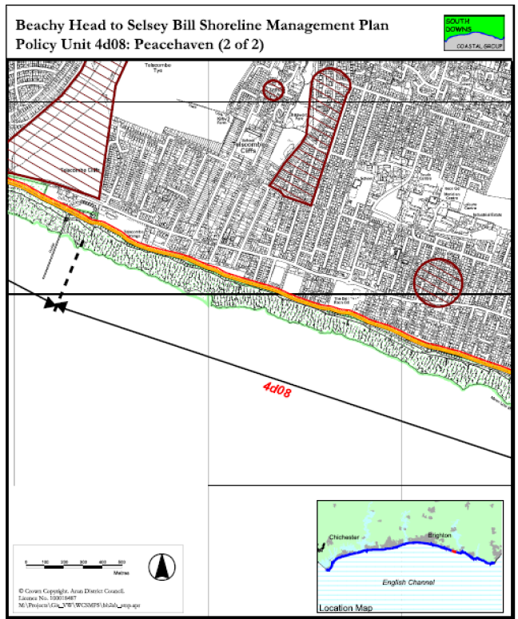
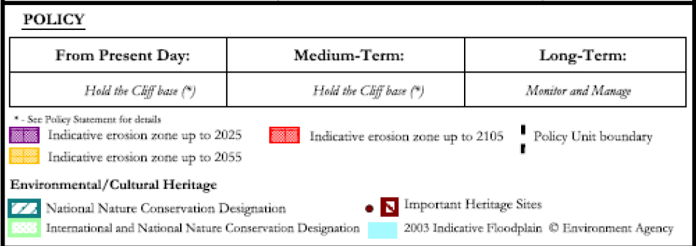

Slide 7
National planning policy and guidance on coastal change
Paras 166-169 National Planning Policy Framework
Effective alignment of marine and terrestrial planning (including Integrated Coastal Zone Management)
Avoid inappropriate development in vulnerable areas and adding to natural physical changes
LPAs define Coastal Change Management Areas (CCMAs) to restrict type and lifetime of development
Planning Practice Guidance
SMPs should be the primary source of evidence in defining the coastal change management area and informing Local Plan land allocation within it
CCMAs not needed where HTL or ATL is preferred SMP option, subject to evidence of how this may be secured

Slide 8
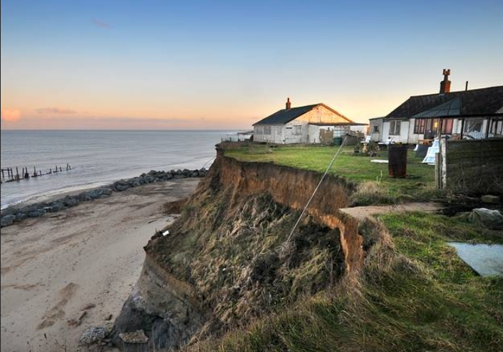
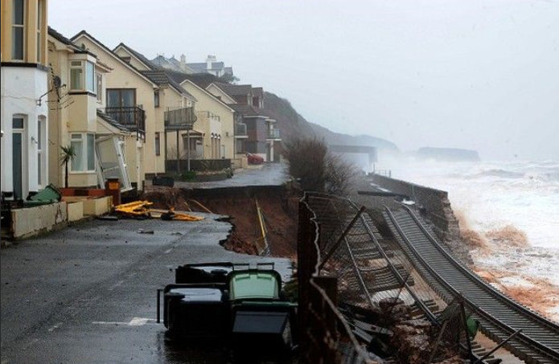
Coastal Challenges
Environmental, Economic, Social, Communication and Organisational
    Source: edp24.co.uk

Slide 9
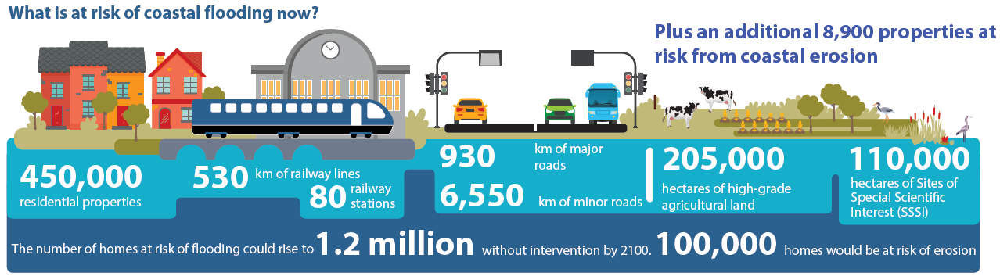
520,000 properties (including 370,000 homes) have a 0.5% or greater annual risk of damage from coastal flooding and 8,900 properties are located in areas at risk from coastal erosion
Environmental Challenges
Notes:
Direct economic damages from flooding and erosion are over £260 million per year. Transport, energy and waste infrastructure and cultural assets are also exposed to coastal flooding and erosion. Approximately 7,500 km of road, 520 km of railway line, 205,000 ha of good, very good or excellent agricultural land, and 3,400 ha of potentially toxic historic landfill sites are currently at 0.1% or greater risk of coastal flooding in any given year. Power plants, ports, gas terminals and other significant assets are also at risk. The benefits of protecting these different assets are not prioritised in the government's coastal defence spending at present, which focusses on properties.

Slide 10
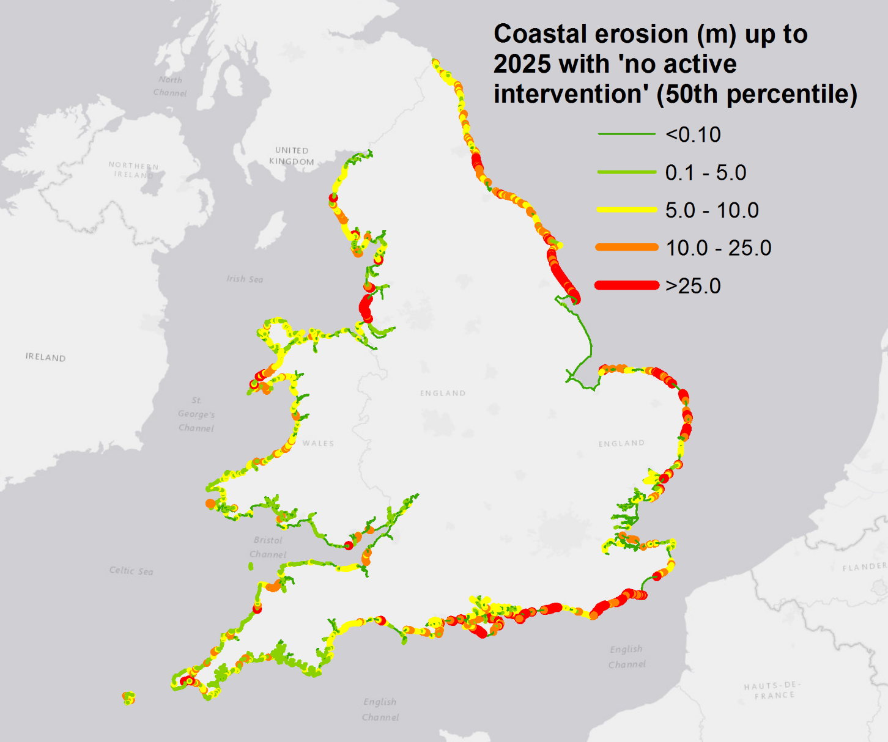
Coastal erosion affects fewer properties than flooding but the impact is usually irreversible and often the loss is complete
Notes:
There are currently around 5,500 properties at risk in England but insurance or compensation is not available to mitigate that risk.
The Environment Agency estimates that 700 properties (including 250 residential) may be lost to coastal erosion by 2030.

Slide 11
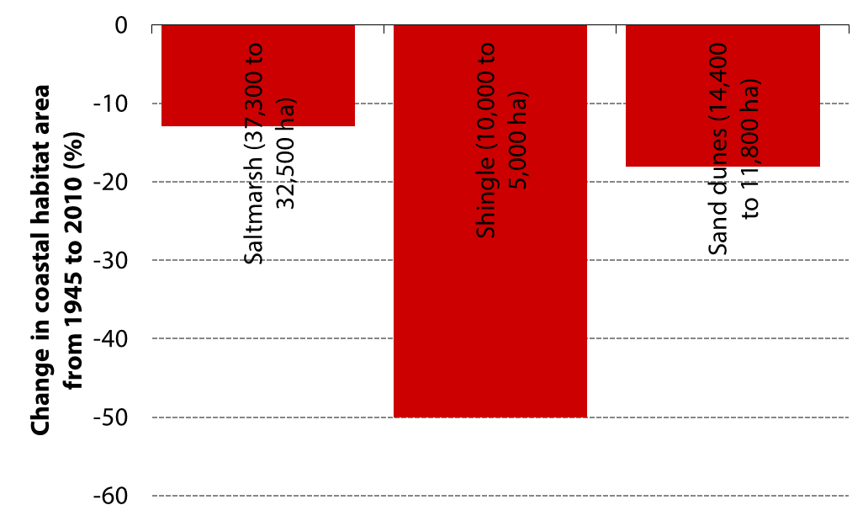
Coastal habitats are deteriorating, which impacts biodiversity and tourism and reduces natural flood defences
Notes:
Coastal habitats, such as saltmarsh, mudflats, shingle beaches, sand dunes and sea cliffs, provide natural protection against waves and storm surges but they are declining: excluding mudflats, these habitats have declined in extent by 20%, from around 62,000 hectares in 1945 to 49,000 hectares in 2010.
[Text on the benefits of these environments]
Coastal steepening… figure from Jim's presentation?
In the future, up to three-quarters of intertidal coastal habitats may not be able to adapt naturally to sea level rise where they are blocked from migrating inland by hard sea defences, a process known as ‘coastal squeeze’. [ASC 2013]

Slide 12
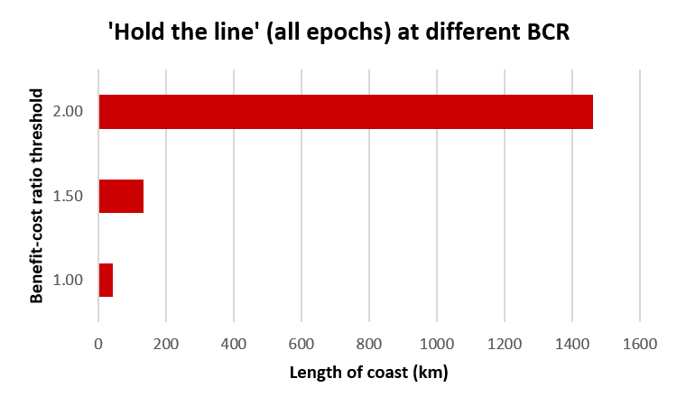
Economic challenges
Implementing the SMPs would cost £24-41 billion, depending on climate change. For 149-185 km of coastline it will not be cost beneficial to protect or adapt as currently planned.

Slide 13

Currently spending £0.55b/year to manage flooding (10% from ‘partnership’ sources)
To adapt to climate change, this will need to double to about £1b / year
Partnership funding will have to increase (including via planning) and new sources of green finance will be developed

Slide 14
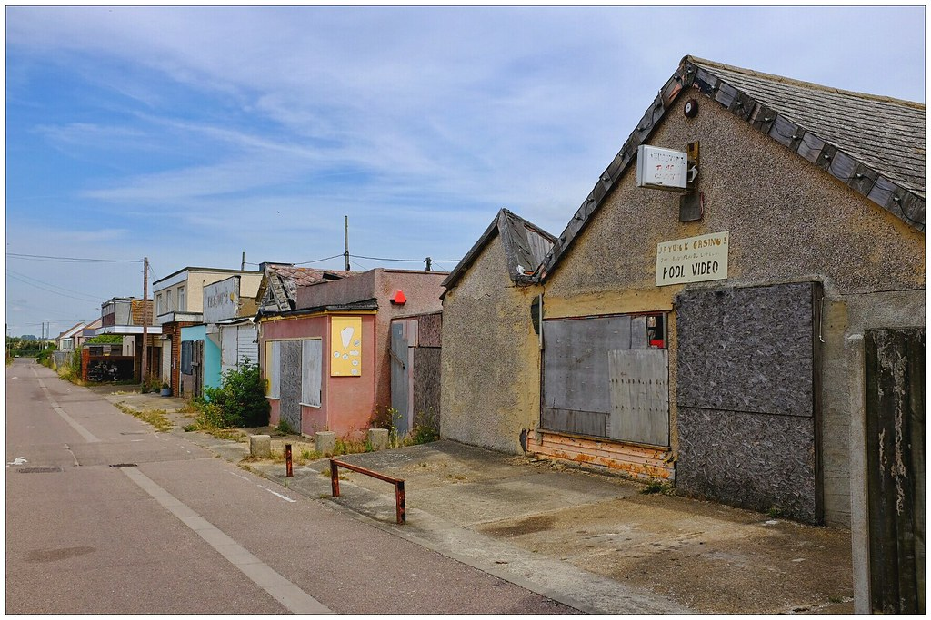
Social Challenges – flood disadvantage
Coastal communities tend to have higher than average populations of people aged over 75, higher unemployment, and poorer infrastructure compared to communities inland.
‘Flood disadvantage' is likely to become more acute in the future

Slide 15
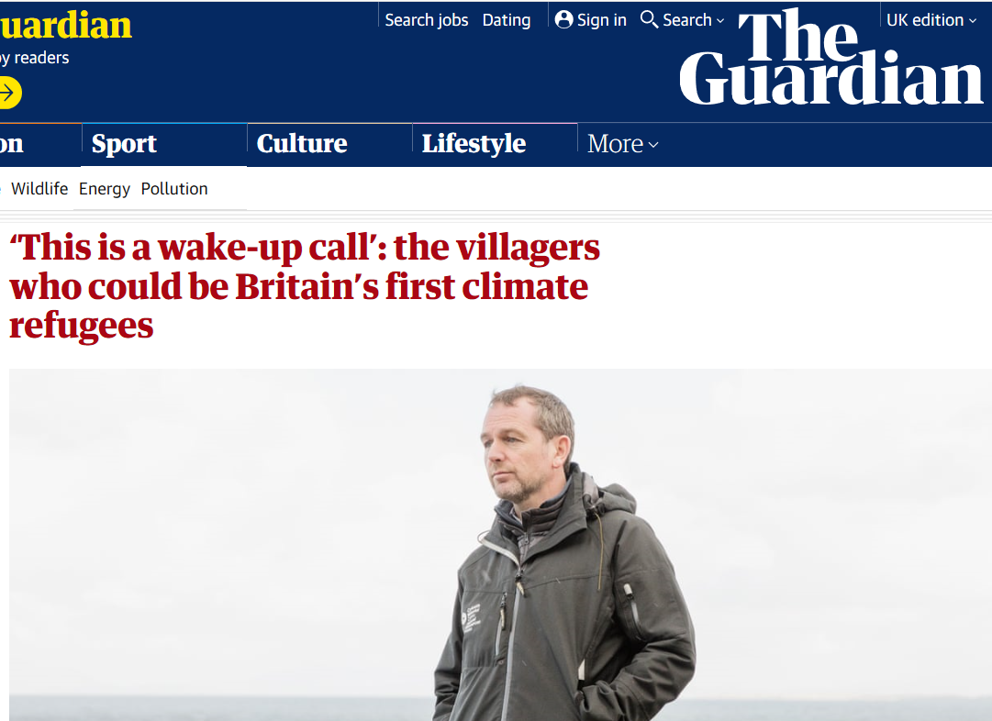
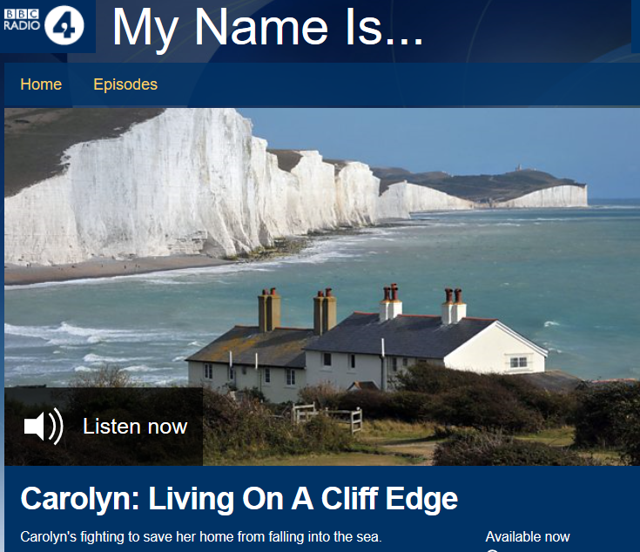
Communication Challenges
Welsh villagers told their village will be 'decommissioned'
Cultural and landscape value of existing coastal landscape can be very powerful

Slide 16
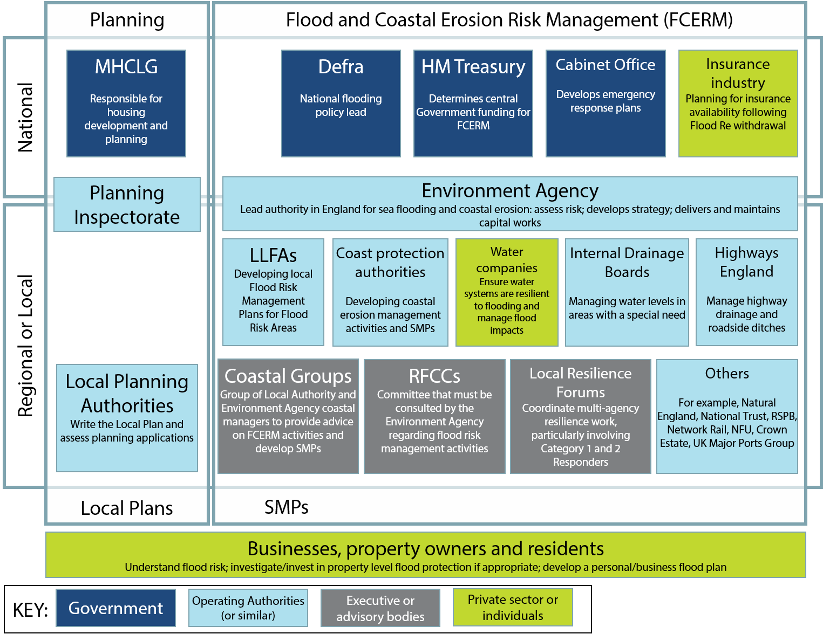

Organisational Challenges
Coastal management is covered by a complex patchwork of legislation and by a variety of organisations with different responsibilities.
Notes:
For example, is the relationship between local planners and Coastal Groups strong enough…

Slide 17
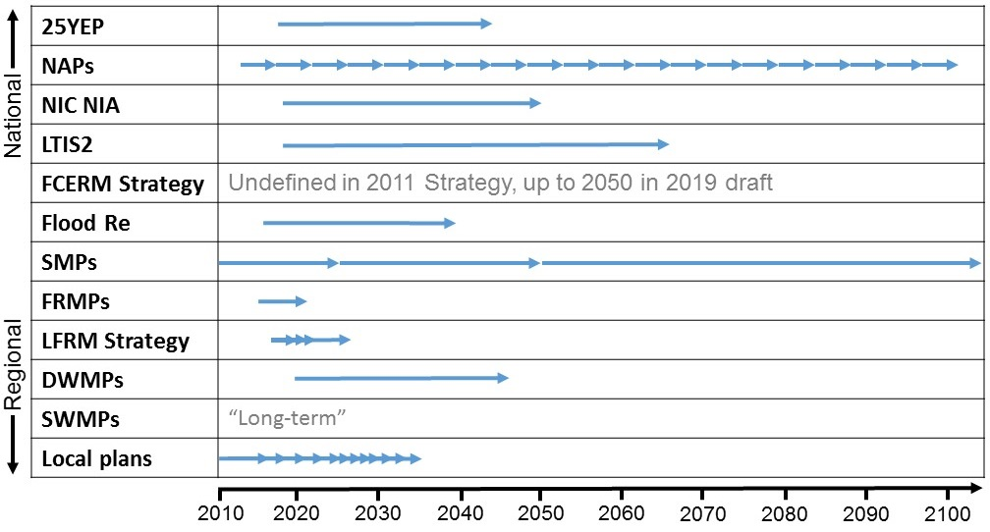
Spatio-temporal mismatch between different plans and policies relating to flooding

Slide 18
Coastal report recommendations
RECOMMENDATION 1: The scale and implications of future coastal change should be acknowledged by those with responsibility for the coast and communicated to people who live on the coast.
RECOMMENDATION 2: Local government and the EA need to be enabled by national government to deliver a long-term and appropriately resourced approach to engaging affected communities and stakeholders.
RECOMMENDATION 3: Defra and MHCLG policy on the management of coastal flooding and erosion risk should specify long-term, evidence-based, quantified outcomes that have the buy-in of the affected communities and stakeholders.
RECOMMENDATION 4: Government should make available long-term funding/investment to deliver a wider set of adaptation actions.
RECOMMENDATION 5: Plans to manage and adapt specific shorelines over the coming century should be realistic and sustainable in economic, social and environmental terms.
Notes:
RECOMMENDATION 1: The scale and implications of future coastal change should be acknowledged by those with responsibility for the coast and communicated to people who live on the coast. At the moment the future risks of coastal flooding and erosion are not fully understood. Improved risk mapping (led by the Environment Agency) and more complete analysis of the full costs and benefits of coastal management options will provide the evidence needed to make realistic plans. This information needs to be communicated (unambiguously but with an appropriate recognition of uncertainties) to communities and policy-makers.
RECOMMENDATION 2: Local government and the Environment Agency need to be enabled by national government to deliver a long-term and appropriately resourced approach to engaging affected communities and stakeholders. Decisions that have a significant impact on communities need to be taken in collaboration with those communities and need to be planned and assessed well in advance of their implementation. These plans need to be dynamic enough to respond to specific events or 'crises'. Difficult decisions (e.g. relocation of existing properties, limiting the approval of new properties) should be considered, discussed and planned with the community and other relevant stakeholders who have specific responsibilities. Adaptation policies can take decades to implement and that process needs be managed with all relevant stakeholders engaged throughout. There are few real world examples of successful, long-term engagement strategies such as those proposed here and significant new resources will have to be provided to the relevant organisations (e.g. Environment Agency, local authorities, Regional Flood and Coastal Committees) to plan and implement them.
RECOMMENDATION 3: Defra and MHCLG policy on the management of coastal flooding and erosion risk should specify long-term, evidence-based, quantified outcomes that have the buy-in of the affected communities and stakeholders. The government's 2nd National Adaptation Programme, 1st Flood and Coastal Erosion Risk Management Strategy and the 25 Year Environment Plan have not proposed actions that can be assessed in terms of their impact on overall exposure or risk. These government statements could provide the institutional framework to achieve this aim, but they will have to be strengthened and augmented with new policies and metrics. Defra and MHCLG should enable and require adaptation planning by local government, and should monitor progress. The Agriculture and Environment Bills offer the opportunity to start the reform of legislation to achieve this.
RECOMMENDATION 4: Government should make available long-term funding/investment to deliver a wider set of adaptation actions. Decisions about funding should be based on a broader and more inclusive economic case than is current practice. Current funding streams provide value for money, largely by delivering hard defences where there is the best economic case supplemented with local 'partnership funding' contributions. Places where continued investment in hard defences is uneconomic tend to lose out. However, these places also need funding to assist them to adapt to inevitable changes, so whilst hard defences may not be fundable they still need support for a broader package of adaptation actions, including community engagement, asset relocation and compensation to move households where appropriate. This should be addressed either by altering existing funding formulae or developing a new funding mechanism, which could, for instance, take inspiration from innovative green finance models or community development corporations. The economic case to support long-term funding should be determined not just by the protection of physical assets but should also incorporate environmental implications and social justice considerations.
RECOMMENDATION 5: Plans to manage and adapt specific shorelines over the coming century should be realistic and sustainable in economic, social and environmental terms. A coastline policy is required that clearly identifies areas that need to be defended in the long term, areas that should remain or be returned to a 'natural' environmental state and communities that are currently unsustainable and require more strategic adaptation, such as relocations. Local government need to be able to make realistic adaptation plans that have regulatory teeth. Local Plans and Shoreline Management Plans should be aligned more closely in the time frames and areas that they both consider. Coastal Groups should continue to act to ensure that Local Plans are joined up. New powers may be required, for example by local authorities, to facilitate relocation or by planning authorities to ensure that a longer term planning outlook is taken.

Slide 19
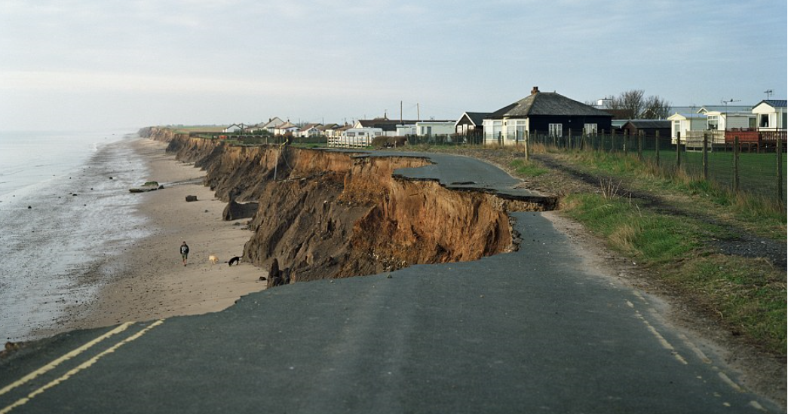
Spatial planning on the coast
Findings of the Committee on Climate Change, Environment Agency and Michael Tucker MSc

Slide 20
The current policy decisions on the long-term future of England's coastline cannot be relied upon as they are non-statutory plans containing unfunded proposals.
18% of all coastal Local Plans do not refer to Shoreline Management Plans
Local Plans are not updated in line with guidance and may not be referring to SMP2s
Published post 2011? | Count | Percentage (%)
Yes | 69 | 73
No | 9 | 10
Not Available | 16 | 17
Do the local plans refer to SMP(s)? | Count | Percentage (%)
Not Found | 16 | 17
No | 17 | 18
Yes | 61 | 65
But that means 65% are referring to SMPs that are potentially (probably?) unrealistic
CCMA or similar policies in 60 of 94 Local Planning Authority areas, but only where managed realignment / no active involvement was SMP policy (C2HM, 2015; Jacobs, 2018)

Slide 21
If current trends continue, there will be a doubling of homes in the floodplain
However, if planning policy or its implementation is weakened, property damage could increase by 38% over the next 50 years
It will be challenging in some places to make future development climate-resilient, due to limited development areas outside of the flood plain. (EA – Long term investment scenarios 2019)

Slide 22
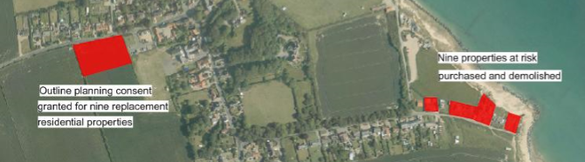
EA accept that some areas will flood and erode and enabling local areas to achieve a managed transition.
We need to take a long-term adaptive approach – identify alternative approaches e.g. Happisburgh (N Norfolk) rollback (£3m for 9 homes). EA will advise LPAs from 2025
From 2021 risk management authorities will invest in planning skills and capabilities to ensure they can advise planners and developers effectively to enable climate resilient places.

Slide 23
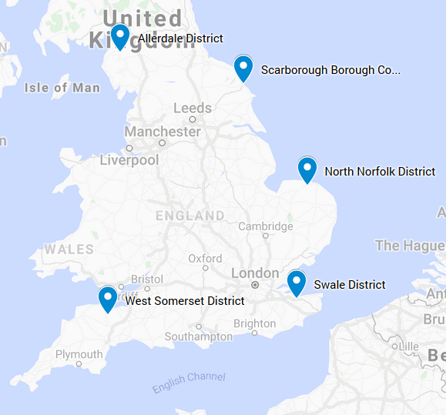
Research by Michael Tucker MSc
Post-NPPF local plans
A variety of coastal land uses and challenges
Some well-documented coastal erosion problems
Some National Park Authorities

Slide 24
Measured
Measured how far the local plans reflected:
  Relevant SMP coastal management policy
  Wider principles of SMP (co-operation, long term view, interconnectedness of coastal processes)
  NPPF policy (CCMA, applying Integrated Coastal Zone Management, refusing inappropriate developments, time-limited planning permission)
Used a numerical scoring method to enable comparison between local plans

Slide 25
Results
Wide variation between reflection of SMP policies
Generally little weight given to SMPs in ‘bold text’ policy. National Park plans were generally better
Reflection of SMP wider principles slightly better
NPPF policy compliance much better –
  3 of 5 included CCMAs
  5 included policies to encourage development to be relocated
  Only 1 plan referred to ICZM
None took long term view

Slide 26
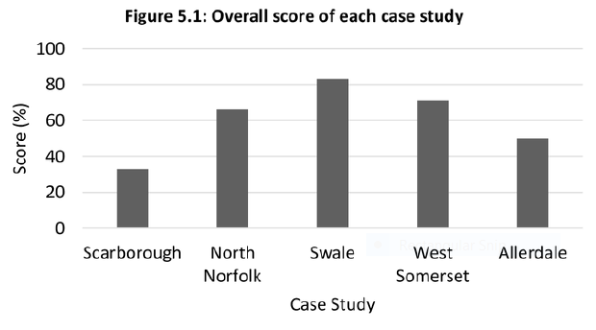
Results

Slide 27
Main Findings and Recommendations
SMPs are probably technically and financially unfeasible – particularly in the long term
EA should take a more robust role in SMPs
Planners need to be involved more in SMP formulation – talk to your coastal engineer
MHCLG should change policy / guidance: CCMAs should be default option over more of coastline, regardless of SMP policy
Local plan coverage of coastal change and flooding is variable and 'locking in' future problems
Planners will need to develop new approaches and skills on the coast (+ use existing guidance)

Slide 28

Coastal change is permanent
Sea levels WILL rise
Only planners can move people out of harm’s way
Roll the coast back NOW
Start planning for future coastal change NOW
My call to action
CALL A PLANNER

Slide 29
Questions?
Contact:
Andrew Coleman MSc MRTPI FRGS
Senior Lecturer, University of Brighton
e: a.coleman2@brighton.ac.uk
t: +44 (0)7806 782485
@theplanorak

Slide 30
Main References
Committee on Climate Change (2018) Managing the coast in a changing climate
Jacobs (2018) Research to Assess the Economics of Coastal Change Management in England and to Determine Potential Pathways for a Sample of Exposed Communities
Environment Agency (2019) Draft Flood and coastal risk management strategy and Long term investment scenarios
MHCLG (2014) Planning Policy Guidance; Meeting the challenge of climate change, flood risk and coastal change
MHCLG (2019) National Planning Policy Framework
Tucker, M (2018) The extent to which SMPs are being reflected in Local Plans MSc dissertation

Slide 31
Other useful references
Ballinger R and Dodds W (2017) Shoreline management plans in England and Wales: a scientific and transparent process Marine Policy 84
CH2M (2015) Shifting Shores +10 Public policy and adaptive approaches to coastal change management: How are we doing?
House of Commons EFRA Committee (2019) Coastal flooding and adaptation to climate change inquiry
Local Government Association (2019) Special Interest Group on Coastal Issues
National Trust (2015) Shifting Shores – playing our part at the coast
Planning Co-operative (2009) Translating SMPs into Spatial Plans Vol 1. Final Report

Slide 32
Useful Guidance
Halcrow (2013) Coastal Change Adaptation Planning Guidance
North Norfolk DC (2009) Coastal Erosion Development Control Guidance
Scottish Natural Heritage (2019) Guidance – Planning Ahead for Coastal Change
Town and Country Planning Association / RTPI (2019) Planning for the Climate Crisis

