Slide 1
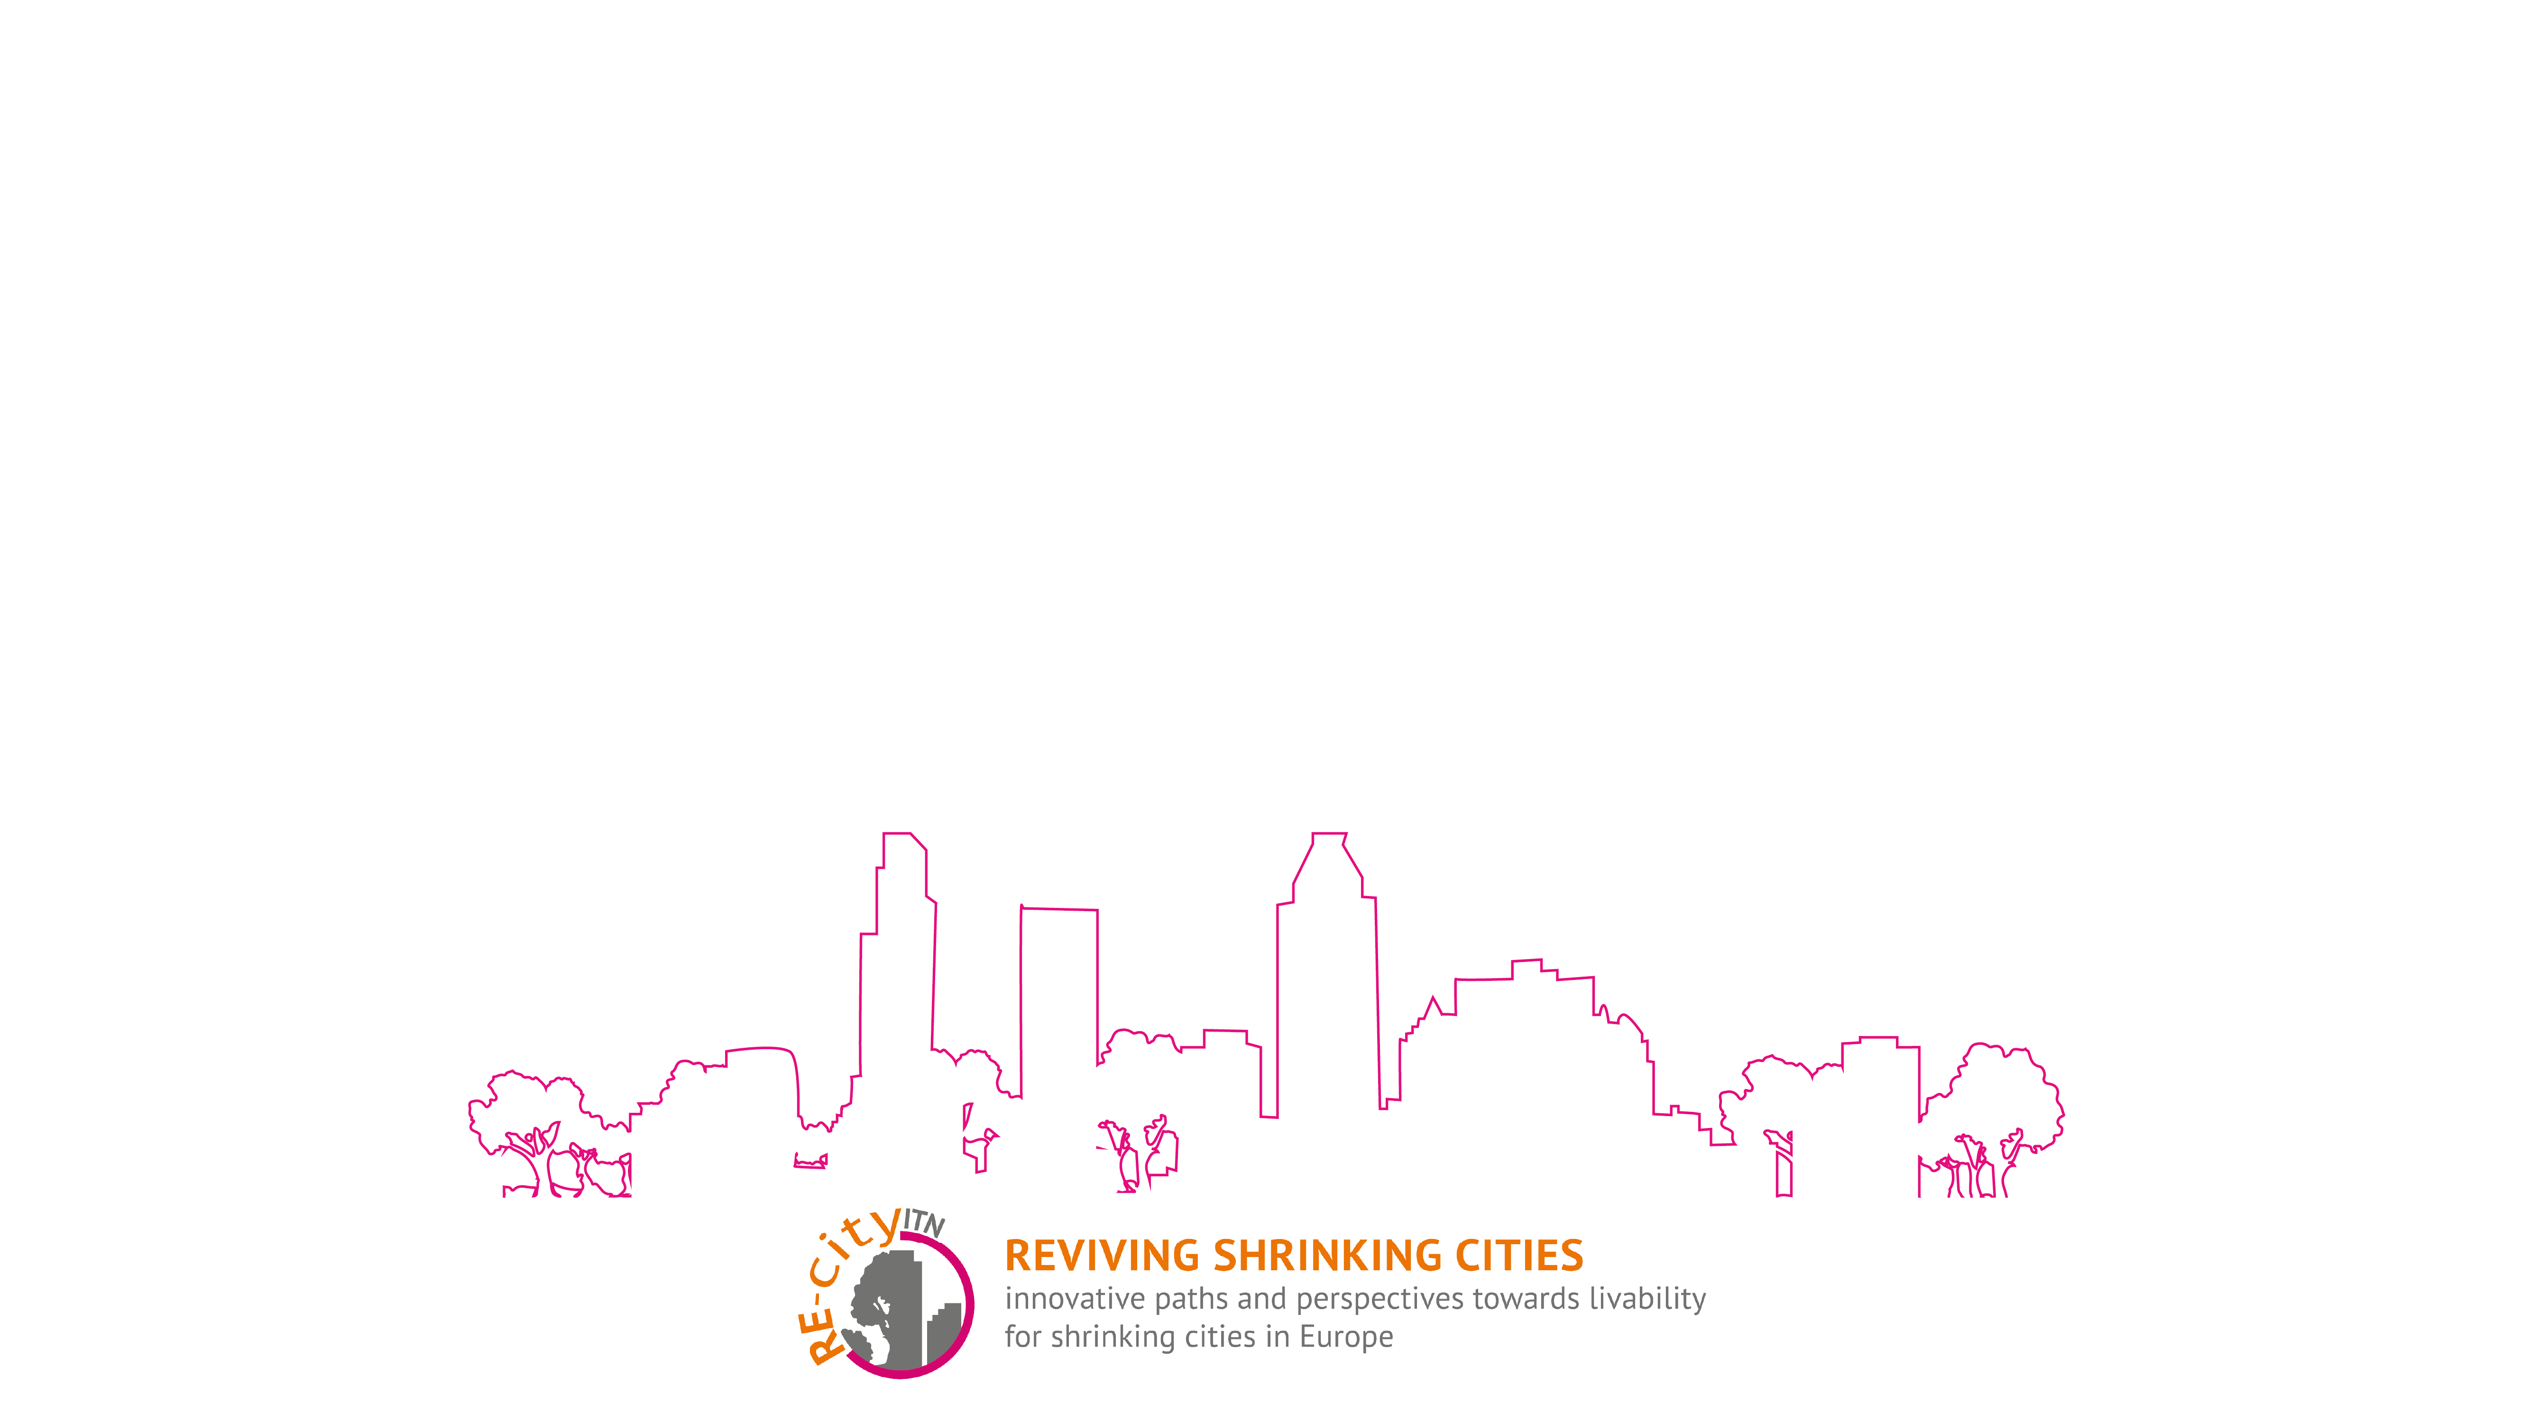

Shrinkage in port cities:
European trajectories and resilience
Victoria Pinoncely, doctoral researcher, École Normale Supérieure
13th European Biennial of European Towns and Town Planners
Plymouth, 13 September 2019
@vpinoncely
@recity_itn
#recity

Slide 2
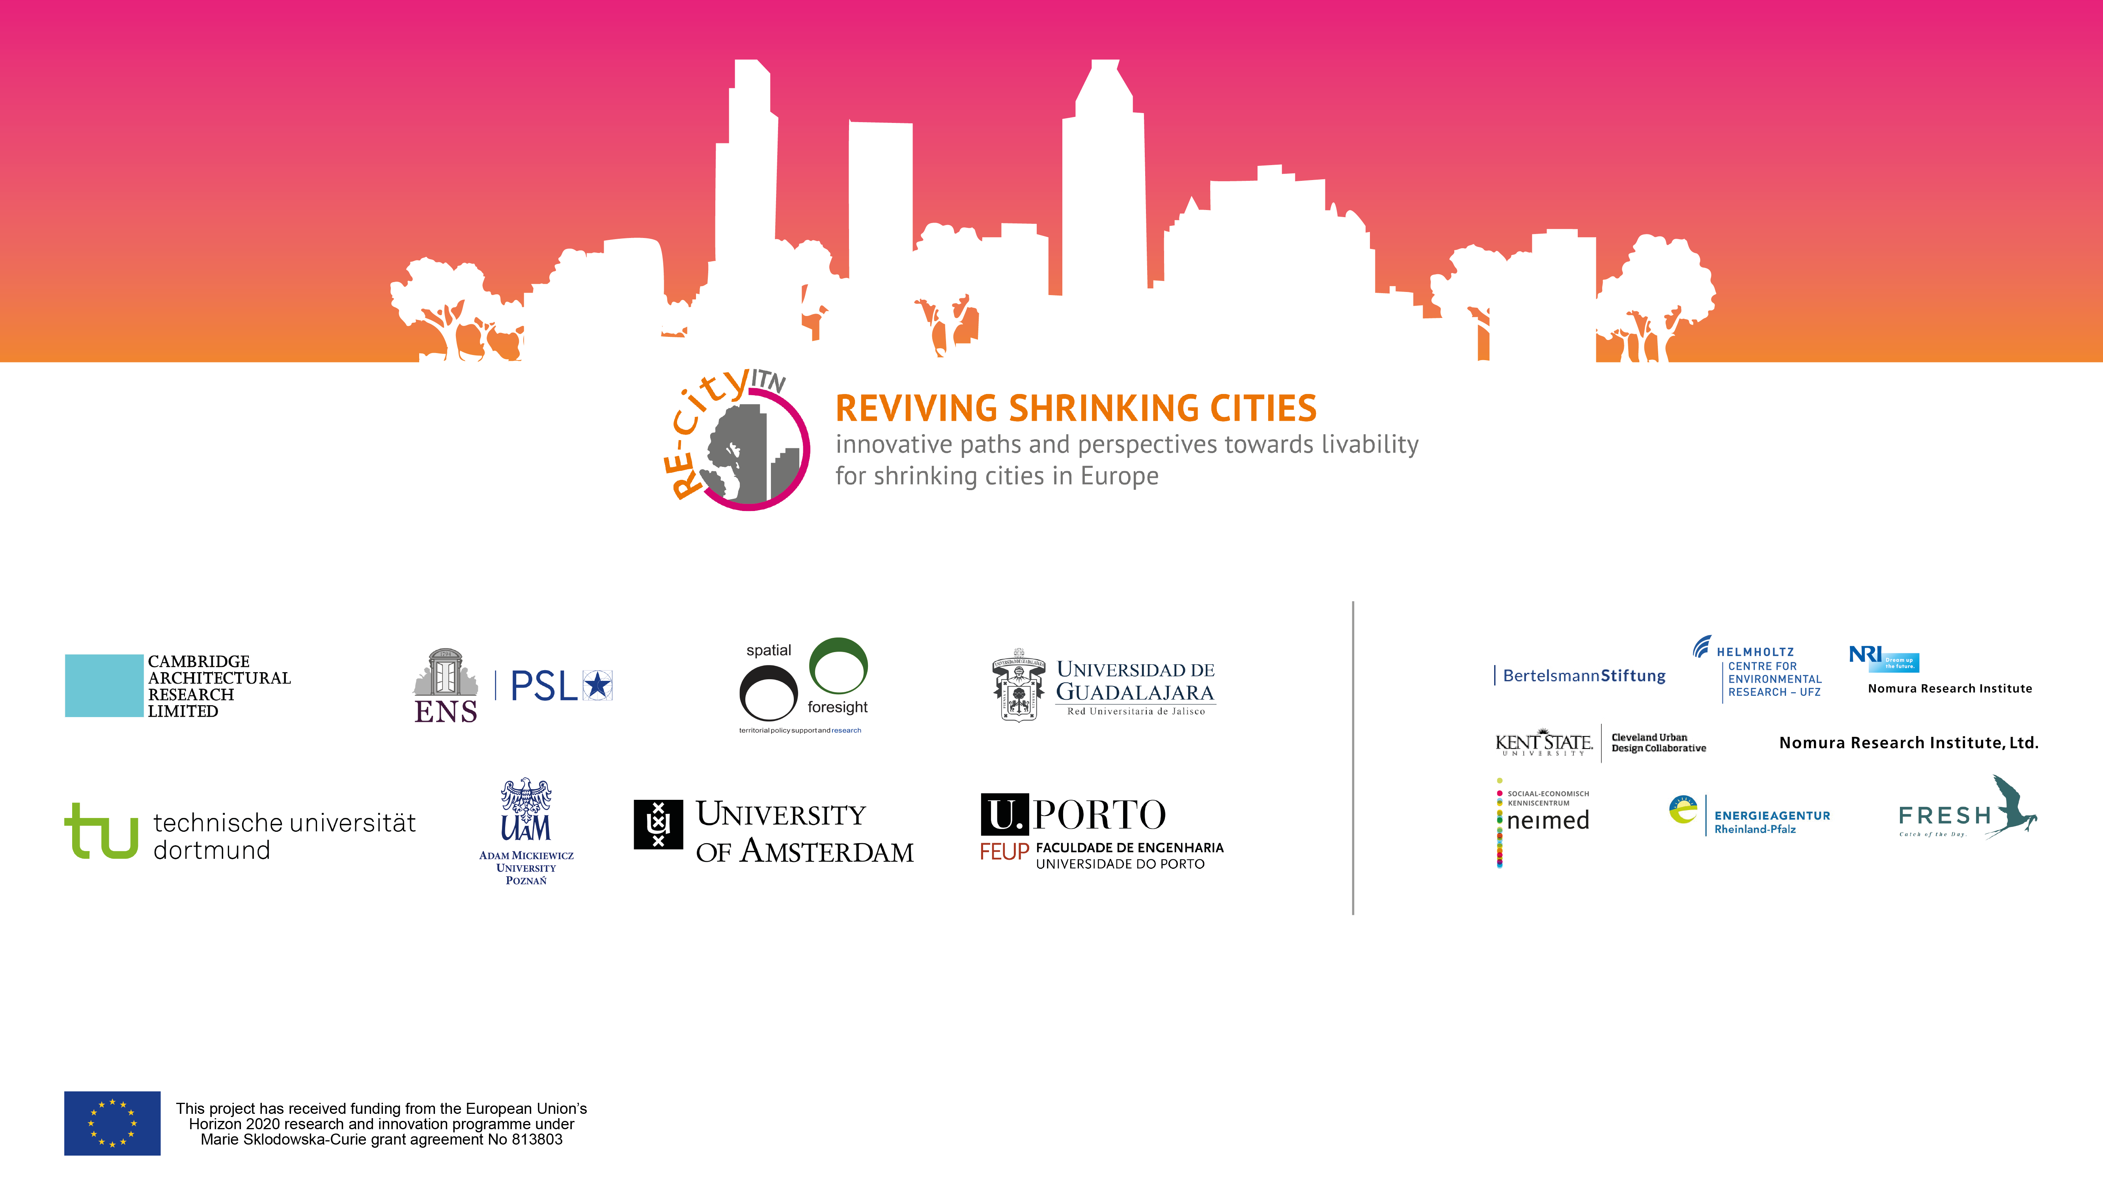


Slide 3
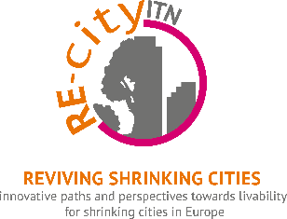
What is urban shrinkage?

Slide 4
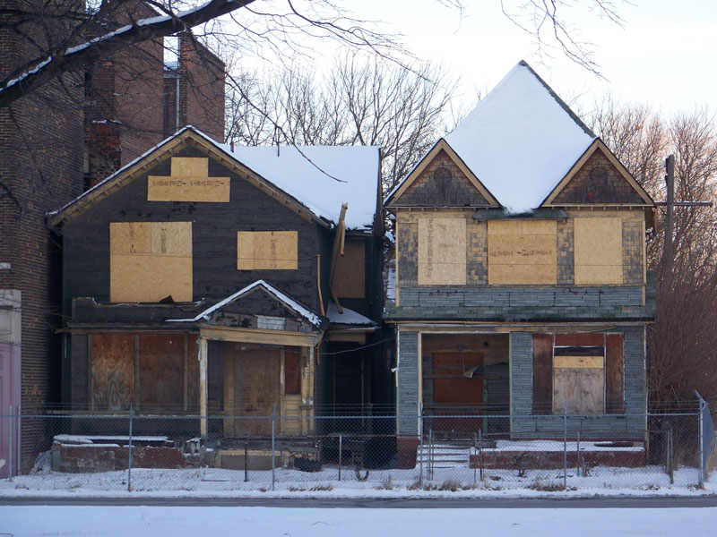
Photo credit: Flickr/Thunder Circus

Slide 5
Urban shrinkage worldwide
Many cities are growing…
but certain cities and regions are not following this growth dynamic
Increased inter-city competition
Fast urbanisation and shrinkage are two sides of the same coin Cunningham-Sabot et al. 2013

Slide 6
Shrinkage is not that exceptional....
between 1990 and 2010, 20 per cent of European cities experienced shrinkage
Source: Wolff and Wiechmann, 2018
between 1960 and 2005,
40 per cent of European cities experienced shrinkage occasionally
Source: Turok and Mykhnenko, 2007

Slide 7
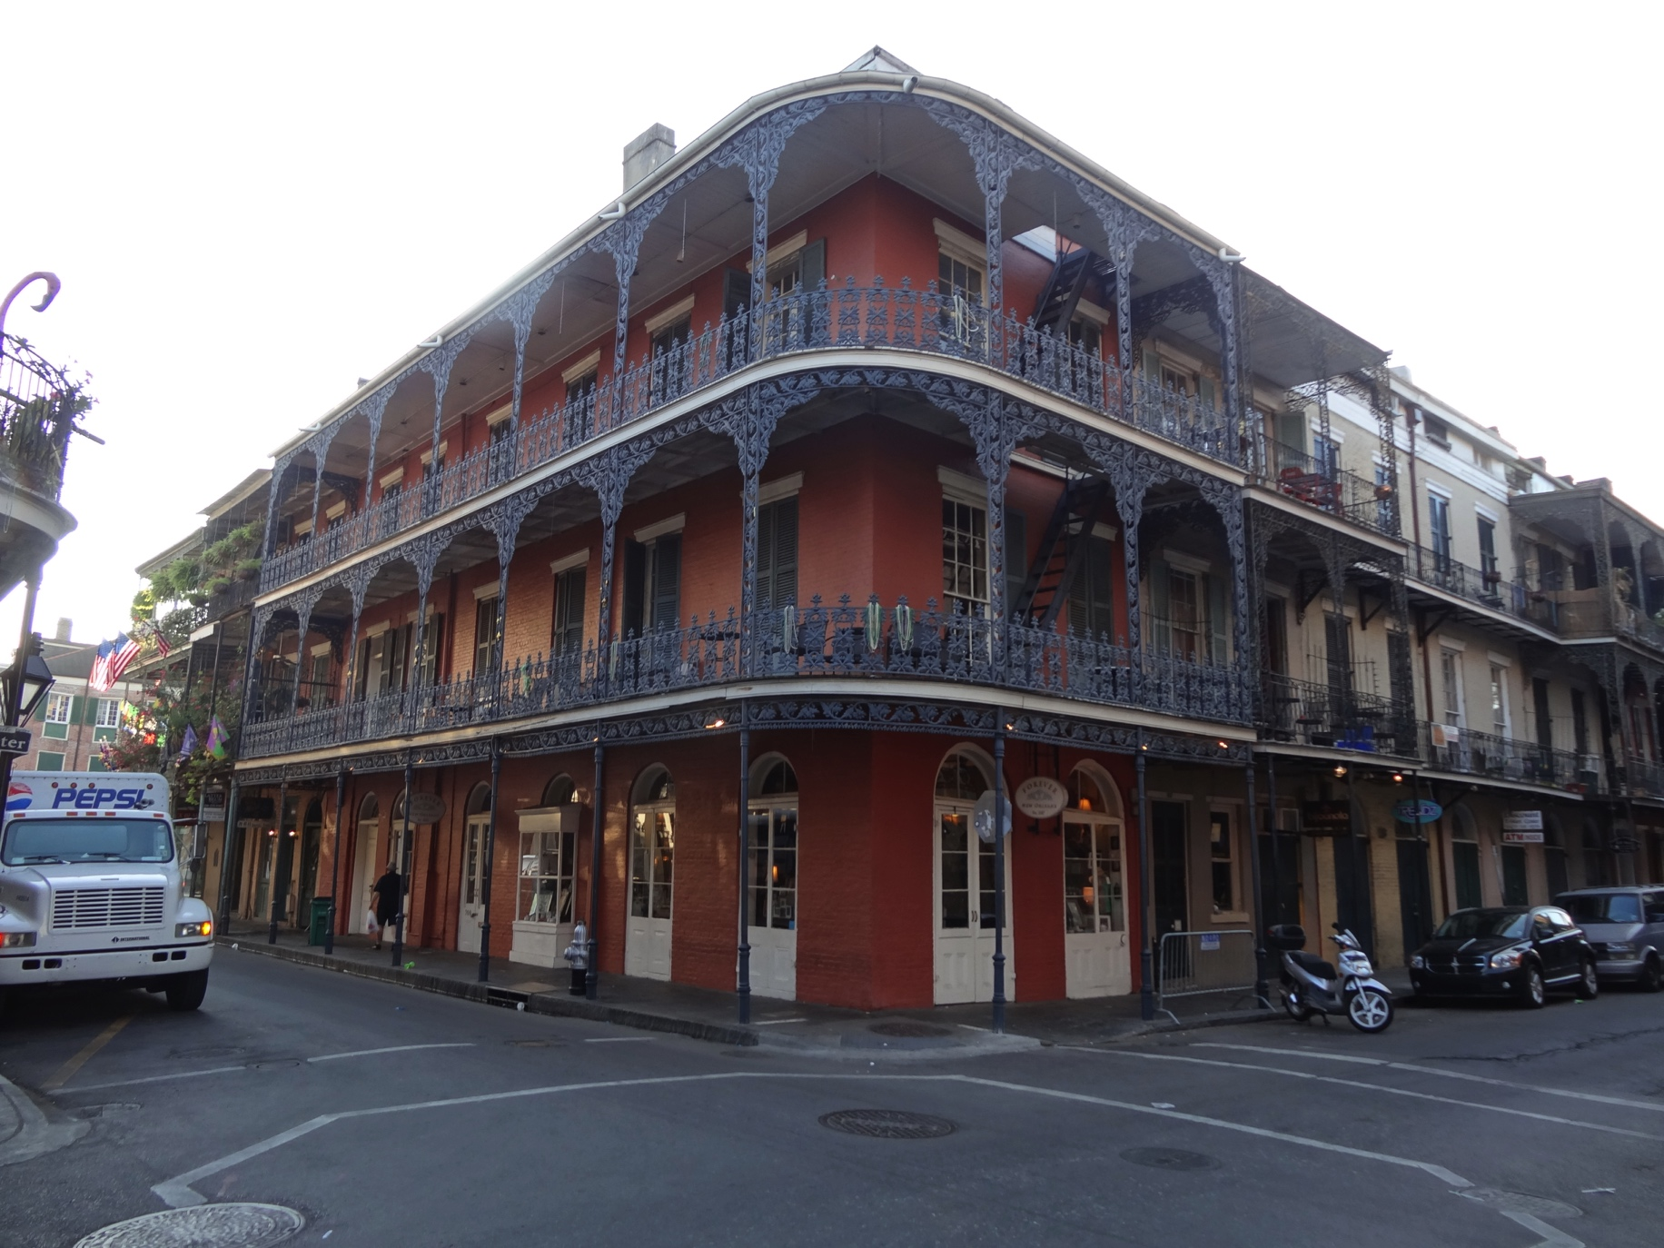
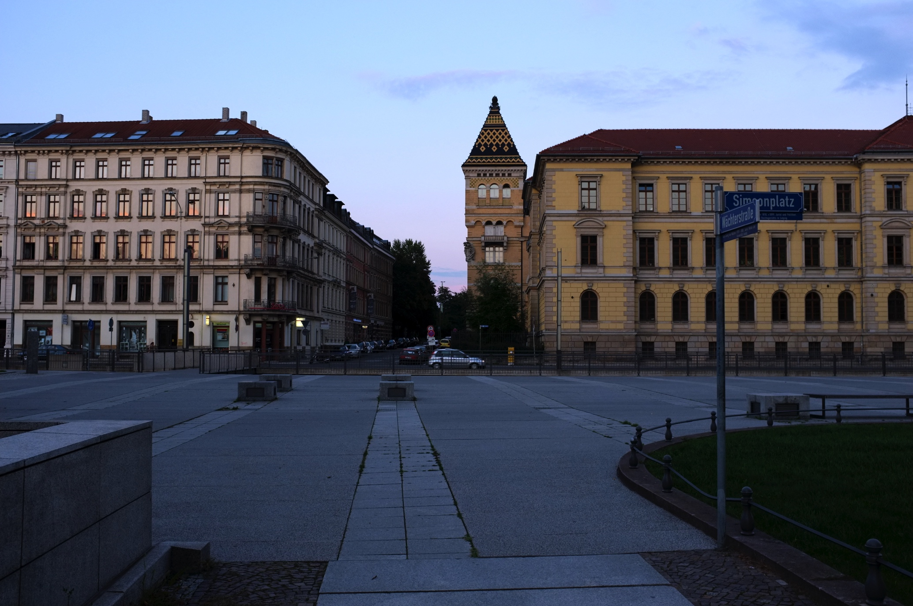
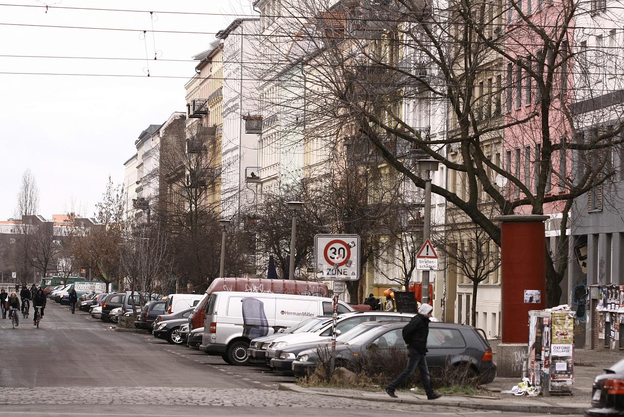
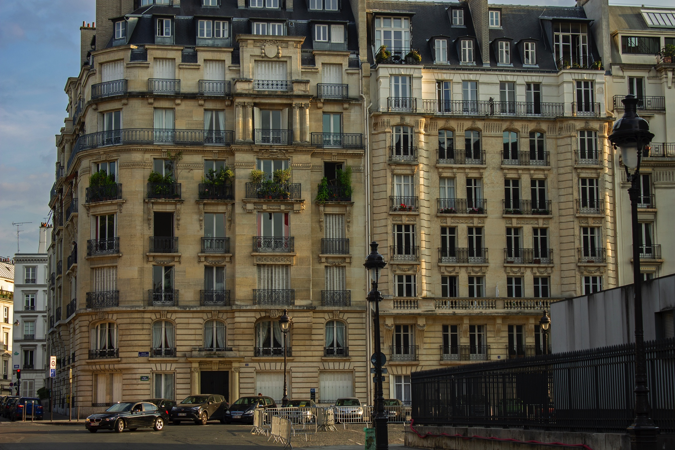

Slide 8
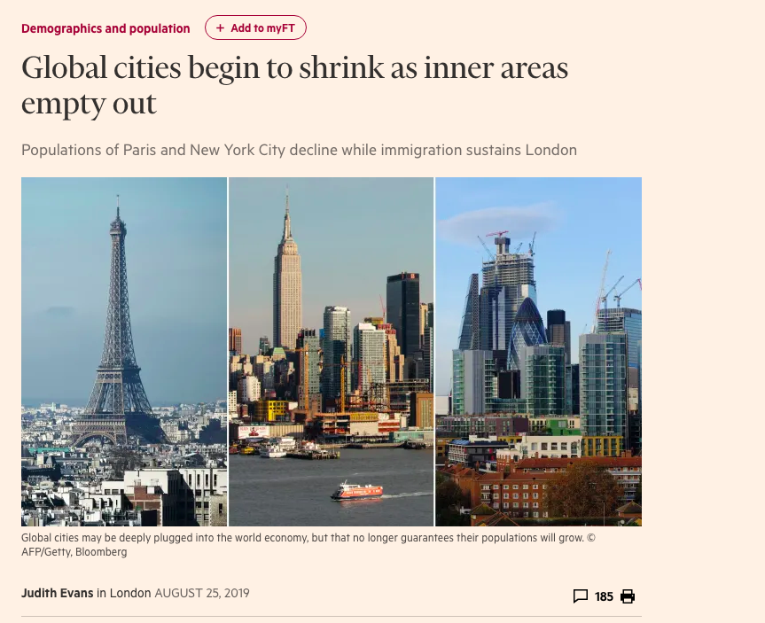

Slide 9
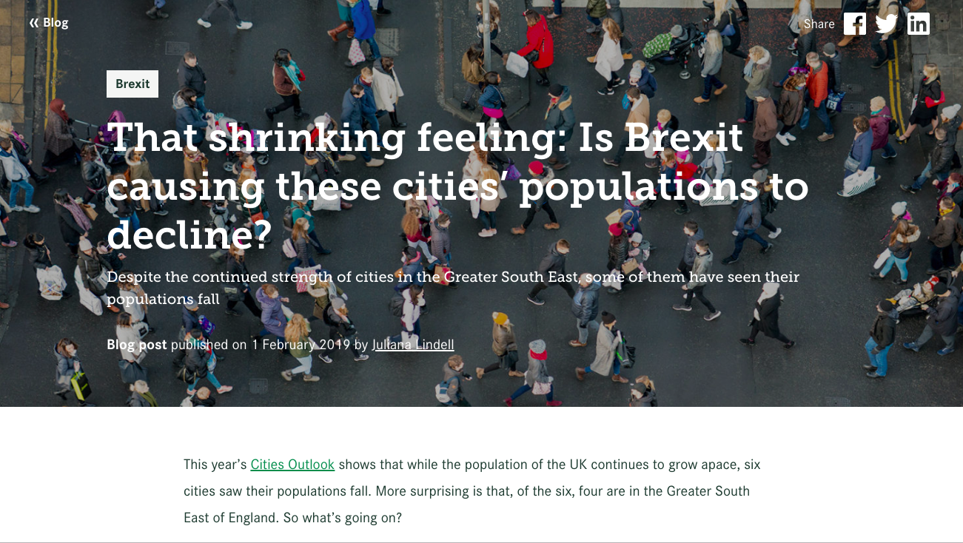

Slide 10
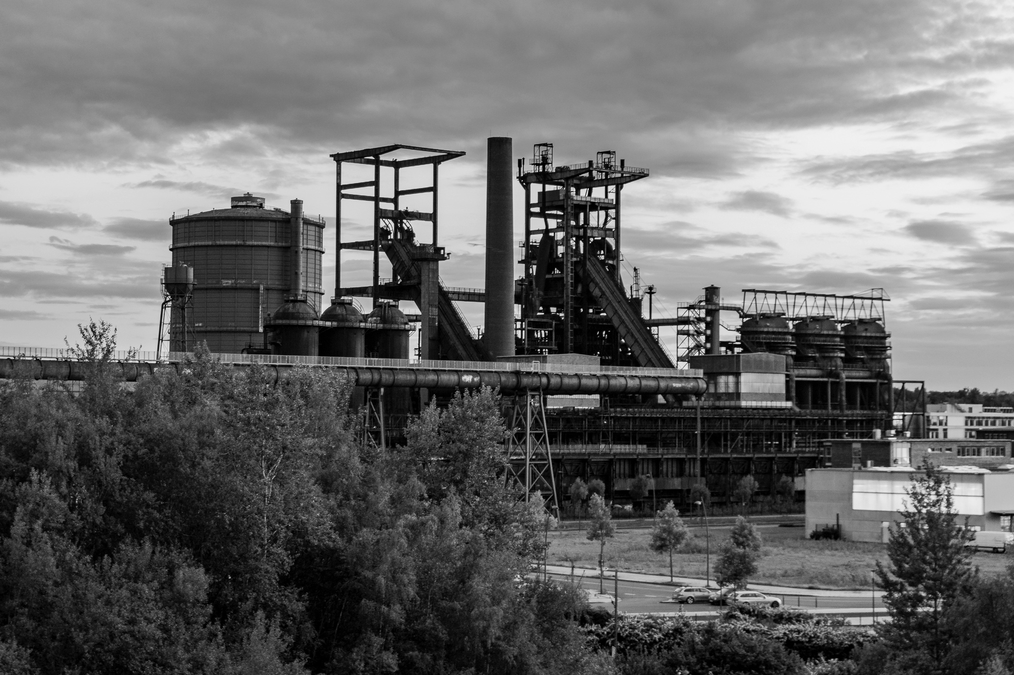
Causes of shrinkage
Economic
Demographic
Political
Urban/spatial
Photo credit: Daniel Grothe

Slide 11

Population loss
Shops closing in city centres
Housing vacancy

Slide 12
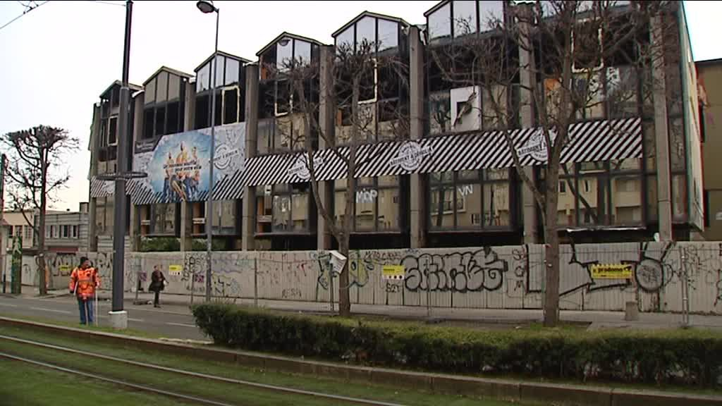
Factories and businesses closing
Vacant sites

Slide 13
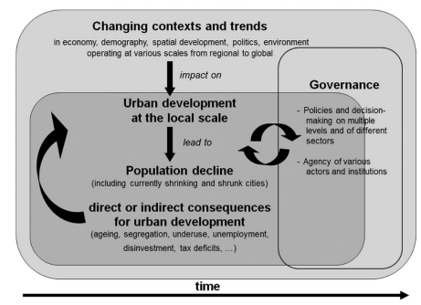
Source: Haase et al, 2013

Slide 14
Why the need for more research?
Relatively recent but rapidly expanding field of research
Studies have focused on definition and conceptualisation of shrinking cities, but gaps in research remain
Many policies on the ground still focused on achieving growth, whereas shrinkage is growing phenomenon in Europe
National policies aspatial and in many cases thought out for growing cities

Slide 15
Research gaps
Shrinkage is “neither a marginal pattern of urban development nor a short-term divergence from the usual growth path” Grossmann et al, 2013
My research aims to address the following research gaps Döringer et al 2019
temporal;
governance and effectiveness of policy responses; and
cross-national comparison.

Slide 16
Path dependency and time
Applying a path dependency framework to urban shrinkage can contribute to these research gaps.
The concept of path dependency is used in the social sciences to emphasise the importance of comparing current conditions and outcomes within the historical evolution of particular places, problems and policy responses.
Context-dependent as well as path-dependent
Are shrinking cities’ pathways shaped by gradual shifts, or rather ‘tipping points’?

Slide 17
Cross national governance
In order to formulate and implement policies aimed at reducing shrinkage, it is crucial for local decision-makers to understand which local city characteristics are alterable and susceptible to policy interventions and which are not Hoekveld, 2012
Taking a temporal research perspective enables to understand the effectiveness of past policy responses to shrinkage by bringing the necessary hindsight.
Looking at governance and the interdependencies between local and national governments is crucial to grasp how cities can impact their future trajectories

Slide 18


Slide 19
Trajectories of port cities
Port cities suffering from shrinkage, even when their ports are successful
The emergence of container-based shipping resulted in challenges for many ports
Further, shift from manufacturing to information-based economy meant access to water and ports matter less
Ports often have different planning arrangements and depend from regional or even national levels

Slide 20
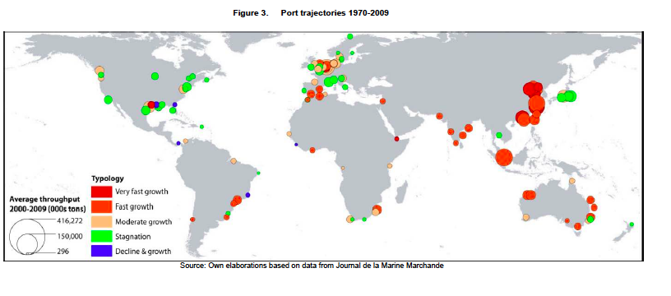
Source: OECD

Slide 21
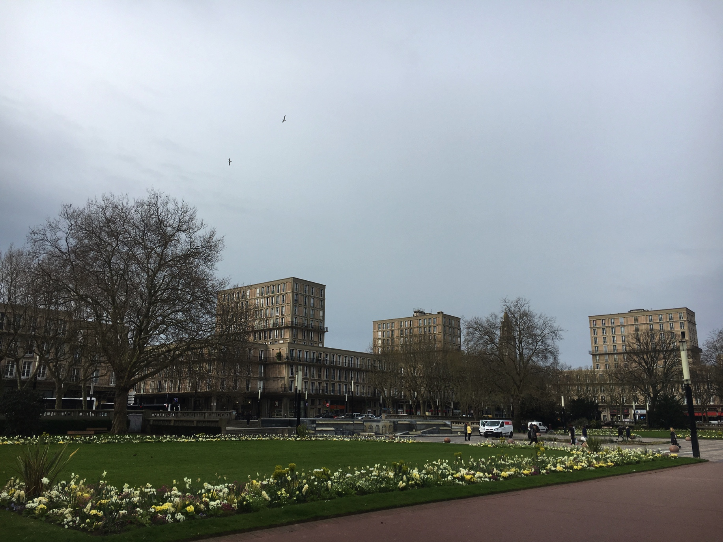
Le Havre

Slide 22
Le Havre
Port provides 30,000 jobs (25% of jobs in metropolitan area)
1st container port in France; 2nd French port for total merchandise traffic
Economic decline and loss of industrial jobs
Poor perception of city centre
Many vacant housing units
Le Havre : funded in 1518 to be France’s maritime city
Competition from other European ports started during the interwar period
In September 1944, a great part of the city was destroyed and subsequently rebuilt under the direction of Auguste Perret
Affected by petrol shock and deindustrialisation during 1970s

Slide 23
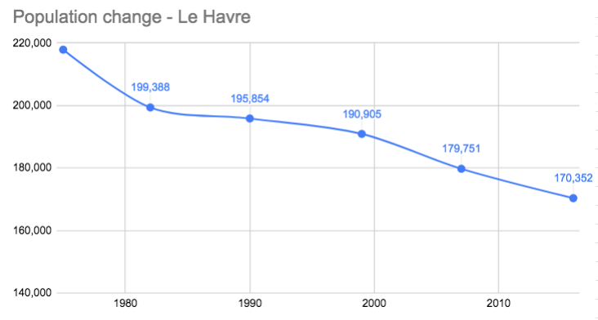
Source: INSEE

Slide 24
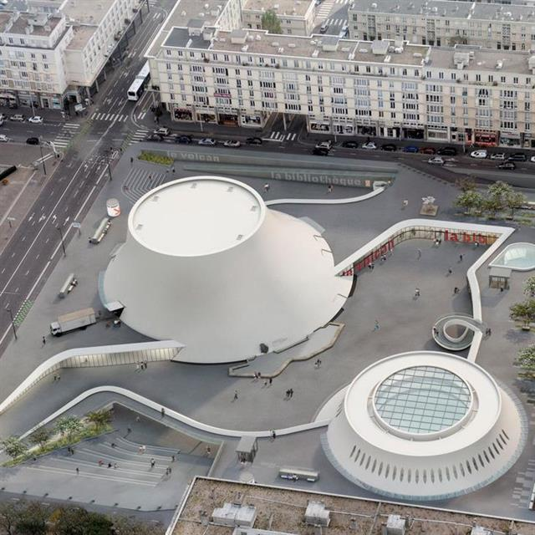
Le Havre
Issues with city centre perceptions leading to efforts to maintain heritage; designated as UNESCO World Heritage Site in 2005
City marketing based on port’s link with the city, and economic reconversion focused on wind farms exports
Renovation of ancient docks, meanwhile uses, use of containers for student accommodation
Tourism offer as part of network with Deauville and Honfleur

Slide 25
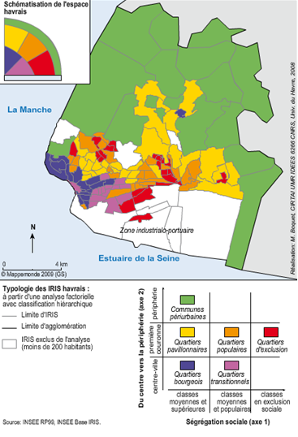
Le Havre
Socially fragmented city (wealthier households settle away from polluted industrial areas)
Urban policies targeting poorer areas (Politique de la Ville/ANRU) : demolition, refurbishment, extending tramway access
PIC Urban (EU-funded) : valorise property potential of former industrial and port-based sites to develop new waterfront uses and attract new inhabitants
Source: Boquet, 2009

Slide 26
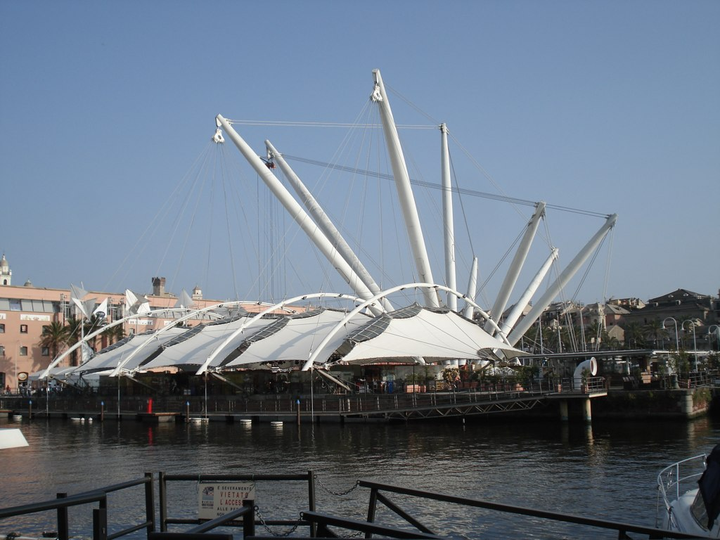
Genoa
Credit: Flickr/Snobum

Slide 27
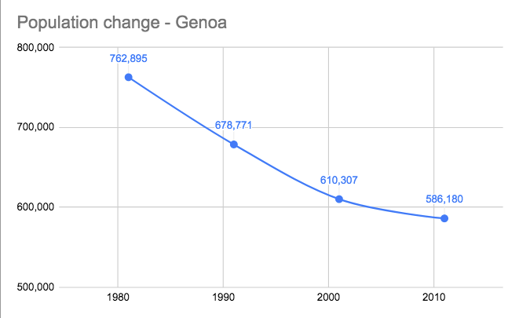
Genoa
Funded 1005
1st port in Italy
Long history of demographic decline and rapid ageing
Reduction in population first hit the historical city centre
Pop graph
Source: Istituto Nazionale di Statistica Italia

Slide 28
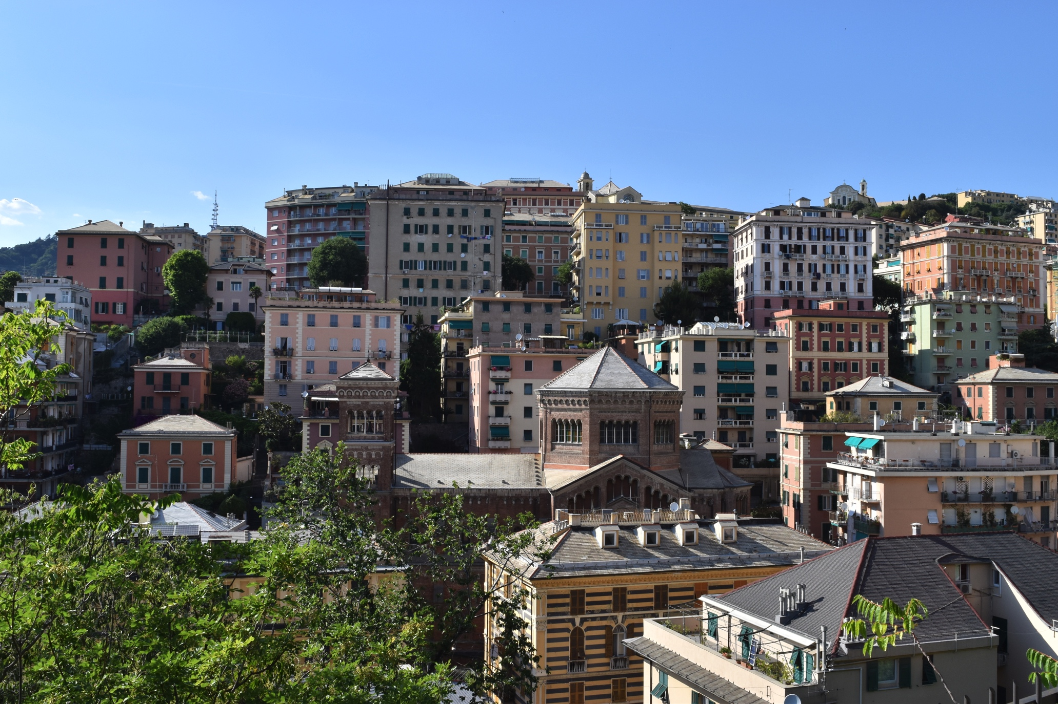
Genoa
Urban strategies limiting developments on greenfield
Use touristic potential to revive historical centre
Regeneration of the historical housing stock
Reduction of the size of large historical flats in order to make them suitable for smaller families
Credit: Flickr/Alexithyme

Slide 29
Genoa
Part of Old Port was redesigned and opened to the public in the occasion of the International Expo in 1992, which paved the way for the rehabilitation of the extended waterfront area.
The regeneration project did not include any residential units but included facilities dedicated to tourism and urban leisure, and retail and commercial units
The Port Authority made a free contribution of the pier area (which could not be used for transshipment anymore), and in return received help from city for the construction of another port in the West of the city.
Awarded the title of European Cultural Capital 2004; UNESCO World Heritage designation in 2006

Slide 30
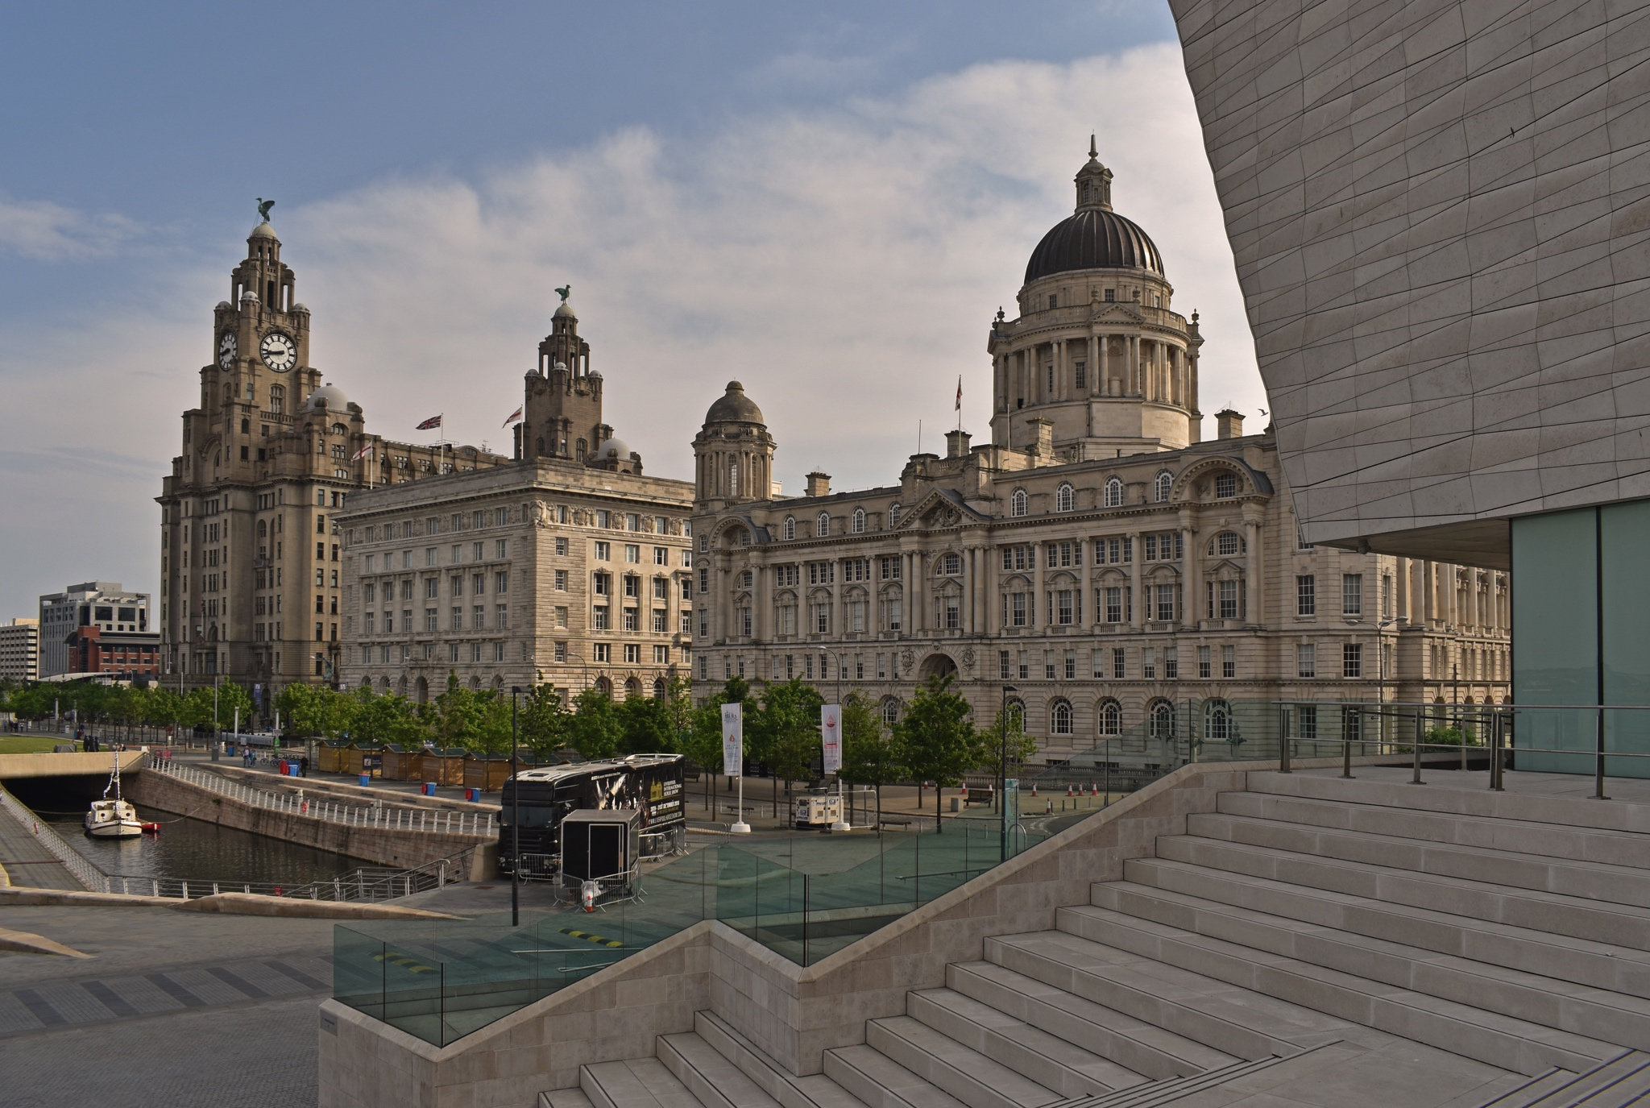
Liverpool
Credit: Flickr/Harshil Shah

Slide 31
Liverpool
Funded 1207
During the 19th century, port handled around 40% of the world's trade.
Containerisation rendered Liverpool's docks obsolete, and most of the south end docks were closed by 1975.
Many economic sectors dependent on port: 1980s difficult time, with high rates of unemployment and out-migration.
4th UK port by tonnage in 2017

Slide 32
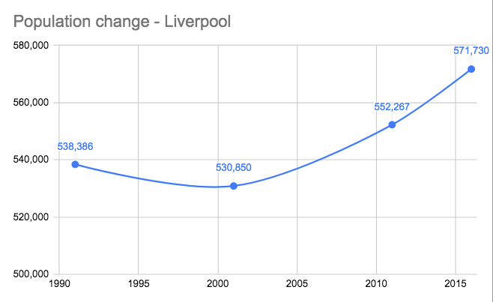
Population growing again; but only one aspect of shrinkage
Source: UK Census

Slide 33
Liverpool
Mix of growth strategy and managing decline (1990-2011)
addressing both the causes and consequences of shrinkage.
Growth strategies:
physical redevelopments;
city marketing strategies (including through large scale events – most notably the European Capital of Culture in 2008);
development of the city’s tourism potential using port heritage as catalyser (UNESCO World Heritage site since 2004);
retail‐led regeneration;
business support and labour market policies.

Slide 34
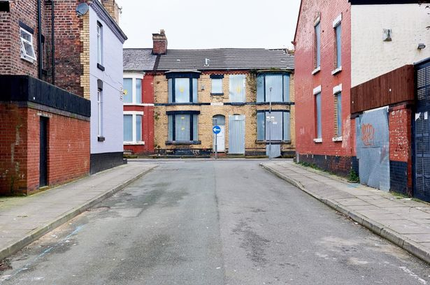
Liverpool
Managing decline strategies:
strategic consolidation of schools in neighbourhoods where the young population was falling;
housing renewal activities;
brownfield management and restrictive land use planning in order to prevent further suburbanisation and strong restrictions on housing development outside inner city areas (through the statutory land use planning system)
Credit: Liverpool Echo

Slide 35
Trajectories of port cities
Common points:
Making the most of their (maritime) heritage (historic building preservation)
Tourism strategies
Port-related waterfront development to increase local economic value from ports.
Economic diversification strategies
External (EU…) funding
Differences:
Shrinkage profile
Size and role of port within city
Importance of urban planning strategies
Actors involved (mostly public in Genoa)

Slide 36
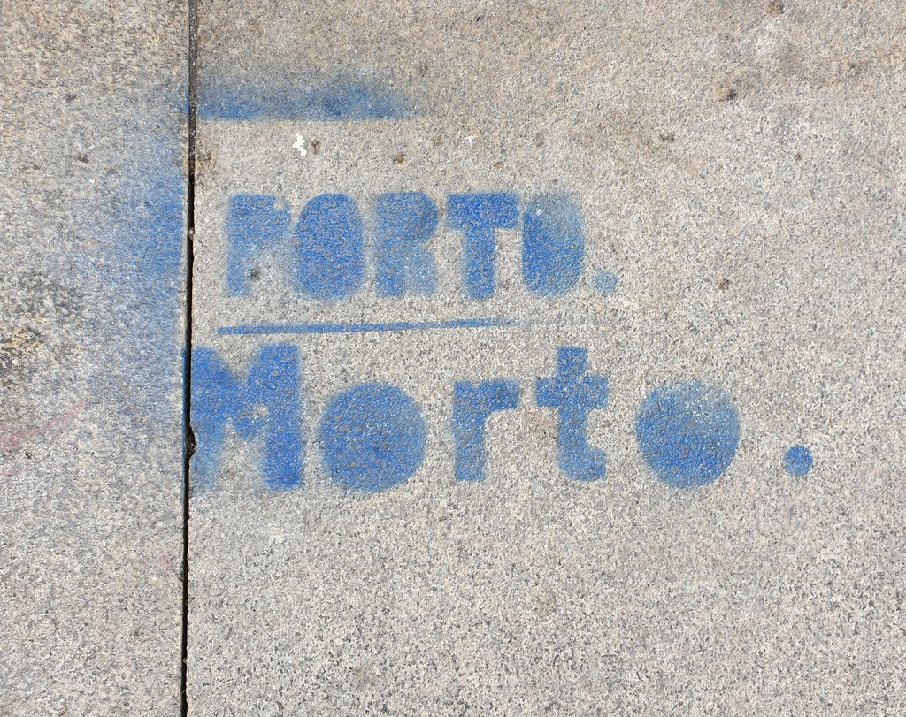
Social impact of waterfront regeneration
One understudied aspect of shrinkage is impact of pro-growth policies on social mix.
Renaissance vs regeneration? Amin, 2000
e.g. Porto
Credit: Flickr Hive

Slide 37
Making shrinking cities resilient
The phrase 'shrinking cities' implies that these afflicted places are following an inevitable trajectory, from something to nothing; perhaps they are simply moving to a new kind of urbanism
If “a city’s history is understood as multiple sets of crossroads that can be hard to navigate” (A. Woodlief), outline which policy responses and crossroads to take
Cities are complex and adaptive systems which have the ability to react to external shocks or stresses (natural disasters or other crises)

Slide 38
To conclude...
Urban research could be enriched by re-focussing on ‘ordinary’ cities, many of which are shrinking
How can we promote good planning and outcomes in cities without long-term growth?
Planners can play an instrumental role in exploring alternatives for shrinking cities

Slide 39
Thank you for your attention!
Any questions?

