Slide 1

“REDISCOVERING COUNTRYSIDE AFTER THE URBAN CRISIS:
NEW EDGES FOR SPANISH INNER MEDIUM CITIES”
12.09.2019
Pablo de la Cal Nicolás
Phd. Architect
Planners Spanish Asociation
Assistant Professor of Town Planning and Urban Design
School of Architecture, University of Zaragoza (Spain)
Notes:
Good afternoon to everyone, and thank you very much to…. and thank you very much to the organization for giving me the opportunnity to talk about urban edges in Spain and contribute somehow to the results of this meeting of European Town Planners. The title of the conference is: “….”. It is a lecture that in fact tries to be complementary to that one that has been presented by Juan Luis de las Rivas…………..

Slide 2
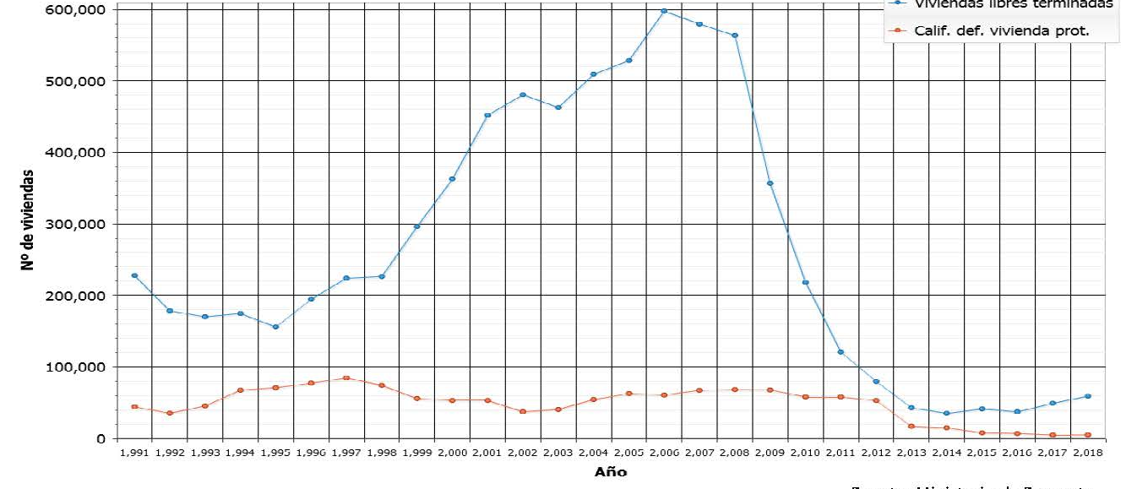
1995
302.339 dwelling units/year
39,6 M inhab.
2007
762.540 du/year
inc. s/ 1995: 152,21 %
45,2 M inhab.
inc s/ 1995: 14,14 %
2017
80.786 du/year
46,57 M inhab.
Notes:
As you may know in Spain we have had several urban cycles of population growth: one in the lates sities, the second in the late eighties (when Spain came into the European Economic Community), and this graphic shows the most recent one. The boom of the first decade of the decade of this century, and the last 10 years of crisis. The specific factor of this last boom was that the population growth does is not proprtional or it does not correspond with the production of land, and the production of dwelling units. It is much related with touristic activity, global economy inverstors, etc. This graphic indicates the number of units built in each year, and represents the two phases (from 1995 to 2007-2008, and the last 10 years). From 302.000 dewelling units in 1995, to 762.000 in 2007, and only 80.000 in 2017.

Slide 3
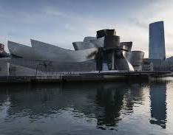
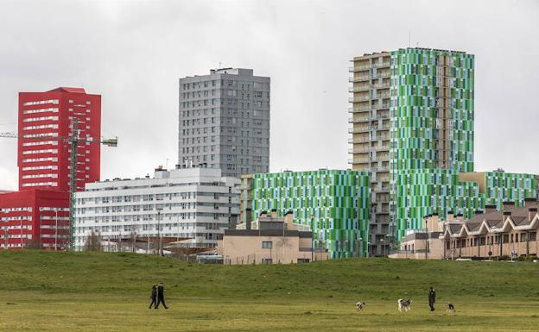
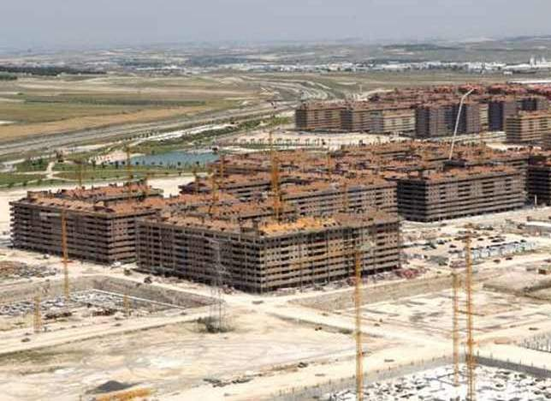
International Exhibition
ZARAGOZA
High Speed Train AVE Madrid-Barcelona
Guhenheim Museum
BILBAO
Olympic Games
BARCELONA
City of Arts and Sciences
VALENCIA
Universal Exhibition
SEVILLA
High Speed Train AVE Madrid-Sevilla
1992
2000
2008
Guggenheim museum. Bilbao
Barrio de Salburua. Vitoria
Barrio de El Quiñón. Seseña (Toledo)
Notes:
In this period we have produce these three urban landscape: highly renovated centers related to important transformation projects. Many of them linked to improvement in road and train networks, some other related to the construction f important cultural or administrative buildings, some other related to internacional events (Olympic games, international exhibitions, etc.). Expansion of the limits of the city, huge urbanized plots, with very repetitive layouts, designed under the idea to be rapidly and easily developed. Ans after the crash of 2008, all the indicators of real estate investment, price of dwelling unit, felt down suddenly, and many urbanized plots remained without buildings, as kind of ‘ghost naighbourhoods’, as J.L. has shown in her last talk.

Slide 4
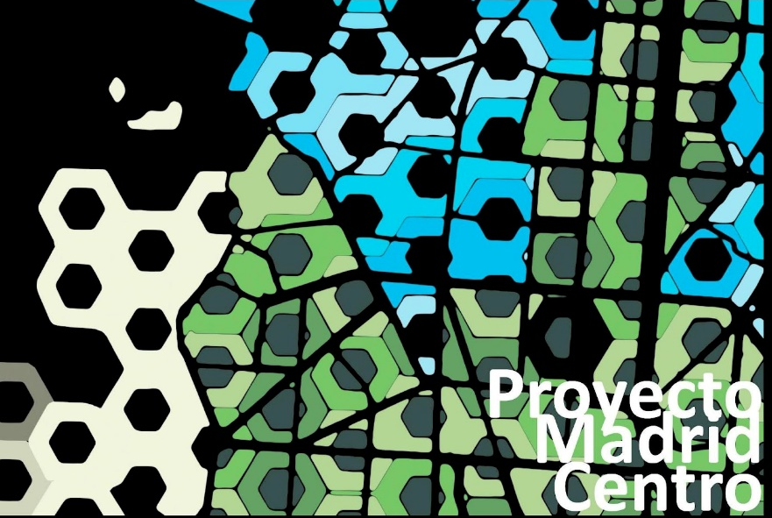
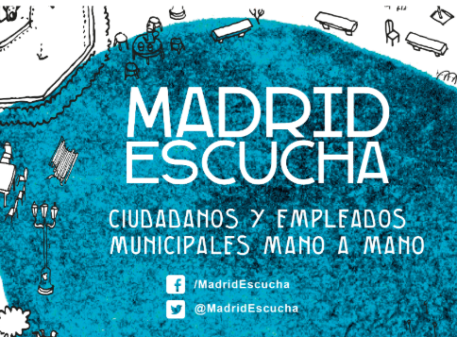
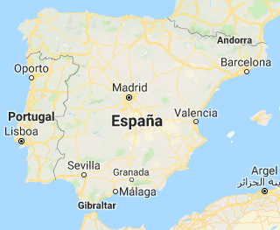
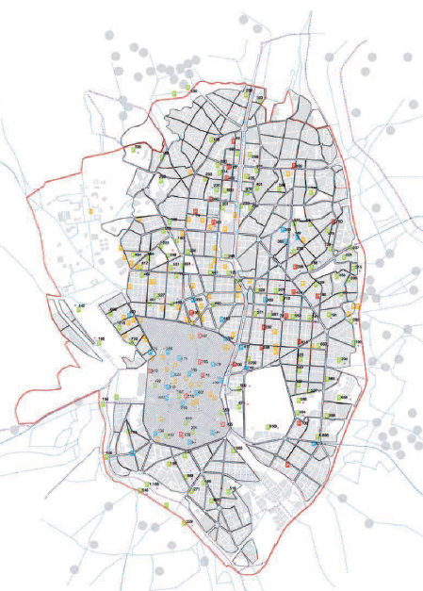
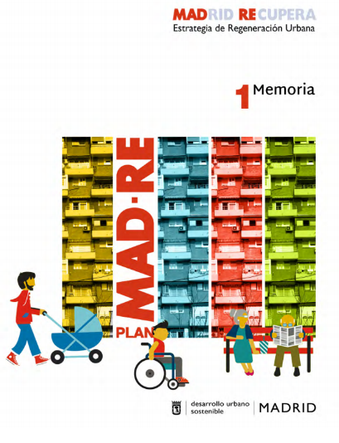
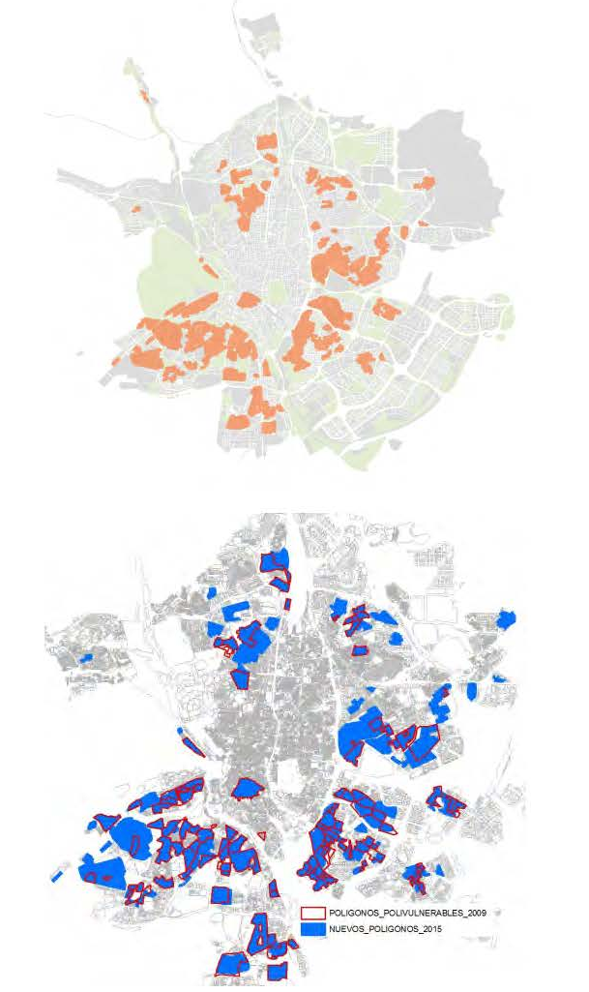
Madrid 3,17 M. inhab.
Strategic Plan: proyecto Madrid Centro (2009-2010)
Madrid Recupera (2016-2019)
Relevant urban experiencies in Spain during the crisis. Madrid: from “Proyecto Madrid Centro” to “Madrid Recupera”
Notes:
During the crisis, most of cities putted the attention not into the extensión, but in the regeneration of vulnerable neighbourhoods, putting the attention to the people. The case of Madrid is very clear, that started with a Strategic Plan to develop the core of the city in the years before the crisis, and it has been working in the last 5 years in a new Plan of recuperation that puts the priority into the peripheral districts of the city.

Slide 5
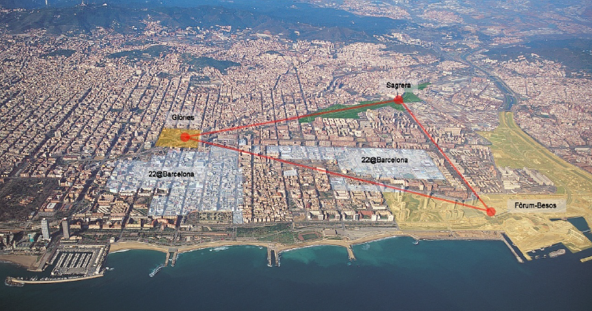
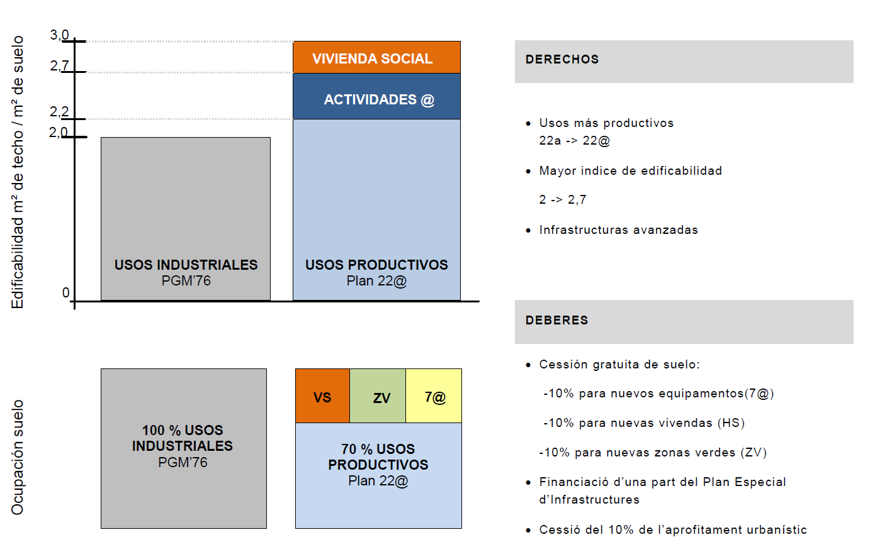
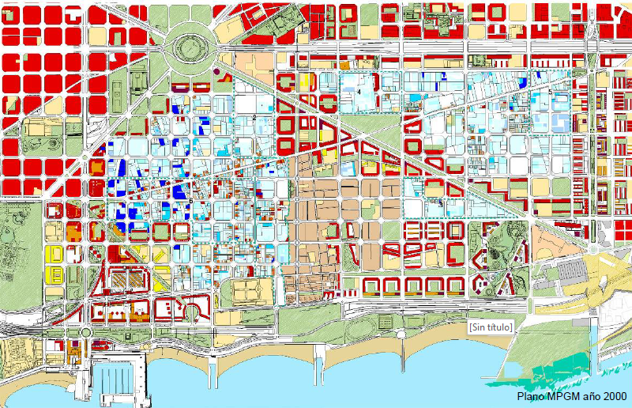
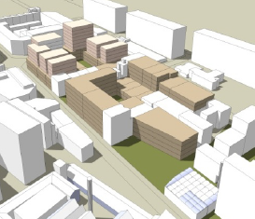
Barcelona 1,65 M. inhab.
1992- Olympic Games
2004- Forum of the Cultures
Ley 2/2004 – Mejora de barrios y áreas urbanas
Proyectos de intervención integral en barrios
Poblenou 22@ - Superilles
Relevant urban experiencies in Spain during the crisis. Barcelona, urban regeneration of industrial areas
Notes:
Also Barcelona has been doing a great wok in neighbourhoods with a specific law for that since 2004, and it is developing a very interesting Project to regenerate the industrial district of Poblenou.

Slide 6
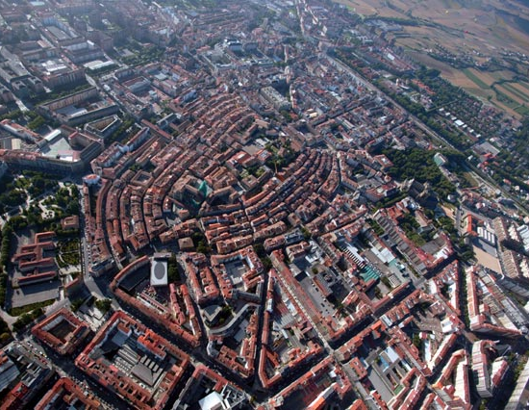

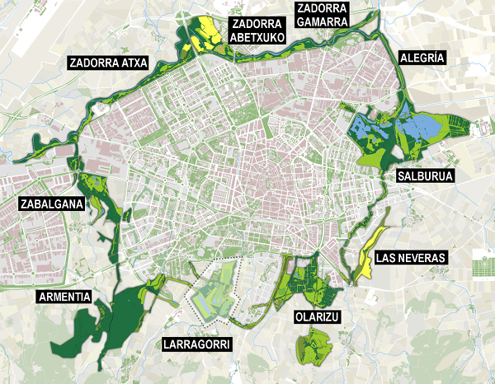
Vitoria 250.000 inhab.
“European Green Capital” 2012
“Global Green City Award 2019”
Global Forum of Human Settlements ONU
Relevant urban experiencies in Spain during the crisis. Vitoria Anillo Verde
Notes:
And there are very good examples of urban improvement, specially in medium size towns, with a peaceful continiuty in its urban policies. Vitoria is very well known example, recognized with the Global Green City Award last week.

Slide 7
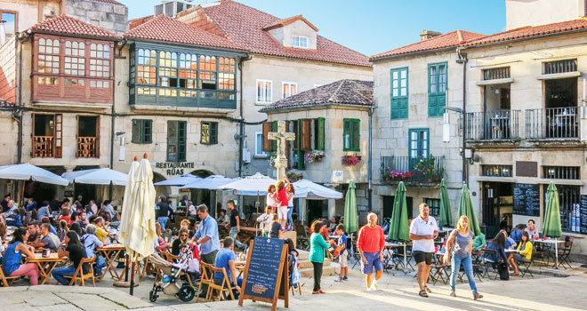
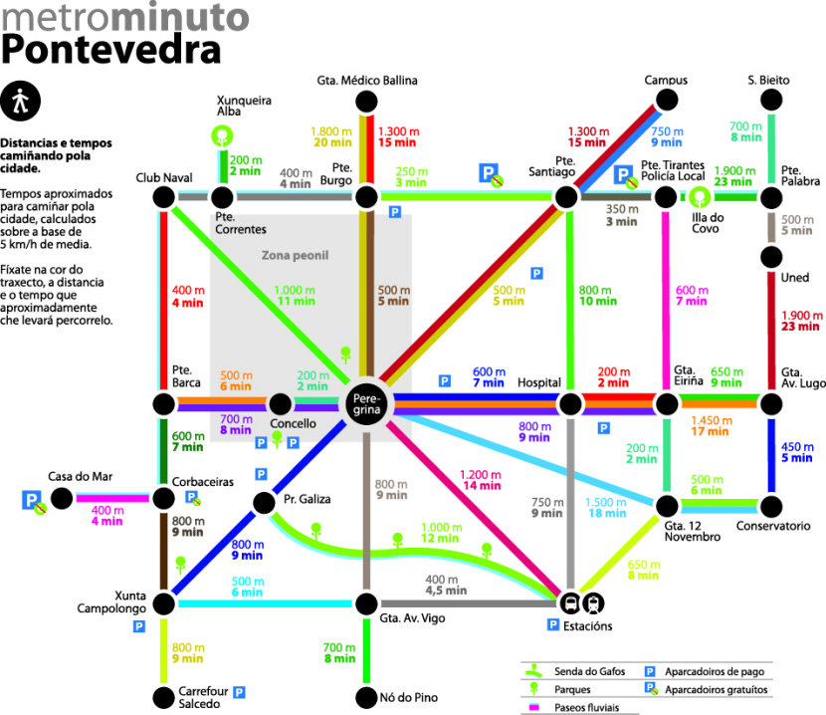
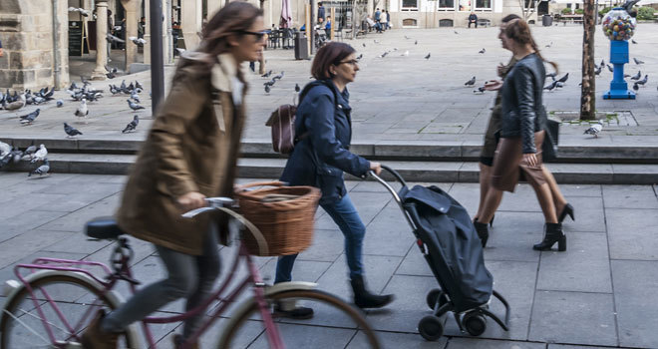
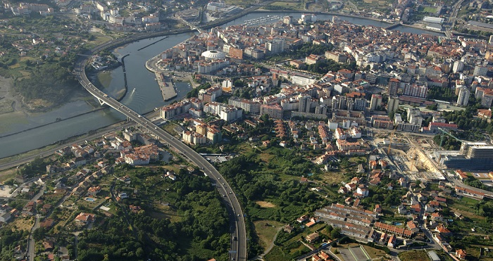
Pontevedra 82.400 inhab.
“Premio Internacional de Dubai”. 2014 Dubai
“Premio Movilidad Sostenible” Hong Kong.
“Premio Active Design” New York
“Premio Intermodes” Bruselas
“World Slowness Forum
and Slowness & Awards 2017”
Global Forum of Human Settlements ONU
Relevant urban experiencies in Spain during the crisis. Pontevedra: pedestrian spaces at historical Center
Notes:
Or the city of Pontevedra (in Galicia), with a very effective car-free design.

Slide 8
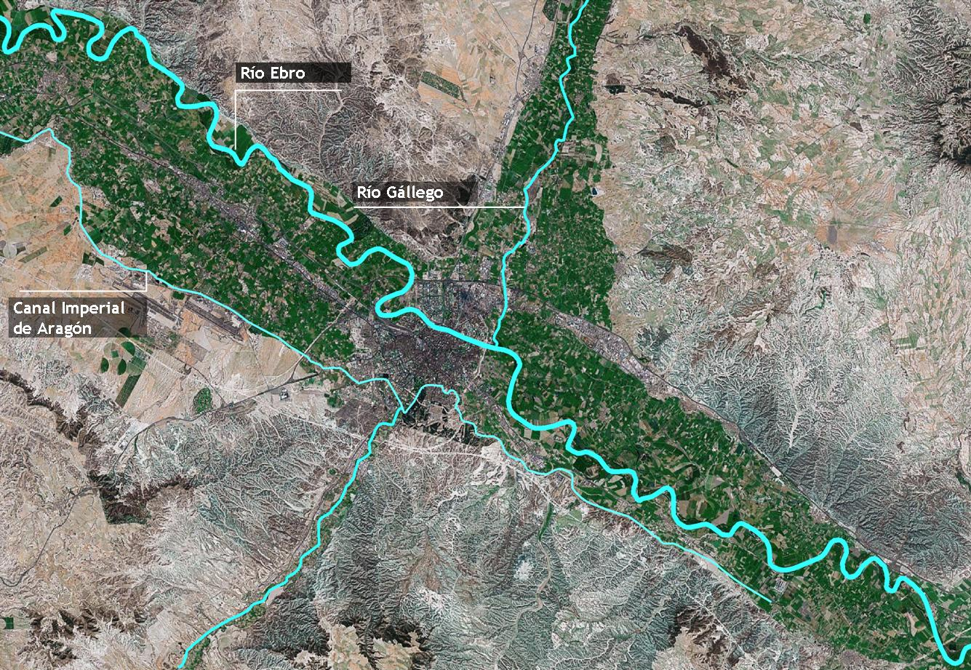
Zaragoza 665.000 inhab.
2008 International Exhibition
“Water and Sustainable Development”
Notes:
Zaragoza can illustrate the situation of medium size cities in Spain. This almost seven hundred thousand people city is located in the center of the nort-east cuadrant of Spain, with a geostrategic location: at 300 kilometers from Bilbao, Barcelona, Valencia or Madrid. The view from the sky is quite singular: a system of fingers of irrigated land, corresponding with three rivers and the Canal Imperial of Aragón. A strong contrast with the non-irrigated land, in a very dry climate conditions.

Slide 9
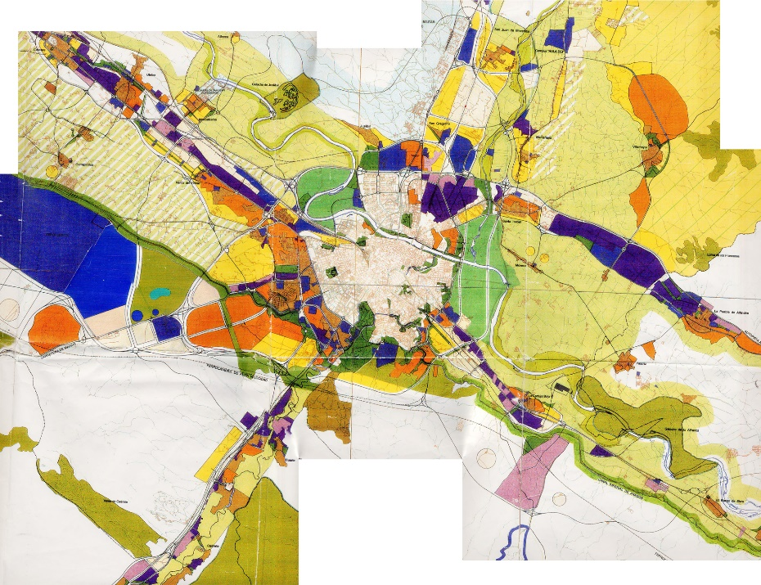
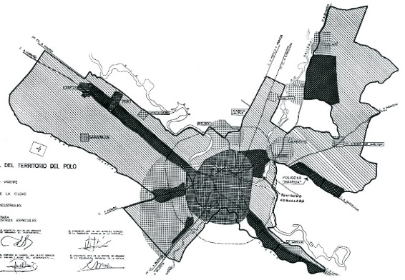
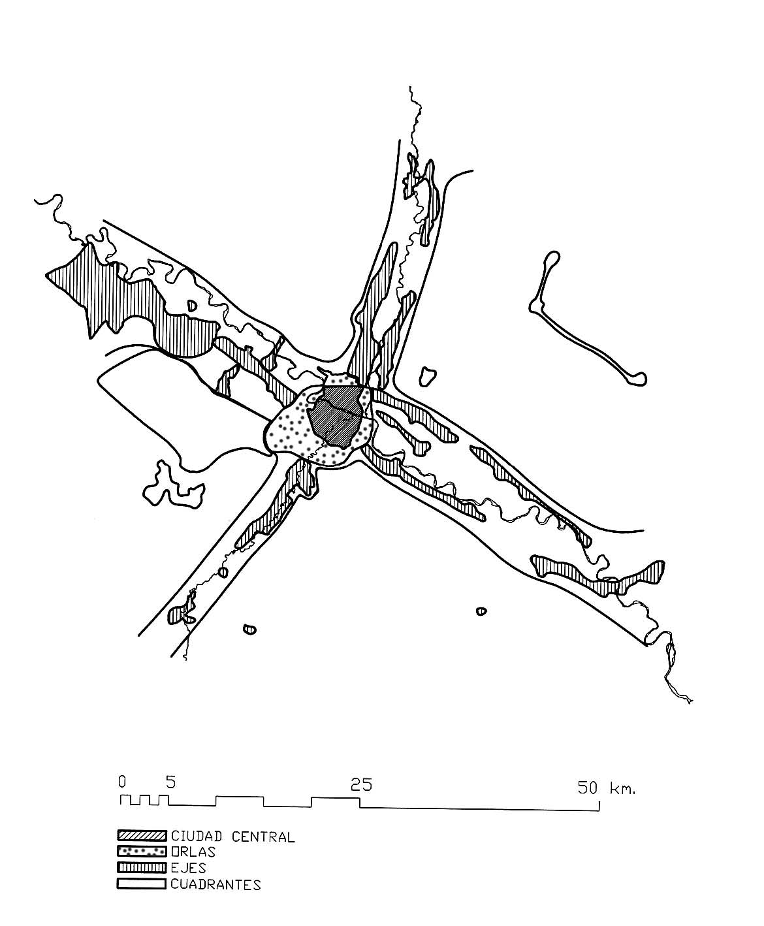
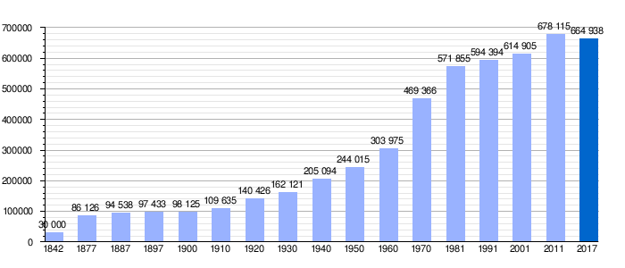
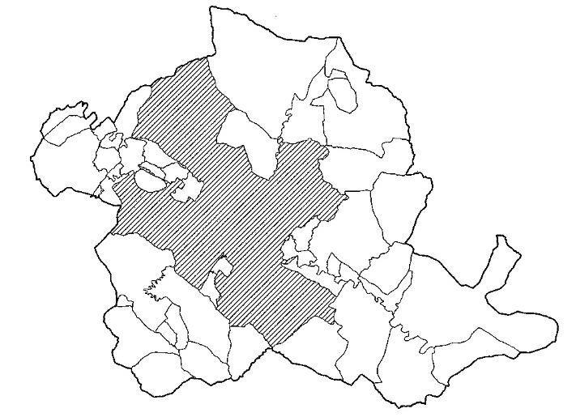
The development of metropiltan axes
Notes:
This diagram of a compact city in the center, and narrow corridors of industrial and low density residential urbanizations have been consolidated in different urban plans during the last 50 years. Population of the metropolitan space in concentrated in the central área, the área that is defined by the road circunvalation (Cuarto Cinturón).

Slide 10
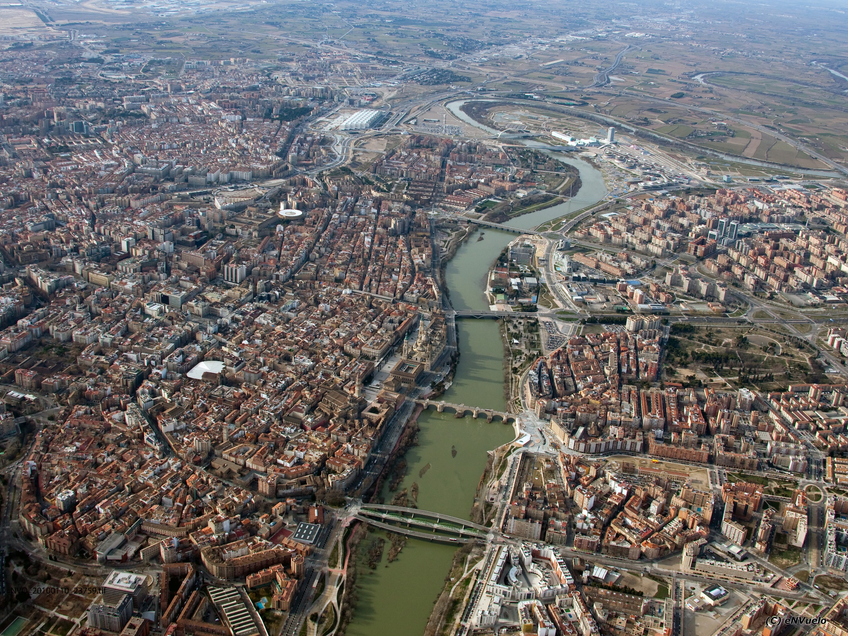
Notes:
It is a very compact city, organized around the Ebro river, with a historic development towars the south, far from the dangerorus floos of the river, but the plan of the XXth century have reequilibrated taking the Ebro as the center of a rounded city, as the major Street of the city.

Slide 11
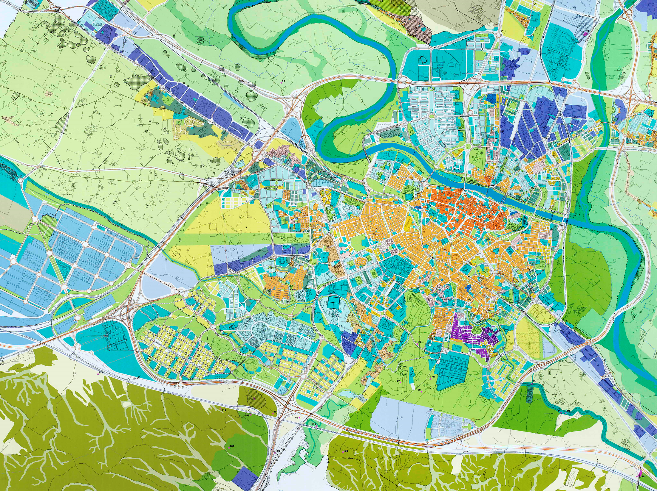
Expo
2008
Airport
Extension
Transformation of riverbanks
AVE raiway
AVE
Station
Plan for
Historical Center
III Road ring
Logistic
Platform
AVE by-pass raiway
IV Road ring
Notes:
The staretgic projects have been related to the construction of the high speed train, the external ring road, the airport, and in a more intense way, the celebration of the International Exhibition 2008.

Slide 12
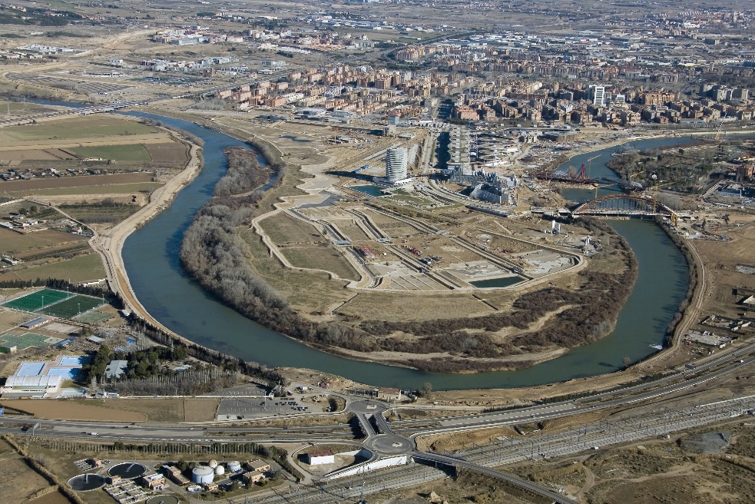
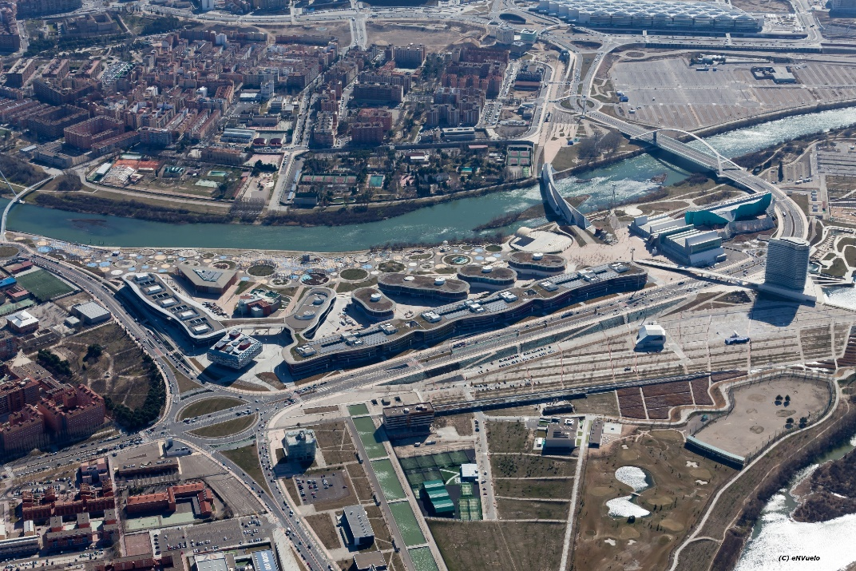
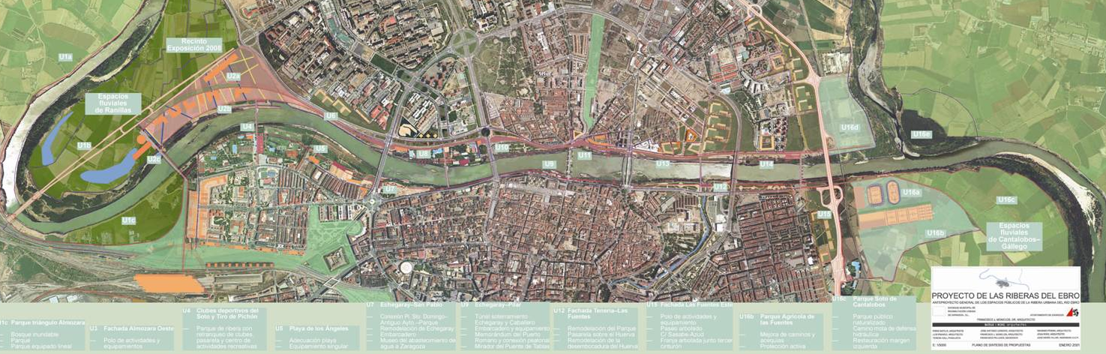
ip
The International Exhibition “ExpoZaragoza2008: Water and Sustainable development”
Pre-crisis landscapes. Reinvention of a new relationship City-Ebro river
Notes:
The International Exhibition 2008 transformed the meander of Ranillas, with the Water Park as one of the outstanding pieces, an well known example of ecodesign.

Slide 13
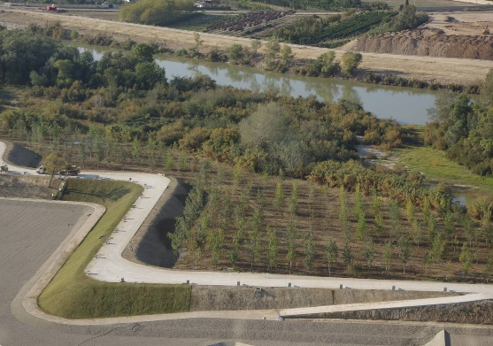
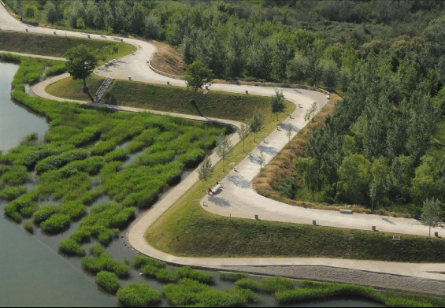
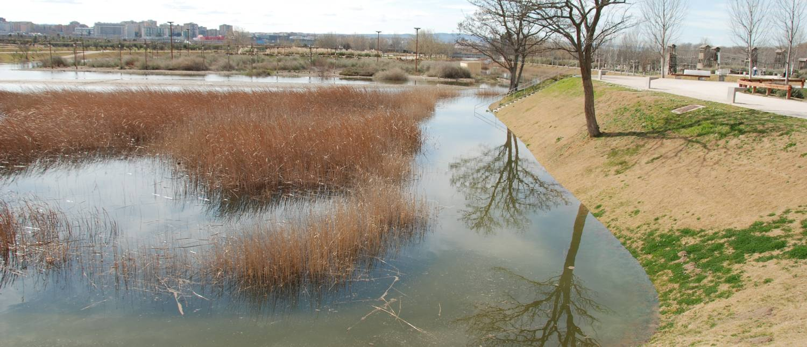
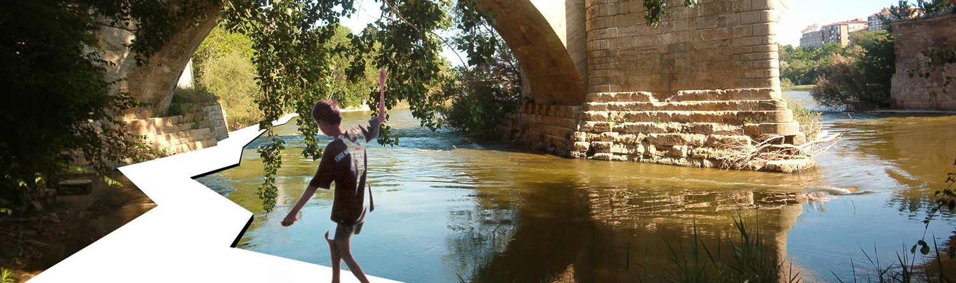
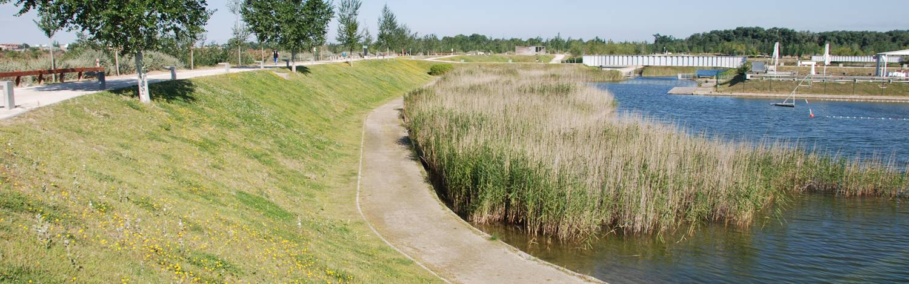
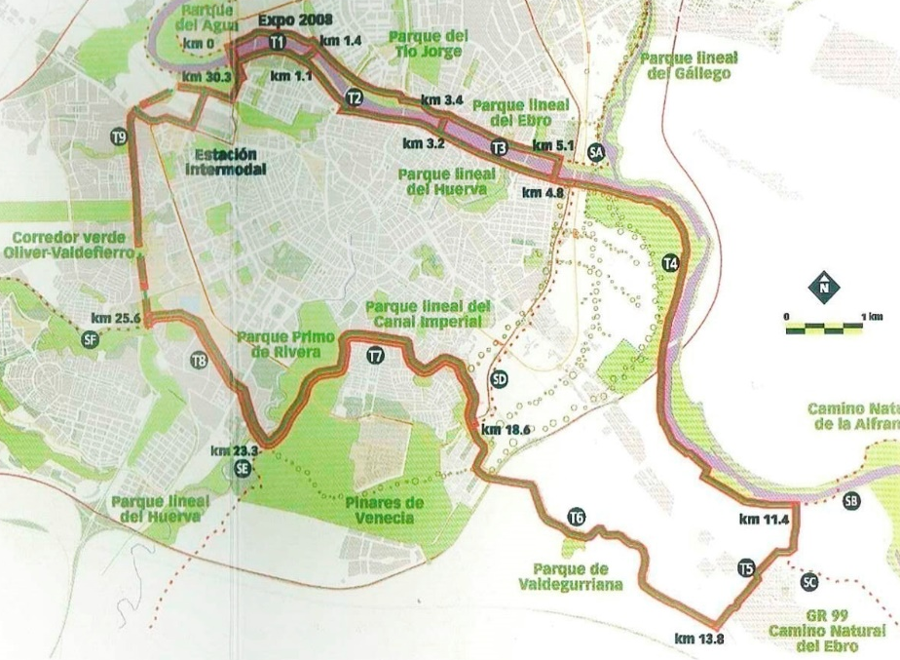
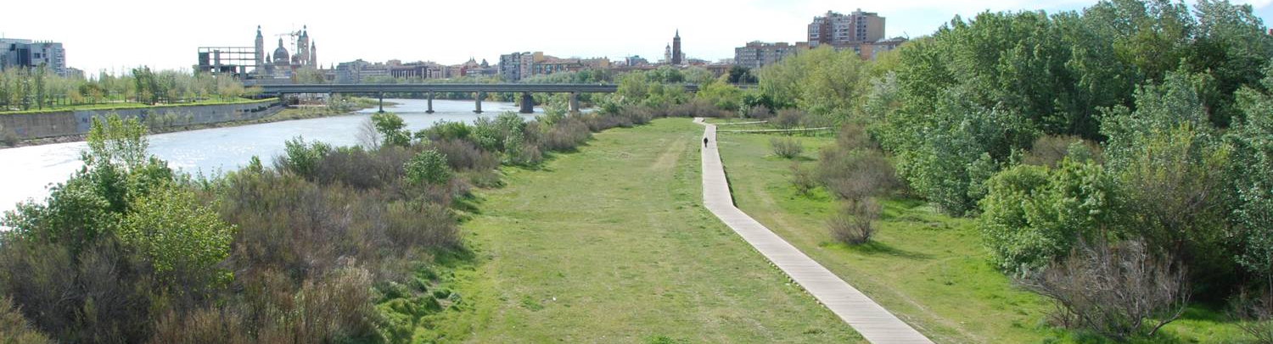
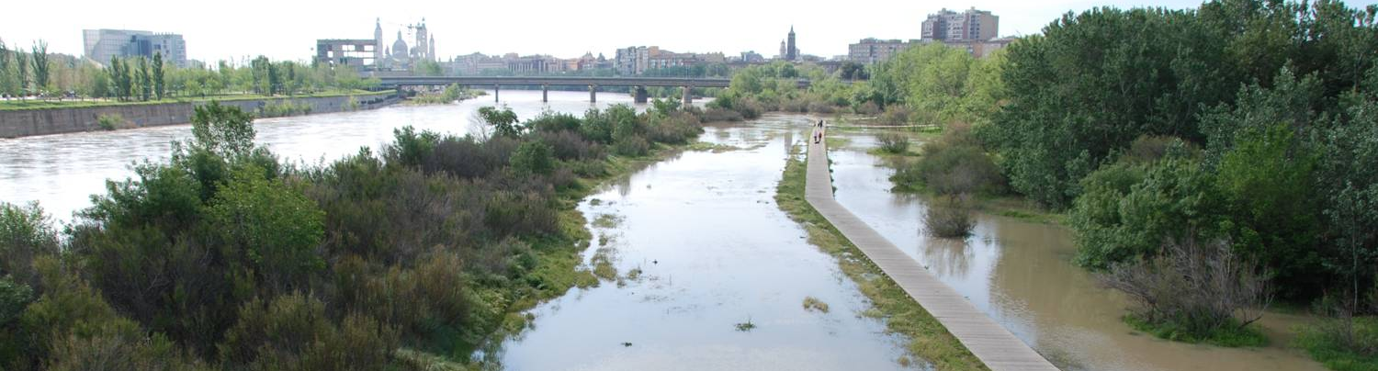
ip, mi
River and city discover ‘compatible spaces’
Pre-crisis landscapes. Reinvention of a new relationship City-Ebro river, and a new system of parks
Notes:
And as one of the major legacies of the Expo, a new system of Parks, that have improved the connectivity between neighbourhoods and have implemented with soft modes of mobility.

Slide 14
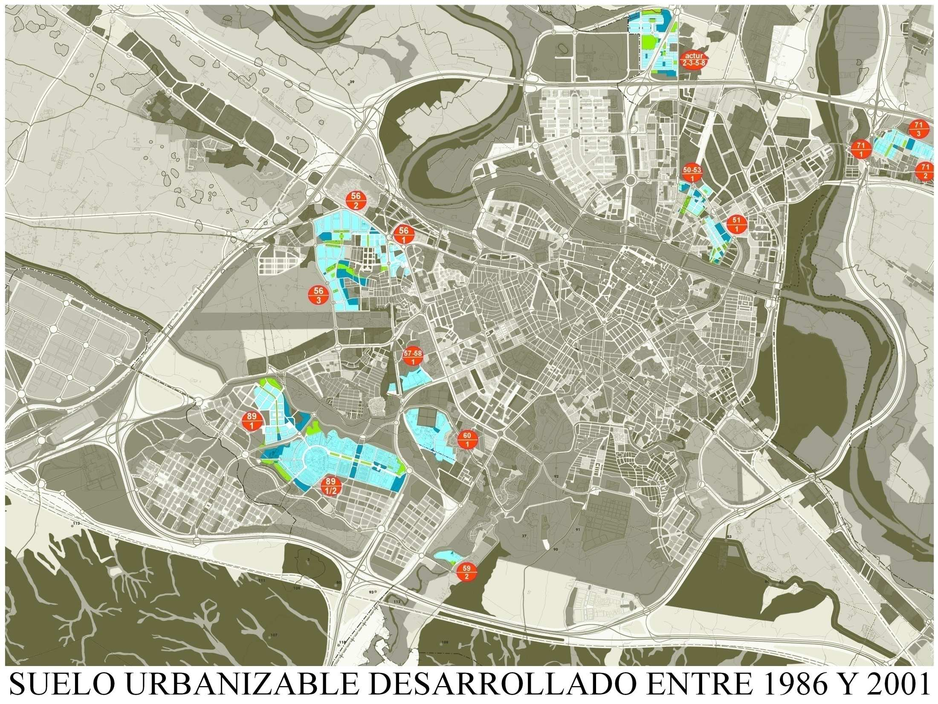
Pre-crisis residential extensions (Master Plan 1986): 1986-2001.
Notes:
With these great urban projects, in the last 20 years, the population has growth in 14%, but the occupation of urban land has a increase of 67%. This urban growth has been based on isolated pockets, with different designs but all of them based on regular layout, with repetitive blocks. Areas of the city that are linked merely by a system of roads and services network, with undefined intermediate spaces between them.

Slide 15
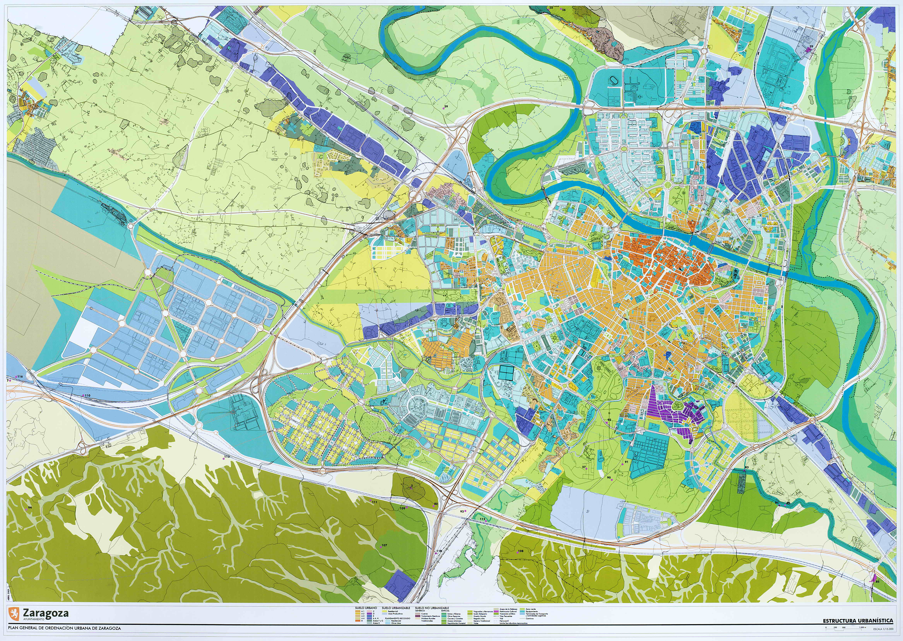
Total new dwellings in Master Plan (2001)
Brownfields (inner city): 48.044 dwelling units
Greenfields (priority): 4.422 du
Greenfields (non priority): 79.300 du
Total : 131.766 dwelling units.
Existing (2001): 283.649 du
SG/1
61/2
55/1
56/5
88/1
‘Plataforma
Logística PLA-ZA’
57/1
38/3
38/5
89/3
‘Arcosur’
38/4
89/4
‘Valdespartera’
88/1
‘Parque
Venecia’
38/1
59/1
88/3
88/1
‘Puerto
Venecia’
Urban extensión areas in the Master Plan (2001)
Notes:
Since 2001 (in almost 20 years) Zaragoza has built more than 40.000 dwelling units, but the master Plan still have a capacity of 90.000 dwelling units. With the average of the last three years, we have land for 90 years. This is the first problem: the oversized dimensión of extensión plans in the Master Plan, with a great compsumtion of land and a loss of agricultural land.

Slide 16
SG/1
61/2
55/1
56/5
88/1
‘Plataforma
Logística PLA-ZA’
57/1
38/3
38/5
89/3
‘Arcosur’
38/4
89/4
‘Valdespartera’
88/1
‘Parque
Venecia’
38/1
59/1
88/3
88/1
‘Puerto
Venecia’
Developed (approved and urbanized) extension areas since 2001
Notes:
The second problem is the location of the new developments. They are not in the place where the Master Plan designated the developments with priority. Instead of beings touching the city, the plans that have been developed are at the south of the city, in the non-irrigated land, owned only by a few properties.
774 hectars of residential land with a capacity of more than therty five thousand dwelling units, and more than 1.000 hectars of productive uses.

Slide 17
Picarral
La Jota
Vadorrey
Oliver
Delicias
Las
Fuentes
San José
Valdefierro
89/3
‘Arcosur’
Torrero
La Paz
89/4
‘Valdespartera’
88/1
‘Parque
Venecia’
New residential developments vs. Inner peripheries (deprived neighbourhoods)
Notes:
And a third problem is that the private capital is at these undeveloped land, retained by the Banks, and the City Council does not have money to invest in traditional neighbourhoods. Administration builds schools, healt care centers, civic centers, markets, in these new neighbourhoods, but there is no money and no effective instruments to work in vulnerable áreas of the city, that have a great loss of young families, and of comercial activiy, and urban vitality at the end.

Slide 18
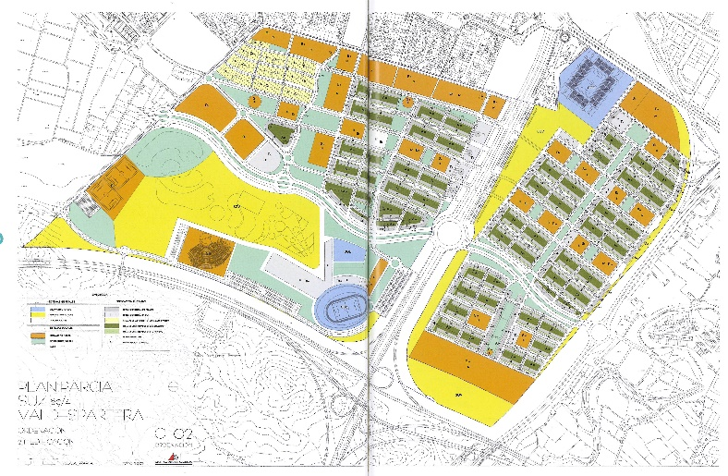
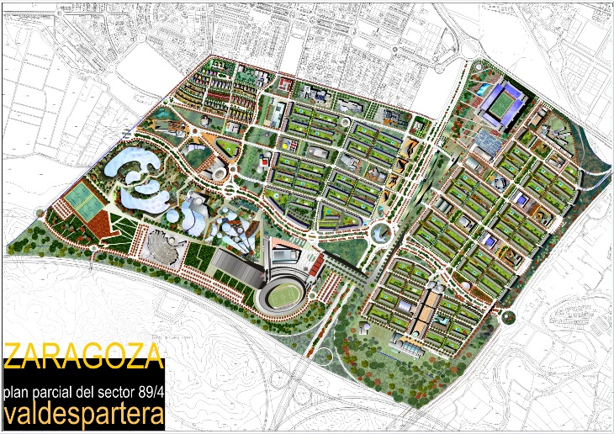
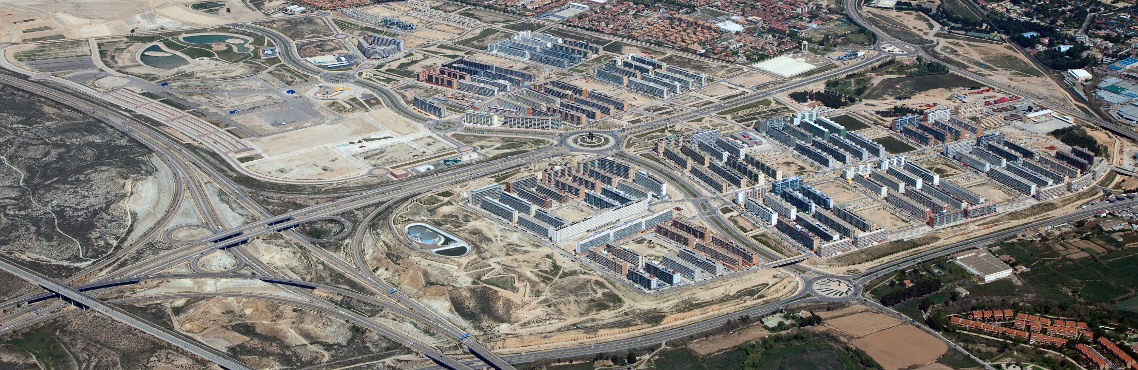
1998
2000
2002
2004
2006
2008
2010
2012
2014
2016
2018
2020
Master Plan PGOU
Plan General
Plan Parcial
Development Plan
Constructions rights Document
Proyecto de Reparcelación
Urbanization Plan
Proyecto de Urbanización
Civil Works
Urbanización
Residential building
Facilities construction
Construcción residencial y Equipamientos
89/4 ‘Valdespartera’. Capacity: 9.687 residential units (ru) (96,9% VP). Density: 40 homes per hectare
Notes:
Valdespartera was the first área in being developed, ten thounsand dwellings, But it was very fast, because is was a propery of the State, and the City Council developed it a very fast manner as we see in the timing diagram.

Slide 19
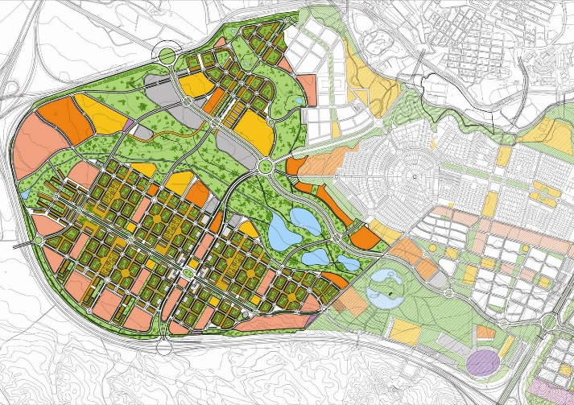
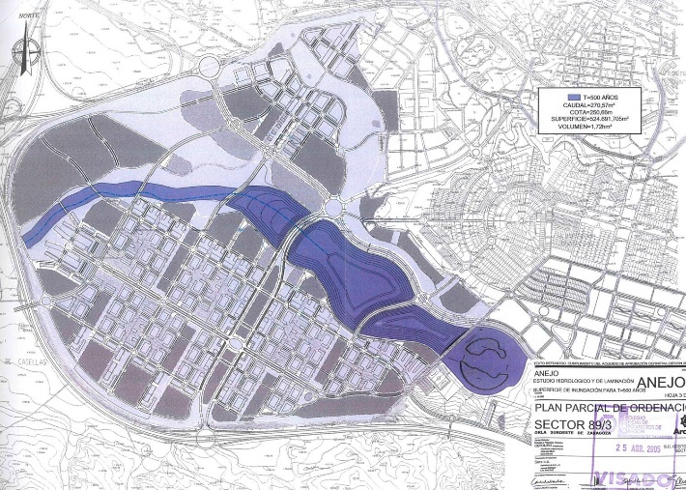
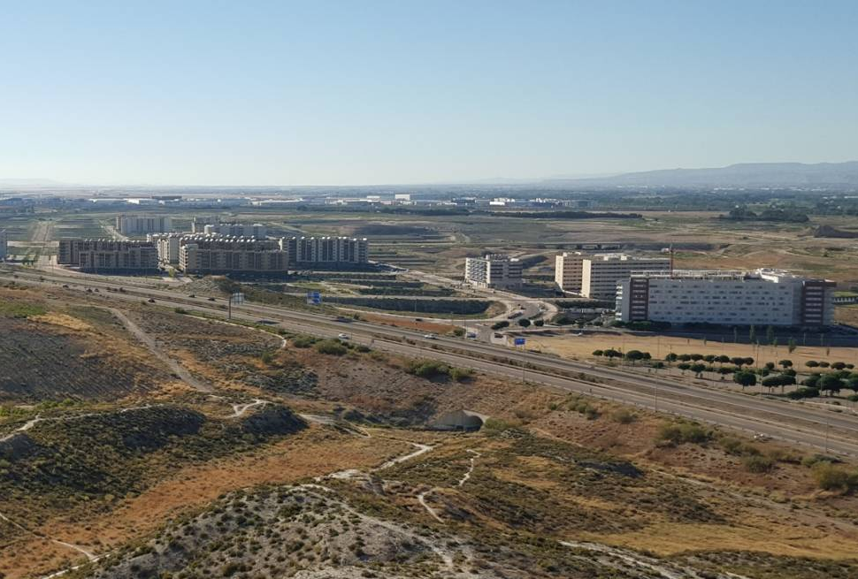
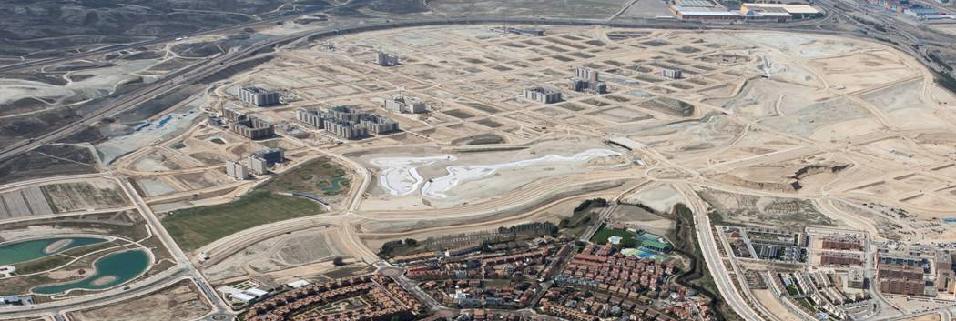
1998
2000
2002
2004
2006
2008
2010
2012
2014
2016
2018
2020
Master Plan PGOU
Plan General
Development Plan
Proyecto de Reparcelación
Plan Parcial
Constructions rights Document
Urbanization Plan
Proyecto de Urbanización
Civil Works
Urbanización
Residential building
Facilities construction
Construcción residencial y Equipamientos
89/3 Arcosur. Capacity: 21.148 residential units (ru) (60% VP). Density: 49 homes per hectare
Los paisajes de la extensión urbana. Repaso a planes parciales
Notes:
But the situation of its neighbour plan is quite different. Four hundred and fifty hectars of fifty dwellings per hectar, twenty one thousand dwelling units. And everything designed at once, in only one phase of excution, urbanized at once… but finally, ten years later, only 10% of the planned blocks has been built.

Slide 20
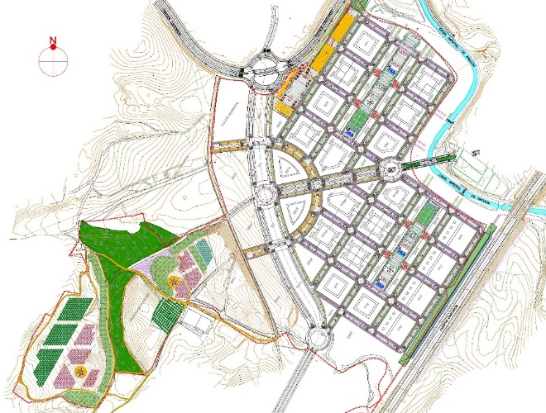
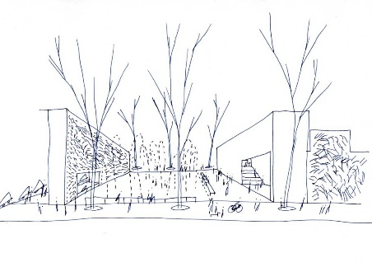



1998
2000
2002
2004
2006
2008
2010
2012
2014
2016
2018
2020
Master Plan PGOU
Plan General
Development Plan
Proyecto de Reparcelación
Plan Parcial
Constructions rights Document
Urbanization Plan
Proyecto de Urbanización
Civil Works
Urbanización
Residential building
Facilities construction
Construcción residencial y Equipamientos
88/1 ‘Parque Venecia’. Capacity: 4.103 residential units (ru) (40,00% VP). Density: 40 homes per hectare
Notes:
Parque Venecia offers better results. It is much smaller, and its location and conection with the city is much better, and its developments has been reinforced by the presence of Puerto Venecia, a sucessfull comercial center.

Slide 21




1998
2000
2002
2004
2006
2008
2010
2012
2014
2016
2018
2020
Master Plan PGOU
Plan General
Development Plan
Proyecto de Reparcelación
Plan Parcial
Constructions rights Document
Urbanization Plan
Proyecto de Urbanización
56/5-1,3 ‘Miralbueno’. Capacity: 1.939 residential units (ru) (50,00% VP). Density: 30 homes per hectare
56/5
56/5-1
56/5-3
56/5-3
Notes:
And we can see the process in which we have what in the Master is defined as the ‘yelow landscape’. Land that has already approved plans and projects for urbanization. Land that is expecting the real estate conditions to improve to start, and finally to do a plan that has been designed about 15 years ago.

Slide 22


1998
2000
2002
2004
2006
2008
2010
2012
2014
2016
2018
2020
Master Plan PGOU
Plan General
Development Plan
Plan Parcial
Urbanization Plan
Proyecto de Urbanización
38/1,3,4 ‘Miraflores’. Capacity: 5.069 residential units (ru) (29,50% VP). Density: 30 homes per hectare
38/5
38/3
38/4
38/1
Notes:
This is another example, precisely the sectors that are at the East of the city, next to the existing urban fabric, and they had the priority in the development under the consideration of the Master Plan.

Slide 23






Urban ecology
Urban agriculture
Plan de Accion para la implementación
de la Agenda 2030
2010. White Paper on
Sustainability Spanish Urban Planning
The Charter of New Urbanism
Resilience
thinking
Citizen
participation
Ley 8/2013, de 26 de junio,
de rehabilitación, regeneración
y renovación urbanas.
New topics of urban discussion. New paradigms
Notes:
One additional problema is that the urban design of these ‘yellow land’ plans do not consider the new concepts and the new urban paradigms that in the last 10 years have been developed, related to a renovated urbanism fully involved with global challenges.

Slide 24





‘Sustainable Mobility PMS’
‘Green Infrastructure’
Renovated planning instruments (complementary of Master Plans)
Notes:
In this sense, almost every spanish city has prepared a Sustainable Mobility Plan (PMS) and a Green infrastructure Plan. They are new instruments that run in parallel with urbanistic Master Plan, and now always well coordinated between them.

Slide 25

SG/1
Picarral
61/2
55/1
La Jota
Vadorrey
56/5
Oliver
Delicias
Las
Fuentes
88/1
‘Plataforma
Logística PLA-ZA’
San José
57/1
Valdefierro
Torrero
La Paz
38/3
38/5
89/3
‘Arcosur’
38/4
89/4
‘Valdespartera’
88/1
‘Parque
Venecia’
38/1
59/1
88/3
88/1
‘Puerto
Venecia
Landscapes of ‘expecting’ urban extensión: Approved but not executed planned areas
Notes:
With this situation, what should be the next future of cities that have similar problems to Zaragoza? What should be the action of planning to solve the mentioned problems? In our opinión, water systems can provide the key for the new intervention in Zaragoza, because it is a system that connects the urban landscapes that we have analyzed: new extensions, full or empty of urban life, yellow land, traditional neighbourhoods. Natural systems historically have been modified by the purposes of agricultura, navigation, wáter managemenet… This system is functioning today… and its recovery and integration as a landscape infrastructure can be applied as a place making instrument. From the dry barrancs of the south, crossing the new developments, crossing the Canal, crossing the inner peripheries, and arriving at the lowest part of the section, in the spaces of the river Ebro, affected by the periodical flooddings.

Slide 26


Watersheds at south-west of Zaragoza: PLA-ZA, Arcosur and Valdespartera
Notes:
The flows of surface runoff

Slide 27



Watersheds at south-east of Zaragoza

Slide 28


‘Barranco de la muerte’. Upper part of the barranc

Slide 29



‘Barranco de la muerte’. Dam 1

Slide 30



‘Barranco de la muerte’. Dam 2

Slide 31


‘Puerto Venecia’. Floodable square / View of the central lake
Notes:
Floodable squares, ludic lakes…

Slide 32







gh
‘Canal Imperial de Aragón’. A mediating element between the non-irrigated land and the consolidated neigborhoods.
Notes:
The crossing of the Canal Imperial Channel of Aragon that was built in the eighteen century with outsatanding features to make posible the passing of wáter ways in subterranean level, at the level of the wáter in the Canal..

Slide 33

Notes:
Under the traditional neighbourhoods there a lot of opportunies to recover irrigation ditches that are functioning, and that once were covered because of functional reason. But today the recuperation can provide a mecanism of connection with the agricultural spaces, and also with natural environment, to introduce nature in city.

Slide 34

Notes:
Zaragoza has 50 km of ditches under the pavement and the houses, that can be recovered. Together with the 72 km that are open, and the 37 km of rivers and Canal. In total, a system of wáter ways of 159 km

Slide 35




Secuencia de estadios o episodios urbanos diferenciados en los terrenos de la antigua torre Ramona, situada en la terraza entre la acequia de la teja y el escorredero de la Filla, en Las Fuentes.
DU: Dispersión urbana en la estructura agrícola
TA: Torre aislada. Torre de D. Marcelo Guallar, en 1874. En 1901 Francisco Andrés Oliván dona esta propiedad a la Diputación Provincial, quien en 1913 la cede al Estado para Manicomio del Pilar.
ES: Equipamiento singular. Reformatorio de Menores (reforma de la antigua torre según proyecto de Regino Borobio, arqto., 1925.). Posteriormente, fue colegio de la congregación Pía Unión de Nuestra Señora del Pilar.
CS: Crecimiento de condición suburbana
PR: ‘Parcelación-retícula’, en las calles la Higuera, etc.
RE: Reordenación, remodelación, densificación
RE: Densificación sucesiva de parcelas de uso residencial.
RA: Regeneración ambiental / potencial integración urbana del edificio y su jardín histórico, como equipamiento de barrio y ordenación de una nueva plaza del distrito Las Fuentes.
ag
TA
DU
ES
PR
CS
RE
RE
s+ca
RA ?
ip ?
‘Enclaves de mediación natural-agrícola-urbana’. Antigua torre Ramona. Las Fuentes
Notes:
The rediscovery of the layer of the former agriculture under the city allows to reinforce enclaves that provide strong identity to the old neighbourhoods, and also introduces nature in the city: old gardens, wáter systems…

Slide 36

1 Conexión Parque de los Tapices de Goya con galacho de Juslibol y con el parque Luis Buñuel; acequia del Rabal y acequia de Juslibol.
2 Dinámica de las antiguas Balsas de Ebro viejo: parque del Tío Jorge-Polígono Balsas de Ebro viejo
3 Tramos finales del Rabal en Vadorrey y La Jota, conexión con la desembocadura del Gállego.
4 Torre Ramona: antigua Torre y sus jardines, escorredero de La Filla. Conexión con el Parque Agrícola de la huerta de Las Fuentes.
5 Sistema de conexión Canal Imperial-Ebro a través del sistema del escorredero de San Antonio y del escorredero de la Media Legua.
6 Falda del barrio de San José. Recuperación integral de la acequia del Ontonar, desde el Jardín de la Memoria-La Harinera hacia la Zaragozana y hacia las terrazas del Canal Imperial. Sistema de la acequia del Plano, en la falda y en los miradores del Canal Imperial: Cabezo Cortado y Quinta Julieta.
7 Sistema de los antiguos depósitos de agua de Pignatelli, conexión con Parque Grande a través de la acequia Adulas.
8 Parque de Delicias y antiguos itinerarios sinuosos que conectan con parque Castillo Palomar (calle Terminillo, calle Constanza de Sicilia, etc.) y conexión con parque Oliver (acequia del Plano).
1
2
3
8
4
7
6
5
‘Enclaves de mediation nature-agricultura-city’. Green infrastructure in consolidated urban fabric
Notes:
This network of enclaves of mediation: nature-agriculture.nature can be integrated in a systems that goes from the city to the agriculture open spaces, from the city to the dry barrancs of the south.

Slide 37







ip
Water neighbourhoods
Notes:
These landscape of wáter ways (ditches, irrigation Canals, etc.) allows to rethink the city in terms os spatial sequences, in terms of placemaking, instead that in terms of cuantitative indicators (Surface, number of dwellings, density, etc.).

Slide 38


Notes:
Ans at the Edge with the open spaces of the Ebro river the city has great opportunities to improve the quality of the existing neigbourhoods, as in the case of Las Fuentes.

Slide 39


“The understanding of the particularity and distinction of local and regional landscapes can provide a point of resistance
to the homogenizing effects of globalization”
Pierre Bélanger
‘Is landscape infrastructure?”. 2019
Notes:
“The understanding of the particularity and distinction of local and regional landscapes can provide a point of resistance
to the homogenizing effects of globalization”
Pierre Bélanger
‘Is landscape infrastructure?”. 2019

Slide 40
THANK YOU VERY MUCH!
“The understanding of the particularity and distinction of local and regional landscapes can provide a point of resistance
to the homogenizing effects of globalization”
Pierre Bélanger
‘Is landscape infrastructure?”. 2019
Notes:
The City Council has to take the lidership of the construction of the city, and to relaying it to the demads of the land owners. It is neccesary to revise, modify partially or drastically, negociate or even eliminate some of the approved but not excuted development plans. But this has to be done under the scope of a new understanding of waterways as placemaking strategy, looking for a much more integrated agricultural and natural landscape into the city. The new urban extensions can not produce any more urban landscaped disconnected to the ecological flows of its context. On the contrary, these ecological features have to be the main shapers of the new shape of the city, these development plans have to be taken into consideration only if they have positive elements that can provide shape to the landscape infrastructure of the overall city.

