Slide 1
Resilient planning for urban rivers: between risk protection and cities regeneration
Messina’s Territorial Strategy
Marta Ducci & Giulia Maroni

Slide 2
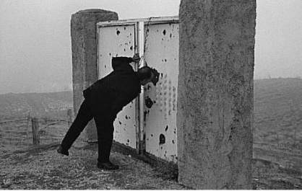
The edge
“line built naturally or artificially to delimit the extension of a territory or a property, or the sovereignty of a state”
It is the expression of the most profound and primordial necessity of the human being to have a barrier around him that delimits the space that has occupied, that separates and protects from something that is "other", "different".
For centuries, nature itself had provided men with the limits and directions in which to move and develop.
As soon as someone, overcoming fear, crossed them and traces paths, they are transformed into places of encounter, commerce, universes with particular characteristics.

Slide 3
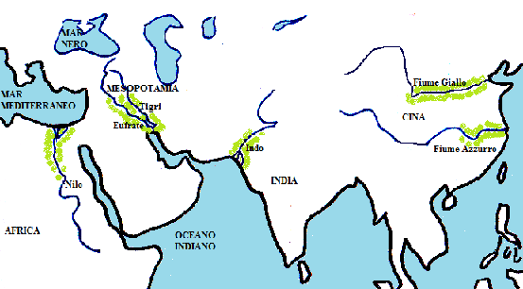
The cities and the rivers
Since the beginning, rivers have been fundamental for urban birth and growth. The first settlements of the most ancient civilizations were erected on the banks of the rivers, adapting to their morphology.
The conditions set by the watercourses were at the same time:
favorable
water availability
defense
use of water energy
dangerous
floods
water stagnation
erosive phenomena

Slide 4
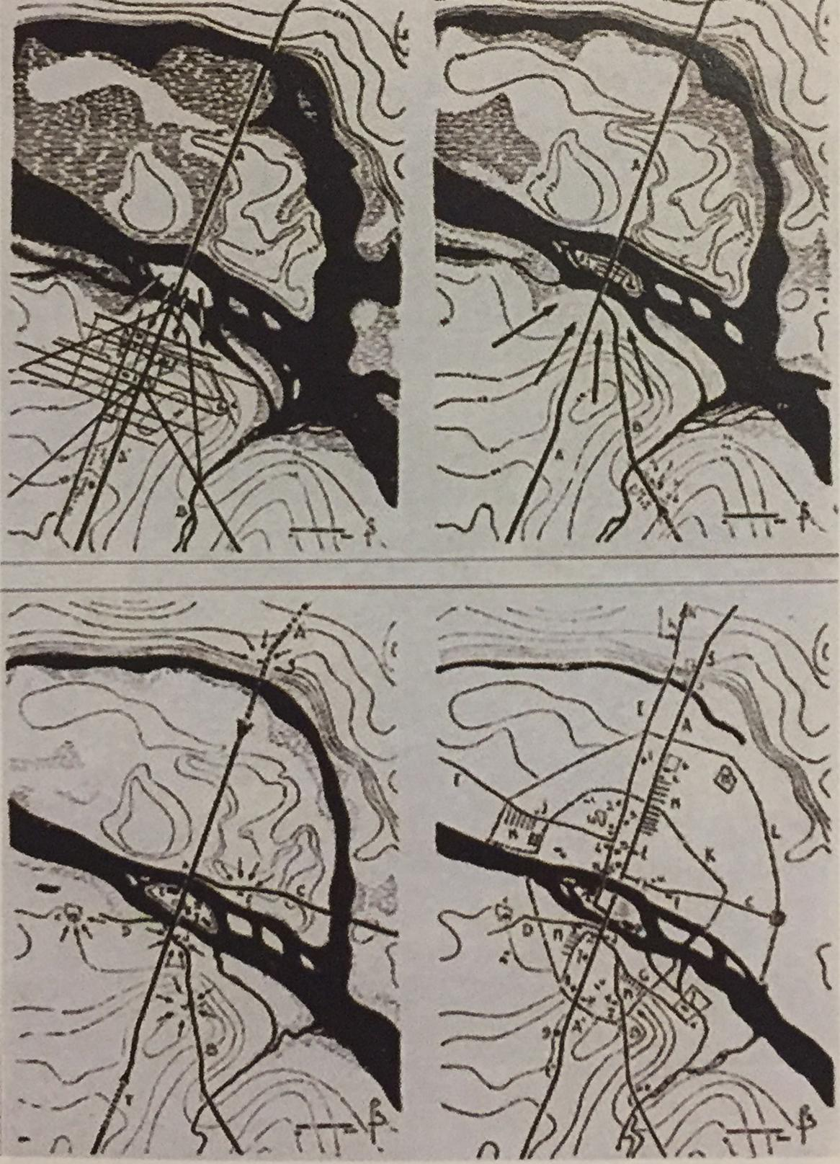
Paris, artificialization of the river Seine
Man has progressively modeled the original features of the rivers, adapting them to the many settlement needs concerning the installation of work, residential, safety and mobility needs.
By the time, along the banks has developed landings, harbors, stores, and depots.
They represented the main nodes of the exchange.
These waterways were real infrastructures for the transport of goods and people.
During the centuries man artificialized the natural state of rivers to facilitate the conditions of settlement and life.

Slide 5
In the 19th century many river cities started the construction of quay and high walls, and roads along the urban stretches of waterways. And ports and industrial activities were relocated
The river becomes progressively an industrial area, a highway, an infrastructure and an area for the marginal residential settlement.
["marginal" indicated both the location on the margins of the formal city and the social marginality that spread among the poor fringes of the population that resides there]
Those important mutations of use of watercourses have been significant and they generate a major problem for water cities.
Today, there are more sensibility and consciousness and a mechanism to rediscover the importance of rivers or canals has been put into action:
projects, policies and actions that have made the relationship between city and river very rich and articulated.

Slide 6
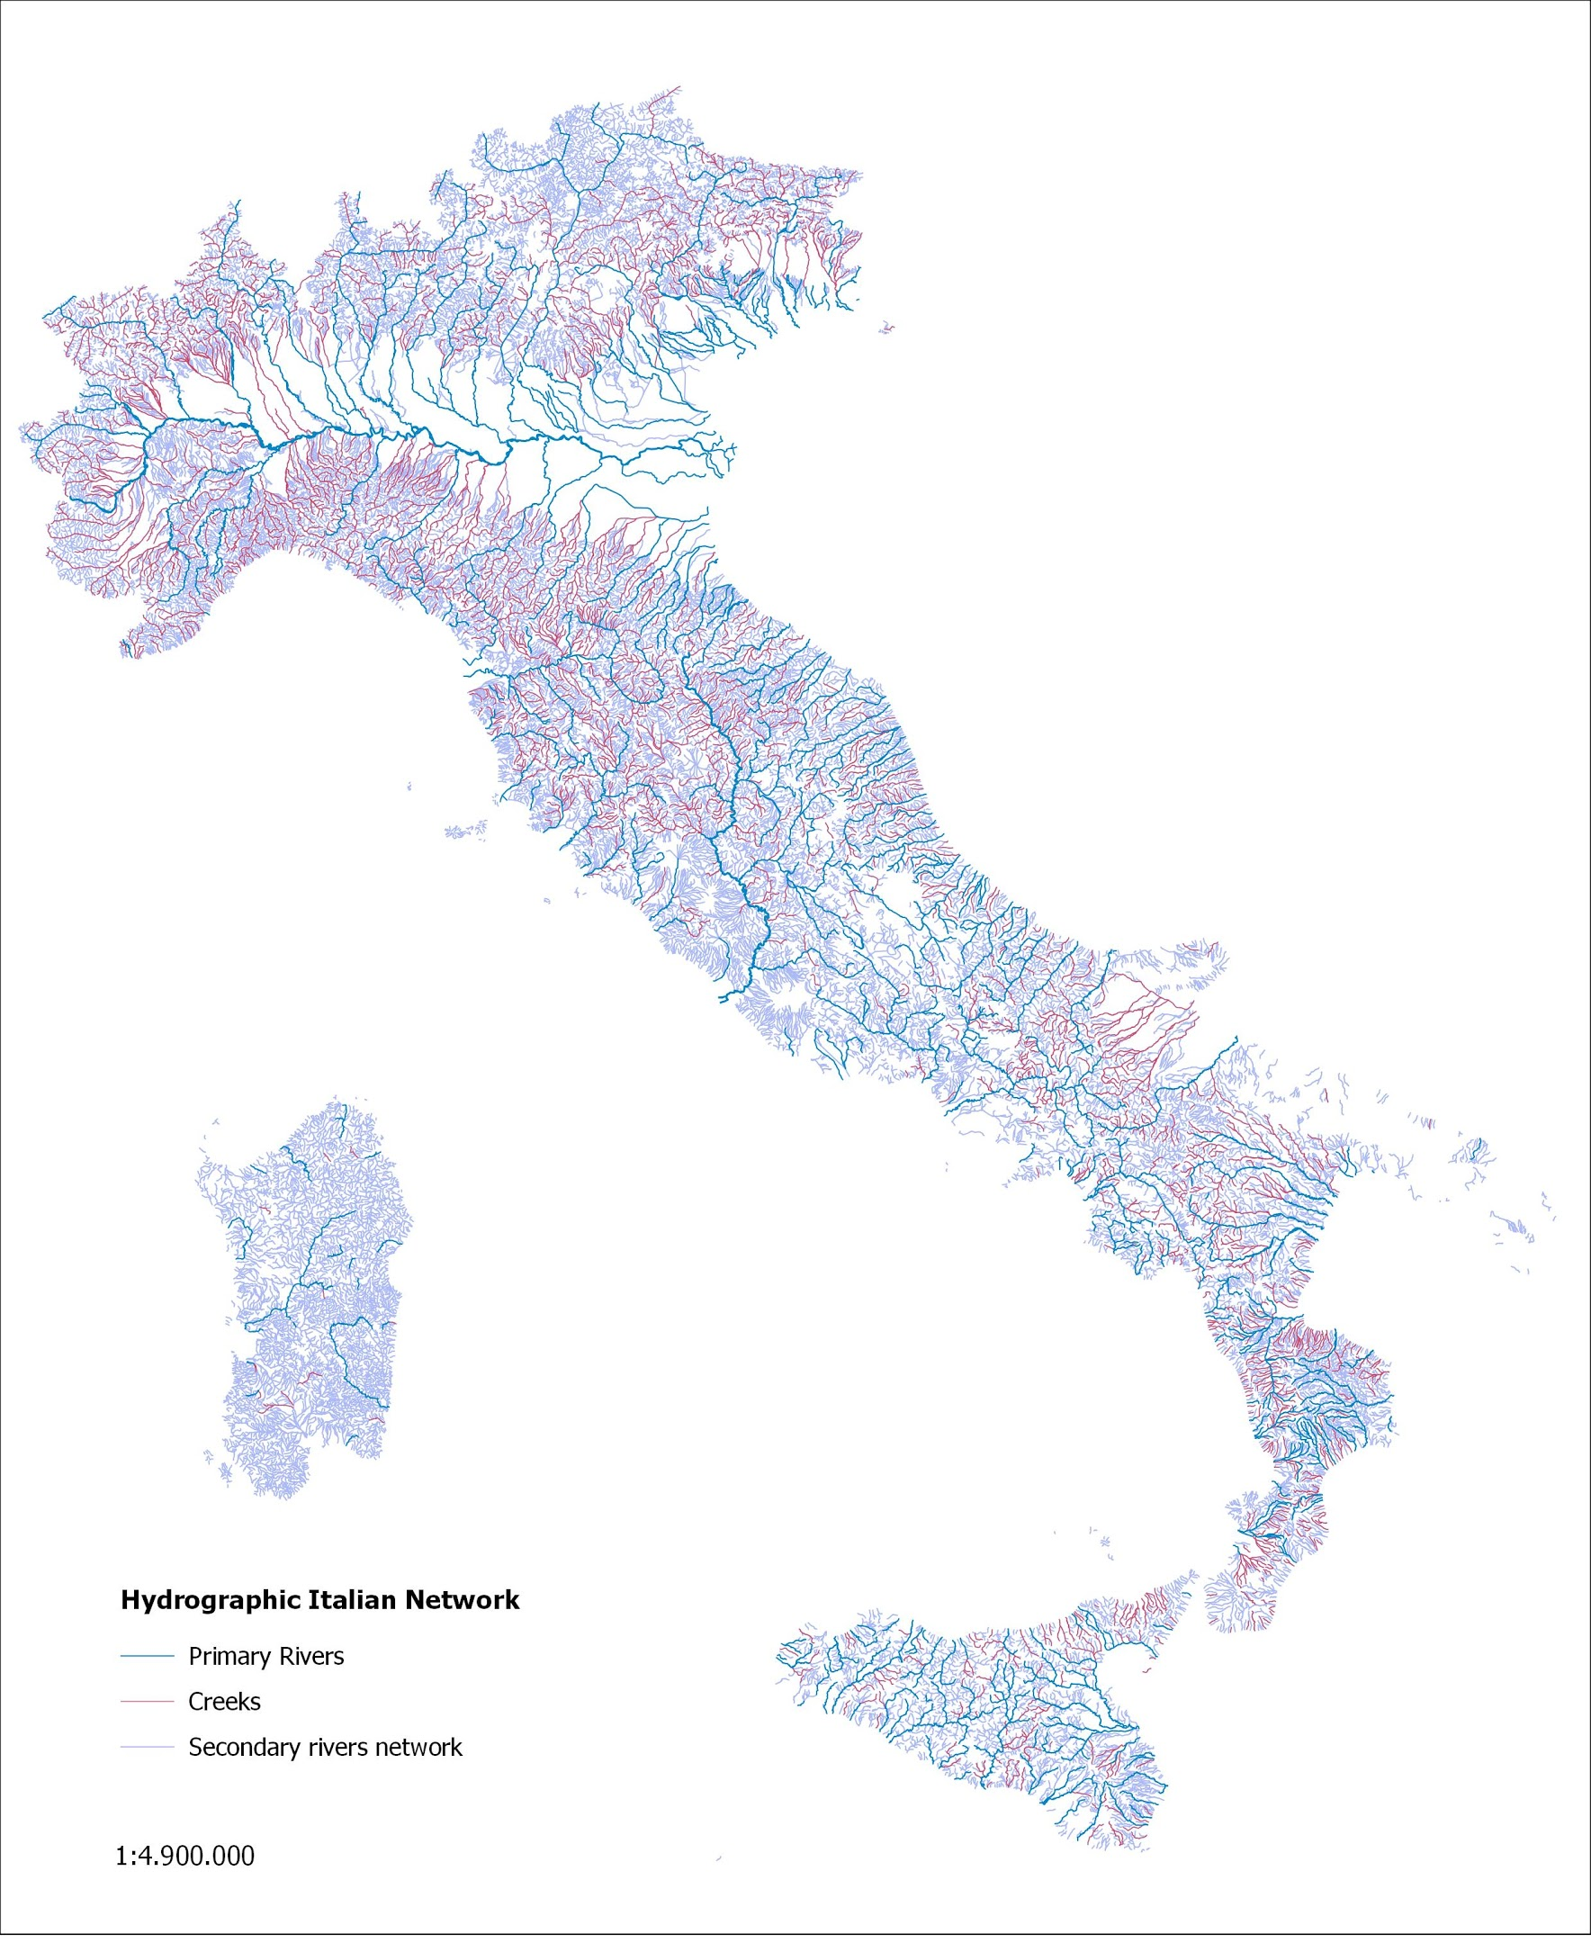
Italian hydrogeological context
Due to its geomorphological conformation, Italy is particularly exposed to hydrogeological risk.
It has a capillary river network, characterized by waterways for the most part small and medium-sized, but with a mainly torrential character
Italian rivers are predominantly irregular with a flow rate that can vary greatly during the year, particularly the Apennine rivers.

Slide 7
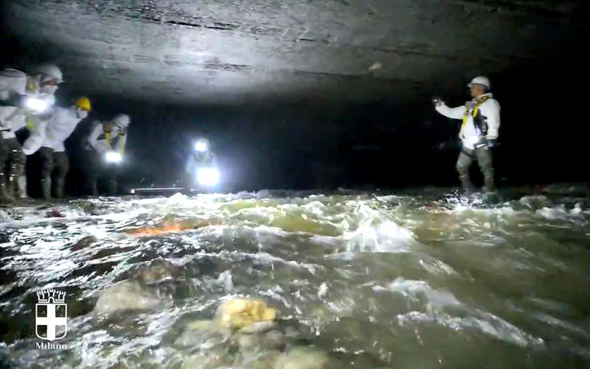
Milano, Seveso river that flows below the city
Today, this widespread presence of waterways in urban areas is not so evident, because most of the rivers have been culverted (above them there are now often roads or other infrastructures, houses and public spaces), diverted or channelled.

Slide 8
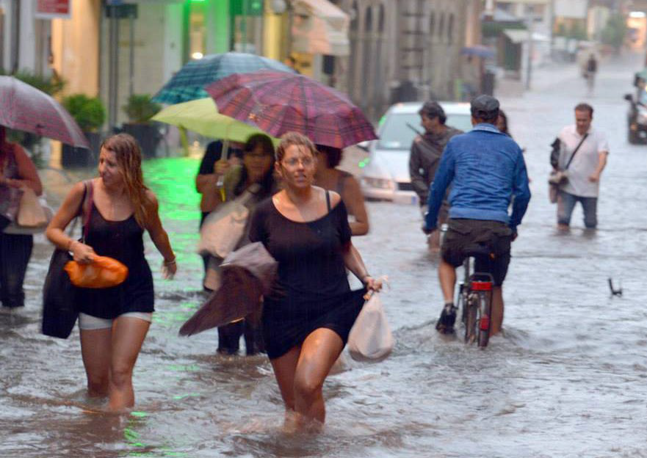
Rimini, 24th June 2013, 120mm rainfall in 30 minutes
In these cases, hydraulic engineering solutions have been calculated with maximum flow rates for exceptional events with return times of 100 or 200 years.
However, with the increase of evident manifestations of the climate changes, these exceptional events have become increasingly frequent, extreme and unpredictable.

Slide 9
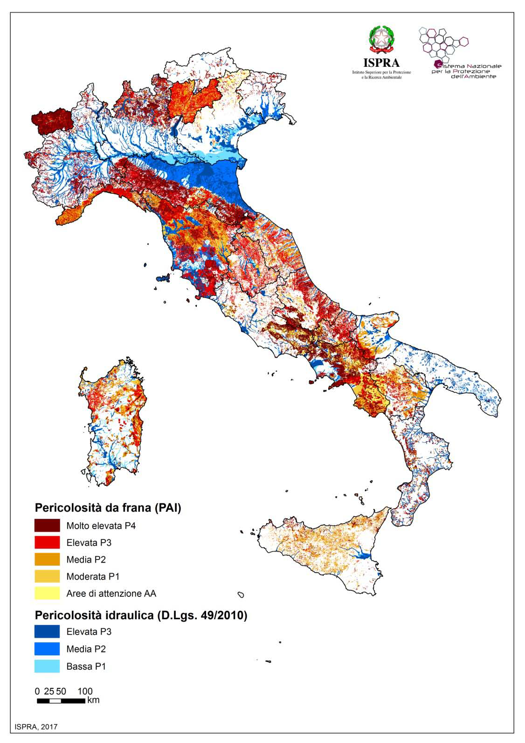
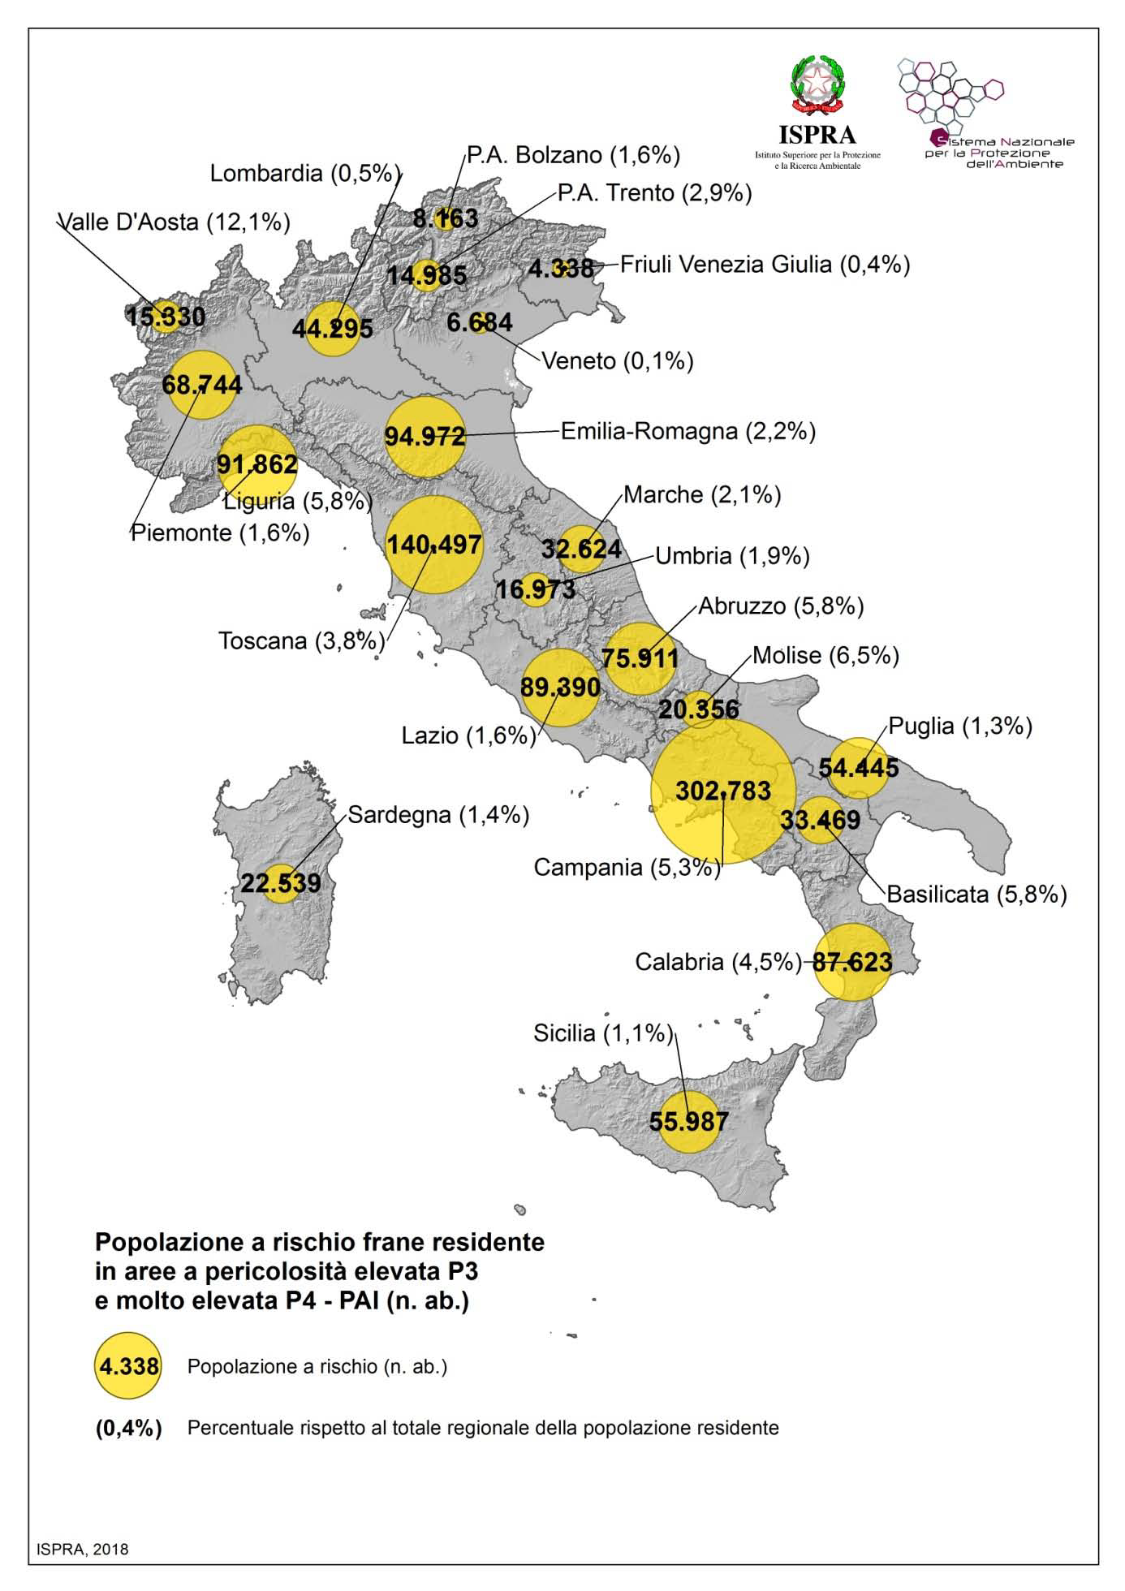
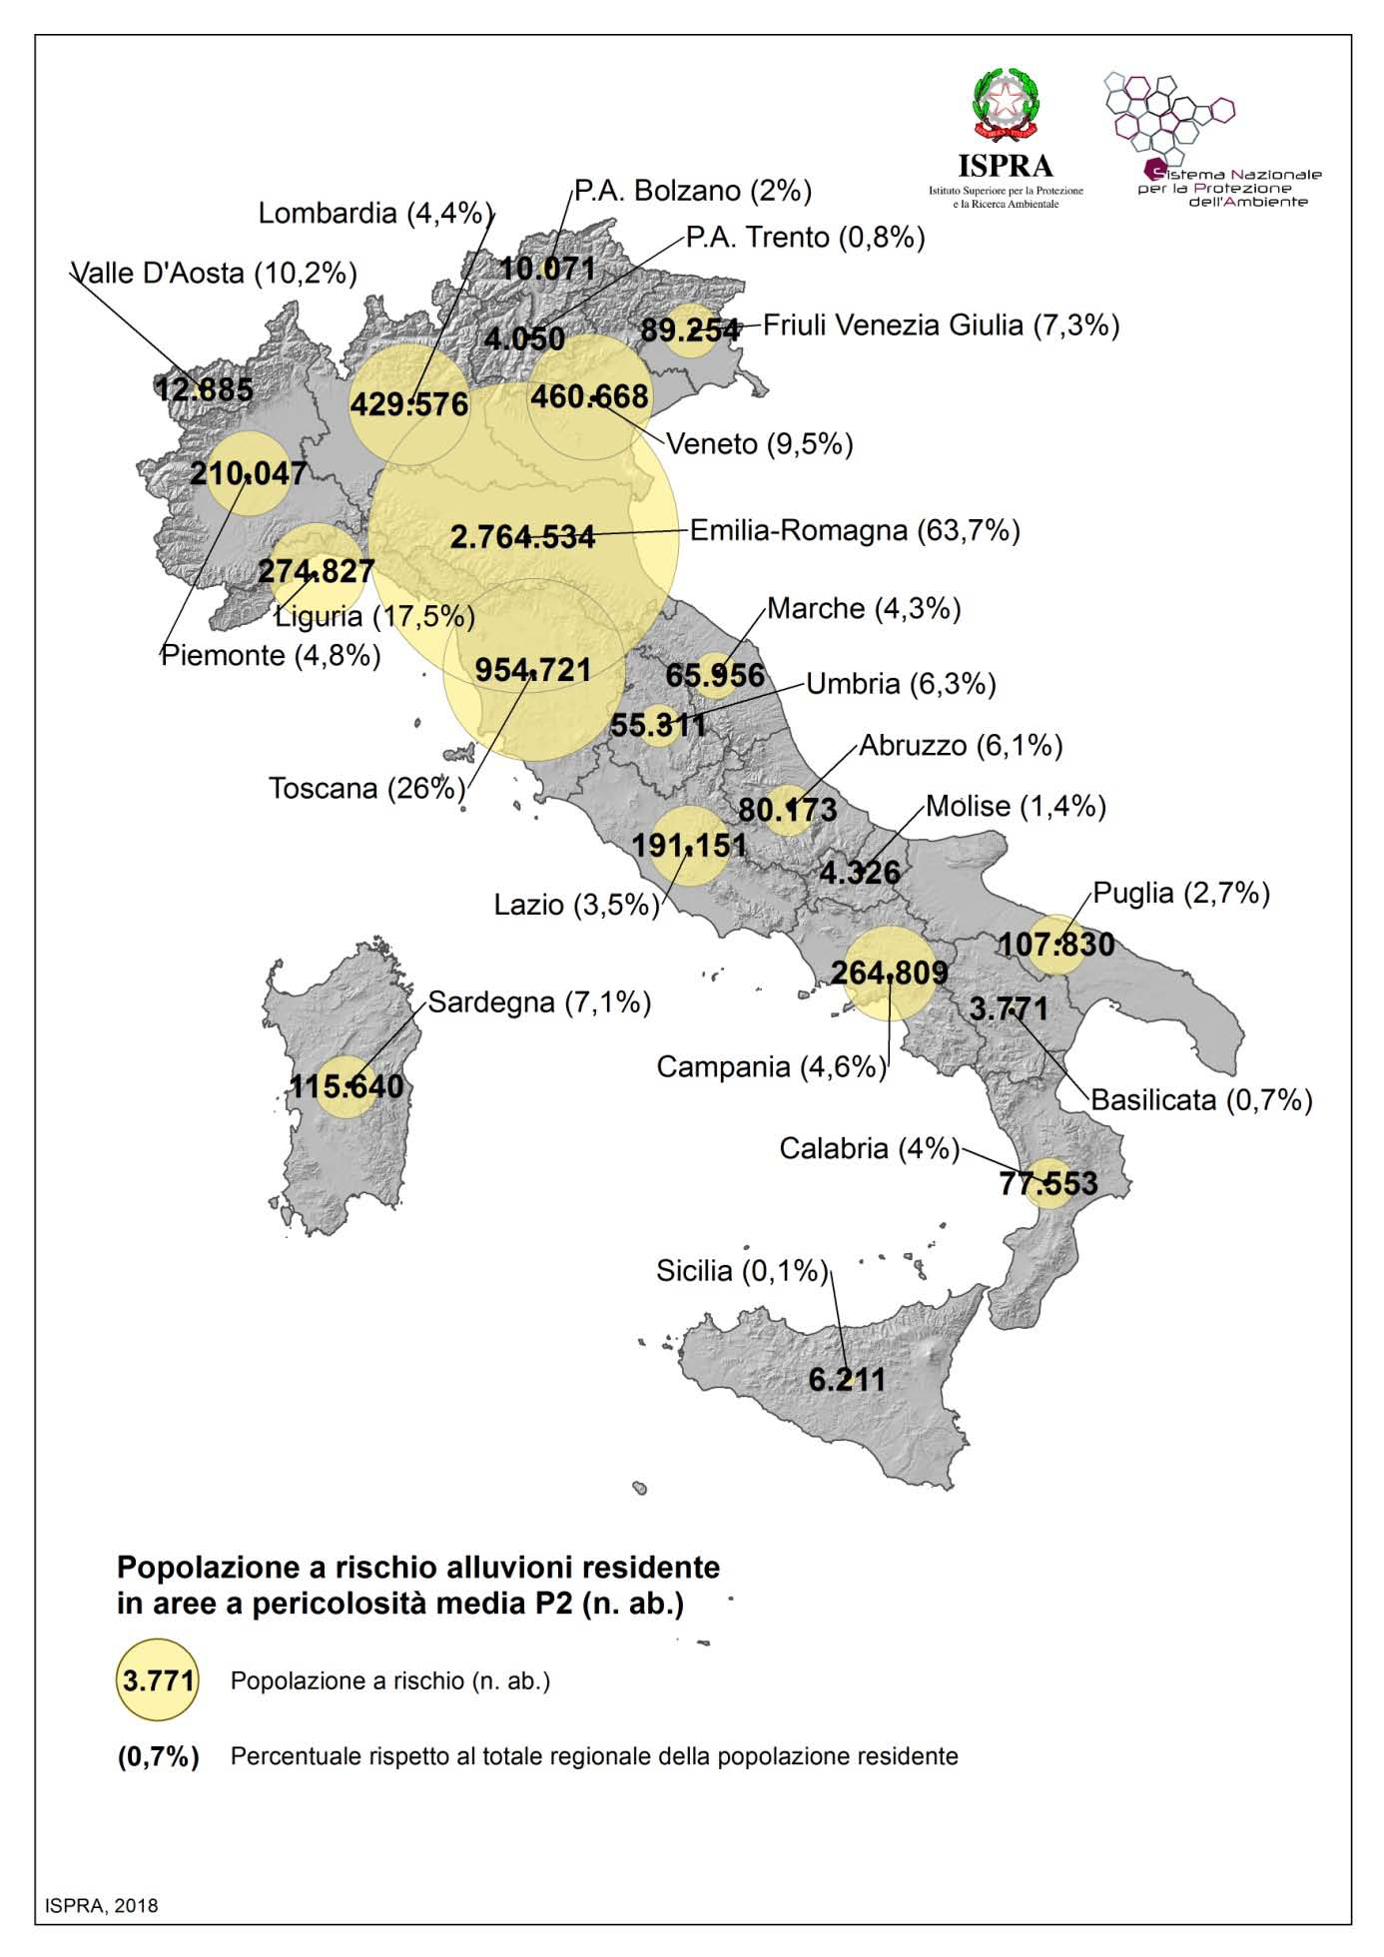
(R) = (E) x (V) x (D)
Different Landslide and Hydraulic Risk scale
Population exposed to landslide risk
Population exposed to flood risk
source ISPRA
source ISPRA
source ISPRA

Slide 10
It is clear that immediate actions are necessary to stem these problems and it is important to rethink the system of environmental resilience
All around Europe, the blue and green infrastructures principle, and nature-based solutions, have become increasingly widespread in order to contain islands of heat and improve the precipitation absorption.
In conformity with the Sustainable Urban Agendas and the Sustainable Development Goals of the United Nations, in particular with the Goal 11 ‘Sustainable Cities and communities’ which aims to “make cities more inclusive, safe, resilient and sustainable”.
Urban rivers may have a strategic function, from the macro-territorial scale up to the urban and micro-local scale.
Notes:
Troppo scritta?

Slide 11
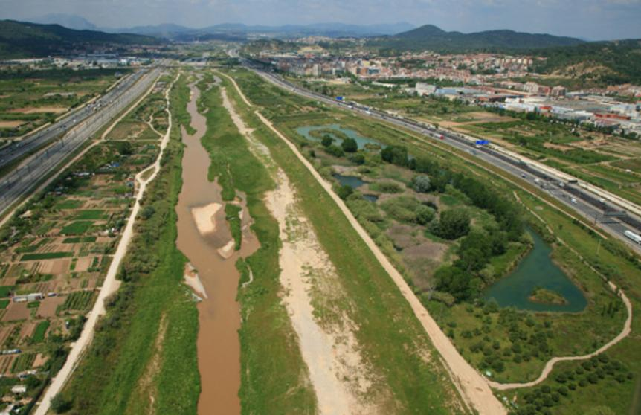
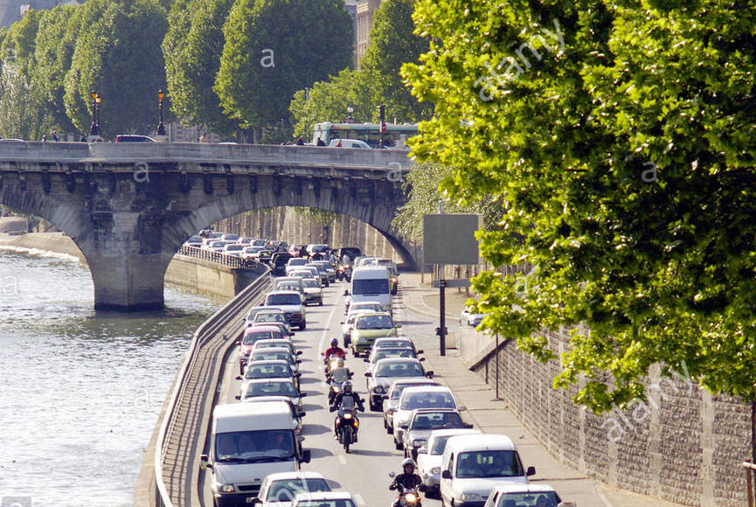
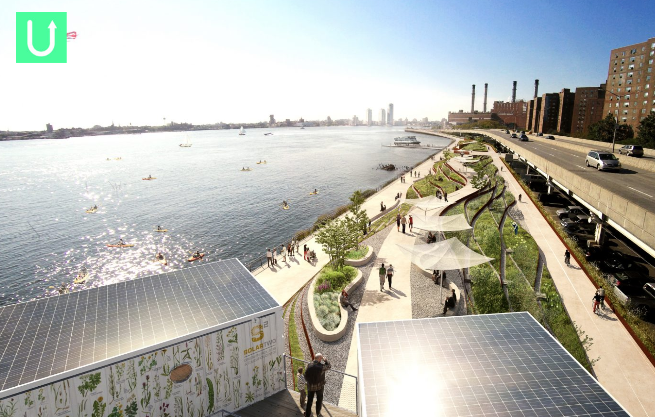
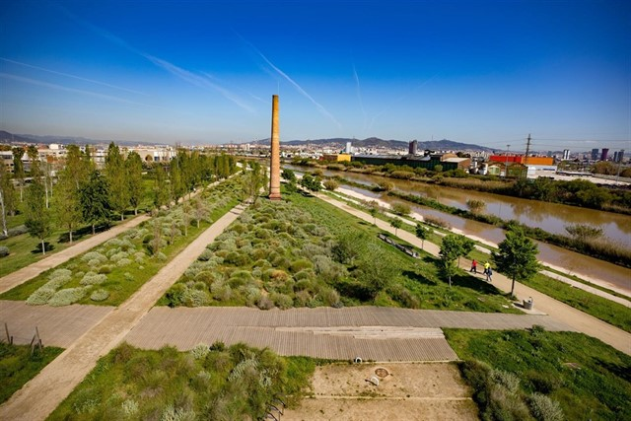
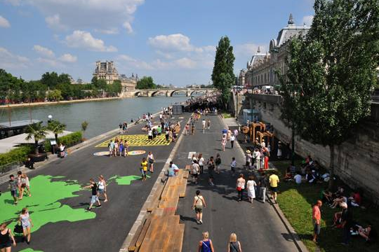
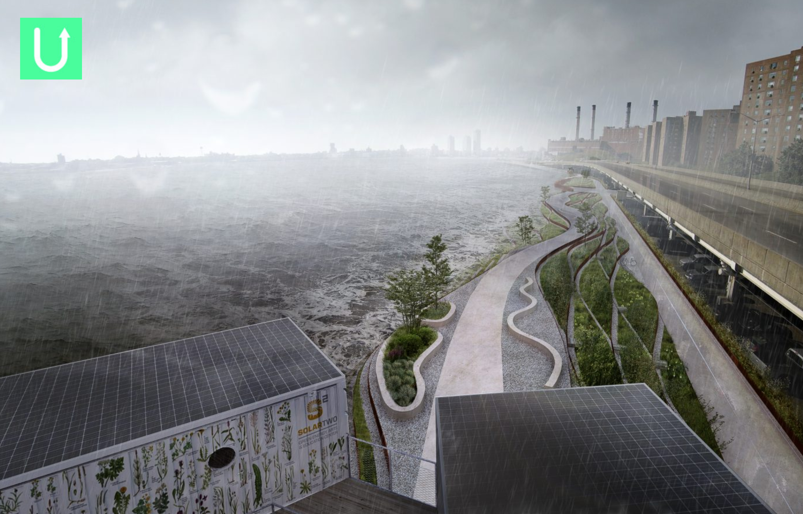
From river borders to resilient green infrastructures
Llobregat river, Barcelona
Seine river, Paris
Hudson river, NY
Notes:
today many cities are launching again them as active factors of their identity, conferring historical and patrimonial value, placing them at the center of actions general ecological-environmental remediation, entrusting them with a structuring role in urban redevelopment projects, through their transformation into public spaces and urban places with articulated functions.
In the grey box above there are just a few examples of cities revealing diverse approaches to how cities should interact with their rivers. They clearly show the need to integrate rivers carefully into their future vision in order to provide the necessary and more demanded public spaces close to nature in our urban reality. Looking for creative solutions to reinvent the functions of the rivers, naturalize them or give them the necessary space and value is a step towards a sustainable and resilient future.

Slide 12
In a river redevelopment view, we should recognize to watercourses these values: urban, cultural, landscape and environmental.
This leads to the promotion of actions aimed at the redevelopment of the banks and rivers, the realization of cycle-pedestrian paths; the recovery of urban river areas and fronts; the enhancement of rural landscapes linked to the river and the promoting of sustainable navigability.
The redevelopment of an urban river context has positive implications both for environmental naturalistic and social aspects. A healthy environment is known to improve quality of life. Restoring rivers helps to provide quality environments and puts people in closer contact with nature.
More green space in urban context offers people a place away from stresses and strains often associated with cities with a higher density of people, poor air quality due to vehicle emissions, heat islands and lack of green space.

Slide 13
Sociale benefits of river restoration
Physical and Mental well-being
Many river restoration schemes on public parks have increased park usage and an increase in sports and games.
Recreation
River corridors can provide opportunities for recreation as part of daily life
Social cohesion
Rivers can play a vital role in the community by encouraging social interaction and bonding.
Aesthetic
Restoring natural landscape benefits the flora and fauna, creating nicer surroundings.
Education
Restoration schemes provide huge learning potential about our natural world.
Cultural
Restoring our cultural links to rivers is a long term goal and an important part of all drivers raised above.

Slide 14
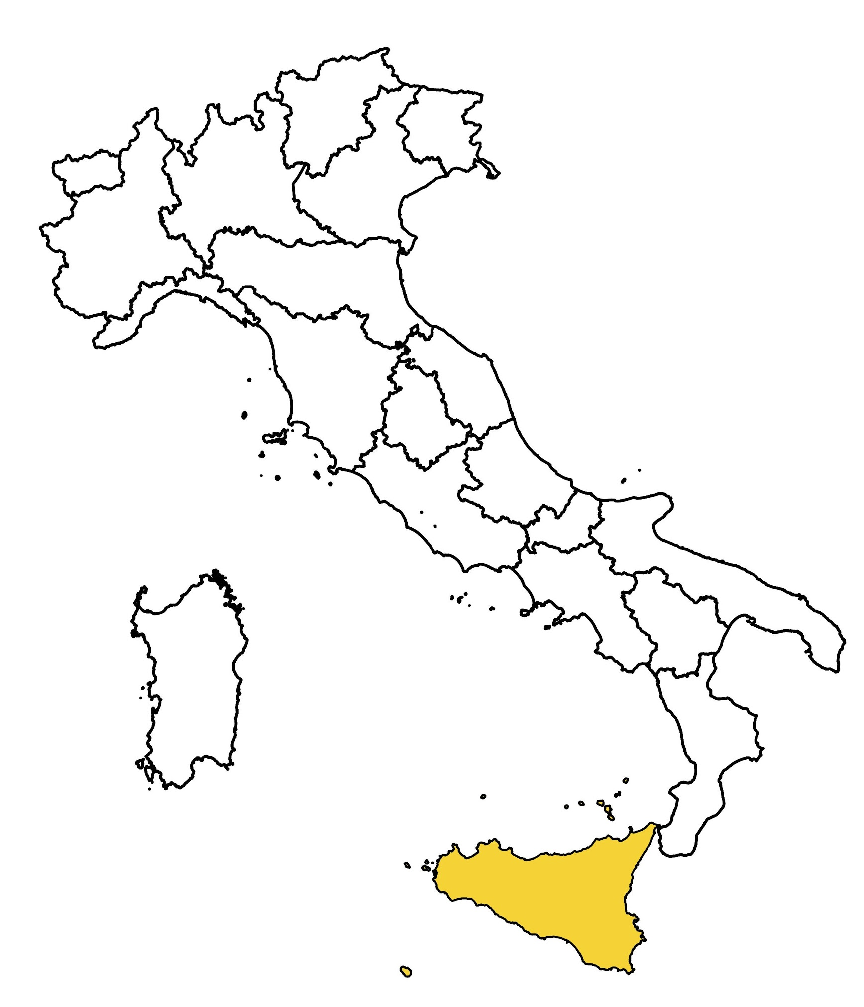
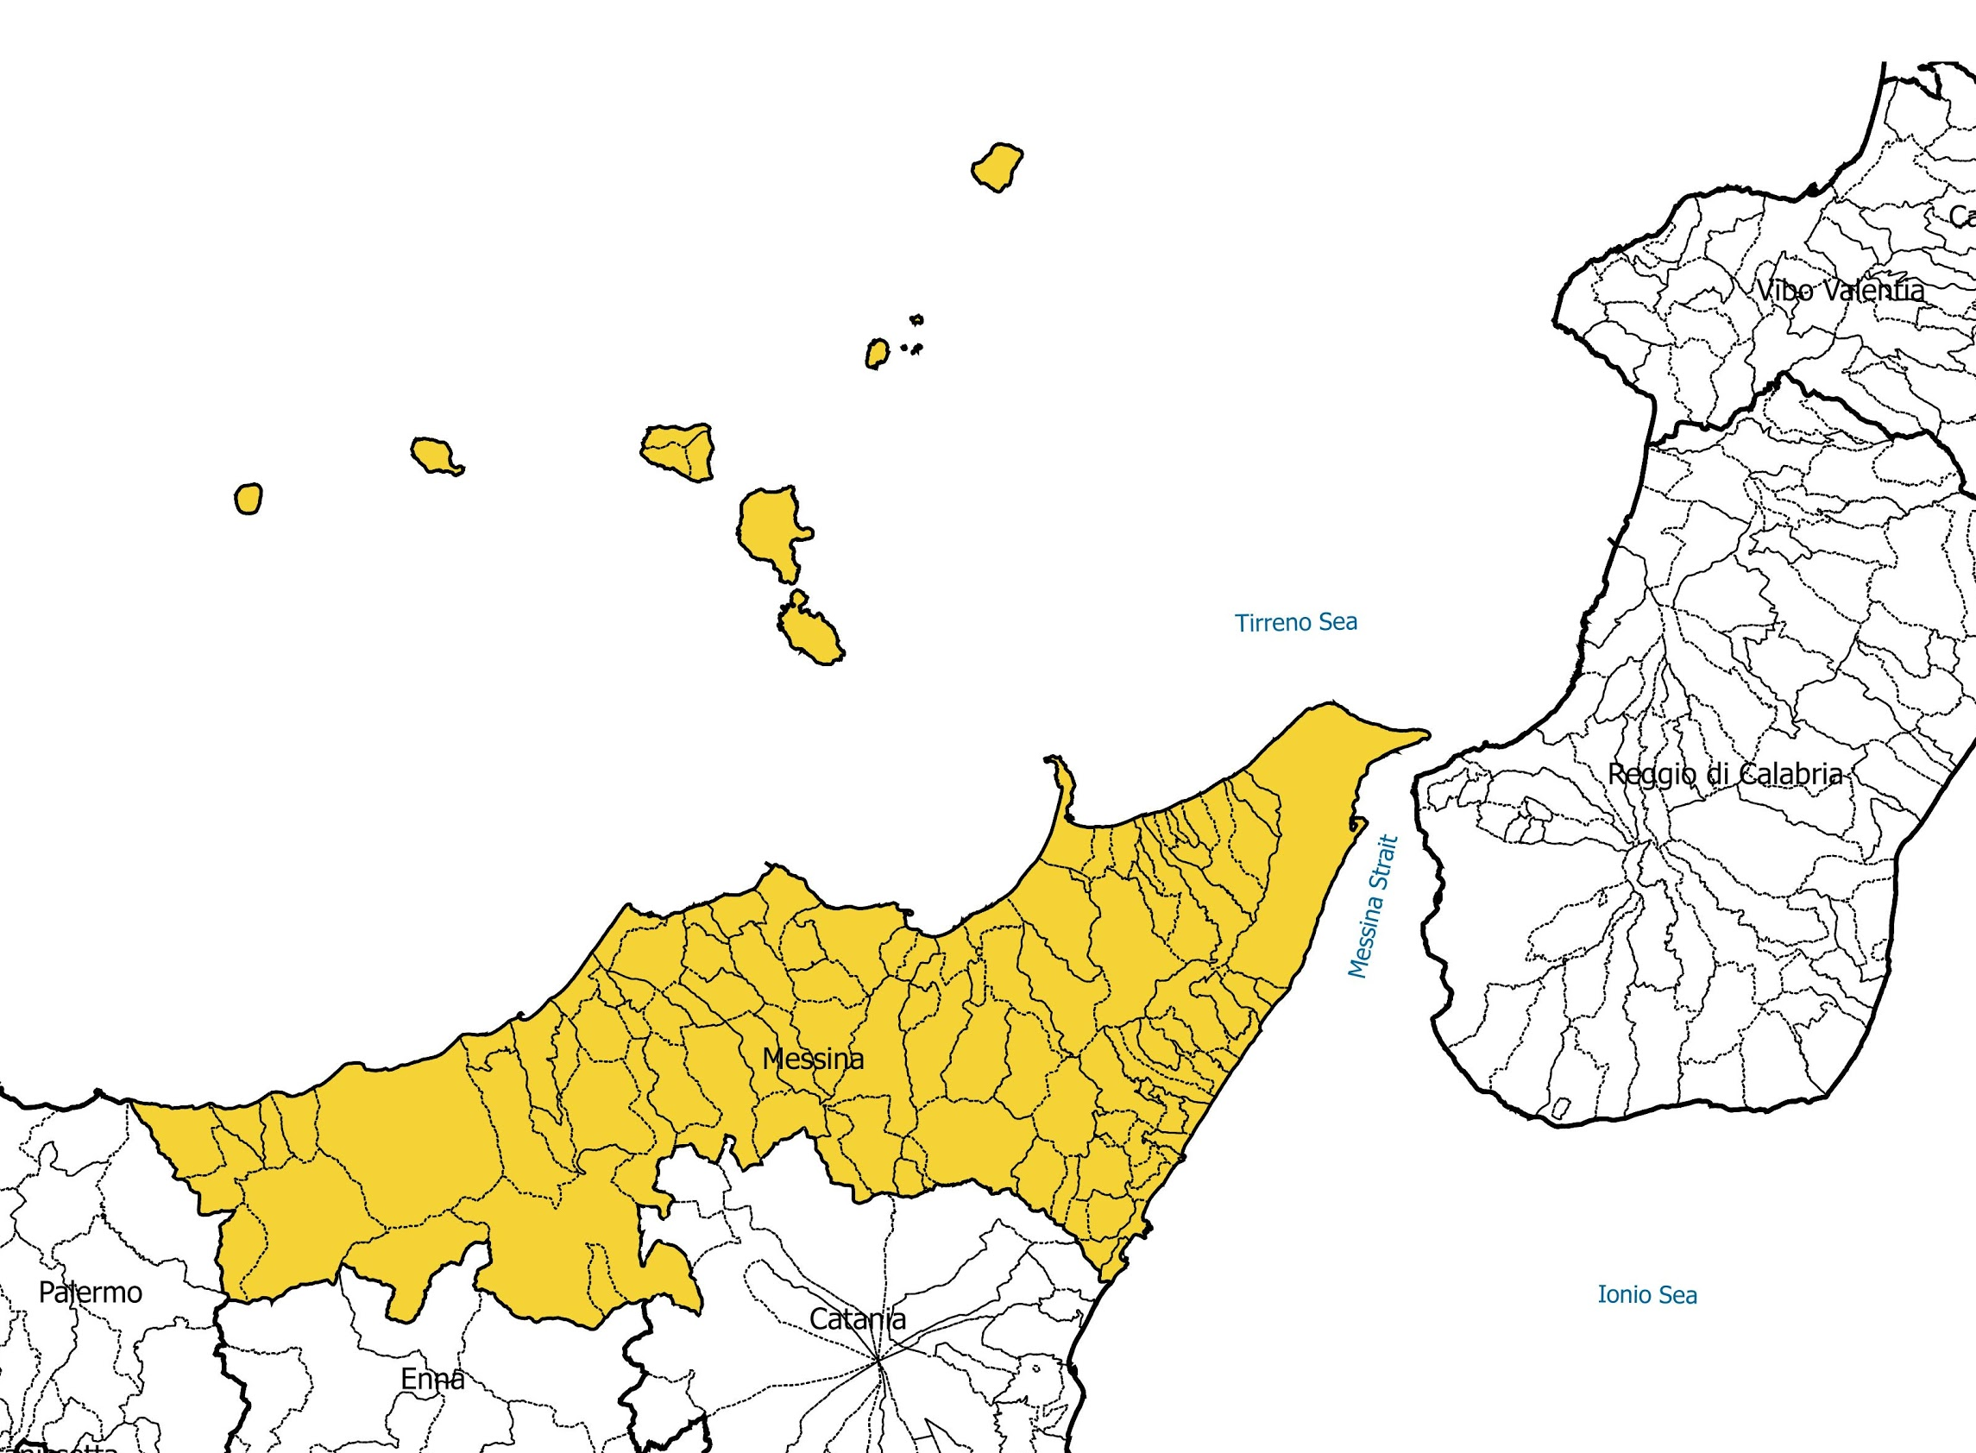
The case of Messina
A virtuous example of a project for a resilient city, which seeks to recover its territorial identity and the social functions of its urban spaces, rediscovering and renewing the forgotten relationship between the city and its hydrogeological system, it is that of the city of Messina.
Like many other Italian cities:
exposure to hydrogeological risk
need to recover its identity, and the ancient and close relationship with its geomorphology and hydrography
need for public spaces and urban quality
Sicily and Messina framework

Slide 15
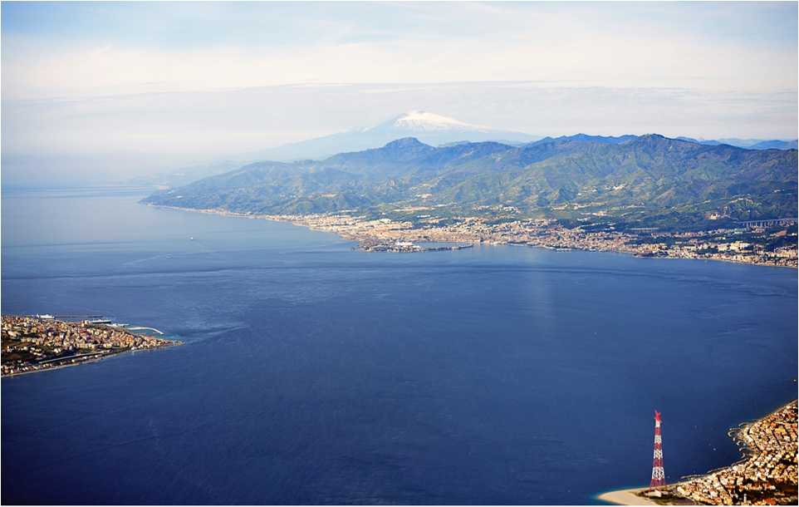
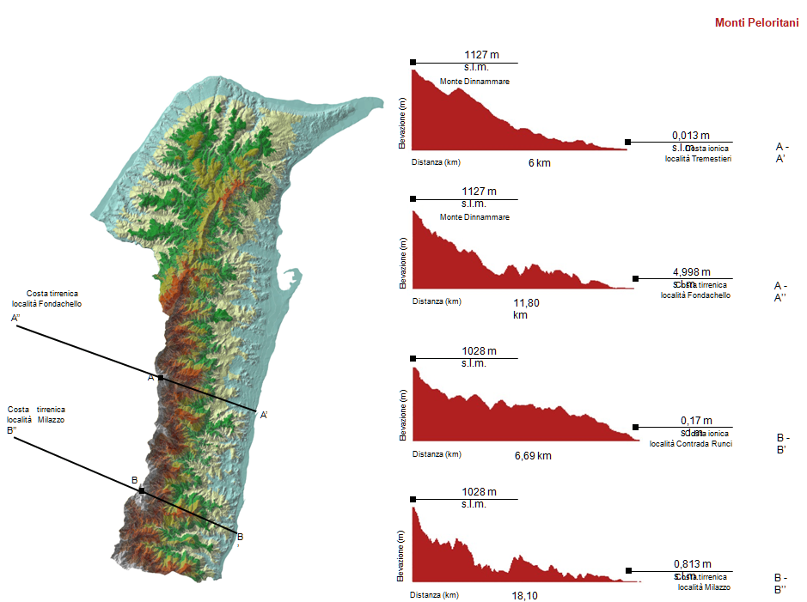
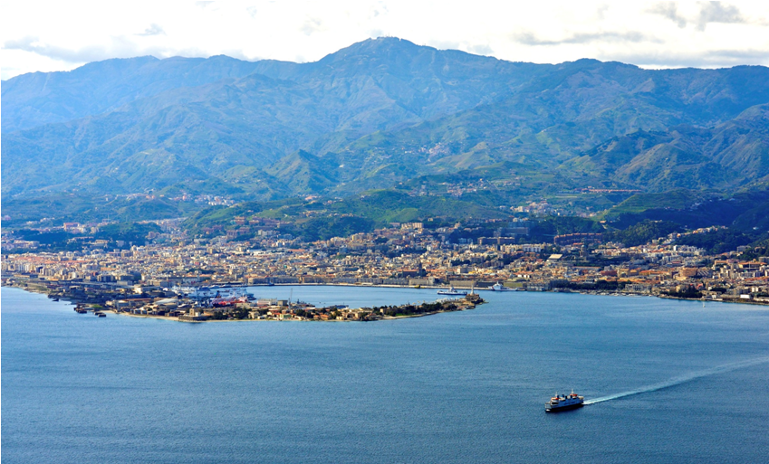
Messina’s geomorphology
Messina’s Strait view
source Prof. C. Gasparrini’s team elaboration
Messina’s view

Slide 16
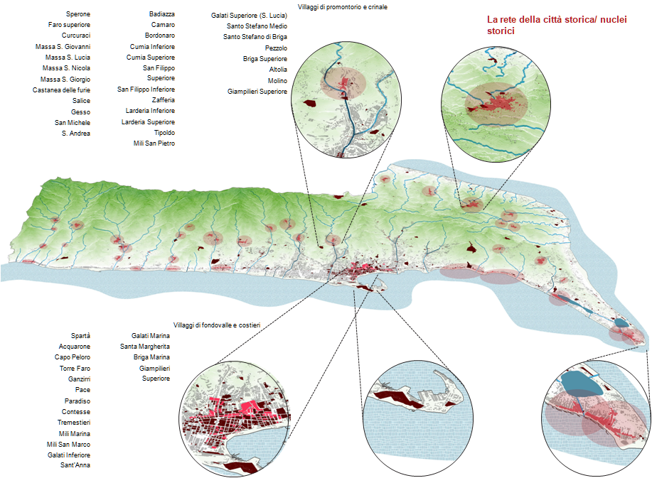
The geomorphology
the Peloritani mountains behind, and one series of secondary rivers, streams and fiumare (a particular type of steams typical of the south of Italy, characterized for their irregular flow rate and pebble bottom) distributed in comb, which defined the birth and settlement of small historical nucleuses along the ridges, distributed orthogonally to the sea
Messina’s Municipality historic nucleuses
source Prof. C. Gasparrini’s team elaboration

Slide 17
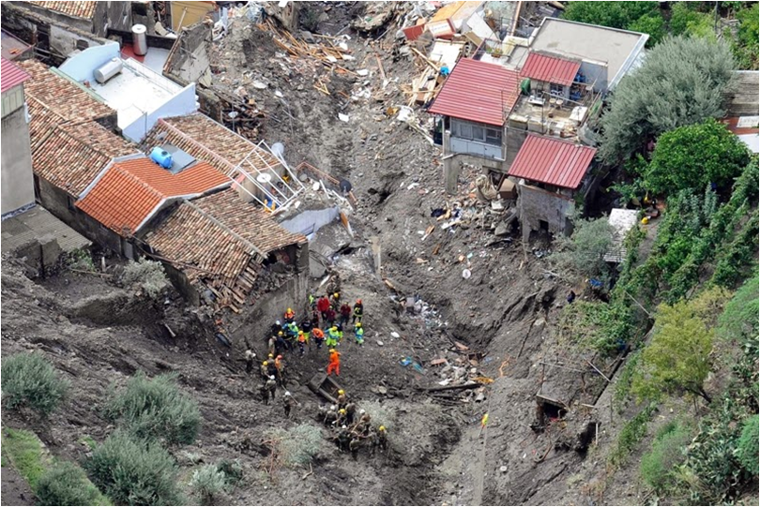
Messina, flood of October 2009 in the south area
This particular territorial conformation, linked to its birth, however, exposes the city to multiple risks including, in particular, the seismic and the hydrogeological ones. Even more, today, being a highly urbanized and densely populated territory, the area is exposed to a particular pressure

Slide 18
Messina’s Masterplan
For a resilient, anti-fragile and of identity city
The Municipality of Messina in the development of its General Town Plan (PRG) has decided to focus particularly on a sustainable urban dimension for a city to regenerate without consuming new soil, thus avoiding to increase even more the risk and territorial pressure to which the area is subjected
For the development of the Project, the Municipality has entrusted the consultancy of the University Federico II of Naples, together they have developed a project based on the principles of urban recycling and regeneration, open spaces and public city, social cohesion and circular economy

Slide 19
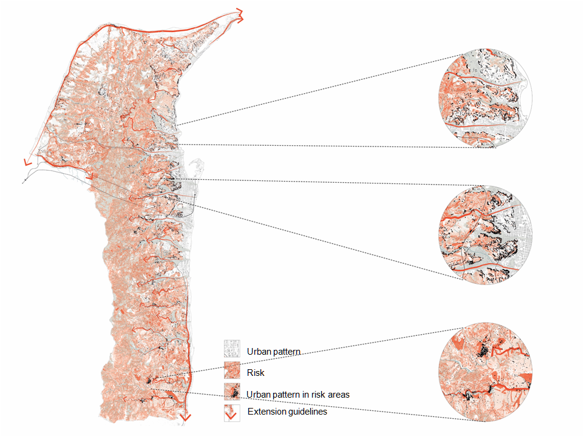
Messina’s Water network and risk factors in relation with the urban pattern
The Plan has been decided to be focused on the existing, on what the city already has but that is not exploited or enhancement, and on the safety of the most exposed risk areas
source Prof. C. Gasparrini’s team elaboration

Slide 20
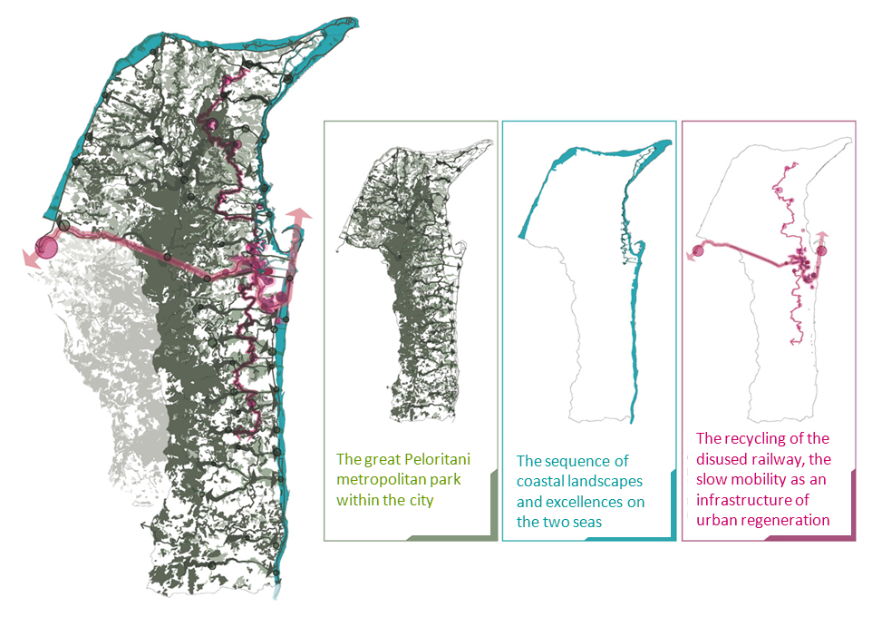
Messina Masterplan’s Guidelines
source Prof. C. Gasparrini’s team elaboration

Slide 21
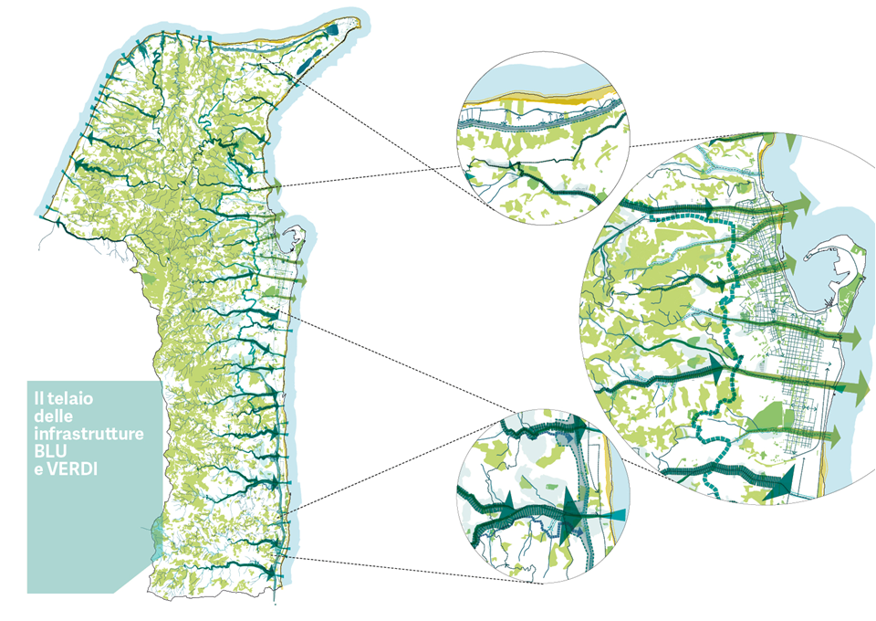
Messina’s Water network and risk factors in relation with the urban pattern
The great Peloritani metropolitan park inside the city
brings together the issue of safety and risk prevention with that of blue and green infrastructures, with the aim of creating an ecological network of spaces and paths, for the community and for environmental mitigation, in particular, for extreme events due to climate change
source Prof. C. Gasparrini’s team elaboration

Slide 22
From territorial to local scale
The local interventions identified to achieve the objectives outlined above are divided into two macro-categories:
interventions in which the fiumare have remained natural waterways: water purification interventions, projects for the revitalization and use of the banks as a public space, creation of a continuous network of green spaces connected to pedestrian and bicycle mobility and the creation of spaces for physical activity and free time
interventions in which the fiumare have been culverted: for redesigning the urban sections, in some cases by adapting the road substructure of drains and sewers to today’s needs, in other cases, re-naturalizing the banked watercourses

Slide 23
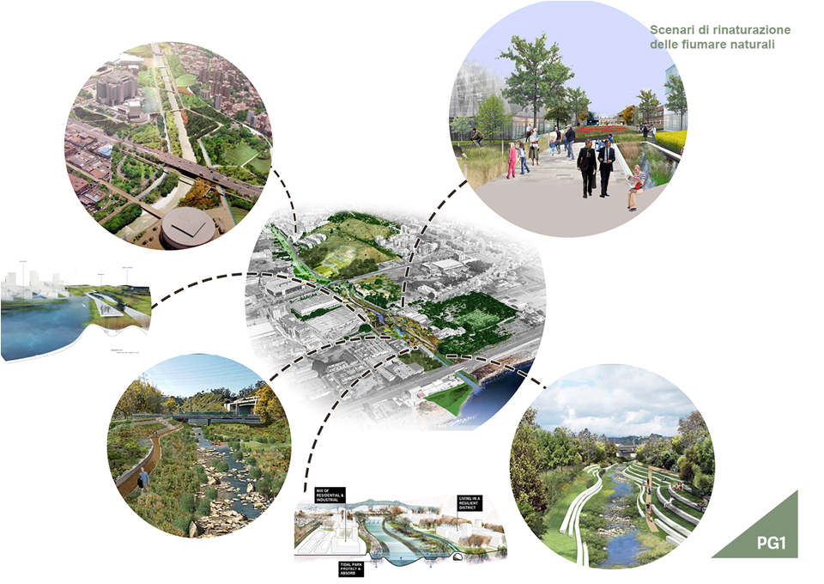
Scenarios for natural fiumare
source Prof. C. Gasparrini’s team elaboration

Slide 24
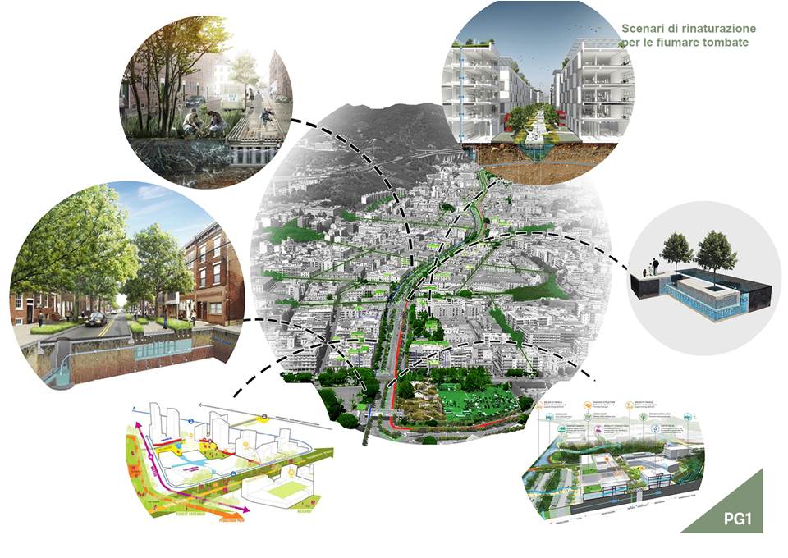
Scenarios for culverted fiumare
source Prof. C. Gasparrini’s team elaboration

Slide 25
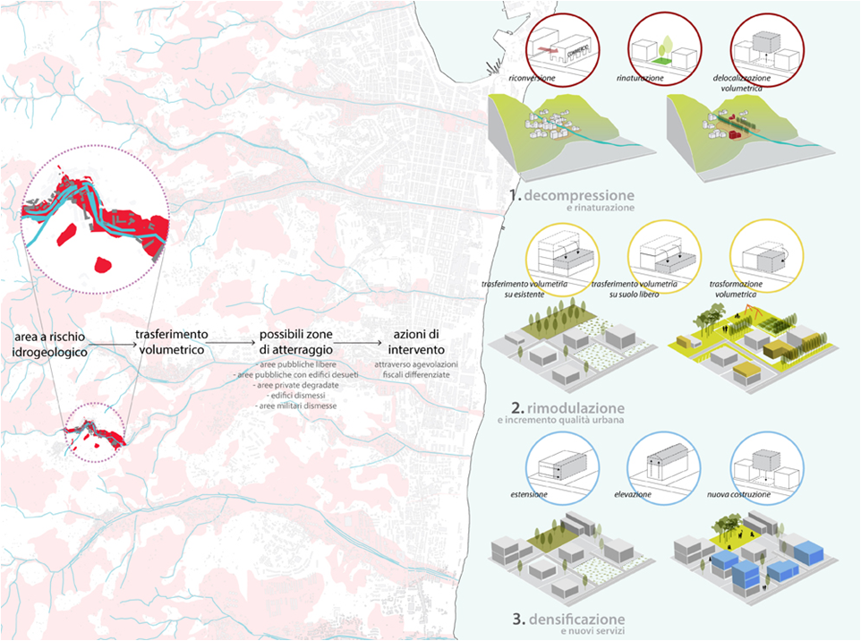
Compensatory equalizing system in relation to risk areas
A fundamental point of the plan is the elimination of the building forecasts from the hydrogeological risk areas. A compensatory equalizing action is therefore proposed
Plan defines three phases for this process:
identification of built-up areas exposed to hydrogeological risk
volumetric transfer identifying possible landing areas: free public areas, public areas with obsolete buildings, degraded private areas, abandoned buildings, disused military areas
intervention through differentiated tax breaks
source Prof. C. Gasparrini’s
team elaboration

Slide 26
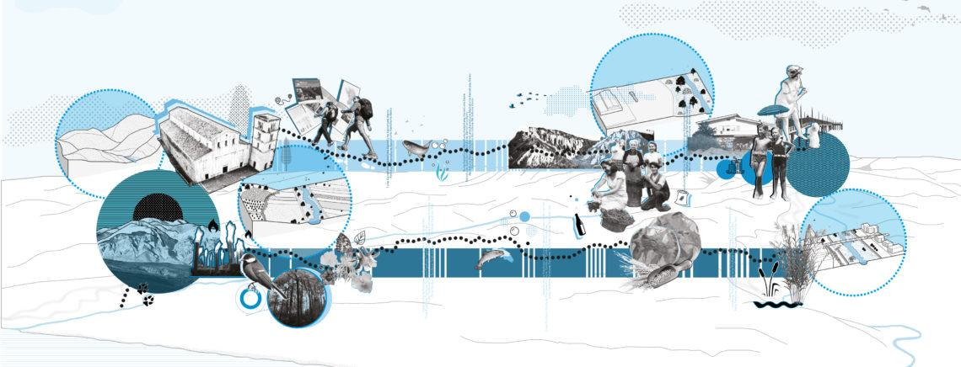
River contracts as implementation tool
In terms of implementation and financial instruments, these actions could be implemented through the use of River Contracts, thus also involving the population in this process of transformation, enhancement and revitalization.

Slide 27
The end
Thanks for your attention!

