Slide 1
PLANNING ON THE EDGE OF EXISTENCE Case study of Velo Grablje, Island of Hvar
ECTP-CEU Young Planners Workshop 2019 & 13th Biennial of European Towns and Town Planners, Plymouth (U.K.), September 2019
Marijana Zlodre, mag.ing.arch.
m.zlodre@gmail.com
Association of Croatian urban planners
APE d.o.o., Zagreb, Croatia
Notes:
The Planning on the edge theme in this paper did not refer to the edge in a physical sense but actually explored the edge of existence in one of the almost abandoned villages in Croatia

Slide 2
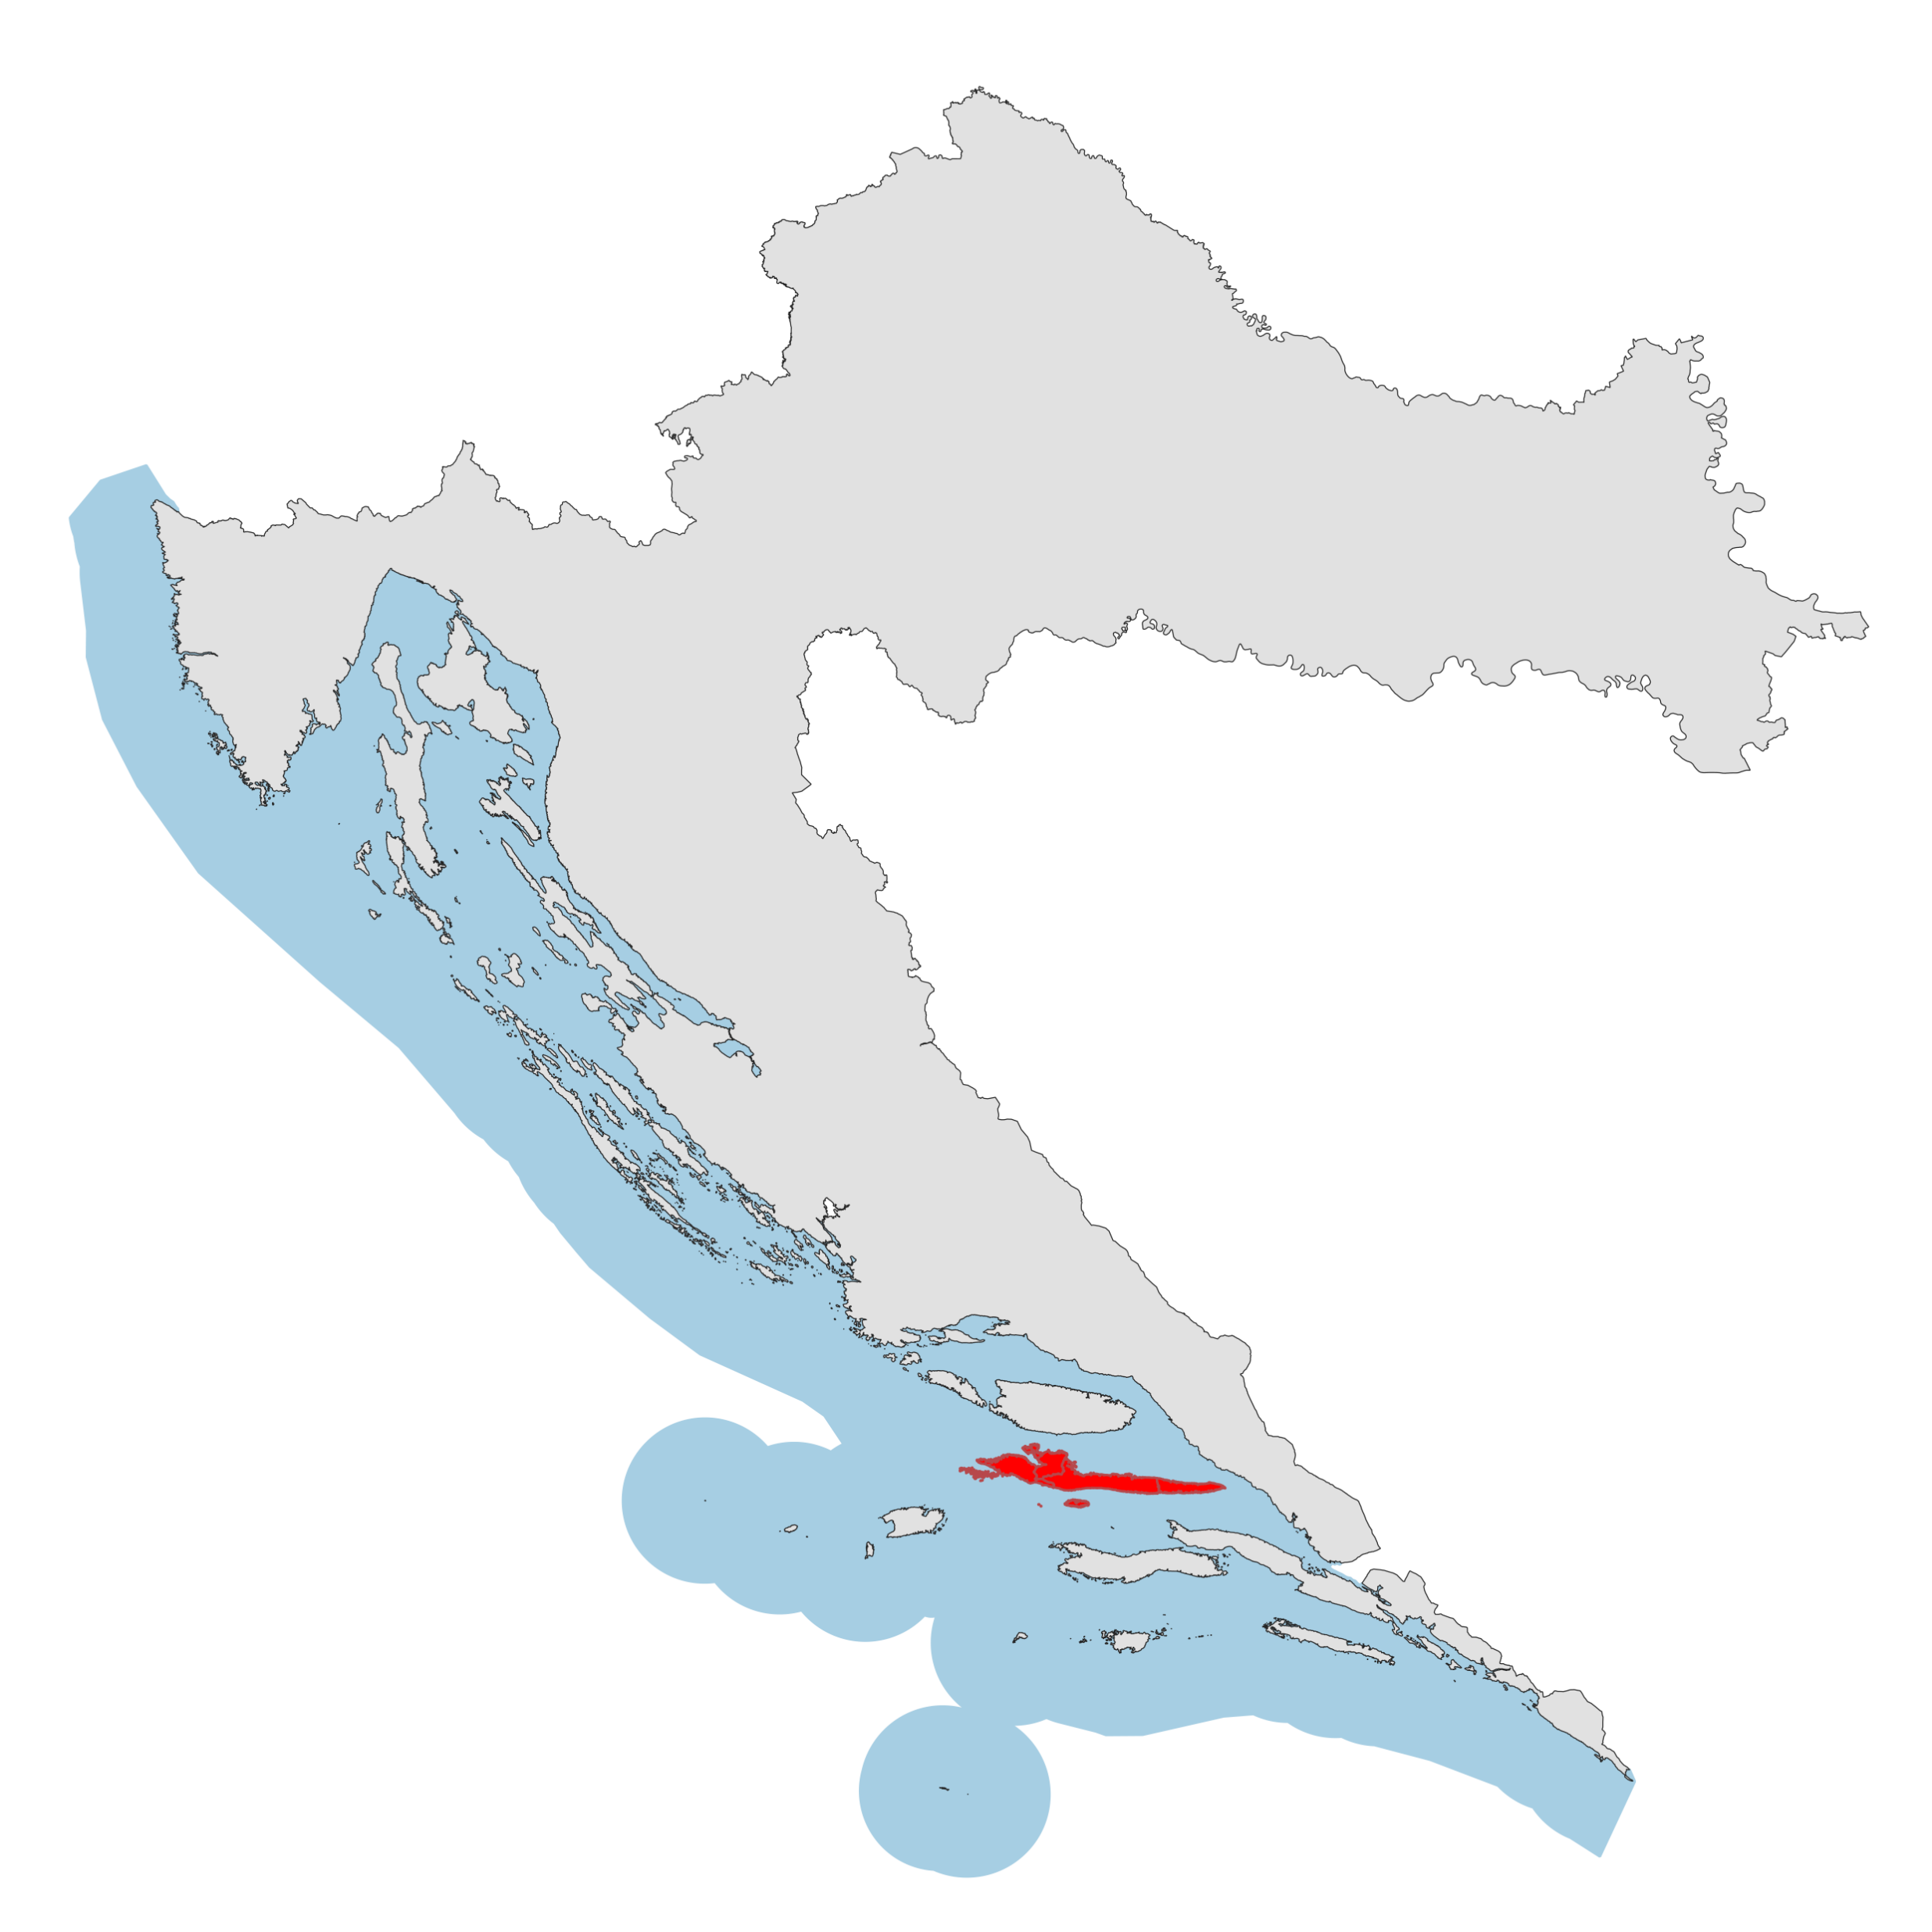
INTRODUCTION
Case study of Velo Grablje
7 inhabitants (2011 census)
City of Hvar marks a population growth
Villages in the inland are losing their inhabitants
Poor traffic connections with the coast and thus with the Croatian mainland
Evaluation of the existing state of the village
Proposition of possible direction for its future development
Notes:
The main focus of the analysis will be the village of Velo Grablje, which according to the 2011 census has only 7 inhabitants.
-
Velo Grablje is facing physical constraints due to its position in the middle of the island and its poor traffic connections with the coast and thus with the Croatian mainland. This has led to depopulation, which makes investing in better connections unprofitable.

Slide 3
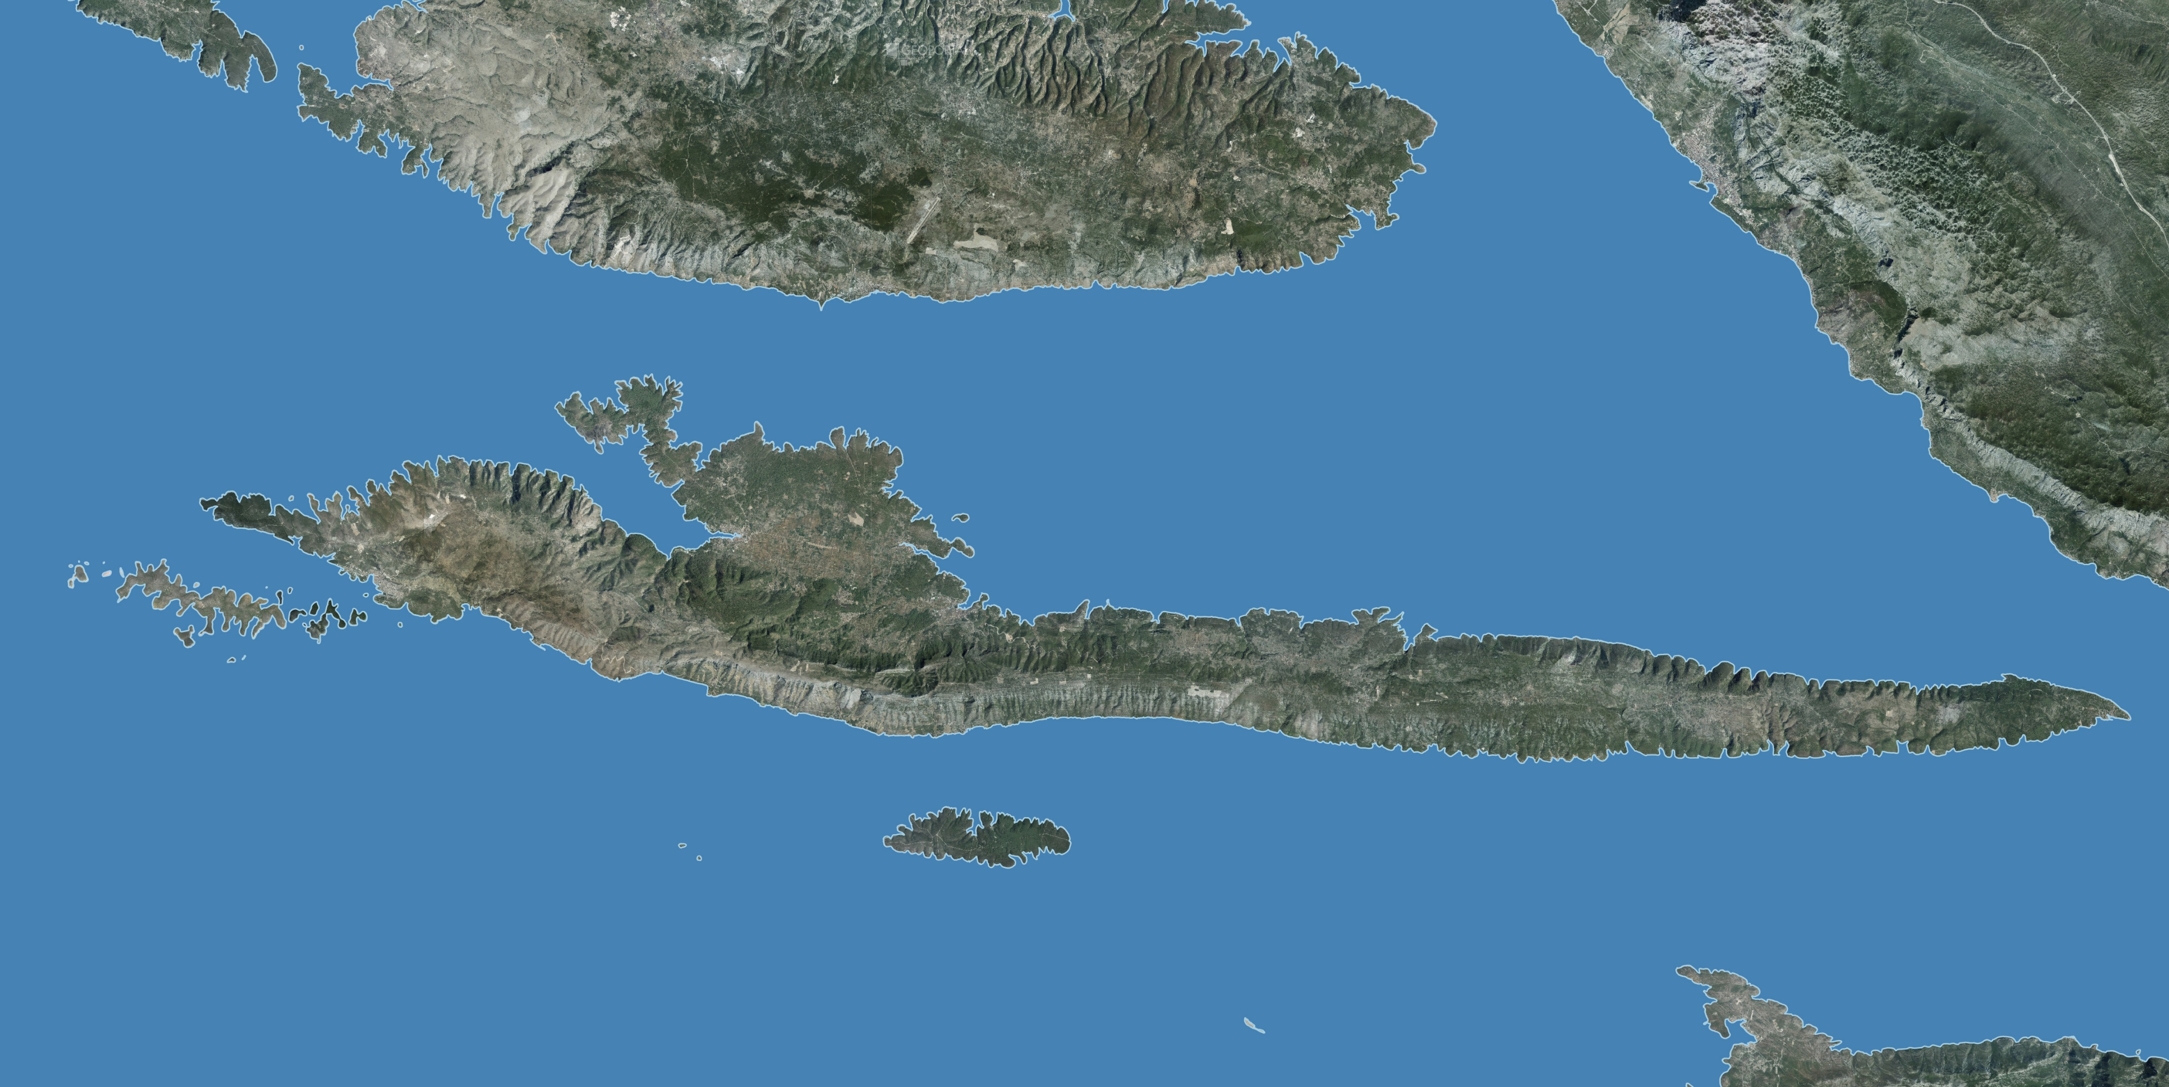
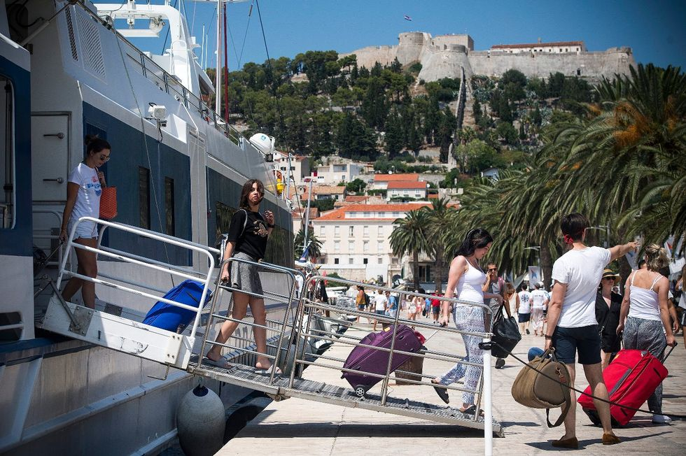
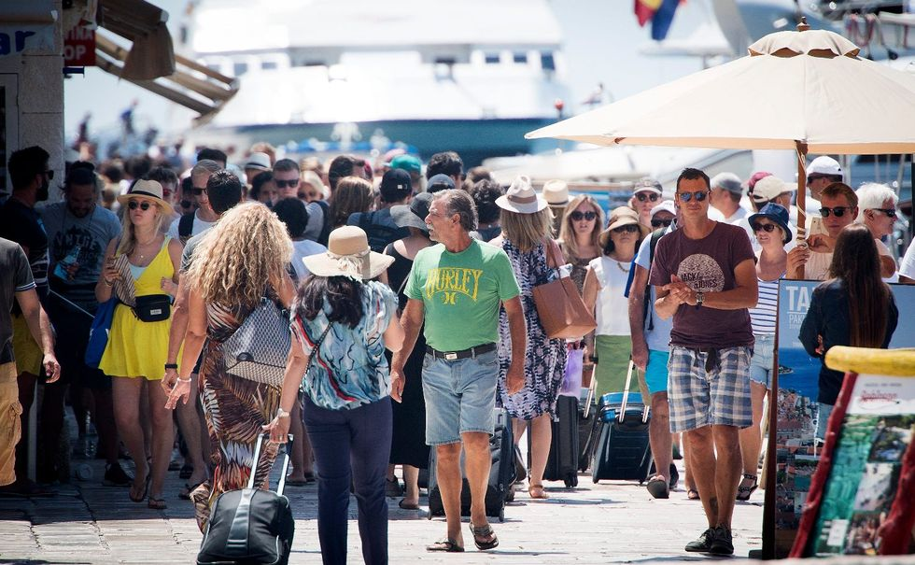
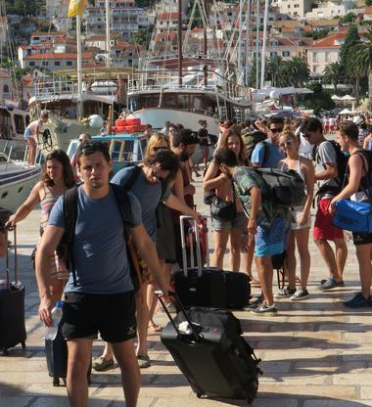
CONTEXT
location
Hvar is located between the islands of Brač, Vis and Korčula
Longest Croatian island
History of settlements dates back as far as prehistoric times
Island is one of the main centres of Croatian tourism
Million and a half tourists visited the island last year – mostly the places located along its coast
What will the growing development of tourism on the coast of the island do to its inland villages?
Notes:
One of the questions raised by this kind of development is: what will the growing development of tourism on the coast of the island do to its inland villages?

Slide 4
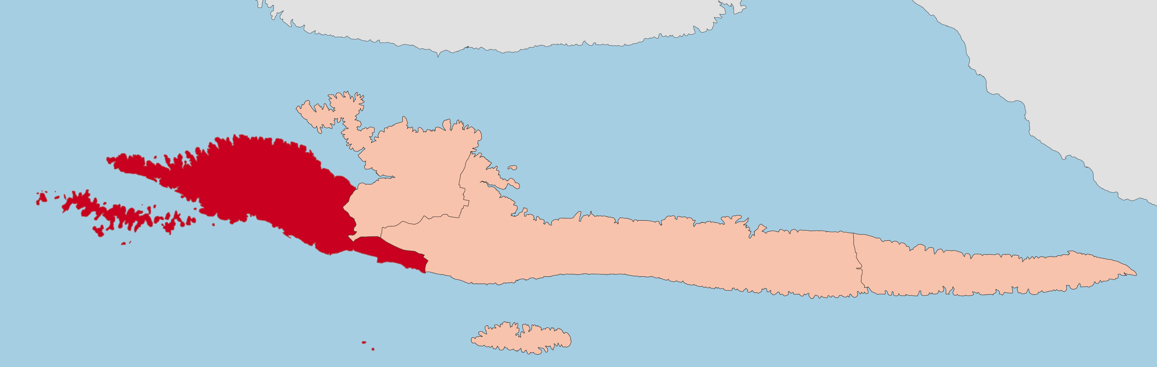
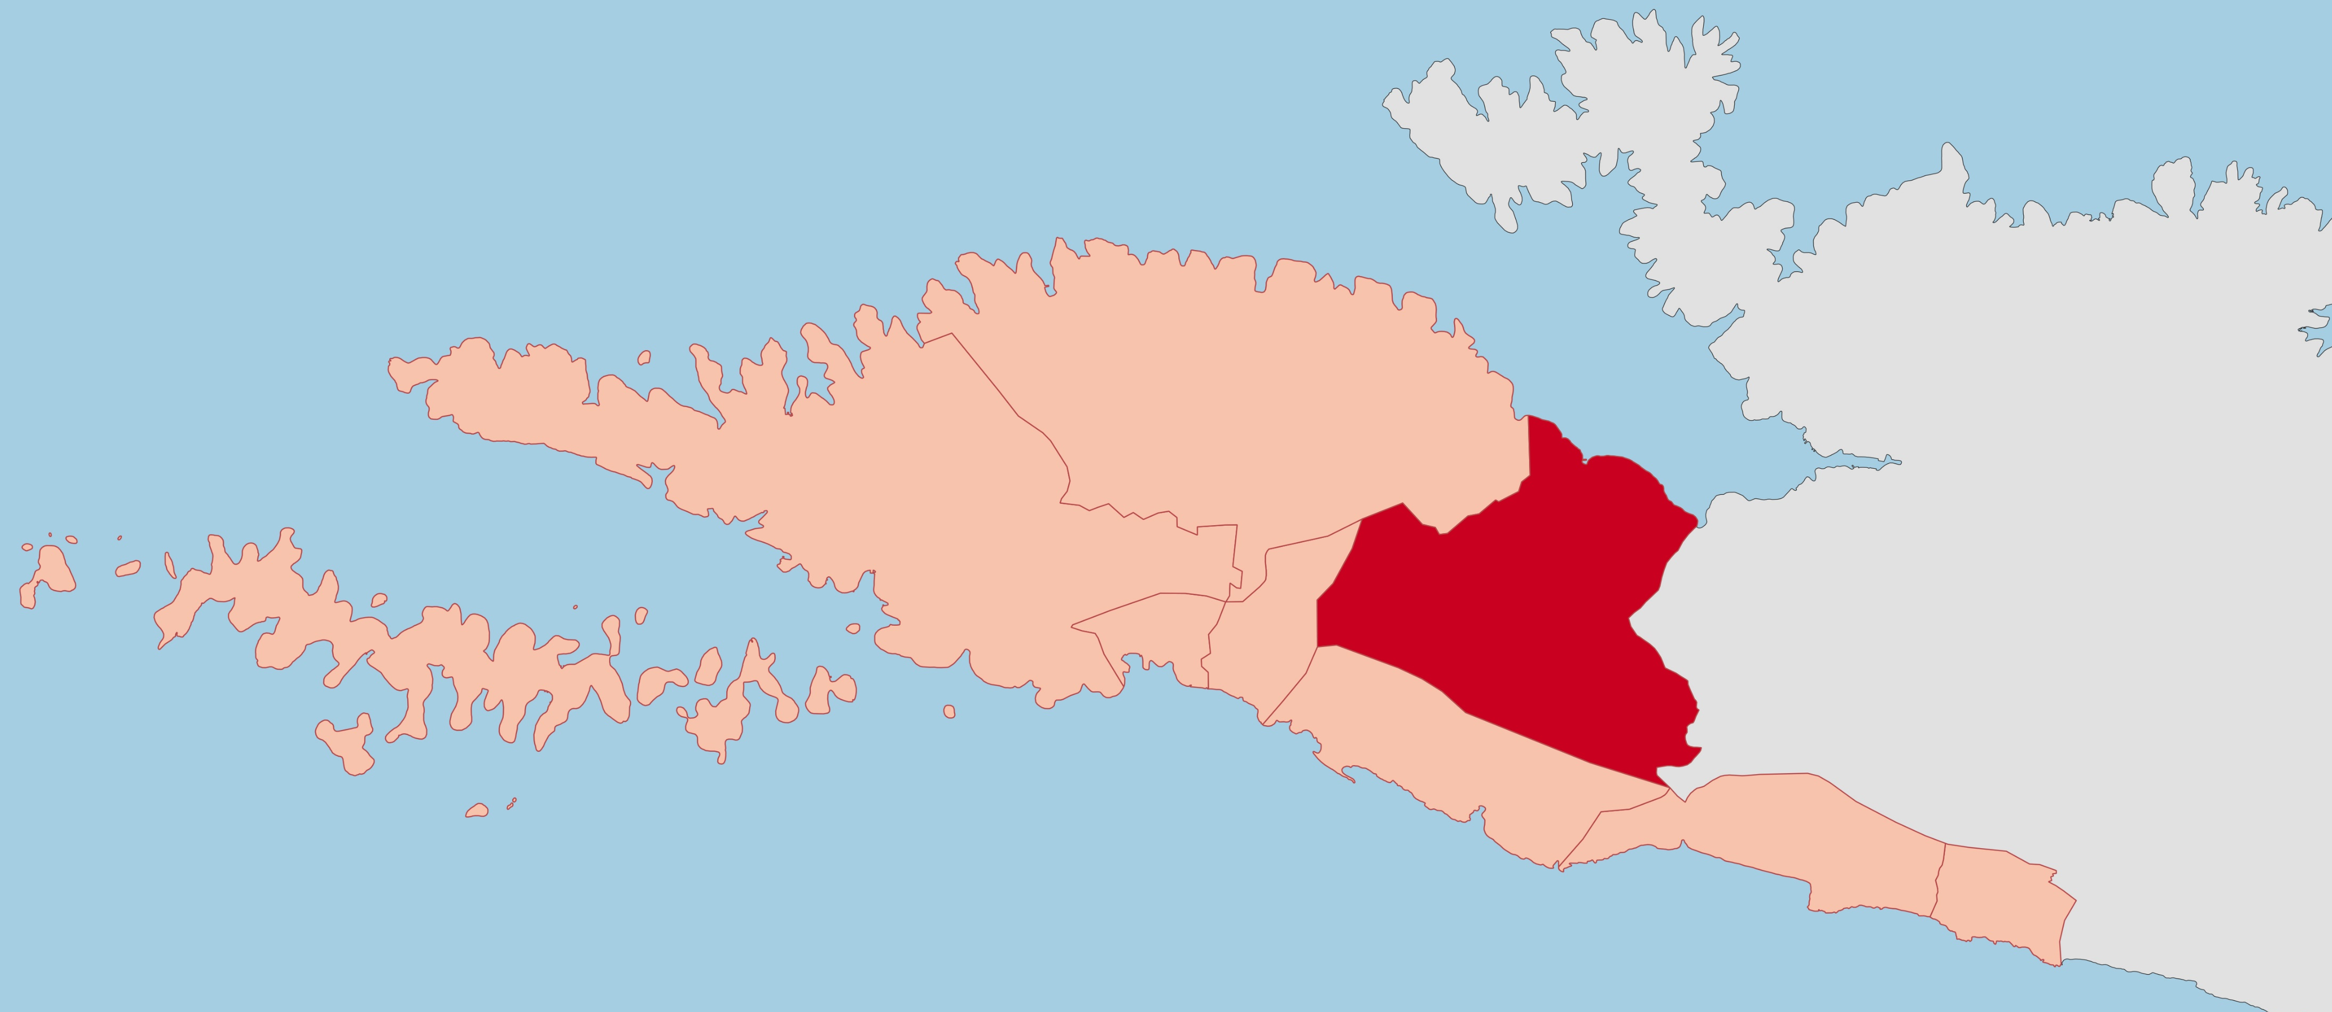
CONTEXT
location
Island municipalities
HVAR
STARI GRAD
Split – Dalmatia County
Island municipalities: Hvar, Stari Grad, Jelsa and Sućuraj
City of Hvar settlements: Brusje, Hvar, Jagodna, Malo Grablje, Milna, Sveta Nedjelja, Velo Grablje, Zaraće
Although almost every settlement on the island has access to the sea within its administrative borders, many villages had historically developed in the inland
JELSA
SUĆURAJ
City of Hvar settlements
BRUSJE
HVAR
VELO GRABLJE
SVETA NEDJELJA
MILNA
ZARAĆE
JAGODNA
MALO GRABLJE

Slide 5
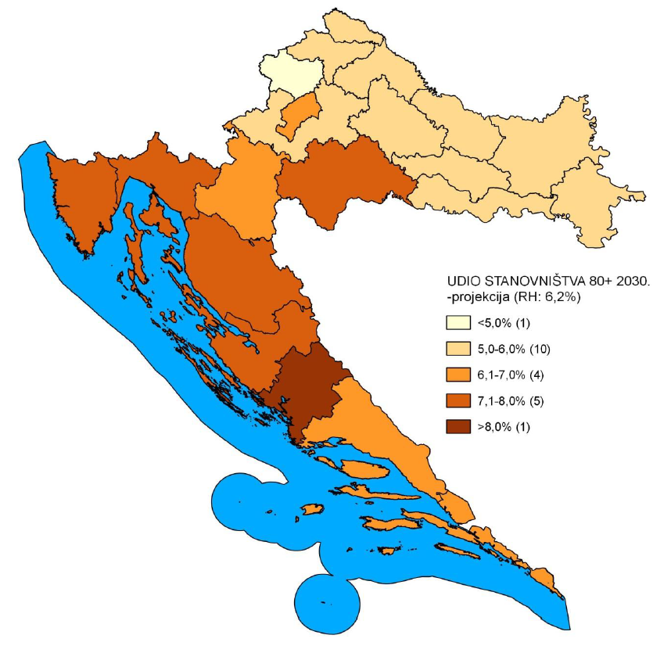
CONTEXT
depopulation
Depopulation and aging – decline in the natural population growth rate and an increase in the number of older people
Velo Grablje = village threatened with extinction
7 inhabitants (2011 census)
Consequence of depopulation - underdevelopment of social infrastructure - fewer schools will be built, many existing ones will be closed, the need for transportation services and the need to build new utility infrastructure are reduced
Notes:
Demographic structure in Croatia is mosty affected with two demographic processes: depopulation and aging.
-
Demographic data show that Velo Grablje, according to the number and age structure of the population, is a place threatened with extinction.

Slide 6
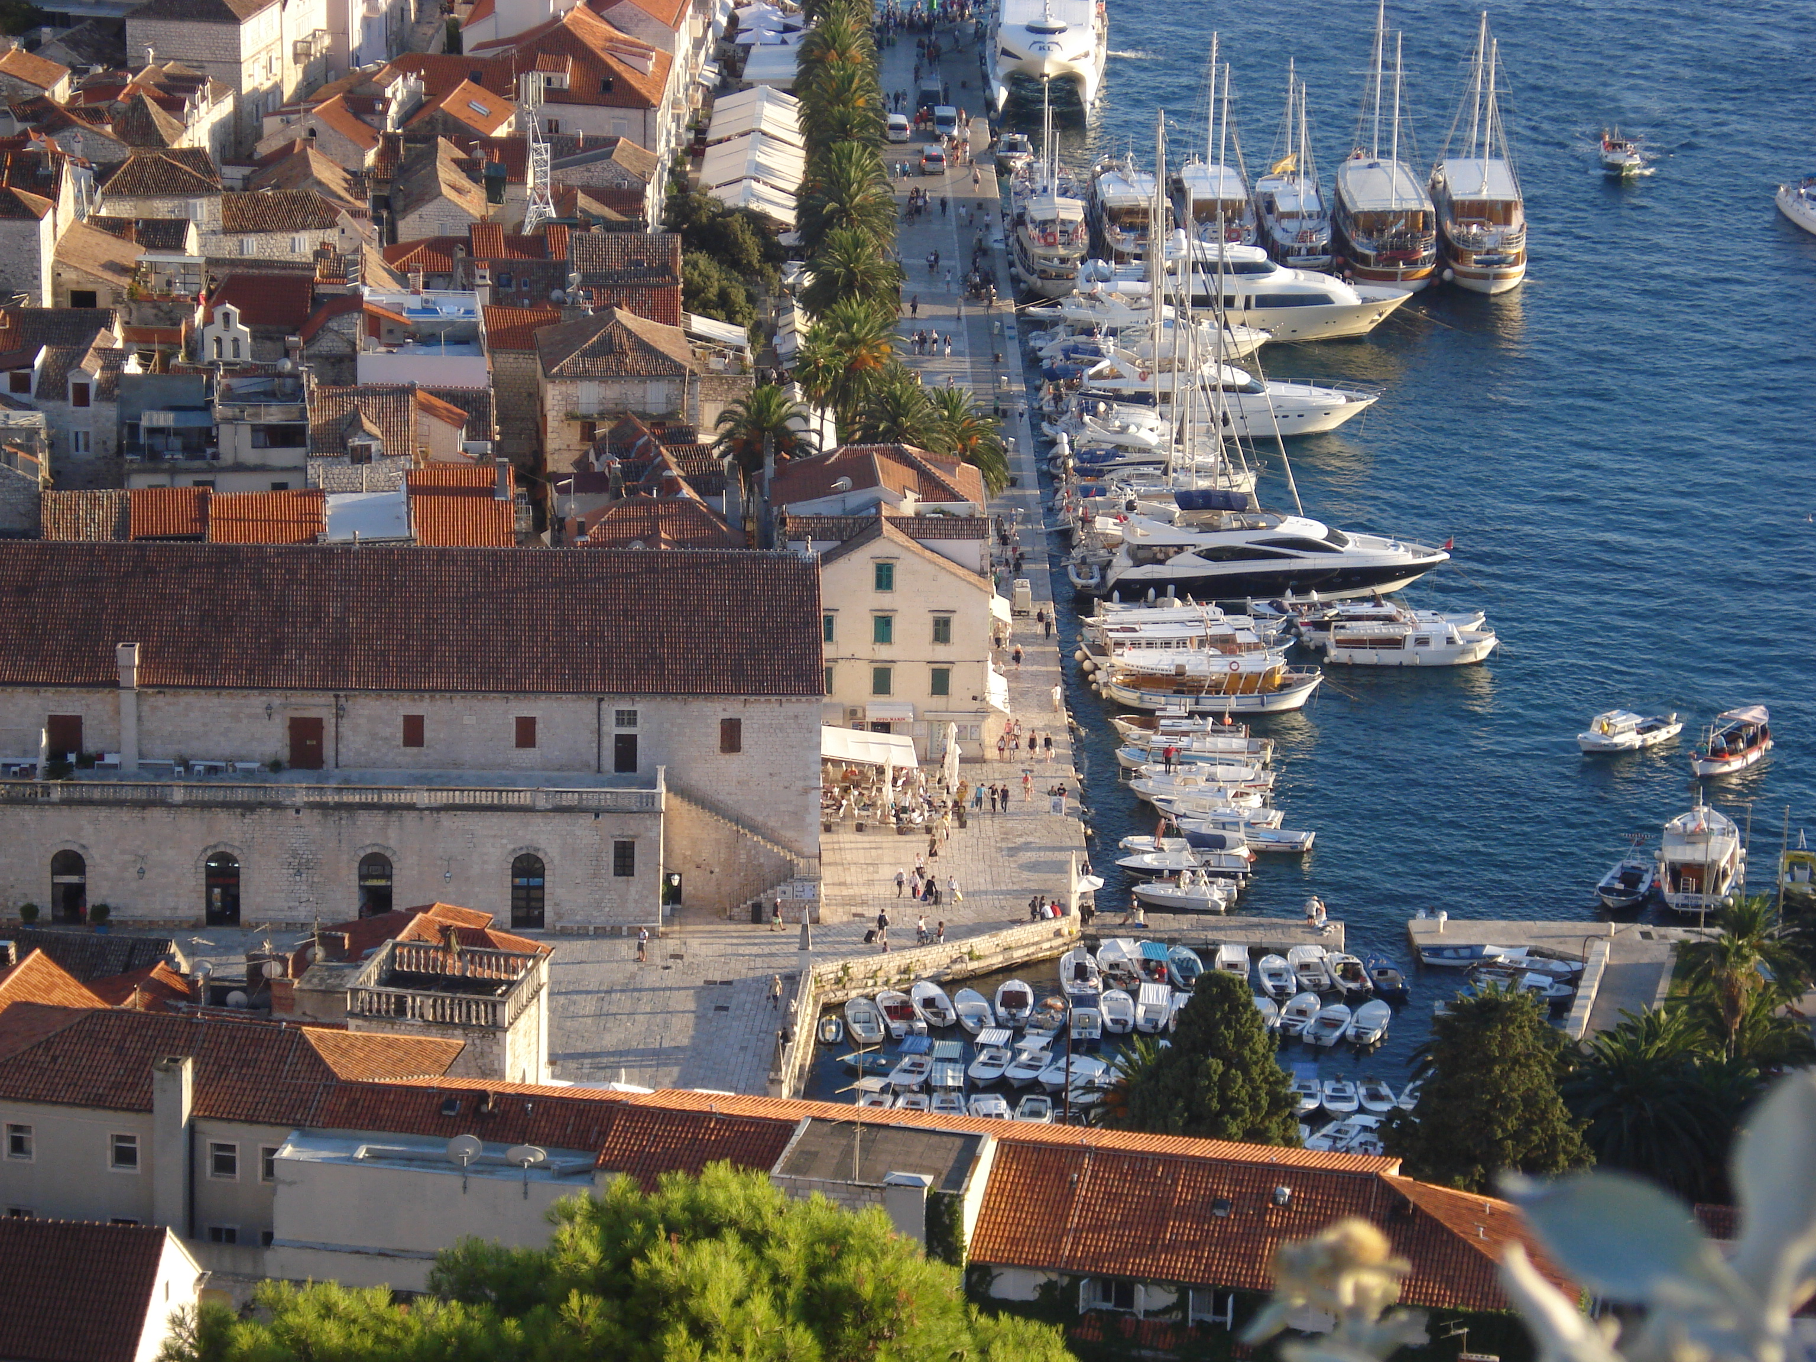
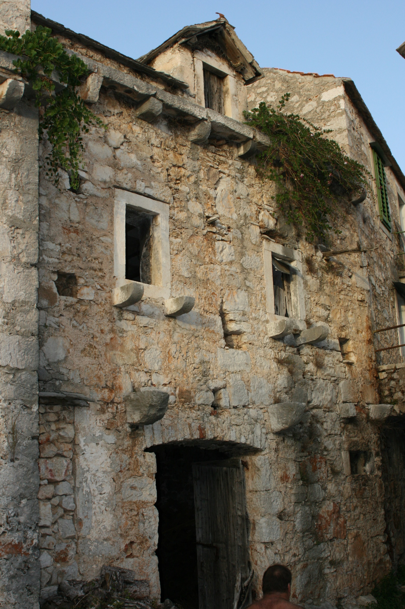
CONTEXT
tourism
Tourism = primary activity on the island
Positive effects:
Better valorisation of natural resources and cultural heritage
Better employment rate
Increased public and private standards
Negative effects:
Seasonal nature of such business
Increasing sales of quality land for the construction of excessive tourist accomodations
With all the resources being directed towards the development of tourism in bigger towns along the coast of the island, Velo Grablje has been systematically neglected over the past decades.
Notes:
Hvar, like other islands, was once an economic, traffic-isolated, entity with activities for everyday needs available on the island.

Slide 7
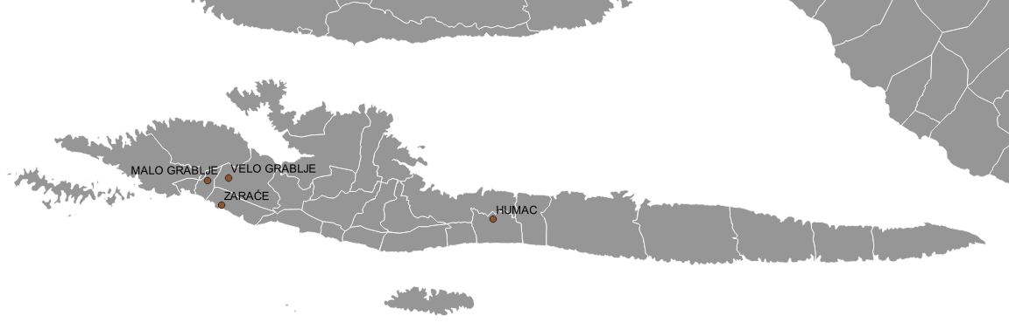
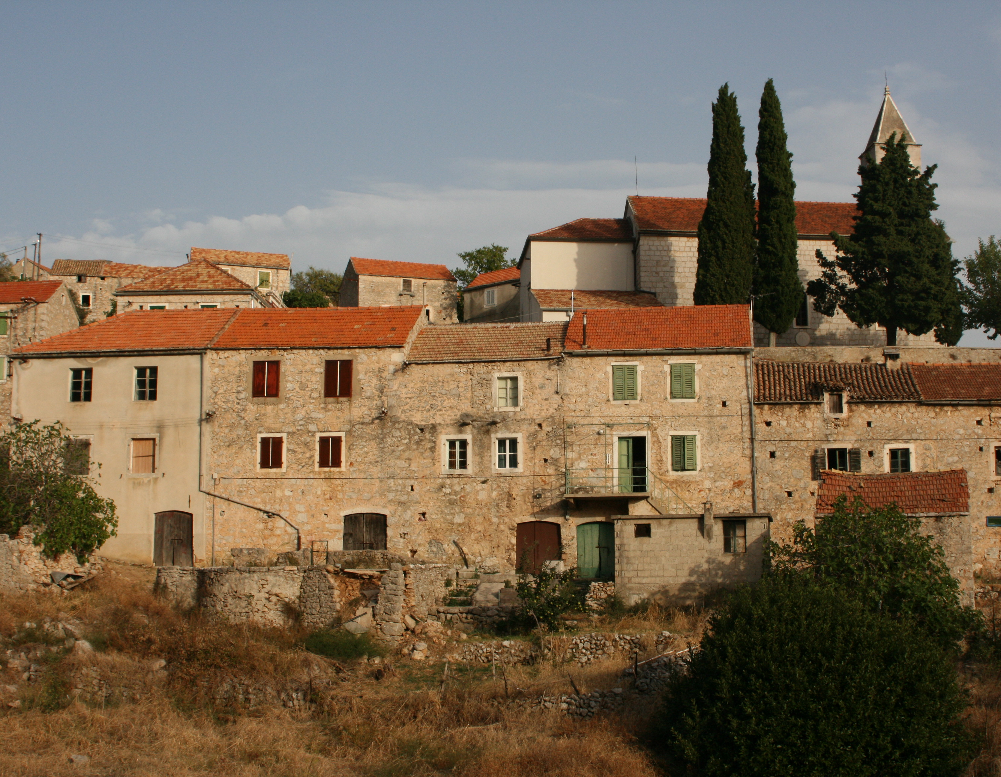
CONTEXT
ethno – eco village
Split-Dalmatia County started an „ethno-eco village” development project (2005)
Revitalize 30 villages on the island and the mainland
Make villages attractive for tourism, highlighting their unique features that make them distinct from other places that have lost their “personality” due to overbuilding
4 villages on the island of Hvar: Humac, Malo Grablje, Velo Grablje, Zaraće
Topići, Topići-Bast (Baška Voda)
Zarače, Malo Grablje, Velo Grablje (Hvar)
Humac (Jelsa)
Podhumlje (Komiža)
Tugare Ume, Čažin Dolac (Omiš)
Dol (Postira)
Gornji Proložac Podi (Proložac)
Blace (Solin)
Grohote (Šolta)
Podi Grab Bugar., Gornje Voštane i Grubišići (Trilj)
Kokorić, Veliki Godinj (Vrgorac)
Karoglani (Zmijavci)
Murvica (Bol)
Gornja Podsrtana, Stara Podstrana (Podstrana)
Lolić i Mijanovići (Split)
Brdaci (Zec), Divojveići, Etno eko selo Škopljanci Radošić
Botić-Opor (Prgomet)
Naklo-tavnice (Lokvičići)
Jesenice, Duće (Dugi Rat)
Mala Rudina (Stari Grad)
Bekavci Kričar (Brela)
Rušinovići, Drvenik Veli Kačine (Trogir)

Slide 8
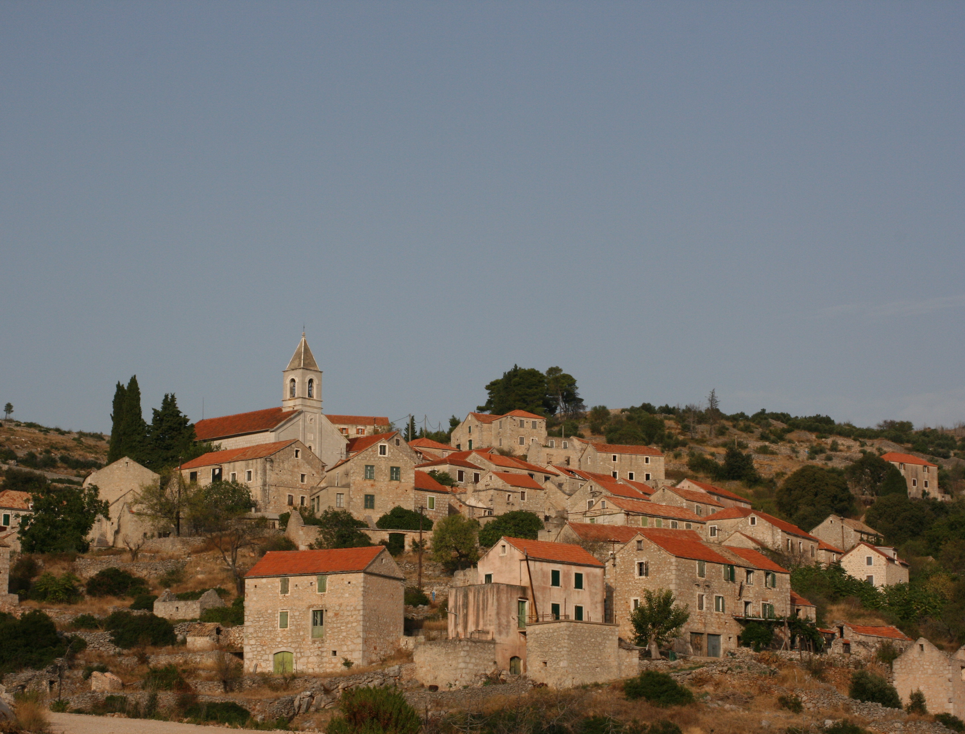
VELO GRABLJE
history and cultural heritage
Village founded in the late Middle Ages
Livestock settlement
17th century – 50 inhabitants
18th century – cattle breeding was replaced by agriculture → development and population growth
19th century – development of viticulture
20th century – 500 inhabitants
Notes:
Exact data on the founding of Velo Grablje is not preserved, but according to existing historical sources and local tales it was founded in the late Middle Ages as a livestock settlement.
-
This number had halved by the middle of the same century and since then, the number of residents has been steadily declining.

Slide 9
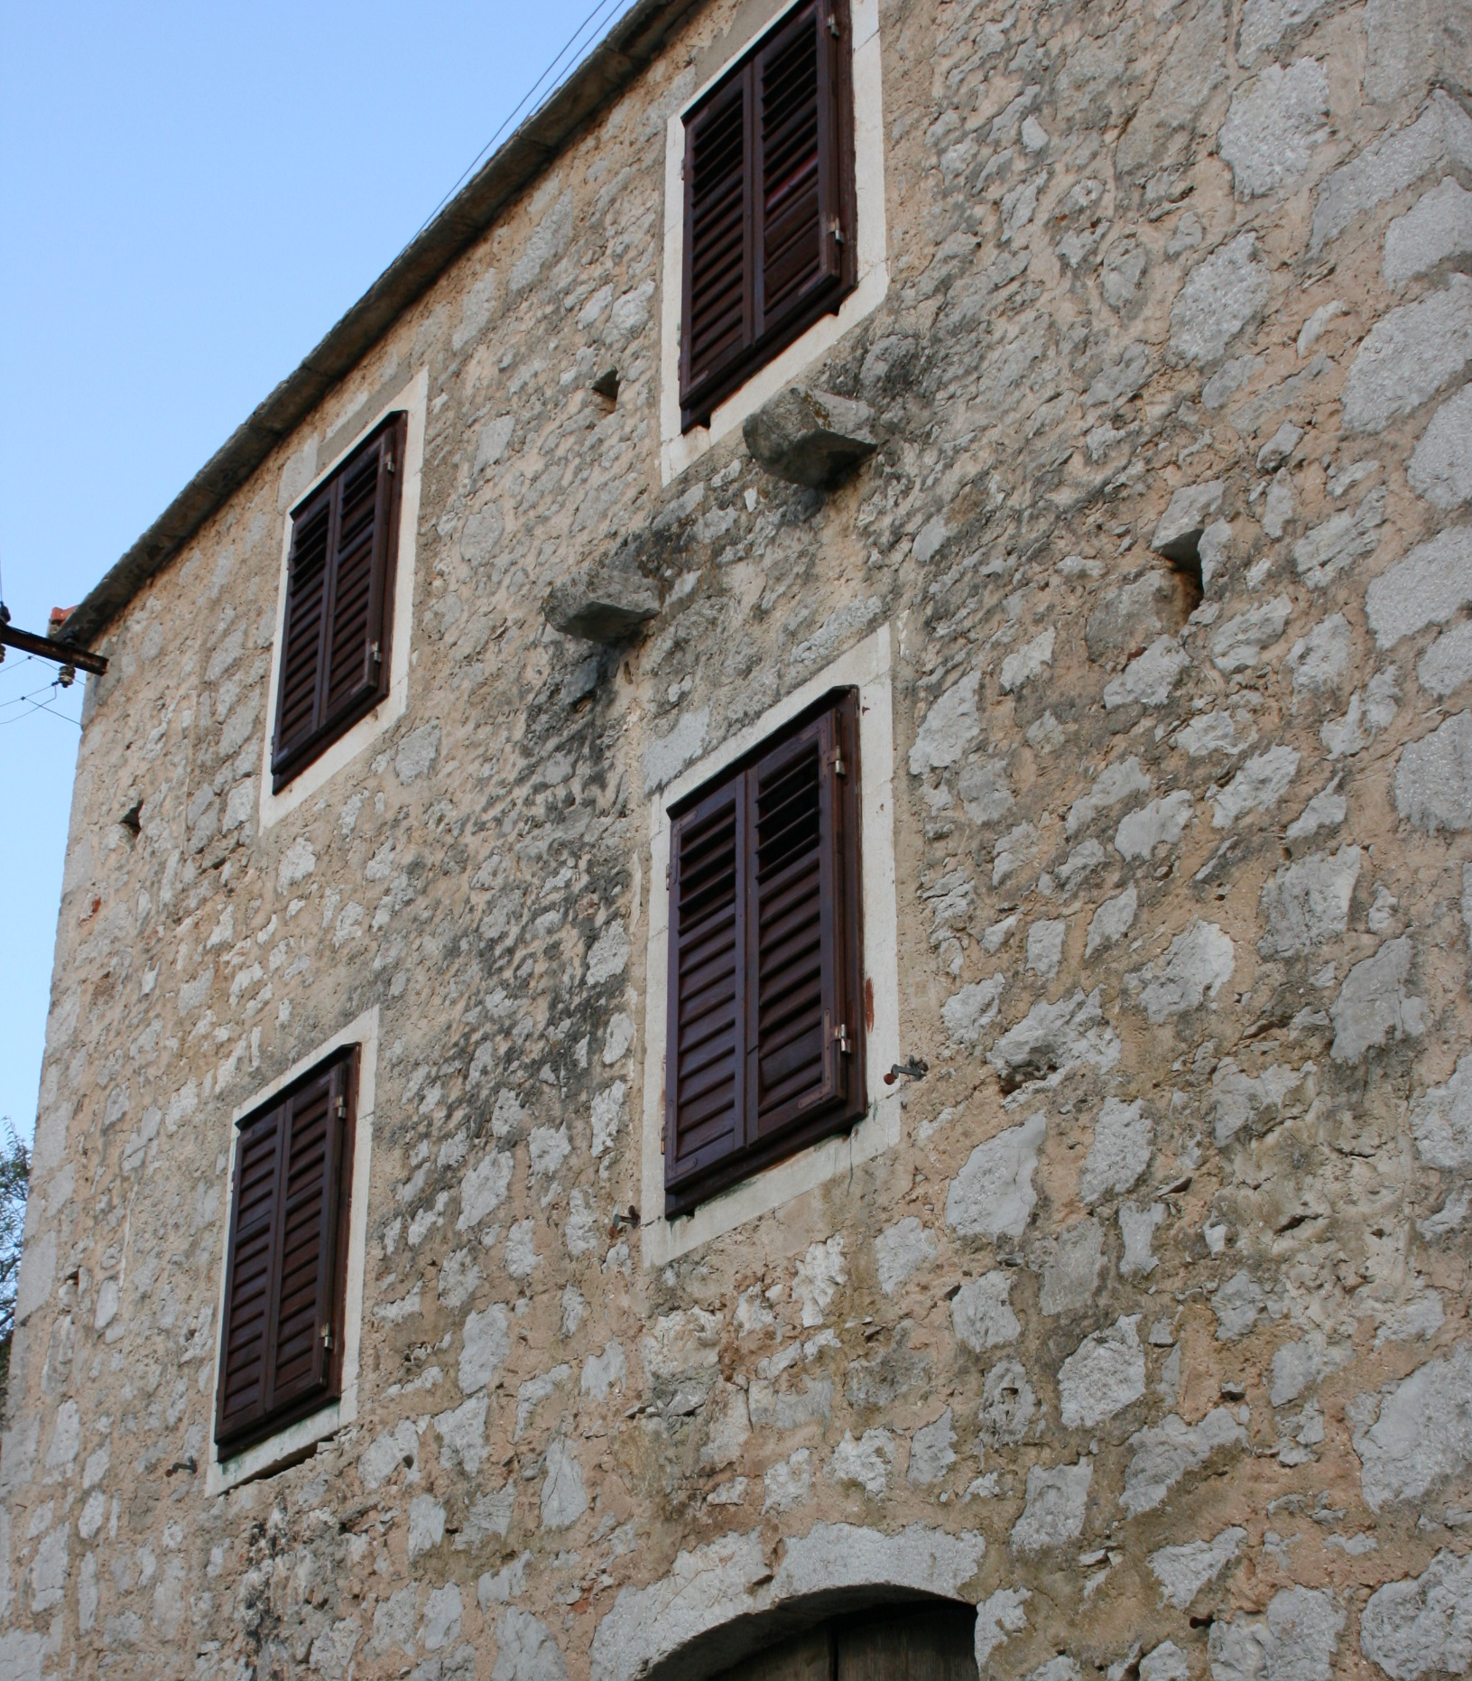
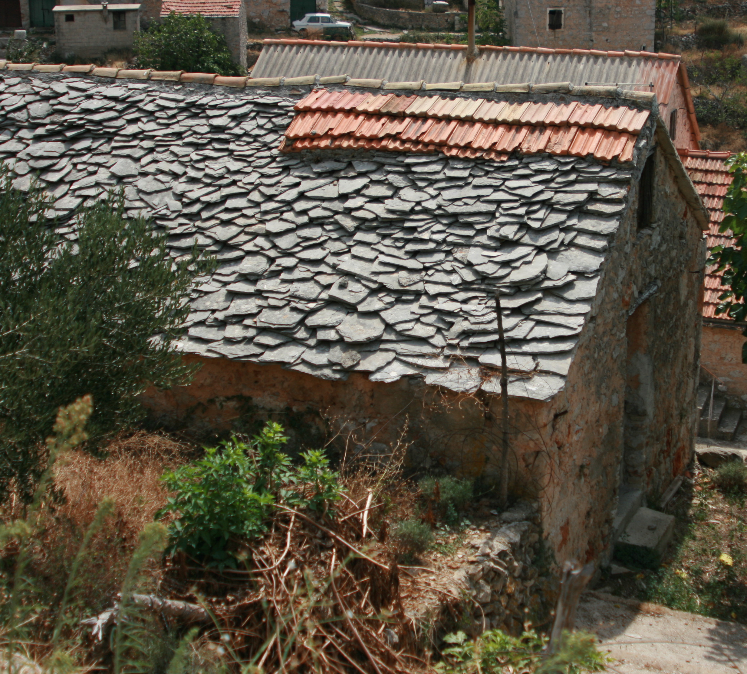
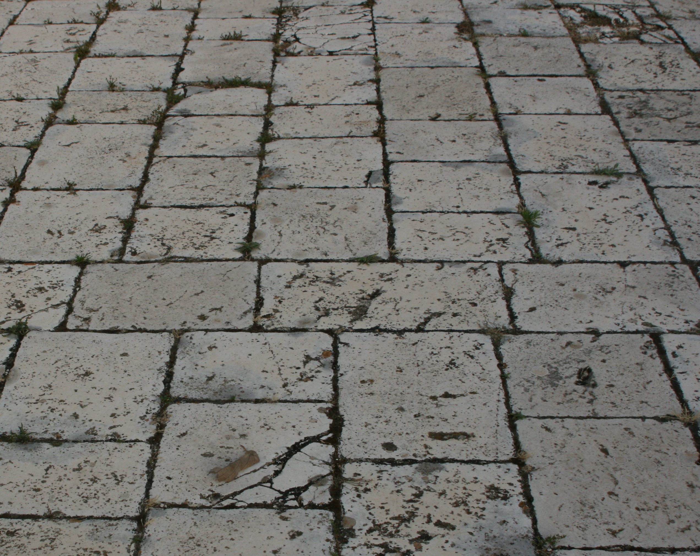
VELO GRABLJE
history and cultural heritage
Register of Cultural Goods of Republic of Croatia – well preserved architectural and urban complex
Uniform style and traditional materials – stone and lime binder
Notes:
Thanks to the absence of intensive tourist and economic development, today Velo Grablje is a well preserved architectural and urban complex and as such is registered in the Register of Cultural Goods
-
Due to the proximity of the local quarry, where many inhabitants of Velo Grablje were working, stone was a logical choice for building and for paving public areas.

Slide 10
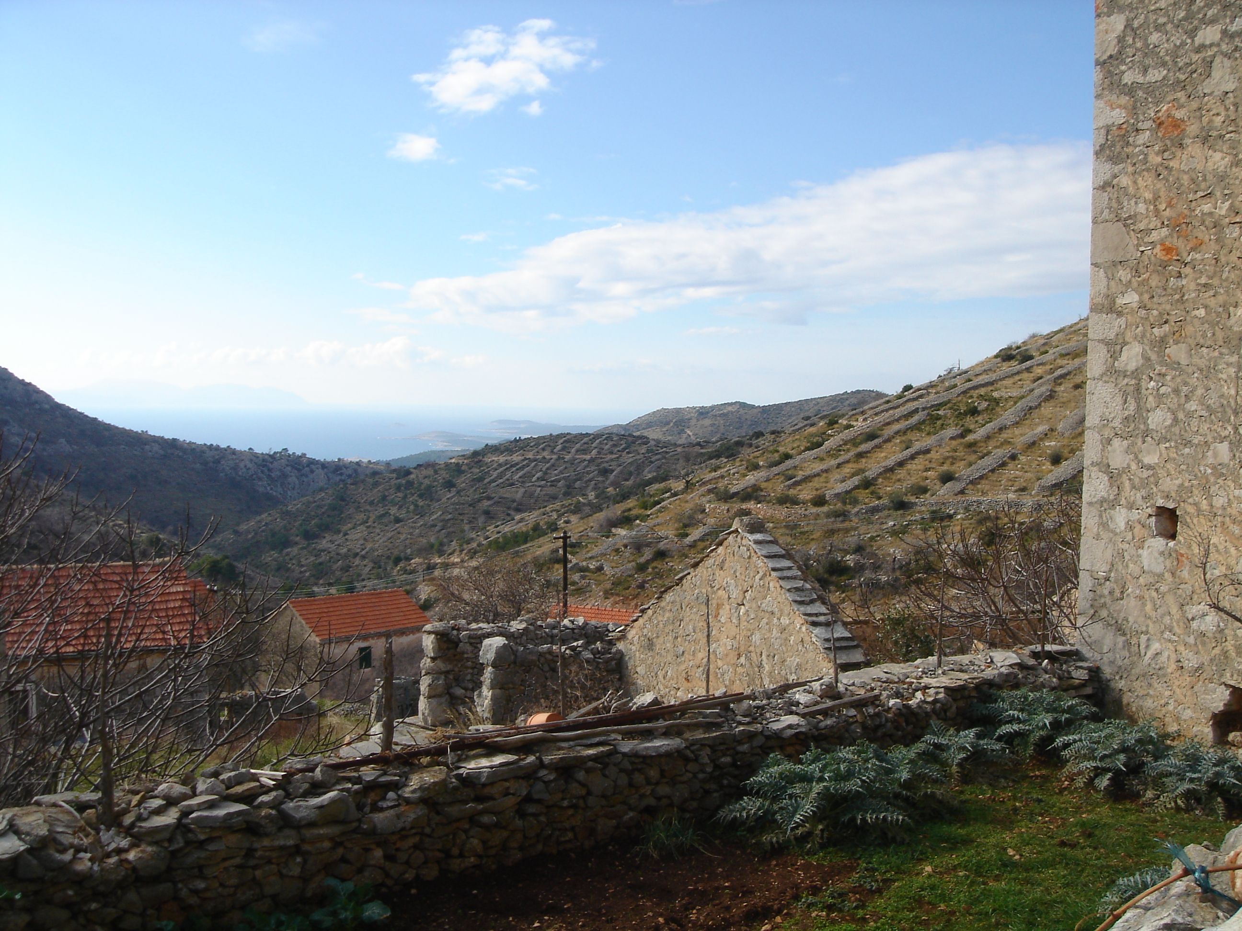
VELO GRABLJE
agriculture
First estates – ground below the village
Grapewine growing was the main agricultural activity – transformed Velo Grablje from the livestock settlement to an agricultural village
1914 – phylloxera destroyed the vineyards
20th century fires – vineyards almost completely ceased to exist
Today – fruit and vegetables are grown for personal needs only
Notes:
Since the establishment of the village, the population of Velo Grablje has been engaged in agriculture.
-
The vineyards have long been spared from diseases , but in spite of all efforts, phylloxera came in 1914 and destroyed the vineyards. After that vineyards were rebuilt, but after a series of catastrophic fires they almost completley ceased to exist.

Slide 11
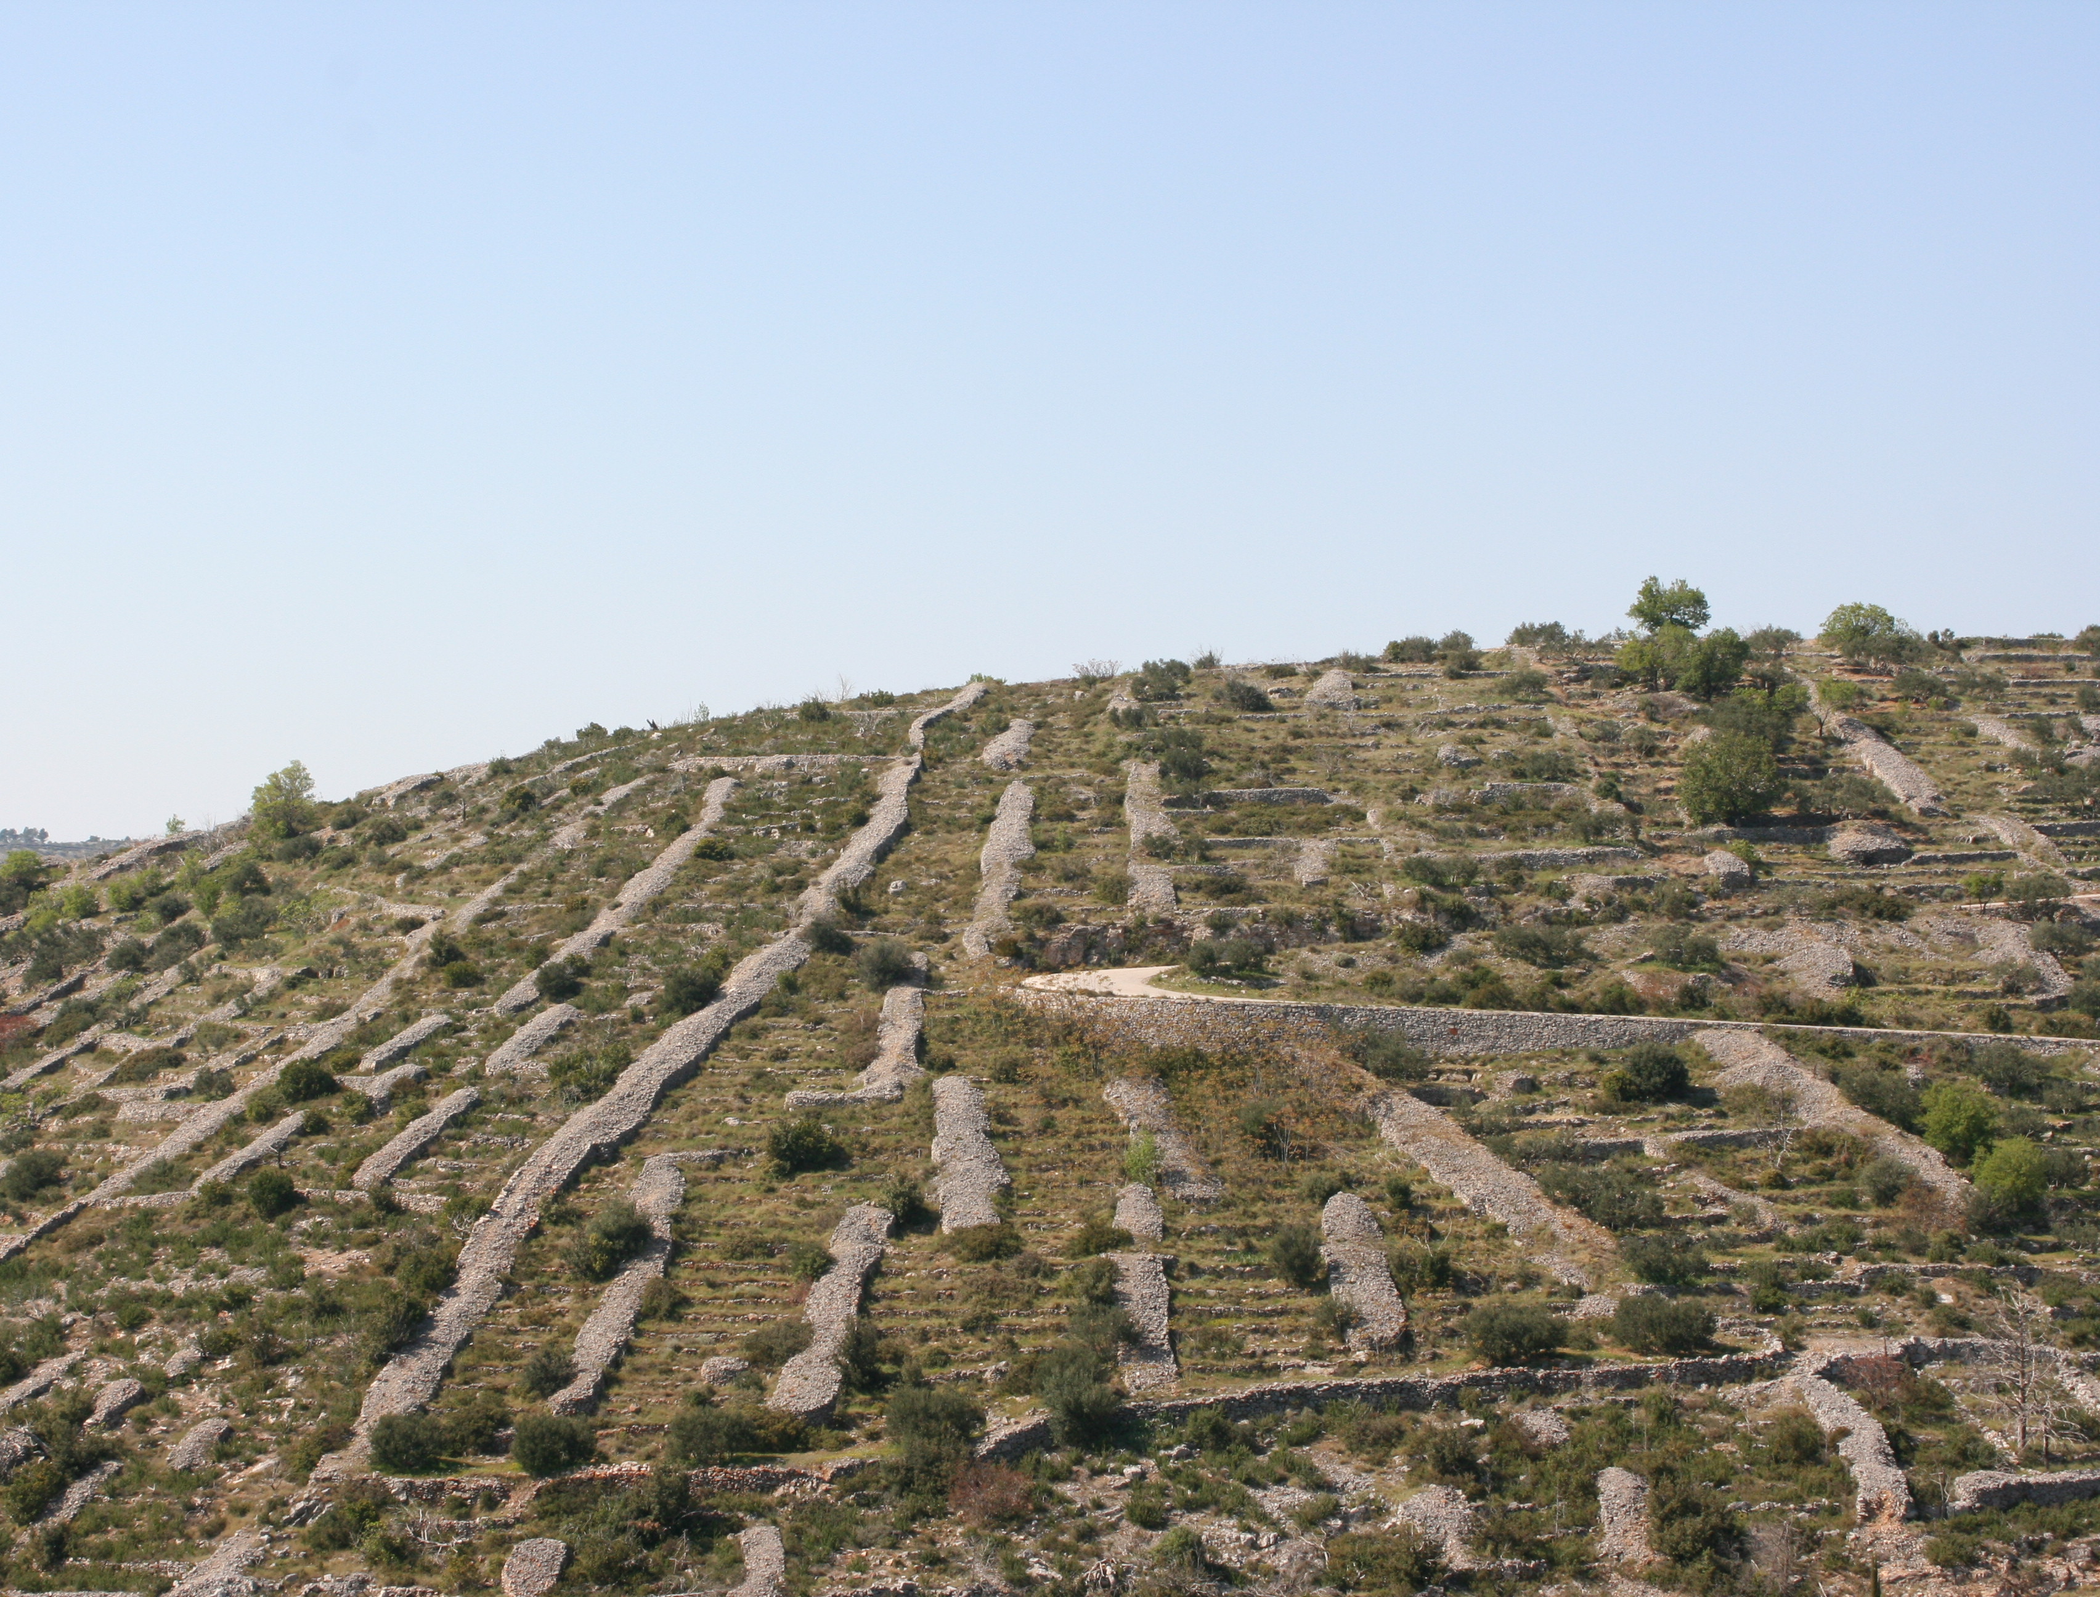
VELO GRABLJE
nature
Cultivated agrarian landscape
Karst area with parts covered in woods and others showing plain limestone rocks
2003 fire – drywalls on the slopes from Velo Grablje to Malo Grablje became visible
Today – most of the surrounding fields are abandoned
Notes:
Because of that intense agriculture through out the years, although not legally protected, the whole area of the Island is registeres as a cultivated agrarian landscape
-
The fire in 2003 severely affected the area and because that drywalls on the slopes from Velo Grablje to Malo Grablje became visible
-
Today, most of the surrounding fields are abandoned and only this “net” of stone drywalls shows the enormous effort that the inhabitants have once invested in “domesticating the nature”

Slide 12
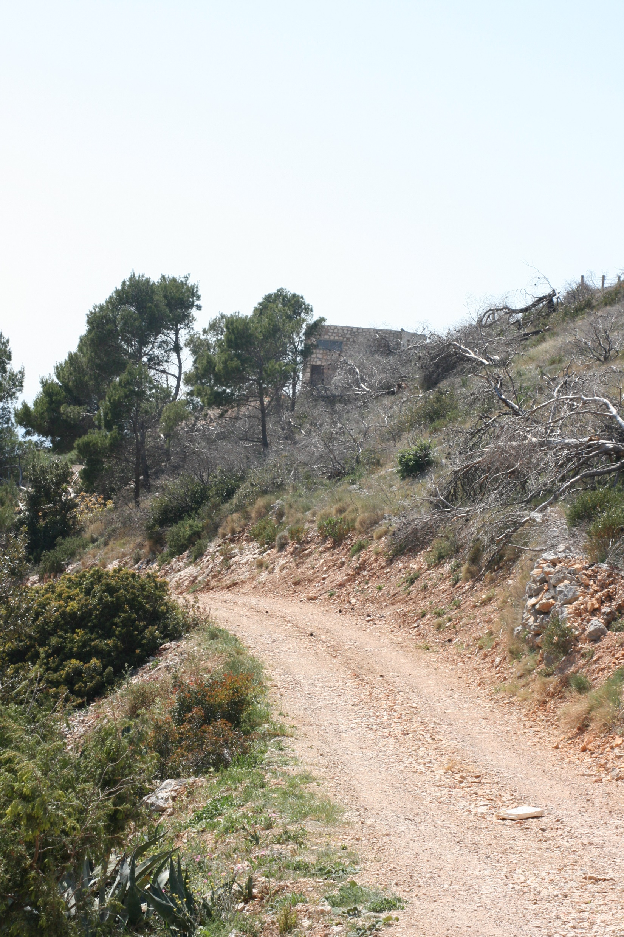
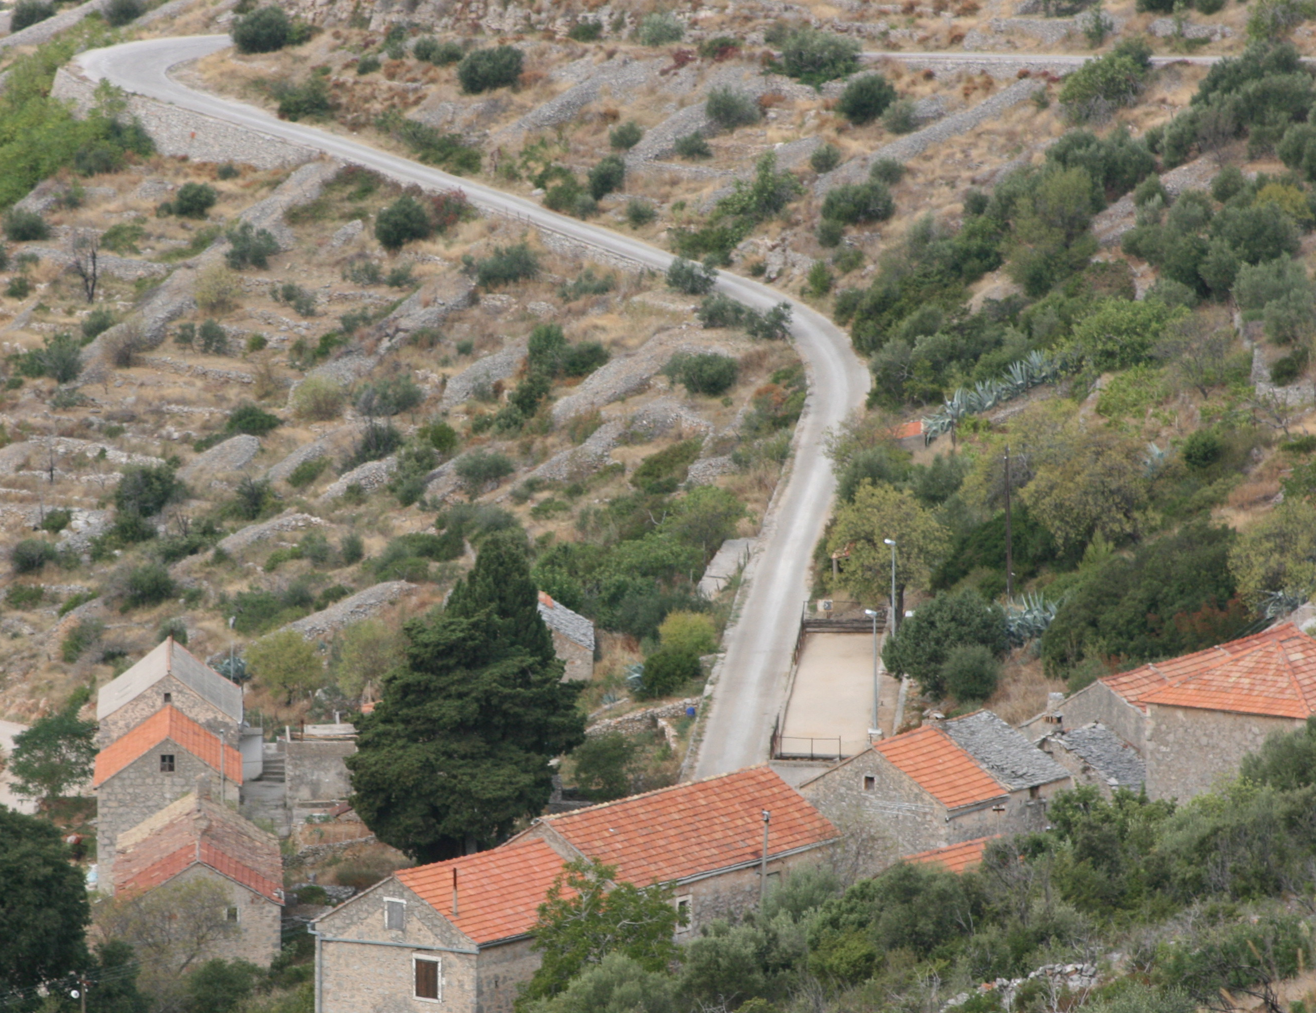
VELO GRABLJE
infrastructure
County road connects Velo Grablje with the City of Hvar
Macadam road connects Velo Grablje with Malo Grablje
Communal infrastructure: water, electricity and telecommunication network

Slide 13
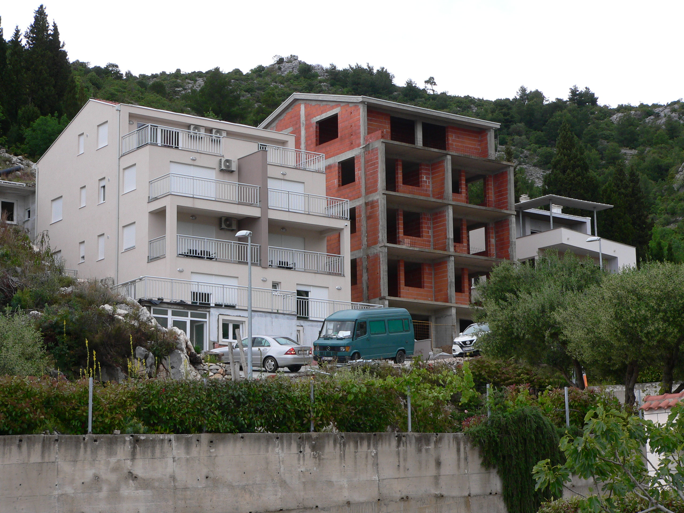
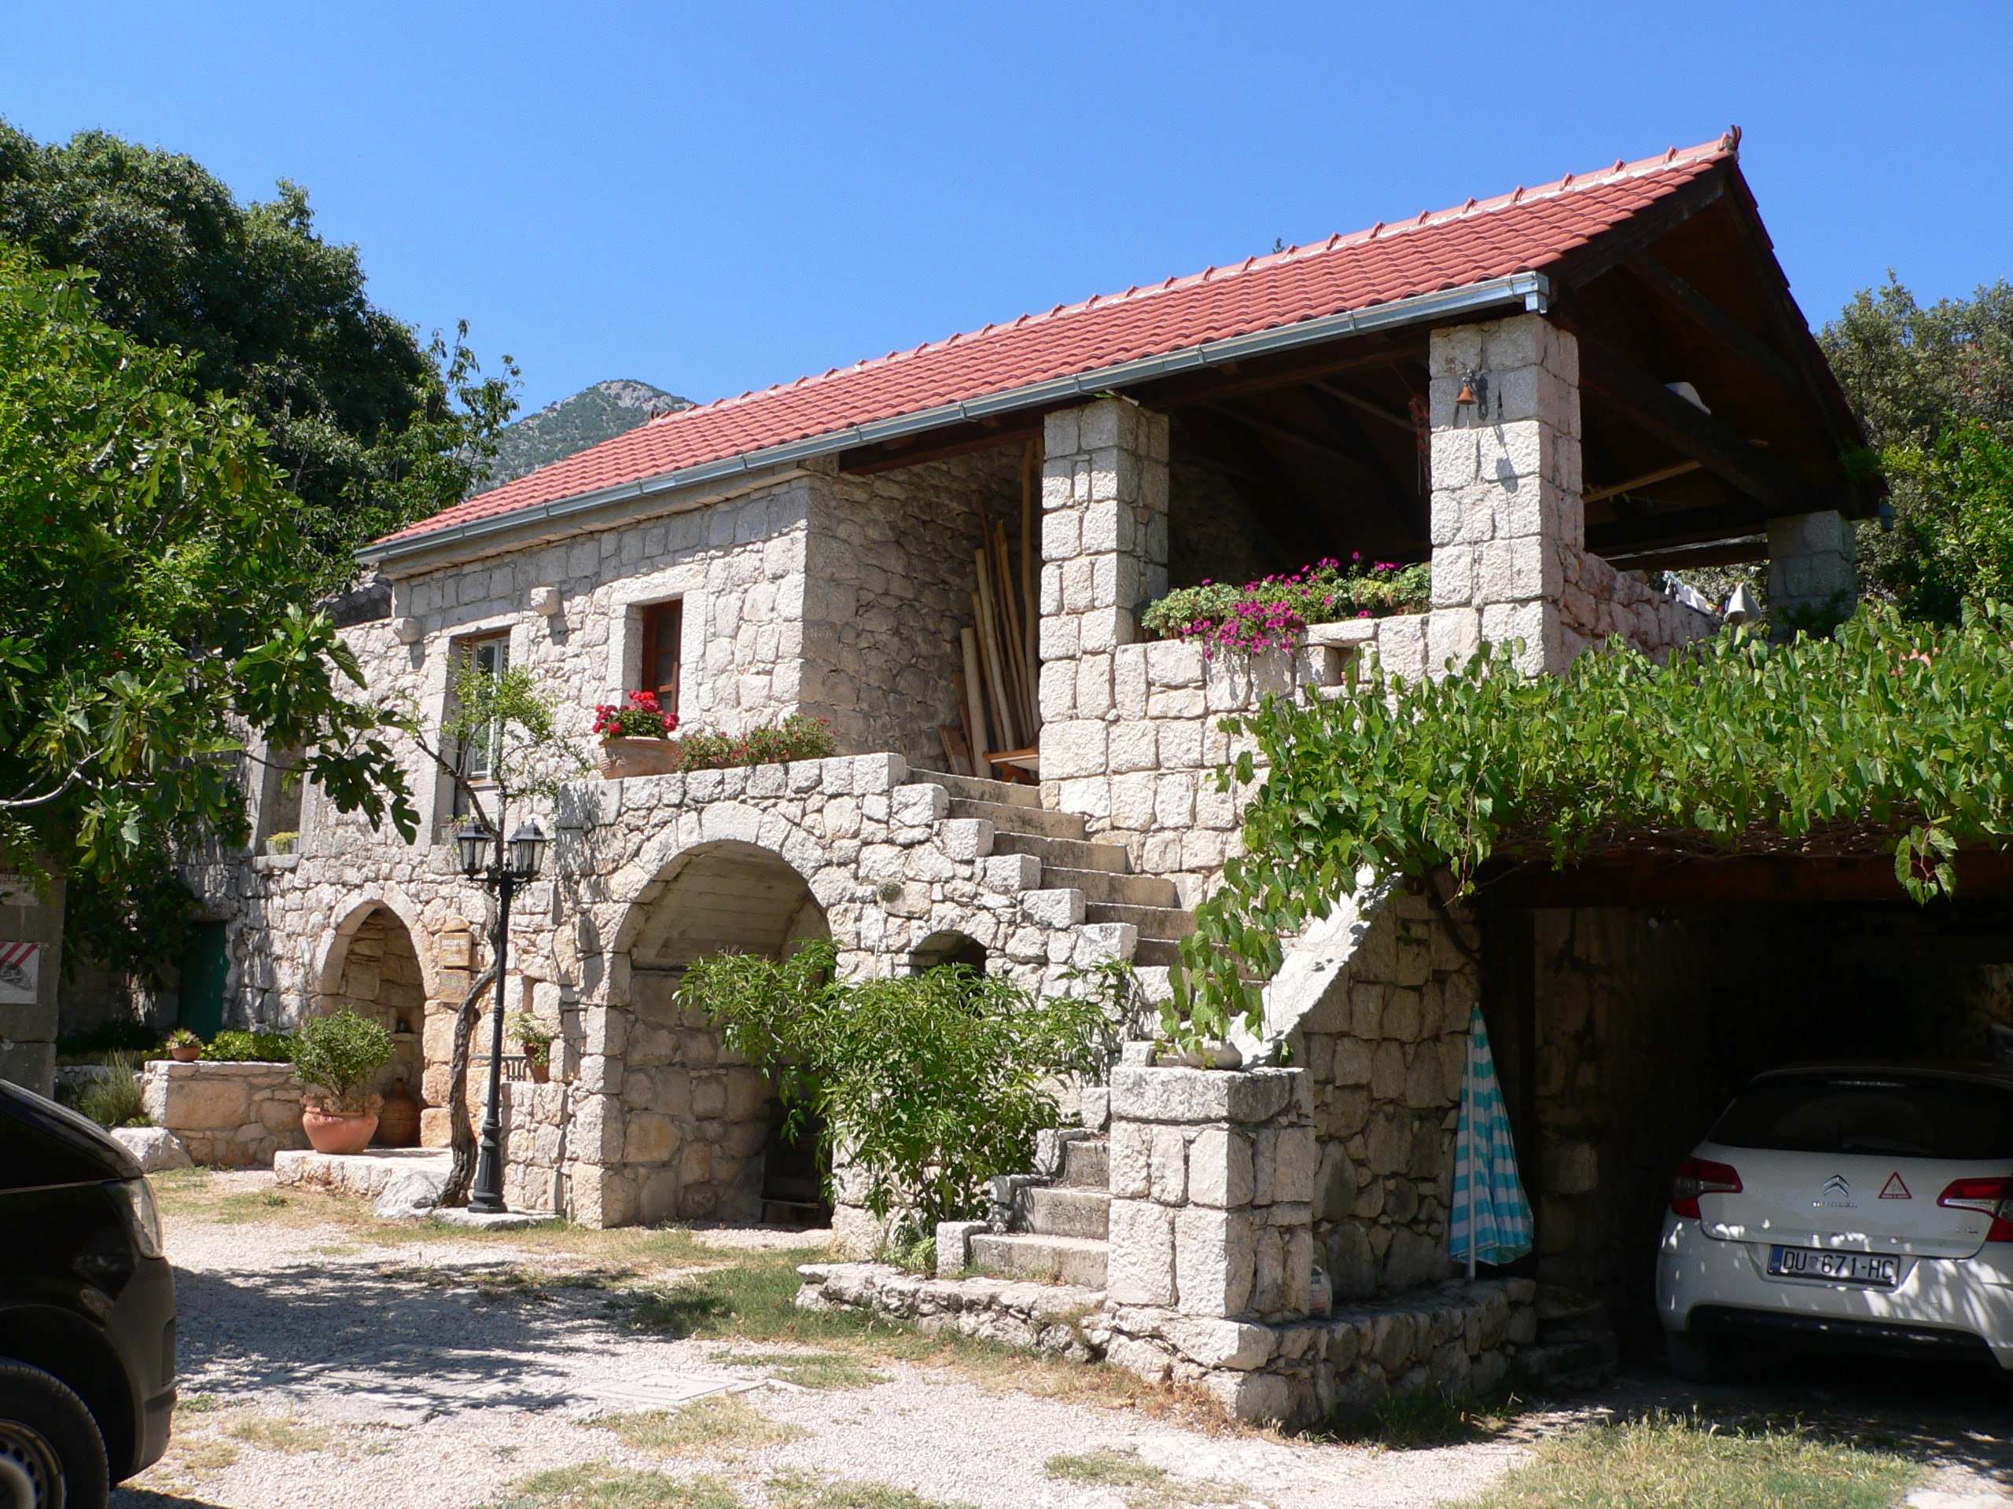
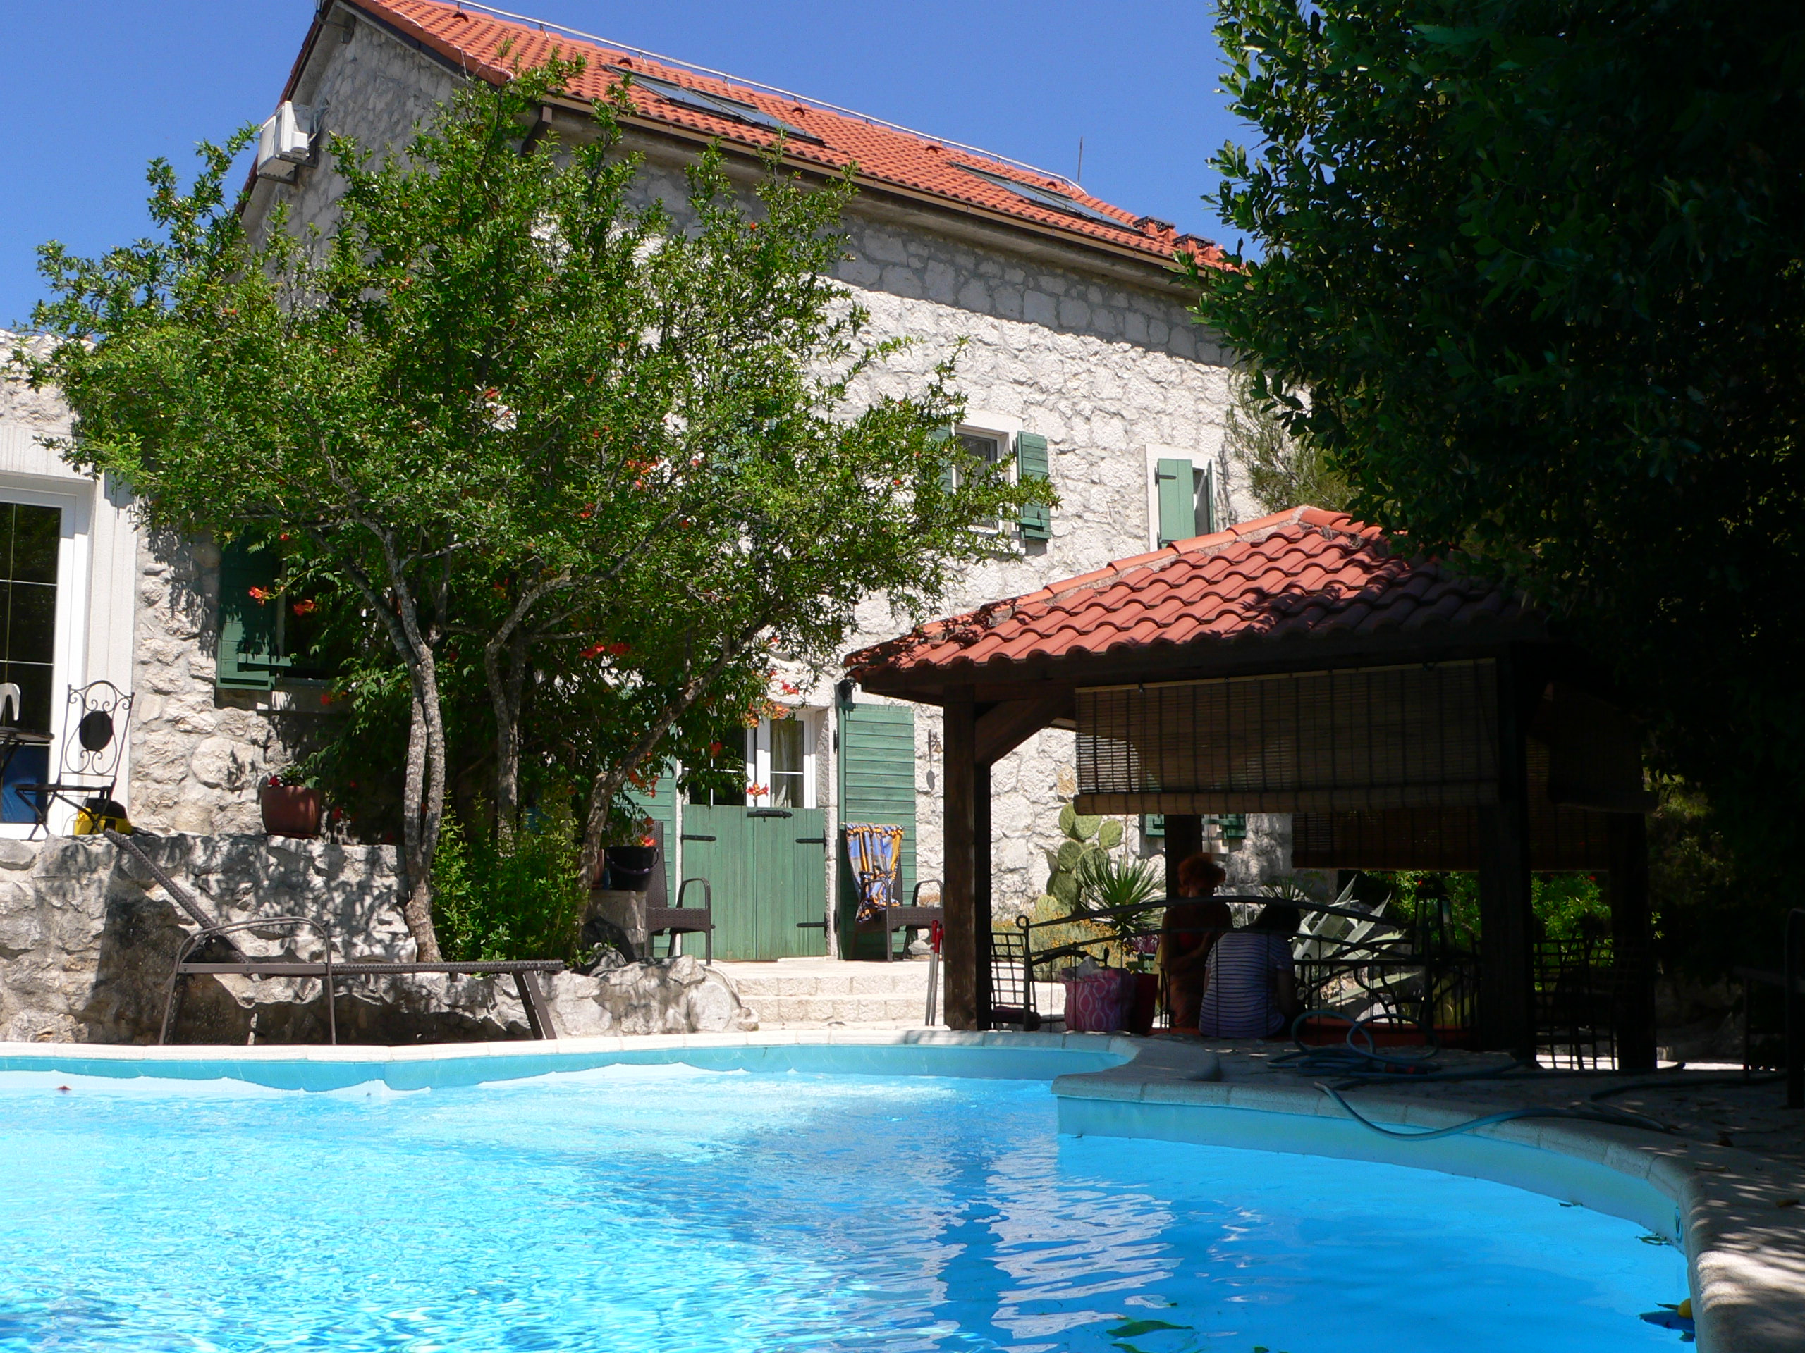
REVITALIZATION
Croatian coast is overbuilt
↓
Reconstruction of abandoned
villages in the inland
Notes:
The potential of the revitalization of abandoned villages in Croatia is only starting to be recognized. Considering that the Croatian coast has been overbuilt for years, the reconstruction of abandoned villages in the inland is becoming more and more popular as they are recognized as real oases of peace and relaxation.

Slide 14
REVITALIZATION
aims of spatial planning
Protection and preservation of valuable parts of the cultural heritage in a way that cultural heritage is not considered only as an element of identity of the village but also as an instrument that could contribute to its development.
Protection of existing natural values without which the settlement cannot function as a whole. Today, the landscape surrounding Velo Grablje is its own natural frame that should be mostly preserved as it is, meaning that any new unnecessary construction should be prevented. At the same time, the revitalization of traditional methods of agriculture should be supported, especially considering that they are the ones that shaped present-day appearance of the landscape.
Provision of space and corridors for traffic, energy, water management and other communal infrastructure, primarily reconstruction of existing roads and construction of new parking areas, reconstruction of pedestrian paths and reconstruction of existing infrastructure.
Planning the contents of public and social purpose and other public spaces according to the estimates of the current and future number of inhabitants as well as the number of visitors in the context of tourist revitalization.
Harmonization of public interest with the needs of owners and users of buildings and construction land.
↓
Future development based on agriculture, traditional crafts and tourism
Notes:
Velo Grablje will continue to develop as a settlement within the City of Hvar. Starting points for its development must be:
-
And with that preconditions for future development based on agriculture, traditional crafts and tourism could be created.

Slide 15
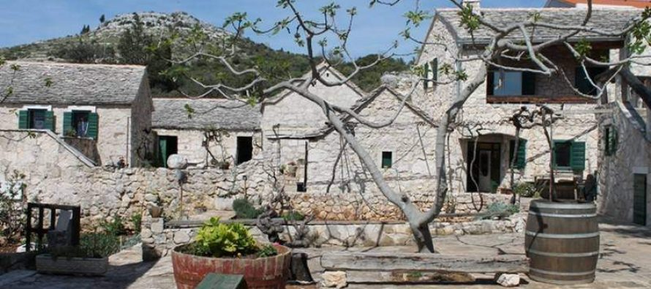
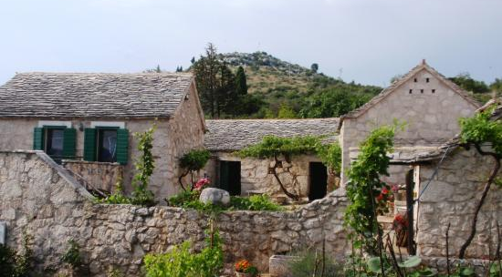
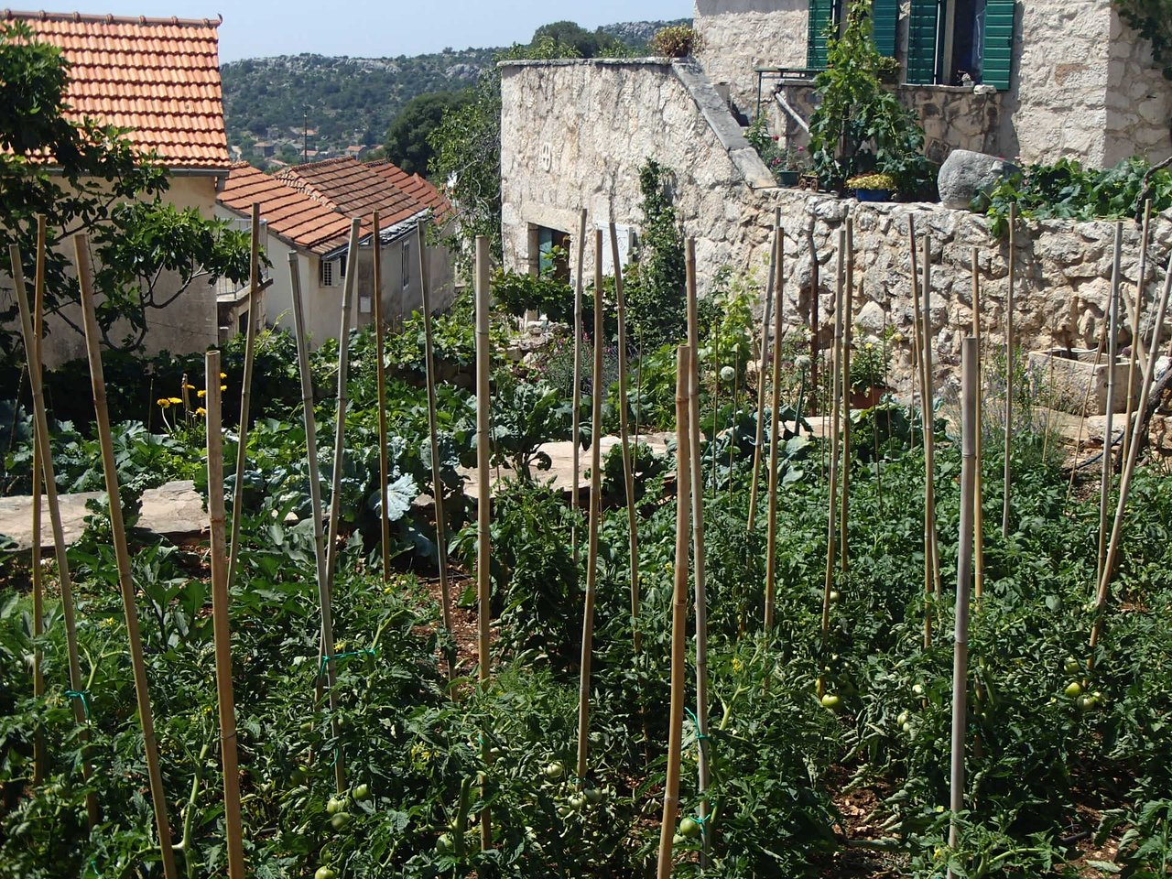
REVITALIZATION
tourism
Revitalization of old forms of intangible cultural heritage
Preservation of the ambience of traditional construction
Tourist accommodations in the City of Hvar and nearby settlements
Local museum – presentation of the village’s history and traditional crafts
Restoration of traditional annual traditions
Restoration of traditional agricultural skills
Preservation of autochthone appearance – authentic furniture and equipment in both interior and exterior
Revitalization example: Jurlinovi dvori, Šibenik, Croatia
Notes:
The tourist offer of Velo Grablje should be based on the rich traditional heritage with the elements of both material and intangible heritage being equally important.
-
Due to the uniqueness of the site and its content offer, any new construction could jeopardize the integrity of the village so one-day visits should be encouraged and tourists could be acommodated in the City of Hvar or nearby settlements.
-
Tourist offer in the village itself could be enriched with the restoration of ……..

Slide 16
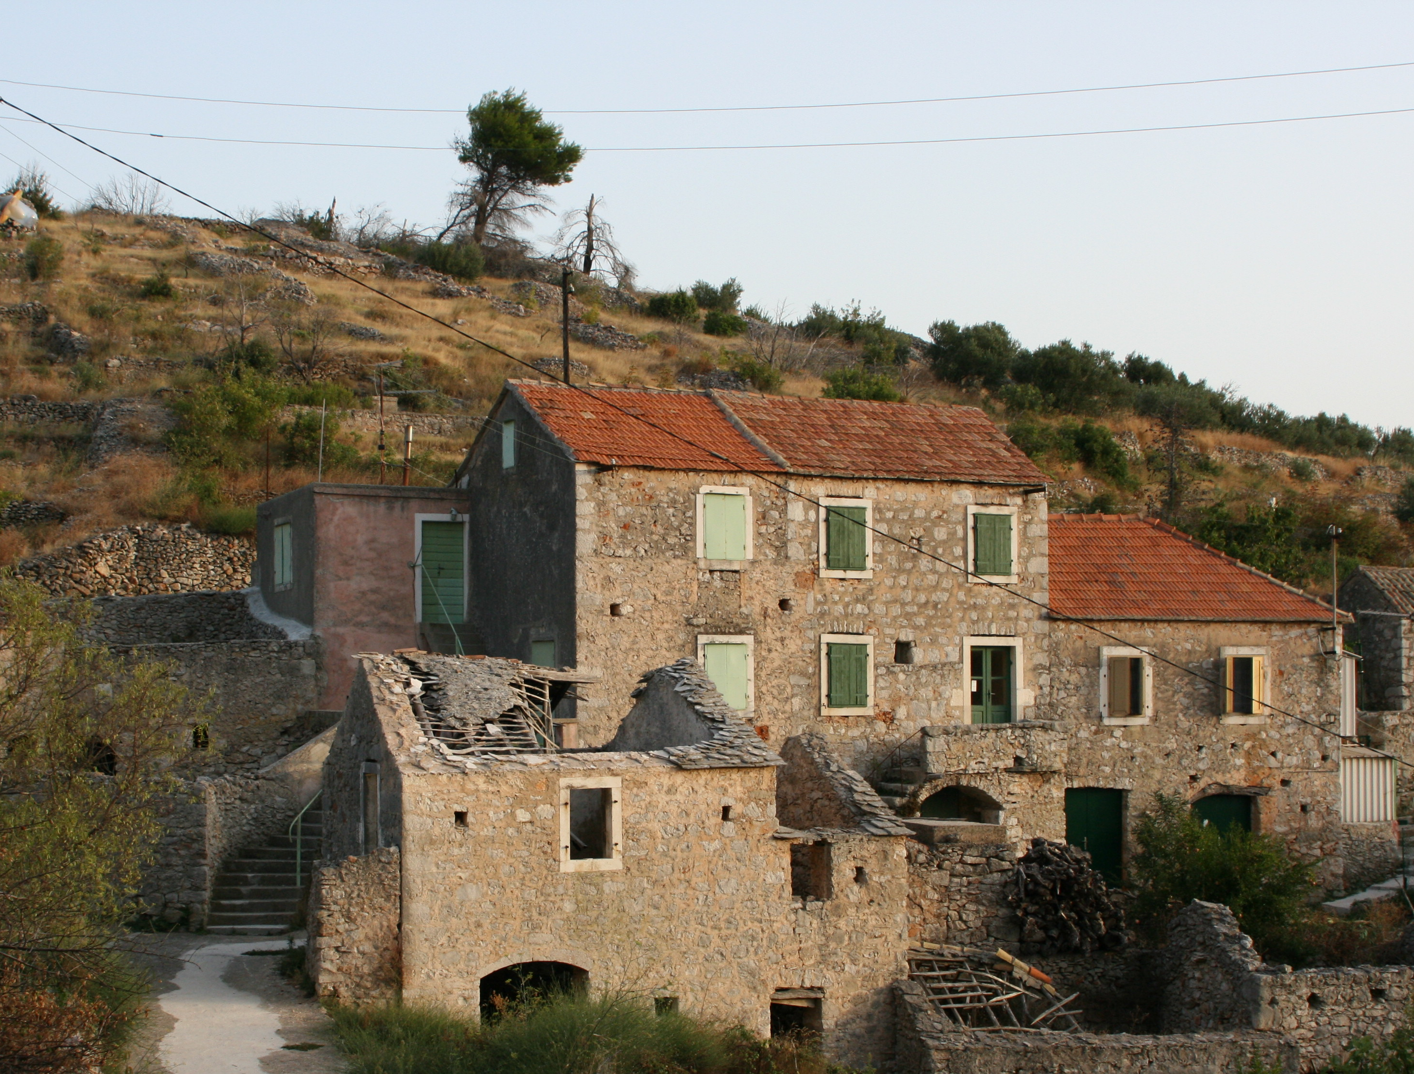
REVITALIZATION
reconstruction
1st step: creating basic living conditions in the village
Construction of basic infrastructure
Reconstruction of existing buildings
Notes:
Before thinking about the possible extension of the tourist offer of the island to Velo Grablje it is necessary to create the basic living conditions in the village. This is primarily related to the construction of the basic infrastructure and the reconstruction of existing buildings.

Slide 17
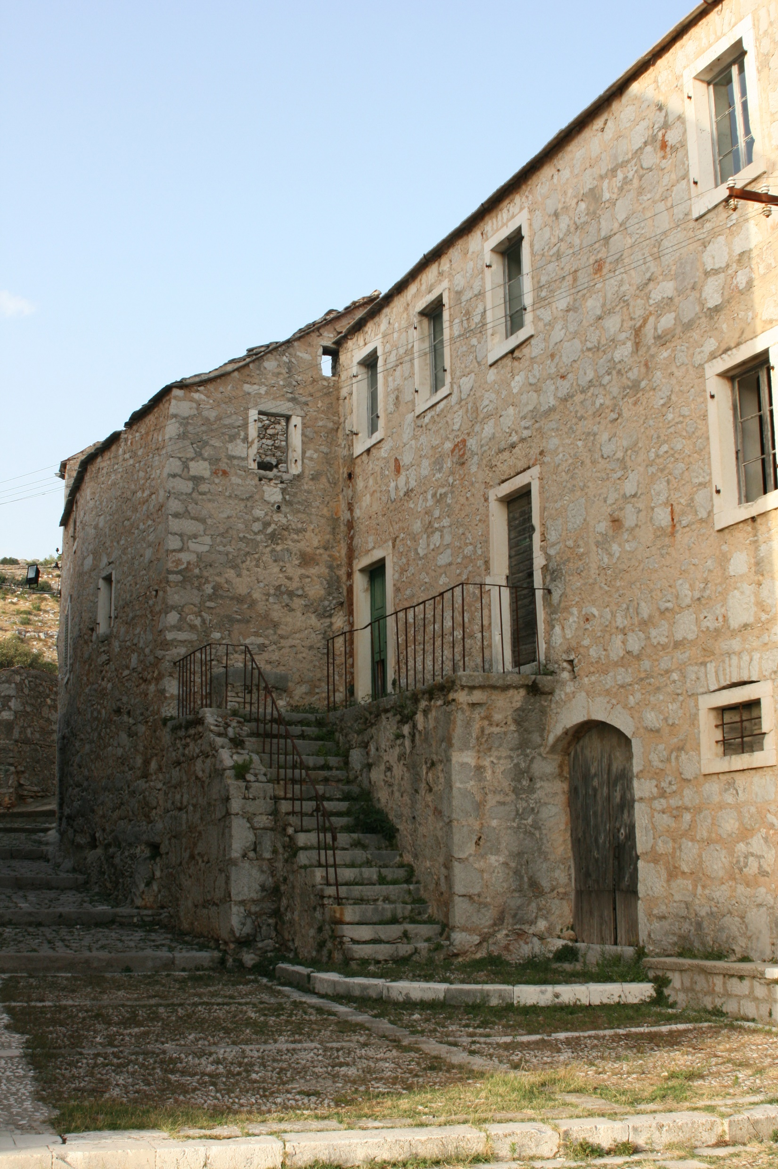
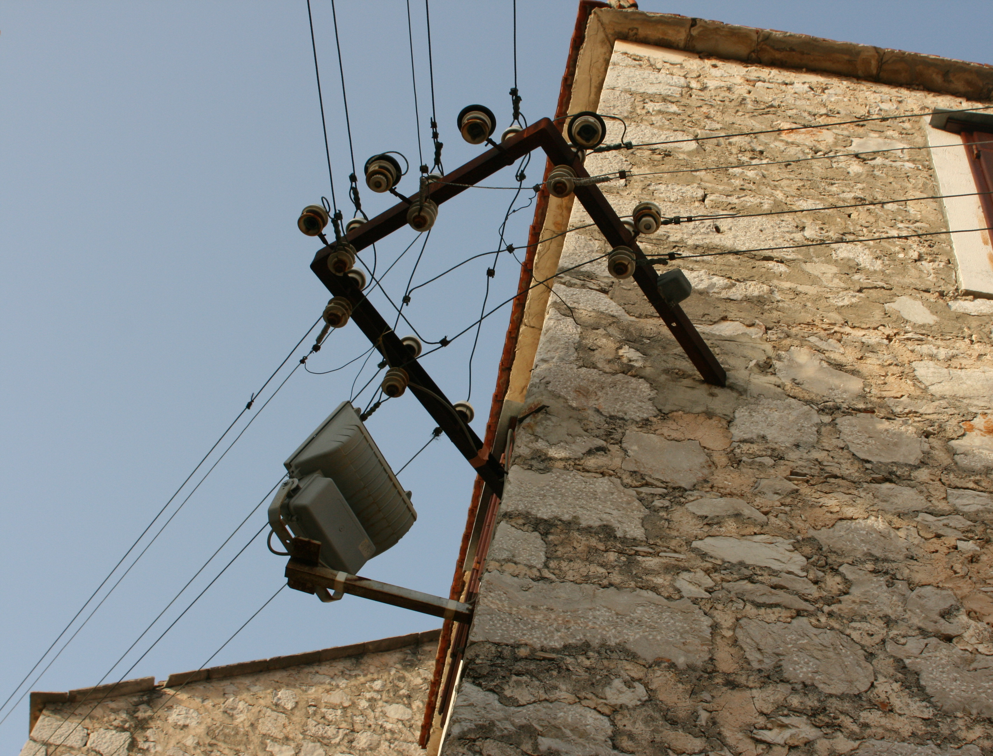
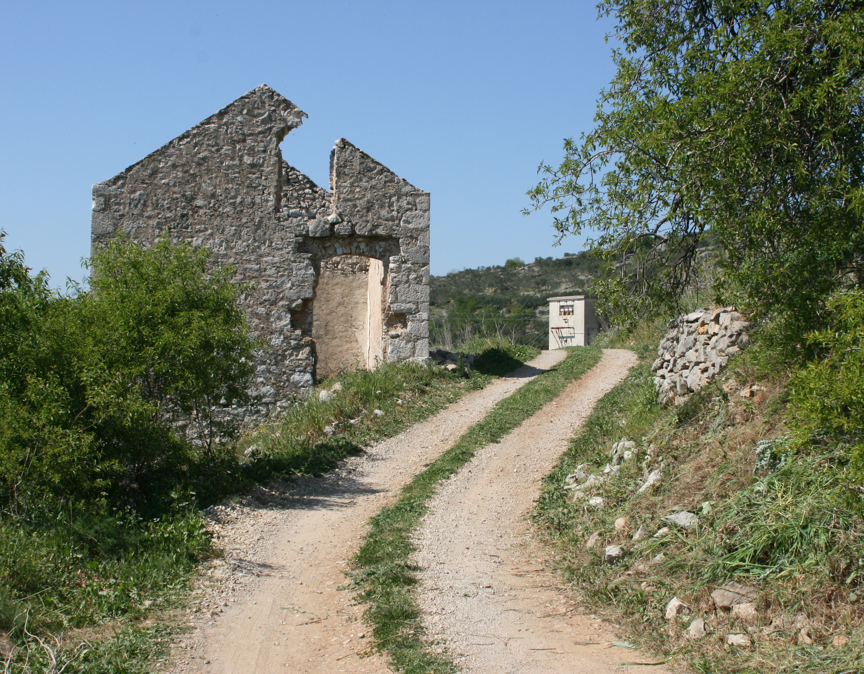
REVITALIZATION
infrastructure reconstruction
Provide enough space to accommodate traffic and communal infrastructure corridors
Primary focus: necessarily broadening of the communal network, construction of sewerage network
Traffic system:
Parking space
Accessibility for emergency vehicles
Pedestrian roads
Connect planned tourist info centres within each settlement – marked pedestrian and cycling paths
Notes:
One of the first steps in quality revitalization of this area is to provide sufficient space to accommodate traffic and communal infrastructure corridors and to plan a new infrastructure that would raise the quality of life in the village.
-
Traffic system should solve the problem of insufficient parking space, traffic accessibility for emergency vehicles and pedestrian roads within the densely built structure of the settlement
-
Velo Grablje should also be included in the system of marked pedestrian and cycling paths of the surrounding area, which should be logically connected to the planned tourist info centres within each settlement.

Slide 18
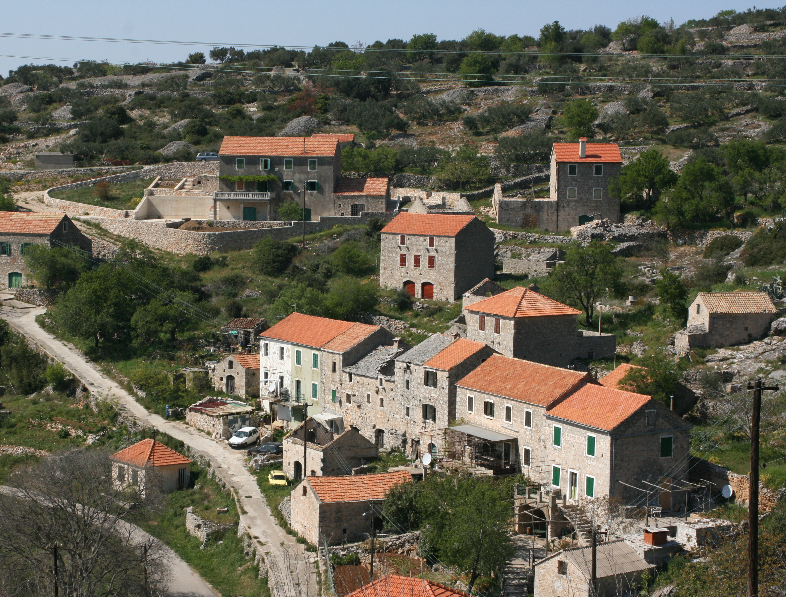
REVITALIZATION
buildings reconstruction
Rationality, logic, beauty
Reconstruction – through research and understanding of the construction techniques
Regular and ongoing maintenance avoids costly and destructive interventions if building are left to decay by inertia
Notes:
When reconstructing these structures, they need to be rebuilt in the spirit of the time in which they were built, which is primarily achievable through research and understanding of the construction techniques of the time.
-
Homeowners should be primarily educated about the benefits of regular and ongoing maintenance that extends the life of a building and avoids costly and destructive interventions if their homes are left to decay by inertia.

Slide 19
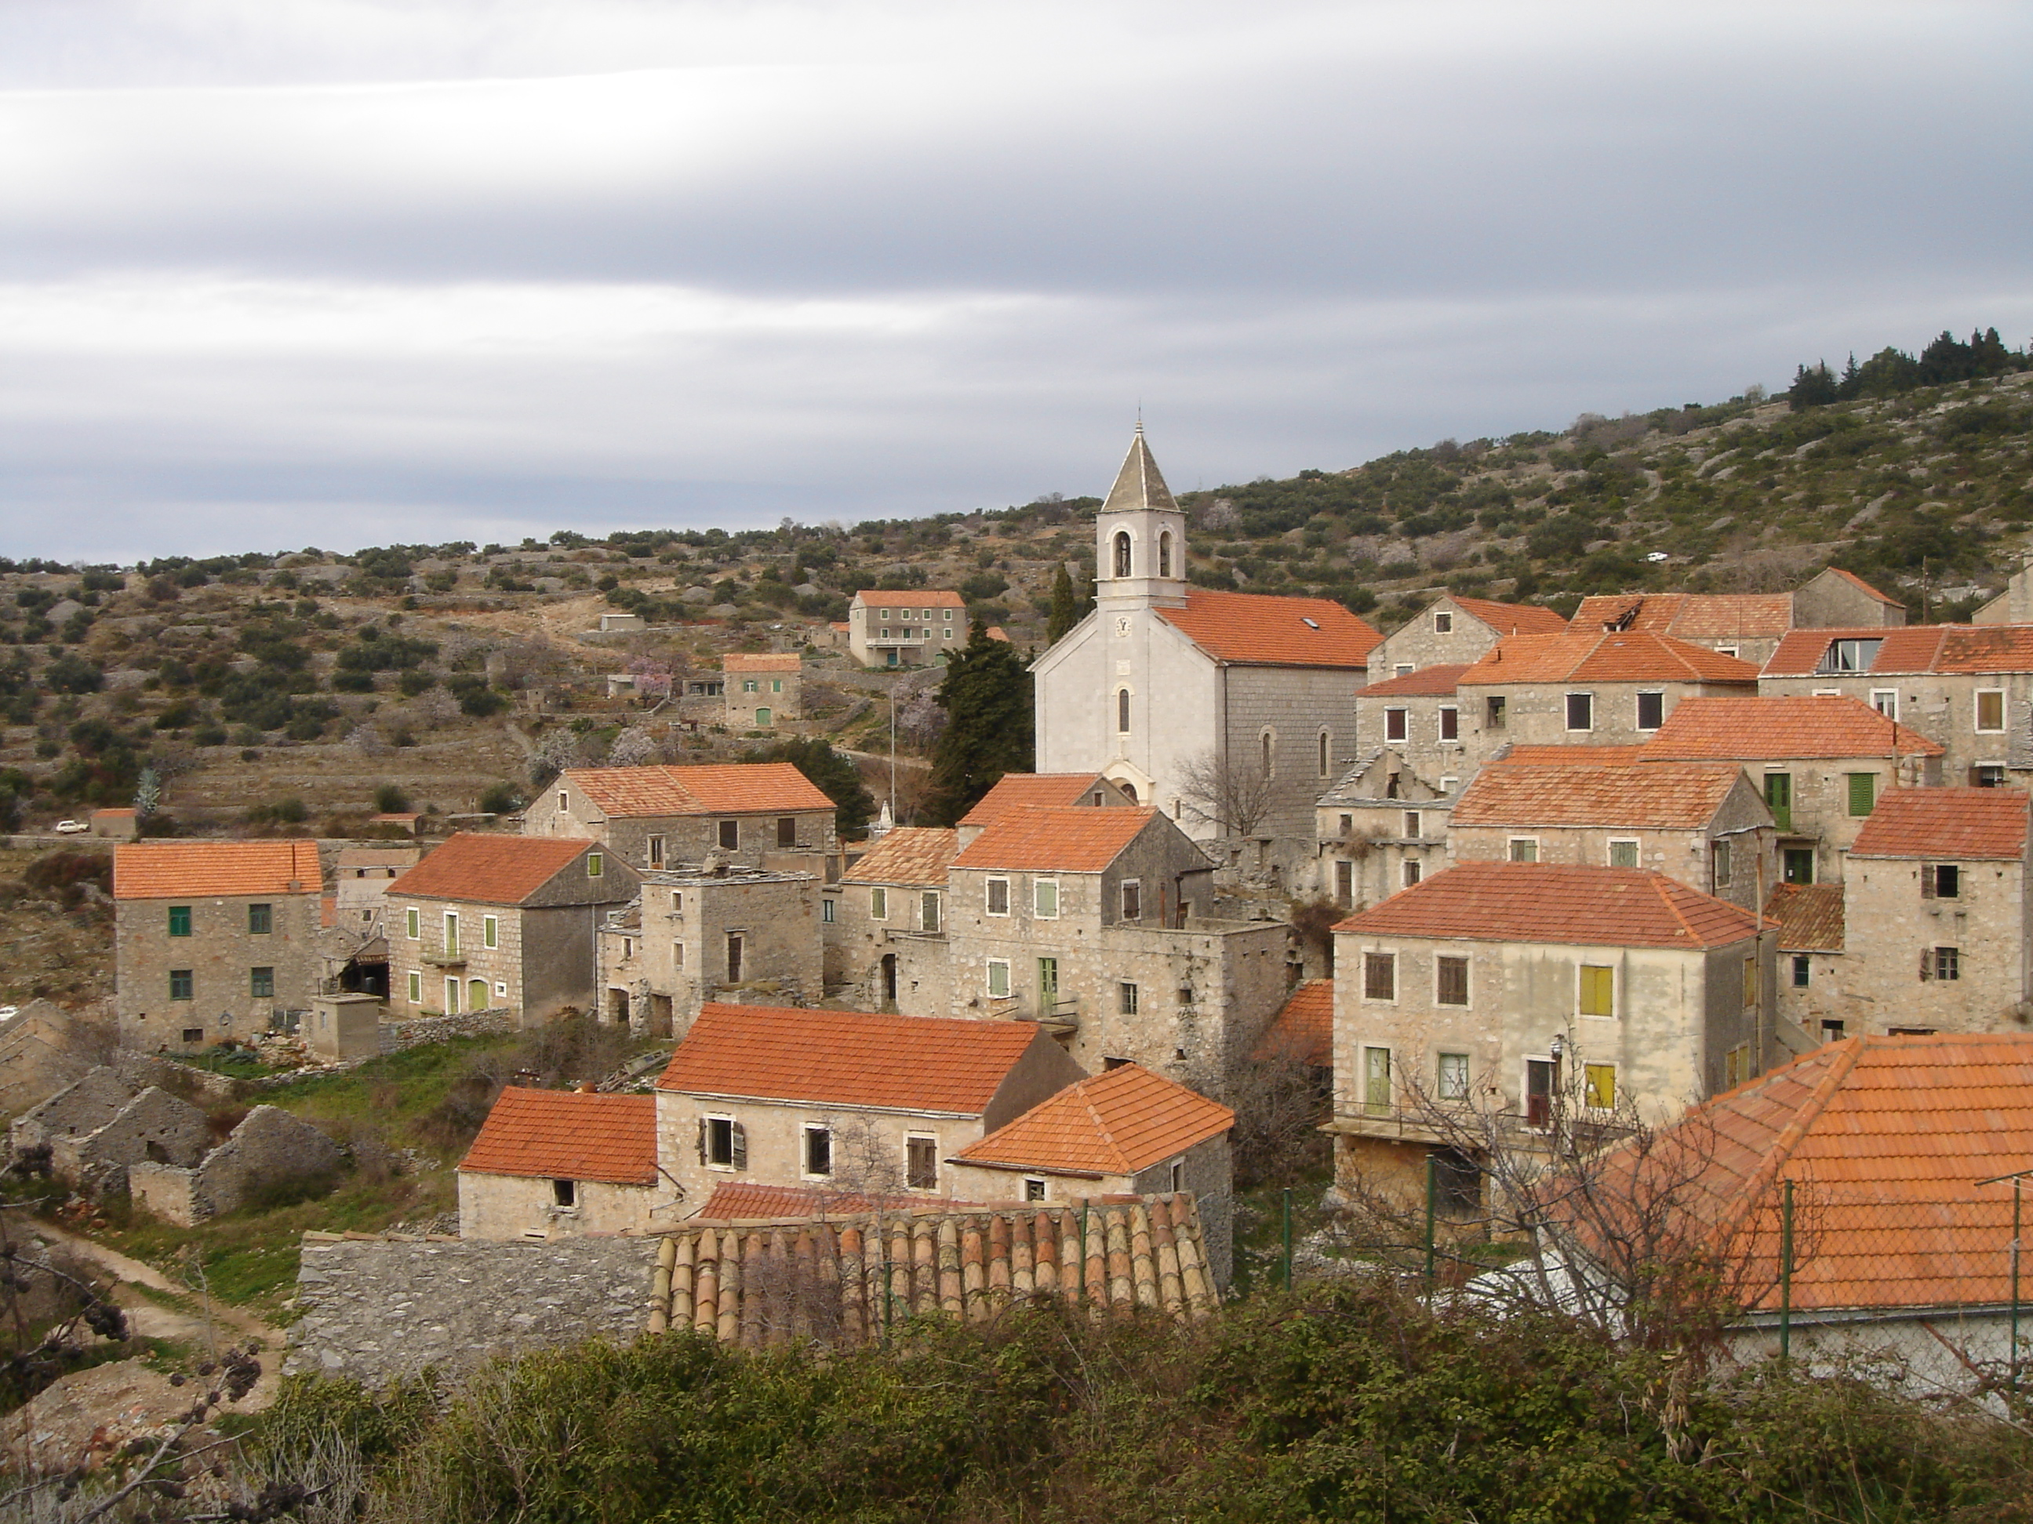
REVITALIZATION
buildings reconstruction
Keep the unified complex - adapt the necesary contents to the existing form
Architectural interventions in the village must not disturb the existing image of the village, but must adjust their dimensions to the existing structure
The interventions that are most difficult to correct are expensive and pretentious buildings that show that the basic problem of space devastation lies in not knowing the real meaning of local construction, and not in financial constraints
Limiting the accommodation capacity in the village itself and encouraging one-day visits by tourists located in the town of Hvar and in nearby locations with more tourist facilities
Notes:
Because the whole village is recognized as a unified complex, it is very important to adapt the necessary contents to the already existing form, and not the other way around.
-
One of the possibilities of preventing such outcomes may be limiting ………………….

Slide 20
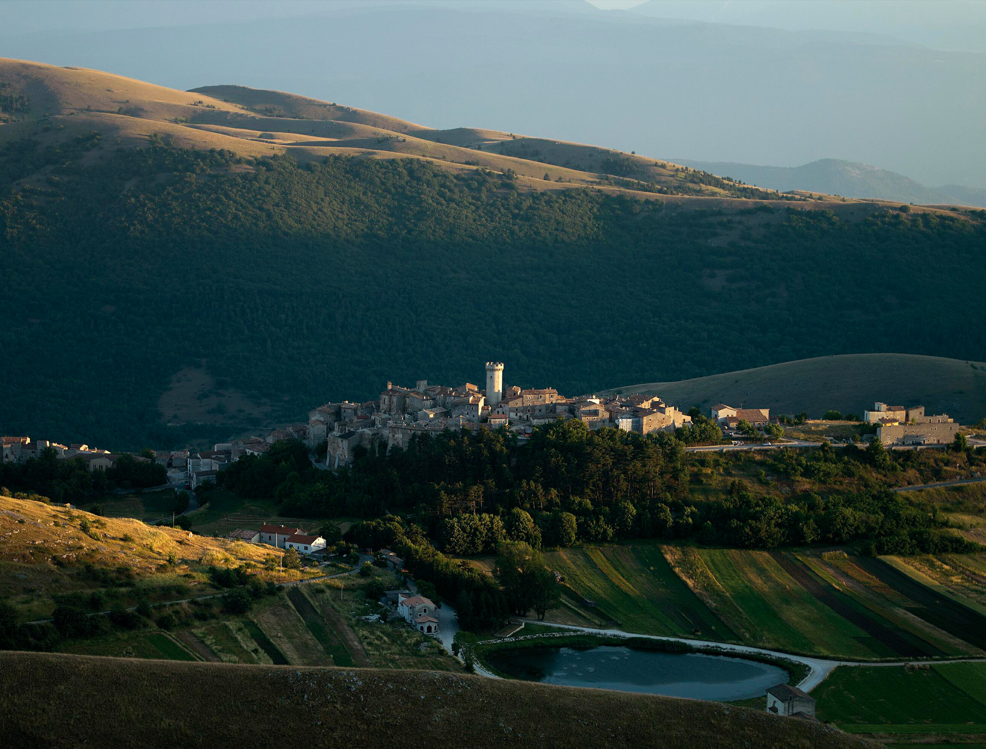
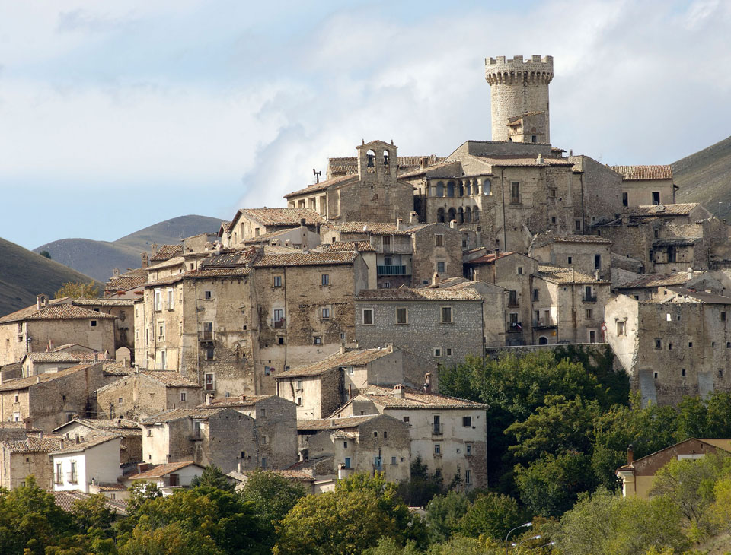
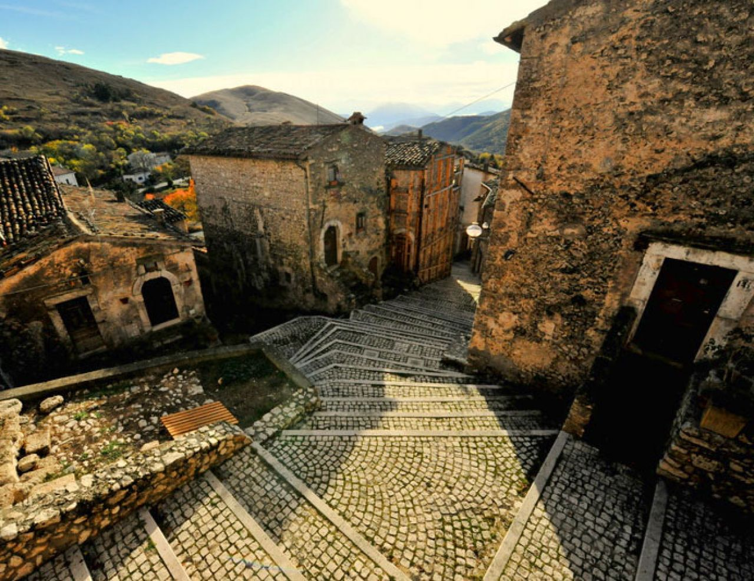
REVITALIZATION
Albergo Diffuso
Sextantio Albergo Diffuso, Santo Stefano di Sessanio
Dispersed hotel, scattered hotel…
Concept of hospitalty launched in Italy in early 1980s
Reviving small, historic villages and town centres off the usual tourist track
Experience of living in authentic towns and villages
Multiple owners, multiple objects - rooms distributed across multiple nearby buildings
Narrow roads replace corridors of traditional hotels
Notes:
Other option is to adapt the „albergo difuso” renovation approach.
-
One of the main characteristics of this concept are that multiple owners are included and the hotel is dispersed in multiple objects meaning that rooms are distributed across multiple nearby buildings and corridors of traditional hotels are replaced by narrow roads in the village itself.

Slide 21
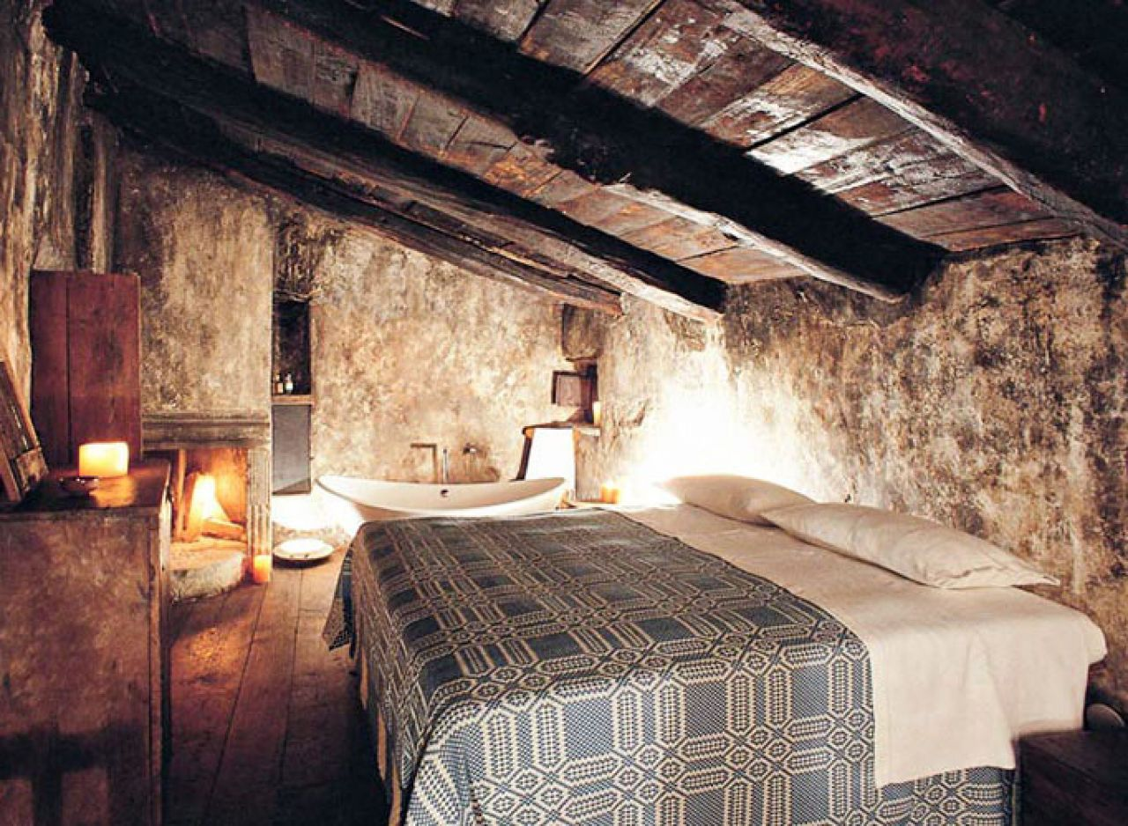
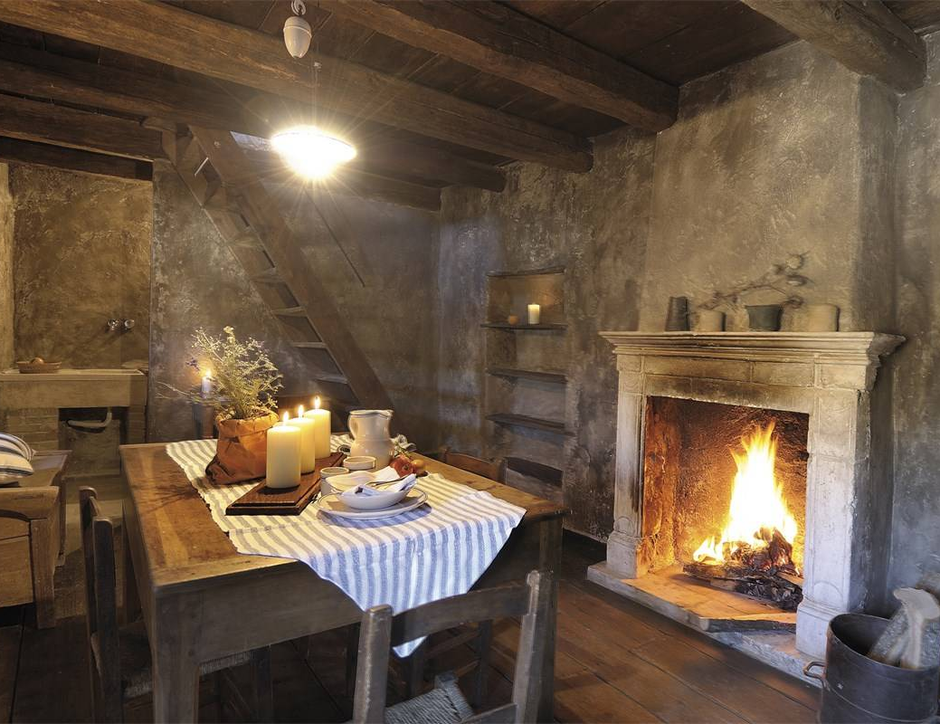
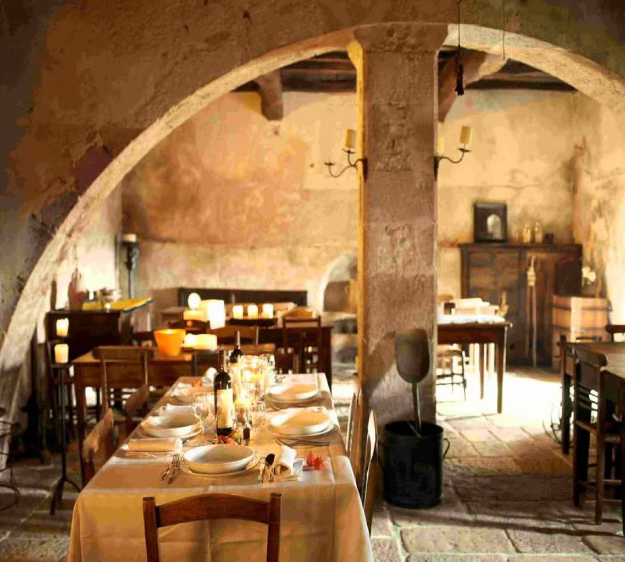
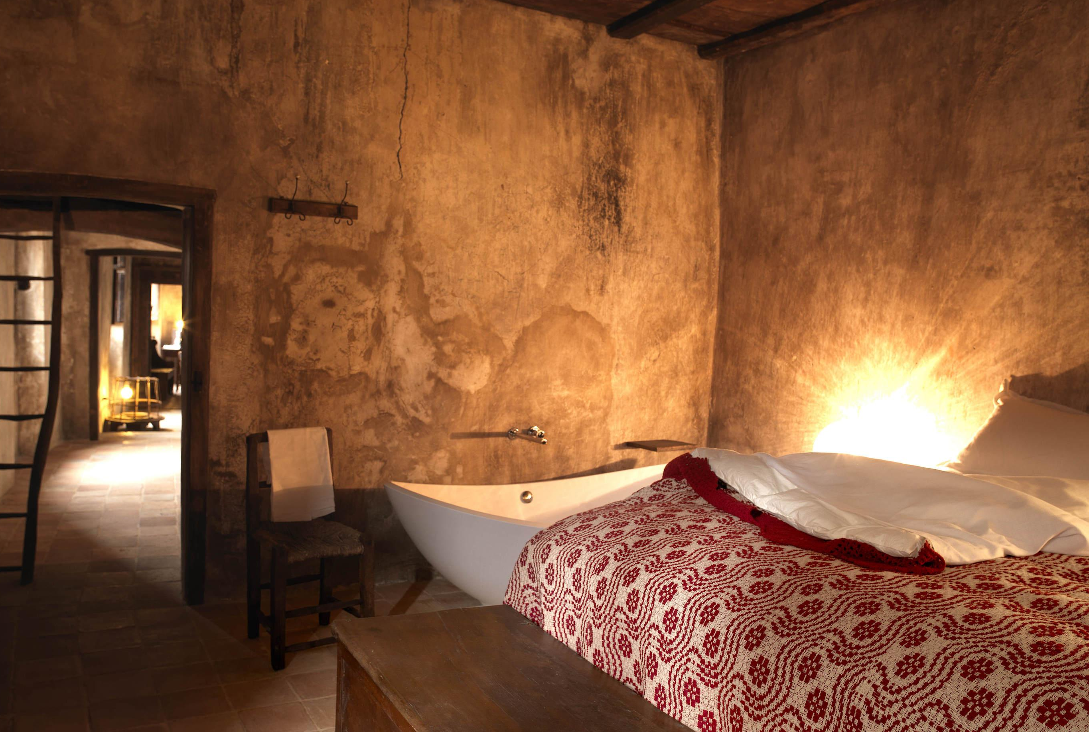
REVITALIZATION
Albergo Diffuso
Sextantio Albergo Diffuso, Santo Stefano di Sessanio
Stimulating the local economy
Promoting local culture – guests are offered an authentic local experience
Sustainabilty – no new construction = no pressure on the environment
Notes:
Main goals of this concept are to stimulate the local economy and to promote the local culture as the guests are offered an authentic local experience.
-
This is also a sustainable approach to revitalization of abandoned villages – with no new construction there is also no pressure on the environment.

Slide 22
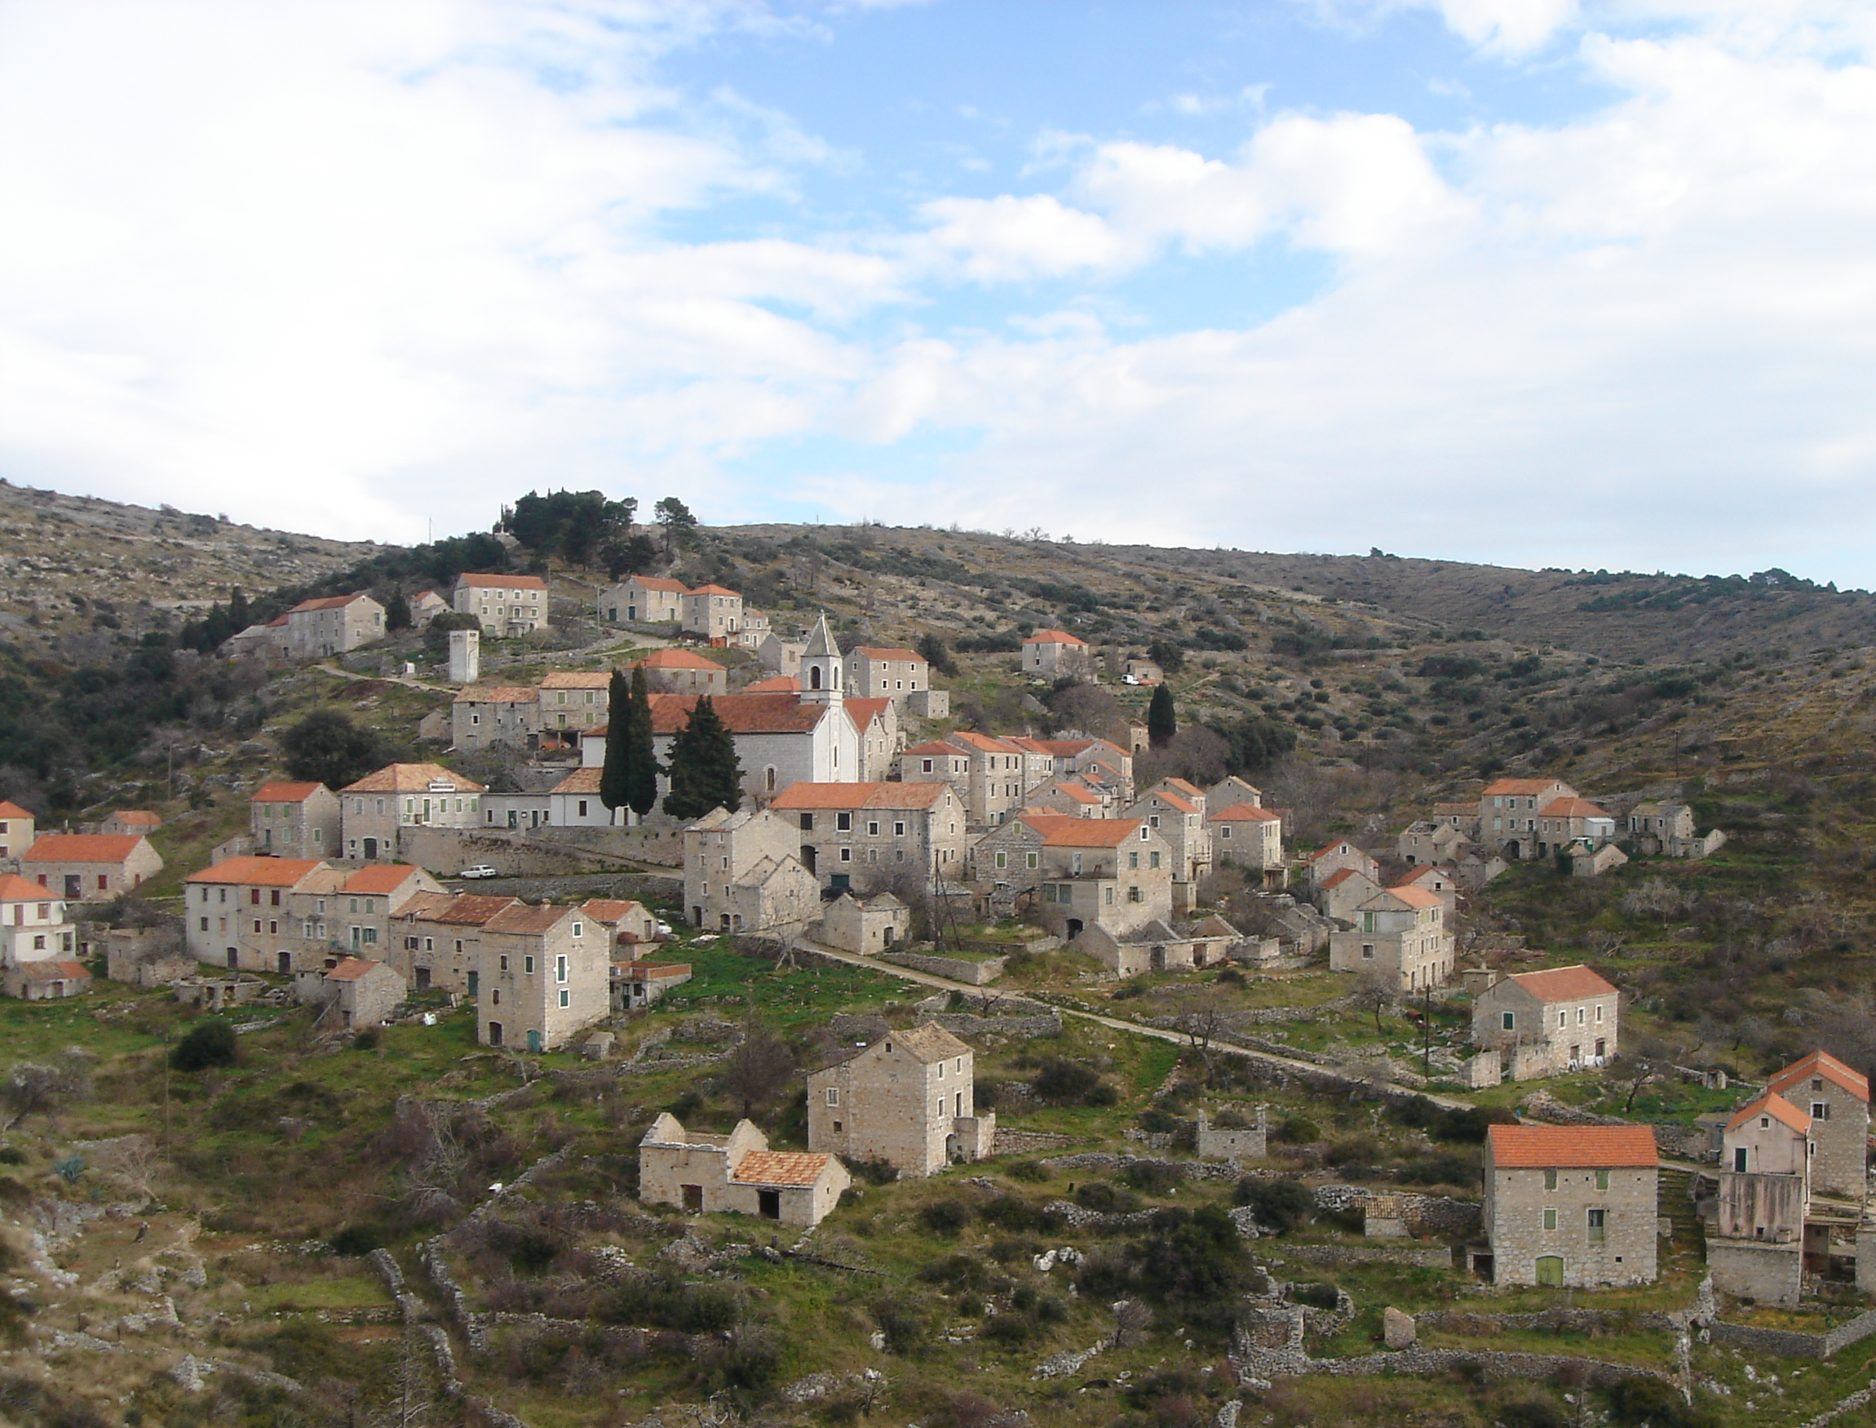
REVITALIZATION
Development vs. preservation of the existing state
Revitalization of Velo Grablje should be based on the authentic cultural, functional and aesthetic characteristics
Priority:
Building the communal infrastructure
Educate the residents and property owners about the importance of the protection of such cultural heritage site
Reconstruction and adaptation of existing objects to meet the needs of today’s life but at the same time remain authentic
Notes:
When restoring protected cultural goods, especially protected historical complex such as Velo Grablje, it is necessary to find the balance between the development and the preservation of the existing state. This is a very complex task because both are equally important and neither should be an obstacle for the other.

Slide 23
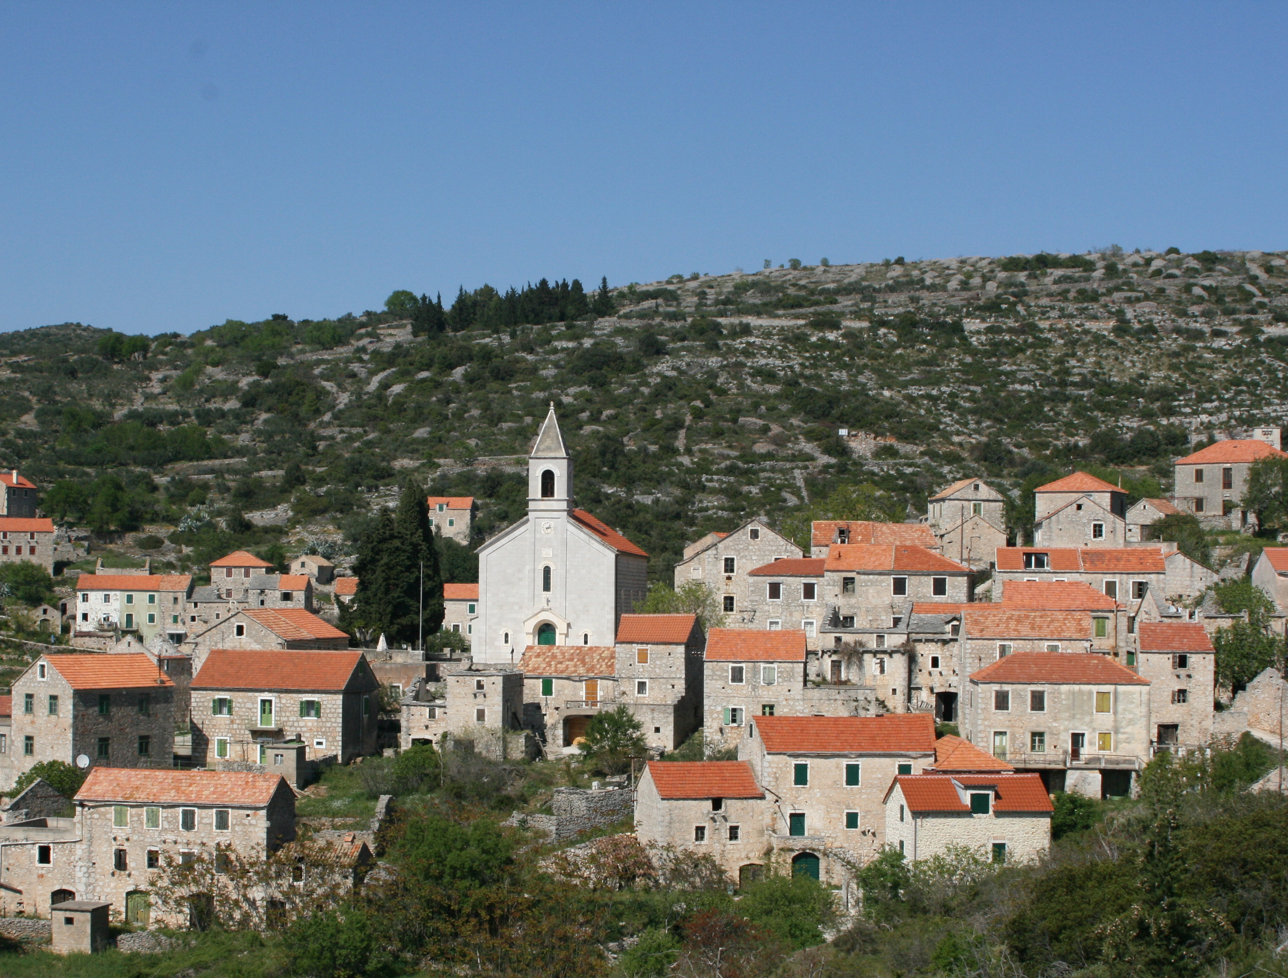
REVITALIZATION
Revitalization of Velo Grablje
↓
an attractive place
to live in
to visit
to invest in
Notes:
With all that in mind hopefully any future revitalization of Velo Grablje will make it an attractive place to live in, to visit and to invest in and maybe also serve as an example for future revitalizations of other abandoned villages.

Slide 24
Thank you for your attention! PLANNING ON THE EDGE OF EXISTENCE Case study of Velo Grablje, Island of Hvar
ECTP-CEU Young Planners Workshop 2019 & 13th Biennial of European Towns and Town Planners, Plymouth (U.K.), September 2019
Marijana Zlodre, mag.ing.arch.
m.zlodre@gmail.com
Association of Croatian urban planners
APE d.o.o., Zagreb, Croatia

