Slide 1



Marine Planning:
Terrestrial integration in England
Joe Smithyman

Slide 2
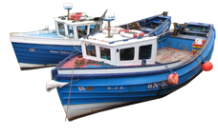
Overview
Marine Planning in England
MMO operational outlook to integration
Existing similarities
Case study
Forward thinking

Slide 3
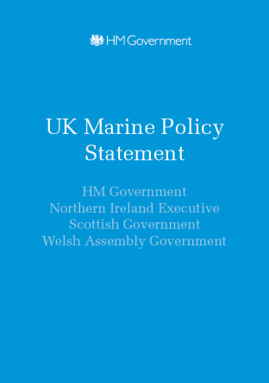
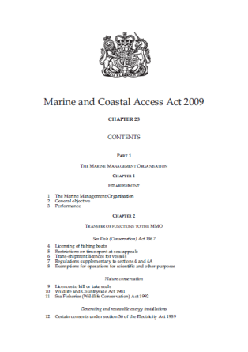
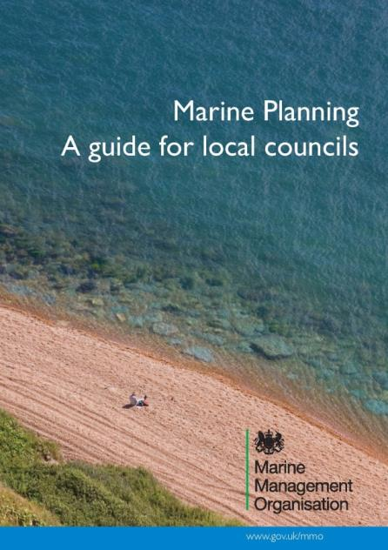
Legislation and Guidance
Notes:
Once adopted marine plans become statutory
They are underpinned by the marine and coastal access act and the marine policy statement
The guide for local councils provides a simple aid memoire for the process (this document is available online on the MMO website)

Slide 4
Legislative basis for marine planning and plans
MCAA
Marine and Coastal Access Act provides legislative basis for a marine planning system
MPS
Marine Policy Statement is the framework for marine plans and taking decisions
Marine Plans
Marine Plans (MMO) will translate the MPS into detailed policy and spatial guidance for each Marine Plan area to guide and direct decision-making
  Public authorities (not just the MMO) must take account of the plans (in various ways) when making decisions (MACAA s58)
Effect

Slide 5
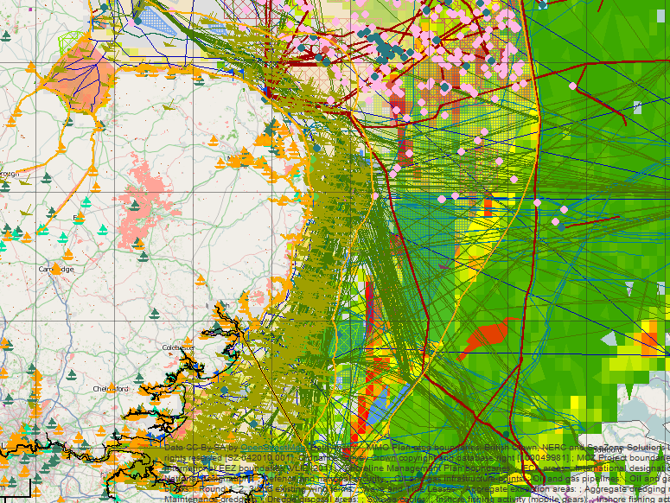

Why marine planning?
Overarching driver – increasing use of marine space and resources (economic growth) without impacting on the sustainability of the marine environment

Slide 6
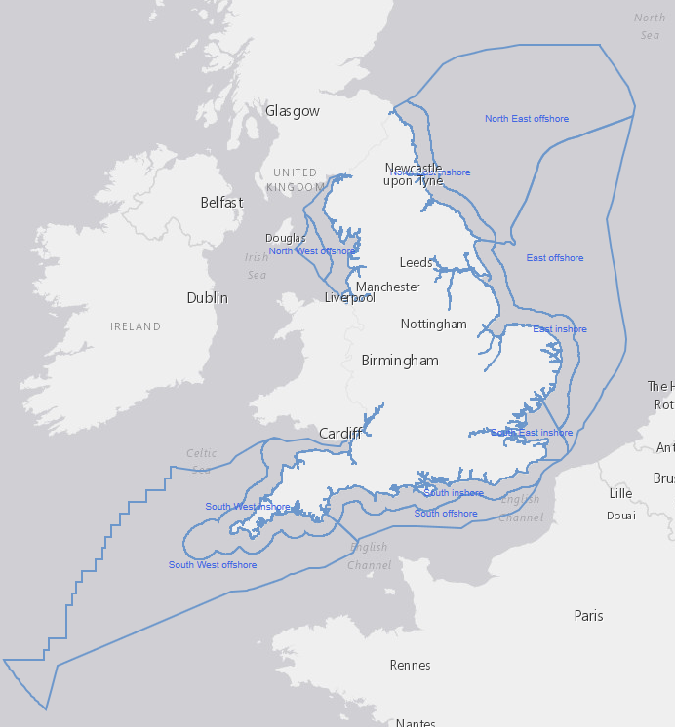
Marine Plan Areas
11 plan areas
Covered in 6 marine plans
Inshore (MHWS or tidal limit – 12nm)
Offshore (12nm – 200nm or territorial limit)
20 year horizon
Notes:
This is the English marine plan area, it is made up of 11 plans (inshore and offshore) and covers 6 plan areas.
It covers approx 231,000 km2
The inshore area is from HWS and the tidal limit up rivers out to 12nm
The offshore plan extends from 12nm to 200nm or the territorial limit

Slide 7
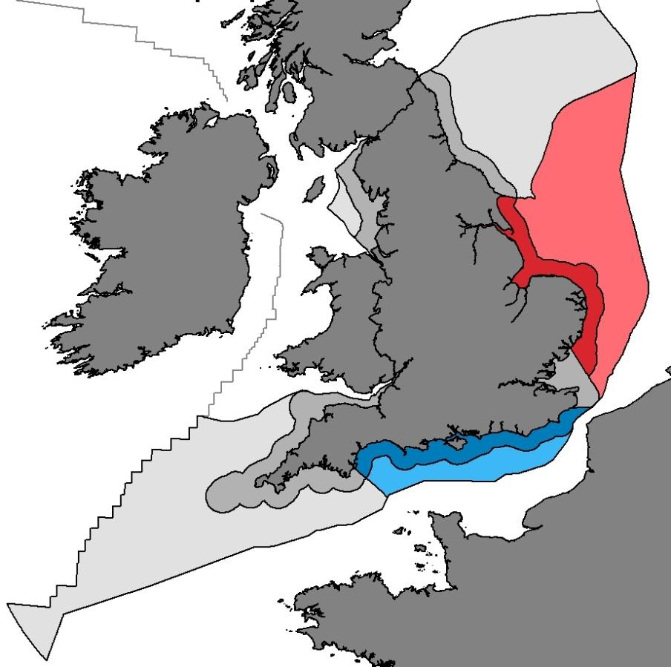
Progress to date
East Inshore and Offshore adopted April 2014
South Inshore and Offshore adopted July 2018
Notes:
As per slide

Slide 8
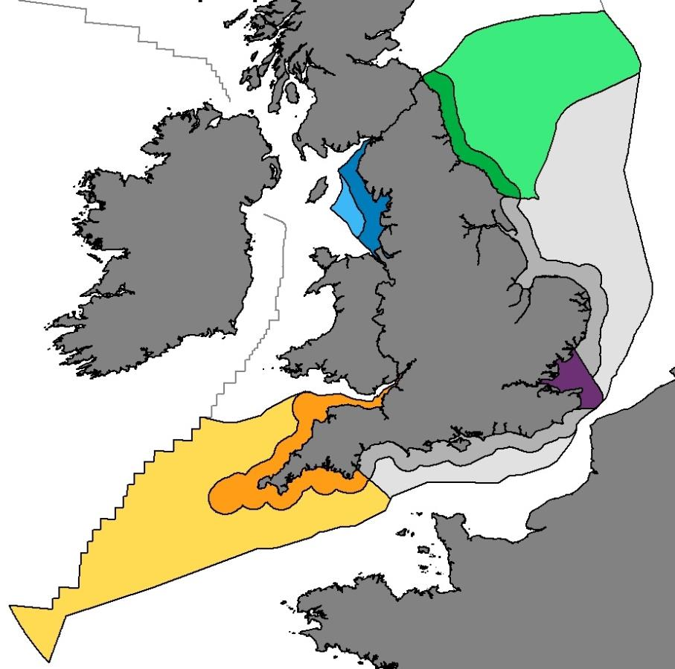
Developing new plan areas
NE, SE, SW, NW developed concurrently
Publish all by 2021*
Iterative approach- Iteration 3, Summer 2018 – Spring 2019
NE
* Adoption by 2021. Aim for June 2020 for contingency, or any Independent Investigation if required
Notes:
As per slide

Slide 9

Operational linkages

Slide 10
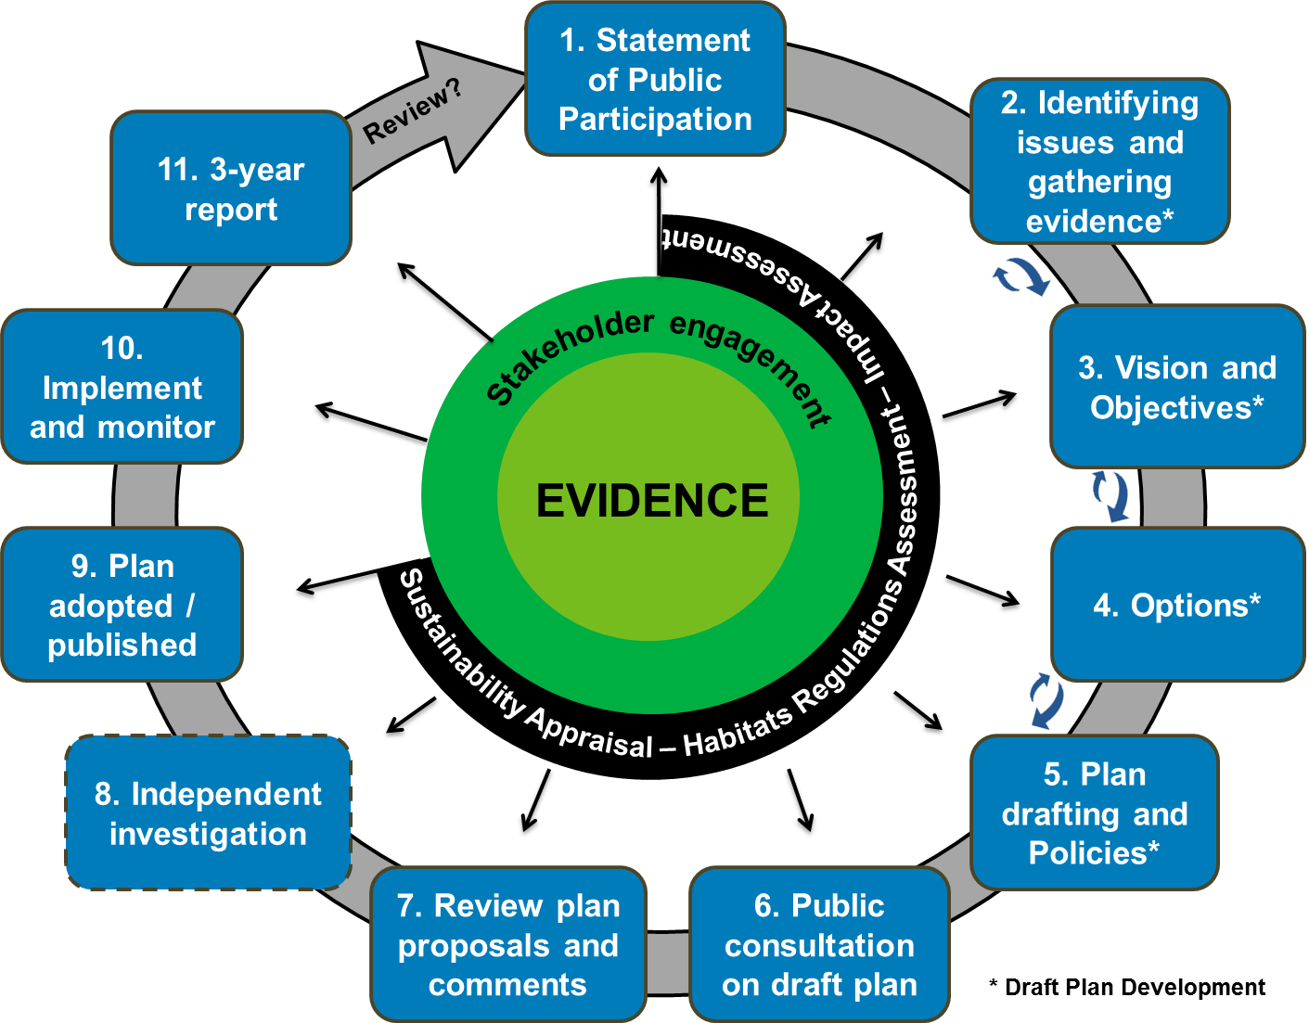
Marine planning cycle
34
18
26
25
24
23
Iterations
22
20
19
Notes:
-This slide shows the marine planning process.
-It is underpinned by evidence and stakeholder engagement.
Show link to terrestrial planning in terms of reg 18, 19

Slide 11
Stakeholder engagement
Aquaculture &Fisheries
Energy production & infrastructure development
OGDs
Defra
Devolved Admini-strations
Marine Aggregates / Dredging & disposal
Tourism & Recreation
The Crown Estate
Government
International
Bordering Countries
Ports & Shipping
Marine Conservation (including MCZs)
Industry & Sector groups/
individuals
Stakeholder Engagement
Stakeholder Focus Group
Coastal Partnerships
Subsea Cables – Power/
Telecoms
Local Authorities, AONB, National Parks, LEPs
Local Government
Delivery Partners
Academia
NGOs
Defence & National Security
Waster water treatment & disposal
Local Government Association (LGA)
MPs and Elected Members
General Public
IFCAs
Notes:
State that government – national level, local government – local level
Industry/sector reps – both national and local
SFG – national
Coastal partnerships – local
NGOs – both
Academia – both
IFCAs – local
Public – local
Delivery partners - local /national

Slide 12
Role Functions
Coastal Marine Planners in all marine plan areas around England
Stakeholder engagement – High level engagement included
Coastal Partnerships/Coastal Groups/Local Authority Groups
Respond to local plan consultations and strategies where appropriate
RTPI Involvement
Notes:
Operational links to integration
Links to MHCLG, Defra

Slide 13

Existing similarities

Slide 14
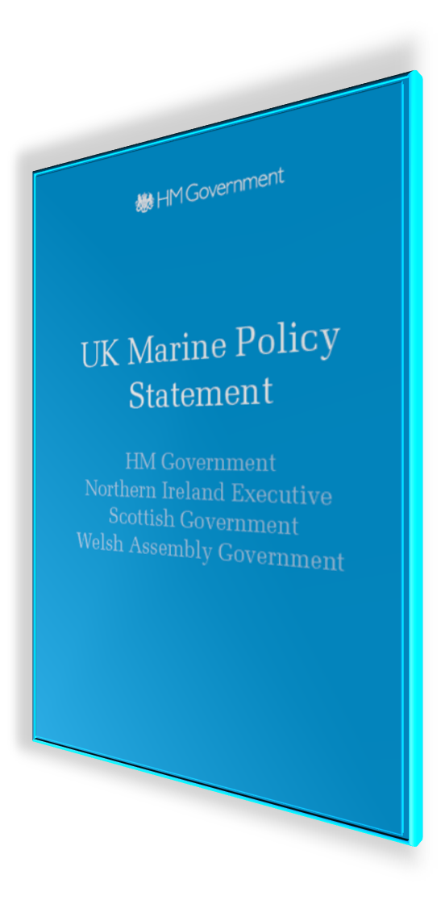
Marine policy statement
1.3.1 The MPS and marine planning systems will sit alongside and interact with existing planning regimes across the UK. These include town and country planning and other legislation, guidance and development plans in each Administration. In England and Wales this also includes the development consent order regime for nationally significant infrastructure projects (NSIPs).

Slide 15
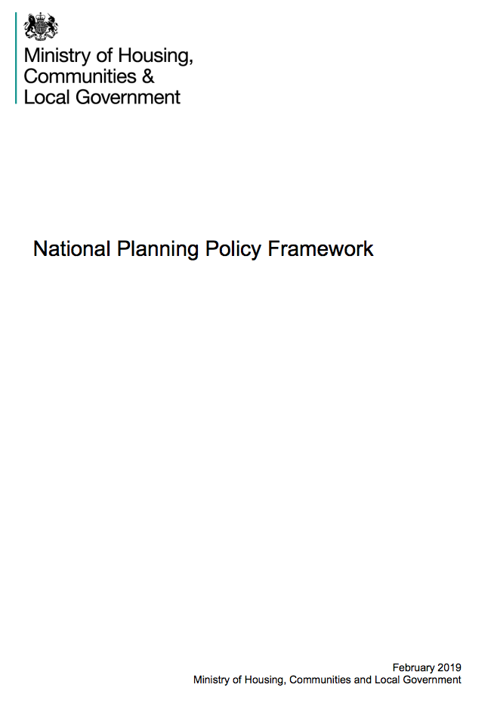
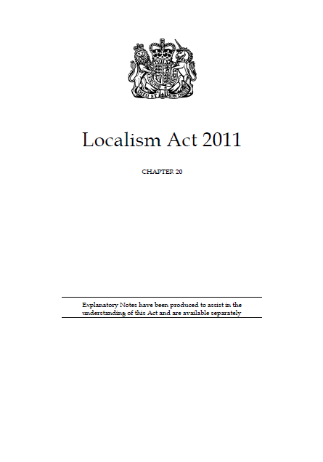
Links to other government documents
Notes:
Paragraph 166

Slide 16
Duty to cooperate
The Marine and Coastal Access Act 2009 requires the marine plan authority to notify local planning authorities of its intention to prepare a marine plan, whose area of jurisdiction adjoins the marine plan area
Marine plan area boundaries extend up to the level of mean high water spring tides while terrestrial planning boundaries generally extend to mean low water spring tides, the marine plan area physically overlaps with terrestrial plans

Slide 17
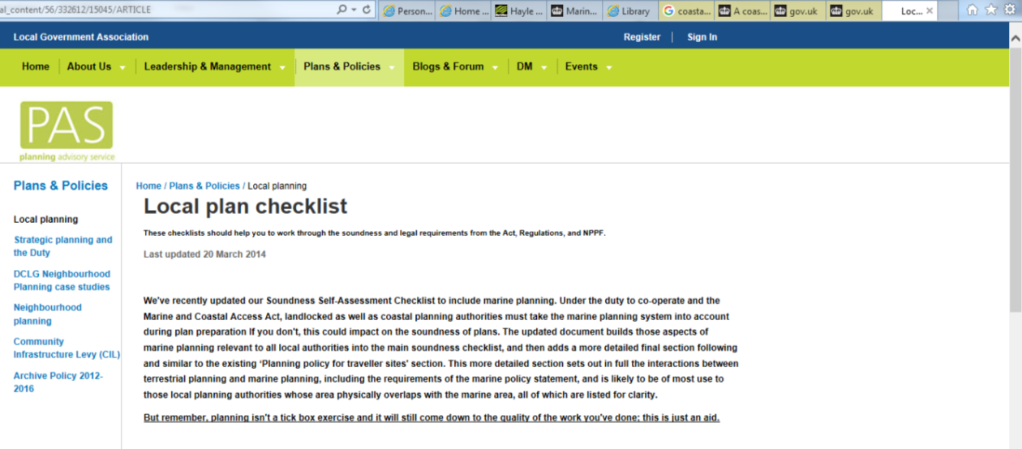
The overlap, and the Duty to Co-operate
The overlap ensures that marine and land planning will address the whole of the marine and terrestrial environments respectively.
Localism Act 2011; Section 110 parts 1-3
PAS checklist
Notes:
The overlap ensures that marine and land planning will address the whole of the marine and terrestrial environments respectively.
The localism act places a duty on Local Authorities and public bodies to engage to maximise the effectiveness of local and marine plan preparation.
The marine and coastal access act requires marine plan authorities to engage with LAs
These duties ensure that marine and land planning jointly address marine and land matters in a consistent way.

Slide 18
Coastal Concordat
Defra 25YEP – All Local Authorities signed up by 2021
An approach to align separate processes
Streamlines development in the intertidal area (overlap)
When a application/proposal comes into a decision-maker i.e Local Authority

Slide 19
Statements of Common Ground
Step change in NPPF
2012 - In marine areas, local planning authorities should collaborate with the Marine Management Organisation to ensure that policies across the land/sea boundary are integrated
2018/2019 27. In order to demonstrate effective and on-going joint working, strategic policymaking authorities should prepare and maintain one or more statements of common ground, documenting the cross-boundary matters being addressed and progress in cooperating to address these. These should be produced using the approach set out in national planning guidance, and be made publicly available throughout the plan-making process to provide transparency
Notes:
Local Authority planners are actively seeking us out rather than us always going to them. Retained knowledge of marine planning.

Slide 20
Marine planning and licensing in context
Planning policy including terrestrial plan development
Development management (planning applications)
Mean High Water Springs
Marine planning including development of marine plans
Marine licensing (licensing applications)
Mean Low Water Springs
Notes:
This slide shows marine planning and licensing in context with terrestrial planning
There are cross over responsibilities between terrestrial and marine regimes
Terrestrial planning extends down to low water springs and marine planning extends up to high water springs – there is an area of overlap between the two.

Slide 21
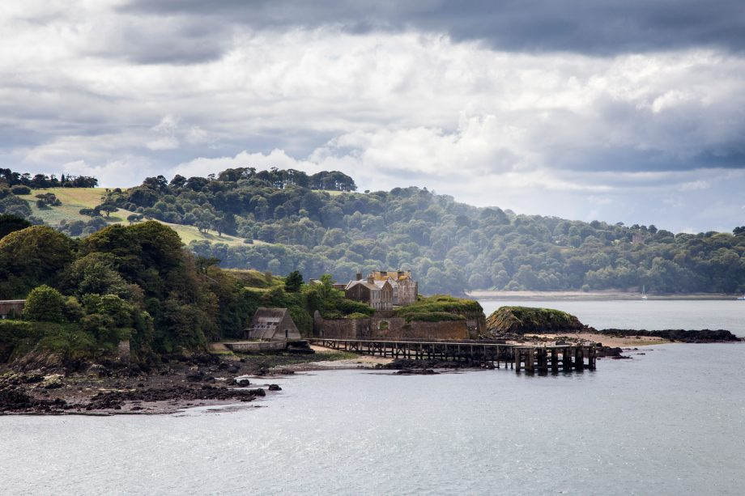
Case study

Slide 22
Local Plans
Waveney – WLP 2.1 “The Policy helps support the objectives of the East Marine Plan and is consistent with East Marine Plan policies EC3 and WIND1 and WIND2. These policies and the objectives of the East Marine Plan should be considered in developing proposals in this area”
Suffolk Coastal – 10.10 “Development proposals located in coastal, riverine and estuarine areas should have regard for the cumulative impact of development on biodiversity and the ecosystem services it provides, particularly in relation to coastal and marine protected areas. This will help to contribute to an ecosystem based approach; a common approach taken in the marine planning sphere”
Notes:
East Marine Plan area. Suffolk Coastal district was merged with Waveney district on 1 April 2019 to form the new East Suffolk district.^{[2]}

Slide 23

Future Integration : Transformation

Slide 24
Digital
PlanTech across systems
Digitisation can heighten accessibility and usage
Key tools for coastal development
Automation of certain planning/licensing processes

Slide 25
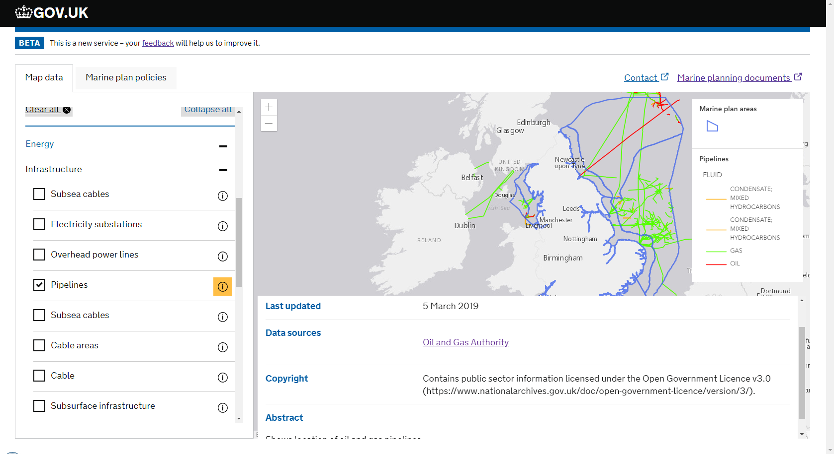
Explore Marine Plans
Notes:
Planning in itself is a detailed document industry. It has to be with statutory documents such as plans either local or marine for example. However, the use of these plans either by applicants, decision makers, interested parties is limited

Slide 26
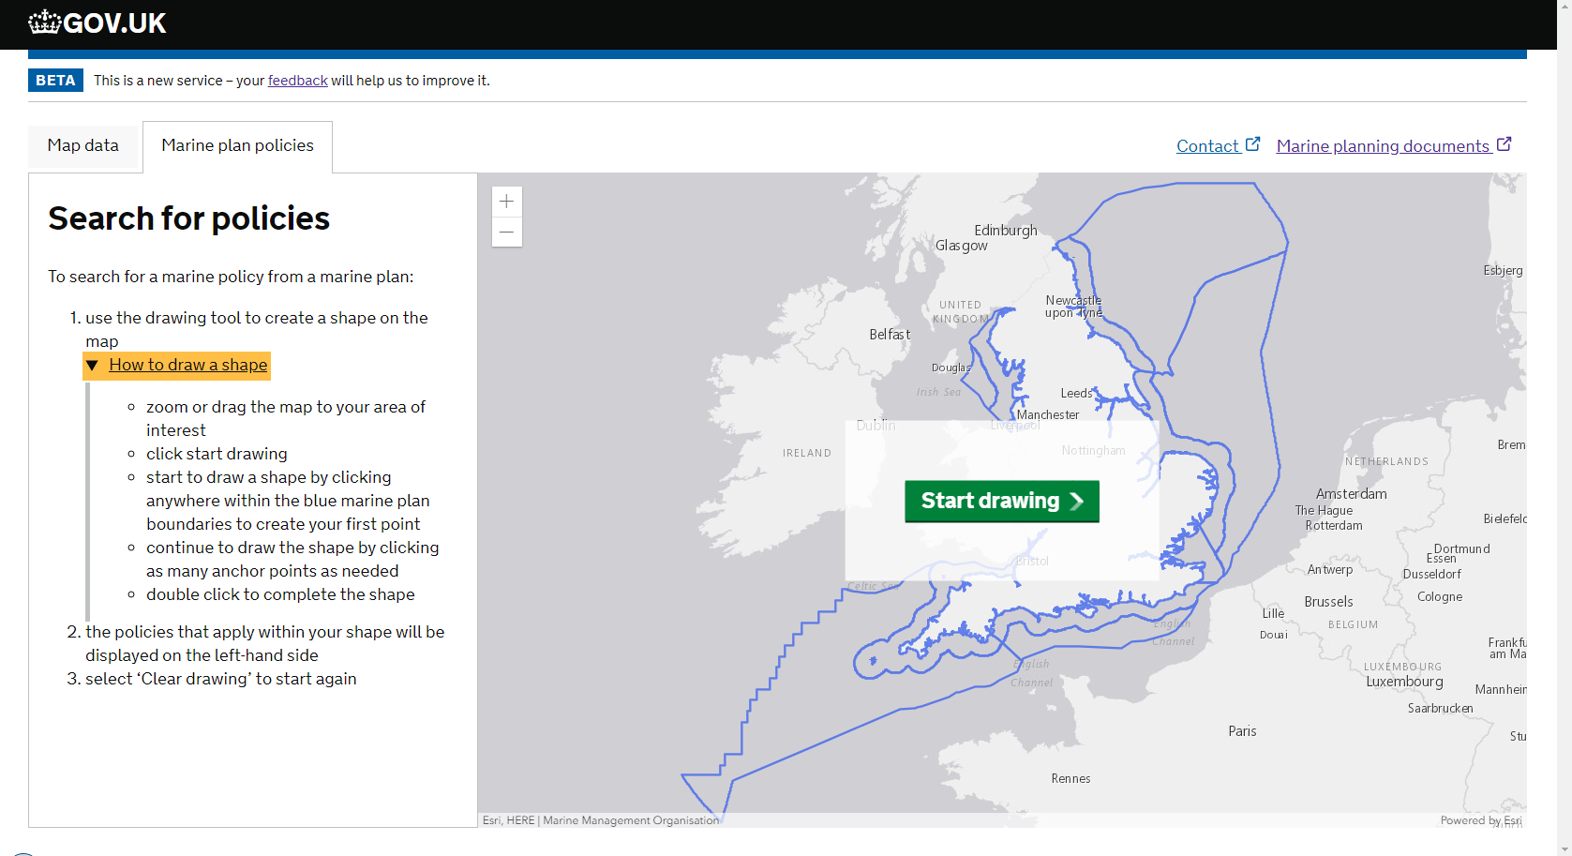
Explore Marine Plans
Notes:
Planning in itself is a detailed document industry. It has to be with statutory documents such as plans either local or marine for example. However, the use of these plans either by applicants, decision makers, interested parties is limited

Slide 27
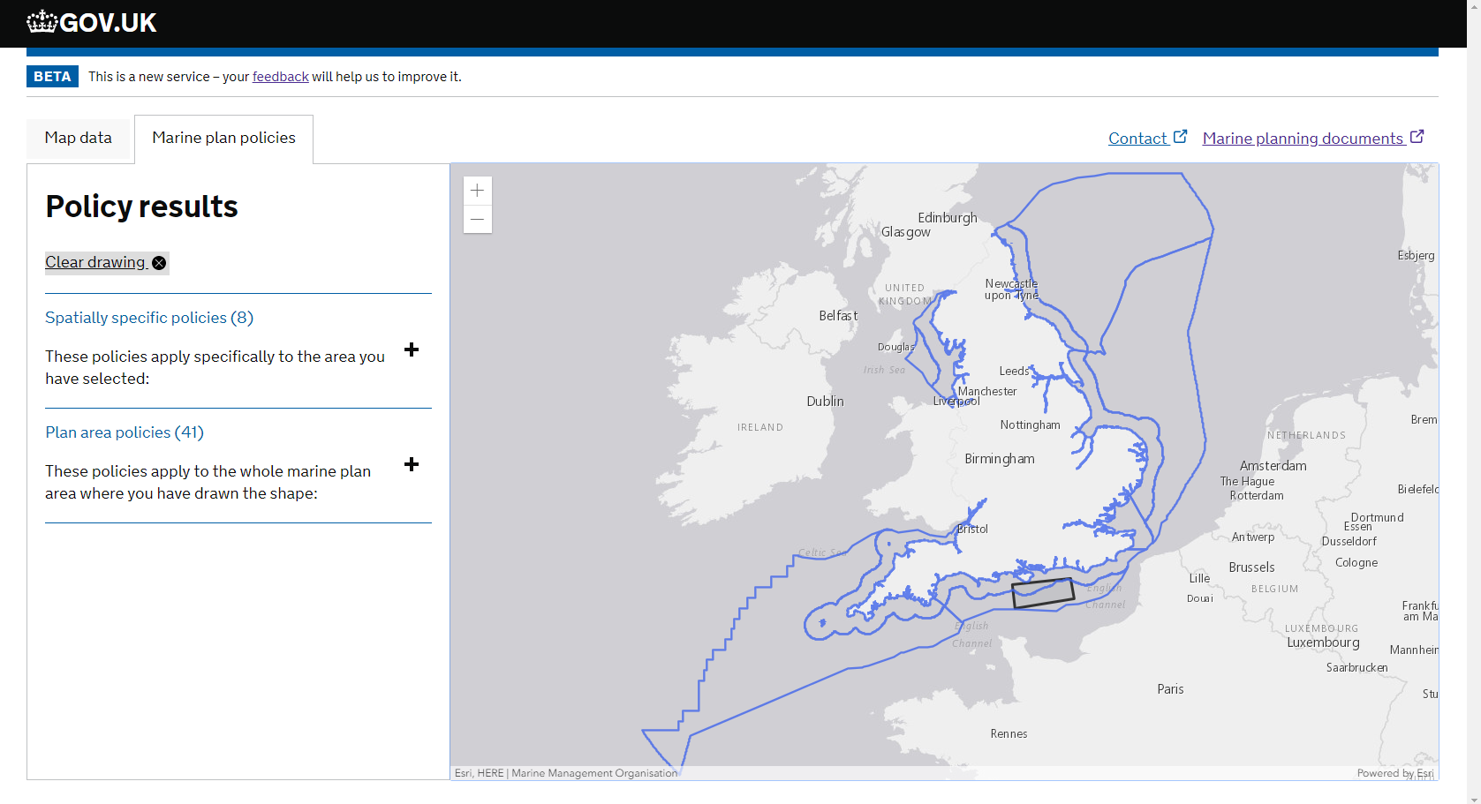
Explore Marine Plans
Notes:
Planning in itself is a detailed document industry. It has to be with statutory documents such as plans either local or marine for example. However, the use of these plans either by applicants, decision makers, interested parties is limited

Slide 28
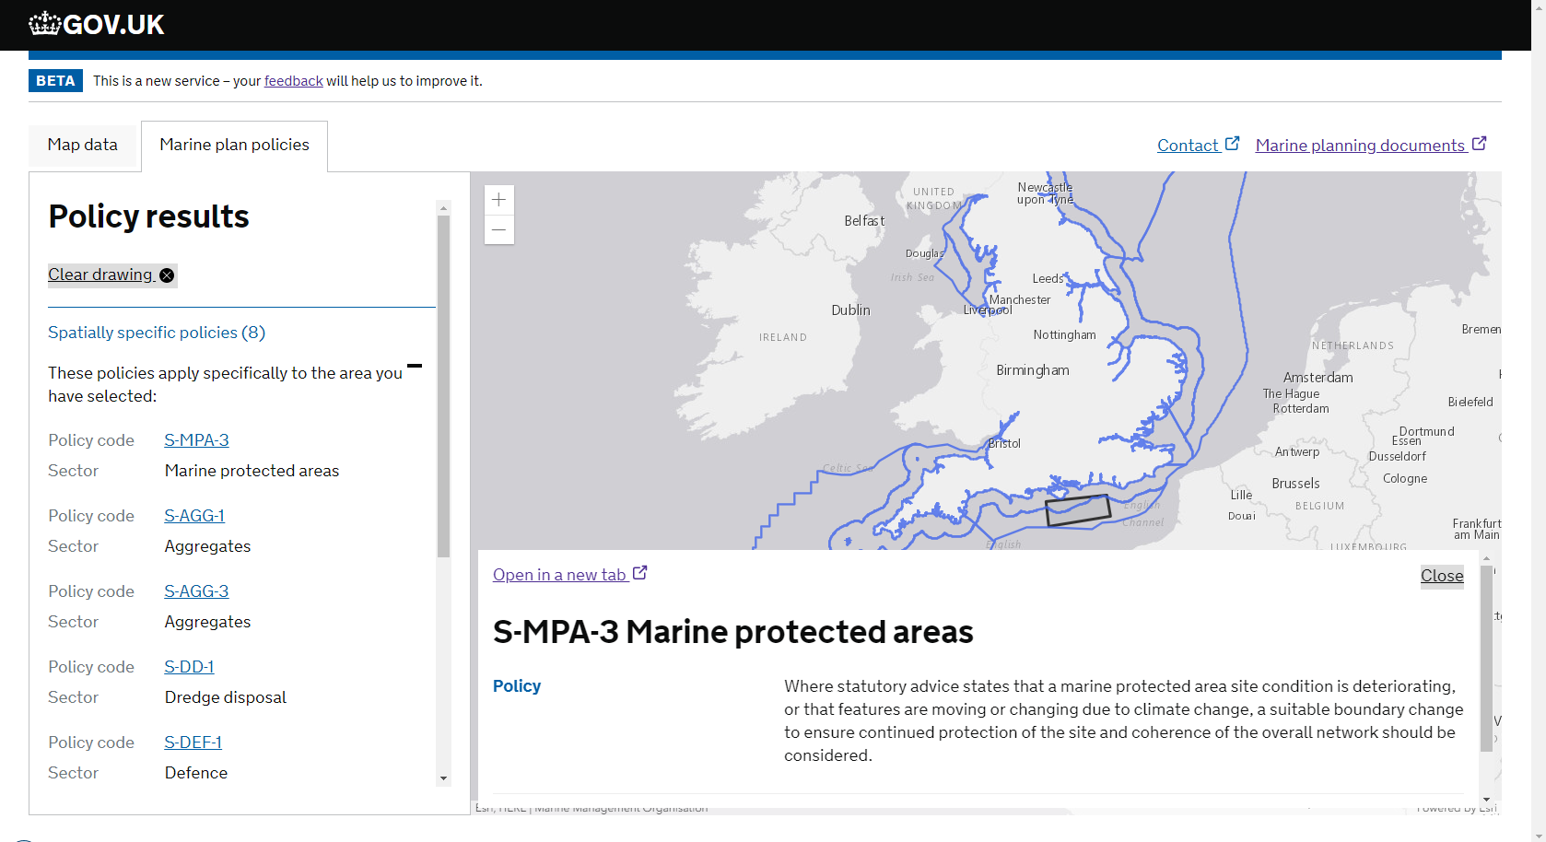
Explore Marine Plans
Notes:
Planning in itself is a detailed document industry. It has to be with statutory documents such as plans either local or marine for example. However, the use of these plans either by applicants, decision makers, interested parties is limited

Slide 29
Summary
Greater features in “traditional” planning spaces
Further Local Plan references
Marine Planning in practice is still new (relatively!)
Digitisation across the planning system will aid integration
Notes:
Marine Planning cannot be viewed necessarily through the same glasses as terrestrial planning, it is in

Slide 30
Thank you
Future updates at: www.gov.uk/mmo
Contact us:
joseph.smithyman@marinemanagement.org.uk
Email: planning@marinemanagement.org.uk

