Slide 1
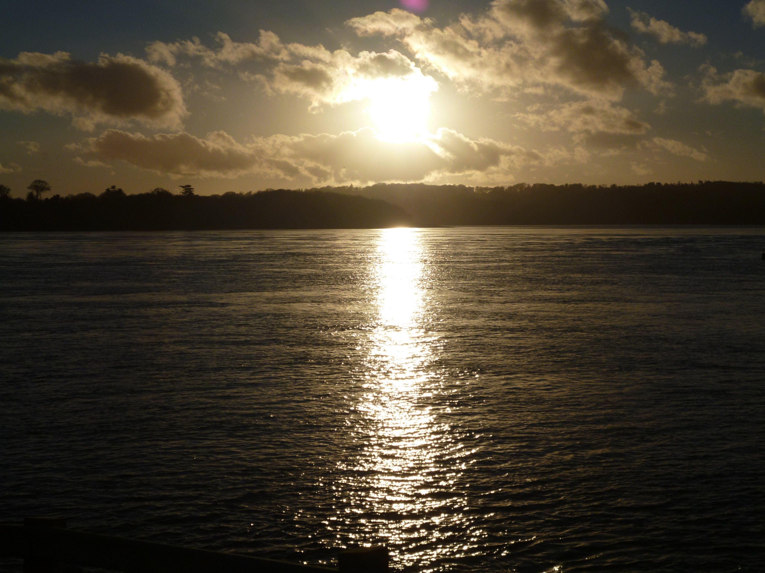
13th Biennial of European Council of Town Planners: – Planning on the Edge
A comparative analysis of marine governance across the Irish Sea
Dr Heather Ritchie & Dr Linda McElduff
Lecturers in Planning
Belfast School of Architecture & the Built Environment
h.ritchie@ulster.ac.uk
l.mcelduff@ulster.ac.uk
Notes:
Introduce self and Linda
Research in MSP

Slide 2
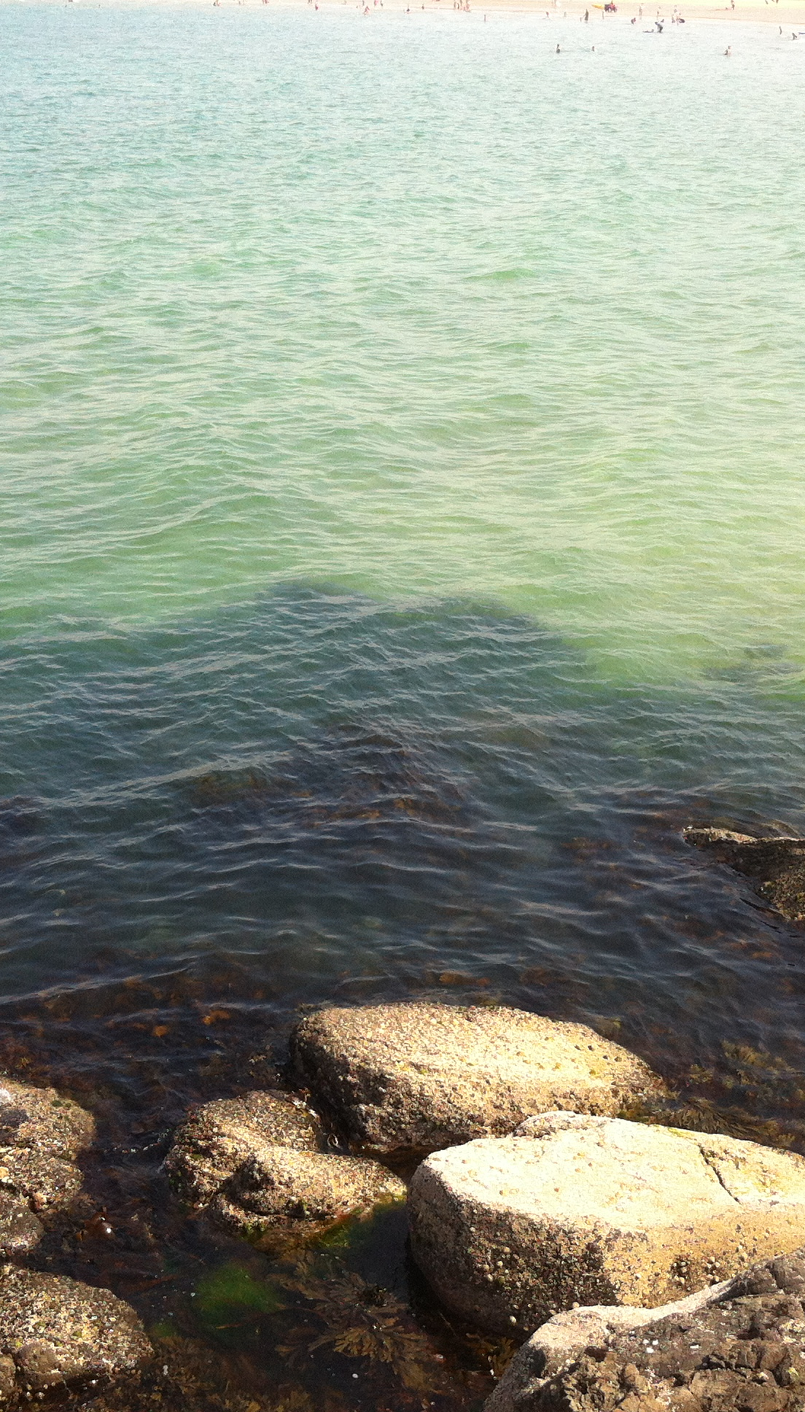
Presentation overview
Introduction to Marine Spatial Planning
Progress of Marine Planning across the Irish Sea
Future outlook for MSP in the UK

Slide 3
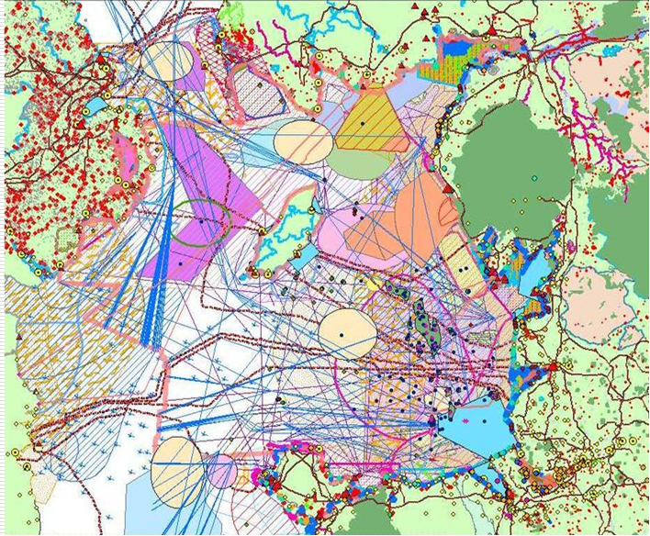
Early Marine Governance
Early 2000s the changing marine environment represents a contemporary challenge to society & government.
Restructuring of activities and progression of technology.
‘Marine problem’ – exacerbated & advancing offshore?
Administrative battleground – perhaps worse now?
Policy and institutional arrangements not even across UK.
Care still needed in how we interpret the marine environment and devise an appropriate intervention - MSP?
Growing pressures on marine environment led to regulatory change
The ‘Marine Problem’
Notes:
Still same isues over ownership boundaries and borders and where does the sea start and land stop – common an private property rights – customary and statutory rules and regs
On top of this diverse range of activities taking place at the land coast and offshore regions

Slide 4
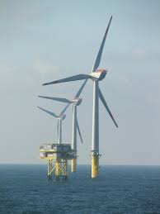
What is Marine Spatial Planning?
Early definition of a marine spatial plan as
"a strategic plan for regulating, managing and protecting the marine environment that addresses the multiple, cumulative and potentially conflicting uses of the sea.” (DEFRA 2003)
Marine Spatial Planning (MSP) is a way of looking at how we use the marine area and planning how best to use it into the future.
The formal introduction of statutory powers to create marine plans at different scales to manage marine environments and coastal areas.
MSP provides the context and the planning policy for the exercise of a range of controls: including licensing and operation of particular sectors (eg. offshore energy)

Slide 5
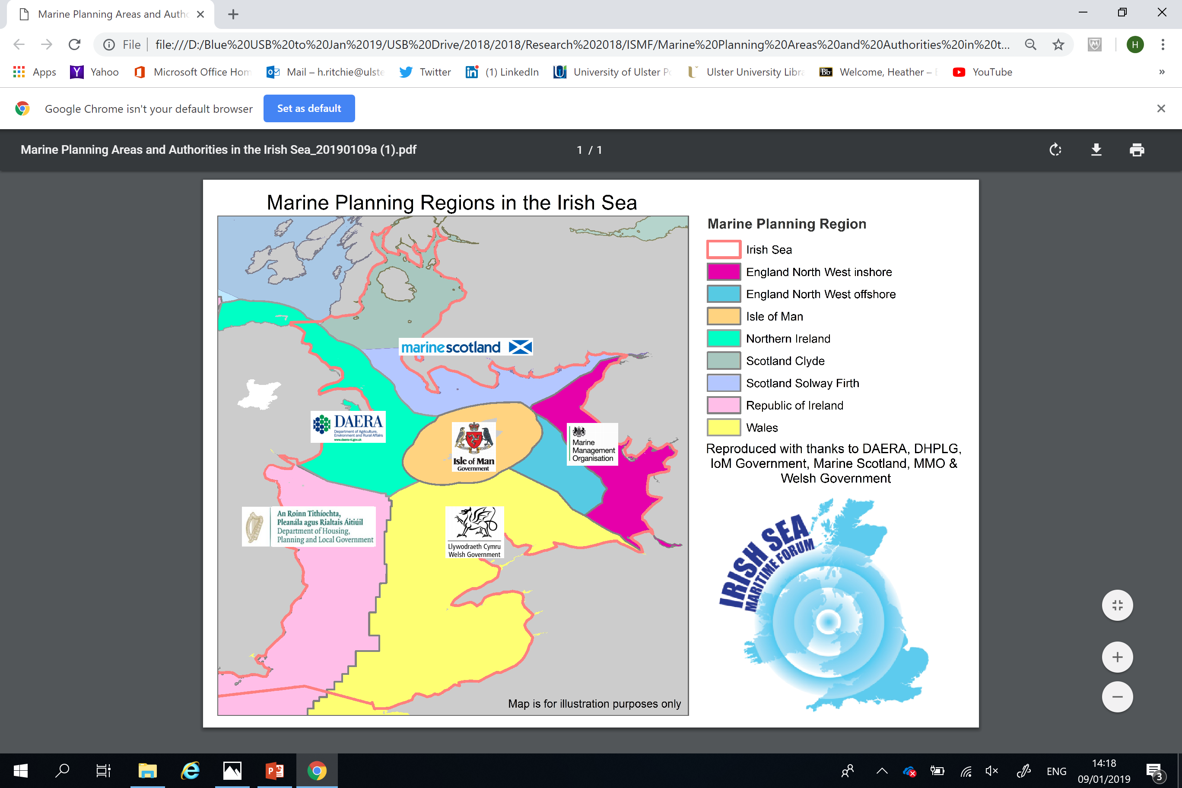

Slide 6
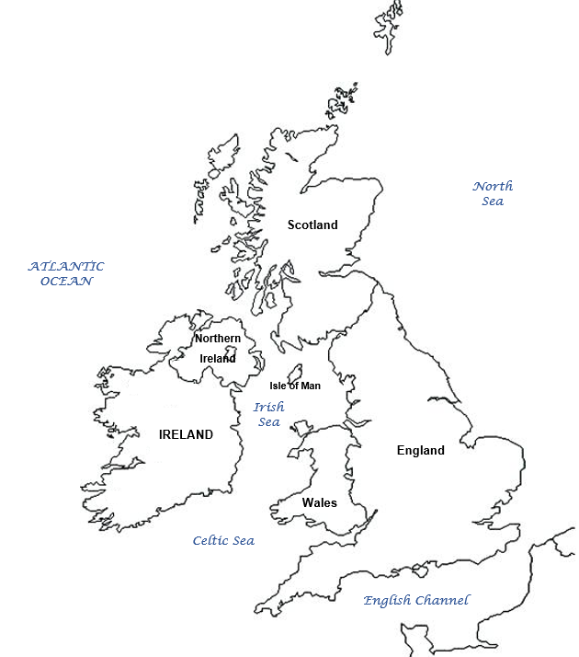
Irish Sea Headlines
Irish Sea governed by 4 pieces of primary legislation, EU Directives and International Conventions
4 National Plan approaches across the Irish Sea
5 Administrations carrying out Marine Planning

Slide 7
Marine Legislative & Policy Context for the Irish Sea
Marine and Coastal Access Act 2009 – All UK
Marine (Scotland) Act 2010 - Scotland only
Marine Act (Northern Ireland) 2013 – N.Ireland only
SI No 352 2016 EU (Framework for MSP Regs 2016) – and Part 5 Planning and Development (Amendment) Act 2018 - Ireland only
UK Marine Policy Statement 2011– policy framework to prepare plans and reiterates UK Marine Vision and UK high level objectives – All UK: Scottish, Welsh, NI governments
MSP Directive 2014/89/EU establishing a framework for maritime spatial planning was adopted in July 2014. The Directive obliges all coastal Member States to establish maritime spatial plans by 2021 - All UK and Ireland but not IoM
Conventions: Annex I-V OSPAR Convention 1992 and– Convention on Biological Diversity 2012 - All UK, Ireland and Isle of Man
Complex location: brings many jurisdictional challenges – reflective of devolution of powers and self-governing IoM
Lots of legislation to consider – International – EU – National – Regional - Local
Different stages of marine plan development - spatial scales, format and timescales

Slide 8
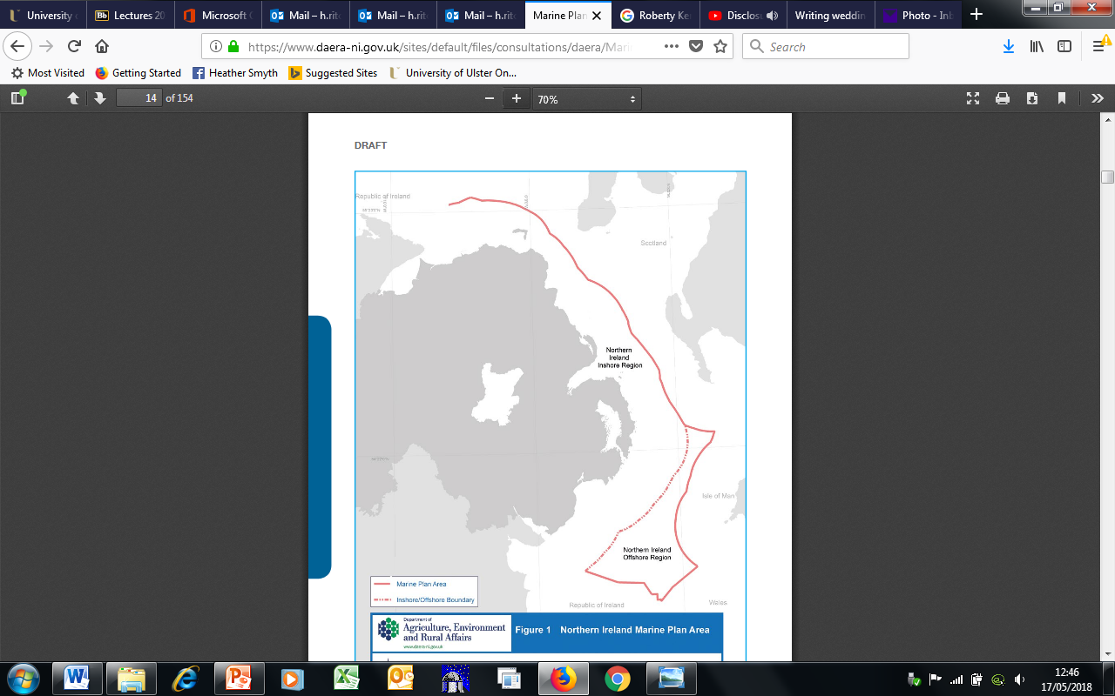
Northern Ireland Marine Plan: Current Status
Lead: The Department of Agriculture, Environment & Rural Affairs (DAERA)
Progress: Draft Marine Plan for Northern Ireland (April 2018).
2 pieces of legislation:
MCAA 2009 s 51 and sch 6
Marine Act (NI) 2013 s4 and sch 1
Legislative wording places onus on marine planning to integrate with terrestrial planning system – no reciprocal duty.
Consultation closed 15th June 2018
Consideration stage – independent investigation?
Next Steps: Plan adoption? - no Stormont Executive since January 2017.
Marine Plan Vision for NI:
A healthy marine area which is managed sustainably for the economic, environmental and social prosperity of present and future generations.
Notes:
Marine Plan Team have been meeting Local Council planners and feeding into the new suite of Local Development Plans – actively trying to influence land sea interaction.

Slide 9
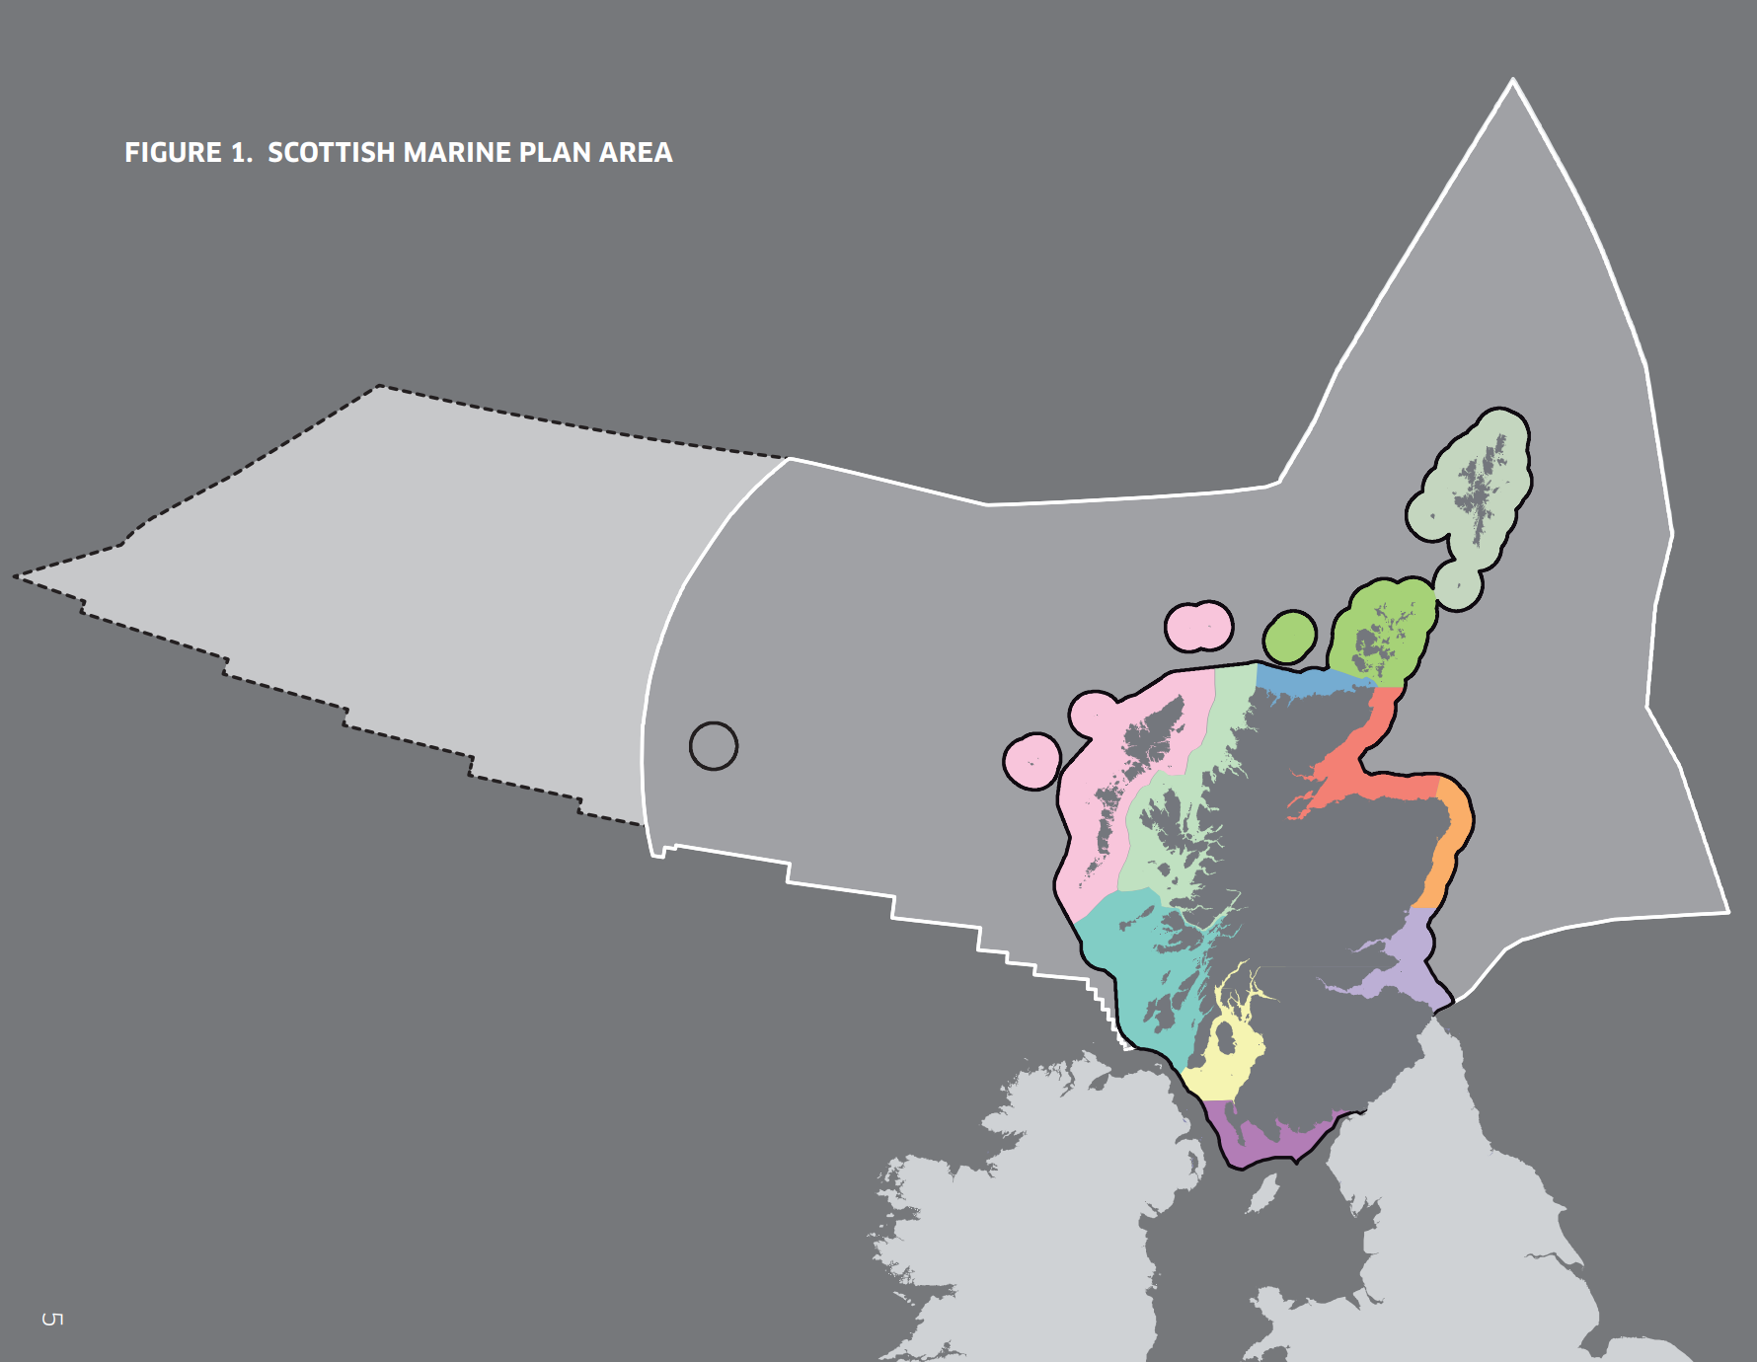
Scotland Marine Plan: Current Status
Lead: Marine Scotland
Progress: Scotland National Marine Plan (2015) provides single framework for managing Scotland’s seas.
First review process – presented to Scottish Ministers in March 2018.
Next Steps: National plan supplemented by 11 Regional Marine Plans prepared by Marine Planning Partnerships - more detailed guidance for inshore waters.
Two key issues:
Different leg. requirements for timings of the plan review cycles and progress:
Resources to establish Marine Planning Partnerships
Recommended to follow best practice from Clyde Marine Planning Partnership and Shetland Isles Marine Planning Partnership
Marine Plan Vision for Scotland:
Clean, healthy, safe, productive and diverse seas; managed to meet the long term needs of nature and people.
Notes:
Scotland National Marine Plan (2015) provides single framework for managing Scotland’s seas – sustainable development of resources 12 to 200nm
Timing of revew
Marine Act (Scotland) 2010 is for inshore waters 0-12nm – requires review every 5 years
MCCA 2009 is for offshore waters 12-200nm (management has been devolved to Scottish Ministers) requires review every 3 years

Slide 10
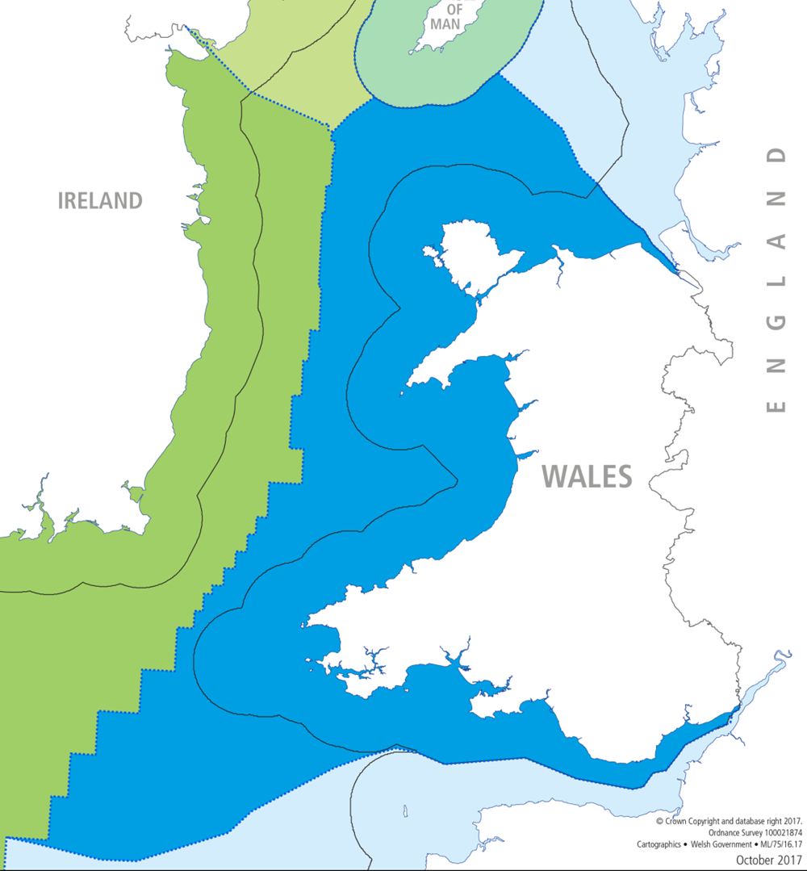
Wales Marine Plan: Current Status
Lead: Welsh Government
Progress: Draft Welsh National Marine Plan (WNMP) published Dec 2017.
Well-being of Future Generations (Wales) Act 2015; Environment (Wales) Act 2016.
Consultation closed - April 2018.
Issues for consideration (e.g.):
  Consideration of cross-border matters in implementation guidance
  Need for guidance & training, update of TANs (TSP)
Next Steps – WNMP aims to be published in October 2019
Marine Plan Vision for Wales:
Welsh seas are clean, healthy, safe, productive & biologically diverse

Slide 11
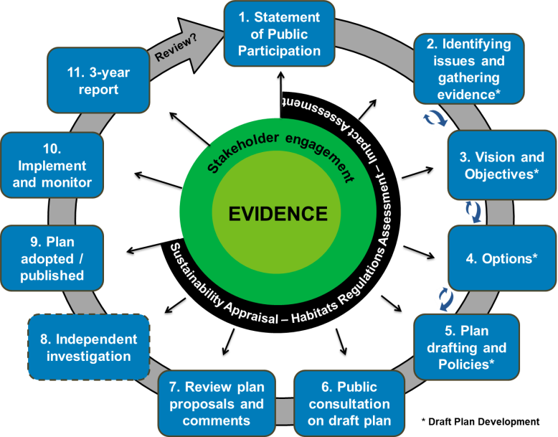
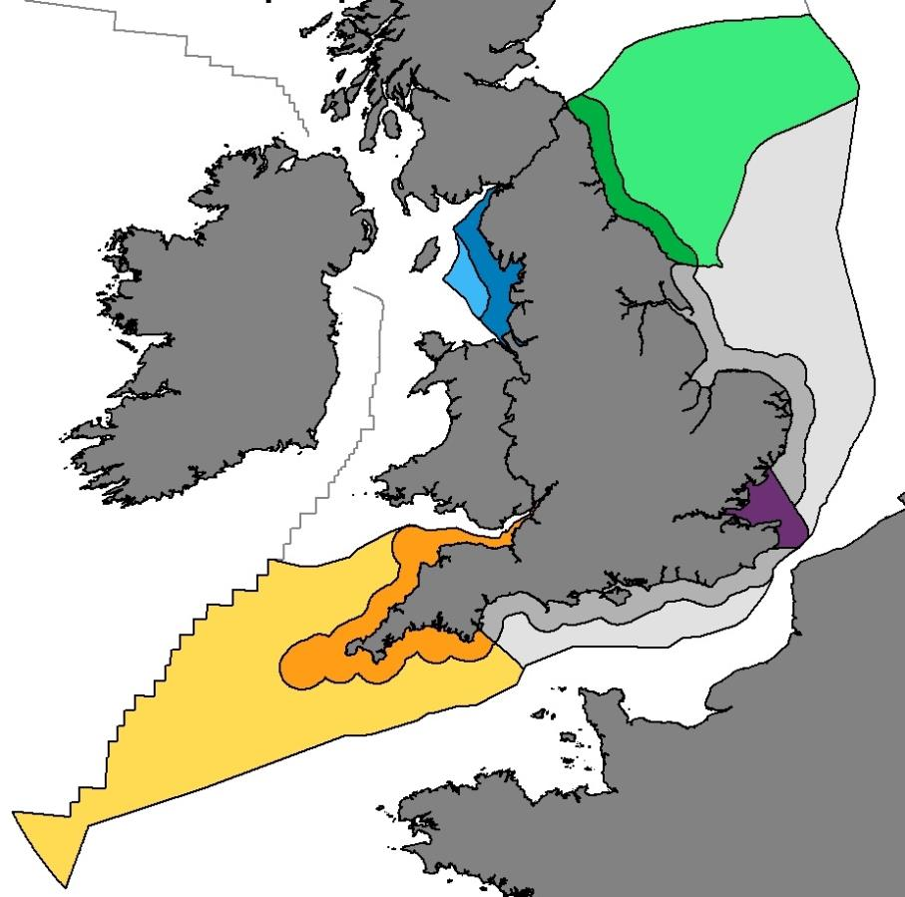
South West & North West Marine Plan: Current Status
Iterations
Lead: Marine Management Organisation (MMO)
4 marine plans – NW, NE, SW & SE - to be published by 2020.
Progress: ‘Iteration 3’ - preferred draft policies & supporting text; Spring 2019 - Iteration 3 engagement.
Next Steps: Sept 2019 - ‘You said, we did’ document published, summary of stakeholder led policy changes for plan drafting; Statutory consultation on draft plans in late 2019.
Notes:
Iteration 1 - Spring 2017 - consulted on first products of the process.
Iteration 2 - Spring 2018 - marine plan area vision, and options to address remaining issues.
Draft policies have been developed following feedback from the Iteration 2 Options engagement in early 2018 and the Call for Issues with Supporting Evidence in 2016.
Workshops to be held between 29th January and 28th February 2019 to support the online engagement and provide an opportunity to comment on the Iteration 3 products.
Opportunities for stakeholders to contribute to the development of the preferred marine plan draft policies ahead of the statutory consultation on the draft marine plans in late 2019.

Slide 12
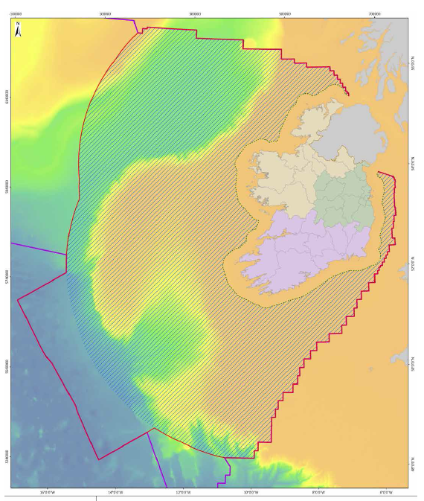
Ireland Marine Plan: Current Status
Lead: Department of Housing, Planning & Local Government
Progress: supporting guidance & bodies:
Harnessing Our Ocean’s Wealth – an Integrated Marine Plan (2012); MSP Roadmap: Towards a MSP for Ireland – (2017); The National Marine Planning Framework (2018).
Next Steps: Interdepartmental group established to lead &oversee the plan development.
Advisory group established to ensure effective participation in the process. Stakeholder engagement events.
Change in legislation from SI to the Planning and Development (Amendment) Act 2018 => the plan becomes a determining factor in consenting decisions & developments of plans and policies.
Draft Marine Policy Statement – public consultation ended August 2019
Notes:
Department of Housing, Planning and Local Government
Working towards the production of a single plan for Irish waters.
Harnessing Our Ocean’s Wealth – an Integrated Marine Plan (2012) – sets out Government’s vision, high level goals, and key enabling actions to enable Ireland’s marine potential to be realised.
MSP Roadmap: Towards a MSP for Ireland – (2017) - general arrangements and timeline for development of plan by end of 2020.
The National Marine Planning Framework (2018) – description of the ‘as is’ situation for existing sectoral development and marine activities and includes an identification of opportunities and constraints.
Public consultation closed 14th December 2018.
Advisory group chaired by minister of state for housing and urban development
The Marine Plan Team has carried out extensive stakeholder engagement raising awareness of the plan – in excess of 100 engagement events with public and stakeholders.

Slide 13
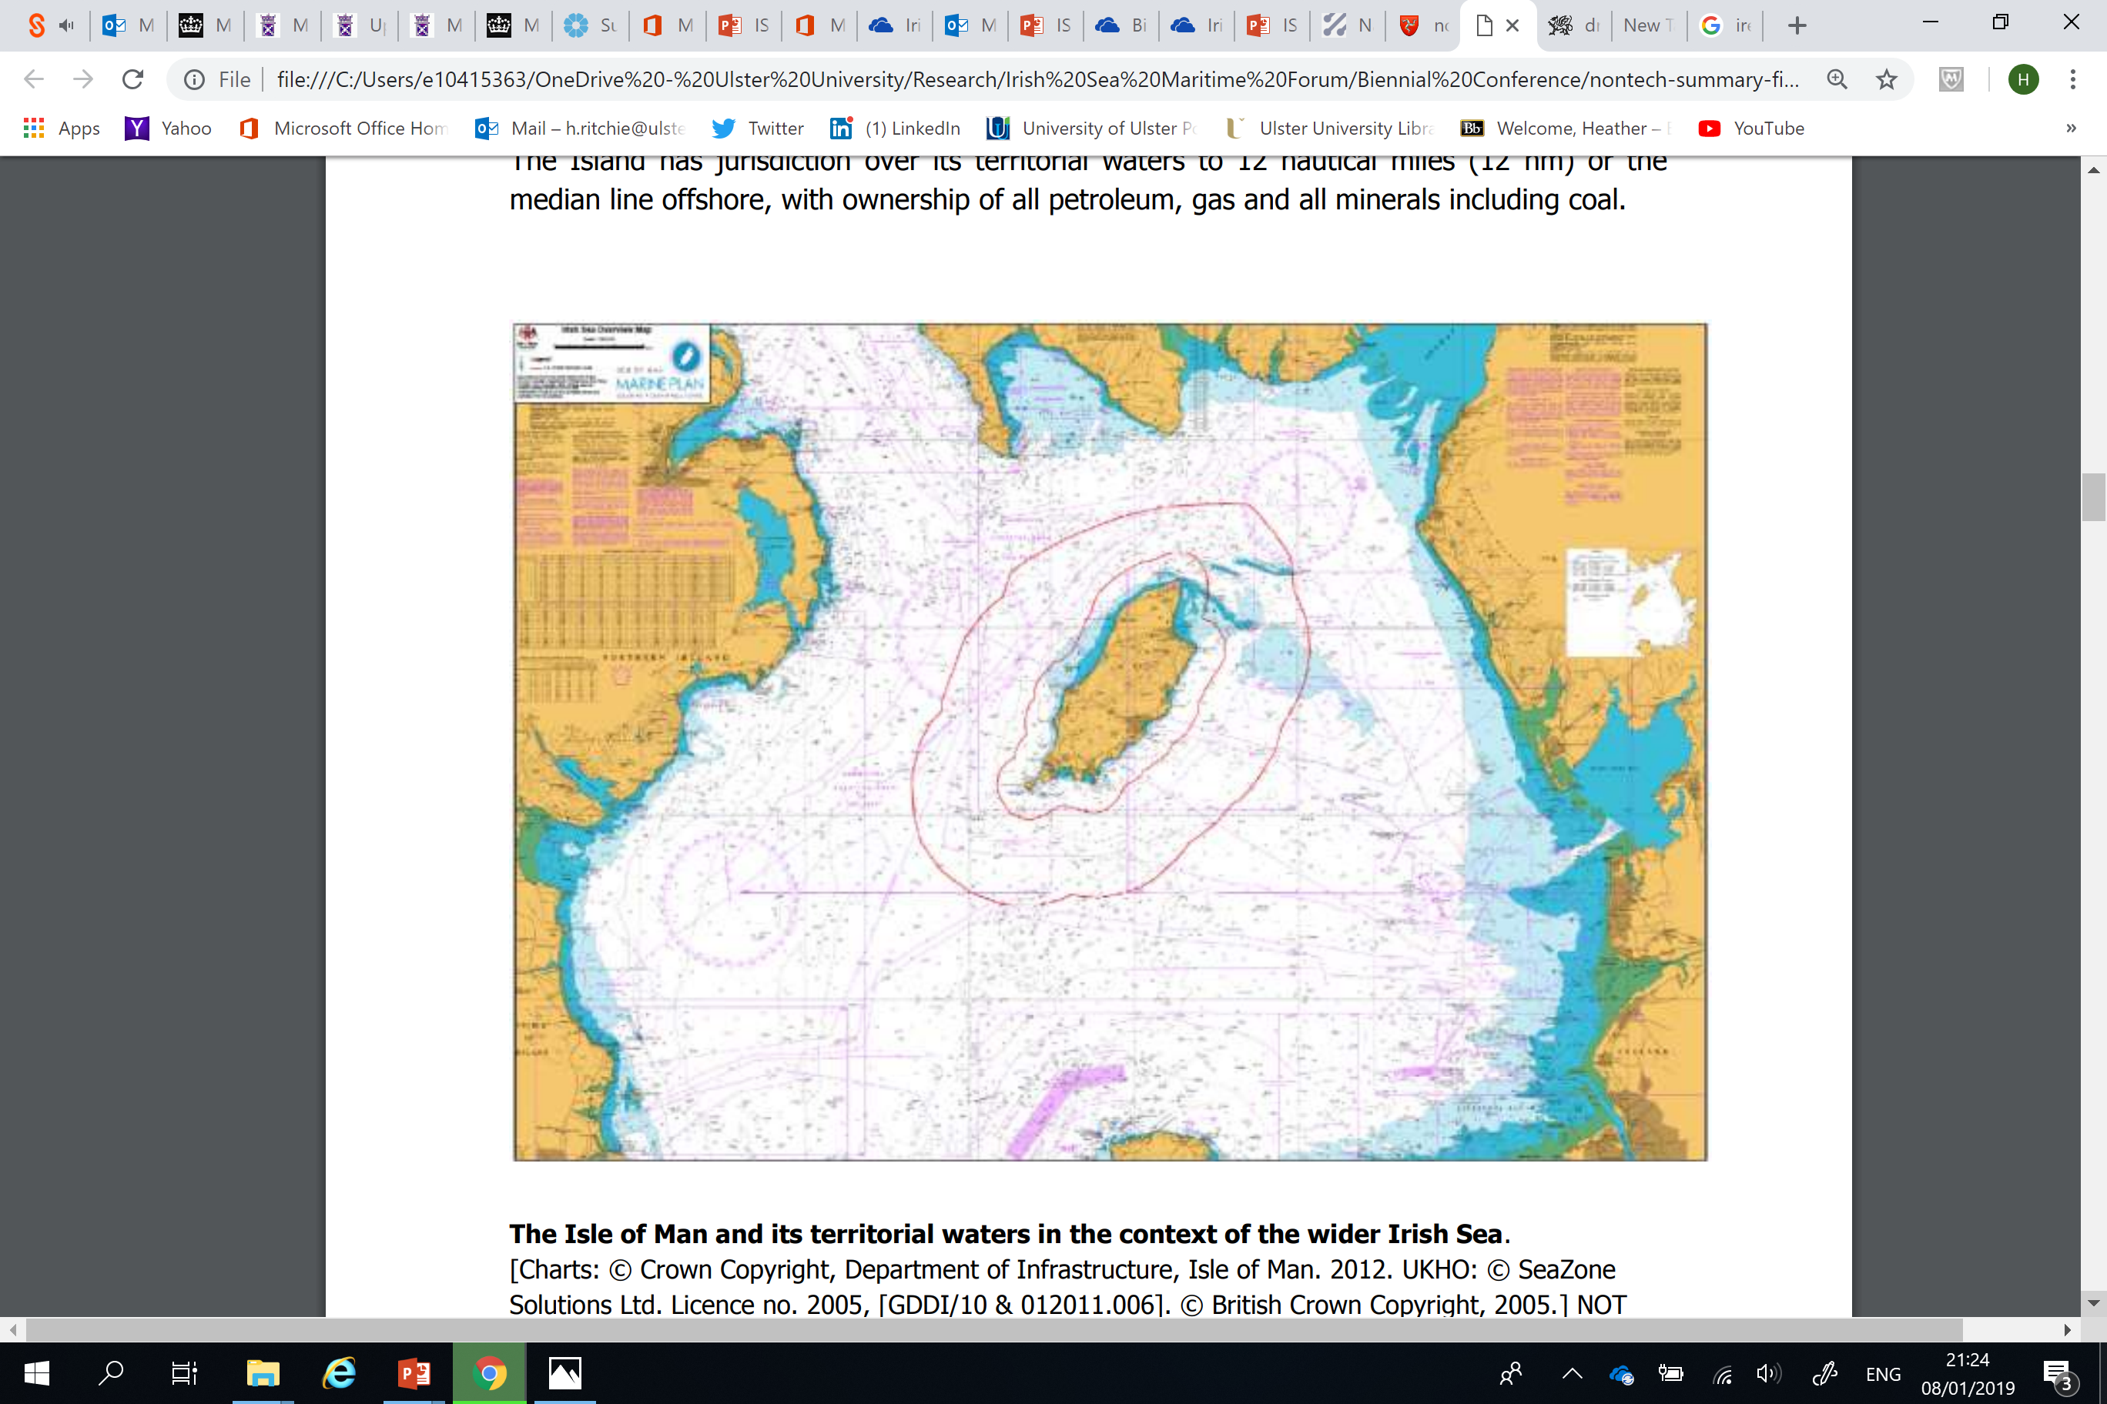
Isle of Man Marine Plan: Current Status
Not having a Marine Plan!
Manx Marine Environmental Assessment (MMEA) Report (2018):
not a policy document - a statement of technical facts that were available and correct at the time of publication – ‘as is’ document.
No public consultation – relied on experts.
Opportunities for future coastal and offshore developments in Manx territorial waters.
Biosphere Isle of Man awarded March 2016 - 1st Island Nation in the world to receive UNESCO biosphere endorsement.
Government Priorities (marine vision?):
- An Island of enterprise and opportunity
- Financially responsible government
- An inclusive and caring society
Notes:
The MMEA Report is designed to be a technical compilation of information on Manx Territorial waters.
Biosphere Isle of Man awarded March 2016
1st Island Nation in the world to receive UNESCO biosphere endorsement

Slide 14
Future outlook to Marine Governance in the Irish Sea – glass half full?
The picture across the Irish Sea is disjointed – different policies, timescales, visions, political priorities
Land Sea integration – lack of holistic approach – need to integrate with coastal policies and terrestrial plans
Lack of co-ordination – enhance cross-border cooperation – UK administrations and ROI/ NI boundary (esp. the ‘B’ word!)
This is a transitional period:
We have plans! It is a starting point for a complex area
Existing partnership working across the Irish Sea – enhanced cooperation and knowledge exchange
Improved public awareness – could be better
Improved marine evidence base – need to disseminate wider

Slide 15
13th Biennial of European Council of Town Planners: – Planning on the Edge
A comparative analysis of marine governance across the Irish Sea
Dr Heather Ritchie & Dr Linda McElduff
Lecturers in Planning
Belfast School of Architecture & the Built Environment
h.ritchie@ulster.ac.uk
l.mcelduff@ulster.ac.uk
Notes:
Introduce self and Linda
Research in MSP

