Slide 1
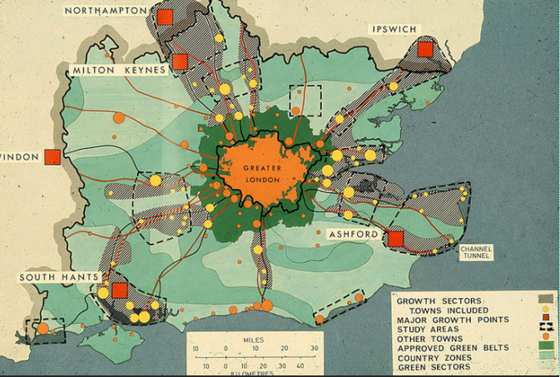
Green Belts, Geography and Governance: The Attitudes of Planners and Campaigners
The 1964 South East Study- from: https://andrewlainton.wordpress.com/2014/12/18/londons-green-belt-has-never-had-a-proper-plan/
By Charles Goode

Slide 2
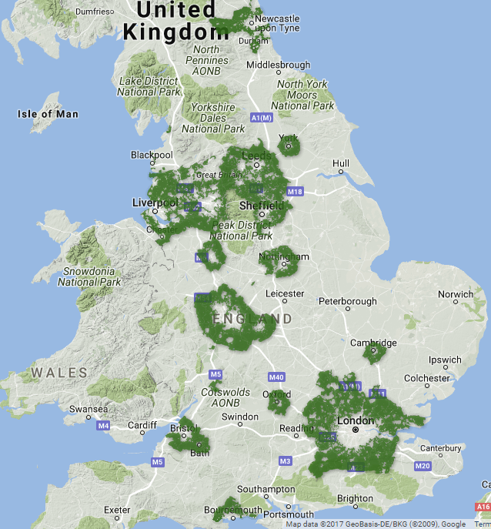
Introducing the Green Belt
Introduced in the 1947 Planning Act and Duncan Sandy’s Circular 42/55.
The Green Belt’s main aim is to prevent urban sprawl so they form a ‘belt’ or a ‘donut’ around most of Britain’s large cities (Elson, 1986, p. 154).
Green Belt covers 13% of Britain’s land compared to 6% which is urban (DCLG, 2017, p. 1). This has remained roughly stable since the 1980s.
Criticised for restricting land supply thus increasing house prices, for causing the unsustainable development of ‘leapfrogging’ and for being too large and restrictive (Morrison, 2010, p. 160).
However, it is fiercely defended by campaign groups, like CPRE, and property owners at both the national and local level.
Map of the Green Belt in England: available at: https://www.telegraph.co.uk/news/earth/greenpolitics/planning/9708387/Interactive-map-Englands-green-belt.html
Notes:
Map of the Green Belt in England: available at: https://www.telegraph.co.uk/news/earth/greenpolitics/planning/9708387/Interactive-map-Englands-green-belt.html

Slide 3
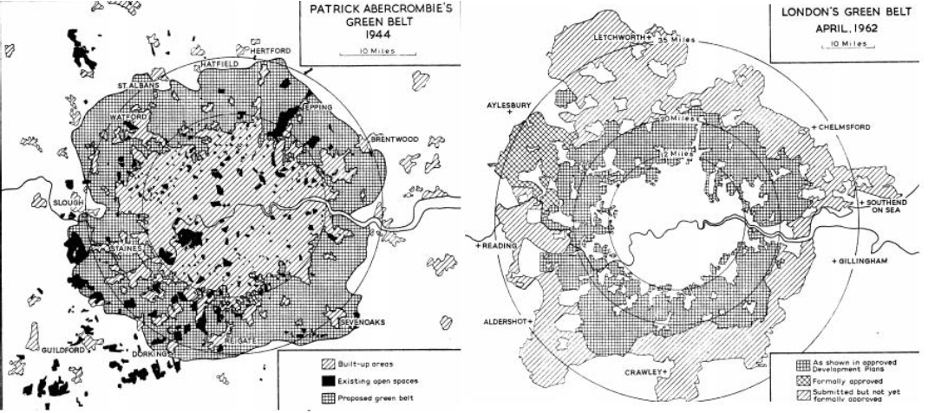
A very brief history of Green Belt
In 1580 Queen Elizabeth I issued a decree which aimed to limit London’s growth.
The Green Belt idea arose from Ebenezer Howard, who in Garden Cities of Tomorrow (1898), argued they should be for agricultural use around garden cities.
1935 Green Belt loan scheme, 1938 Green Belt Act, 1935 Ribbon Development Act.
They were proposed by Raymond Unwin as a ‘green girdle’ 5-8 miles wide primarily for recreation and formed the basis of Abercrombie’s Green Belt 1944 London Plan.
1947 Town and Country Planning Act and Duncan Sandy’s 1955 Circular 42/55.
From: Thomas, 1963, p. 19

Slide 4
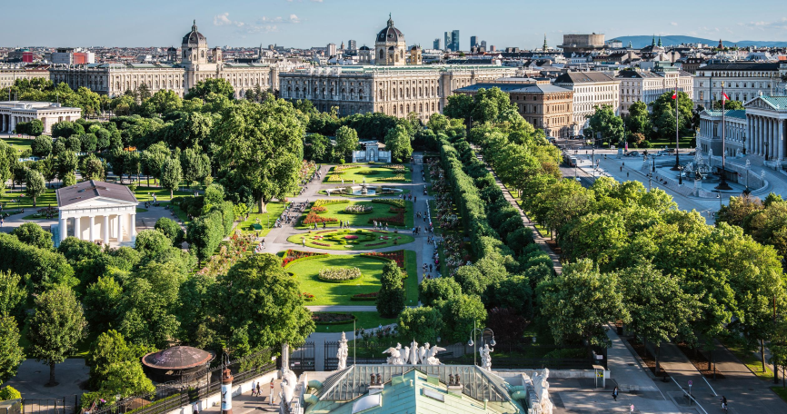
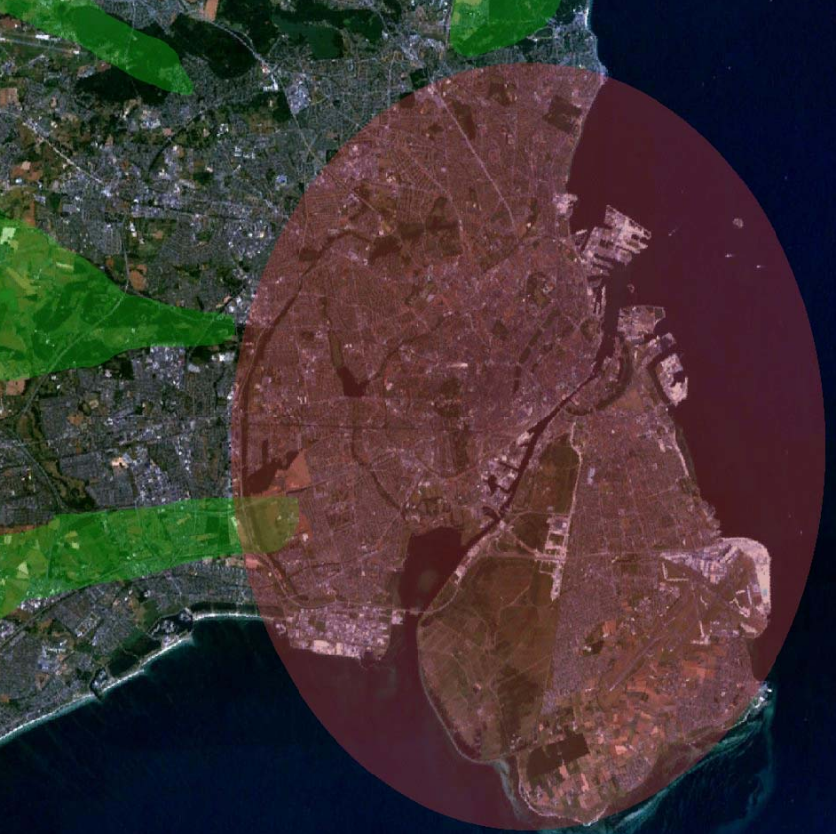
History: ‘European’ Influences and Policy Divergence
The Green Belt idea arose from the Arts and Crafts Movement and the parkways in Berlin and Vienna/ US (Manns, 2014). Ebenezer Howard, in Garden Cities of Tomorrow (1898/1902), argued that they should be for agricultural use around new garden cities.
However, Green Belts are now distinctive in being such a strict central government designation compared to urban growth management in other European cities (Hickman and Hall, 2008; Papa and Bertolini, 2015).
Vienna’s Ringstrasse- an early inspiration for Green Belt
Copenhagen’s famous Finger Plan

Slide 5
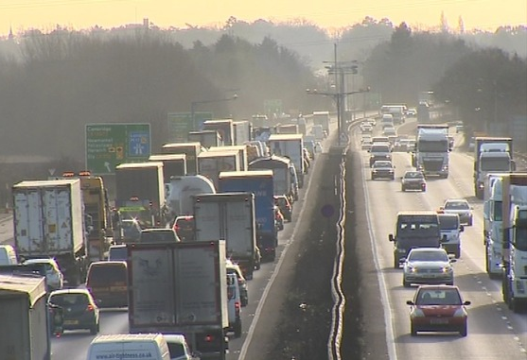
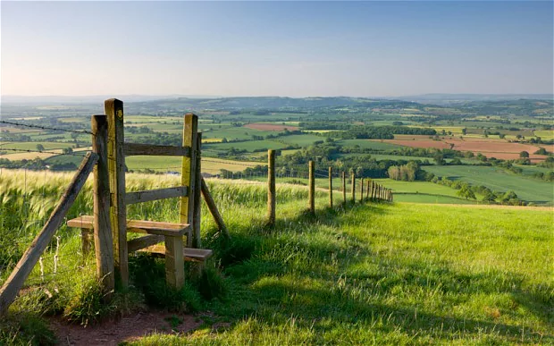
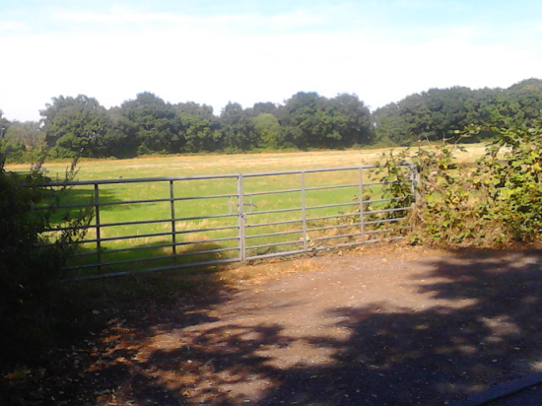
Evaluating the Green Belt
Green Belts and the housing crisis (Hilber, 2015).
Puts huge development pressure on urban greenspace with higher recreational and societal value than Green Belt land (Foresight Report, 2010; Harrison, 1981).
Separates where people live and work causing congestion, pollution and unsustainable development patterns - ‘leapfrogging’ (Hall, 1973; Morrison, 2010).
Defended for their recreational and environmental value as have 30,000km of public footpaths and visited by 1.3 billion people (2014) (Kells et al, 2007, p. 3).
A14 between Cambridge and Huntingdon used by 40,000 vehicles daily
The popular image of Green Belt- idyllic, rolling landscape
GB Land near a railway station, Whitlocks End
Notes:
The popular image of Green Belt

Slide 6
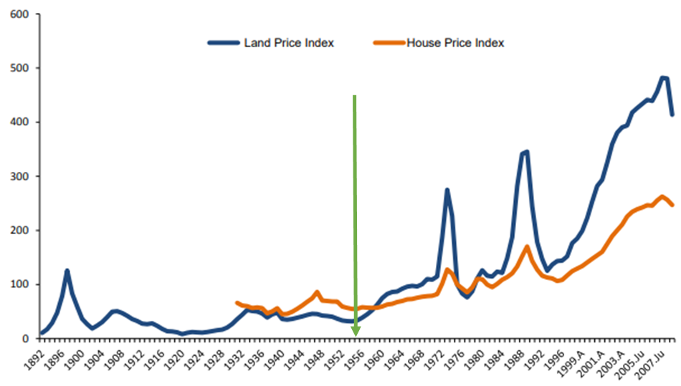
Framing the Green Belt: ‘Wider’ Issues
Green Belts and English cultural attitudes towards the countryside (i.e. Bunce, 1994; Matless, 1998).
Homeownership and the economic model (Edwards, 2016; Gallent et al, 2018).
Green Belts and cultural attitudes towards homes and gardens (i.e. Evans, 1992; Breheny, 1996).
Green Belts and the land market (e.g. Bentley, 2018; Airey and Blakeway, 2019).
Green Belts and local government (i.e. Hall et al, 1973a, 1973b).
GB Introduced
A CPRE Green Belt campaign
Green Belts and Land Prices- Adapted from Coelho et al, 2014, p. 23
Notes:
A CPRE Green Belt campaign

Slide 7
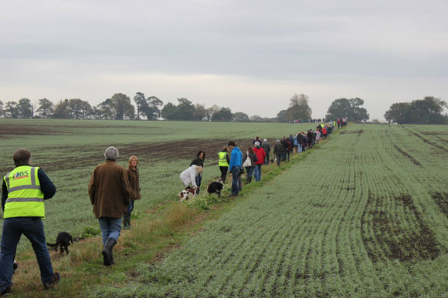
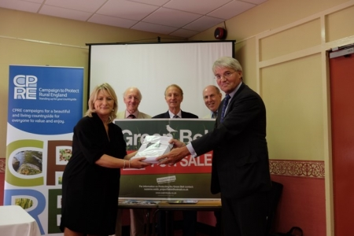
Methodology
Two key aspects - the views of planners and the general public on the Green Belt.
Looking at the national picture and the primary regional case study of the West Midlands.
70 interviews and 2 focus groups have been conducted - these have mainly been with professional planners, planning stakeholders and ‘professional’ campaigners.
Questionnaire of planners in the West Midlands.
Engagement with local campaign groups in the West Midlands.
40% of the interviews at the national level, 14% in other regions and 46% in West Midlands.
Analysed popular attitudes from the Social Attitudes Survey and CPRE’s Green Belt survey.
A Green Belt protest march organised by Project Fields, Birmingham
Project Fields joined by Andrew Mitchell, MP who was in the Cabinet
Notes:
Save Stourbridge Green Belt, Project Fields and South Solihull Community Group
A Green Belt protest march organised by Project Fields
Project Fields joined by Andrew Mitchell, MP

Slide 8
Methods- National
Planners: interviews and focus groups with key national planners and campaigners.
Methods- Regional
Planners: Qualitive - interviews and focus groups with planners. Quantitative - a Green Belt questionnaire of West Midlands planners.
The general public/ campaigners - case studies with West Midlands Green Belt campaign groups - Save Stourbridge Green Belt, Project Fields and South Solihull Community Group - and interviews with campaigners.
The general public: quantitative methods (the Social Attitudes Survey and CPRE’s Green Belt survey) to explore popular attitudes.

Slide 9
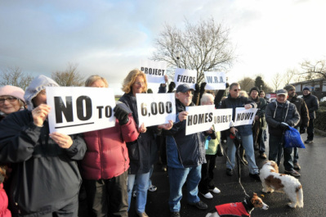
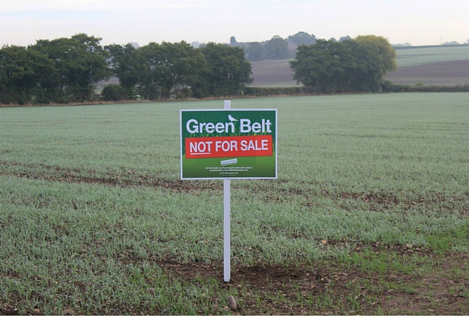
The Politics, Post-Politics and Statecraft of Planning
A large geographical literature on governance but this paper focuses on planning.
It has long been recognised that planning is very political (Cherry, 1982; Altshuler, 1966) although in recent years this has begun to be challenged by the concept of post-politics with its ideas of displacement and dissipation (Allmendinger and Haughton 2012).
However, this notion of post-politics has itself been challenged (Lord and Tewdwr-Jones, 2018), especially as we seem to be in an era of hyper politics.
Another protest by Project Fields demonstrating the politics of planning
Slogans used by Project Fields
Notes:
Slogans used by Project Fields

Slide 10
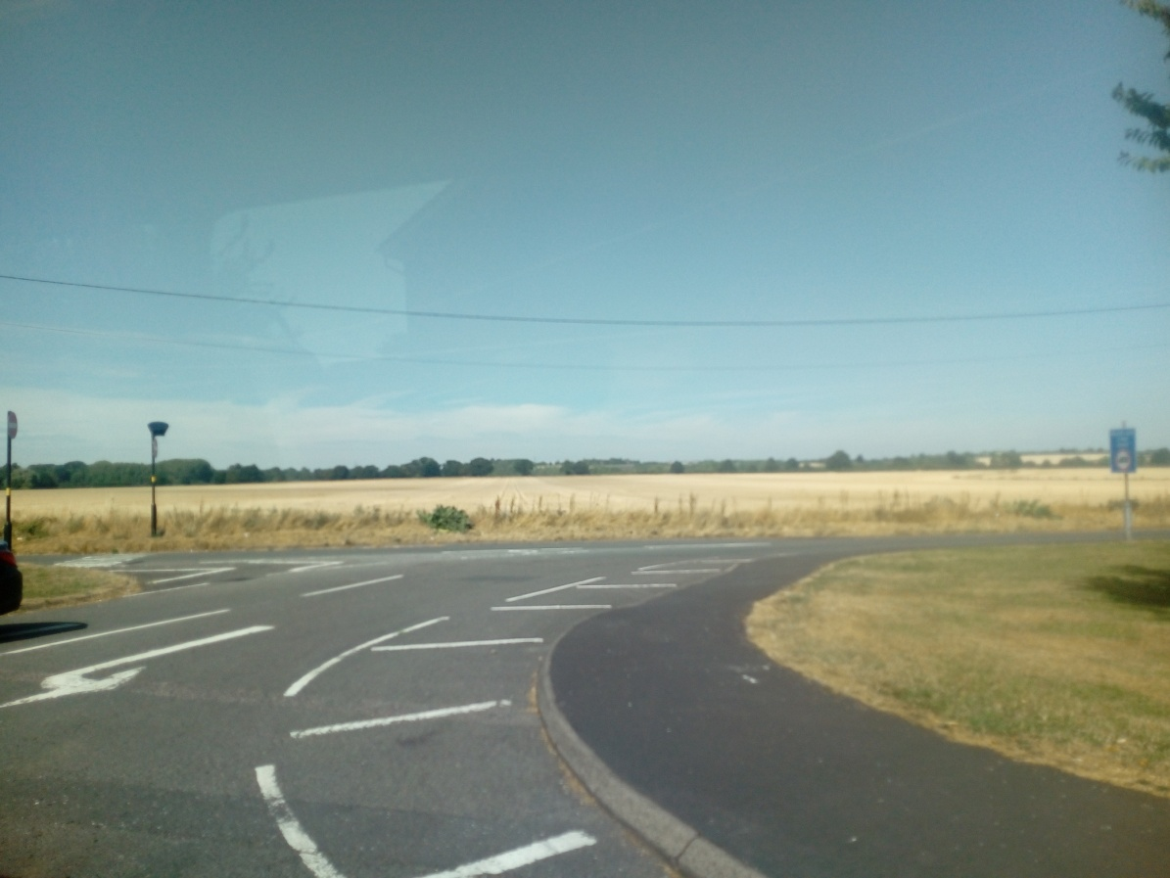
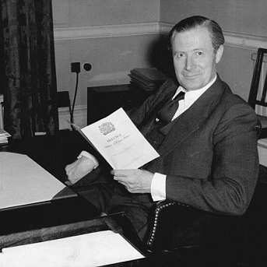
The Politics of Green Belts: History
The political nature of planning can be seen most clearly in relation to Green Belts - it is the ultimate area of contestation (Amati, 2007; Amati, and Taylor, 2010).
This can seen historically, e.g. the Wythall Enquiry 1958 (Hall, 1973b, Self, 1962).
However, in this era of hyper politics, the Green Belt has become increasingly political, especially since regional planning was abolished in 2010 (Boddy and Hickman, 2018).
Land released from the Green Belt at Langley
Minister for Housing, Duncan Sandys

Slide 11
Historical Quotes on Green Belt Politics
‘The main object of these revisions is to bring the greater part of Surrey into the Green Belt with the object of ensuring that if London’s population overlaps the Green Belt, as it’s clearly doing, the emigrants shall alight, say in Hampshire or Sussex, rather than in Surrey’
Herbert Commission (1960, p. 186)
‘The restrictive use of Green Belts has tended to run far ahead of measures to redistribute population…The Government warmly recommended the implementation of restrictive Green Belts but it held aloof from the complex problems of urban dispersal which must be solved if Green Belts are workable’.
The planning academic Peter Self reflecting on the Wythall Enquiry (1958)

Slide 12
Recent Reflections on Green Belts: Past and Present
‘For most of its existence (the Green Belt), there were satisfactory strategic
mechanisms in place so it’s only since 2010 that there has been no strategic planning
mechanism in place...it’s the London Green Belt, it’s not the Brentwood Green Belt! So, yes, we would argue that, if there is a need to reconsider Green Belt boundaries, it must happen at the level of the entire Green Belt whether it’s the London one or the West Midlands one’ (Planner from the RTPI).
‘The positive bit was that you had growth areas outside that (Green Belt) and this was in an old, old plan (the Abercrombie Plans)…the most famous one was Area 6, which was down the Thames valley, Reading, Woking and Bracknell. So, all of these were massive growth areas…we had growth…because we were constrained (with the Green Belt)…There is (now) no regional planning and there is no discussion between all the people who are affected by what is a blanket policy, so, a strategic policy like Green Belt should surely be sorted out at a strategic level and yet we don’t have a strategic level of planning with which to do it’ (Planner from the Home Builders Federation).
Growth Area 6
Notes:
Growth Area 6

Slide 13
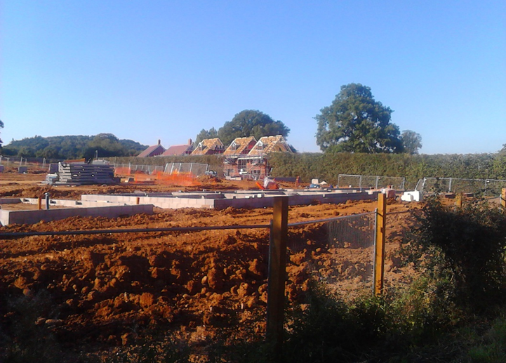
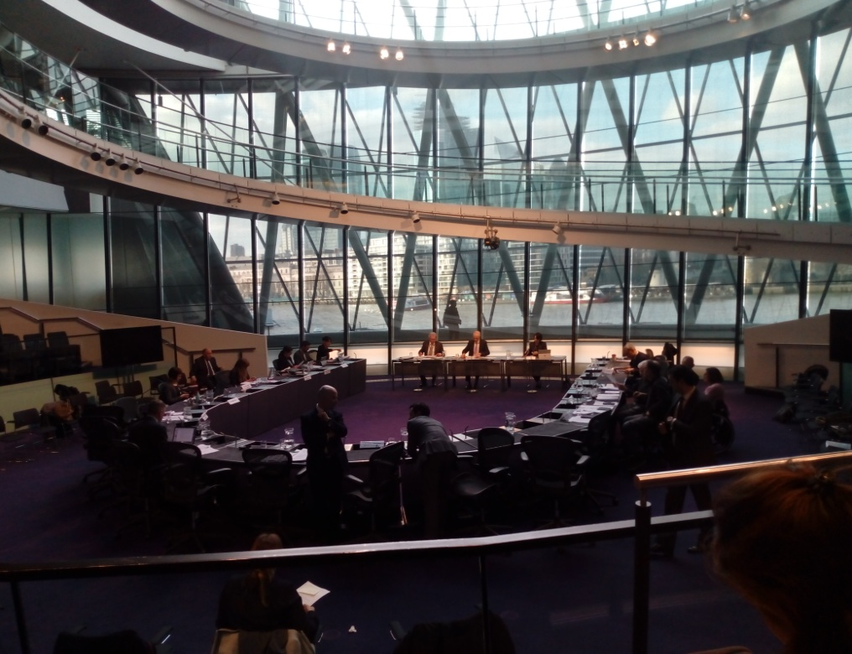
The Politics and Statecraft of Green Belts: Continued
A national designation largely managed by local authorities resulting in huge central-local tension and statecraft in this ‘fuzzy’ space (Allmendinger and Haughton 2012). The Government defends Green Belt and often intervenes in plan making but says that councils need to meet their own housing need (Goode, 2019).
The Planning Inspectorate is then left to resolve the contradiction- it is ‘between a rock and hard place’ (Boddy and Hickman, 2018, p. 208).
New housing on land previously in the Green Belt
The London Plan Examination in Public

Slide 14
Quotes on the Politics of Green Belt
‘It has taken a political edge so that effectively Green Belt has been seen effectively as
an absolute policy...Politicians see Green Belt as a particular sacred cow and I’m
afraid they are encouraged in doing that by pressure of public opinions and the press’ (National private sector planner interviewed)
‘Every single one of the responses on our consultation, well most of them, will be on the Green Belt, and every single one of them will use the phrase, ‘we don’t want our Green Belt to be plundered. I don’t mind the next borough’s Green Belt, fine for them, it doesn’t matter, but our Green Belt will always remain untouchable’. Well it is not our Green Belt really so it is not for us, it is not for our community. It is to stop the urban sprawl and it is the Metropolitan Green Belt and so it is a regional issue. But that is not how it works in people’s minds at the moment’ (Local authority planner (South East))
‘It was never expected to be an easy ride (Duty to Cooperate) and sometimes it is difficult (and it continues to be difficult) but I think it is the right approach because the alternative is that you automatically revert to a kind of national or a very high level of regional planning by bodies that don’t have the local knowledge that LPAs have. So, I think it is the right approach and the Green Belt is always one of the issues of greatest contention within that’ (National Conservative politician)

Slide 15
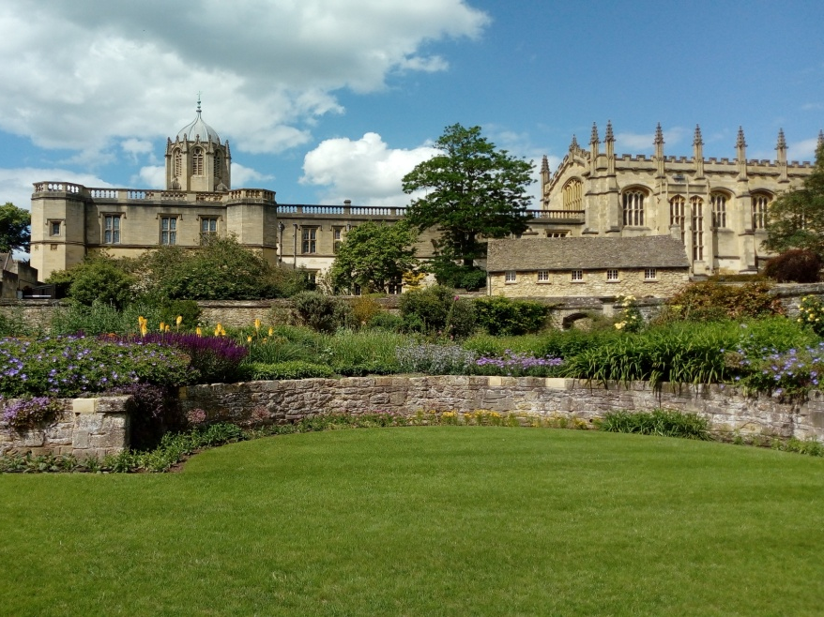
The May 2019 Local Elections
The Green Belt was a crucial issue in the recent election with the Conservatives losing overall control of councils in places like Tandridge, South Oxfordshire and Guildford - primarily due to opposition to these local plans by Resident Groups and the Liberal Democrats. As a planner from Savills reflected on South Oxfordshire:
‘In the end, planning is as much about politics as it is about anything else and it is how you weigh up what is more important. Is it putting development in the most sustainable place or is it protecting the Green Belt? Both are laudable but actually there are times when they directly conflict with each other and that is what is happening in Oxford at the moment and in the end, you can’t protect the Green Belt and put development in the most sustainable place. Some things have got to give and that is the political choice’ (Planner from Savills)
Notes:
Oxford

Slide 16
Areas of Divergence: Planners and Campaigners
Grosvenor (2019) recently highlighted the lack of trust in the planning system as a huge problem.
Campaigners were often distrustful of planners/ developers:
“There should be a strategic review of it (the Green Belt) and not by these consultants employed by individual councils to review it and rank bits of parcels of land - they never consult the public and just bung it on a website” (Retired Planner at CPRE West Midlands).
Likewise, planners were also sceptical of campaigners:
“The benefits of the countryside therefore tend to go towards those people who say ‘what about my house prices’ or who don’t necessarily need social housing” (Planner from a national house builder)
There is “the majority of people are objecting on the basis of things that result in loss of value of their property” (Former public sector planner now employed by the private sector)

Slide 17
Areas of Consensus: The Lack of Regional Planning
‘I think that bigger than local planning in the Midlands is atrocious…there is a shortage in Birmingham of 38,000 homes and I see absolutely no evidence whatsoever of them (the local authorities) resolving the problem, to be perfectly honest’ (Planner from the housebuilding industry)
‘There should be a strategic review of it (the Green Belt) and not by these consultants… I don’t think you can say there are specific parts that should be removed…without this whole strategic review and we haven’t had one yet’ (Retired Planner from CPRE West Midlands)
‘You have a political choice and which is more important protecting the Green Belt or putting development in a sustainable place? I think that strategic planning is something that the system needs…because inevitably when you are making big controversial decisions, if as members going back to the politics you are all in that district, you are all going to be affected to a greater or lesser extent by that decision and you are going to be lobbied by people who live in the district, it is very difficult to make difficult decisions’ (Planner from Savills).

Slide 18
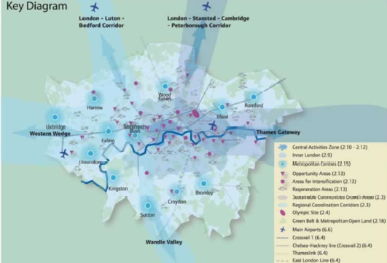
Green Belts, Governance and Sustainability: So what is to be done?
Many in Government/ the opposition now realise the locally led planning system is not working effectively.
Many planners agree that, rather than being significantly reformed as a policy, the governance of Green Belt should move to the strategic, regional level in long(er) term plans (see also: Mace, 2018). Ideally, this would be a semi-independent body or Green Belt Council, like national parks, to both manage existing Green Belts, balance competing pressures and plan their future (there would be problems with democratic legitimacy).
The London Plan’s Coordination Corridors (Mace, 2018, p. 17)
From: https://andrewlainton.wordpress.com/2014/12/18/londons-green-belt-has-never-had-a-proper-plan/

Slide 19
Towards a 21st Century Green Belt
‘So, it is basically lift it (the Green Belt) and review what you want for a longer period. Fifteen years or five years as now in local planning is not enough - not when you are imposing something of this magnitude. Do that - be really ambitious but realistic’ (Planner at a national house builder).
‘The previous regional planning system...got too big. We need simple sub regional and city wide planning statements’ (National private sector planner interviewed).
‘Regional planning should be that you make a broad decision about where the location of development should be’ (Planner in a focus group at David Lock Associates).
‘You do really need to do a Green Belt strategy review in a comprehensive way over the whole region and I don’t think it should be left up to individual councils to do this’. (Retired Planner from CPRE West Midlands)

Slide 20
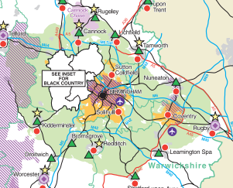
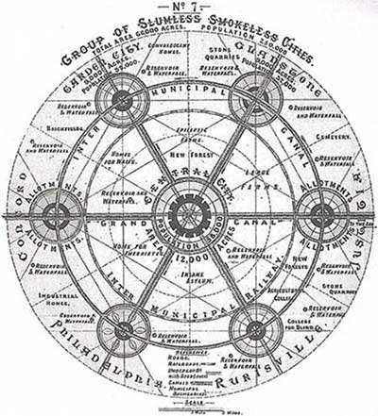
Regional Green Belt Governance
A CPRE campaigner in the West Midlands has helpfully set up criteria for a Green Belt Review:
• ‘It must be steered by a body without a vested interest in development;
• It must include representation by a wide range of interests – conservation and environmental bodies as well as developers.
• It must examine the strategic purpose of the Green Belt in question besides its geographical extent, for the two things go together.
• It must examine possible deletions from the Green Belt and possible additions to it on an equal footing. There must be equal potential for either change.
• A comprehensive review of the Green Belt should not take place within 15-20 years of the previous comprehensive review’.
(Letter from Jean Walters MRTPI to Andy Street, Mayor WMCA (2018)- quoted with permission)
https://www.google.co.uk/search?q=howard+garden+cities+of+tomorrow- originally from: Howard, 2003, p. 131)
West Midlands RSS: file:///C:/Users/cxg227/Downloads/APD_1_West_Midlands_Regional_Spatial_Strategy_January_2008.pdf
Notes:
Extract from the West Midlands RSS: file:///C:/Users/cxg227/Downloads/APD_1_West_Midlands_Regional_Spatial_Strategy_January_2008.pdf

Slide 21
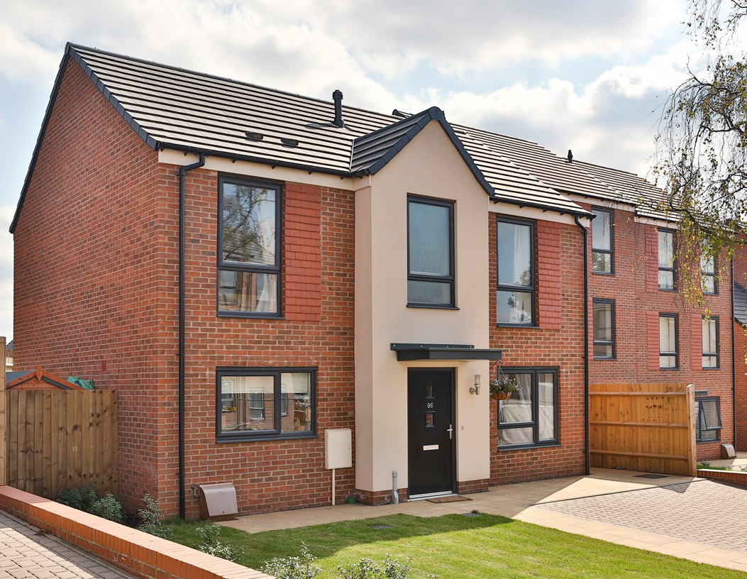
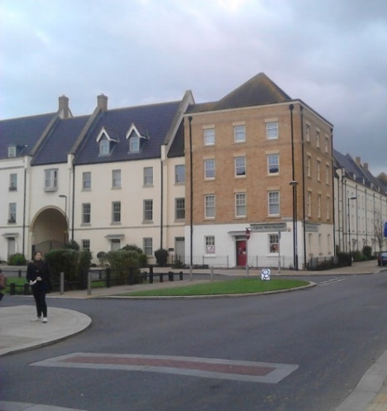
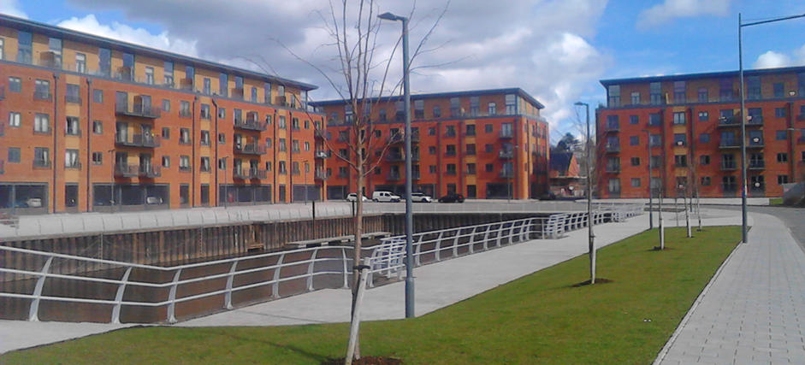
Thanks for listening!

Slide 22
References
Amati, M. and Taylor, L. (2010) ‘From green belts to green infrastructure’, Planning Practice and Research, 25(2), pp. 143–155.
Ball, M. et al. (2014) ‘Urban growth boundaries and their impact on land prices’, Environment and Planning A, 46(12), pp. 3010–3026.
Breheny, M. (1997) ‘Urban compaction: feasible and acceptable?’, Cities, 97(4), pp. 209–217.
Cherry, G. E. (1996) Town Planning in Britain Since 1900. Oxford: Blackwell Publishers.
Creswell, J. W. (2013) Research Design: Qualitative, Quantitative, and Mixed Methods Approaches. Third. London: Sage.
DCLG (2017a) Fixing our broken housing market. London.
DCLG (2017b) Local Planning Authority Green Belt: England 2016/17. London.
Elson, M. (1986) Green Belts: Conflict Mediation in the Urban Fringe. London: Meinemann.
Foglesong, R. (1986) Planning the Capitalist City: The Colonial Era to the 1920s. Princeton, NJ: Princeton University Press.
Foresight Report (2010) Land Use Futures Project: Final Project Report. London.
Hall, P. et al. (1973a) Containment of Urban England Volume Two. London: PEP.
Hall, P. et al. (1973b) The Containment of Urban England Volume One. London: PEP.
Hall, P. (1974) ‘The containment of urban England’, The Geographical Journal, 140(3), pp. 386–408.
Hall, P. (2002) Urban and Regional Planning. Fourth Edi. London: Routledge.
Harrison, C. M. (1981) ‘A playground for whom? Informal recreation in London’s Green Belt’, Area, 13(2), pp. 109–114.
Harrison, C. M. (1983) ‘Countryside recreation and London’s urban fringe’, Transactions of the Institute of British Geographers, 8(3), pp. 295–313.
Healey, P. et al. (1988) Land Use Planning and the Mediation of Urban Change. Cambridge: Cambridge University Press.
Hilber, C. A. L. (2015) ‘UK Housing and Planning Policies: the evidence from economic research’, Centre for Economic Performance, (May).
Hilber, C. A. L. and Vermeulen, W. (2014) ‘The Impact of Supply Constraints on House Prices in England’, Economic Journal, 126, pp. 358–405.
Howard, E. (1902) Garden Cities of Tomorrow. London: Swan Sonnenschein.
Kells, G. et al. (2007) What Price West Midlands Green Belts? London.
Lukes, S. (2004) Power: A Radical View. Second. Basingstoke: Palgrave.
Mace, A. et al. (2016) A 21st Century Metropolitan Green Belt. London.
Mace, A. (2018) ‘The Metropolitan Green Belt: Changing An Institution’, Progress in Planning, 121, pp. 1–28.
Manns, J. (2014) Green Sprawl: Our Current Affection for a Preservation Myth? London: London Society.
Morrison, N. (2010) ‘A green belt under pressure: The case of Cambridge, England’, Planning Practice and Research, 25(2), pp. 157–181.
Sturzaker, J. (2010) ‘The exercise of power to limit the development of new housing in the English countryside’, Environment and Planning A, 42(4), pp. 1001–1016.
Sturzaker, J. and Shucksmith, M. (2011) ‘Planning for housing in rural England: Discursive power and spatial exclusion’, Town Planning Review, 82(2), pp. 169–194.
Thomas, D. (1963) ‘London’s Green Belt: The Evolution of an Idea’, The Geographical Journal, 129(1), pp. 14–24.
Hickman, R. and Hall, P. (2008) ‘Moving the City East: Explorations into Contextual Public Transport- Oriented Development’, Planning Practice and Research, 23 (3), pp. 323-339.

Slide 23
Image Credits
(https://www.google.co.uk/search?q=howard+garden+cities+of+tomorrow- originally from: Howard, 2003, p. 131).
Abercrombie’s Green Belt- (Forshaw and Abercrombie, 1943, p. 40; reproduced in Thomas, 1963, p. 19).
From: https://www.google.co.uk/search, (Abercrombie, 1945, p. 78)).
Quilty-Harper, 2012, p. 1
https://en.wikipedia.org/wiki/History_of_Birmingham#/media/File:Birmingham_in_1886.jpg
https://www.google.co.uk/search?rlz=1C1GCEB_enGB789GB789&biw=1920&bih=969&tbm=isch&sa=1&ei=g8C0W-vAEu2OlwTQo7fwBw&q=austin+car+factory
https://www.google.co.uk/maps/@52.3595658
https://www.google.co.uk/maps/@52.3727316,-1.8860866,3a,76.4y,16.96h,75.89t/data=!3m6!1e1!3m4!1sjEOk3FpCisA5Ctm_1HIdIg!2e0!7i13312!8i6656
https://en.wikipedia.org/wiki/Chelmsley_Wood#/media/File:Chelmsley_Wood_Tower_Block.jpg
https://blythevalleypark.co.uk/about/gallery/
http://www.suttoncoldfieldrural.com/
https://www.google.co.uk/search?q=wheatley
https://www.google.co.uk/search?q=eddington+cambridge
http://www.telegraph.co.uk/news/politics
http://www.suttoncoldfieldrural.com/
http://www.itv.com/news/anglia/2015-02-02/a14
https://www.theguardian.com/uk
https://www.google.co.uk/search?q=surrey+downs
https://www.google.co.uk/maps/@51.5656999,0.3261107
https://www.cpre.org.uk/what-we-do/housing-and-planning/green-belts
https://www.google.co.uk/search?q=duncan+sandys
http://www.telegraph.co.uk/news/earth/greenpolitics/planning/9708387/Interactive-map-Englands-green-belt.html
https://www.cpre.org.uk/
https://www.google.co.uk/search?q=project+fields+sutton+coldfield
https://www.capitaproperty.co.uk/projects-folder/residential/bmht/
https://www.cpre.org.uk/what-we-do/housing-and-planning/green-belts
https://www.google.co.uk/maps/@51.4357495
http://www.suttoncoldfieldrural.com/
https://en.wikipedia.org/wiki/Finger_Plan#/media/File:Fingerplanen.jpg
All other images author’s own

