Slide 1
Containment: a normative frontier German metropolitan areas between „Innen- and Außenentwicklung“
Dr. Ute Knippenberger
architect and planner
City of Wiesbaden
Department of urban planning, head of urban design
ute.knippenberger@wiesbaden.de

Slide 2
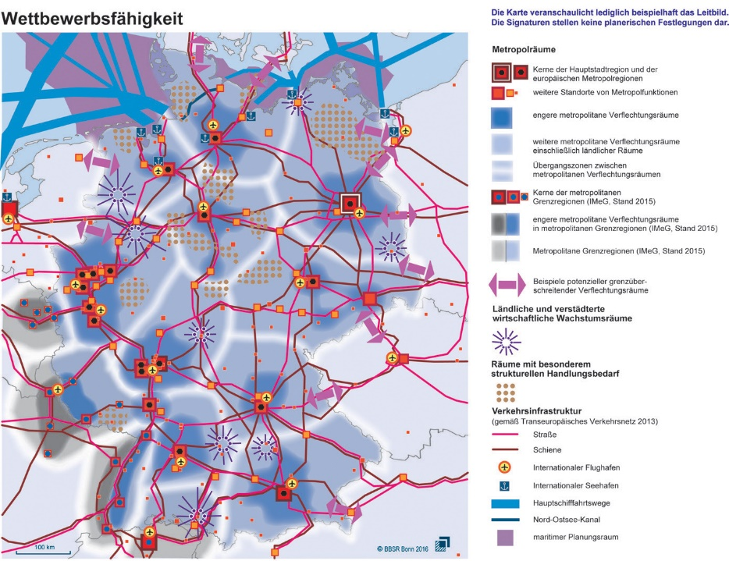
Germany Metropolitan Areas
Berlin
Cologne
Frankfurt/Main
Munich
Source: BBSR 2016, Bonn

Slide 3
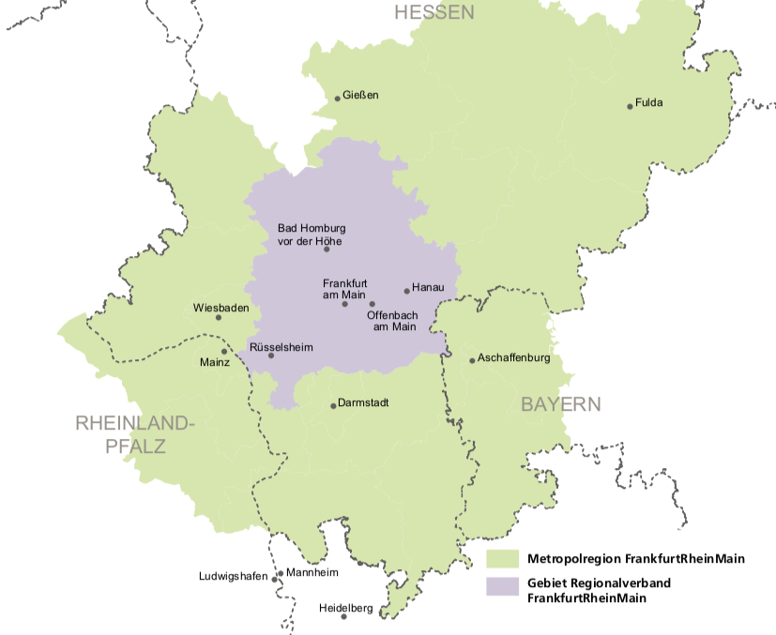
Rhine-Main Metropolitan Area
Source: Regionales Monitoring 2015, Regionalverband, Frankfurt am Main

Slide 4
Wiesbaden
290.743 population today
2014 bis 2030
+ ca. 17.000 inhabitants
State capital of Hessen
Adminstrative center, e.g. Federal criminal police office (BKA)
Headquarter U.S. Army
203 km2 area
Chemical industries
Famous wine region
Historical spa town
19th century architecture

Slide 5
Preparatory land-use plan Wiesbaden

Slide 6
Thesis
Containment instruments and increased nature conservancy concerns in German planning legislation have resulted in an activation of potentials within the built environment (Innenentwicklung) but are and will exacerbate housing shortage as they are preventing development at the urban fringes (Außenentwicklung).
Indicators are crowding effects and a continous growth in housing prices in the urban agglomerations, here the Rhine-Main conurbation.

Slide 7
Structure
Federal system
State: Länder
District: Region
Metropolregion
County: Kreis
City: Stadt
Source: Academy for Spatial Research and Planning: The Planning System and
Planning Terms in Germany, Elke Pahl-Weber, Dietrich Henckel (Eds.), Hanover 2008

Slide 8
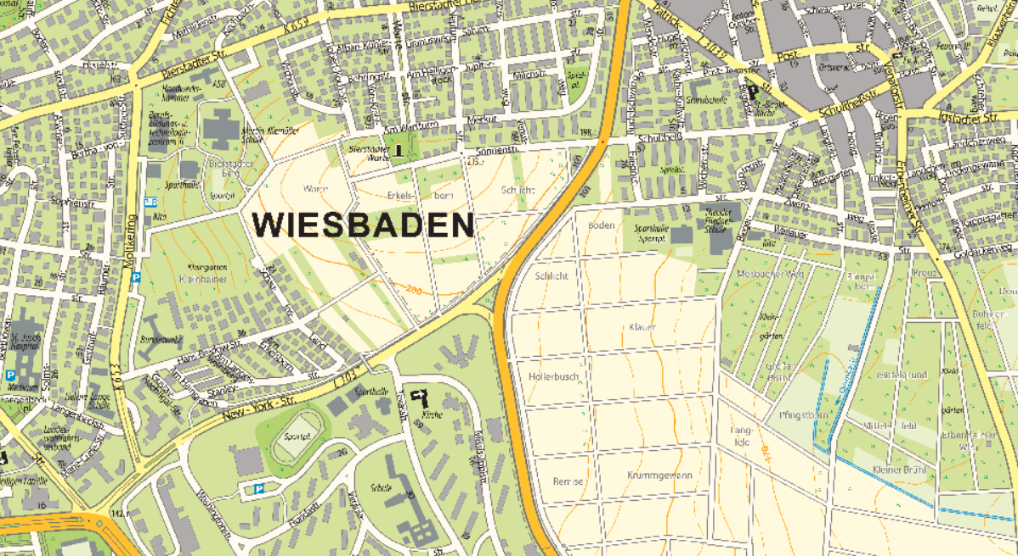
Containment policies in German planning
built-up area- Innenbereich
Binding land-use plan § 30 BauGB
§ 35 BauGB (Baugesetzbuch)
§ 34 BauGB
open range - Außenbereich

Slide 9
Legal structure
Baugesetzbuch + Baunutzungsverordnung
National Planning Law + Land-Use-Code
UVP-Gesetz implementation of Nr. 85/337/EWG followed by Nr. 97/11/EG 2001
Duty to eleborate an environmental report
environmental auditing has become obligatorial for all binding plans 2004 (exc. §13 und §13a BauGB)
Climate protection and adaptation („Klimanovelle“ 2011)
Innenentwicklung (2013)

Slide 10
Amendments in planning law „Baugesetzbuch“ „30-Hektar-goal sustainability“
acceleration
2004 | 2005 | 2006 | 2007 | 2008 | 2009 | 2010 | 2011 | 2012 | 2013 | 2014 | 2015 | 2016 | 2017 | 2018 | 2019
§13a
Bebauungsplan der Innenentwicklung
§13b
Bebauungsplan der Außenentwicklung
EAG Bau
UVP-Pflicht
„Klimanovelle“
Innen- vor Außenentwicklung
complexity
Source: Own diagram

Slide 11
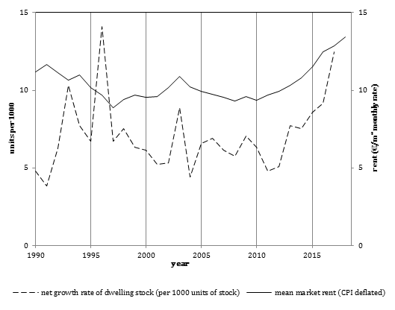
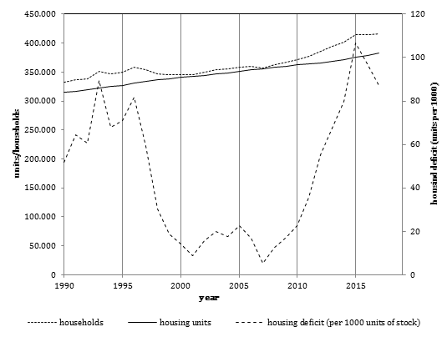
Housing market indicators*
* Numbers for Frankfurt/Main; Source: Institut Wohnen und Umwelt, Darmstadt 2019

Slide 12
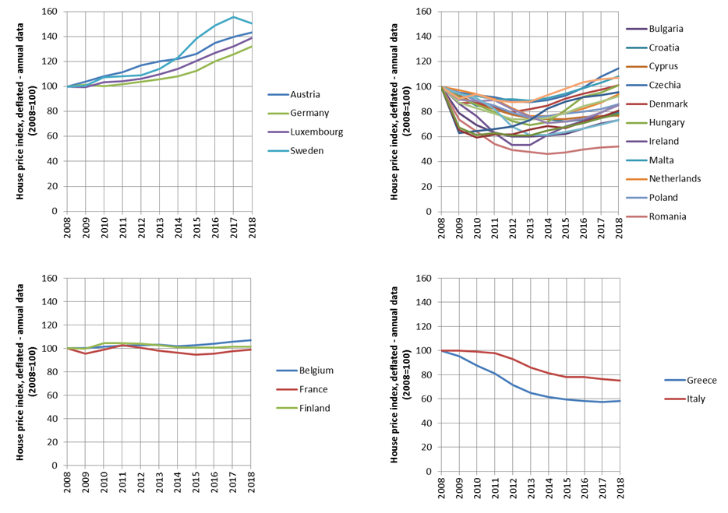
Housing prices since 2008 compared
Source: Eurostat / Institut Wohnen und Umwelt, Darmstadt 2019

Slide 13
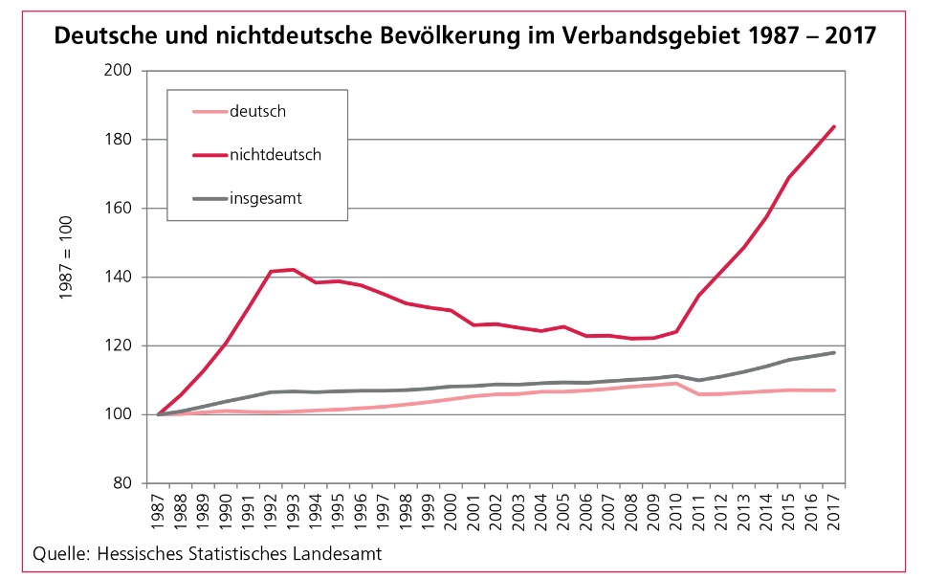
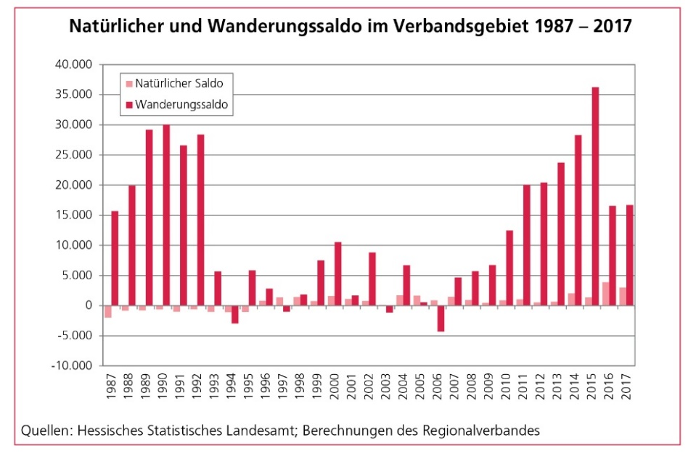
Growth factor migration
Source: Regionales Monitoring 2019, Regionalverband, Frankfurt am Main

Slide 14
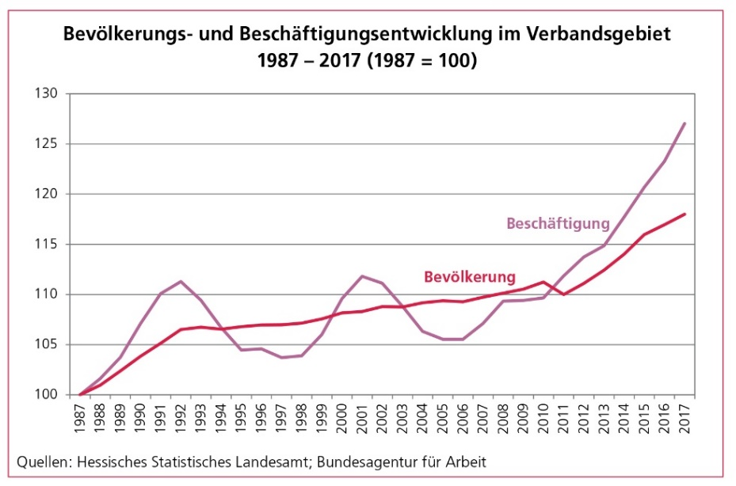
Job market + crowding effects
Source: Regionales Monitoring 2019, Regionalverband, Frankfurt am Main

Slide 15
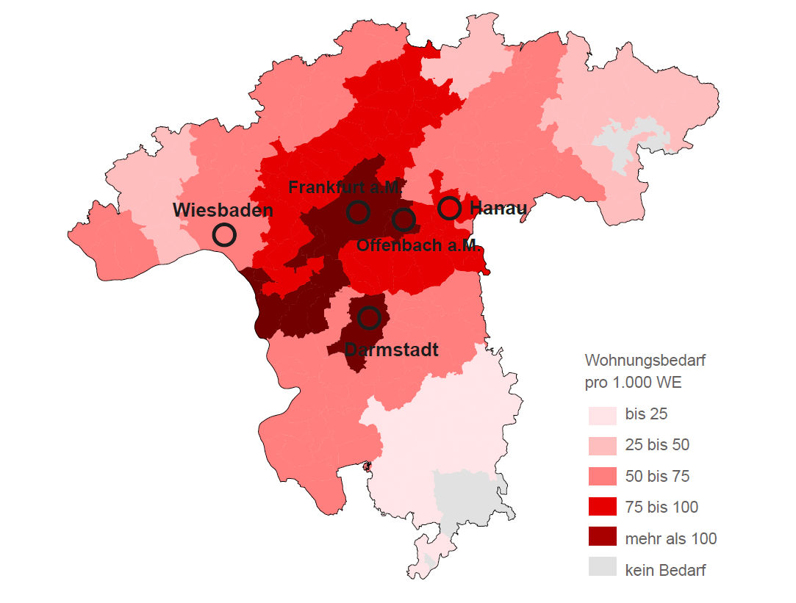
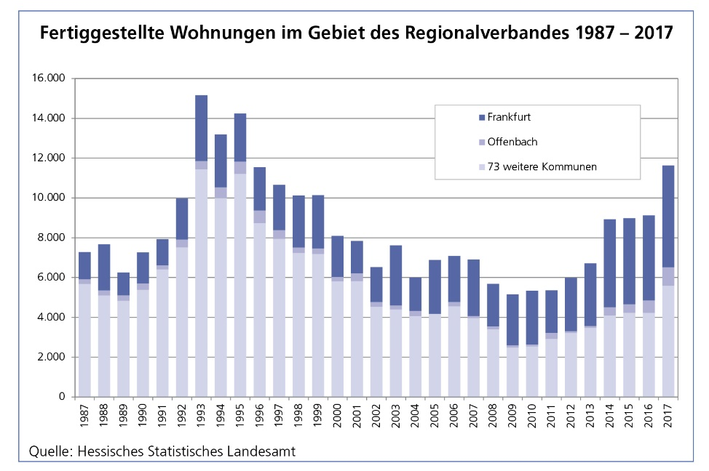
Housing deficit and completed units
Source: Regionales Entwicklungskonzept 2019, AS&P / Regierungspräsidium Darmstadt
Source: Regionales Monitoring 2019, Regionalverband, Frankfurt am Main

Slide 16
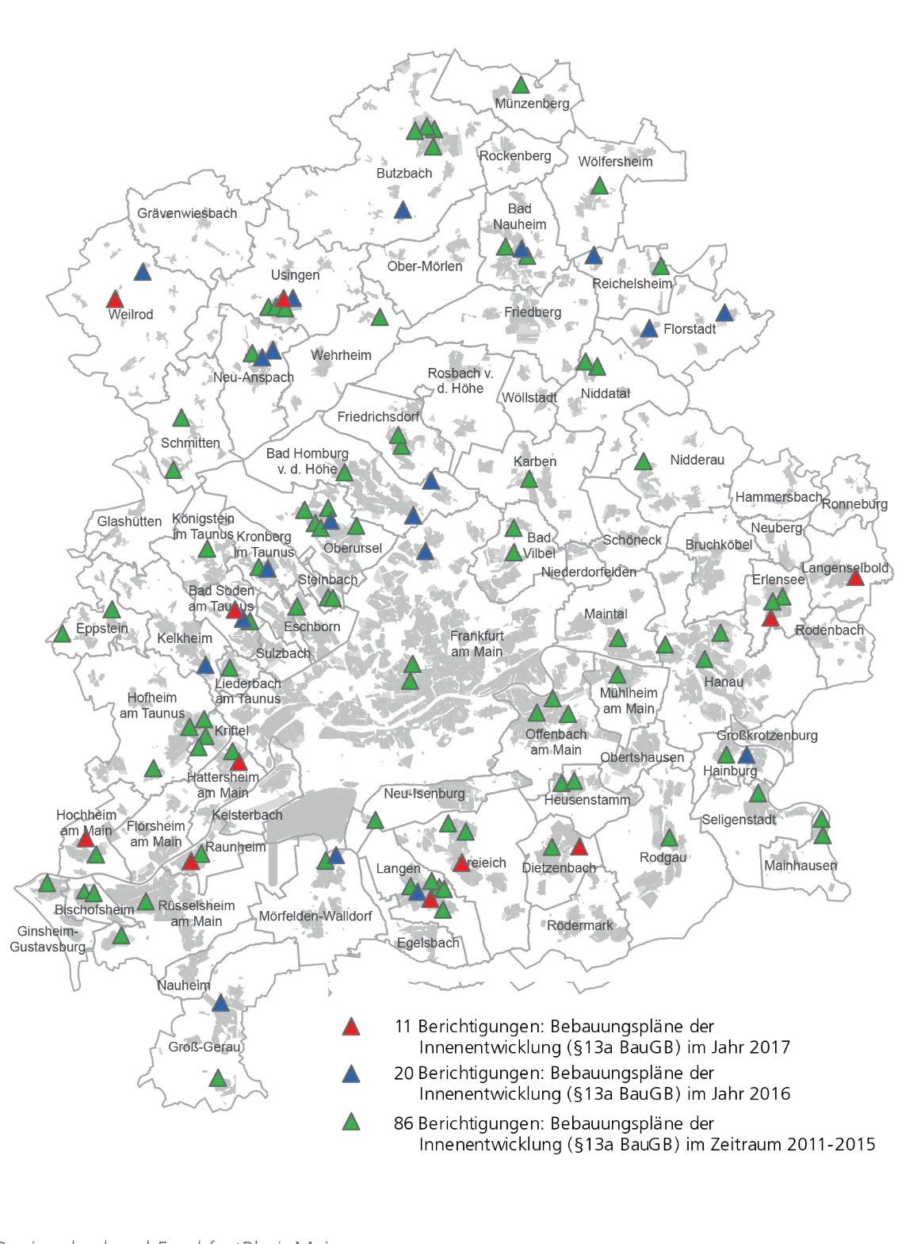
Instruments of Innenentwicklung
Source: Regionales Entwicklungskonzept 2019, AS&P / Regierungspräsidium Darmstadt

Slide 17
Potentials for „Außenentwicklung“
Source: Regionales Entwicklungskonzept 2019, AS&P / Regierungspräsidium Darmstadt

Slide 18
Conclusion
Growth derives mainly from migration at different levels
Natural population growth has become stable
Housing demands are generally not met
Demands are met mostly in Frankfurt
Many cities are using accelerated planning instruments
Further mitigation of demands will result in development outside built-up area

Slide 19
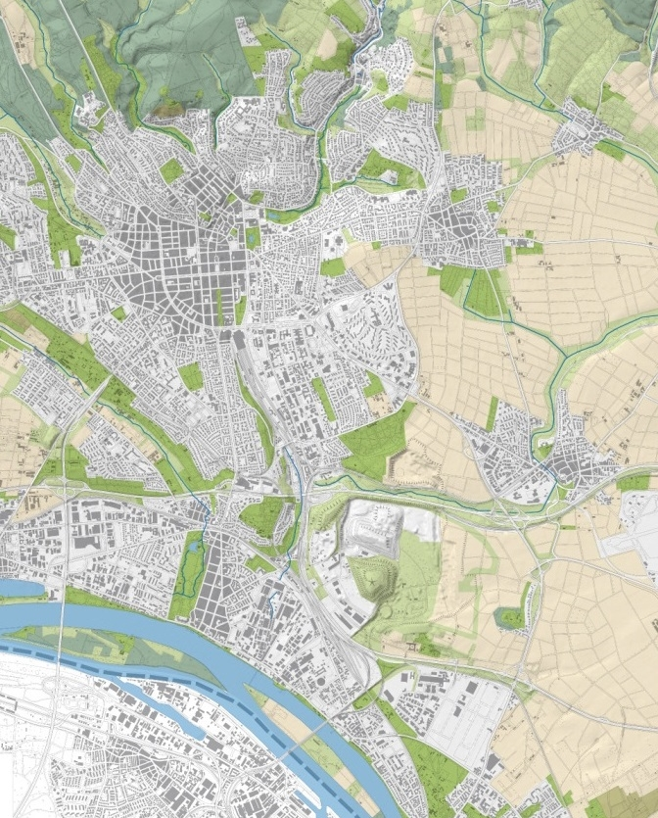
Perspective for Wiesbaden
Stadtentwicklungsmassnahme – Urban development measure
Biotop
Exploration area
Ostfeld
Siedlung „Fort Biehler“
Tier- und Cyperuspark

Slide 20
Rhine-Main landscape

Slide 21
A district for the region
FFM
OF
WI
Ostfeld
M Z
DA

Slide 22
Polarisation
Enhancement of planing complexity due to environmental protection and adaptation to climate change
Skyrocketing housing prices
Impossibility to meet demands
Action groups opposing development
Where do we go from here?

Slide 23
Containment: a normative frontier German metropolitan areas between „Innen- and Außenentwicklung“
Dr. Ute Knippenberger
architect and planner
City of Wiesbaden
Department of urban planning
ute.knippenberger@wiesbaden.de

Slide 24
Examples
Source: Academy for Spatial Research and Planning: The Planning System and
Planning Terms in Germany, Elke Pahl-Weber, Dietrich Henckel (Eds.), Hanover 2008

Slide 25
Rhine-Main Regional Plan
Hessen
Rhineland-Palatine

Slide 26
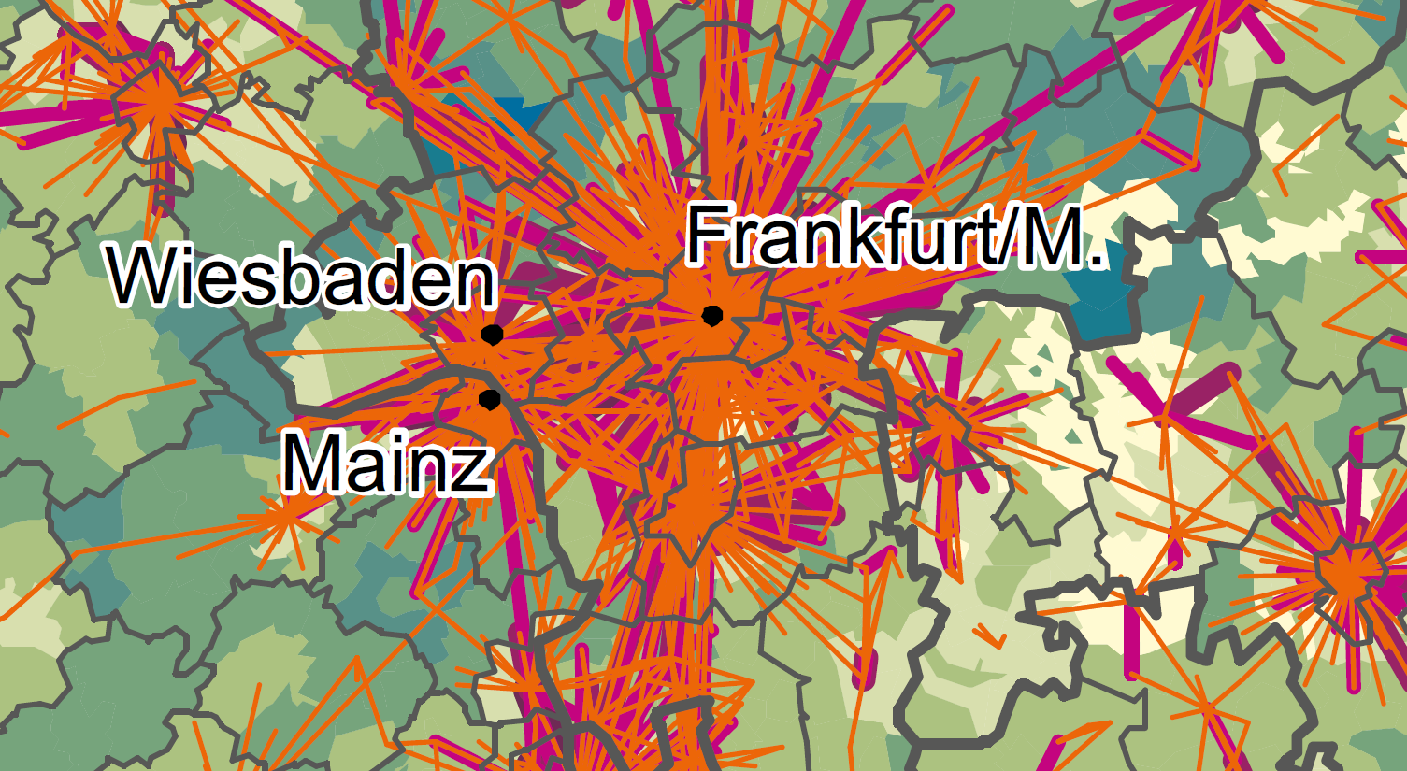
Commuting

Slide 27
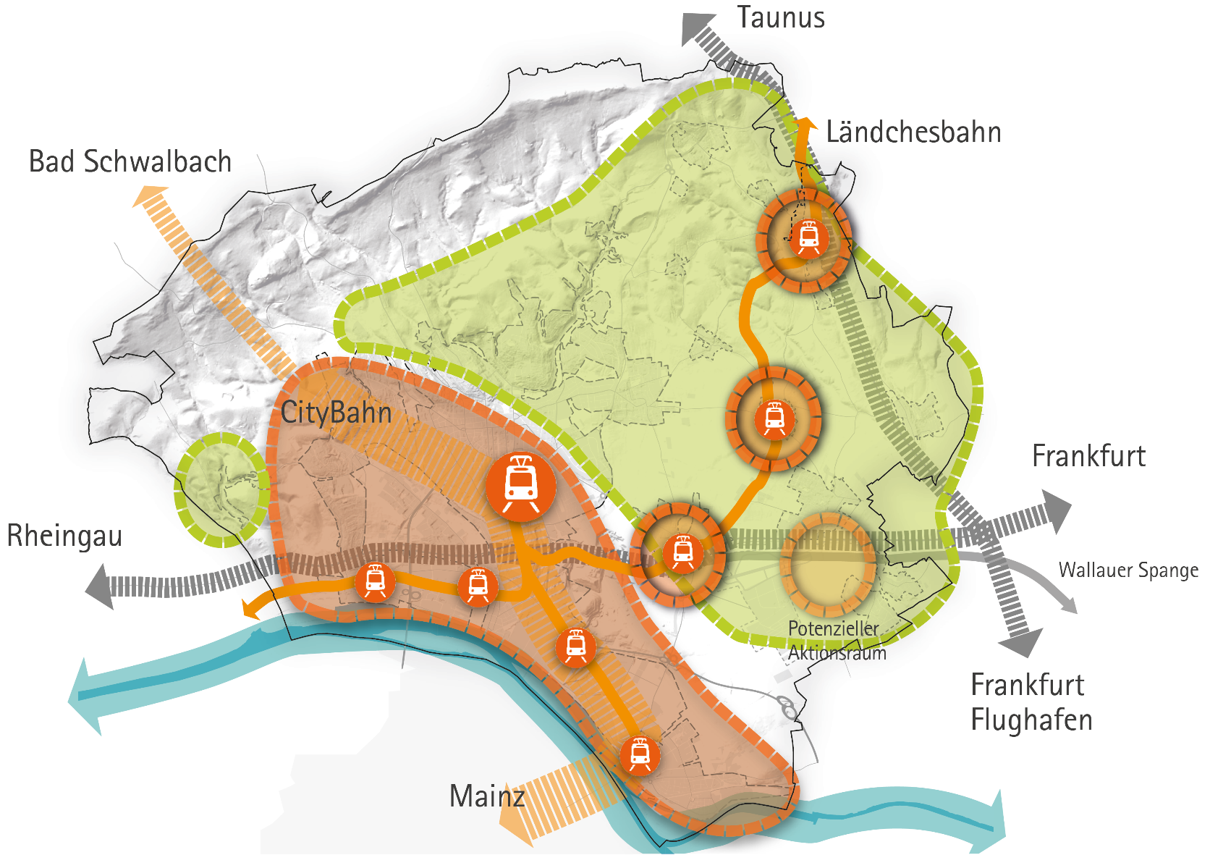
City development concept Wiesbaden

Slide 28
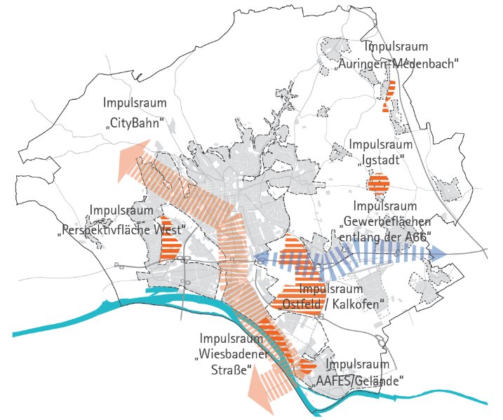
City development concept Areas of impulse

Slide 29
Legal structure
Baugesetzbuch
UVP-Gesetz
Duty to undergo a
Source: Academy for Spatial Research and Planning: The Planning System and
Planning Terms in Germany, Elke Pahl-Weber, Dietrich Henckel (Eds.), Hanover 2008

Slide 30
Binding land-use plan
Minimum duration 16-18 months
Bigger plans take longer 24+
Contracts prolong the procedure
Conflicts prolong it too
Source: Academy for Spatial Research and Planning: The Planning System and
Planning Terms in Germany, Elke Pahl-Weber, Dietrich Henckel (Eds.), Hanover 2008

Slide 31
Planning levels

