Slide 1
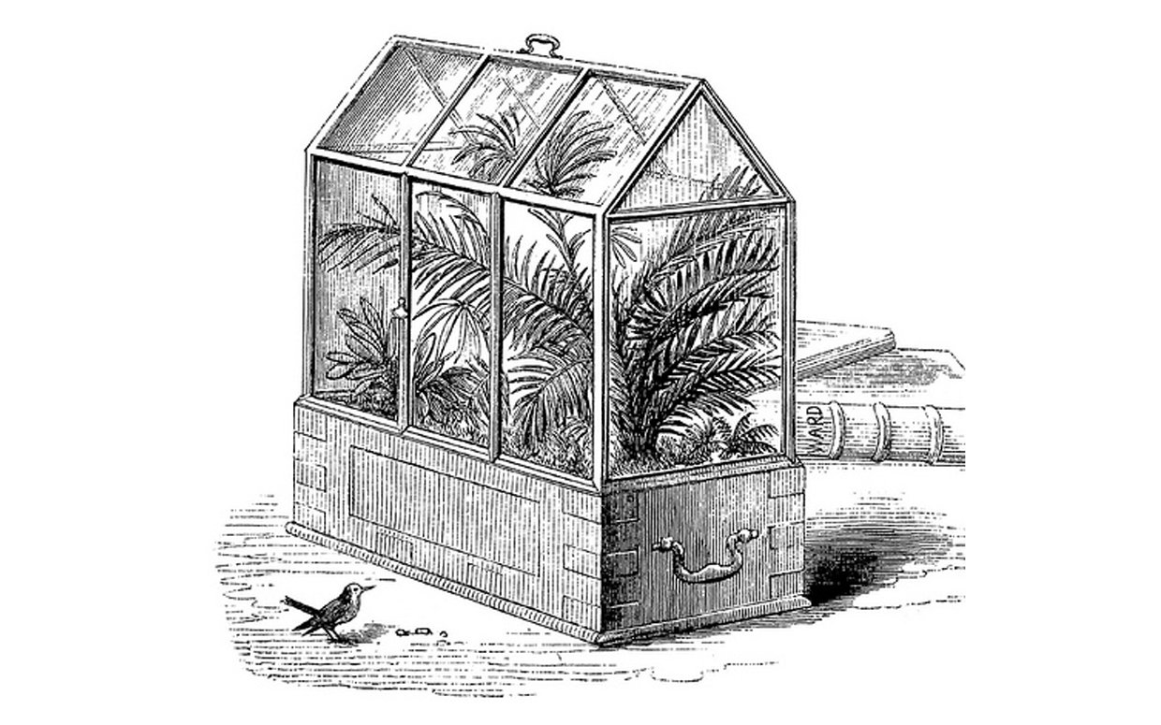
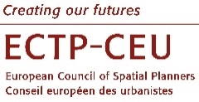
A WARDIAN CASE OF PLANNING
The Edge as a Preservation Mechanism
Karla Santos Zambrano
ECTP-CEU Young Planner
13th Biennial of European Towns and Town Planners 2019
Planning on the Edge
Plymouth, UK – 11-13 September, 2019
(Source: Wikipedia)

Slide 2
If you think good design is expensive, you should look at the cost of bad design.
(Dr. Ralf Speth)

Slide 3
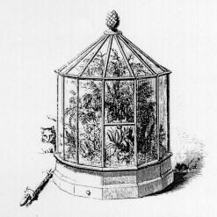
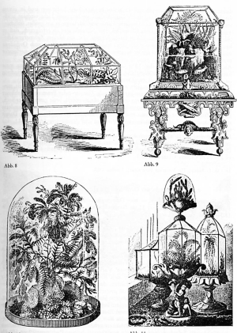
INTRODUCTION
A Wardian case of Planning: The Edge as a Preservation Mechanism
The Wardian case was invented by Nathaniel Bagshaw Ward as a form of terraria which helped carry and preserve living specimens for shipping across the world around the 1800s, merely for studying and/or research purposes.
“”
As early as the eighteenth century the form of the Wardian case was known, but not its combination of glass and use as an enclosed micro-system.
(Keogh 2018, p.1)
The introduction of the word ‘micro-system’ instinctively resonates with living habitats, territories, cities, also with the boundaries which can often define the footprint of a city and their idiosyncrasy. The use of the Wardian case as an analogy brings forth the matter of the edge as a preservation mechanism for any given territory.
Fluvial edges = many challenges + a plethora of choices within the realm of heritage and preservation of the built environment bordering the water, this is enhanced by climate change occurrences and urban development.
The recent trends in waterside regeneration highlight the issues of the approach taken by the Office of Public Works (OPW) involving a flood-defence scheme for the city of Cork, Ireland.
(Source: Wikipedia)

Slide 4
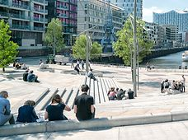
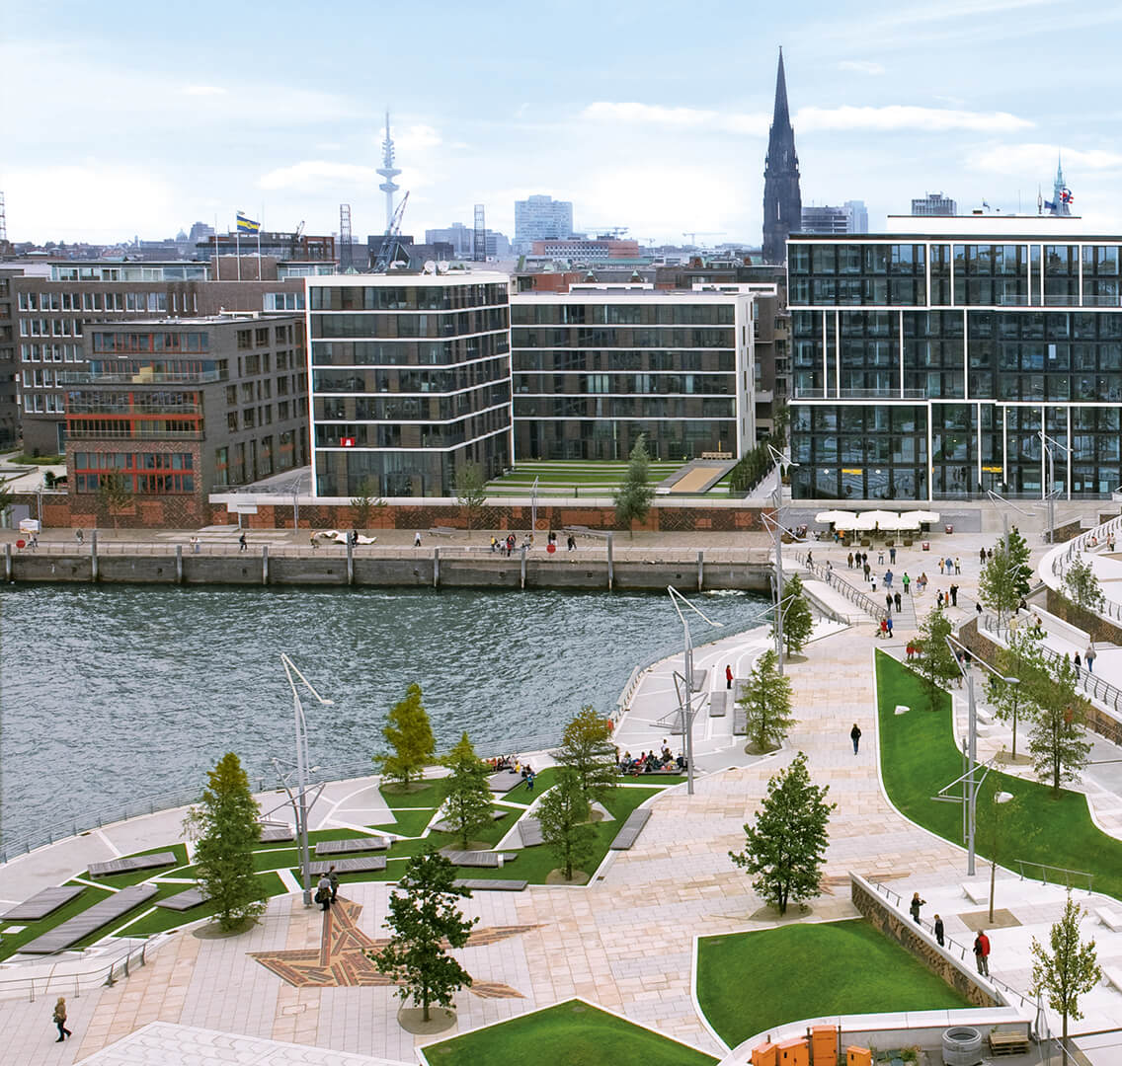
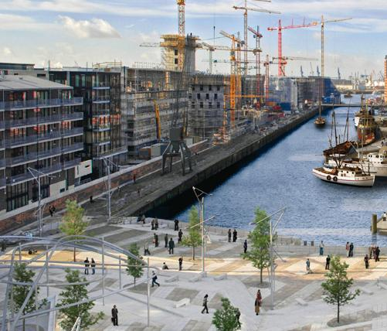
INTRODUCTION
A Wardian case of Planning: The Edge as a Preservation Mechanism
The Wardian case was adapted depending on the user’s needs: flood schemes rely heavily on the particularity of the place. […] By identifying elements which made other schemes successful via a review of case studies, certain aspects of said schemes could assist in finding a sustainable solution fit for the city by means of adaptation.
If ‘preservation’ seeks to maintain the existing state of a place and ‘adaptation’ means changing a place to suit the current-day needs of its inhabitants: is it possible to use both adaptation and preservation and refer to the edge as the city’s own preservation mechanism?
1. How can the edge act as a preservation mechanism?
2. What elements are being prioritised for preservation?
The city would need to become one with the edge, at a breaking point of merging with it.
Albeit a highly utopic view, it could be the answer the city is looking for—an edge which is a place of action dividing different conditions in an apparently immaterial space while attempting to preserve the character of the city.
(Source: Wikipedia)
…
(Source: HafenCity)

Slide 5
CONTEXT
Of Wardian cases and Inevitable changes
The Wardian case is an analogy for a city enclosed by its river—the main sustenance of its people, health, and economic development. In this way, the case becomes much more than an object.
[T]he global flows of migrants, commodities, and ideas surged through circuitry that, generally, became denser—but at different speeds and with various effects.
(Rosenberg 2012, p.7)
Increased global interconnectivity: interactions carry more impact and integration is even deeper, more pronounced, especially when the subject is the city.
In terms of planning, the Wardian case can be translated to ideas and concepts that could travel elsewhere and be adapted as deemed fit. Perhaps the success of some projects is their ability to be adapted to many locations and be able to contribute to the sustainable development of said place.
Variety in design could be applied to the same concept. The variations would aim to answer to the current needs of users and society, and we are no strangers to the changes perpetuating our environment.
Climate change poses a threat to our natural world and it is obvious that significant works may need to be carried out in order to preserve our habitats and built environment, or to find a different way of allowing nature and man-made structures to coexist in a manner that is sustainable for both.
“”

Slide 6
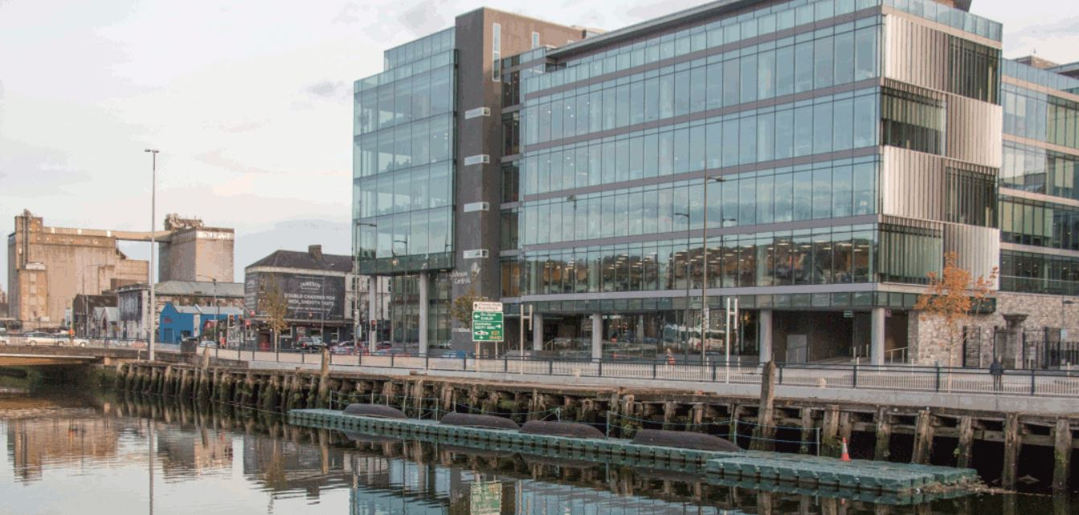
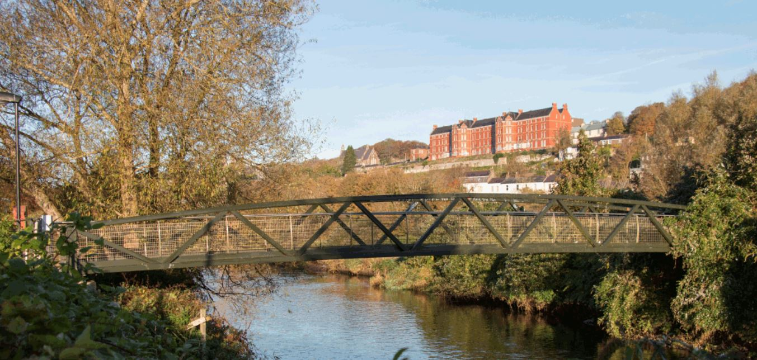
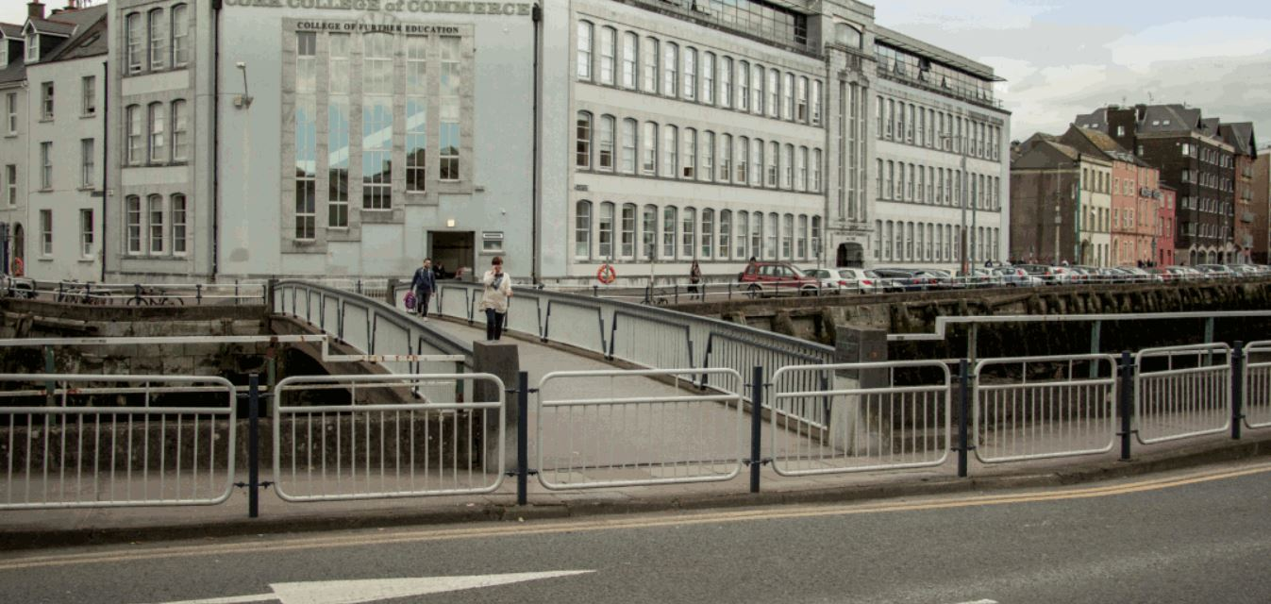
DESCRIPTION: CORK CITY
An Edge with a Purpose: Between the City and the River Lee
People and society will always have strong associations with their home and the encompassing elements of it.
The history of the River Lee carries a strong cultural significance, and even more so its relevance as an economic driver for the city and surrounding area.
The Office of Public Works Flood Relief Scheme
The Office of Public Works (OPW) proposed flood-defence scheme aims to provide flood relief to the areas identified at risk of flooding from the River Lee downstream of the Inniscarra Dam—including CorkCity.
Outcomes of the Scheme:
Permit greater discharges from the Inniscarra Dam without causing flooding of affected properties.
Provide protection along the Lower Lee and through Cork City against residual fluvial and tidal flooding.
The OPW flood-defence scheme for the Lower Lee (‘the Walls scheme’) has been criticised due to the foreseen severe impact on the visual amenity of the city. The approach does not seem appropriate nor sensible given the significance of this highly-regarded edge. Other examples prove to be better solutions without adversely affecting the area with such a significant intervention.
(Source: OPW)

Slide 7
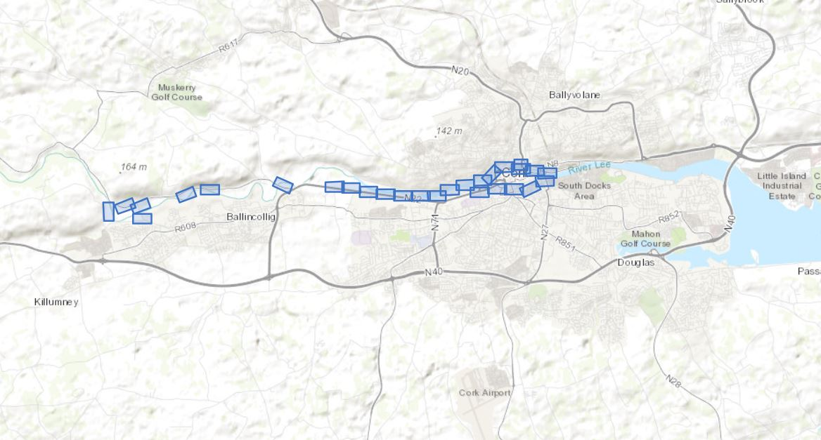
DESCRIPTION: CORK CITY
The Office of Public Works Flood Relief Scheme
Cork City
Inniscarra Dam
Proposed Tidal Barrier
(Source: OPW)

Slide 8
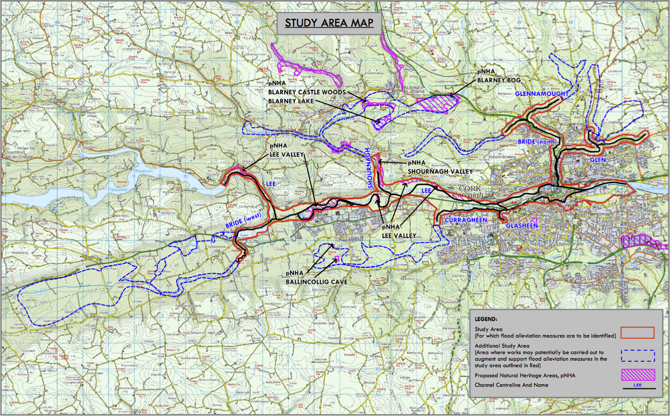
DESCRIPTION: CORK CITY
The Office of Public Works Flood Relief Scheme
(Source: OPW)

Slide 9
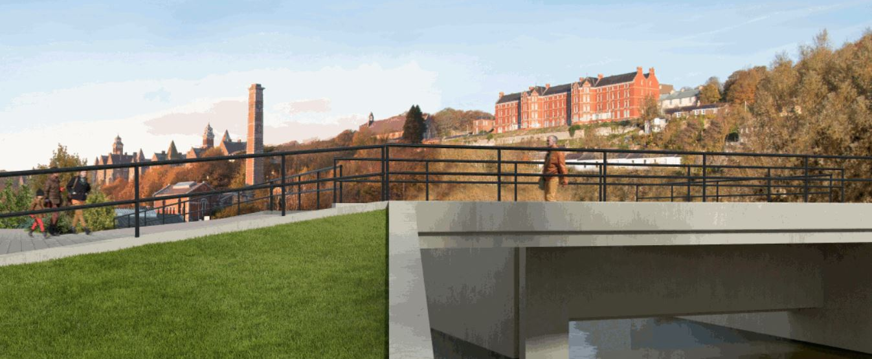
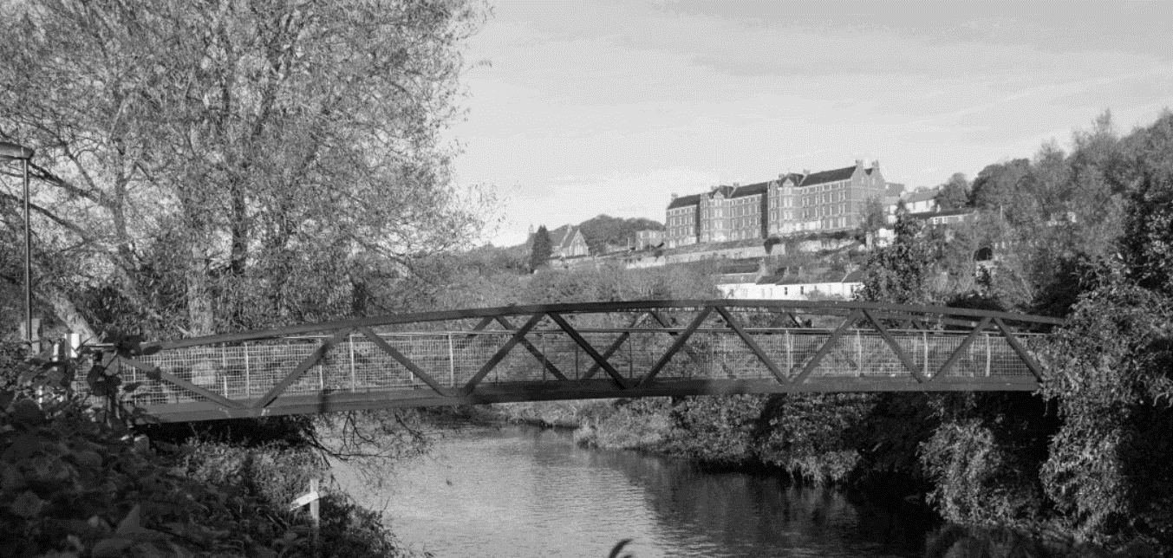
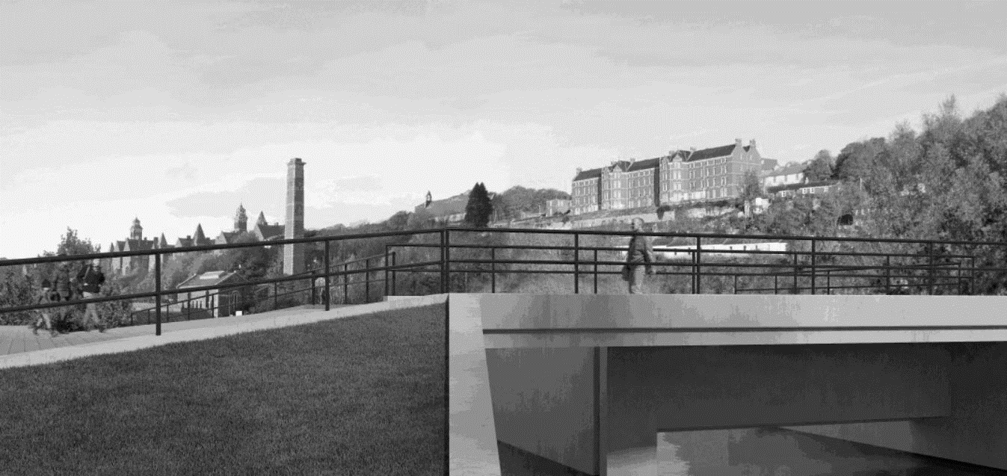
DESCRIPTION: CORK CITY
The Office of Public Works Flood Relief Scheme
(Source: OPW)

Slide 10
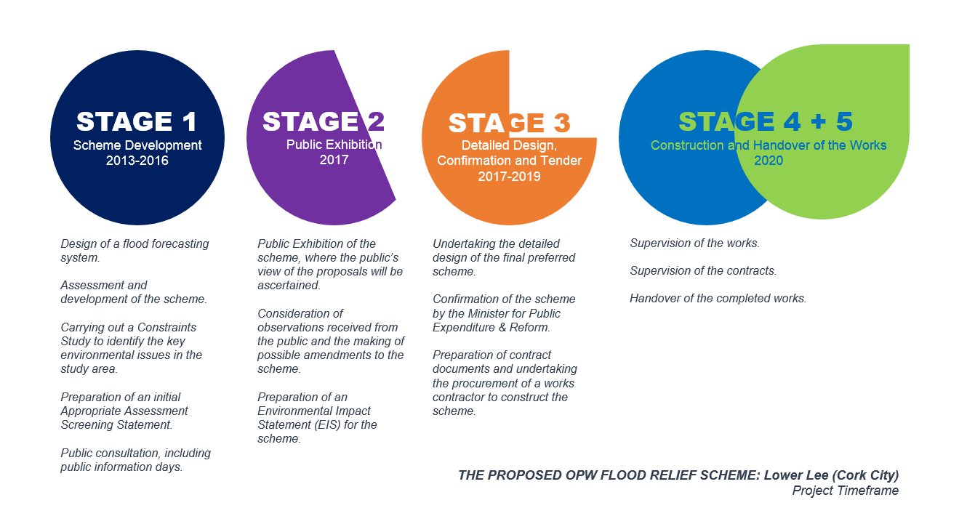
DESCRIPTION: CORK CITY
The Office of Public Works Flood Relief Scheme

Slide 11
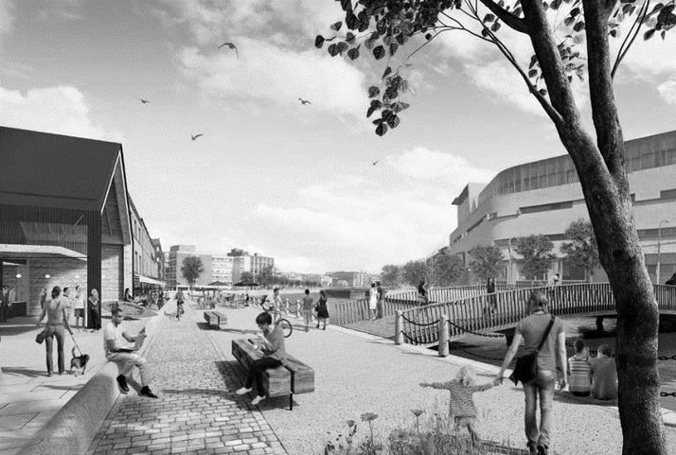
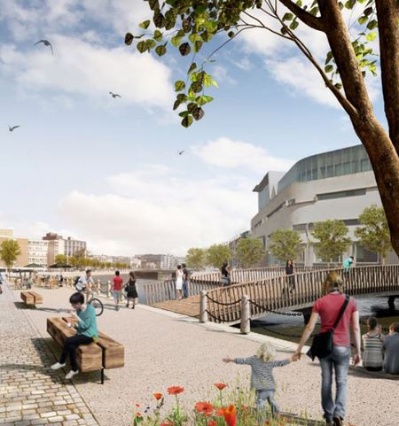
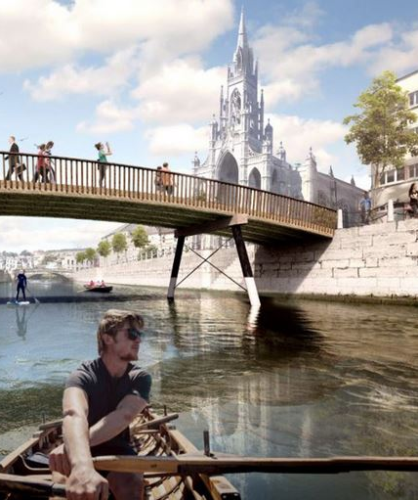
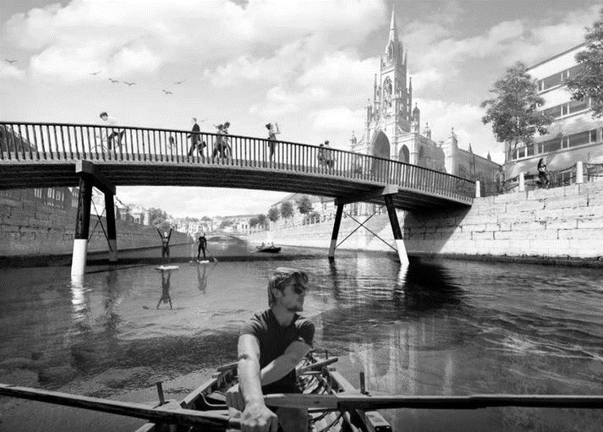
DESCRIPTION: CORK CITY
Community Engagement and a Three Point Plan
The ‘Save Cork City’ organisation was founded by professionals of the pertaining fields and members of the public. The organisation has engaged with the public and provided a comprehensive quantum of information in relation to the flood-defence scheme and also carried out a Design Competition that showcased the diverse uses which can be given to the edge and surrounding area.
The ‘Save Cork City’ campaign Three Point Plan:
1. Control of flooding using a downstream tidal barrier.
2. Restoration of the historic quay walls.
3. A combination of upstream catchment management measures.
This is considered to be the most appropriate and less intrusive solution for preserving the edge in a sustainable way—in contrast to the scheme proposed by the OPW.
(Source: Save Cork City)

Slide 12
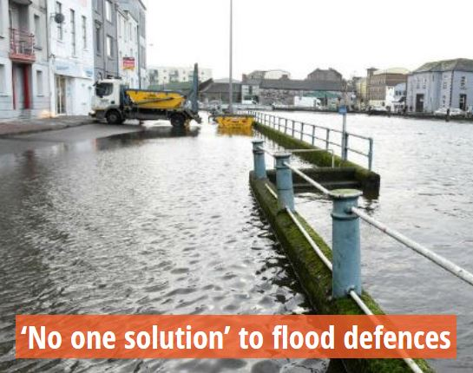
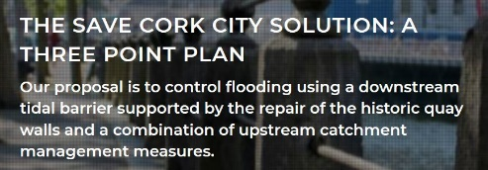
RESEARCH
Planning on the Edge and the Wardian case: An analogy
The Wardian case represents a comparable analogy to flood-defence schemes taking up the edge of a city.
The edge of the Wardian case was meant to avoid any interaction with the outside environment—thus it was passive. The edge of a city ought to do the opposite—it should be active.
When speaking of preservation and conservation, it is important to identify the actual elements we are seeking to preserve:
… Is it the man-made structures that physically sustain a city, or is there a more intangible element requiring our attention?
As planners, the answer to this question is vital in order to find the right solution—or at least the more sustainable and fitting solution—to this query. The proposals and designs vary depending on the current needs, much like the Wardian case varies in design to fit its purpose.
‘No one solution’ fits all, so we will look at a couple case studies which have succeeded in the past.

Slide 13
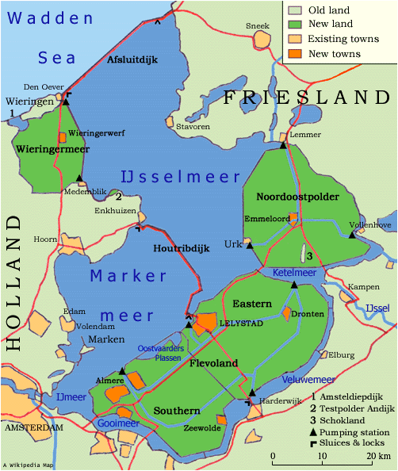
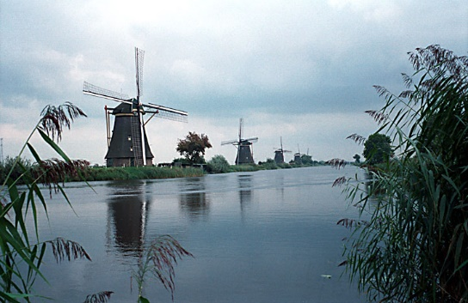
THE CASE STUDIES: FROM AMSTERDAM TO BELFAST
The Dutch Approach
Geographical location + Geological character = one option for survival of the Netherlands, hence why water-related schemes have become their expertise. The Netherlands recognise the need for innovation in their approach and have learned from experience what works best for a diversity of water fronts.
Flood Defences Projects:
The Zuiderzee Works (Zuiderzeewerken) are a system of dams, land reclamation, and water drainage works.
The Delta Works involves sea defences and the construction of the Oosterscheldekering, a storm surge barrier which is only closed during storms.
The country is vulnerable to flooding, and so flood control is vital for survival. Many flood-defence schemes comprise the approach taken by the Dutch, such as natural sand dunes and constructed dykes, dams, and floodgates against sea storm surges; and river dykes to prevent a fluvial flood, with all associated and complex drainage system consisting of ditches, canals, and pumping stations—i.e. renowned windmills.
(Source: Wikipedia)

Slide 14
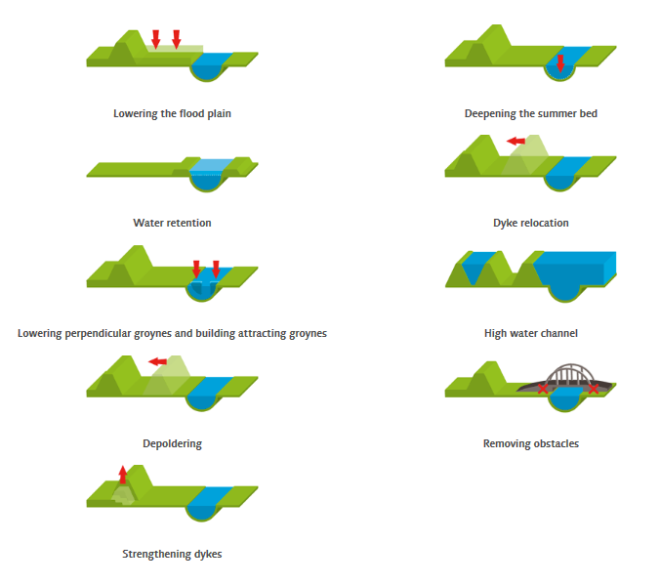
THE CASE STUDIES: FROM AMSTERDAM TO BELFAST
Room for the River & Climate Change
The predicted sea level rise is reason enough to pursue the strengthening of current sea defences…
…even if they remain stronger than ever as of today.
Room for the River introduces innovation and technology, constantly seeking for alternate or better solutions and relying on knowledge being shared across all platforms, thus enhancing flood protection techniques and approaches across the globe.
The approach of widening the rivers might only be suitable for certain places…
…but the vision of staying away from higher dykes (i.e. higher walls) denotes that the solution is elsewhere as dykes would eventually need to get higher due to a rising sea level and climate change–proving not to be a sustainable long term solution.
River or waterside activities (for an active use of the place)…
…those where spatial quality is enhanced, such as nature, recreation and community.
This proves that the Wardian case principle applies if we think of the edge as an active and accessible space.
(Source: Room for the River)

Slide 15
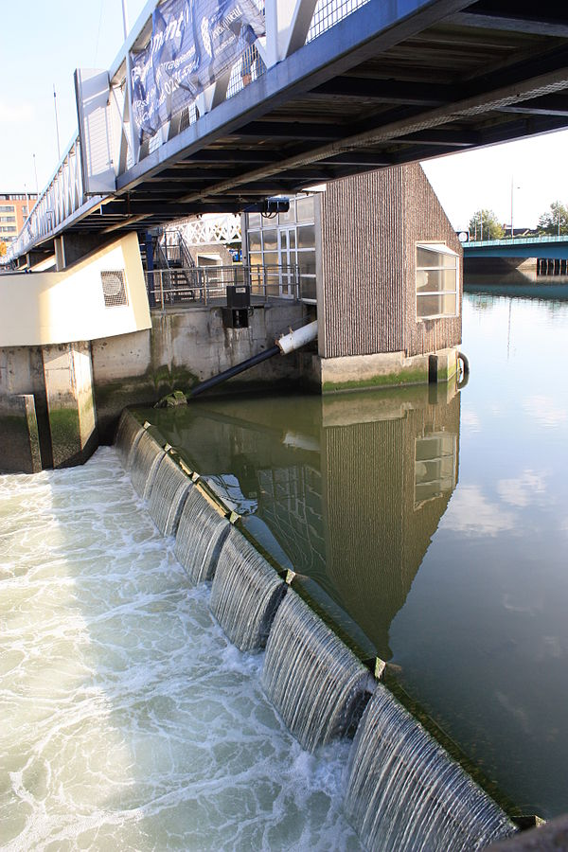
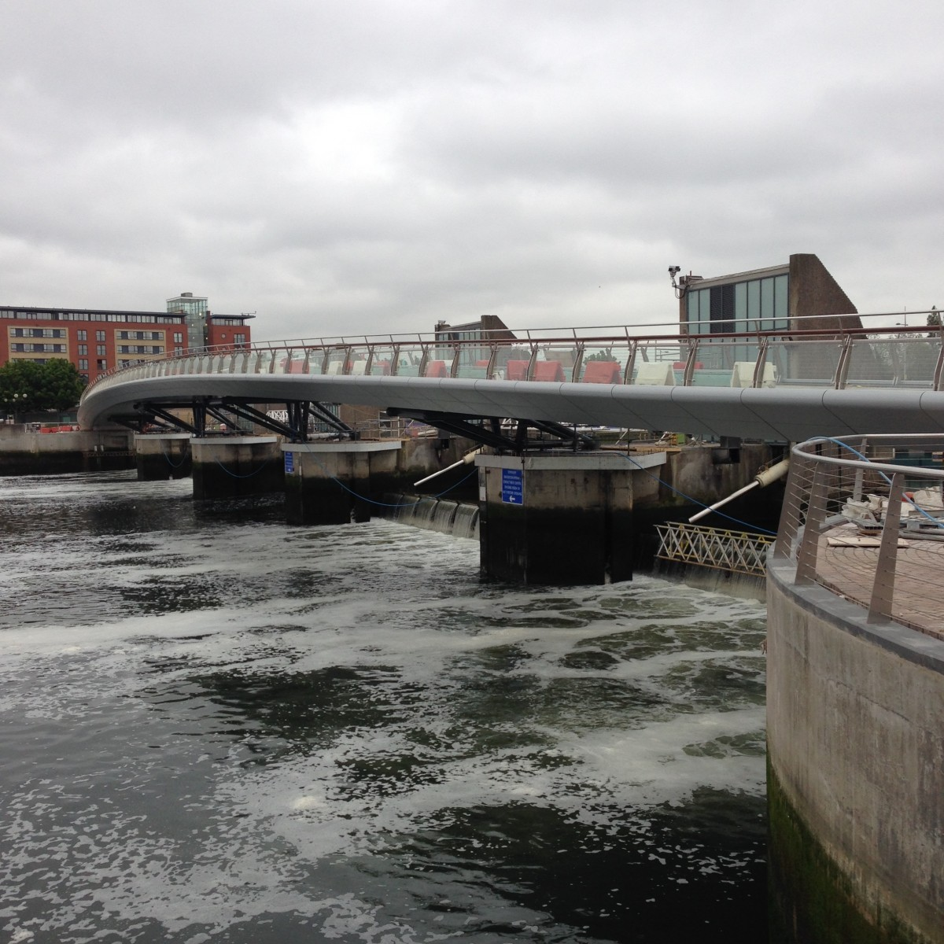
THE CASE STUDIES: FROM AMSTERDAM TO BELFAST
Laganside and the Lagan Weir
The Lagan Weir across the River Lagan is a tidal flood relief scheme completed in 1994 and located in the city of Belfast.
The scheme comprises…
a ‘Lookout’ which houses the control and surveillance system for the weir,
a Visitor’s Centre with the aim to inform all visitors about the project and the history of the River Lagan.
The Lagan Weir consists of five weir gates and four intermediate gatehouses which contain the weir gate motors. In the event of a high tide, the weir gates can function as a barrage, thus ensuring the river levels remain lower than the harbour levels while protecting the city from tidal flooding.
Essentially, the Lagan Weir is an operational Wardian case assisting in the preservation of a balanced ecosystem under appropriate conditions.
The re-establishment of the River Lagan as a focal point for the city of Belfast has had many benefits throughout the years, with the associated environmental improvements to the water quality and biodiversity as one of the main benefits and further riverside development (i.e. new residences, commercial and retail blocks, restaurants, and an improved public realm).
(Source: Google Images)

Slide 16
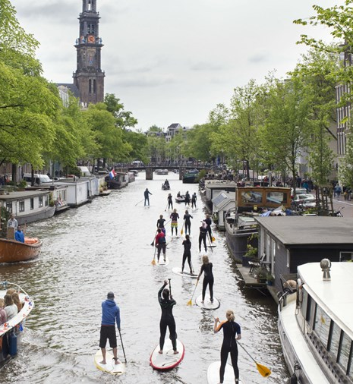
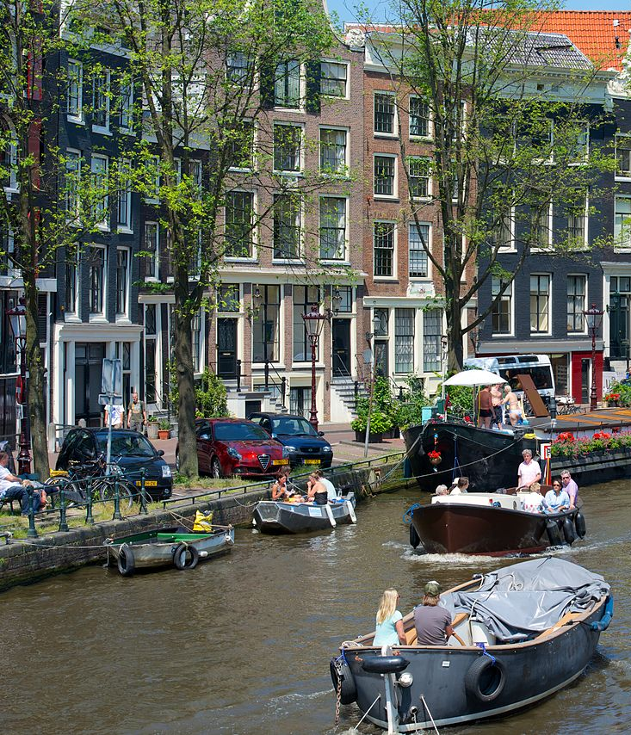
THE CASE STUDIES: FROM AMSTERDAM TO BELFAST
Waterside Regeneration: A Series of Successes
Waterside regeneration… a must.
Development in urban waterways… more attractive.
One of the reasons behind this is that waterways provide a commercially and socially attractive opportunity for restoration and regeneration—and this is particularly true for the city of Cork, where historically the streets used to be waterways continuously used for trade and transport.
The only downside?
…development which is detrimental to the area and fails to integrate with the existing character of the place—particularly those who are enriched by historical landmarks and social attachments.
When it comes to heritage sites, societal evolution has often led to the disuse and loss of a site’s original built purpose. However, the site still embodies cultural, historic, spatial and economic values and can be adapted to our current needs while preserving the pertaining valuable elements and making the place suitable for new uses and activities.
…this adaptability allows us to create more resilient and sustainable cities.

Slide 17
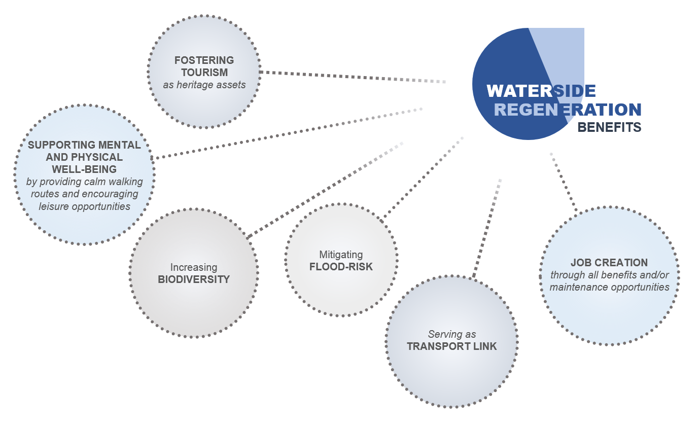
THE CASE STUDIES: FROM AMSTERDAM TO BELFAST
Waterside Regeneration: A Series of Successes

Slide 18
THE CASE STUDIES: FROM AMSTERDAM TO BELFAST
Preservation of the Fittest
The identification of the Wardian case as an artefact for the purpose of preserving any given micro-system allows for an analogy of a similar ‘case’ acting as the edge of the city.
Preservation…
[it] means maintaining a place in its existing state and retarding deterioration.
(The Burra Carter 2013, p. 2)
is appropriate where the existing fabric or its condition constitutes evidence of cultural significance, or where insufficient evidence is available to allow other conservation processes to be carried out.
(The Burra Charter 2013, p. 6)
Adaptation…
[a]daptation means changing a place to suit the existing use or a proposed use.
(The Burra Charter 2013, p. 2)
is acceptable only where the adaptation has minimal impact on the cultural significance of the place.
(The Burra Charter 2013, p. 7)
In relation to Cork…
[...] do as much as necessary to care for the place and to make it usable, but otherwise change it as little as possible so that its cultural significance is retained.
(The Burra Charter 2013, p.1).
“”
Adaptation more than preservation should be the solution for the city.
“”
“”
(Source: Wikipedia)

Slide 19
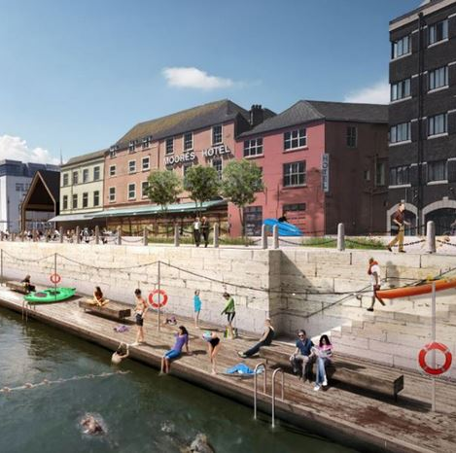
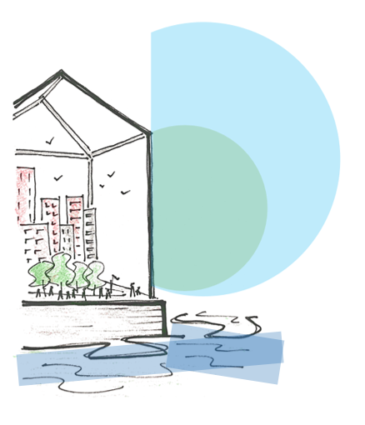
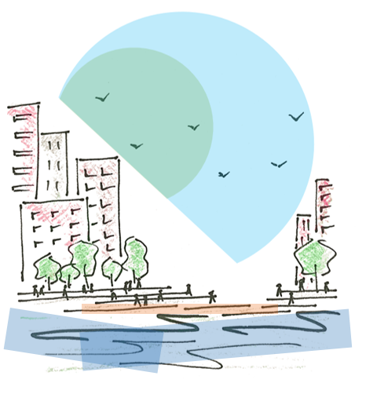
THE CASE STUDIES: FROM AMSTERDAM TO BELFAST
The Edge as a Preservation Mechanism: Active vs Passive
An interesting approach in art techniques and methods used by Jackson Pollock…
…a kind of sensed but not yet materialised line, a result of transitional works where line no longer indicated the edge of a plane but a sort of optically imprecise ‘place’.
This imprecise place would refer to the edge. It appears simple, but the boundaries of an edge can be rather complex—especially when the built environment is involved.
(Source: Save Cork City)
The creation of this imprecise place can be seen in the following illustrations which aim to distinguish a physical tangible edge from another physical yet intangible one.

Slide 20
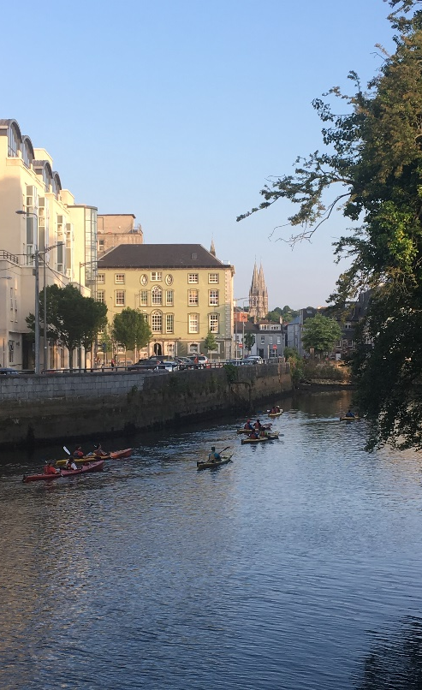
THE CASE STUDIES: FROM AMSTERDAM TO BELFAST
The Edge as a Preservation Mechanism: Active vs Passive
Amsterdam...
their success could be due to the uses given to the river and canals and the seemingly invitation of the open space towards the river. This active use of the canals by the people and the city’s openness to it has led to the significant and constant work towards maintaining and preserving this status.
Belfast…
provides activity around the river and over bridges, the city has acknowledged the river in a different and yet successful way, making the most of their waterside history.
While this was not always the case…
Cork…
has done the opposite in the past by turning its back to the river, with several developments turning a blind eye on it and not incorporating the waterside element at all. The rehabilitation of the River Lee has led to different approaches, one that is more in keeping with current research and relates to the re-connection of the river to the city—more so than it ever was.

Slide 21
CONCLUSION
A Wardian case of Planning: The Edge as a Preservation Mechanism
A conclusion… the use of the edge as a preservation mechanism with inclinations to adaptability. Preservation will only maintain the physical and organic features—but adaptation with a focus on conservation will allow the organism, i.e. the city, to grow sustainably and its community to thrive.
an active, collaborative process among public and private stakeholders is necessary—in all aspects of planning—for development to be successful.
(Santos Zambrano 2018, p.174)
The Room for the River project presented by the Netherlands has proven to heavily rely on collaborative efforts supporting a “mutual sharing of knowledge” (Room for the River 2019).
As for the Wardian case… this same principle can be applied to a city’s edge, although not in the same enclosed conditions as it would not work. A city is not an isolated system and thus it is vital for the edge to be in constant interaction with all its parts.
The role of the Wardian case as an analogy has allowed for different fields to come together in the attempt to find a sustainable solution to planning on the edge. The aspects that revolve around the planning industry are intricate and extremely varied, which makes reaching a final solution all the more complex.
…it can be concluded that the use of the Wardian case principle with an active edge is the more sustainable preservation mechanism and thus can help achieve the balance between nature, people and the built environment.
“”

Slide 22
Flood risk management plans should focus on prevention, protection and preparedness. With a view to giving rivers more space, they should consider where possible the maintenance and/or restoration of floodplains, as well as measures to prevent and reduce damage to human health, the environment, cultural heritage and economic activity.
(EU Floods Directive 2007, p.263)

Slide 23
THANK YOU!
REFERENCES
Council Directive (EC) 2007/60/EC of 23 October 2007 on the assessment and management of flood risks, available: https://eur-lex.europa.eu/eli/dir/2007/60/oj [accessed 11 May 2019].
Daseking, W., Köhler, B. and (2012) The Freiburg Charter for Sustainable Urbanism, London: Academy of Urbanism, available https://www.academyofurbanism.org.uk/freiburg-charter/ [accessed 09 July 2019]
Department for Infrastructure, An Roinn Bonneagair (2017) Belfast Tidal Flood Alleviation Scheme [online], available: https://www.infrastructure-ni.gov.uk/articles/belfast-tidal-flood-alleviation-scheme [accessed 04 Apr 2019].
English, E. (2018) ‘No one solution to flood defences’, Irish Examiner, 04 Feb, available https://www.irishexaminer.com/ireland/no-one-solution-to-flood-defences-466664.html [accessed 12 May 2019].
English, E. (2019) ‘Flood-defence scheme process as long and winding as the River Lee’, Irish Examiner, Cork on the Rise, 26 Apr, 18-19.
Grist, B. (2012) An Introduction to Irish Planning Law, 2nd ed., Dublin: IPA Publishing, Chapters 15 and 16.
Higgins, A. (2012) ‘Lessons for U.S. From a Flood-Prone Land’, The New York Times, 14 Nov, available https://www.nytimes.com/2012/11/15/world/europe/netherlands-sets-model-of-flood-prevention.html [accessed 04 April 2019].
Keogh, L. (2018) ‘The Wardian Case: Environmental Histories of a Box for Moving Plants’, Environment and History, 25(2), published as Fast Track on April 2018.
The Office of Public Works (OPW) (2013) Major Flood Schemes [online], available: https://www.opw.ie/en/floodriskmanagement/floodriskmanagementoperations/majorflooddefenceschemes/ [accessed 10 Apr 2019].
The Office of Public Works (OPW) (2018) Lower Lee (Cork City) Flood Relief Scheme – Project Info Morrison’s Island [online], available: https://www.lowerleefrs.ie/project-info-morrisons-island/ [accessed 10 Apr 2019].
Robinson, A. (2019) ‘On the waterfront: The rise of waterside regeneration’, The Planner, 05 Apr, available https://www.theplanner.co.uk/features/on-the-waterfront-the-rise-of-waterside-regeneration [accessed 10 April 2019].
Roche, B. (2018) ‘Cork councillors approve controversial flood protection plan’, The Irish Times, 15 May, available https://www.irishtimes.com/news/ireland/irish-news/cork-councillors-approve-controversial-flood-protection-plan-1.3496705 [accessed 11 May 2019].
Room for the River (2019) Room for the River Programme [online], available: https://www.ruimtevoorderivier.nl/english/ [accessed 27 Jun 2019].
Rosenberg, E. (2012) A World Connecting: 1870-1945, ed., Cambridge, MA: Belknap Press, 7.
Santos Zambrano, K. (2018) ‘The Edge of an Airport City’, in ECTP-CEU, ed., ECTP-CEU Young Planners Workshop 2018 Airports, Cities and Urban development, Brussels: ECTP-CEU, 160-176.
Save Cork City (2018a) Good Design in Historic Places [online], available: http://savecorkcity.org/content/good-design-historic-places [accessed 11 Apr 2019].
Save Cork City (2018b) History of Cork [online], available: http://savecorkcity.org/content/history-cork [accessed 11 Apr 2019].
Save Cork City (2018c) Our Campaign [online], available: http://savecorkcity.org/content/our-campaign [accessed 11 Apr 2019].
Save Cork City (2018d) The Save Cork City Solution: A Three Point Plan [online], available: http://savecorkcity.org/content/our-proposals [accessed 11 Apr 2019].
Save Cork City (2018e) The Walls Scheme [online], available: http://savecorkcity.org/content/morrisons-island [accessed 11 Apr 2019].
Scannell, Y. (2006) Environmental and Land-Use Law, 2nd ed., Dublin: Thomson Round Hall, Chapter 4.
Simmons, G. (2007) Planning and Development Law, 2nd ed., Dublin: Thomson Round Hall, Chapter Eight.
The Burra Charter: The Australia ICOMOS Charter for Places of Cultural Significance, 2013, available https://australia.icomos.org/wp-content/uploads/The-Burra-Charter-2013-Adopted-31.10.2013.pdf [accessed 09 Jul 2019]
Wikipedia (2019, March 20) ‘Lagan Weir’, available: https://en.wikipedia.org/wiki/Lagan_Weir [accessed 04 Apr 2019, 19h30].
Wikipedia (2019, April 30) ‘Flood control in the Netherlands’, available: https://en.wikipedia.org/wiki/Flood_control_in_the_Netherlands [accessed 04 Apr 2019, 18h45].

