Slide 1
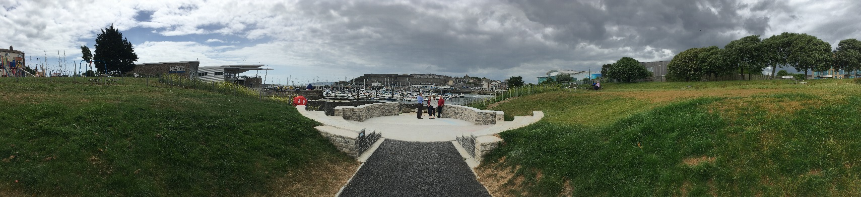
Teat’s Hill: An urban acupuncture intervention for health & wellbeing in a deprived coastal community
Mat White (Exeter Uni), Jemma Sharman (Plymouth CC), Zoe Sydenham (Plymouth CC)
(+Simon Bell, Lewis Elliott, Himansu Sekha Mishra, Gloria Niin, Rebecca Shellock, Nicole van den Bogerd & Peeter Vassiljev)
mathew.white@exeter.ac.uk

Slide 2
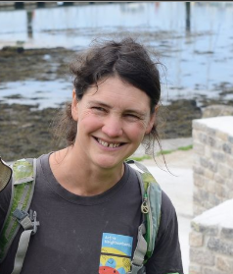
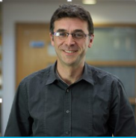
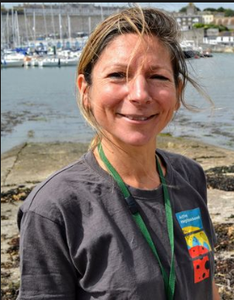
Talk overview
Active neighbourhoods: A quick overview
Teat’s Hill: Site, process, renovation
Outcomes: Environment
Outcomes: Health & well-being
Local level management
Wider policy & practice implications

Slide 3
Talk overview
Active neighbourhoods: A quick overview
Teat’s Hill: Site, process, renovation

Slide 4
Active Neighbourhoods
3-year project based in Plymouth and aims to get more people being more active and feeling better by using, improving and caring their local green/blue spaces.
Partnership project between Plymouth City Council , Devon Wildlife Trust (DWT) and Public Health’ and funded by the Big Lottery Fund’s Reaching Communities programme (£419k). Match funding includes PCC S106 developer contributions and BlueHealth
Neighbourhoods within AN experience high health inequalities and have urban greenspaces that have suffered from neglect
More than one third of Plymouth is greenspace and it’s surrounded by blue space on its coast, with rivers and streams running through it

Slide 5
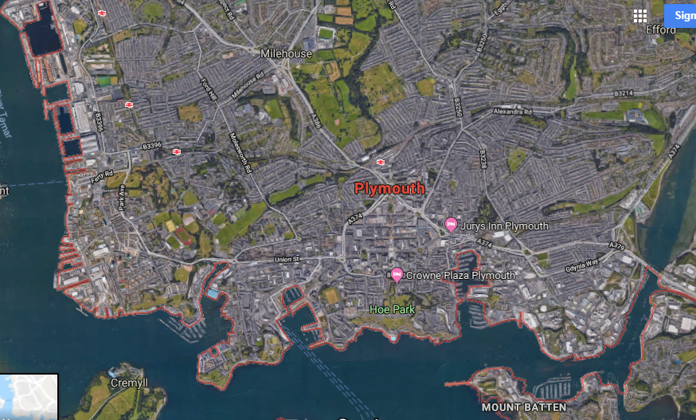
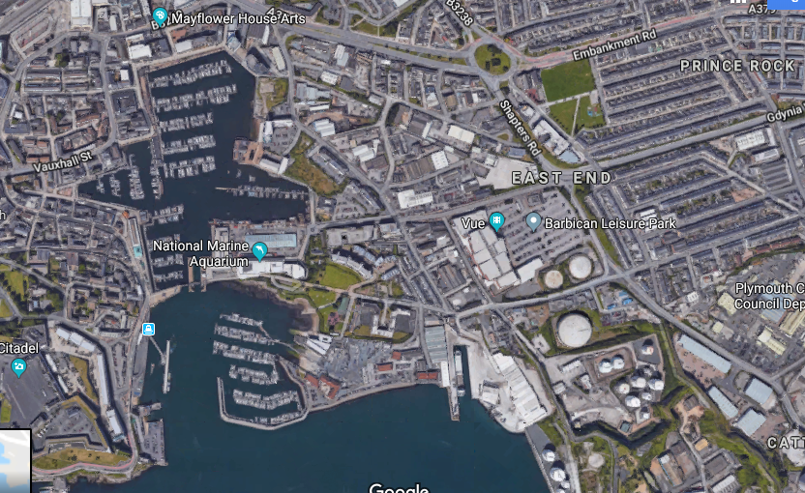
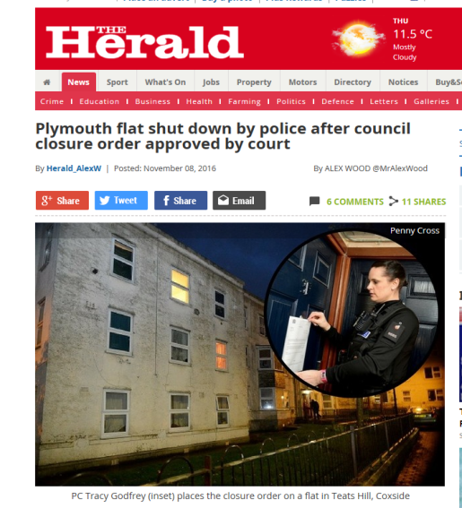
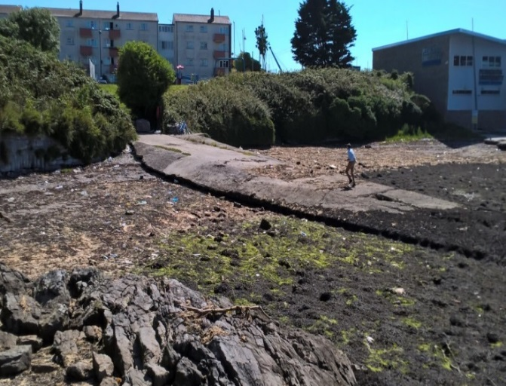
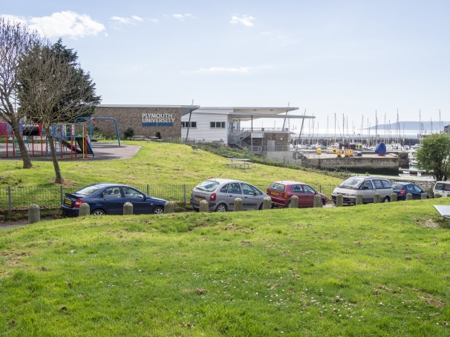
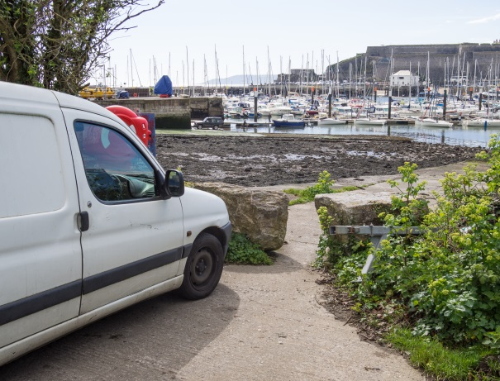
Teat’s Hill: Site

Slide 6
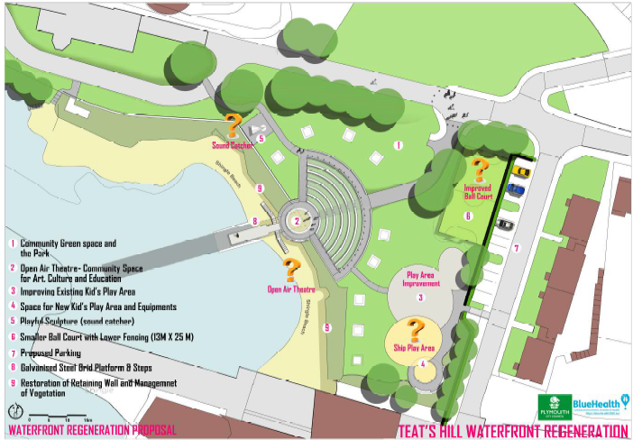
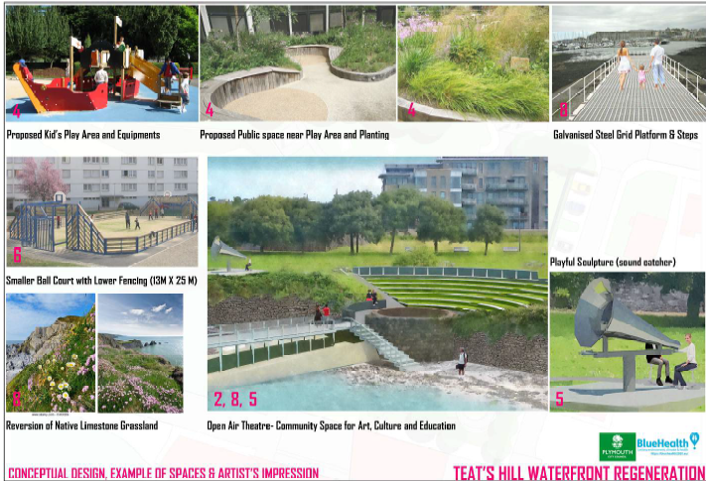
Teat’s Hill: Process - Design concepts

Slide 7
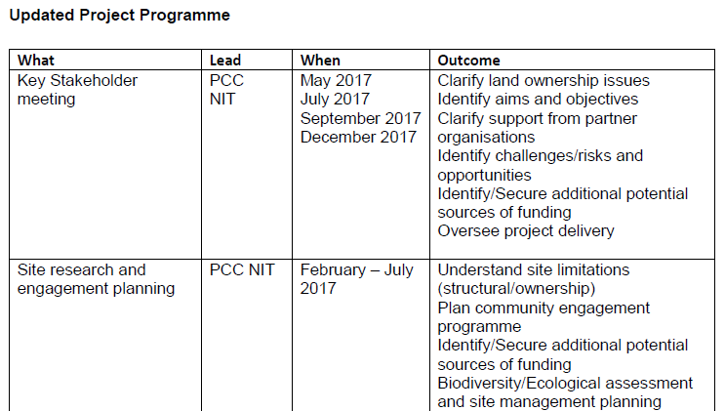

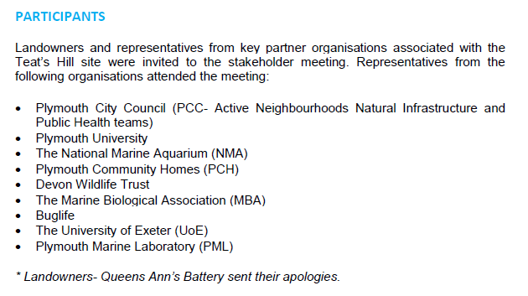

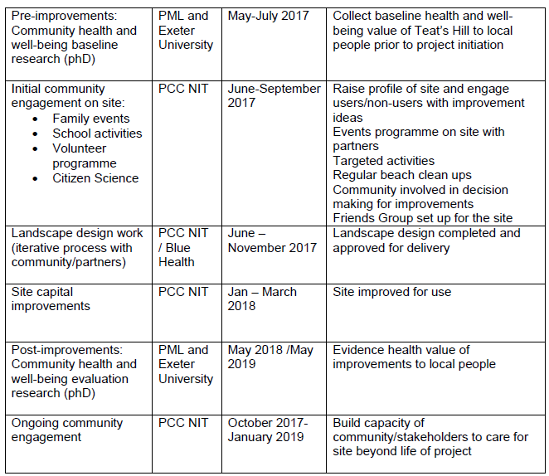
Teat’s Hill: Process - Early stakeholder meetings
& engagement planning
Detailed plan for stakeholder and local community engagement and co-creation

Slide 8
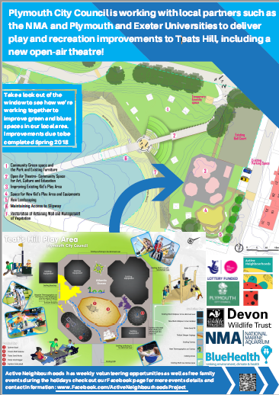

Teat’s Hill: Process – local reinvigoration
and building local pride
Putting pride back into Teat’s Hill – making the changes part of a bigger social process and linking it to the fun that could be had on the site…
…while also providing detailed plans for discussion in a much more friendly fashion than your usual planning notice

Slide 9
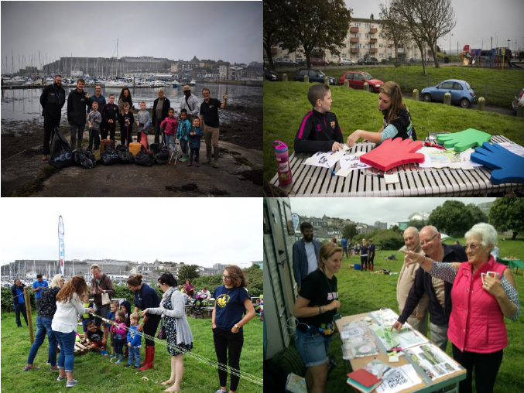
Teat’s Hill: Process -Local engagement
Building pride and redesign
Volunteer days helped clean-up and prepare the site for initial renovation work
Local social housing provider had extensive discussions with residents (of all ages!!) about the plans
Fun days brought a lost beach back to life (e.g. making rope again on the ‘rope walk’)
Local primary school developed the site in “minecraft”
On site discussions with local residents …..

Slide 10
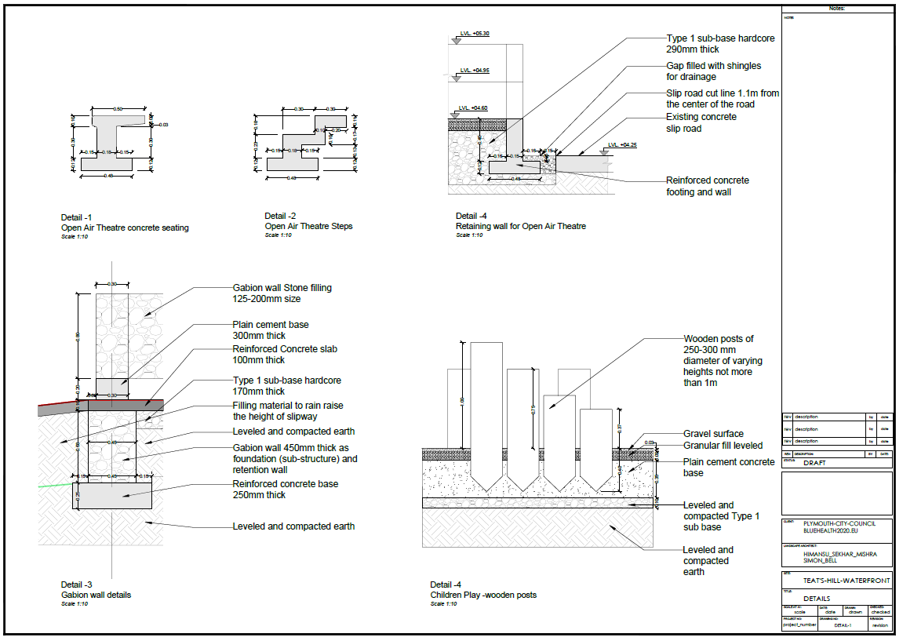
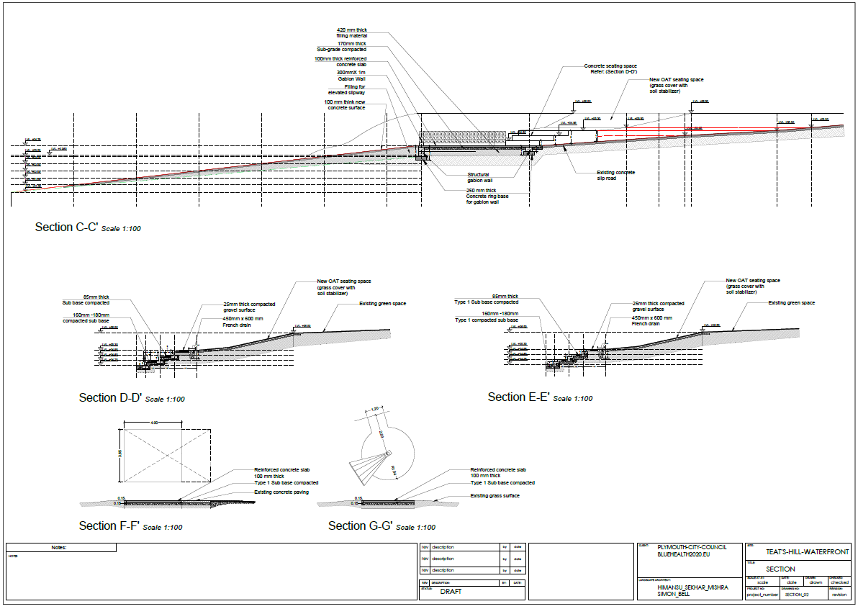
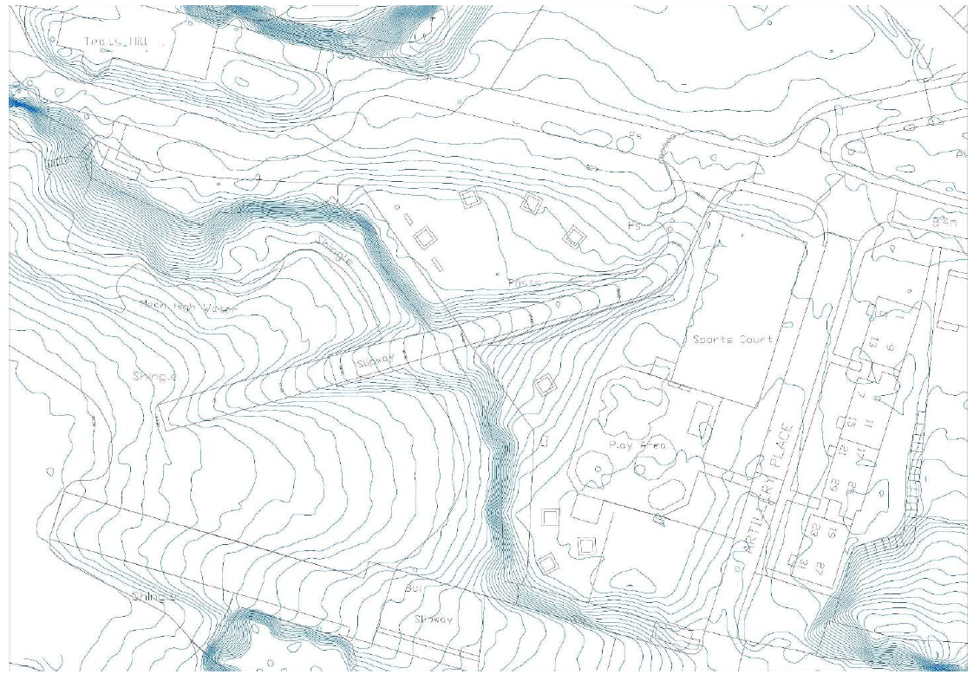
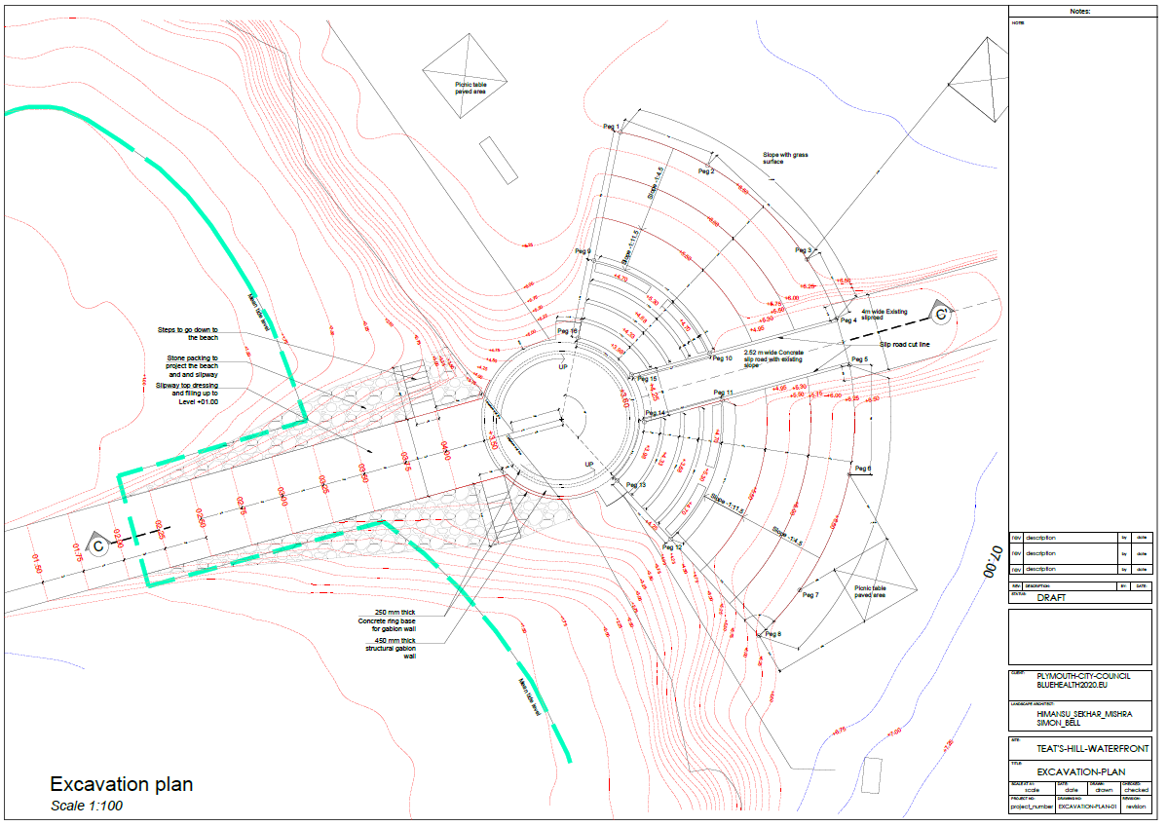
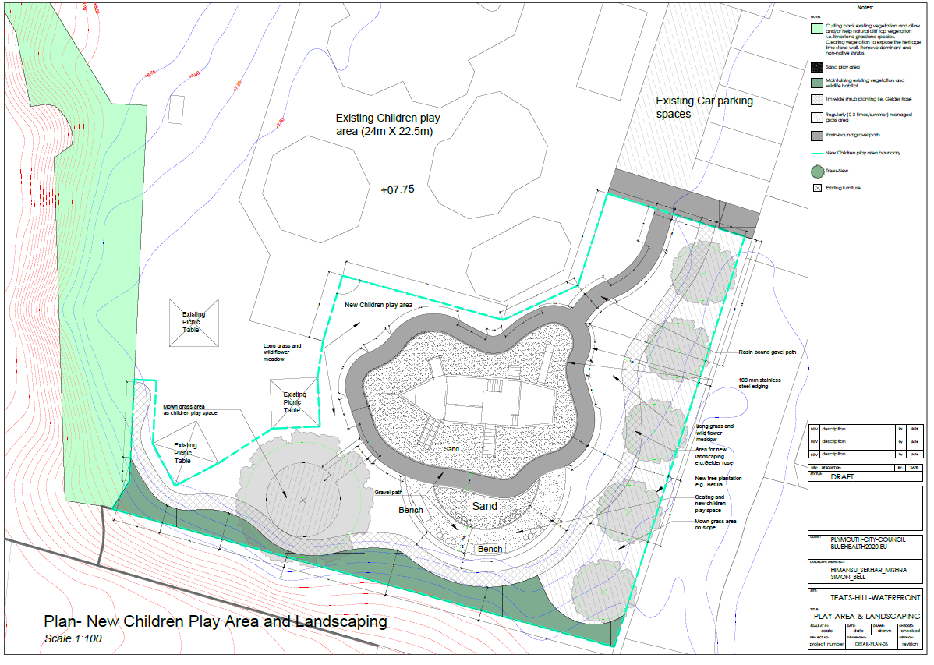
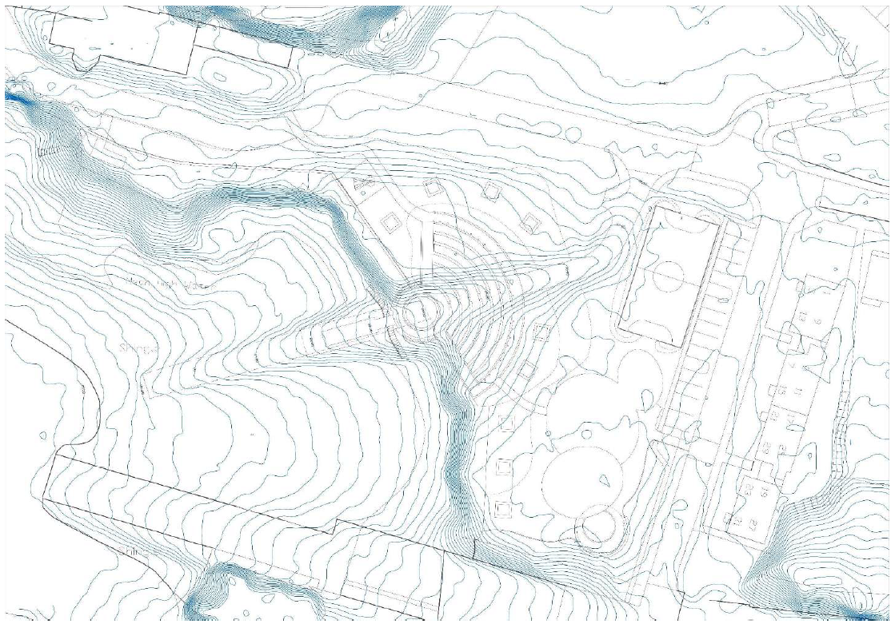
Teat’s Hill: Renovation - The technical planning
Months of work

Slide 11
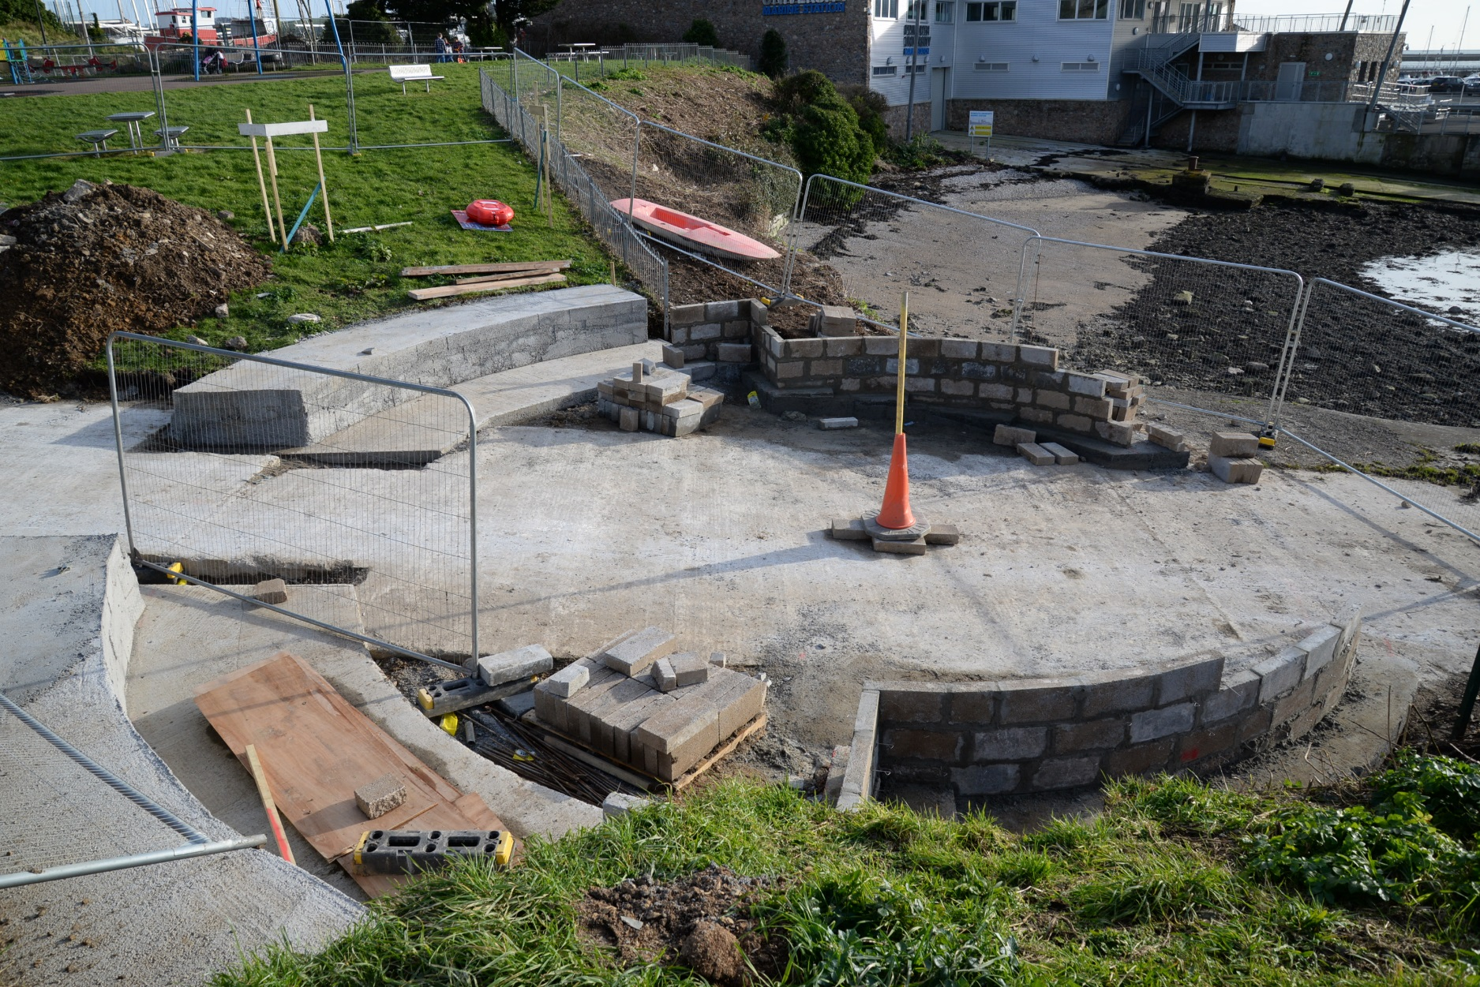
Teat’s Hill: Renovation - Landscaping and construction
craftsmanship

Slide 12
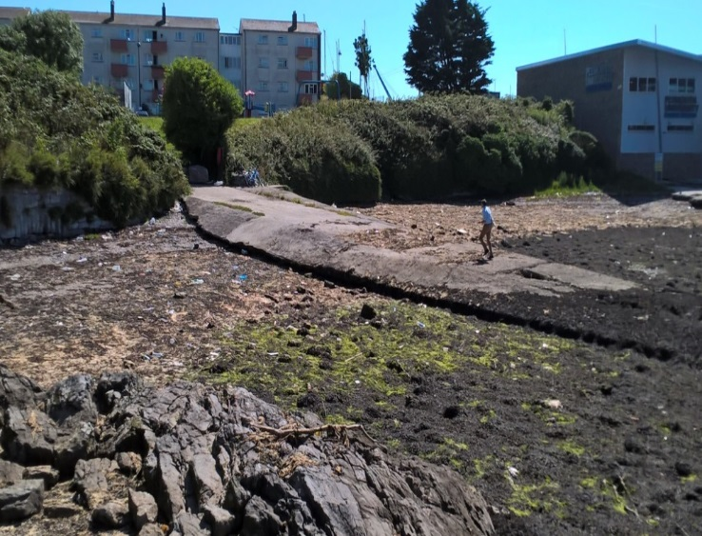
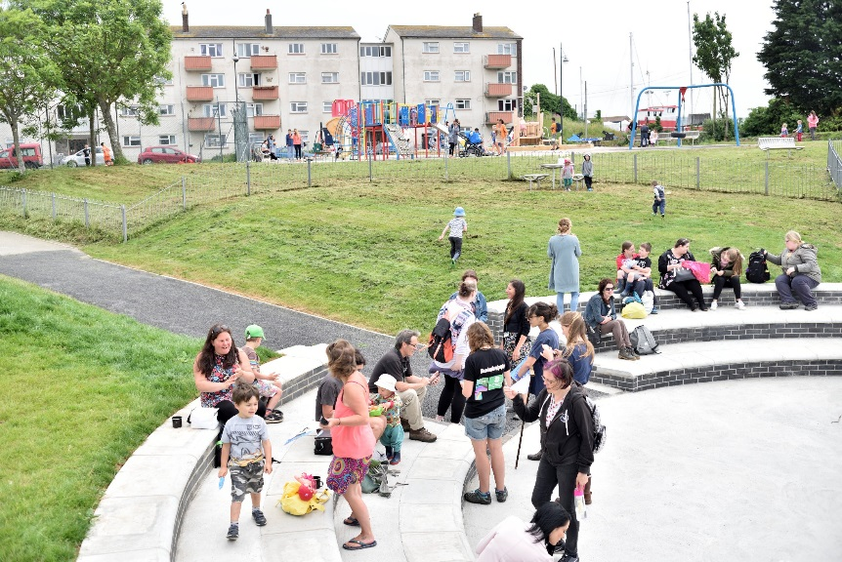
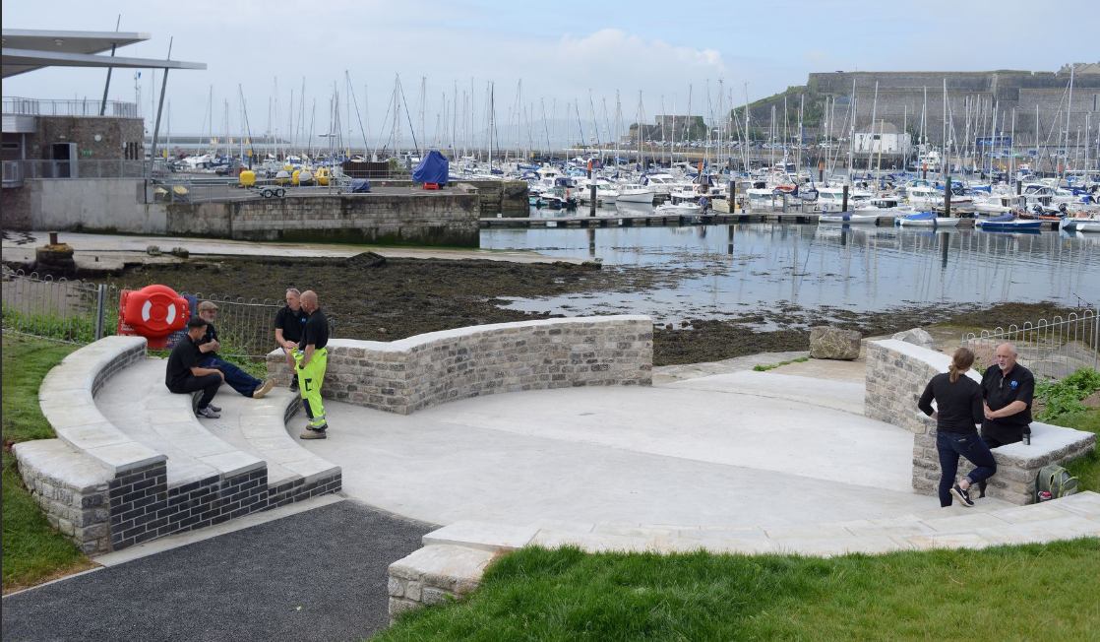
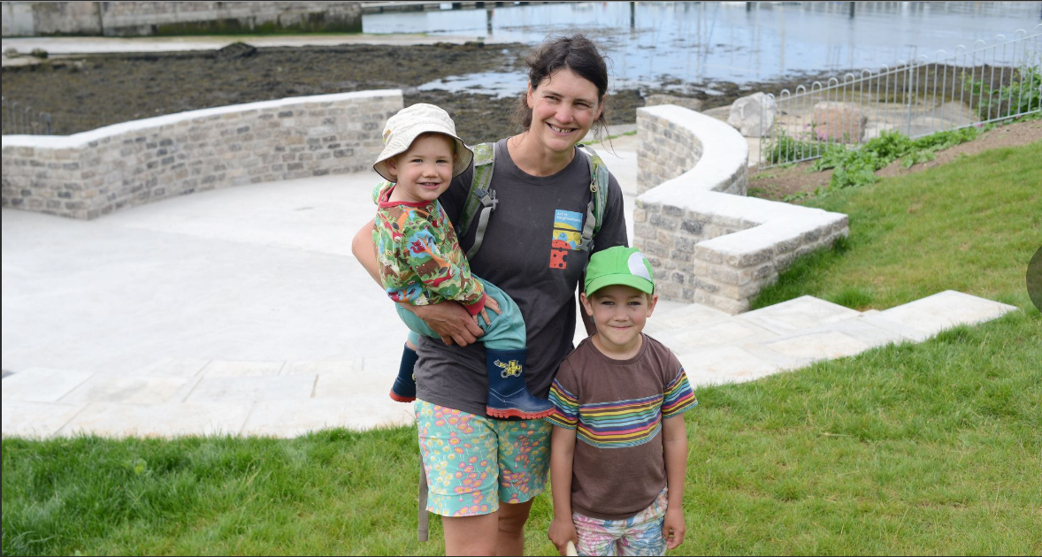
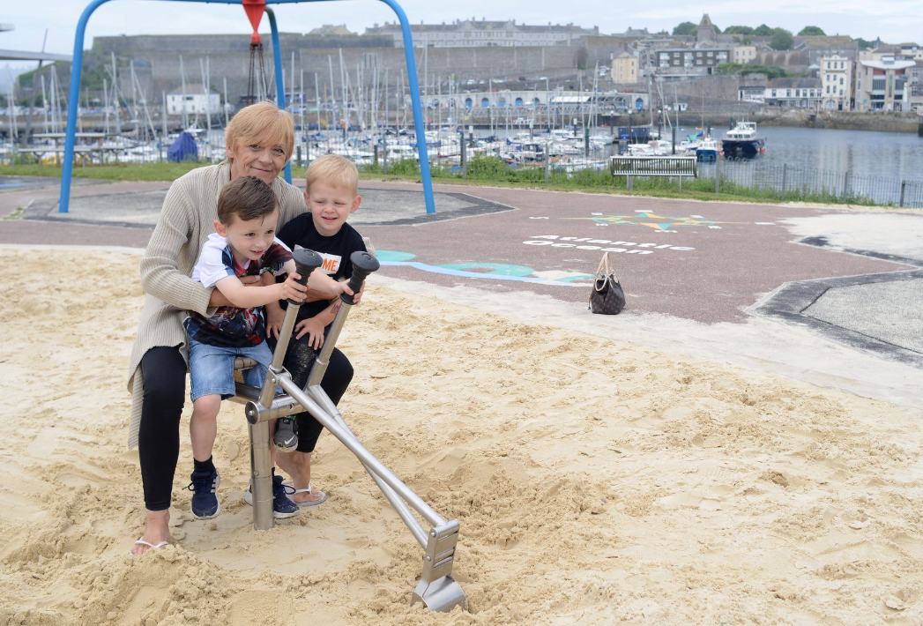
Teat’s Hill: Renovation- A site transformed

Slide 13
Talk overview
Active neighbourhoods: A quick overview
Teat’s Hill: Site, process, renovation
Outcomes: Environment
Outcomes: Health & well-being

Slide 14

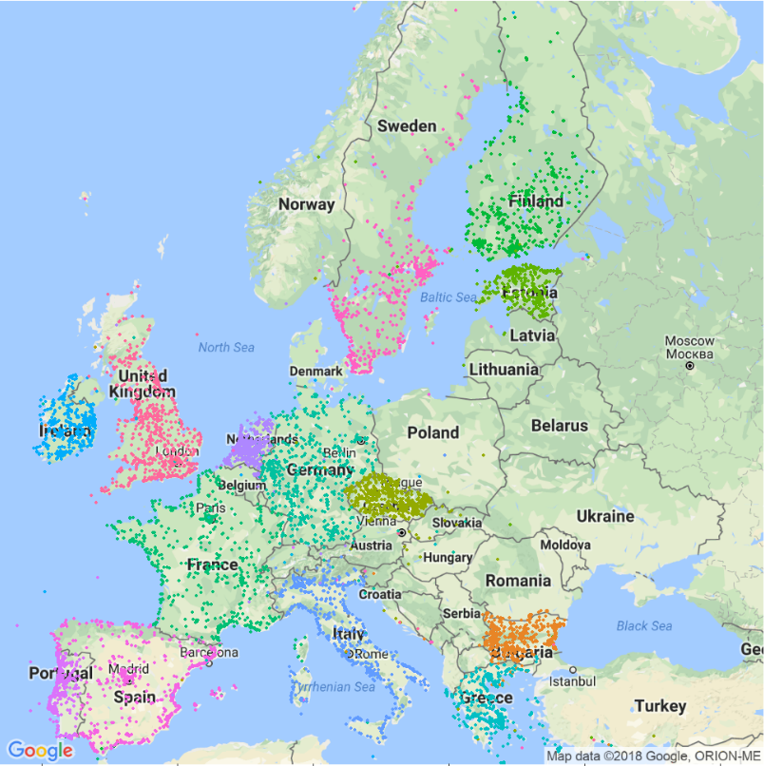
BlueHealth
A quick overview
Blue space proximity, accessibility and use & health and wellbeing across 14 European (+ 4 non-European countries).
WP1 - Management
WP2 – Large surveys
WP3 – Natural experiments
WP4 – Health care & VR
WP5 – Acupuncture interventions
WP6 – Future scenarios
WP7 –Policy development (WHO)
WP8 – Communication/Dissemination
€6,000,000
2016
2020
  Investigate the relationship between urban blue infrastructure and health and wellbeing in Europe

Slide 15
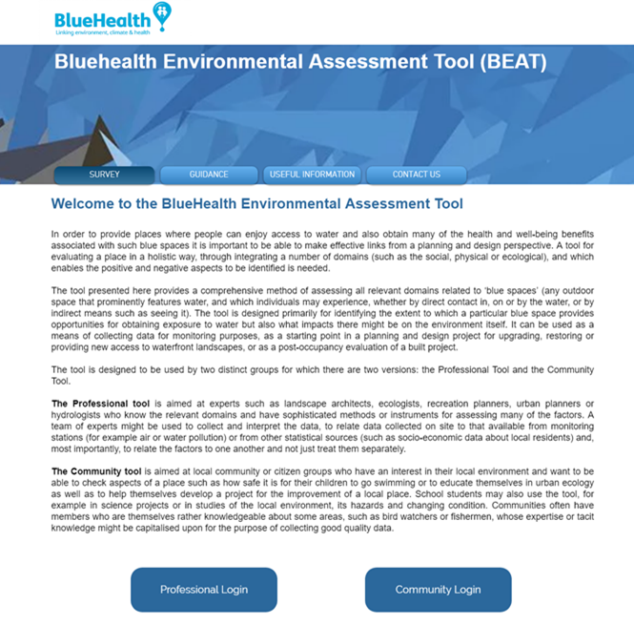
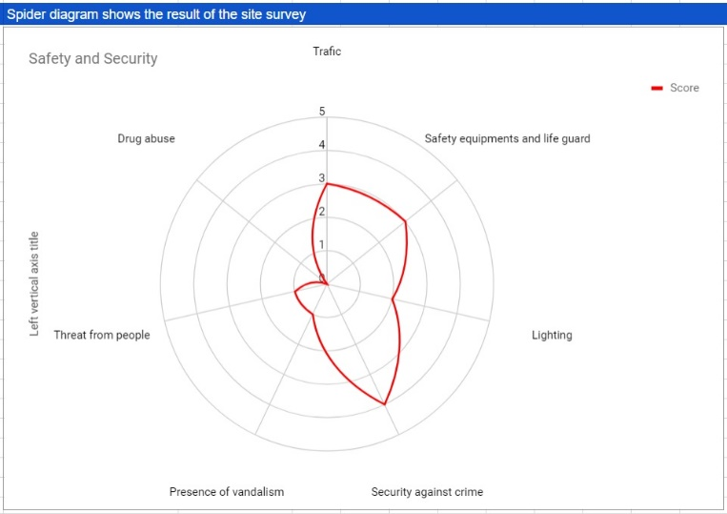
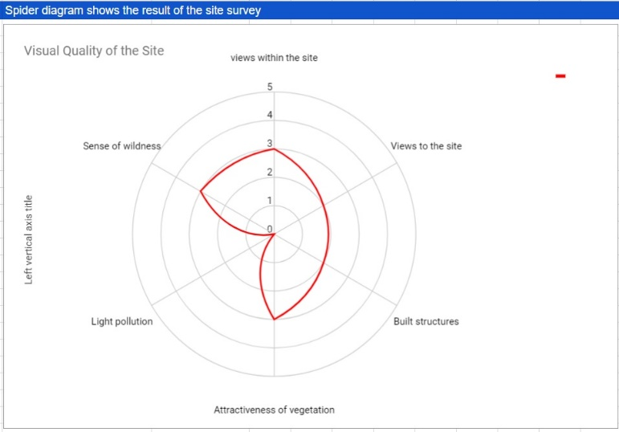
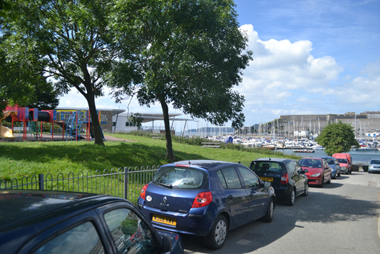
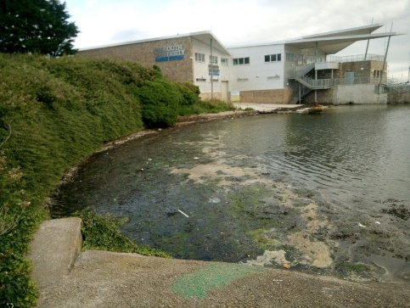
Environmental assessment positive changes
On site Assessment
Safety and Security
Visual quality

Slide 16
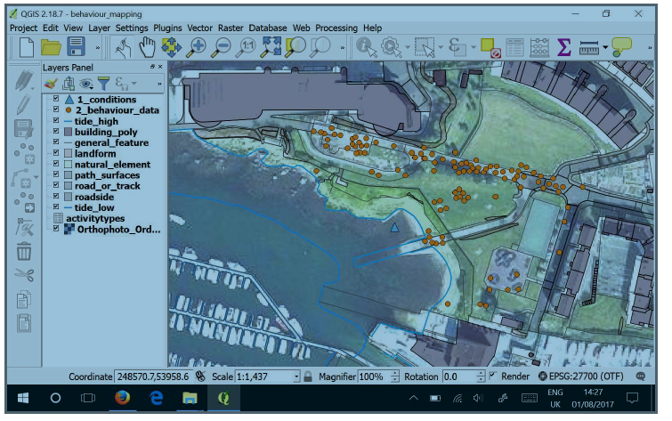
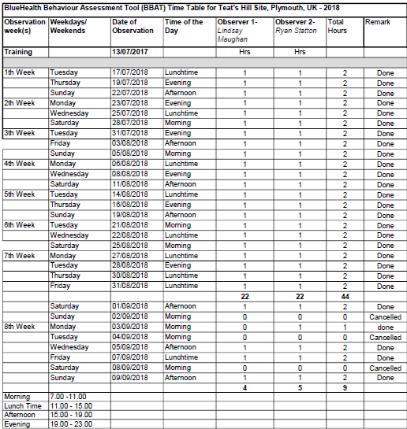
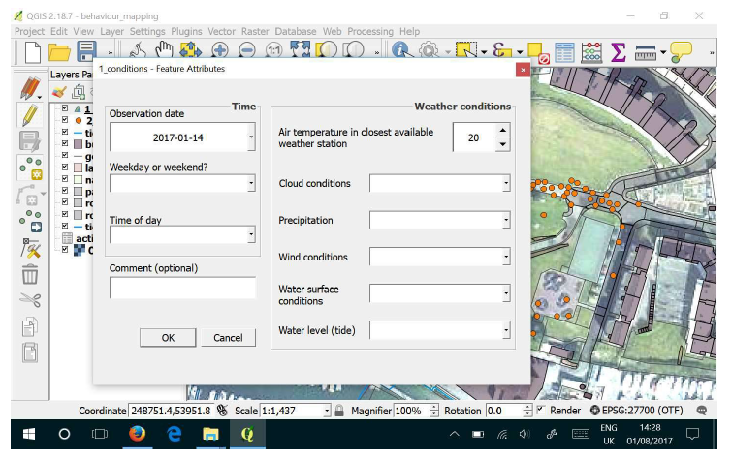
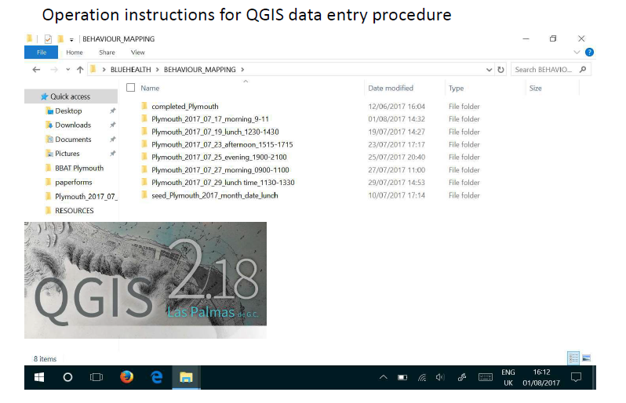
BlueHealth Behavioural Assessment Tool
On site observations
12 weeks pre and post
All (daylight) times, all days covered by two observers

Slide 17
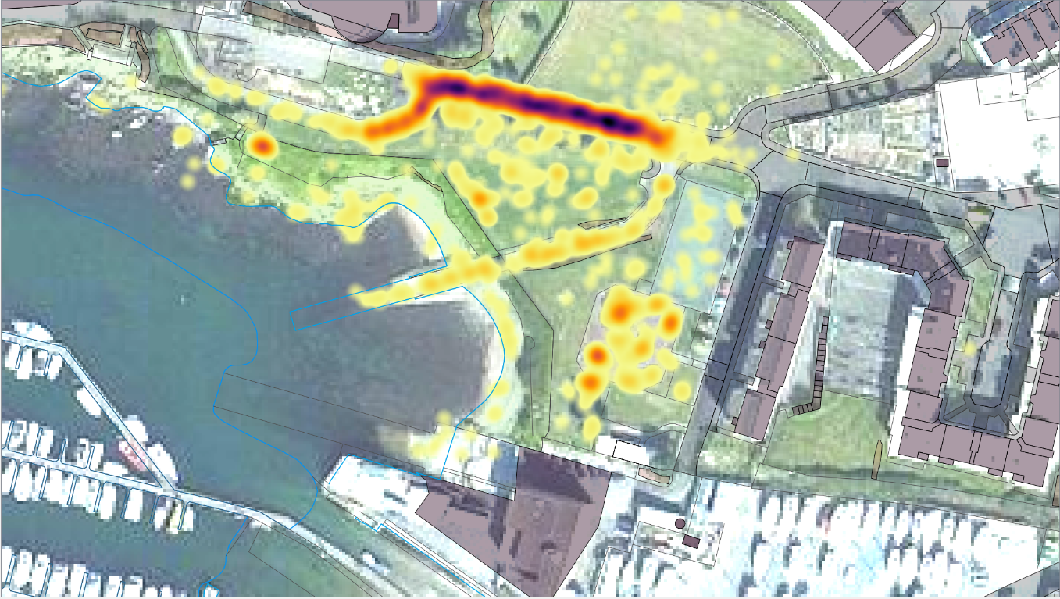
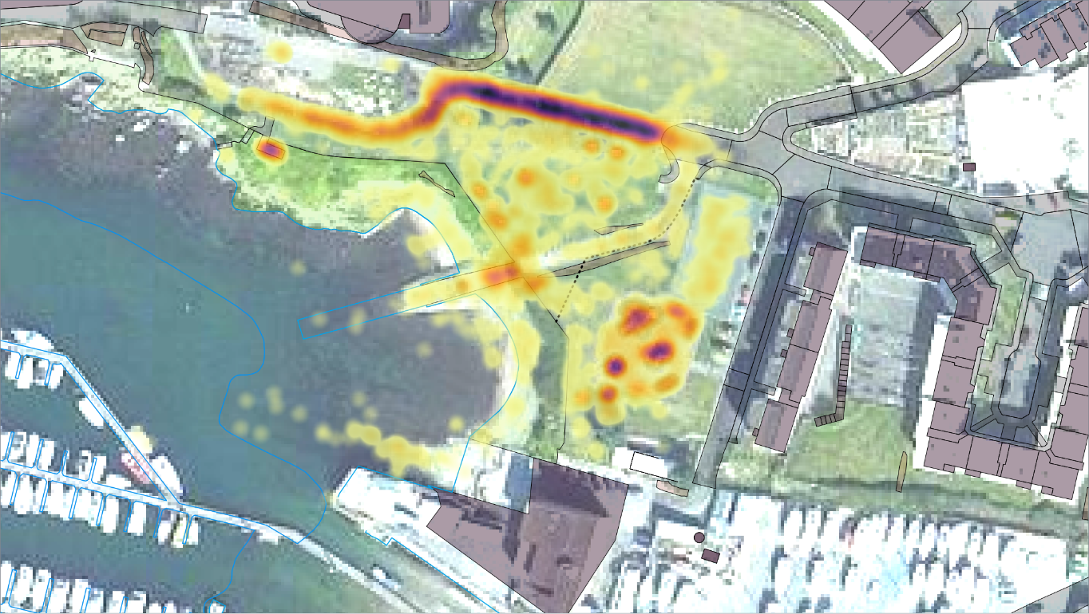
More people visited the site
On site observations
Pre-Intervention 2017
(June-September) n= 2181
Post-Intervention 2018
(June-September) n= 5027
Using the same 12 week observation schedule – visits increased by 130%
Visit Duration (% >30mins)
Pre - 56% ; Post - 64%

Slide 18
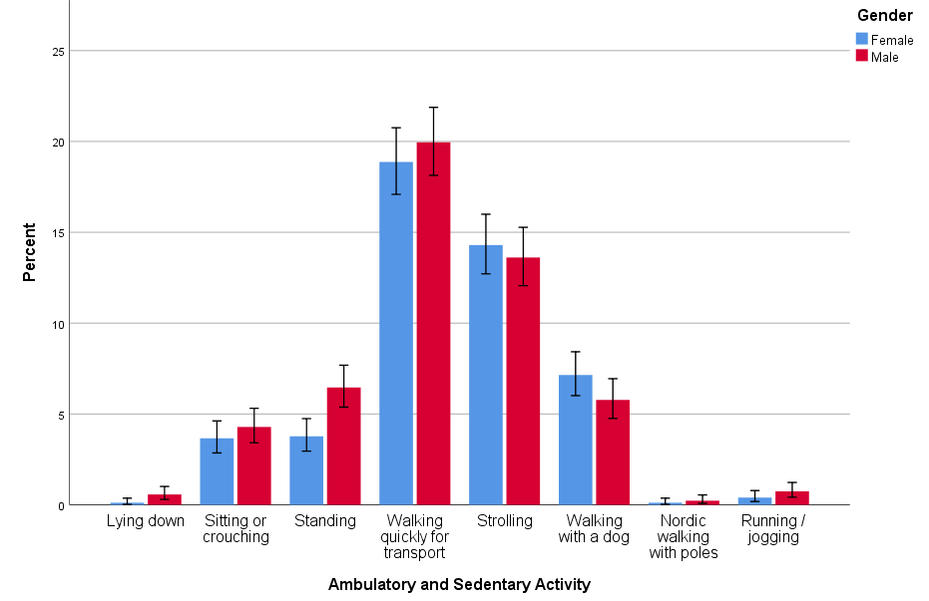
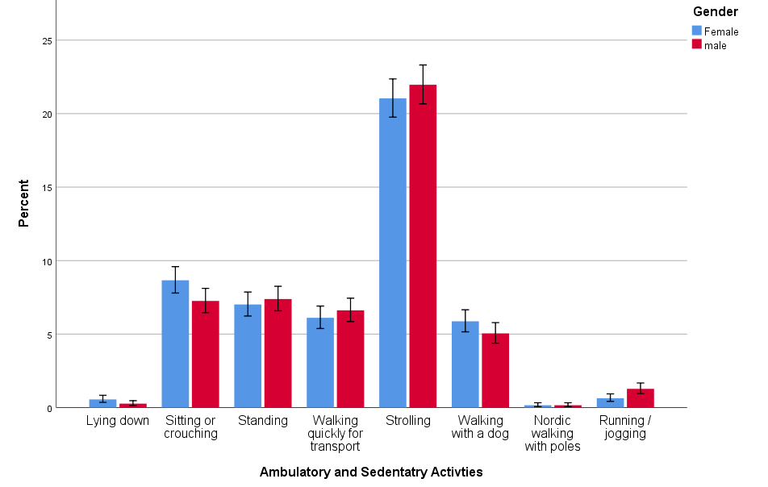
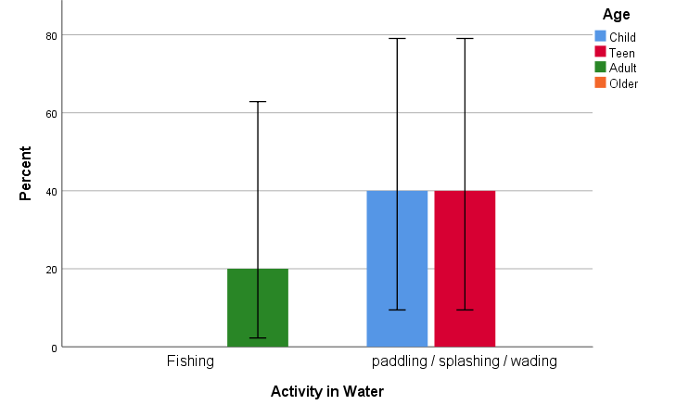
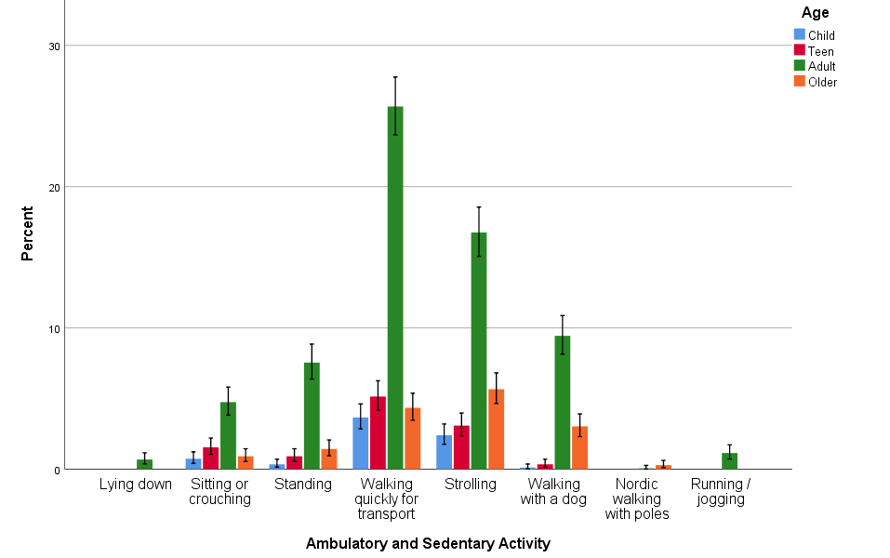
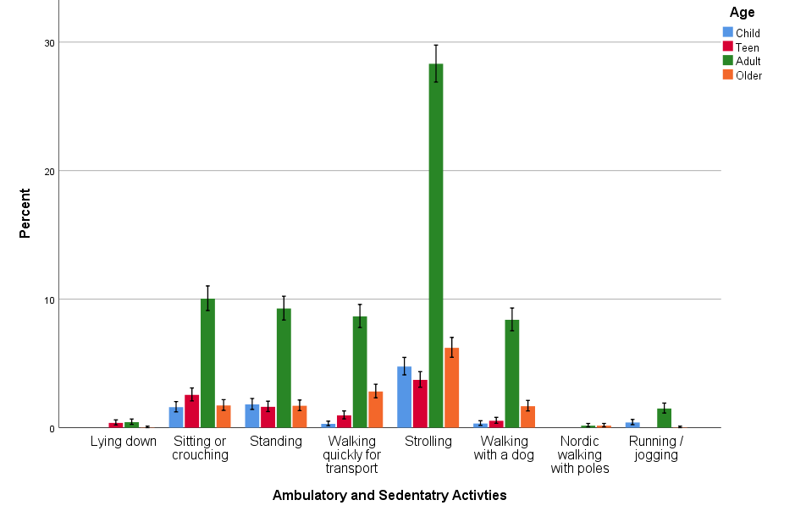
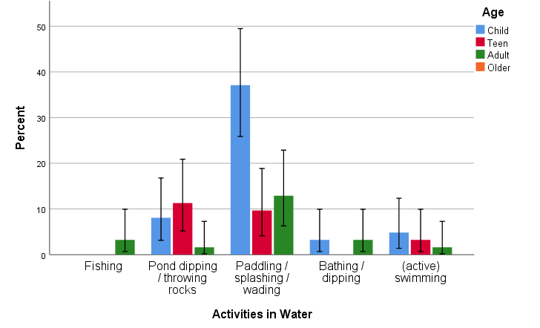
Types of poeple & activities changed
On site observations
Pre-Intervention Physical Activity
2017
Post-Intervention Physical Activity
2018
Pre-Intervention Water-based Activities
2017
Post-Intervention Water-based Activities
2018

Slide 19
BlueHealth Community Level Survey
A mini-version of the BIS
Face to face structured interview (10-15 mins)
  - Sampled on local doorsteps and in-site
  - Sampling strategy – alternate houses in streets within ~1000m of the site at T1 and T2
T1 June 2017-Sept 2017 (n = 314) | T2 June 2018 – August 2018 (n = 353)
General contact with outdoors etc. | General contact with outdoors etc.
Teat’s hill specific use & attitudes | Teat’s hill specific use & attitudes
Self-reported health and well-being | Self-reported health and well-being
Willingness to pay for renovations | Willingness to pay for maintenance
Demographics etc. | Demographics etc.

Slide 20






BlueHealth Community Level Survey
Preliminary results
Contingent Valuation Method
Economics method
(HM Treasury Greenbook 2018).
Commonly used to value goods that have no market value (e.g. coastal environments, wildlife, parks etc.).
Asks people for their willingness to pay (£) for a future change in a good (project/policy).
Nature based and recreational events and workshops at Teat’s Hill for families.
Conservation efforts and clean-ups to remove litter and debris from the beach.
Improvements to paths and access throughout the site to allow pedestrian, buggy, wheelchair and mobility scoor access.
Improvements to seating area and viewing points over the harbour. Improvements to the children’s play area.
New signs and education boards throughout the site, describing the local environment and history of the area.

Slide 21
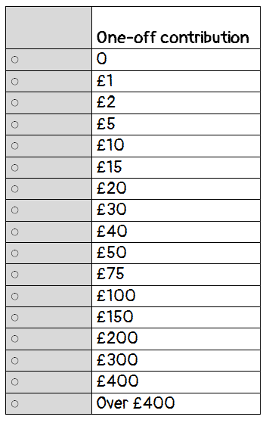

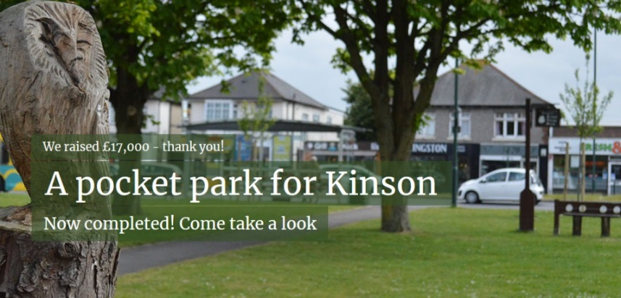
BlueHealth Community Level Survey
Payment vehicle
Hypothetical ‘Plymouth Parks Foundation’ based on:
Q: Considering the benefits of this project for you and your household, what is the maximum that you would be willing to contribute to this fund, as a one off payment, for these improvements?

Slide 22
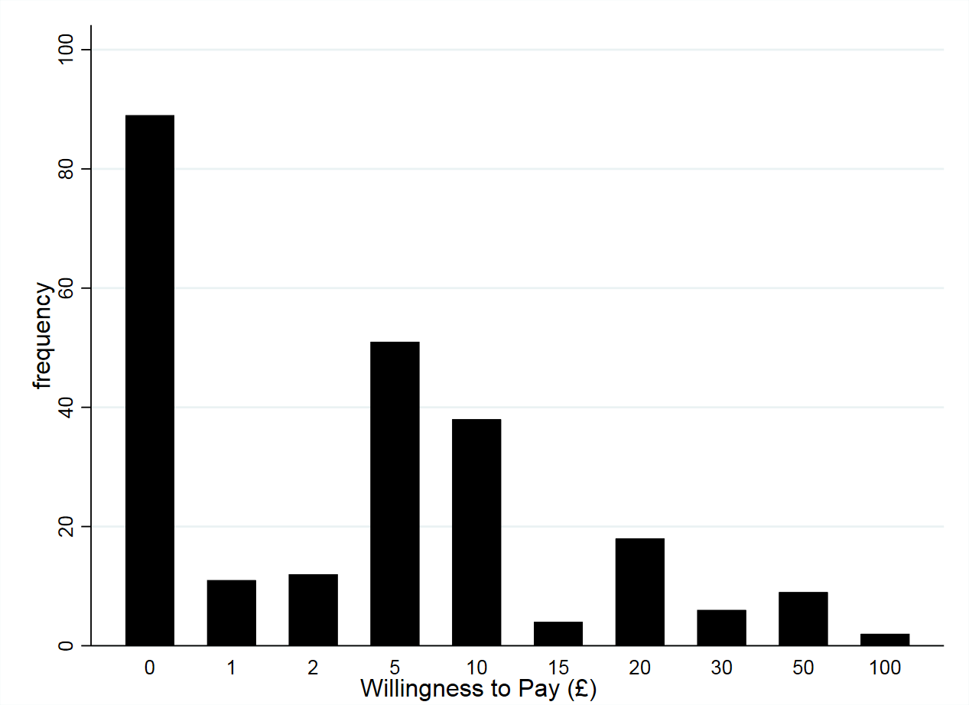
BlueHealth Community Level Survey
Preliminary results (n = 240)
The average willingness to pay for the Teat’s Hill regeneration project was £8.00 (95%CI £6.24, 9.76) per household.
37.08% (n=89)
62.92% (n=151)
Sociodemographics of our sample similar to census data for the area (=representative)
How much are households living within 1km of Teat’s Hill willing to pay (n=2169)?
Aggregation: £8.00 x 2169 households = £17,352

Slide 23
BlueHealth Community Level Survey
Preliminary results
People felt “safer”
8% increase (statistically significant)
No Change
People were more satisfied with their local community
Mental health gains
~ £2,000 per household

Slide 24
Limitations and strengths
Limitations (reasons to be cautious):
No control site (Hawthorne / regression to mean effects)
No delayed post-test
Sampling not perfect
Strengths (reasons to be optimistic):
Strong working partnership with Council, stakeholders and local residents
Unique creative design that used ‘affordances’ of the site
4 integrated assessment/monitoring tools
Blue Space…………………..

Slide 25
Talk overview
Active neighbourhoods: A quick overview
Teat’s Hill: Site, process, renovation
Outcomes: Environment
Outcomes: Health & well-being
Local level management
Wider policy & practice implications

Slide 26

Local Level Management: Neighbourhood level
Continued neighbourhood partnership forum
Catalyst for new residents’ group
Additional community-led improvements to enhance space
Community-led events and activities based around the amphitheatre

Slide 27

Wider policy & practice implications
Process is key: we’re all experts
It’s not just about the physical intervention
Research helps make the case

Slide 28
Thanks very much
for your attention
Jemma Sharman
Mat White
Zoe Sydenham

