Slide 1
Coastal settlements and regions have a future
But what future?
And what about planning?
13th European Biennal of Towns and Town planners 2019 – Planning on the edge
Plymouth September 12th 2019
Petter Wiberg
Head of Town Planning
City of Bergen

Slide 2
This is where we may come from
Wikipedia: Hydrothermic vents

Slide 3
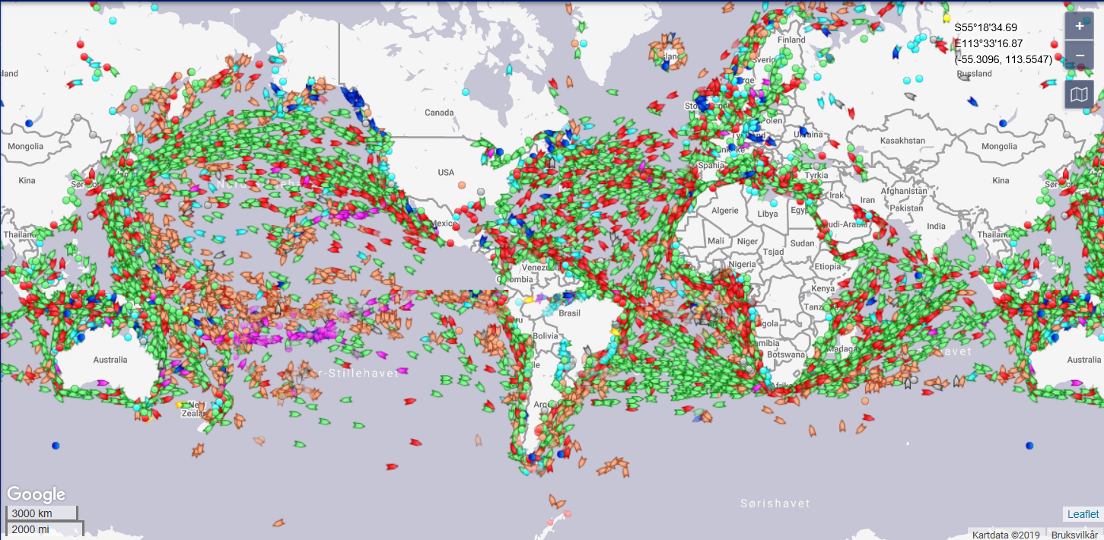
This is where we go…. all the time 17.07.2019 kl 12.33

Slide 4
The oceans are rich in resources
We need them
….but we don’t seem to know much about how to use them wisely

Slide 5
We need to live on the edge!
40% of the world’s population lives within 100 kilometers of the coast. (UN)
Ca 400 million people live within 20 m of sea level and within 20 km of a coast, worldwide. NASA Science brief

Slide 6
And we need air
Phytoplankton may contribute between 50 to 85 percent of the oxygen in Earth’s atmosphere.

Slide 7
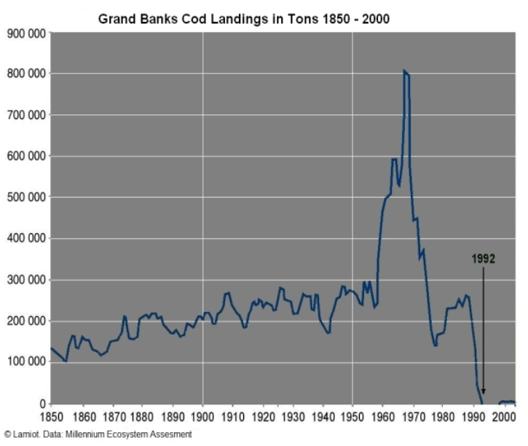
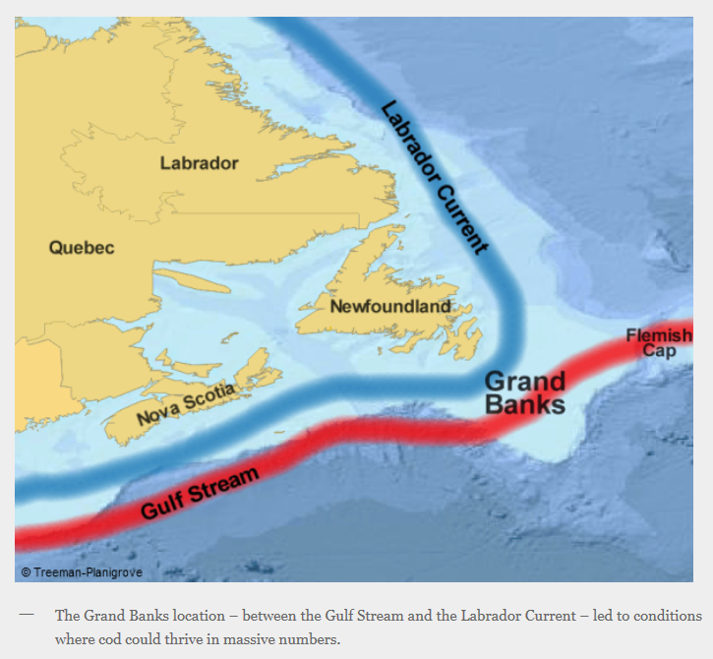
https://britishseafishing.co.uk/the-collapse-of-the-grand-banks-cod-fishery/
- And what happens to the communities on the edge?

Slide 8
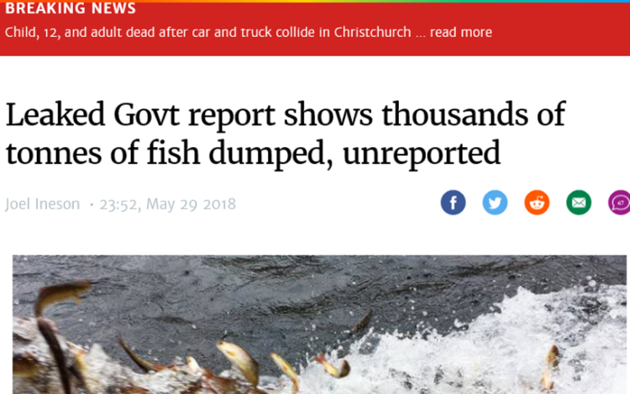
Resource management - a global issue
FAO: (2015) over seven million tons of fish are discarded every year.
2019: all catches have to be landed and counted against quotas.
Enforcement?

Slide 9
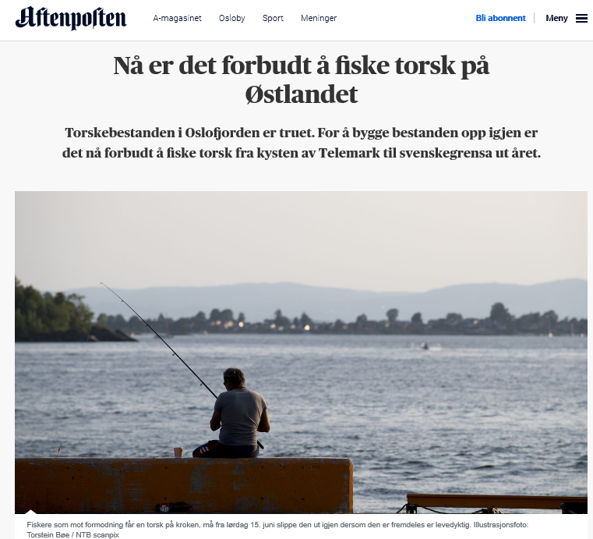
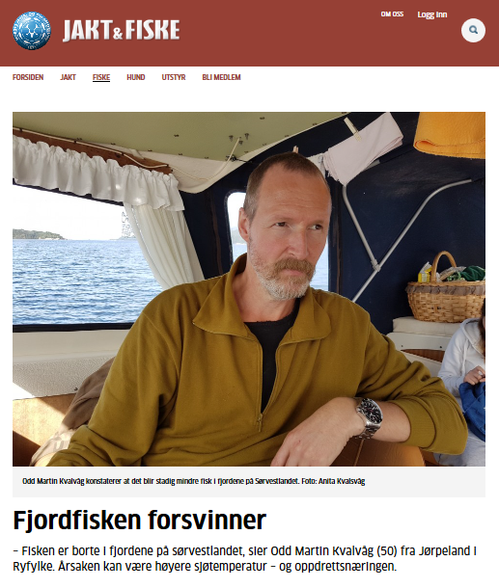
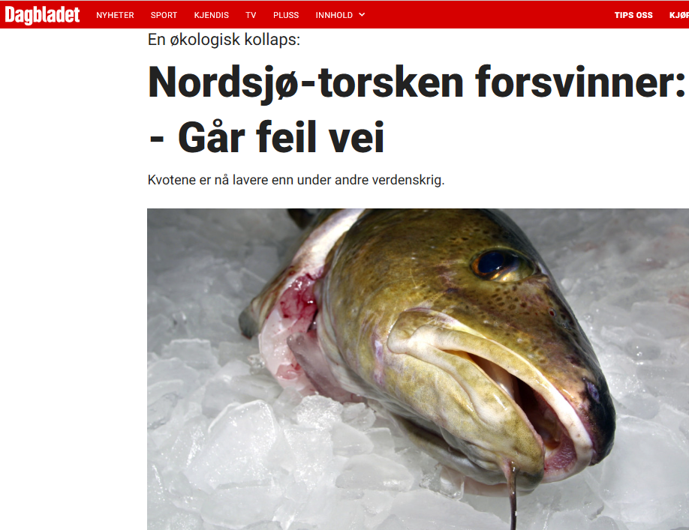
And a local issue
Why? ……. Who knows!
The Cod is disappearing from the North Sea and the fjords
The blame game
Sea temperatures?
Expanding fish farming?
The oil industry?
Overfishing?
Growing conflict of interests
A political dilemma

Slide 10
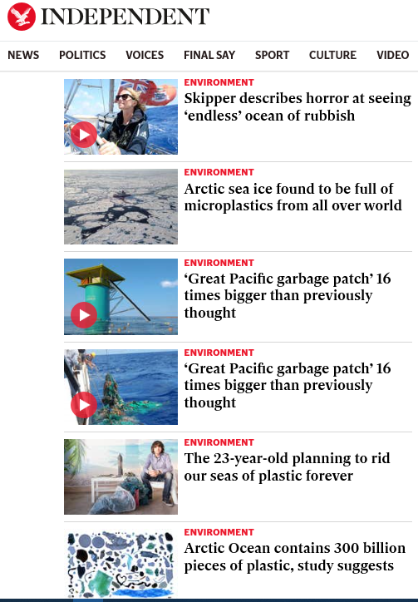
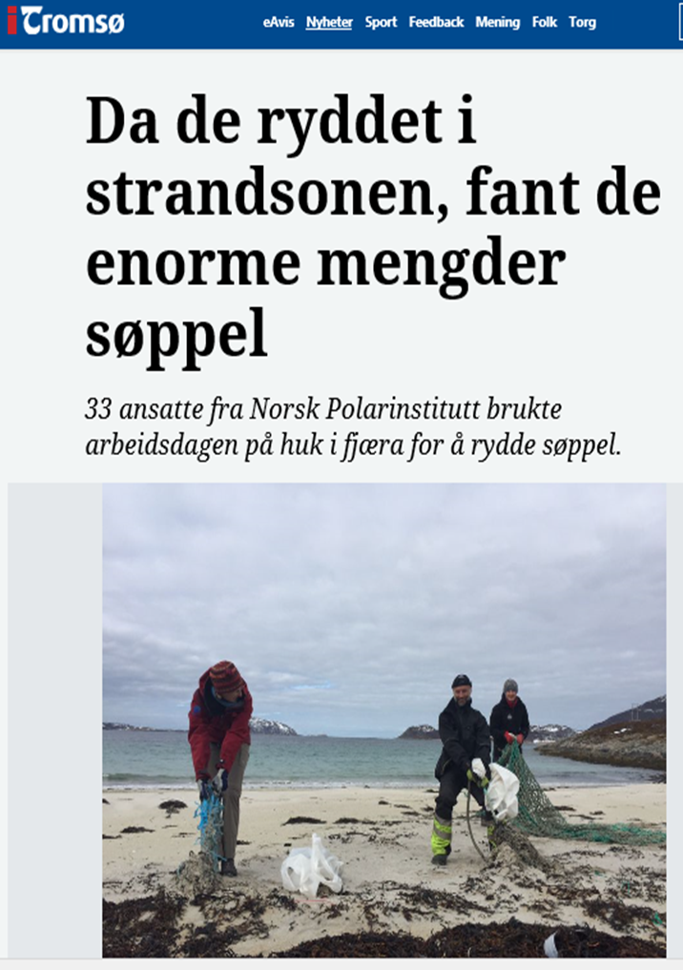
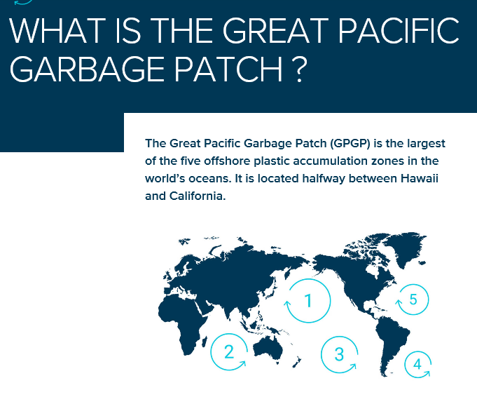
The oceans – our common dustbin
Arctic beaches innundated with rubbish

Slide 11
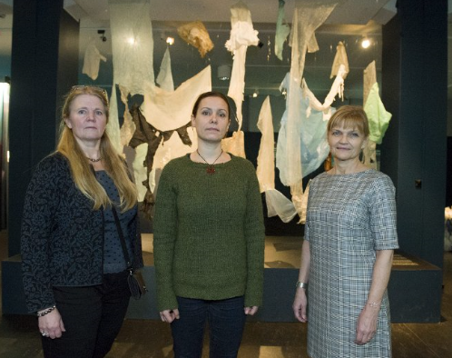
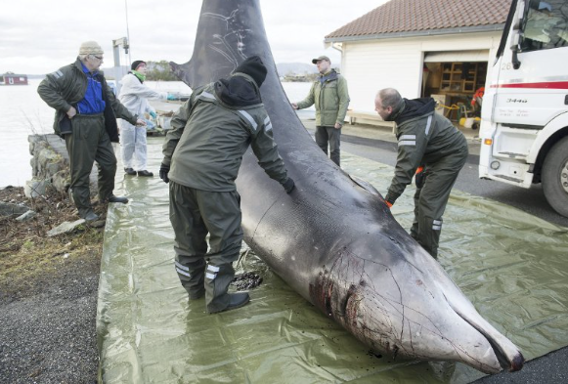
30 plastic bags found in the whale’s stomach. The starving whale had to be killed.
The bags are in Bergen museum.
Vindenes på Sotra i Hordaland.Foto: Christoph Noever / UiB / NTB scanpix

Slide 12
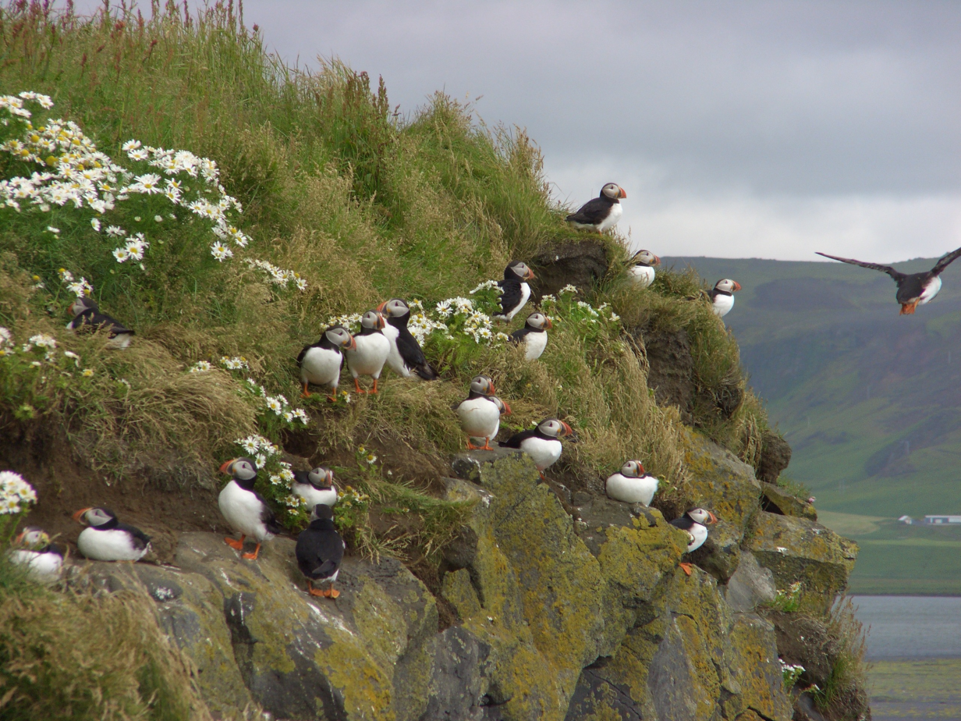
Climate change and the oceans
Rising sea temperature
Polar ice melting and
Sea level rise
Effects on currents
Sea water chemistry: acidification
Effects on marine life, biodiversity and availability of food

Slide 13
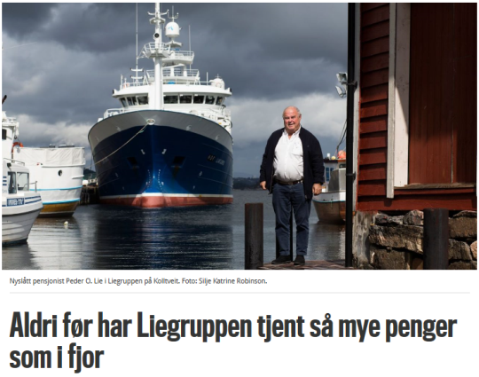
Three ships on the way to Iceland. One would be enough
Politics of resource management and viable conditions for business and employment in the regions
«We have 3 ships with quotas and over capacity»
One very modern – capable of catching almost as much as the 2 older ones.
Quotas follow the ships, not the company
«if we can redistribute the quotas and take more fish with the new ship and less with the old ones, we can save emissions to the air equivalent to 180 000 cars»

Slide 14
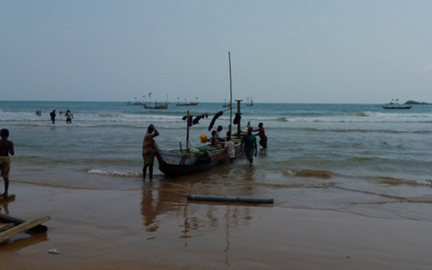
The sea, the coast and social justice

Slide 15
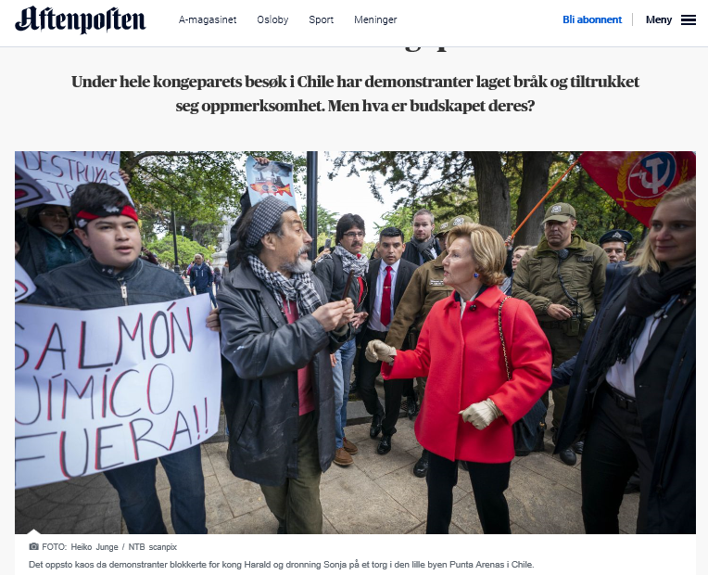
Conflict and Cultivation of marine resources
Profitable global business.
Different environmental standards and requirements.
Different labour markets and labour relations and law.
Large scale food production.
Social polarization.
Clean industyry here but not there?

Slide 16
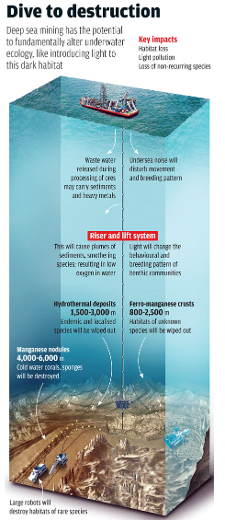
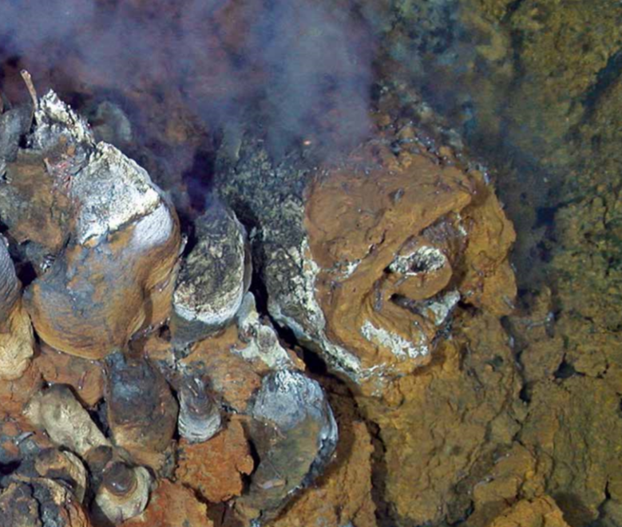
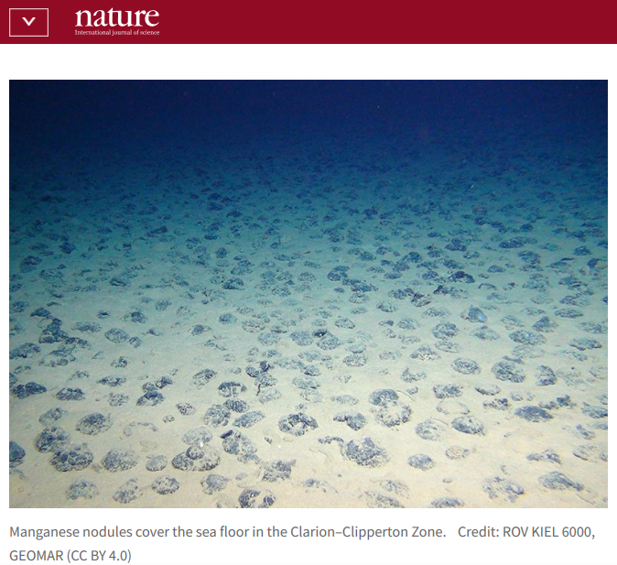
The sea bed and below, «a rare treasure trove»

Slide 17
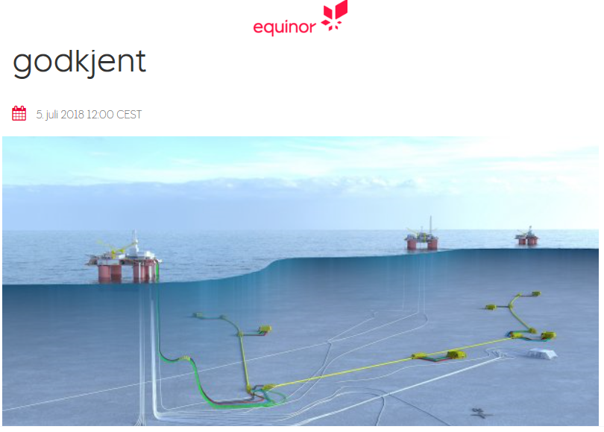
Are we able to handle the consequences?

Slide 18
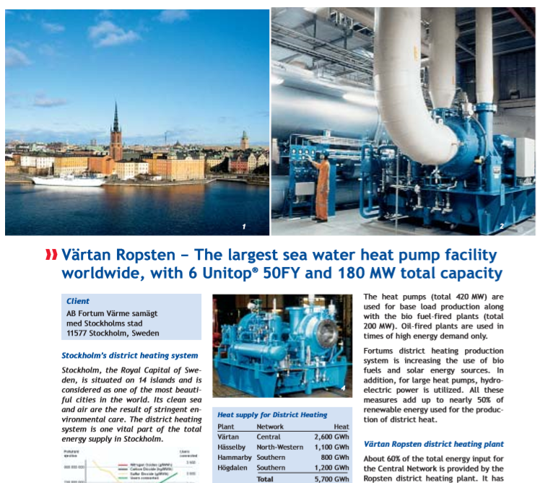
Energy straight from the sea (I)

Slide 19
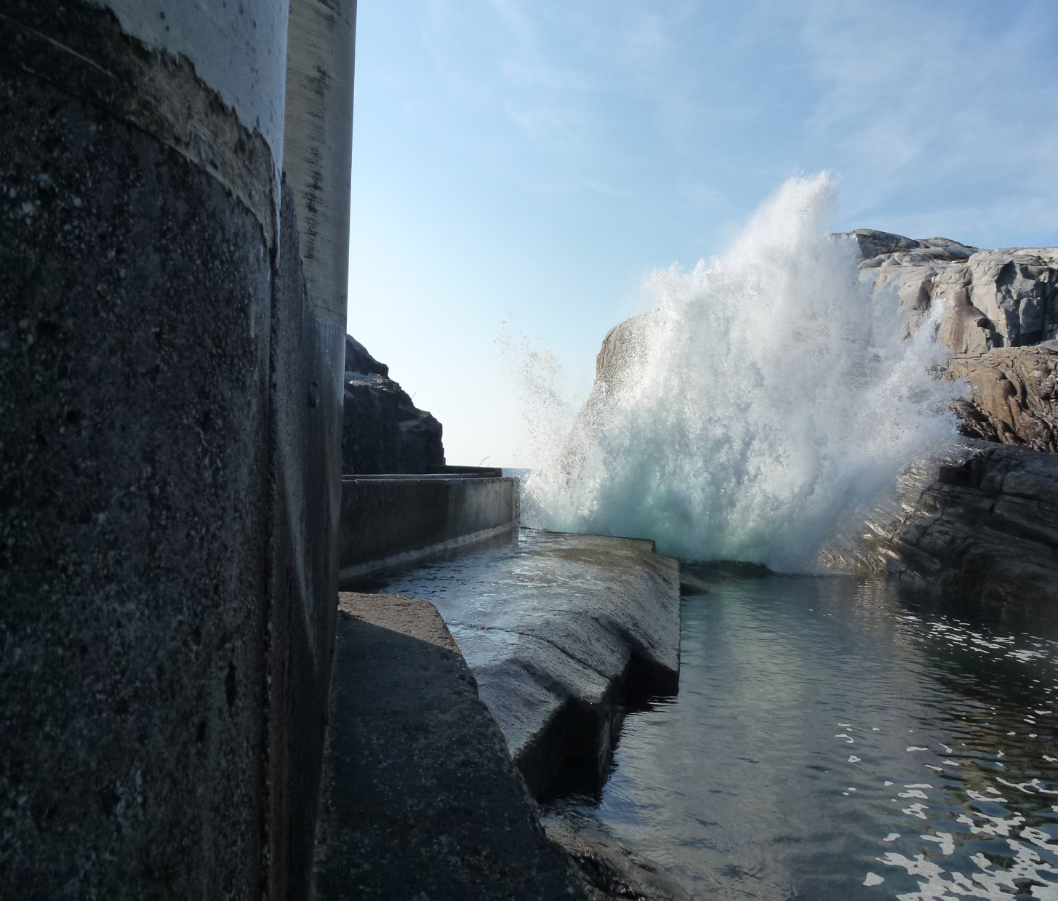
Sustainable energy alternatives (II)

Slide 20
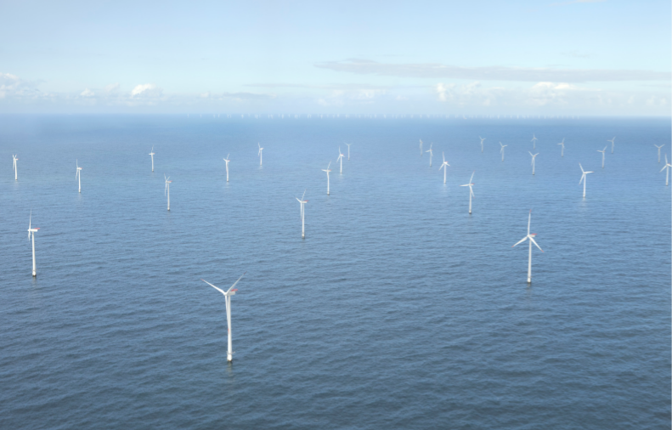
Sustainable energy alternatives (III)

Slide 21
Did we say good bye to solidarity? Short term, neo liberal approaches to coastal development miss a much needed perspective on
Ecology, resources and sustainability
The marginalization of some regions and growing social and economic inequality
Risk and how to handle threats
Opportunities
The need for new knowledge and insight and how to use it
The need for coherent and integrated rules and practices locally and globally

Slide 22
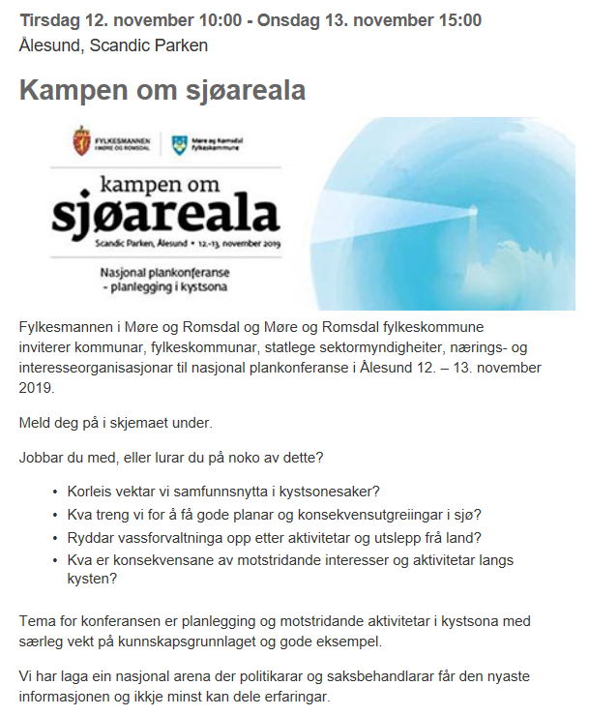
The struggle for marine space:
Occupation
Colonization
Privatization
The public interest

Slide 23
An agenda for planners and policy makers
Holistic perspective – local – global interconnectedness
Understand our interaction with nature
Understand the communities we work with and critical business decisions
Articulate local experience, needs and requirements on the national and global arena

Slide 24
The job of the planner is to see and understand the connections

Slide 25
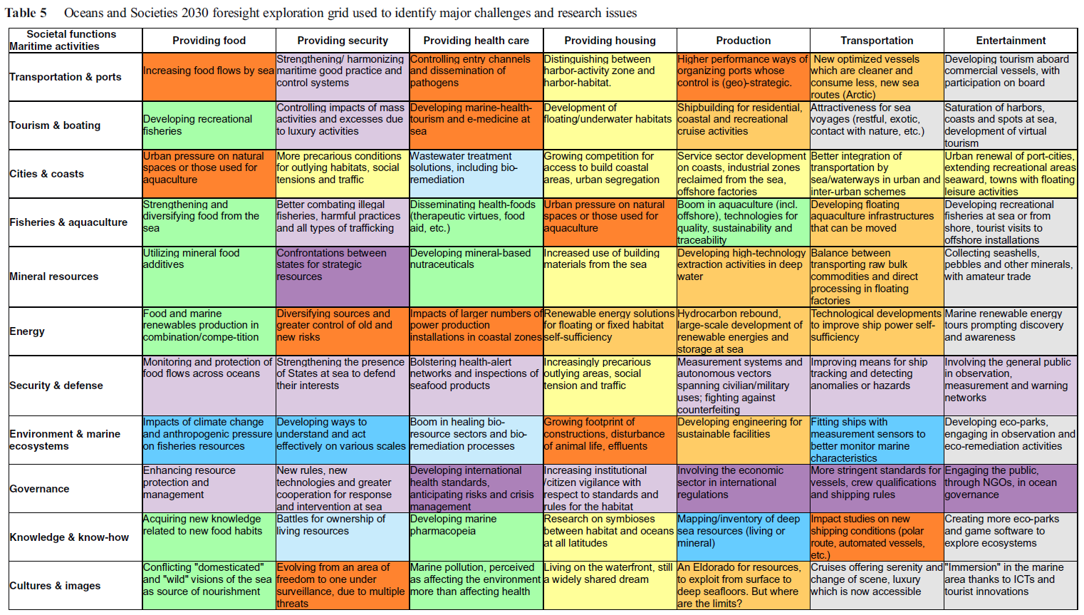
Interactions between oceans and societies in 2030: challenges and issues for research
Denis Lacroix et al. Eur J Futures Res (2016) 4: 11

Slide 26
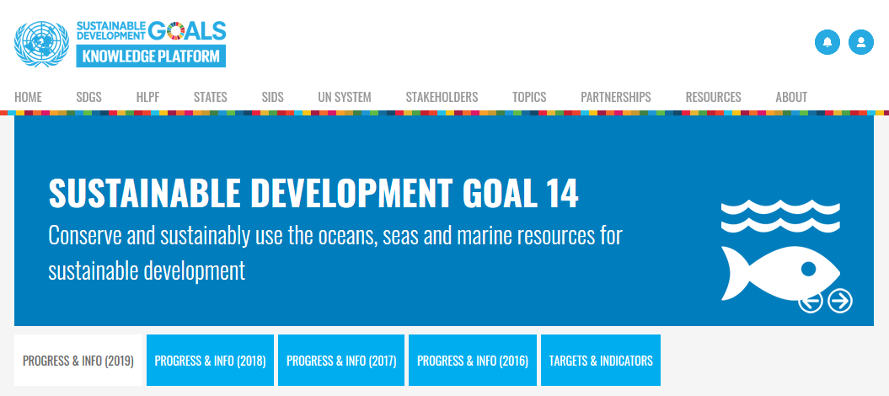

Slide 27
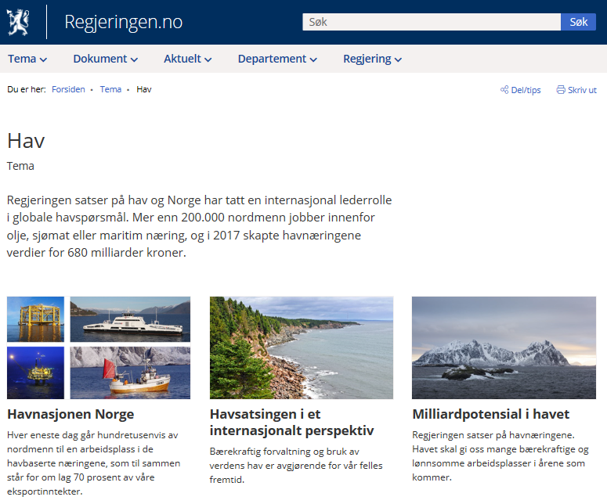
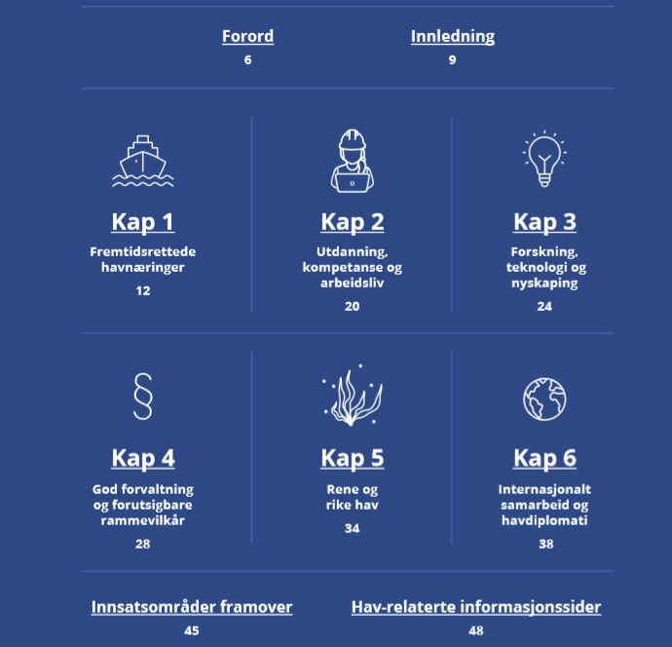
Required: National and international strategies for education, research, management, climate, environment, climate and business

Slide 28
Essential: local experience and knowledge

Slide 29
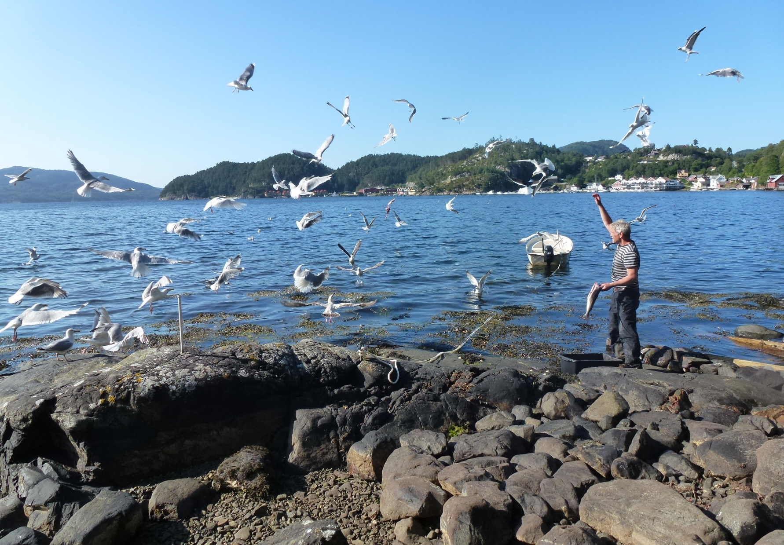
Thank you

