Slide 1
Where is the edge of transition in spatial planning?
Vít Řezáč
rezac@fa.cvut.cz
Faculty of Architecture CTU, Prague, Czech Republic
©

Slide 2
Content
Introduction
Regimes go, people stay
Central European context
Case study: new (Czech) planning legislation
Conclusions

Slide 3
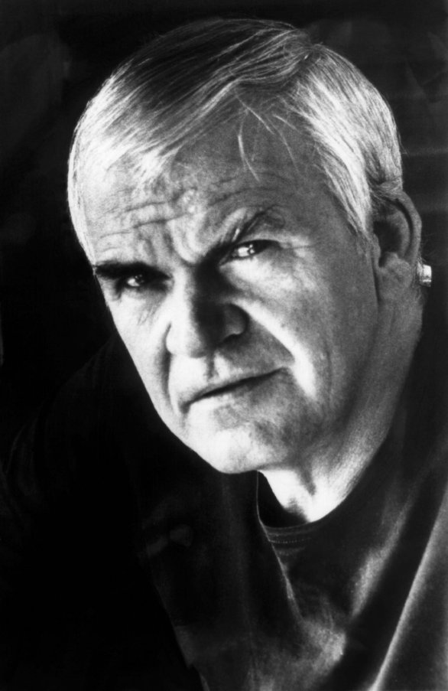
Introduction
Milan Kundera
Czech writer
„Central Europe –
it is a state of mind“
Source: My heritage

Slide 4
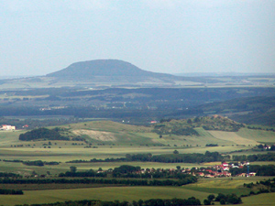
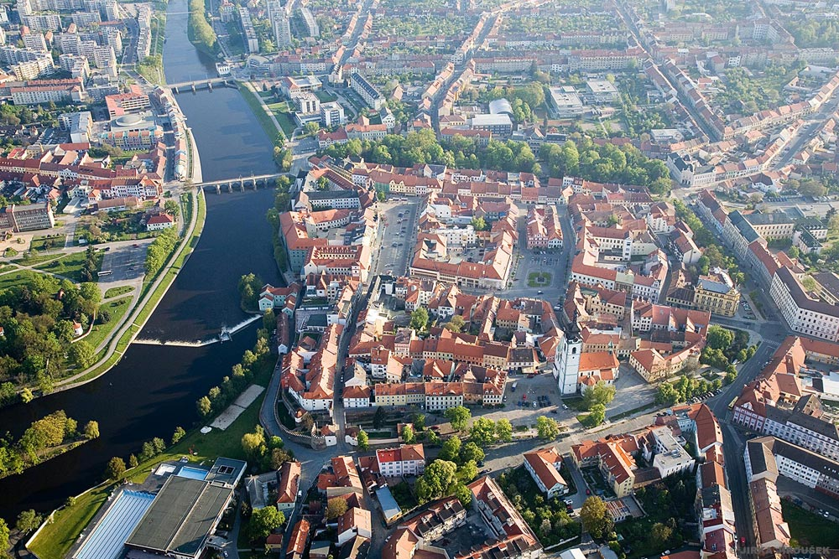
Introduction
Czech Republic in brief
territory | 78 866 sqkm
population | 10,5 mil 134 inh/sqkm
GDP per capita (2018) Average salary (2018) | 22 000 EUR 1 250 EUR

Slide 5
Regimes go, people stay
Habsburg Monarchy (I)
Building code 1866
Building code 1886
public buildings, construction,
permitting, preventing damages
Regulatory plan, Prague 1889

Slide 6
Regimes go, people stay
Czechoslovakia (II) 1918- 1938
Austrian legal model used
1929 failed an attempt
for a new building code

Slide 7
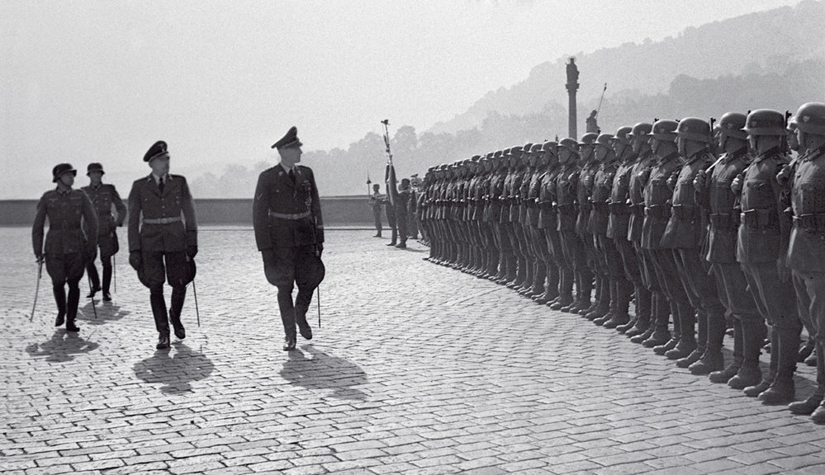
Regimes go, people stay
Protectorate of Germany (III) 1939 - 1945

Slide 8
Regimes go, people stay
Protectorate of Germany (III) 1939 - 1945
Decrees 1941 and 1942
structure to settlement system municipality financing

Slide 9
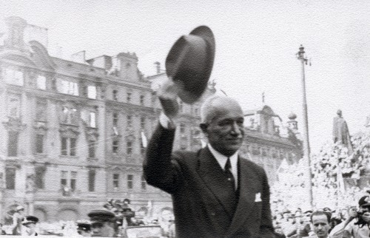
Regimes go, people stay
Czechoslovakia rebirth (IV) 1945 -1948
Preparation of new building code

Slide 10
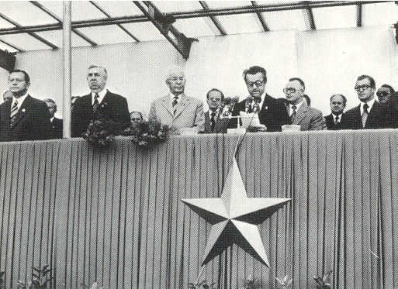
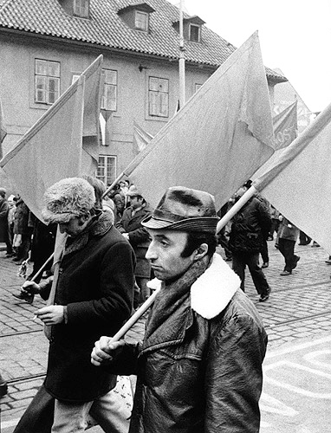
Regimes go, people stay
The socialist state (V) 1948 – 1989
Buidling Code 1958
spatial issues opend in complex way
restrictive construction norms
Building Code 1976
spatial planning and building code together

Slide 11
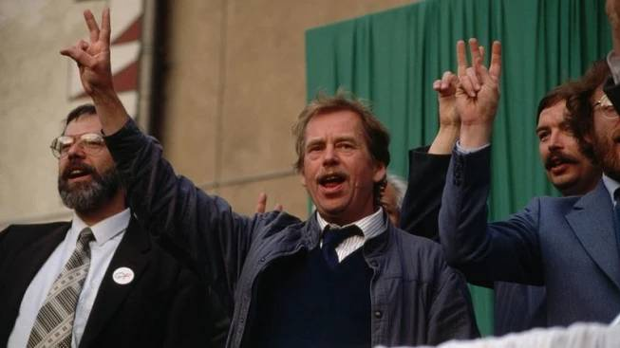
Regimes go, people stay
Back to capitalism (VI) since 1989

Slide 12
Regimes go, people stay
Back to capitalism (VI) since 1989
Building code update 1992
adaption to democratic conditions
Building code 2006
new complex system reflecting EU entry

Slide 13
Regimes go, people stay
EU entry 2004
bureaucracy even increased by „own“ additional rules
Photo: Martin Janoska, iDnes

Slide 14
Central European Context

Slide 15
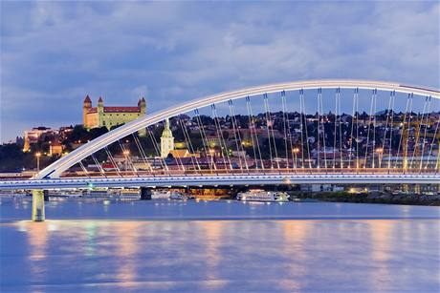
Central European Context
Slovakia
Building code is based
on code from 1976
Land use plan – binding for builders
Regulatory plan – binding for builders
Act Nr 175/1999 Zb.

Slide 16
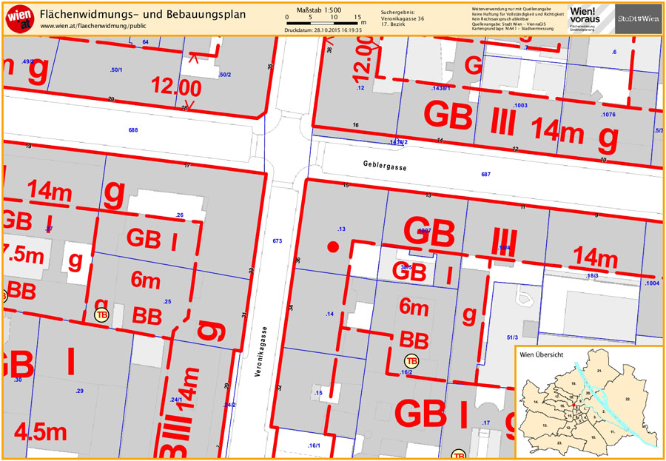
Central European Context
Austria
Wienna building code is based
on legisaltion from 1930
Land use plan – conceptulal
Regulatory plan – binding for builders

Slide 17
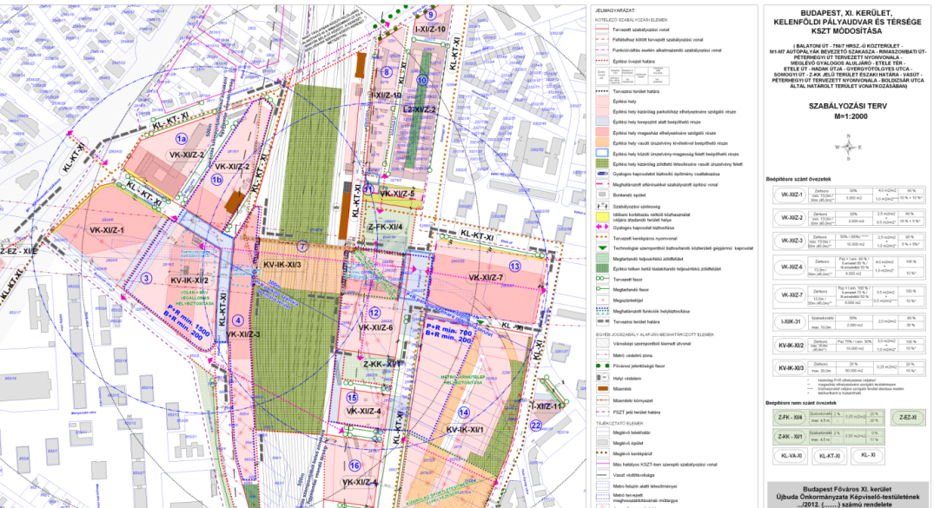
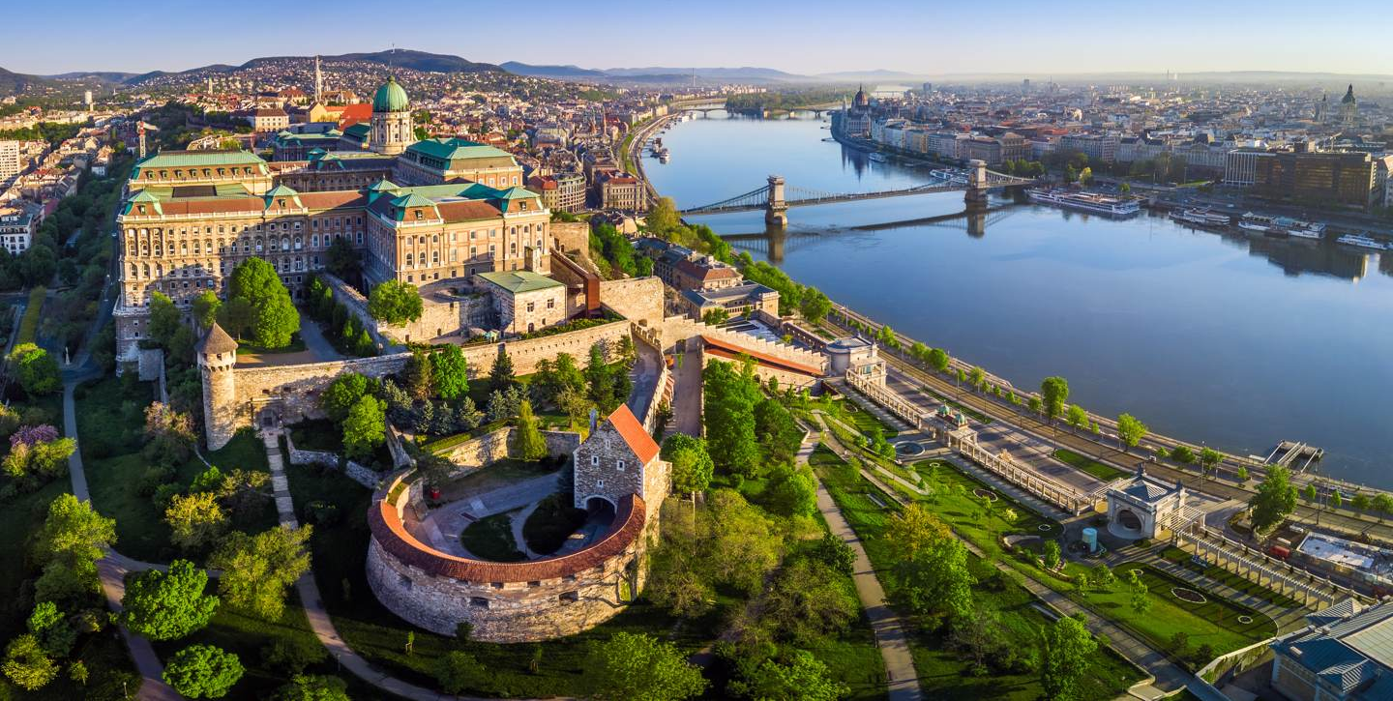
Central European Context
Hungary
New building code 1998
and its modification 2012
Land use plan – conceptulal
Regulatory plan – binding for builders

Slide 18
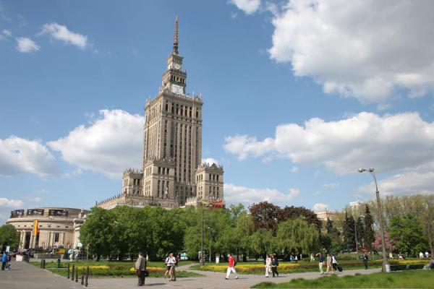
Central European Context
Poland
New building code 2004
Land use plan – conceptulal
Regulatory plan – binding for builders

Slide 19
Case study
New planning legislation vs housing

Slide 20
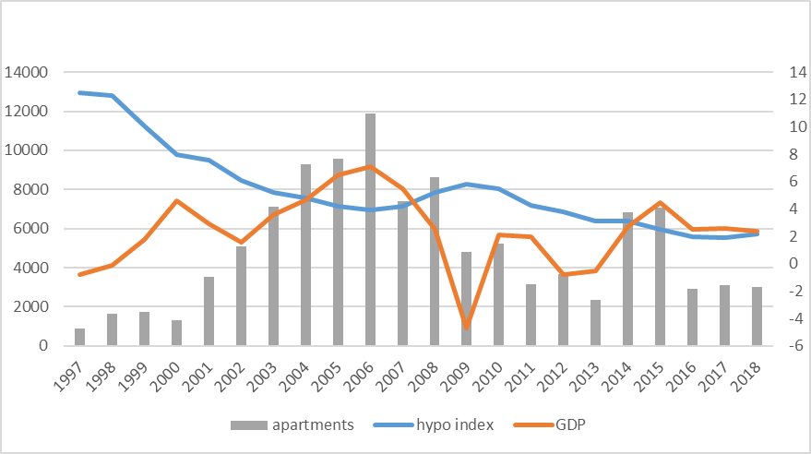
Case study
New planning legislation vs housing
Housing development in Prague + hypo index and GDP in the Czech Republic
Source: Czech National Bank, 2019

Slide 21
Case study
New planning legislation vs housing
Number
of statements
in permit process
Length of building approval process in central European region in days
Number of days needed for building permit
Source: http://www.doingbusiness.org/en/data

Slide 22
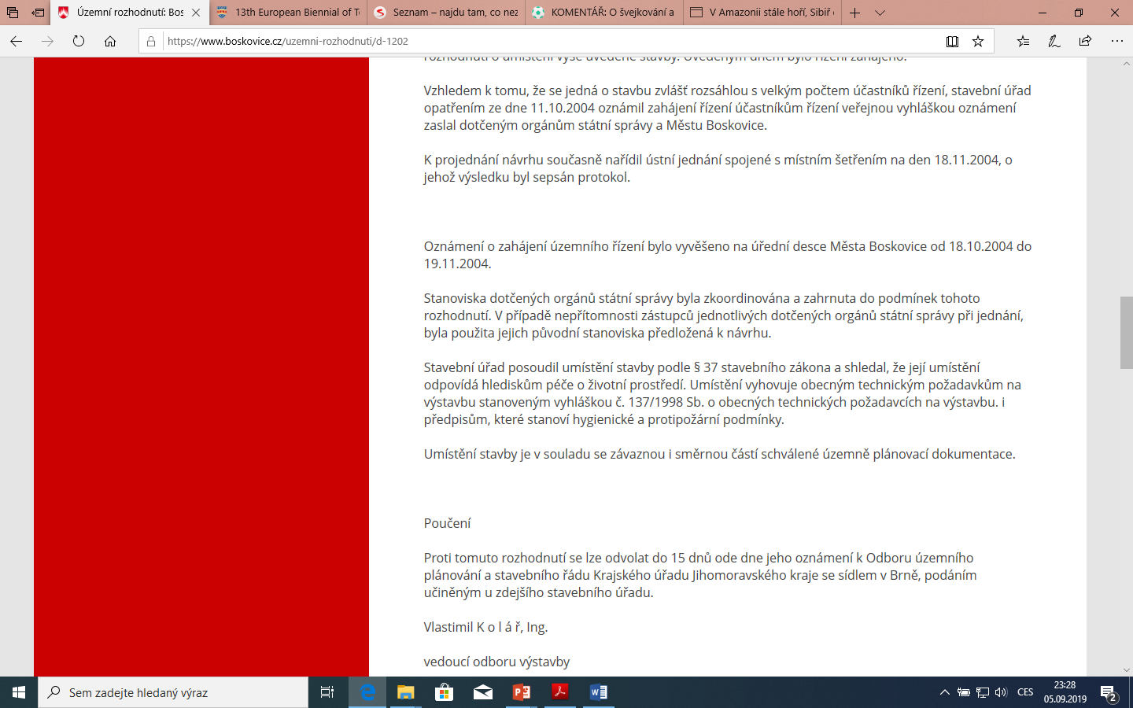
Case study
„§96b: concordance with land use plan“
2009 1 – 5 sentences 2019 10 – 50 pages

Slide 23
Case study
New planning legislation vs housing
Building proces duration
1914
1954
2014
Planning&permittig
Construction
Denmark
today

Slide 24
Case study
New planning legislation vs housing
Is there a way out ?

Slide 25
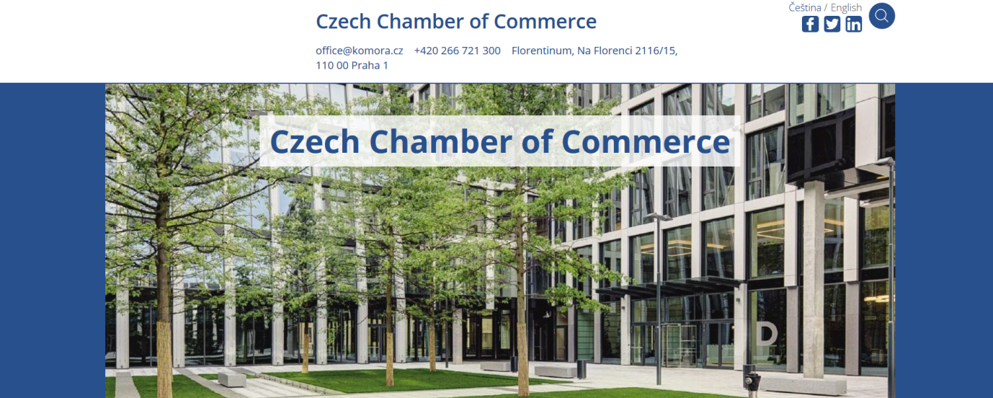
Case study
A brand new building code ...
Code preparation timeline:
Concept
Evaluation of the concept
Paragraph wording
Evaluation
Legal validity
6 months
2 months
6 months
3 months
2021
Andrej Babiš,
Prime Minister
Authors
of the concept
of new buildig code

Slide 26
Case study
.. or a change of planning paradigma ?
Roman Koucky
author of the concept of a new land use plan of Prague (Metropolitni plan)
„old vs new“

Slide 27
Conclusions
Building code principal changes in time
The 1st phase, the longest, since 1886 til the 40th of XX century,
The 2nd phase til 1958,
The 3rd phase from 1958 to 1976,
The 4th, since 1976 til 2007, validity of Building Act from 1976, updated in 1992,
The 5th phase since 2007 - new Building Act
3rd
?
1st
2nd
4th
5th

Slide 28
Conclusions
Building code modifications and changes
after approval of current building code from 2006
Amendment: 68/2007 Sb.
Amendment: 191/2008 Sb.
Amendment: 223/2009 Sb.
Amendment: 345/2009 Sb.
Amendment: 379/2009 Sb.
Amendment: 227/2009 Sb.
Amendment: 424/2010 Sb.
Amendment: 281/2009 Sb.
Amendment: 420/2011 Sb.
Amendment: 142/2012 Sb.,
Amendment: 167/2012 Sb.
Amendment: 350/2012 Sb.
Amendment: 257/2013 Sb.
Amendment: 39/2015 Sb.
Amendment: 91/2016 Sb.
Amendment: 298/2016 Sb.
Amendment: 264/2016 Sb.
Amendment: 183/2017 Sb.
Amendment: 194/2017 Sb.
Amendment: 205/2017 Sb.
Amendment: 193/2017 Sb.
Amendment: 225/2017 Sb.
Amendment: 169/2018 Sb.
?
number of states
Legislative „accelerando“

Slide 29
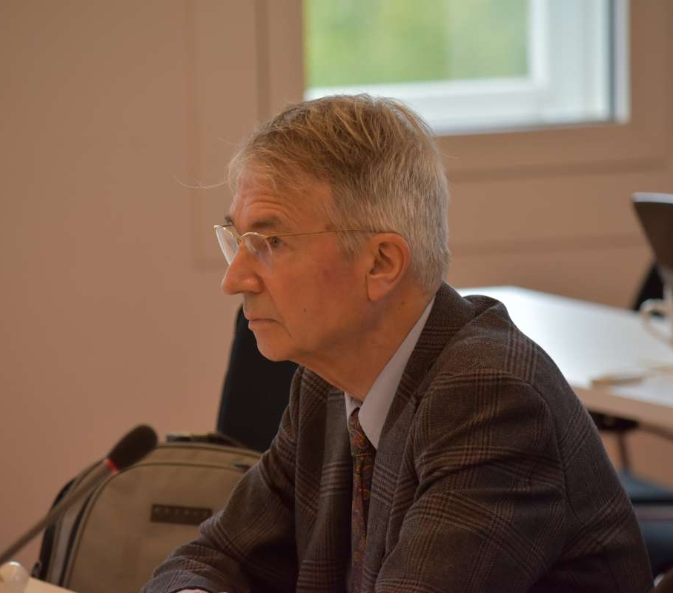
Conclusions
„Any attempts to change or modify the German planning system failed as the expert community appreciates stability and predictability more than any other expected positive / practical outcomes of change.“
Prof. dr. Gerd Schmidt-Eichstaedt
Transition makes you flexible, creative, aspirating for the better future…
…but do not forget to count losses.

Slide 30
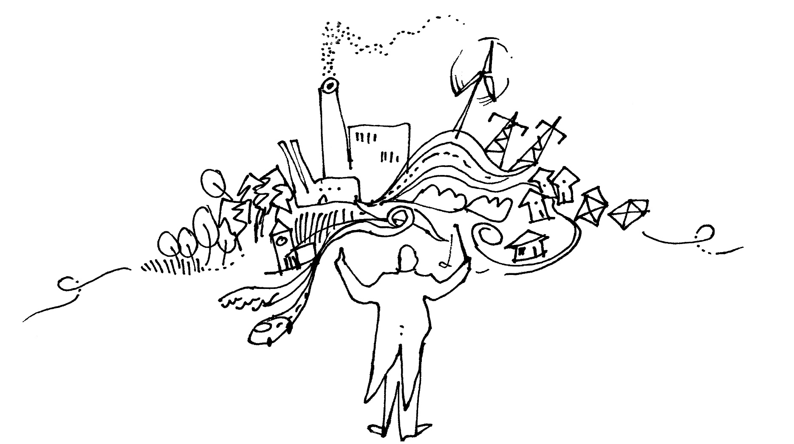
Thank you for your attention
Vít Řezáč
rezac@fa.cvut.cz
Faculty of Architecture CTU, Prague, Czech Republic

