Slide 1

13th European Biennial of Towns and Town Planners 2019:
Planning on the Edge
Lessons Learnt from a Bulk Renewable Energy Infrastructure Project CAES (Compressed Air Energy Storage) at Coastal/Marine Transitional Zone
“Spatial multi-diverse Transitional Zone:”
Consenting Regimes, Marine and terrestrial, terrestrial, sub-terrestrial, foreshore, marine and sub-maritime environ and coastal and terrestrial communities.

Slide 2
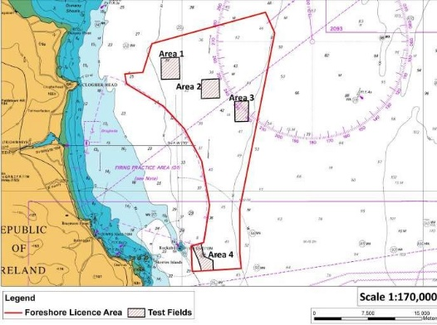
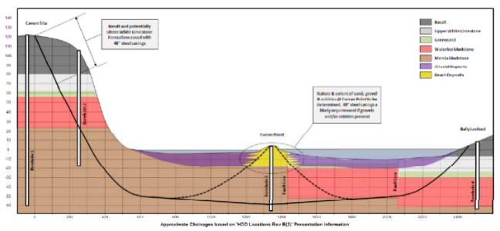
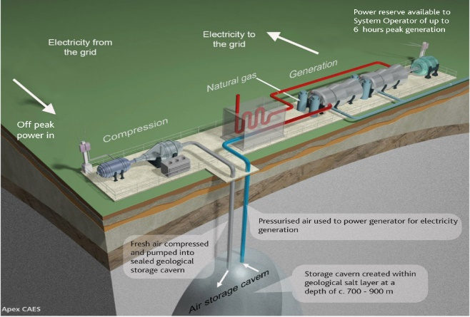
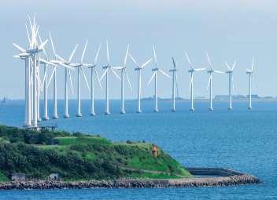
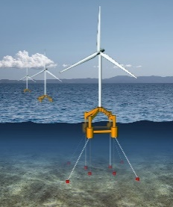
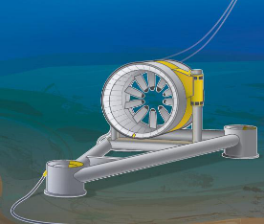
Bulk Energy/Renewable Energy Infrastructure Projects on the Terrestrial & Marine “edge” Transition Zone
Bulk Energy/Renewable Energy Infrastructure Projects are increasing located on the terrestrial marine transition zone, i.e. coastal areas, foreshore, near shore.
What kind of projects are these Offshore Wind Farms, Offshore Floating Wind Farms, Marine Tidal Generation, Wave Generation, Marine Transmission Cables, Marine Interconnectors, Renewable-energy Power Stations, etc.
Why now at marine transition zone?
  Firstly the drive away from fossil fuels towards renewables to reduce global warming and sustainable energy.
  Secondly the spatial location of the resource. (in the marine environment, the sea –one of the biggest natural sources of energy [sun & geothermal) i.e. coastal tides, sea-streams, winds, waves.
  Thirdly, the spatial location and distribution of the end user, i.e. populations, population centres and regions.
  Fourthly the scale of these kinds of infrastructures.
  Fifthly, the physical “piped transmission” of electrical transmission and distribution cables and/or gas pipelines vs. product transportation of the declining fishery industry.
  Sixthly, the surface marine-use (land-use take) demand and the more finite, pressurized and constrained resource of terrestrial land.
  Finally the need for international interconnectivity to enhance national and international energy security of supply

Slide 3
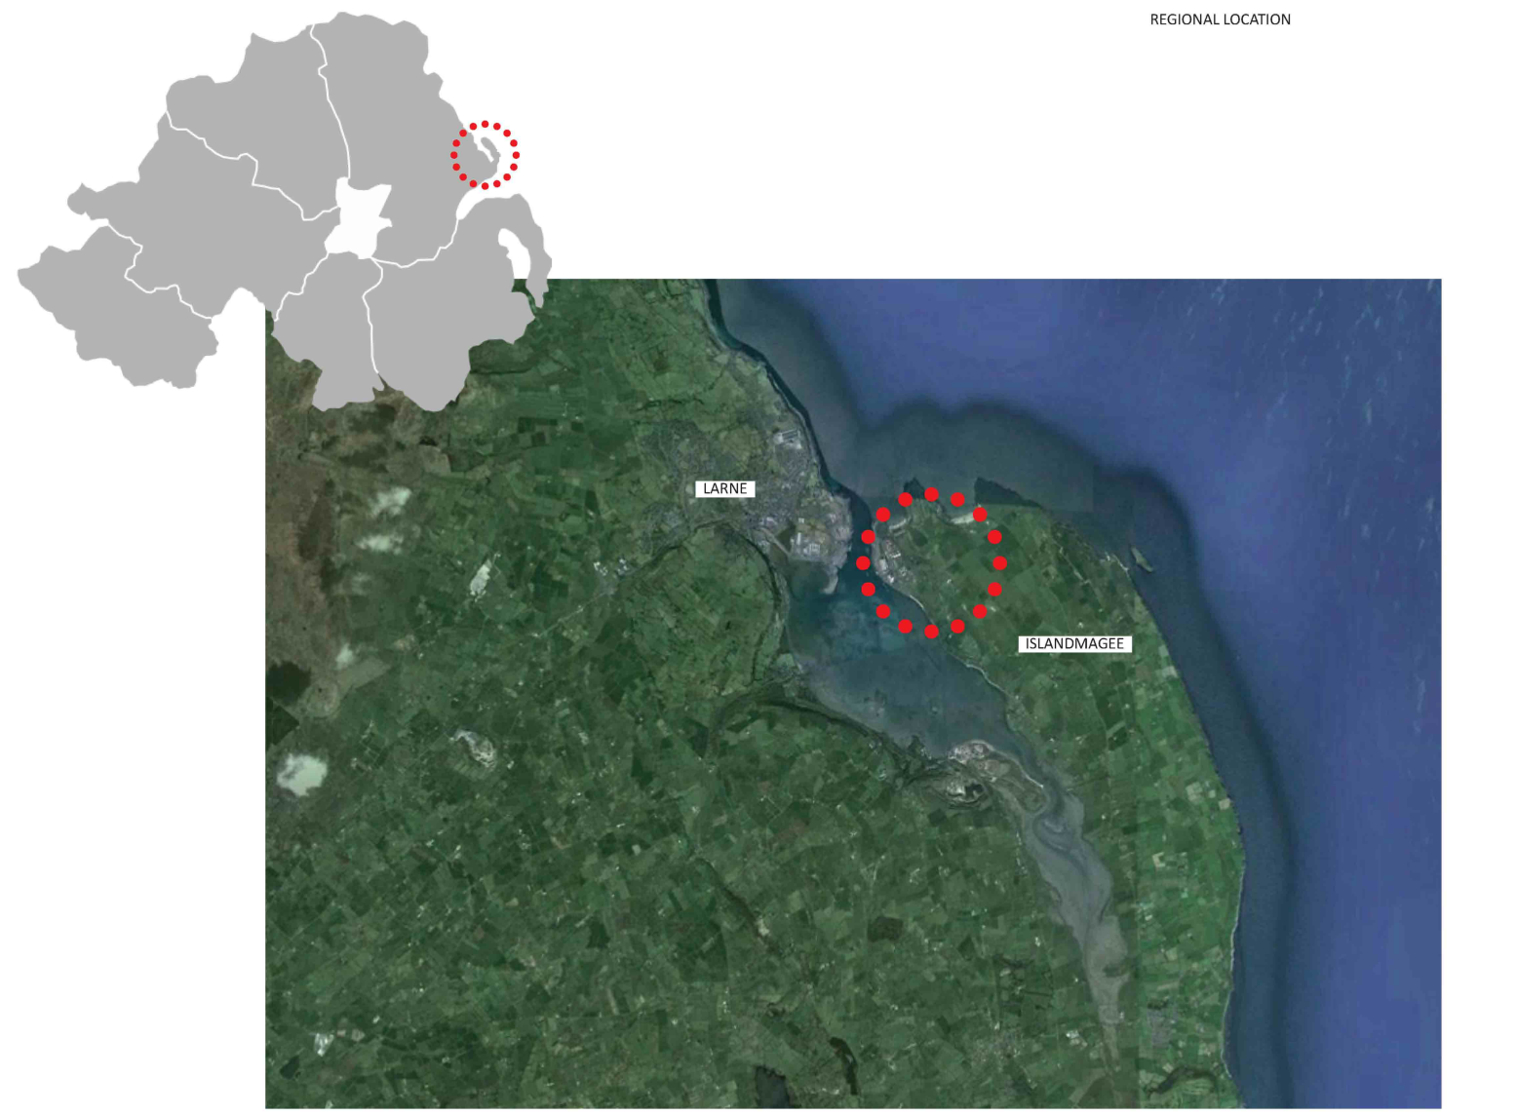
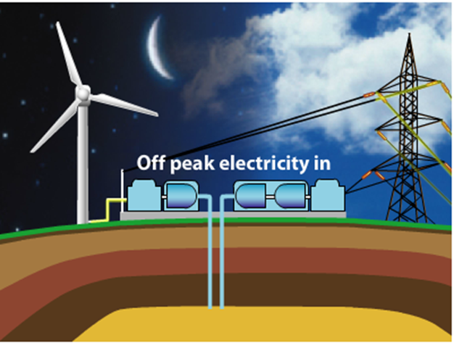
CASE STUDY: Project Location
What is CAES?
Compressed Air Energy Storage (CAES) is a proven storage technology which has new application to enable high levels of renewables
CAES advantages
Provides essential grid balancing services that:
Optimises the value of Northern Irish Wind
Reduce emissions and costs
Reduce reliance on expensive peaking generators

Slide 4
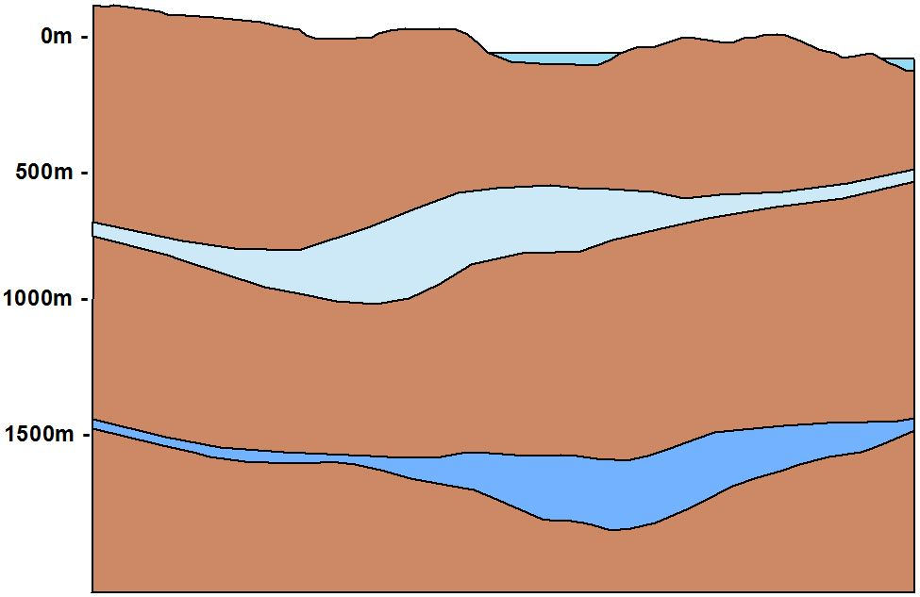
Project-CAES, Larne NI
NE
SW
Borehole
Larne Halite
(Triassic)
Permian Halite
Small cavern, low %
insoluble material
2km

Slide 5
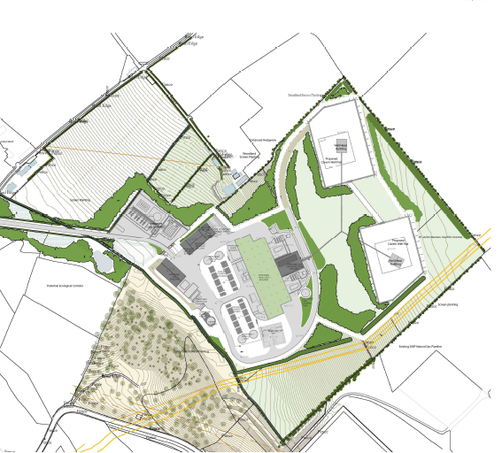
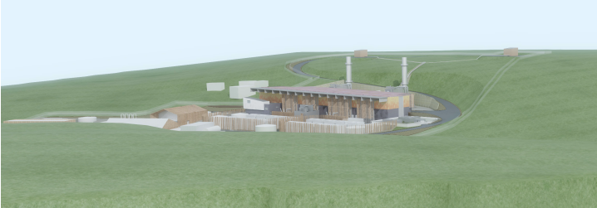
Project Description
Project-CAES Larne, NI:
“A 330MW Compressed Air Energy Storage(CAES) Station: Consisting of an industrial, circa 4/5-storey CAES Station, Solution Mining Water Pumping Station, Processing Building(WWTP), GIS Building, Security and Admin Buildings and balance of plant; Well Pads Wellhead; two underground, Geological Storage Caverns at depths between circa 1400m-1800m, with linear infrastructure consisting of a Marine Water Intake Pipeline;. Brine Pipeline(marine outfall), 275kV Transmission Cables, a gas connection and a new access road. Also Included is an Appraisal Drilling Operation, Drilling Rig, Drilling Compound, well and all associated works.”

Slide 6
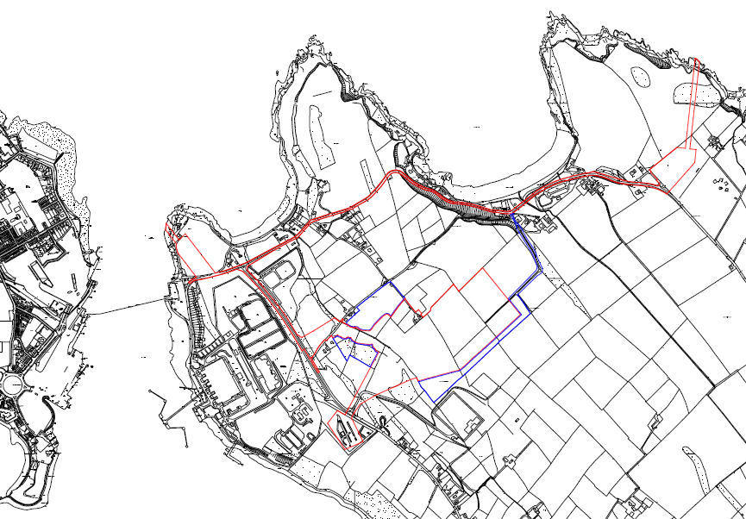
Site Location Plan:
“Redline Boundary” Terrestrial

Slide 7
“Redline Boundary” Including Marine

Slide 8
High-level strategic spatial and nodal location
The location of this project at what may seem an unlikely coastal location at a marine transitional zone (confluence of spatial strategic, coastal and locational factors).
  First High Level Locational Factor: Location at Islandmagee a coastal peninsula is based on primary locational factor of a finite “located” natural resource. i.e. Permian halite salt
  Interestingly enough, there is a strong marine connection, this geological resource located under the banks and sea bed of Larne Lough was formed by shallow seas in geological times that repeatedly filled a shallow sea basin then evaporated leaving a layer of sea salt
  This resource only occur at either a present-day coastal location or prehistoric sea location or in land sea, it is therefor no accident that this marine resource is located in a marine buffer zone
  This very geographical and geological shallow nature of the seas and proximity of the landmasses that allow the interaction of the coast and sea i.e. pre-historic land bridge between Northern Ireland and Scotland, and in modern times formed the Port of Larne.
  At the present day, the character of this strategic location is still dictated by the geography, topography and geological nature of the location as it is the same shallow waters and the landmass proximity between of NI and Scotland.

Slide 9
(…continue) High-level strategic spatial and nodal location
  So what appears random at first is shown not to be unrelated, a natural resource formed by geological, topographical and geographical forces, are also responsible for the presence day strategic nodal point.
  In “land-use/marine-use” terms facilitated a transportation/transmission/communication corridor between NI and Scotland as the closest spatial point between the two landmasses.
  The Second High-level Locational Factor: for the location of the CAES Project on Islandmagee is the presence of the SNIP (Scotland-Northern Ireland Pipeline) a major gas transmission pipeline and 500 MW Moyle Electrical Transmission Interconnector between Northern Ireland and Scotland.
  Again, these strategic infrastructures’ spatial corridor locations are dictated by the strategic spatial corridor between of Islandmagee, NI, and Auchencrosh Scotland.
  The Third High-level Locational Factor: New technology, once new technology could be innovated to make use of a finite coastal/marine resource such as Halite Rock in a sustainable way to be used for the physical storage of energy either through compressed air energy storage(fresh air storage) or by an unrelated project the through storage of natural gas, new functional land-use/marine use interactions were formed between the unique marine resource, and the strategic spatial locational advance to human activity created by similar forces at this location.
  In a general sense certain marine transitional strategic locations, where the presence of high-level strategic locational factors are present such as to create national and international spatial corridors between opposing nodal locations on opposing land-masses are likely to continue to be used over time for economic activities, which can utilise their strategic location and the agglomeration advantages that existing strategic infrastructure offer at these locations.
  While fish were once the natural resource imported and exported from such locations. Energy is likely to be the new import and export commodity. While these locations are likely to be utilised under new bulk renewable energy projects.

Slide 10
Multi-diverse Transitional Zone
With these kind of projects at the marine transitional zone, a number of transitional functional spaces comes into play.
Considering this and given the size and scale of these projects, they are not limited to either jurisdictional, physical/ecological or geographical boundaries. By their very nature they “bridge and stand in the gap” of these typical spatial regions through their linear components.
  Multi markets i.e. traditional building industry/construction market and regulated electricity and energy markets.
  Multi jurisdictional, i.e. more than one municipal, regional or national jurisdiction, i.e. different nation states (Ireland, Northern Ireland, UK and Europe).
  Therefore, multi-consenting regimes i.e. Terrestrial Planning Consent, Marine Licence Consent, EU Project of Common Interest(PCI) strategic consent & finance and PCI TEN-E(Trans European Network for Energy) Construction Consent, EPA discharge licences, Water Discharge and Extraction licences, Geological Mineral Licence Consents, Electricity Transmission Connection Agreement, etc.
  Multiple Property Estates: terrestrial private property and wayleave along linear routes, marine estate (Crown Estate).
  Terrestrial and Sub-terrestrial EIA, Marine, Marine Bed and Sub-marine bed regions
  EIA, Cumulative Impacts and Transboundary Cumulative Impacts, Natura Regulation Assessment (NRA), etc.
  Terrestrial, Coastal and Marine Ecological Systems.
  Terrestrial Communities, Coastal Communities and Fisherman/Shell Fisherman/Boatmen, Sailors communities.
  These are connected by a typical organic or ecological type network.

Slide 11
Transitional Zone: Held in Trust by Local Community
Given the strategic spatial importance that often extends to regional and national coastal locations and corridors. There is increase infrastructure pressure at these locations and therefore, on their local communities.
From fishery to energy trade: the fundamentals of the strategic spatial locational advantages remain.
In a changed international market and a move away from fossil fuels. The import and export of energy and in particular, renewable energy are becoming increasingly important, for these coastal locations as points of entry between offshore generation to domestic markets and international import and export of renewable energy.
While these strategic energy imports and exports, theoretically brings significant economic activities to these areas. Their offsets aimed at regional, national and international energy markets are often much further afield and therefore, do no translate to local economic transposition. While often only the negative impacts through physical infrastructure are transferred to the local communities.
Here in lies the challenge of how to relate what is a national market economic activity directly to a local communities and directly to a local economic gain.
Local communities and the landscape that they oversee should be recognised as custodians of these strategic and natural ecological coastal locations and strategic landscapes and subscribe the economic value to oversee, maintain and foster these locations which they hold in trust for the nation. It will be important to find ways to directly transpose economic advantage to these communities. They are the gate keepers of critical land and sea bridges to a country and should be recognised as such and appropriately compensated for this functions .
The issue of spatial justice arises, when strategic infrastructure that benefits the larger whole population imposes negative externalities on a local population, i.e. visual impact, environmental impact, sterilisation of lands, creating infrastructure barriers, etc.
Some form of modified Socio-econ Community Infrastructure Levy or Planning Gain Compensation or community fund to mitigate negative externalities in a more equitable way needs to be found.
A possible solution could be to offset the upper end economic advantage that national infrastructure provide to certain location against the negative externalities that their transient nature have through other areas i.e. environmental enhancement programmes and environmental rehabilitation of former infrastructure development areas.

Slide 12
Case Study: 330MW Project CAES, Larne, NI
Strategic Project status confirmed August 2011 i.e. Project of Regional Significance.
Applicant seeks structured engagement with Planning Services & Statutory Consultees in the Pre-Application Discussion (PAD) process.
Consultation Strategy 2011 international best practice.
Half way through process Northern Ireland planning system undergoes a reform through the new Planning Act (NI) 2011 & Development Management (NI) Regulations 2015 and other Regulations. (took effect on 1 April 2015) as well as member state incorporation of TEN-E Regulatory PCI consenting regime.
New regime, “Planning Act 2011(enacted 2015)” came in force in 2015.
PROJECT PRINCIPLES AND OBJECTIVE ADOPTED TO LEAD THE “PLANNING CONSENTING APPROACH”:
  Non-project splitting, since 2011
  Single Project Approach and overarching EIA, sHRA over all integral parts and secondary consents, since 2011
  Application of best-practice Corridor, Route & Site selection terrestrial and marine studies; hierarchy of planning docs.; sHRA.
  1st Application of Rochdale Envelope in NI.
  Consultation Strategy since 2011; Voluntary Community Consultation, event programme, mail drops, notices over a 3.5 period.(Followed by Statutory Consultation since mid 2015, totalling 4.5 yrs.) -Largest consultation in NI to date.
  Voluntary Consultation Website, since 2012. (Statutory PCI website, since 2013)
  Voluntary Newspaper Public Notices since 2012. (Statutory since 2015).
  Anticipate Legislative and Regulative Planning and environmental change, during project life time. Following emerging international best practice

Slide 13
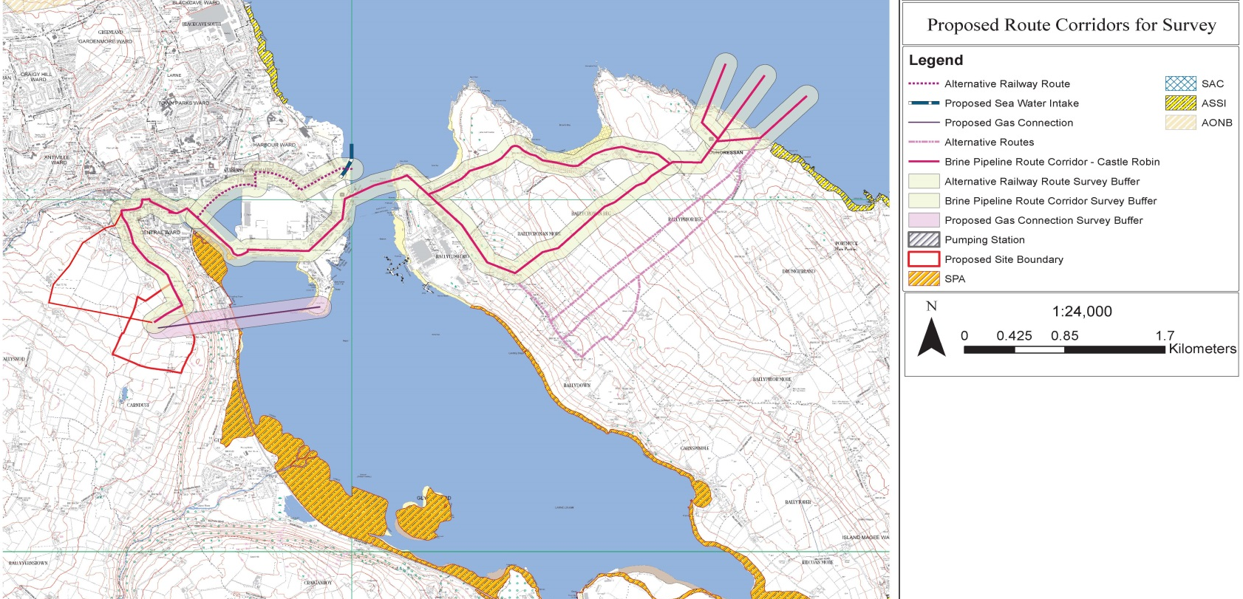
Spatial Terrestrial & Marine corridor-route selection, extent:
(across different physical and functional space)

Slide 14
PLANNING & ENVIRONMENTAL CONSENTING IMPLICATIONS:
1. Bulk Energy/Renewable Energy Infrastructure Projects on Coastal/Marine
Interface, very different character:
It is a different beast to a typical consenting application !
Bulk Energy/Renewable Energy Infrastructure:
  Is complex and multi-facetted consisting of a Primary Industrial Complex (nodal centre) and linear infrastructure (axis or corridor developments).
  Projects that cover and or traverse significant spatial and geographical areas.
  It's of relevance and importance to a much larger group of people, local community and stakeholders alike given its geographic area size.
  The potential to cross a number of consenting jurisdictions and enter separate consenting regimes i.e. Spatial Regimes, Functional(transmission/distributions) and Environmental regime.
  Traverse different Spatial Regions or Spaces, i.e. terrestrial, sub-terrestrial, coastal, marine, sub-marine bed.
Typically have both nodal (central place) and axis (corridor development) i.e. built form, land use functionality and environmental expressions of these.
Have both a local and national/international character i.e. NI, UK, EU
  EU wide goals, National interests, Common Good, and Local interests and objectives.
Multi diverse community groups, i.e. urban, farming/country side, coastal and fishing communities.
Substantial Community Concern, Large Public Consultations and often Emotive Objection.
Typically a Different Planning Application Status, i.e. Project of Regional Significance, Strategic Infrastructure Project, Nationally Significant Infrastructure Project (NSIP)
  Why? - national strategic nature in the interest of the region or country as a whole.
  Inherent Conflict of interests: Local Interest vs National Interest
Challenging Planning Timeline and project member longevity.
A complex investment, Econ. model & long run-in Eng. Design & Project composition – difficult to converse on “Design Freeze”
Strict application environmental directives, laws and regulations. i.e. EU, PCI
PLANNING & ENVIRONMENTAL CONSENTING IMPLICATIONS:
  Requires an overall, “Single Project Concept,“ approach to consider what the project description is, and therefore, describe in Text parameters, Site Layout/Drawings or “Rochdale Envelope” what needs to be assessed for its potential environmental effects, against the baseline environment.
  Requires a Sophisticated and Planning Consenting Strategy, “Non-project Splitted” EIAR, AA (nodal & linear) and Consultation (Planning & Community) Approach
  A Day-one, un-biased Community Consultation Strategy, i.e. Trust can only be earned over time.

Slide 15
2. Project Dimensional & Medium diversity (functional space).
Terrestrial (surface) “functional space”
Sub terrestrial (underground) “functional space”
Deeper Sub terrestrial, (1.4-1. 8km), "Geological Depth” “functional space”
Marine bed “functional space”
Sub-marine bed “functional space”
Air, noise, brine plume, EMF emissions ( 3 dimensional)
Marine Water Colum (brine plume, tides) ( 3 dimensional)
Geological Rock strata ( 3 dimensional)
PLANNING & ENVIRONMENTAL CONSENTING IMPLICATIONS:
  The “Single Project” needs to be considered in 3-dimensions and for multitude of potential interactions and potential environmental effects.
  The changing degree of environmental impact needs to be considered as the project crosses over into different regions or ecological areas.
  Divergent corridor/route and nodal location constraints assessment between terrestrial ecology and marine ecology need to be anticipated.
  Environmental spatial bottleneck nodes need to be anticipated, as numerous linear infrastructures may seek to move through physical, geographic and environmentally constrained locations to reach their long distance destinations.
  Spatial planning principles (economics of location) need to be interpreted for application in “different functional space” i.e. sea, sub-terrestrial, etc.
  Different Consenting Jurisdiction; Consenting Regimes and Licences may apply across different space.
  Land-use, Marine Use, geological “Storage Use in Minerals” (as it is not mineral extraction).

Slide 16

3. Different Market(functional space) Regimes.
The tale of these Market Regimes are that they largely work in isolation from each other, while concerned with exactly the same “topic” or development description.
  The planning /marine construction/building market operates in a “physical development spatial region” (Free Market)
  The Transmission and Energy Market operate in a “technical and economic functional space/region” (Regulated Market)
  The PCI process operates in “EU Energy/ Transmission Market“ and “EU Development market” within “an EU, policy and financial region” with a mechanism aspiring to consolidate the first two regions.
  (European Economic Area and future Single European electricity market)
PLANNING & ENVIRONMENTAL CONSENTING IMPLICATIONS:
  Bulk Energy/Renewable Energy Infrastructure Projects operates in three different economic markets. There different focusses and requirements can lead to divergence of information and in particular, environmental information, and confusion in terminology, i.e. planning: land-use/marine use planning and transmission engineering planning, etc.
  Thus a Project Promotor has to work on all three fronts at the same time, while negotiating touching points between these spatial functional space regions.
  PCI’s market extends across energy, development, construction and spatial development regions.

Slide 17
4. Different Strategic Consenting Regimes
Different Decision Makers: EU, Northern Ireland(member states, & TSO(SONI)
Different strategic consenting regimes, i.e. N-S Interconnector, Project-CAES, Intrastata Gas project, etc.
  The EUs TEN-E regulations, the Member State Consent and Regulated(NI & UK) Planning Process
  Technical/Economic TSO(SONI & EirGrid) grid connection consenting regime:
  NI Planning Regime, under the then Planning (NI) Order 1991 and 2012 Regs; replaced 2014 by Planning Act (NI) 2011 and Planning (Development Management) Regs (NI) 2015.
  Section 26; Section 27 and Section 28
  Marine Act 2011
  EU TEN-E Regulations and PCI Directive
PLANNING & ENVIRONMENTAL CONSENTING IMPLICATIONS:
  Different decision makers with differing asks, negotiated co-operation required, robust documentation to serve all needs to avoid duplication.
  Careful monitoring is required to avoid divergence of information, especially environmental information.
  Awareness needs to be raised of what the other decision makers require, or request, and it needs to be mutually interpreted and ideally noted in all the other consents.
  Over arching EIAR, HRA assessment and non divergence of environmental information, are critical in assessment given the timelines that can be involved for infrastructure projects.
  Seek to use the PCI TEN-E unifying regs and member state guidelines or laws.

Slide 18
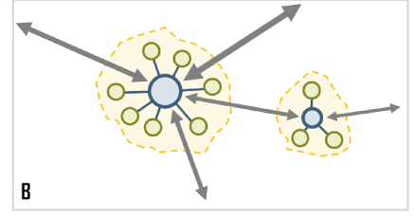


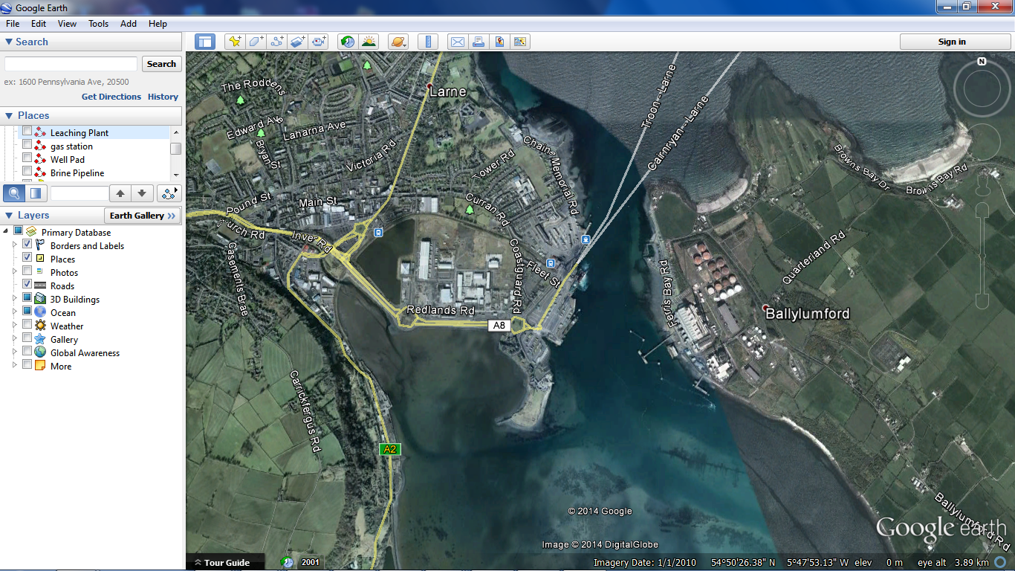
5. Spatial Nodal & Corridor(axis/linear) locational factors
Under the Spatial Planning theory of Nodal Location, which predicts land use, environmental and economic cost sustainability
i). ii.)
(Growth Pole Theory, Francios Perroux) (Central Place theory, Walter Christaller)
Where would they predict a new Bulk Energy Power Station, a Marine Outfall, transmission corridor routes, brine intake outfall pipelines, etc?

Slide 19
PLANNING & ENVIRONMENTAL CONSENTING IMPLICATIONS:
IDENTIFIED PRIMARY SPATIAL LOCATIONAL FACTORS:
Land Use Precedent: Heavy Industrial Use adjacent to the west.
Succession of Land Use: expansion or intensification of the land use.
Agglomerational Advantages: due to similar type of land use similar functionality, interaction, infrastructure, service connection and economic sustainability.
Reduced Development Foot Print: relocation of CAES Project from Carnduff to Ballylumford, Islandmagee, the overall physical project foot print is significantly reduced, and not only reducing economic costs, but the physical impact and sterilisation of land use by the development.
Planning and Environmental Sustainability: The existing land use, existing service investment and infrastructure, development foot print and established impact on the environment --future development at this location will be more sustainable than development on a random green field location.
Reduced Relative Environmental Impact: Due to existing industrial land use, environmental impact is significantly decreased as a much higher environmental impact baseline exit for i.e. Noise, Visual Impact, Physical Foot Print, Bulk Scale and Massing at this location, therefore, the relative increase is lower.

Slide 20
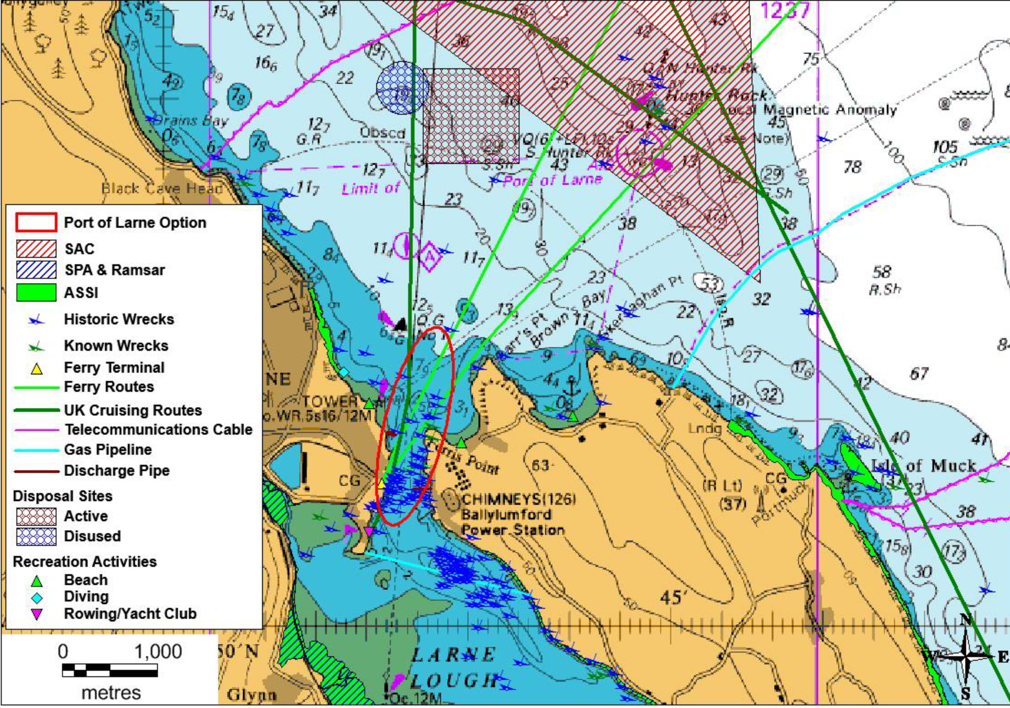
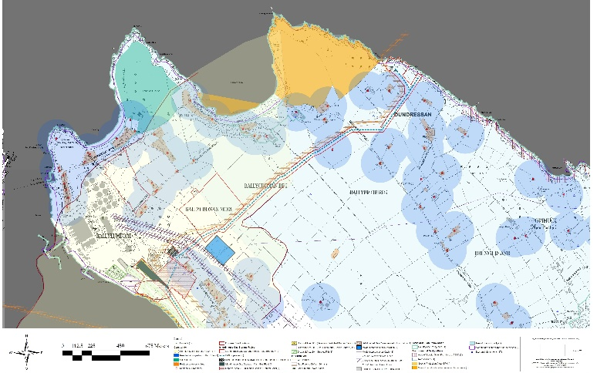
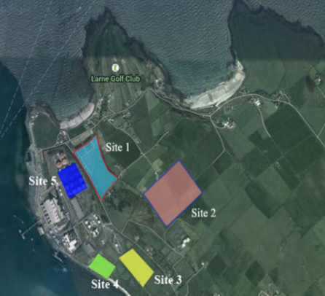
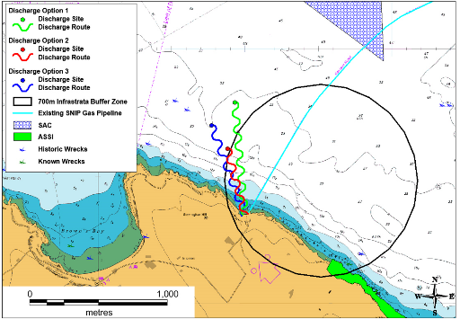
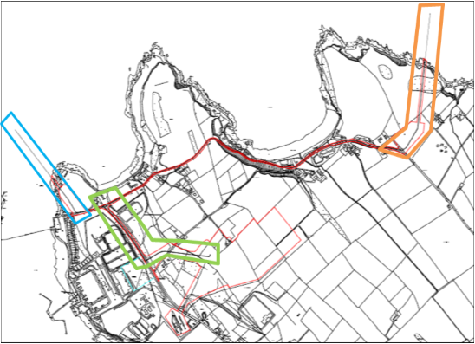
Hierarchy of Site(nodal) selection, Corridor-Route(axial) Environment and Technical Constraints Analysis and Selection
For example:
The marine corridor route selection study took account of the following constraints:
700m distance from the Infrastrata (another unrelated project) discharge location;
water depth ≥ 20m close to shore, the deeper the water the smaller the portion of the total water column affected by the discharge;
dynamic tidal regime and sufficient distance from conservation sites and sensitive seabed communities;
technical constraints of suitable shore access; interference with shipping lanes;
distance to shore – shorter distances minimise the energy required to deliver the seawater to the plant and brine solution from the plant;
and substrate type – trenching and direct-lay can be carried out with any strata, including rock.

Slide 21
6. Planning & Environmental Process of Alternatives
Principle of Alternatives:
The project was developed firmly under the “Principle of Alternatives”
The EU Directives indicate
A critical category of which is “Alternative Technology” as referred in the EIA Directive(85/337/EEC, SEA 2001/42/EC and AA Article 6(3) and (4) of the Habitats Directive 92/43/EEC ; New EIA directive 2014/52/EU),
Alternative, Project Design:
corridors and routes of brine, electrical transmission
and gas pipelines’. Overland routes, combined overland and
underground routes, overland and HDD routes
Alterative Spatial Location:
  1st Alternative- shallow Triassic salt)
  2nd Alternative resource(significantly deep Permian salt)
  Alternative location end(nodal)

Slide 22
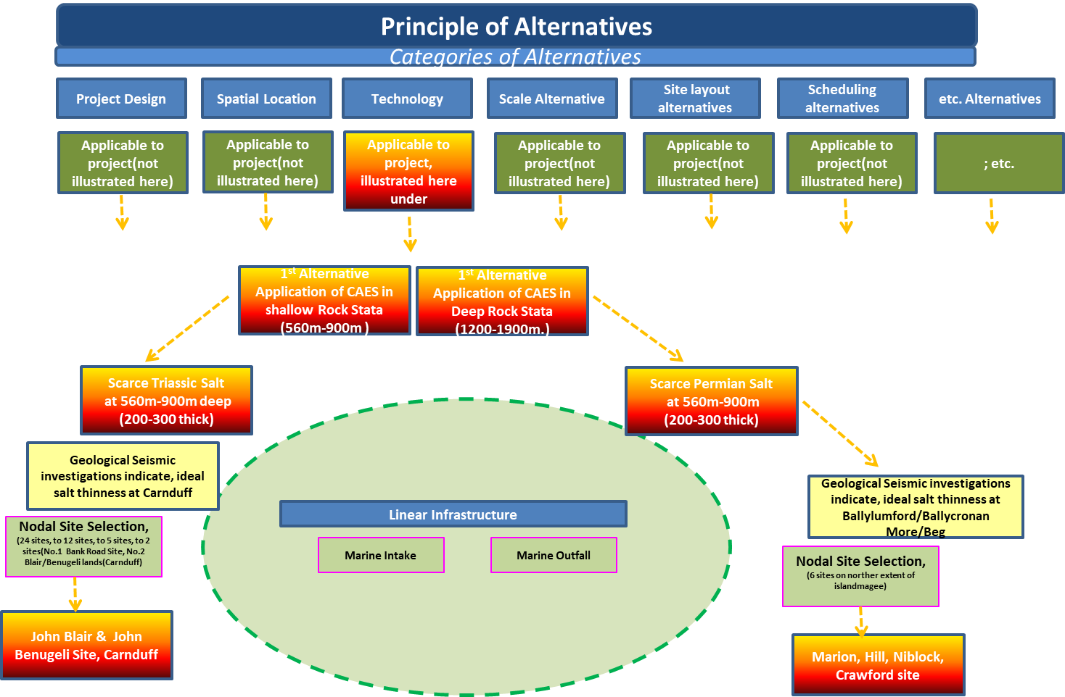
Development of CAES Technology
- Alternative location for CAES Station

Slide 23
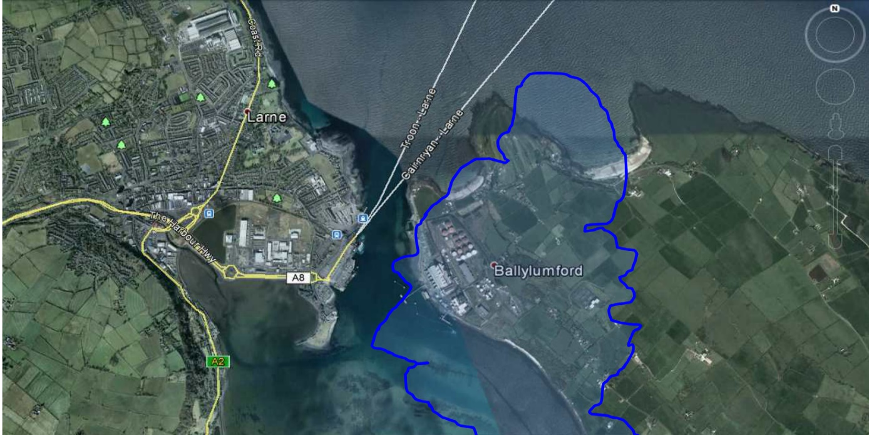
6. (Continue)… Planning Process of Alternatives
Change in a Primary Locational Factor/s - “Resource Constraint”
Why located at Carnduff?
  One of four “Primary Locational factors”, ideal Triassic salt location.
Why now at Islandmagee, Ballylumford?
  A new “Primary Locational Factor” e.g. Permian Salt location.
  Consequently, By Considering a New Technology a New Geographical Location was Induced.
When applying Nodal Theory and taking account of the Four main Primary Locational Factors for the project.
  Geographical Distribution of natural resource constraint, Permian Salt.
  Land Use and Environmental Sustainability( specifically Growth Pole/Central Place theory)
  Most ideal spatial location of Brine Outfall.
  Electrical Transmission connection(Point to Point study).
Ideal Brine outfall location
Permian Salt Sesource
Transmission Connection location
Ballylumford Generation Station location(existing node)
New Site Location, induced East of Ballylumford

Slide 24
6. (Continue)… Planning Process of Alternatives
PLANNING & ENVIRONMENTAL CONSENTING IMPLICATIONS:
  Savings to the Environment:
  (The 2nd Alternative has substantially savings to potential environmental impact)
  Significant reduction of the overall project foot print
  Transmission grid foot print length from circa5.4km to 0.7km
  Brine Pipeline from circa13km to 6km
  Gas Transmission from circa 2Km to 600m
  Geological caverns from 3no. to 2No. Only
  Cavern size reduced by more than 40%

Slide 25
7. Largescale Community Consultation:
Since 2011, the project adopted a best-practice approach for Bulk Energy/Renewable Energy Infrastructure projects from international best practice and in anticipation of the published but un-enacted Planning Act 2011.
Statutory Planning Consultation: PAD Process:
Developed in coordination with DOE Planning Section and Marine Consenting Authority an ongoing approach and agenda in the PAD Process.
  To provide the best opportunities for iterative scoping by the Decision Maker/s; and both Planning and EIA Statutory Consultees.
Presentations to the Borough Council and now to the new Super Council.
Largely up to the Prospective Applicant or Project Promoter to lead and formulate the agenda.
  This is dictated by the functional progress of the planning project and its environmental assessment.
Given the size of a PAD Meeting different meeting structures have been explored, and the Prospective Applicant has now settled on Plenary Meeting and sub meetings along project themes, led by the applicant's in house planners and environmental specialists.
Voluntary & Statutory: Community/Stakeholder Consultation Process:
Drafted a Community consultation strategy in 2011/2012
  Diversity of coastal communities, Urban, Village, coastal areas, Fishermen & Shelfishermen
  Different cultural approaches and catered event are required sensitive to needs.
Public Notice, Mail Drop and email invitations.
Robust and ongoing Community Consultation Events
  two or three day events 2-8pm, at project specific localities.
Consultation Website (a Virtual Public Desk)
Personal and project specialist engagement at each event with the community and other stakeholders.
Reporting function and “pre-application community consultation report” under Section 28, Act 2011.

Slide 26
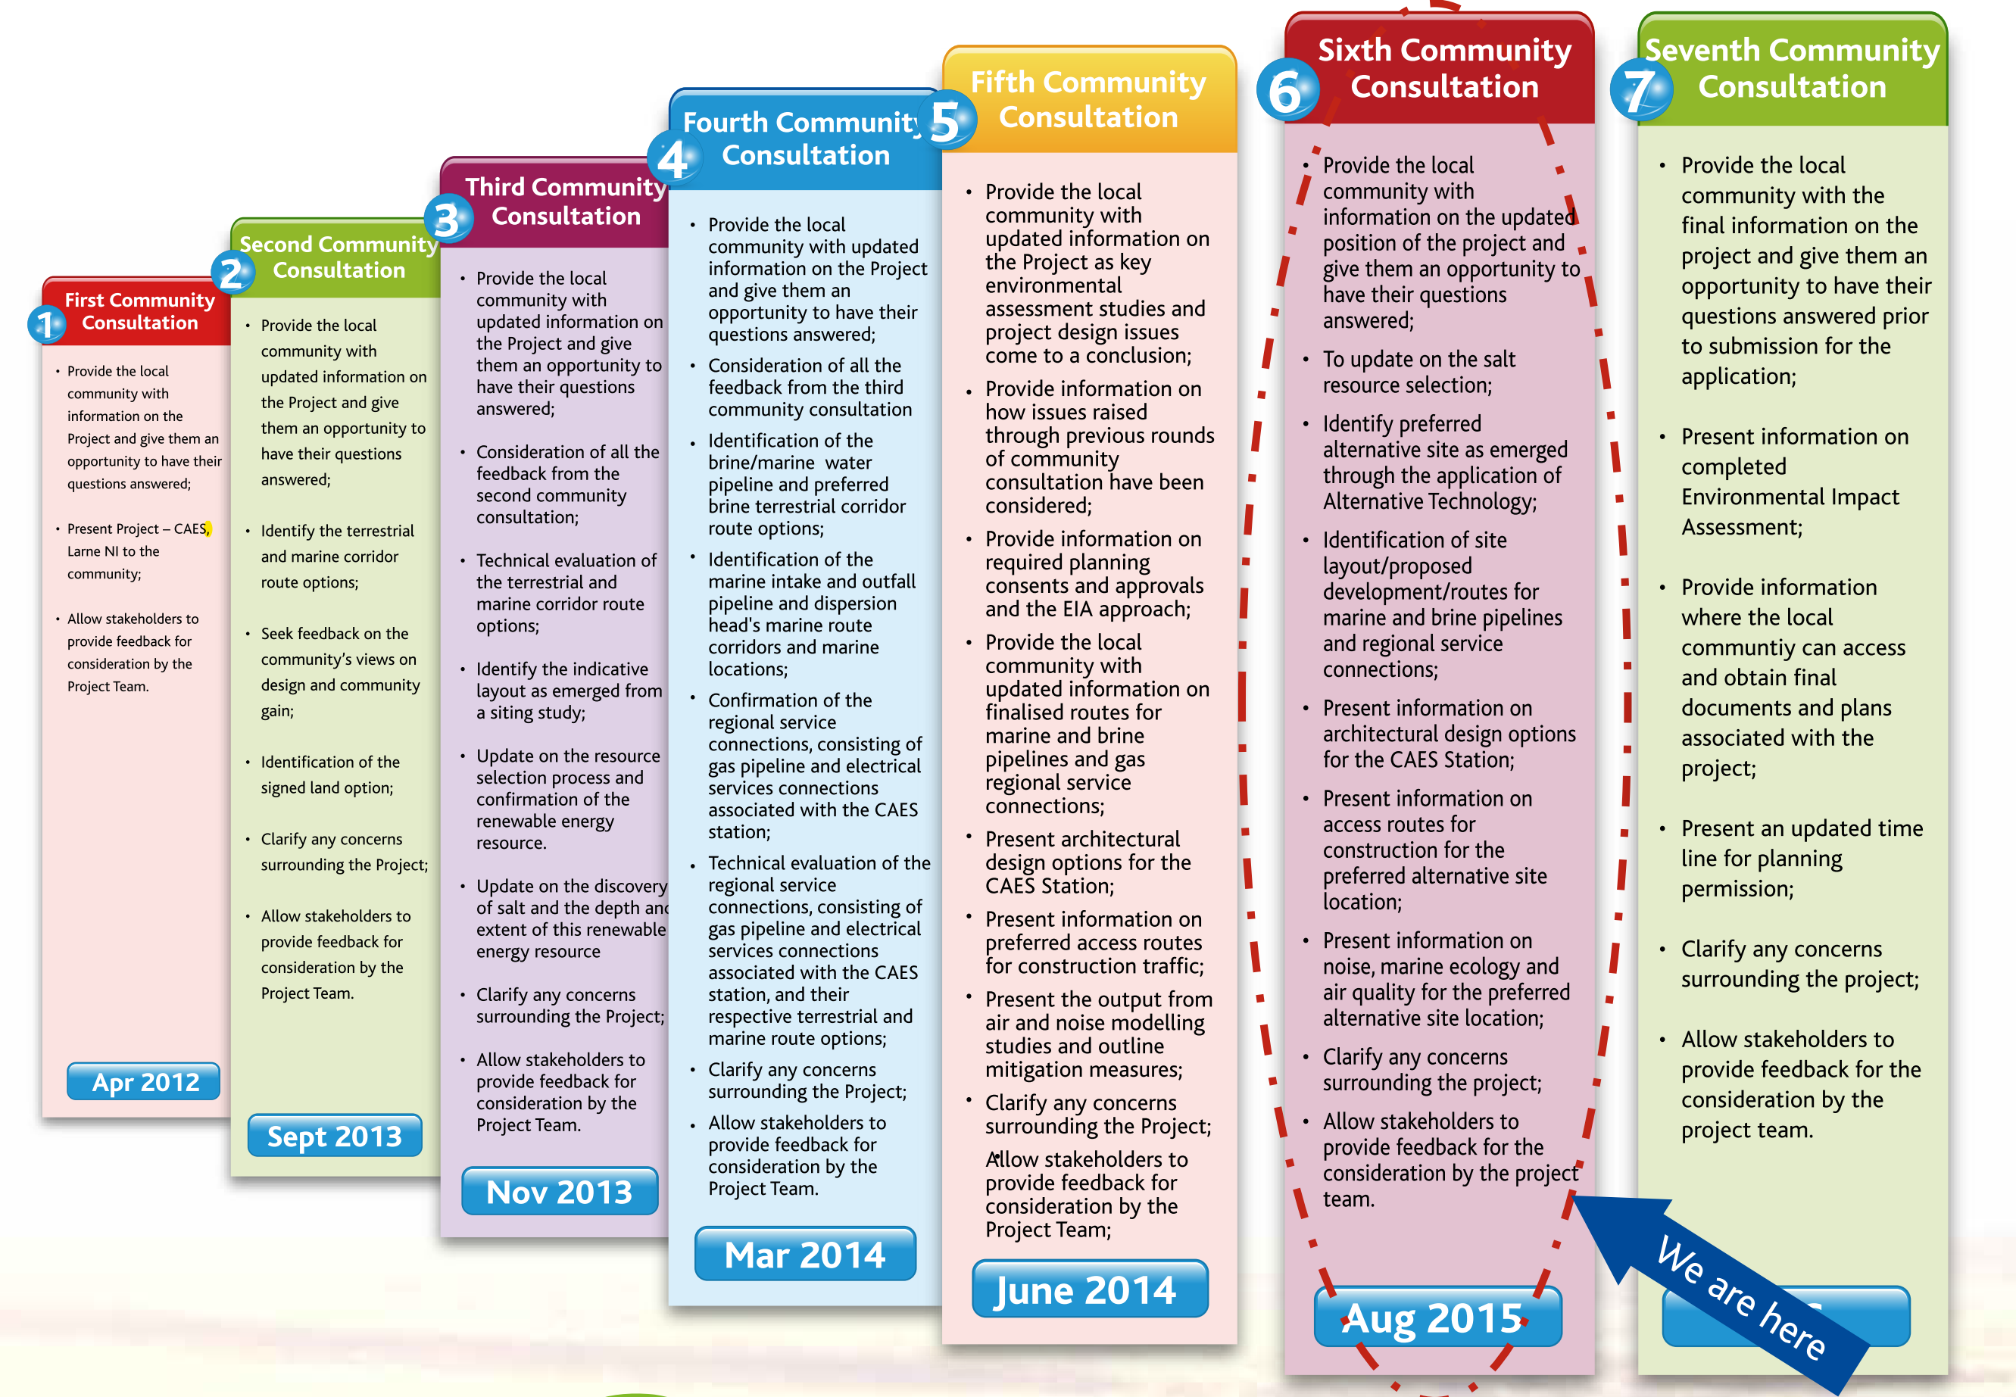
Community Consultation Rounds

Slide 27
PLANNING & ENVIRONMENTAL CONSENTING IMPLICATIONS: The Consultation Focus
  Honesty and trust should be built overtime; be the source of accurate and consistent info.
  Be available, on floor and make project team and specialists available.
  Be consistent and continuous in hosting consultation “it is a conversation."
  It is also as forum to learn from the community.
  Both the developer has a right to develop and the community has a right to raise concerns, and the question is can a consensus be reach? (a natural process).
  Transitional area has a diversity of community groups, urban, village, coastal, fishermen & shell fishermen.
  Must speak to other forums also, stakeholder groups, i.e. fishermen/lobstermen, local conservation groups.
  What is the “Planning Message” at any particular consultation event as it relates to land and sea ?
  The, in principle, project and planning process progress should be expressed.
  The on going planning and environmental programme should be stated.
  Project issues of particular interest should receive more attention and more personnel on the floor.
  Tangible planning gain should form part of the project if possible i.e. community benefit fund & schemes, local job creation.
  A developer should be committed to a “good neighbour approach," as the residents of an area will become your neighbours once a project is built.
  Consultations and community input should be documented and reported in the “pre-application community consultation report”
  It is important at the end of the consultation process that it be shown what influence or mitigation the consultation process had on the project.

Slide 28
8. Rochdale Envelope/ Engineering Design Envelope
The maximum credible envelope for the proposed Larne CAES facility, likely significant effects, and other matters relevant to the EIA process are described in a table.
The ‘Rochdale Envelope’ is derived from two cases: R. v Rochdale MBC ex parte Milne (No. 1) and R. Rochdale MBC ex part Tew [1999] and R. v Rochdale MBC ex parte Tew Milne (No. 2) [2000]. These cases concerned outline planning applications for a proposed business park in Rochdale.
  At outline application stage there should be acknowledgement of a need for details of a project evolving over a number of years, within clearly defined parameters;
  EIA needs to take account of and reflects the likely significant effects of such a flexible environmental statement
  Any permission (whether in the nature of the application or achieved through ‘masterplan’ conditions) must create ‘clearly defined parameters’ within which the framework of development must take place…. It is for the local planning authority in granting outline planning permission to impose conditions to ensure that the process of evolution keeps within the parameters applied for and assessed;
  The more detailed the proposal, the easier it will be to ensure compliance with the Regulations;
  The level of detail of proposals must be such as to enable a proper assessment of the likely environmental effects, and necessary mitigation - if necessary considering a range of possibilities;
  EIA may conclude that a particular effect may fall within a fairly wide range. In assessing the ‘likely’ effects, it is entirely consistent with the objectives of the Directive to adopt a cautious ‘worst case’ approach;
  The level of information required is ‘sufficient information to enable ‘the main,’ or the ‘likely significant’ effects on the environment to be assessed…., and the mitigation measures to be described….’;
  It will be for the authority responsible for issuing the development consent to decide whether it is satisfied, given the nature of the project in question, that it has ‘full knowledge’ of its likely significant effects on the environment;
  It is for the planning authority to determine what degree of flexibility can be permitted in the particular case having regard to the specific facts of an application.

Slide 29
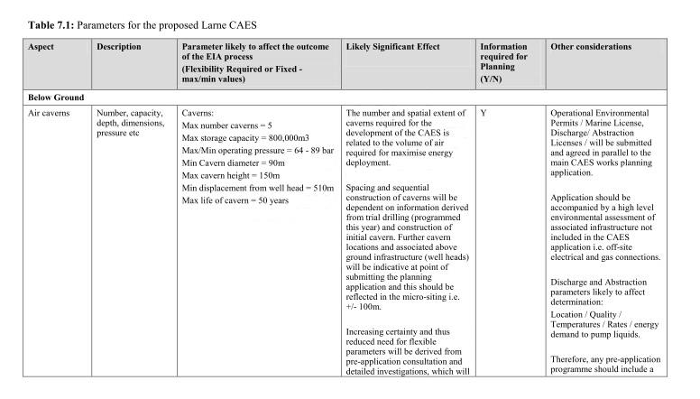
CAES Rochdale Envelope
PLANNING & ENVIRONMENTAL CONSENTING IMPLICATIONS:
  An engineering envelope description or “Rochdale Envelope Description” can affectively act as the “Planning Description” for environment assessment purposes if clearly defined and according to the maximum credible envelope of potential significant environmental effects.
  This can allow Bulk Energy/Renewable Energy Infrastructure projects that has long run-ins, costly design, huge investment that only comes at the end of the consenting period, and are subject to changing to be environmental assessed at a much early stage.
  It can also be effectively used for actual consenting, within a flexible envelope description that would allow for the required flexibility in nodal and linear layout, array layout and final design of proposed built structures.

Slide 30
9. PCI and TEN-E regulations
At the same time, since 2011, the project explored its eligibility as a Project of Common Interest (PCI) under the TEN-E EU-Regulation (Regulation (EU) No 347/2013; OJ L 115/39 adopted by the European Parliament, and the EU Council's Guidelines for Trans-European Energy Infrastructure. Application and negotiation on this resulted in the project being adopted as, a PCI Project on the PCI List 2013-2015.
  In 2013 the project was opted under the TEN-E Regulation (Regulation (EU) No 347/2013; OJ L 115/39; adopted onto the PCI Candidate List of projects eligible to apply for EU funding. In particular the project appears on the “Project of Common Interest/Cluster of PCIs”
    “1.12. PCI compressed air energy storage in United Kingdom – Larne ; Compressed Air Energy Storage using caverns / chambers to be created in bedded salt deposits with an annual storage capacity of 550 GWh. ; Electricity Northern Seas Offshore Grid (NSOG)”
    In July 2015 and Feb. 2017 Project-CAES was successful in receiving funding for some project works and activities.
    The TEN-E process can be divided in the candidate application process and regulations to streamline member states development consent processes.
PLANNING & ENVIRONMENTAL CONSENTING IMPLICATIONS:
  A parallel process need to be run, not withstanding domestic guidelines to consolidate different decision makers will still be involved or play a decision making role.
  Negotiation with different decision makers for the need for co-ordination
  Overarching EIAR, HRA are required

Slide 31
10. Project Splitting
The CAES project applied a holistic approach to the conceptualisation and pre-application phase of the planned project, which integrated a Single Project Approach with non project splitting from the start, and planned and integrated community and statutory consultation as part of the project. In this context, a single EIA was prepared to include as far as practical all the integral parts of the proposed development.
All integral parts of the project included i.e. marine consent, transmission, gas, primary consent.
PLANNING & ENVIRONMENTAL CONSENTING IMPLICATIONS:
Single Project Principle can be used for EIA project description, subject of assessment.
Non project splitting has a natural project evolutionary advantage, while very big projects and easier to understand in smaller components, they are, in fact, single projects, and thinking in these terms allows for more holistic solutions and integrated thinking.
At the same time, it provides for the robust assessment of the project and the non-divergence of EIAR reports as a single over-arching EIAR could be developed and presented even if different consents apply.
Non-project splitting or a Single Project approach needs to be taken into the language and culture of the project, and the project team and stakeholders and communities involved.

Slide 32
11. Project Design Freeze:
There is a need at the start for a Project Description and Rochdale envelope on which to progress the EIA, and overall planning process but a critical point in time is reached where no further engineering design changes, or changed parameters can be tolerated and in a complex electrical engineering, energy project, industrial civil project this with the numerous design players are very difficult to achieve.
This has to be carefully, managed, and a point must be reach along with the engineering design, and the multi disciplinary project team where design is finally Frozen. First for close out of EIA and then for Planning Pack and Final Planning Submission.
Wide support and understanding need to be garnered in the broad project team to achieve this difficult moment.
Estimated as 3-4 months before submission.
PLANNING & ENVIRONMENTAL CONSENTING IMPLICATIONS:
  Wide support and understanding need to be garnered in the broad project team to achieve this difficult moment.
  Consensus should not be underestimated.
  Sophisticated Project Management is a helpful tool.

Slide 33
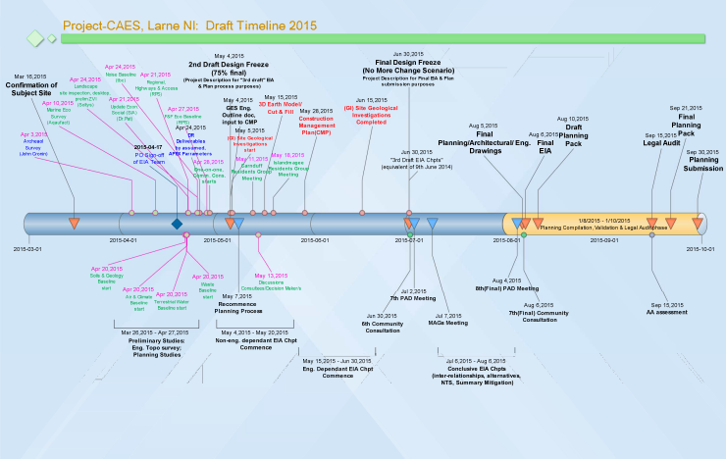
PM towards Project Design Freeze:

Slide 34
SUMMARY : LESSONS LEARNT
Bulk Energy/Renewable Energy Infrastructure Projects on Coastal/Marine Interface, very different character:
Project Dimensional & Medium diversity (functional space).
Different Market(functional space) Regimes.
Different Strategic Consenting Regimes
Spatial Nodal & Corridor(axis/linear) locational factors
Planning & Environmental Process of Alternatives
Largescale Community Consultation
Rochdale Envelope/ Engineering Design Envelope
PCI and TEN-E regulations
Project Splitting
Project Design Freeze:

Slide 35
END

