Slide 1
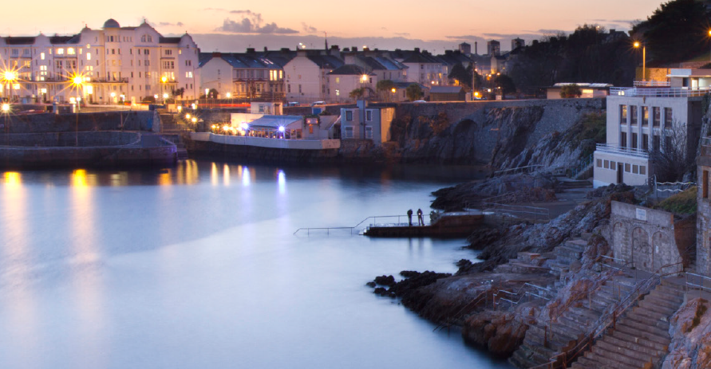
Plymouth Sound
The UK’s First National Marine Park
www.plymouth.gov.uk/marinepark
#MarineParkPlym
Notes:
Welcome – this is a momentous day for Plymouth and it is brilliant that I have the opportunity to share our work on the National Marine Park.
During the boat trip to Mount Edgcumbe you will have had the opportunity to experience our spectacular Plymouth Sound so I hope you will be able to understand why we are so excited about the concept we are developing.
This morning we want to share with you our vision for a NMP for Plymouth Sound, what it is, why we want to develop it and the benefits it will deliver for our businesses, visitors and every person in Plymouth.

Slide 2
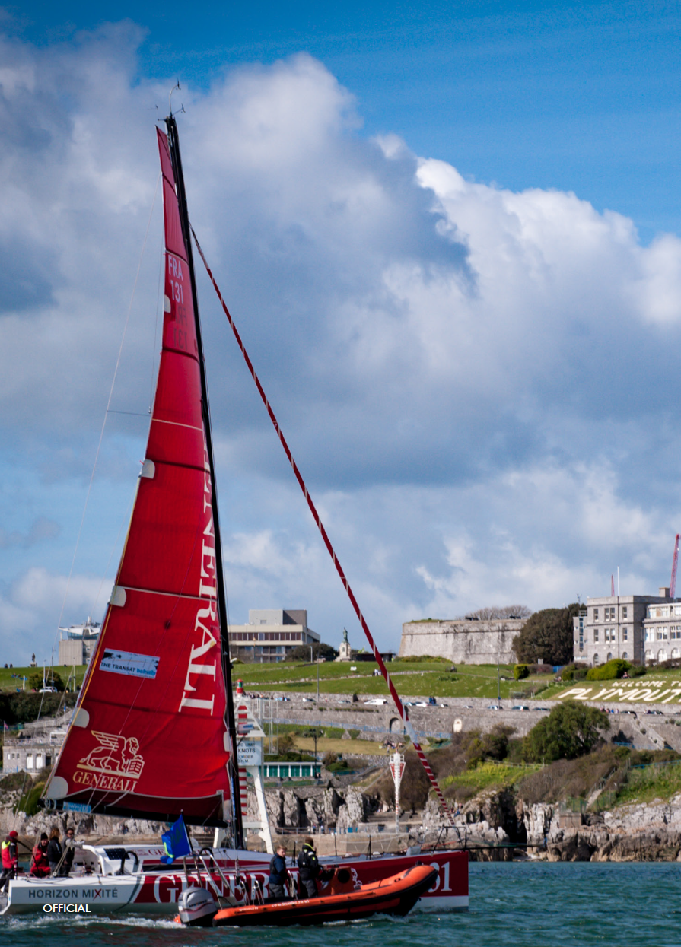
Plymouth Sound - our Unique Place, our Unique Offer
Plymouth Sound and Tamar Estuaries Marine Protected Area covers 405 km2 - over five times the size of the city
Plymouth is home to the second largest fish market in England by value and an incredibly important asset for the UK fishing industry
The waters are currently collaboratively managed by the Tamar Estuaries Consultative Forum that brings together the 18 organisations with statutory responsibilities for the waters
HMNB Devonport, the largest naval base in Western Europe is located off Plymouth Sound
The marine sector in Plymouth employs over 7,100 people
Like National Parks on land, there is a huge level of support for and interest in the marine environment with 116 million day trips to the coast recorded in 2017
Notes:
Plymouth Sound is a unique place
Largest naval base in western Europe
Wildlife of International Importance
World leading marine research
Cutting edge innovations in marine tech
Significant fishing port
Highly regarded recreational destination
It is busy, complex and brilliant – a perfect place to develop a blue print for a new way of working with our marine environment for the benefit of people, planet and place.

Slide 3
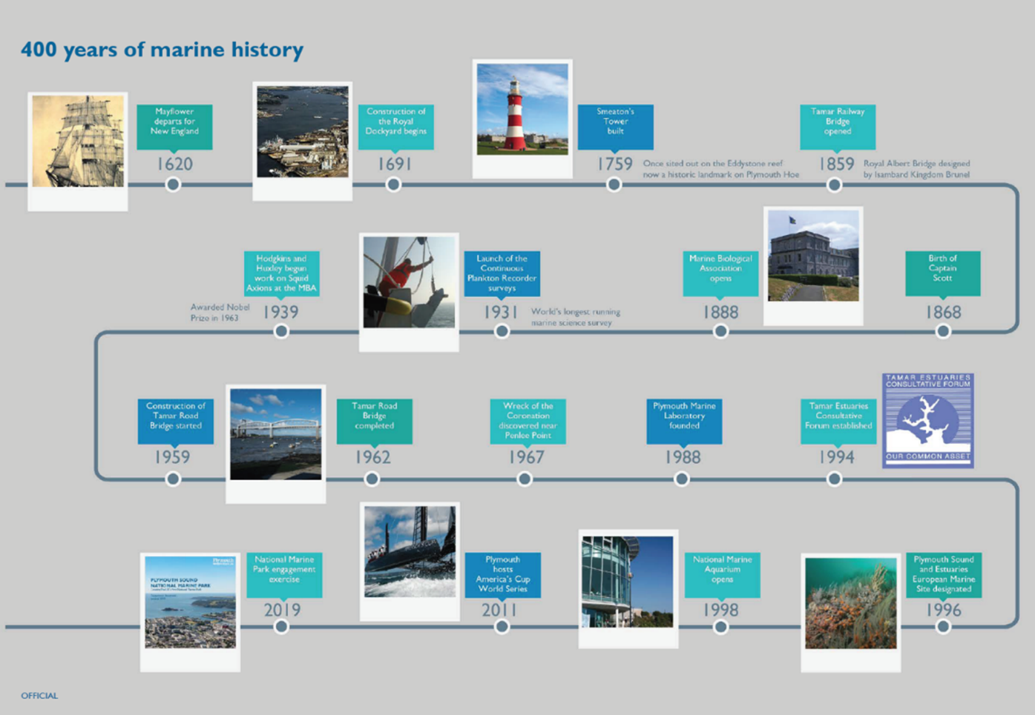
Mayflower departure
Building of the iconic Smeaton’s Tower
Royal Albert Bridge – Brunel
Marine Biological Association Opens
Longest running marine science survey
Notes:
Plymouth has a long history of exploration and adventure –
Mayflower – celebrating next year
Feats of engineering innovation – Brunel’s bridge, Smeaton’s Tower
Marine Science and research - Longest running marine science survey
And we are developing a new future
Marine Technology Hub
National Marine Park

Slide 4
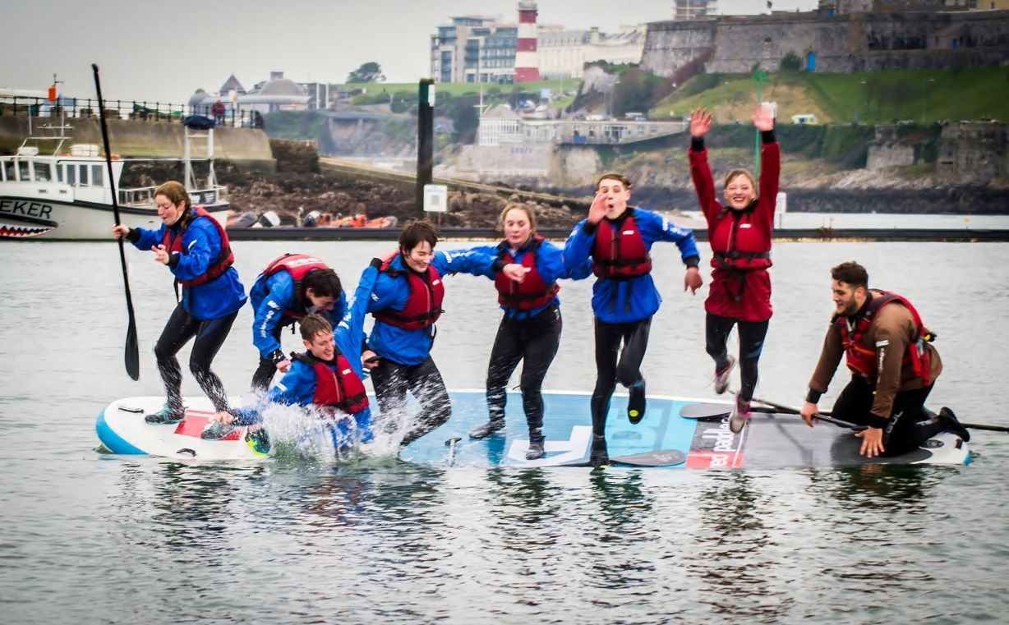
Plymouth Sound - our Unique Place, our Unique Offer
17% of children not visited a beach – should be a Plymothian’s birth right
Significant well-being benefits from a site on our door step
Over 2000 students studying marine related subjects
“Research has demonstrated that engaging with the marine environment has major health and wellbeing benefits, particularly its restorative capacity to protect mental health.” Blue Space
“NMPs will provide a vehicle for public engagement with the marine environment, which will not only enhance understanding and ownership, but also result in extensive social, economic and health and wellbeing benefits.” Marine Research Sector
Notes:
The National Marine Park will also help to meet some of our greatest challenges
Children accessing the beach – benefiting from our marine environment
Health and well being benefits
The opportunities to inspire learning.

Slide 5
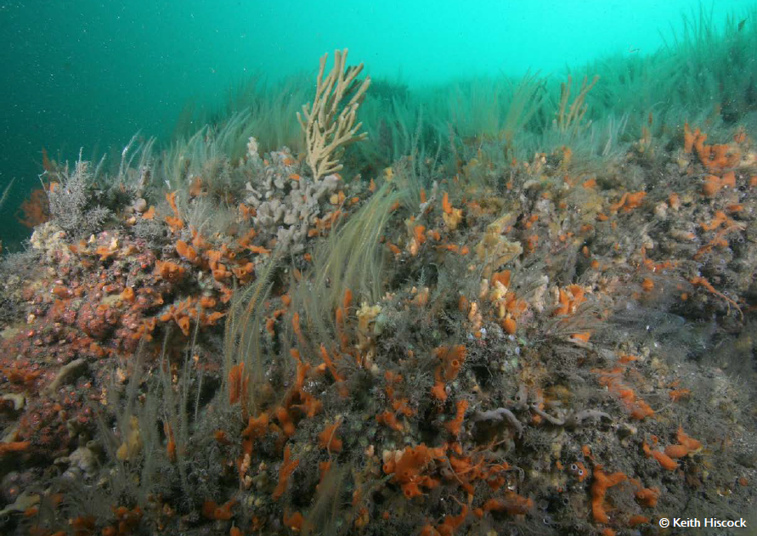
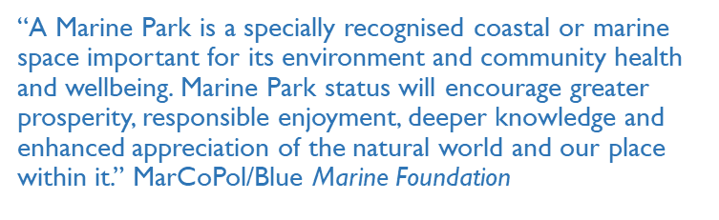
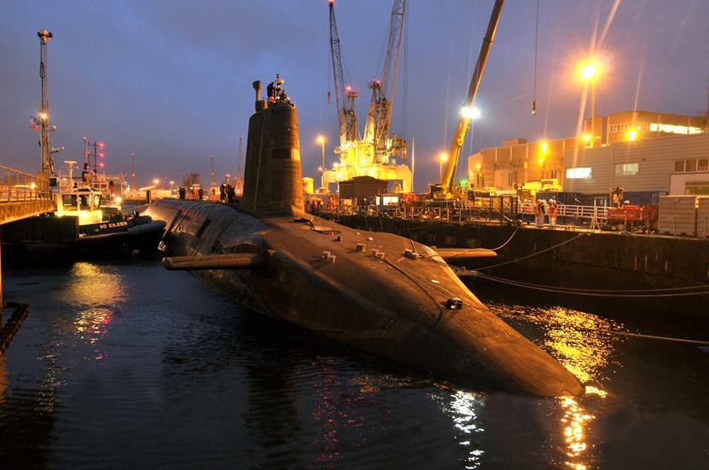
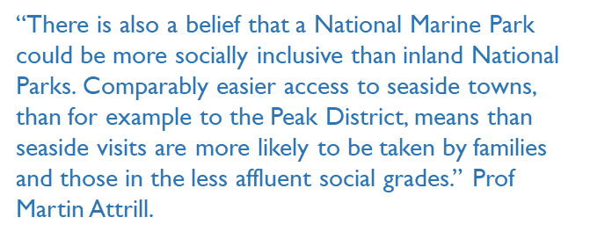
Notes:
We feel we are in a unique position to develop a blue print locally that can be applied nationally.
The Sound is unique, our partnerships are strong, we want to do this for us and we want to initiate a transformation across the country.
I will now handover to Kat Deeney – Head of Environmental Planning to provide some more details about the NMP how we are going to take this forward.

Slide 6
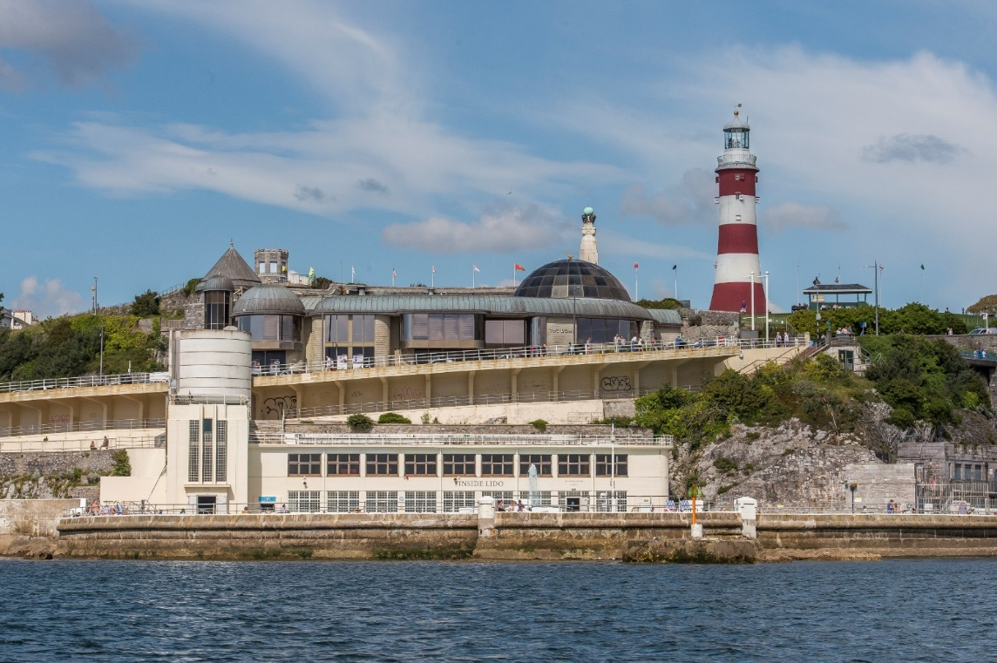
A National Marine Park for Plymouth Sound
Why A National Marine Park?
New vision
Building on terrestrial planning refocus towards the waterfront
‘One of Europe’s most vibrant waterfront city’s where an outstanding quality of life is enjoyed by everyone’
Britain’s Ocean City

Slide 7
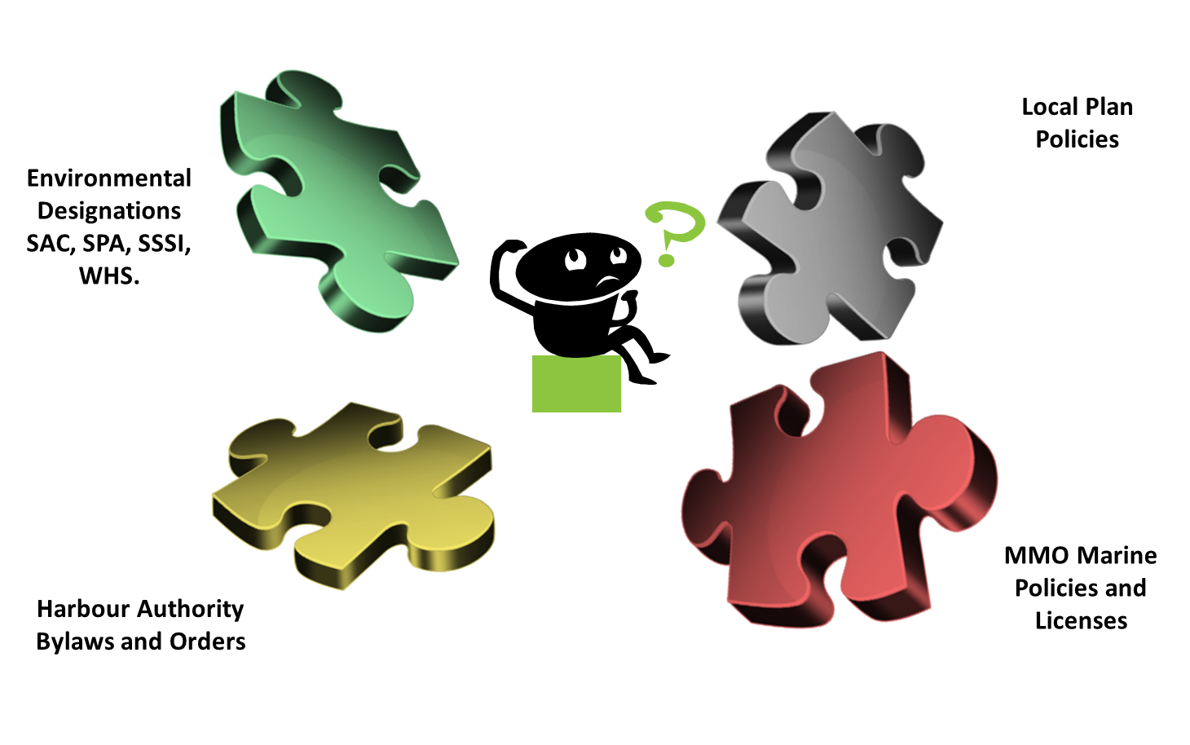
Why do we need something new?

Slide 8
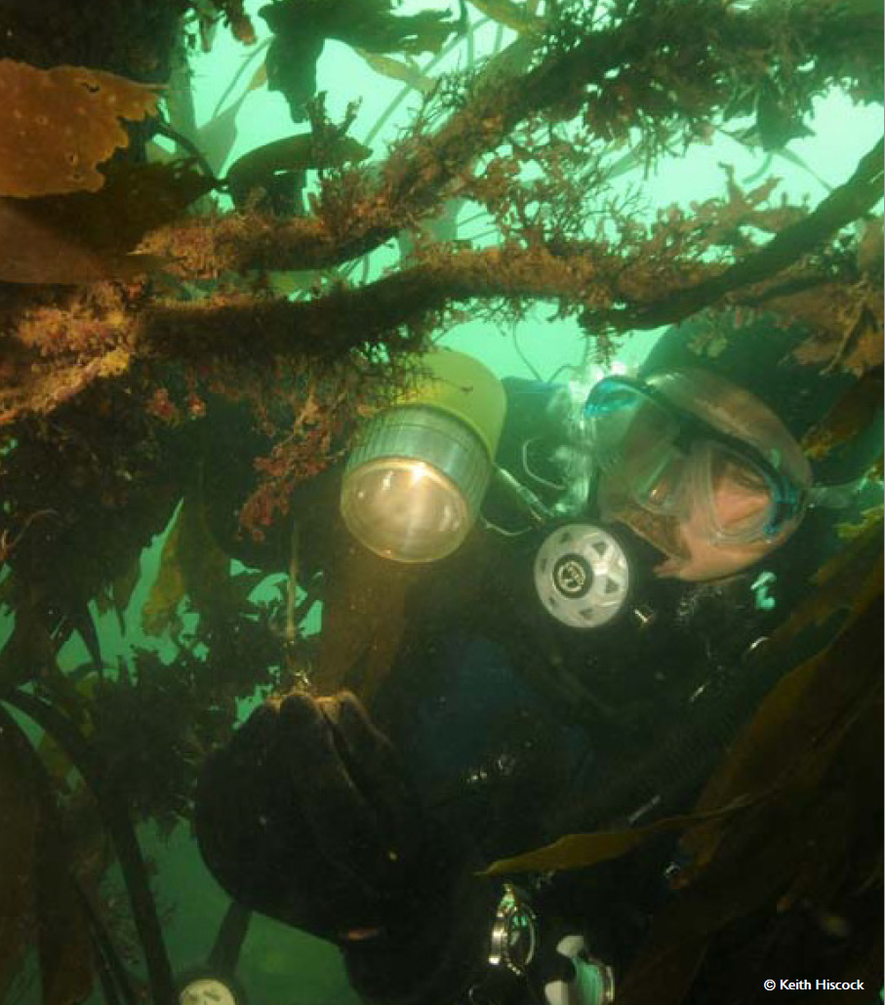
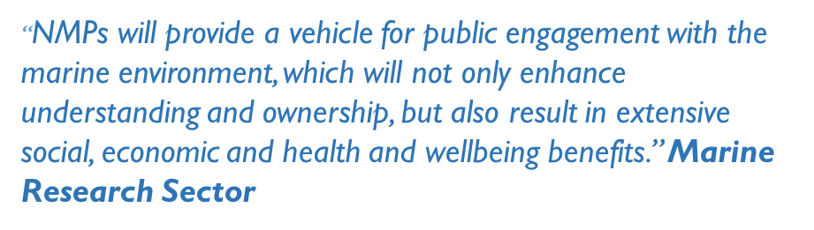
What is a NMP in the UK?
Doesn’t currently exist in the UK
We want to pilot a new approach for the UK
Across the world there are many different versions of Marine Parks
We want to set a new framework for our marine environment:
  ‘Blue print to end all blue prints’ – Tudor Evans OBE (when developing the new City Plan)

Slide 9
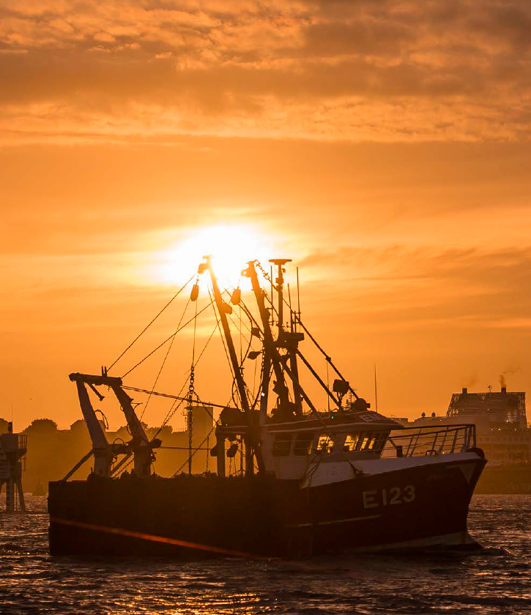
Why a NMP?
Thriving Business
Connected Communities
Inspired Visitors
Promote opportunities for understanding and enjoyment
Take the concept of a terrestrial park and apply it to the sea
Reposition the City - sets a new vision
“when nature determined that the two river systems of Tamar and Plym should join the sea (here), it determined all that has happened since”. Historian RAJ Walling

Slide 10
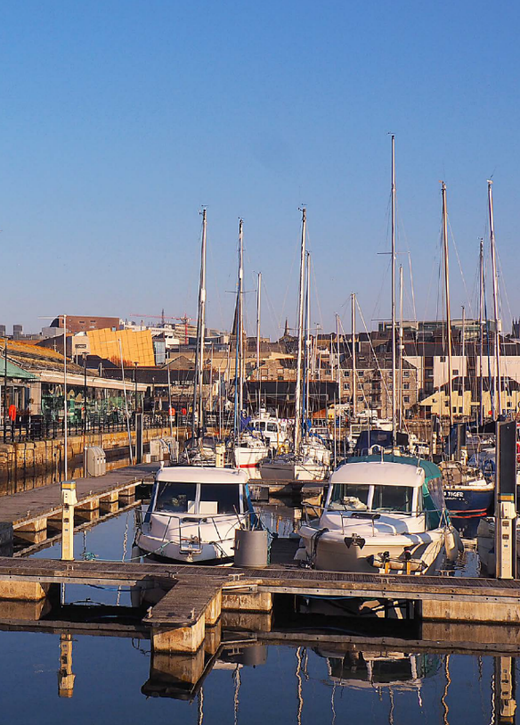
How do we develop and deliver a NMP?
Learn from Planning on the land
Co-design and collaboration
Commitment to working with others – locally and Nationally
Development of a 5 year Business plan
Turn up the volume on what is already great
Build on our successes

Slide 11
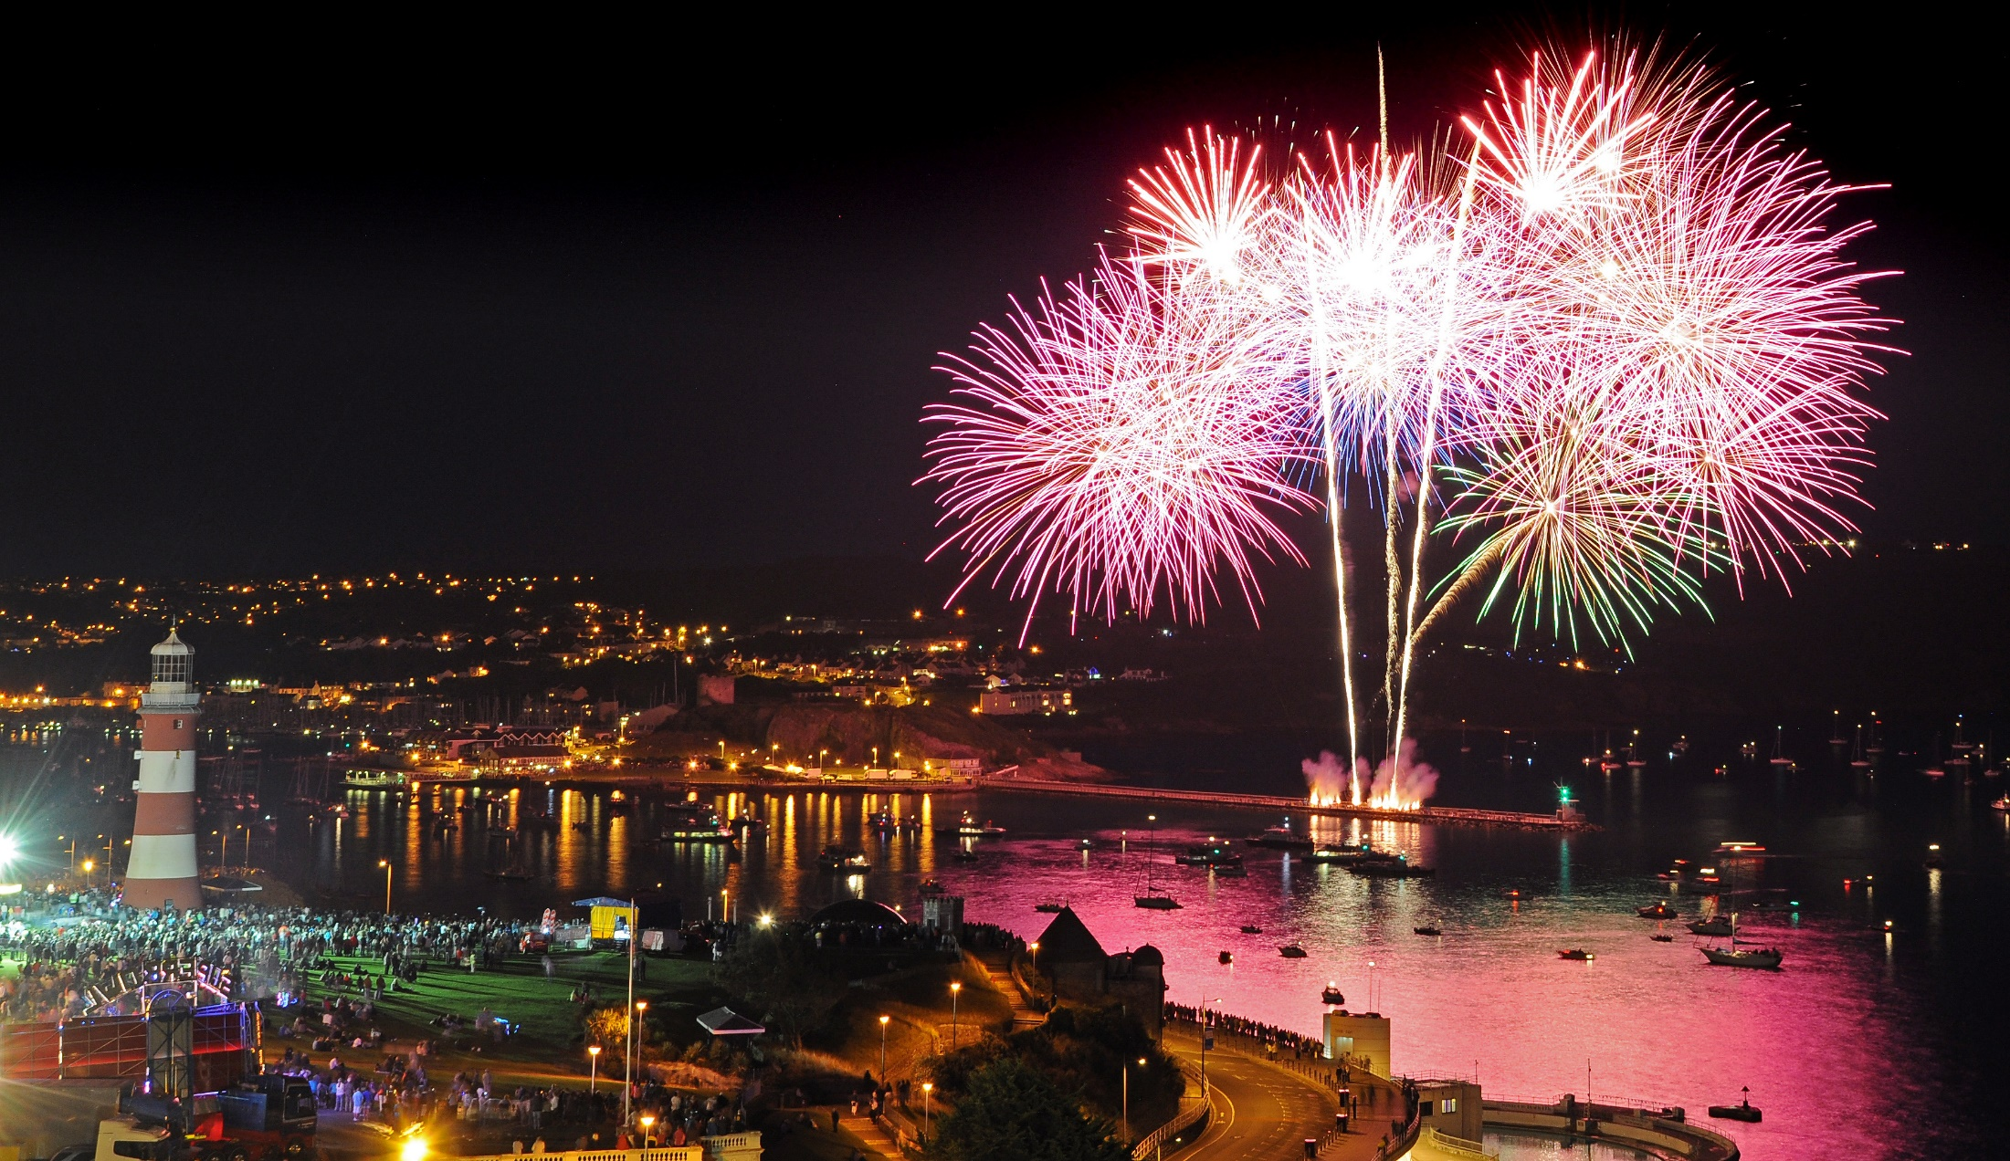
"In the past Plymouth launched many great voyages that changed the history of the world. It is my hope that, in the future, people will look back at Plymouth as the ocean innovator that set the standard for National Marine Parks in Britain and across the globe." Lewis Pugh, UN Patron of the Oceans.

Slide 12
NationalMarinePark@plymouth.gov.uk
www.plymouth.gov.uk/marinepark
#MarineParkPlym

