Slide 1

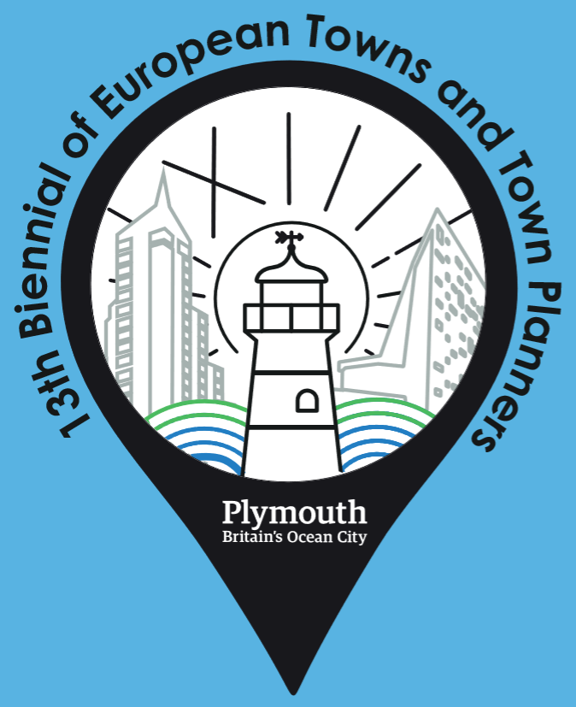

‘EUropean’ trends in planning
Lessons from a survey on changes of spatial planning
Géza Salamin
Notes:
I use the overall European term Spatial planning, which is an umbrella term covering various forms of plannaing and development policies ao different levels.
Bő 1,5 évtizede fogl ter-i és várostervezéssel, ebből jelentős részben európaival. Ezek tapasztalataira építek, de egy az elmúlt 1,5 évben megvalósított konkrét kutatásom adja dolgozatomat.

Slide 2

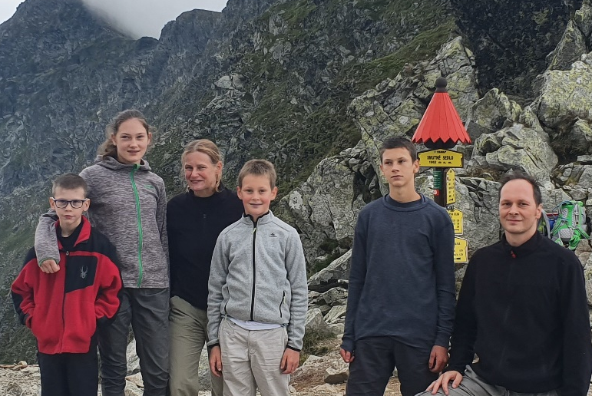
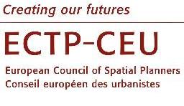


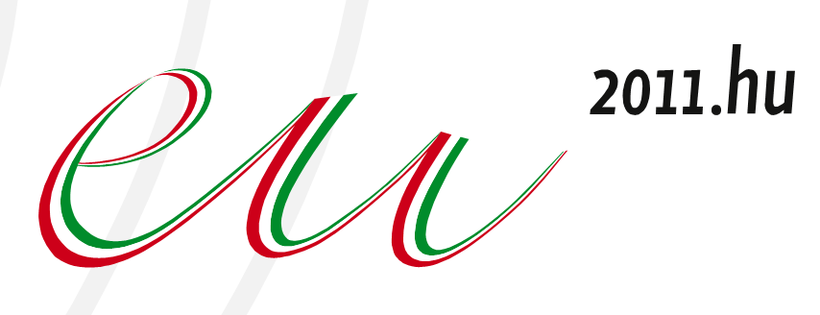
About the lecturer
Background:
Geographer-economist in planning spec
PhD in regional science (on European planning)
Director of Institute for Geography, Geoeconomics and Sustainable Development
President of Hungarian Society for Urban Planning
Father of four ☺
National delegate
National planning and development agency (VÁTI) 2002-2010:
Ministry for National Economy- head of Territorial development planning dep. 2011-2014
The Central Bank of Hungary - head of strategic dep. 2014-2019
  Leading role in projetcts:
  National spatial development concepts-strategies (2005, 2014)
  National & regional strategies and programmes for EU funds,
  Planning of cross border cooperation strategies and programmes.
  Head of drafting team of Territorial Agenda 2020 and TSP (2010-2011)
  Actor of EU wide networks, programmes in ESPON, URBACT
Notes:
I am the one, who

Slide 3
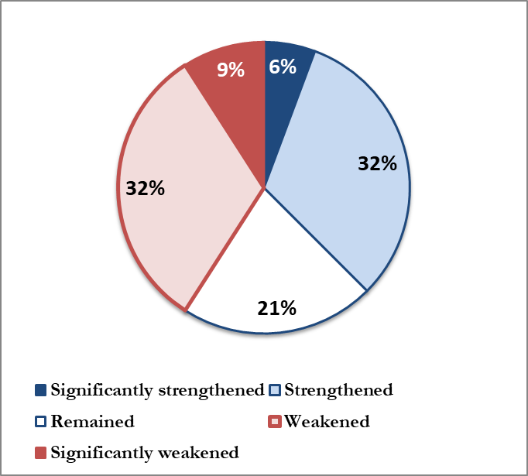
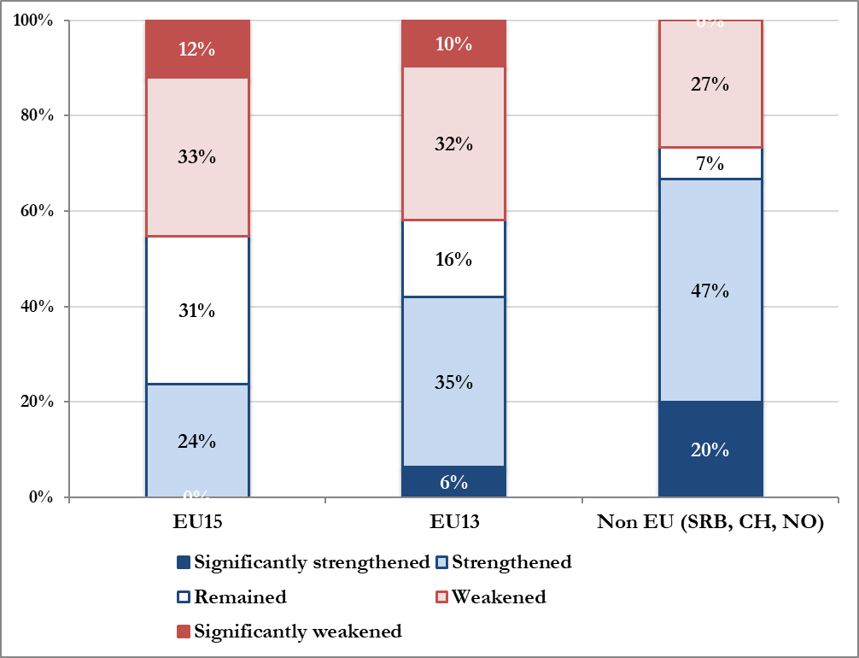
During the last 15 years the general role (and reputation) of spatial/urban/regional planning and spatial development in society has... (all responses)
Winning or loosing?
Changing status of spatial planning
Source: Questionnaire survey Salamin G. 2017 (M:120)

Slide 4
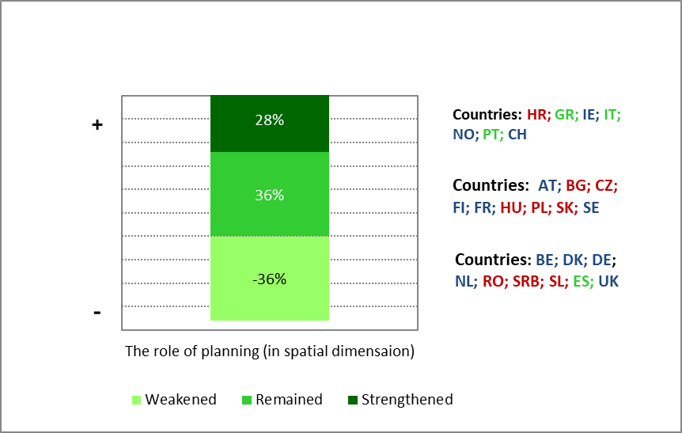
Winning or loosing?
Changing status of spatial planning
During the last 15 years the general role (and reputation) of spatial (inc.urban,regional) planning and spatial development in society has... (Answers aggregated to countries)
Source: Questionnaire survey Salamin G. 2017 (M:120)

Slide 5
No single European approach, no single meaning of spatial planning
A.) European traditions (types) of spatial planning
Land use managament
BE, IE, LU, UK, HU, CY, CZ, MT (PT, ES)
Comprehensive integrated
AT, DK, FI, NL, SE, DE, NO, BG (UK, BE, FR, IE, LU, EE,, LV, LT, PL, RO, SL, SK)
Regional economic
B.) Cultural macroregions of planning:
Western Europe
  Northern Europe
Southern Europe
Central and Eastern European
PT, FR, DE, HU, LV, LT, (IE, SE, UK)
Urbanism
GR, IT, ES, CY, MT
Source: EC 1999, Nadin, V. – Stead, D. 2008, Farinósi-Dasí eds. 2006, Dühr S etal 2010.
Source: Based on Knielling-Othengrafen 2016, Faludi 2008.
Notes:
We know, thAT THERE ARE NO A SINGLE MEANING POF PLANNING.
It is national competence – though the EU policies and especially are influencing it –
Even the terms used for planning type activities in different countries can not be translated.
We know well the four categorisation of planning traditions by the EC – I think it is quite valid also for CEE countries as well – but we have to emphasize the cultural planning regions of Europe too.

Slide 6
Identifying EU trends in domestic practices:
The logic of the research
Literature of European planning
Review
Changes in spatial planning systems and practices of 30 European countries
Empirical analysis
European Model of Spatial Planning
(EMP)
Theoretical framework of changes
EU strategies and policy documents
Content analysis
1. European Spatial/Regional Planning Charter (1984)*
2. Europe2000+ (1994)**
3. European Spatial Development Perspectives (ESDP) (1999)
4. Guiding Principles for Sustainable Spatial Development (2000)*
5. Territorial Agenda of the EU (and the TSP) (2007)
6. Lepizig Charter (2007)
7. Green Paper on Territorial Cohesion (2008)**
8. Territorial Agenda of the EU 2020 (and the TSP updated) (2011)
9. (Urban Agenda (2016))
*Adopted by Council of Europe
** policy reports (not political documents)
Methods:
Key expert questionaire survey + 27 interviews
Content analysis of 35 national spatial plans/strategies
Databeses of planning systems (ECTP, ISOSCARP, ESPON)
Studies on Europeanization of specific countries
3 main trends in the literature:
Postmodern turn in planning
Governance turn from formal governement
New spaces

Slide 7
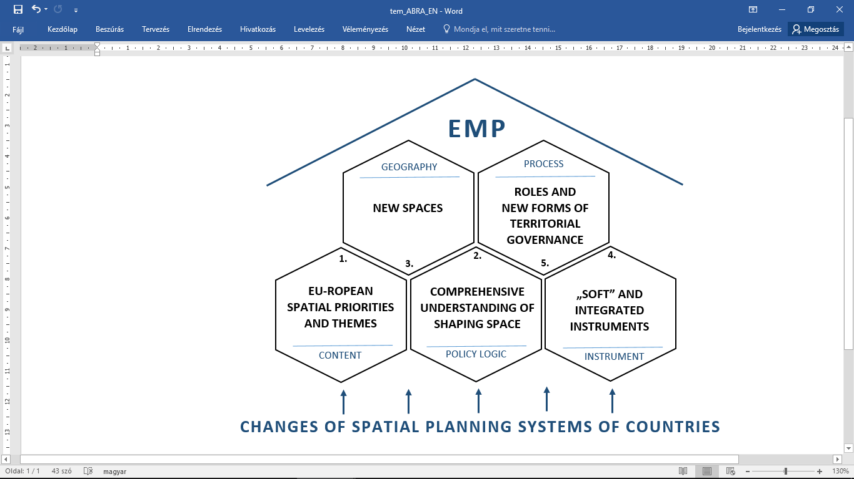
The ‚EUropean’ Model of Spatial Planning (EMP)
A model of directions of changes based on main statements of European planning literature and content analisis of relevant EU strategies and policy documents
5 + 7 indicator
4 + 4 indicators
7 + 6 indcators
5 + 4 indicators
7 + 6 indicators
Notes:
2. Emergence of a more comorehensive understanding of spatial planning-develpment. Beyond the traditional urban plannign and regional planning it is about more comprehensive afforts to tackle – socio-economic or environmental challanges ion spatial dimension. The notion of territorial cohesion, using territorial capiatal and so on gain floor instead of a more technical regulation of development opportunities.
3. A broadly investigated issue is the geography of planning, which levels, territories are planned, governed. Emergence of new spaces, which are not administrative territories, but defined by a certain problem or potential, border crossing spaces, ofnet relational spaces, networks are in the focus of planning. And at the same time the higher territorial levels - national levels, internarional units get into focus.
4. The instruments mof planning are ultiplying. Instead of thr tradional masperplan (blueprint) there are more and more soft instuments, such as joint vision, strategies, cooperations, etc. And on the other hand there are more interated instruments, which are adressing more sectors (The physical space, the economi-business, the social relations, etc.
5. The roles, the actors, the institutions are changeing radically. Accordint to this argument planning is not a purely a legislated governmenal function, with clear responsibilities, but is much more an interplay of several actors: business, social, civic and governemental, and cooperation of different levels at the same time. It indluences the ways of planning, the role of different actors, the methods, the expectations from planning.

Slide 8
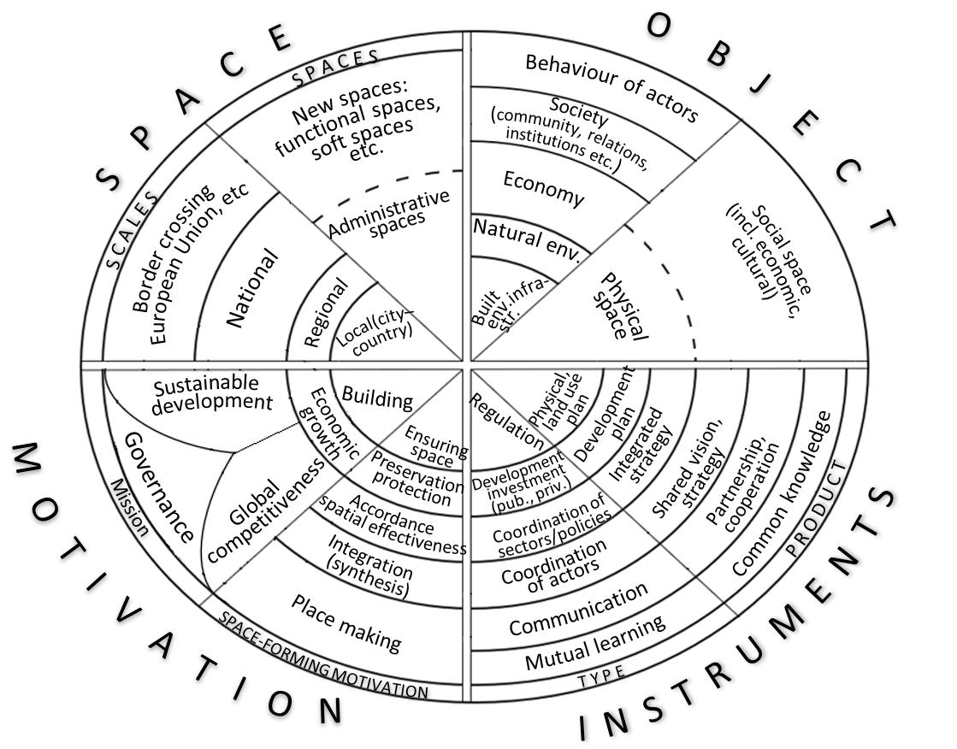
Possible forms of spatail planning as umbrella term
Traditional and rather new forms
Trends
Traditional planning
New forms
of planning
Source: Salamin - Péti 2019
Notes:
In a very recent paper we tryed to include all possible forms of planning and development policies into asingle figure, which can fall uinder the European umbrella cathegory of spatial planning (which is actually in a significant ovwrlap with the term territorial governance). For identification we used four dimensiond by which we can describe planning system of a certain country.
Accordint to the EMP there is a shift in the meaning od spatial planning – towards a territorial governance approach.
On the figure we indicated the more traditional lanning forms in each dime nsion near the centre and the new formsnear to the edge of the round.
And the trend ins what the red arrows are indicating.
I have to enphasize that this statement is based on , what the literature is saying, what the EU documents are encoureging.
This is what I tryed to measure in a comparative way.

Slide 9
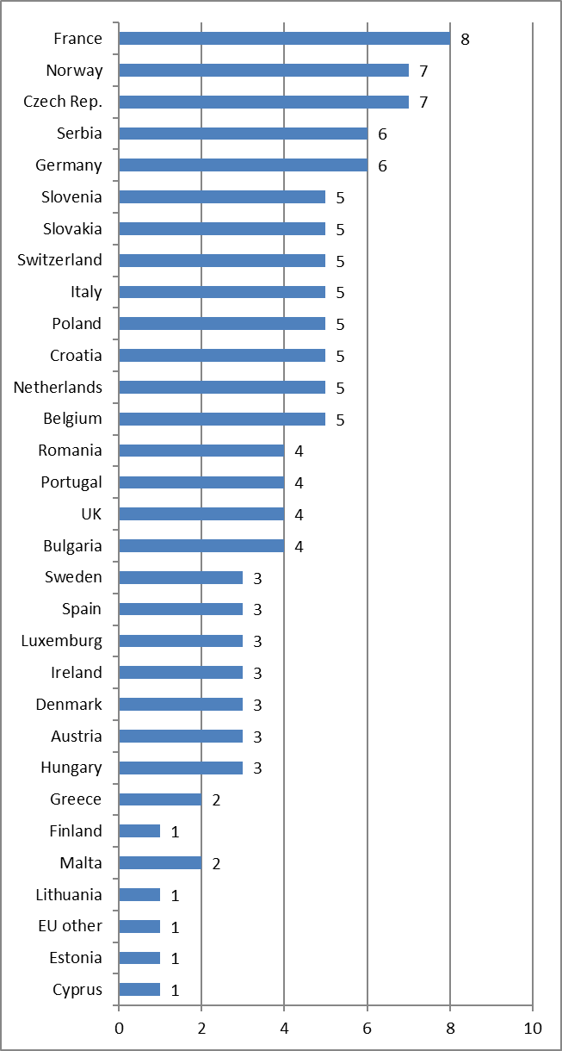
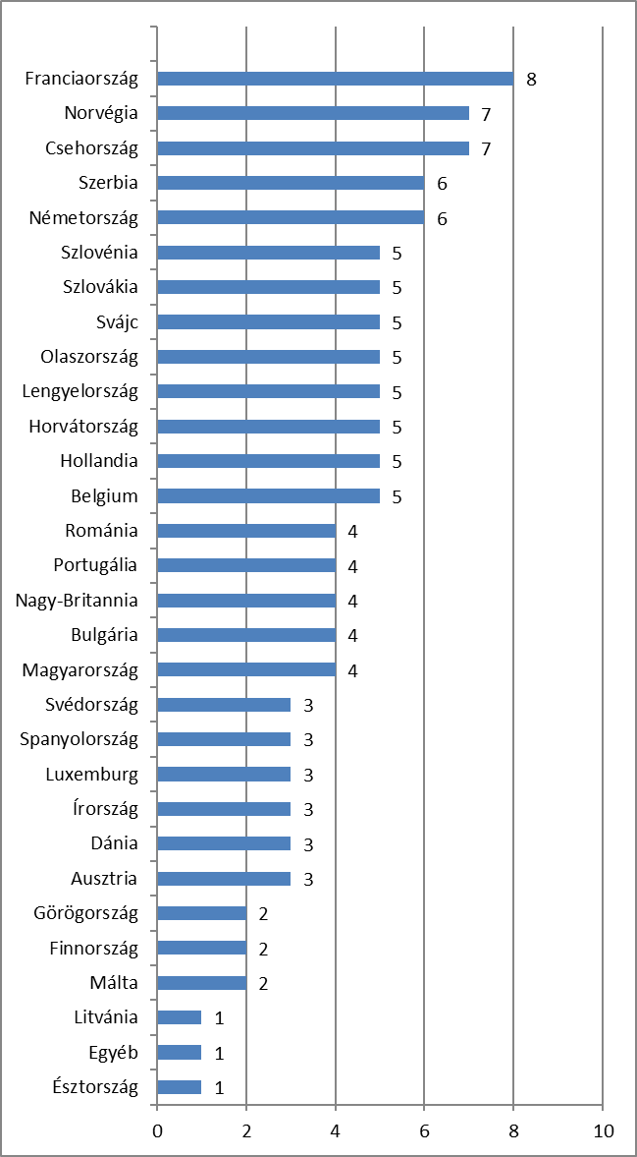
The key expert survey
2017 May -december
No. of respondents:
Fully: 87
Partly: 34
Total: 121
Geography:
EU member states + Norway, Switzerland, Serbia.
In country relevant figures 25 countries covered, CY, EE, LT, LV, MT, LU was excluded from this part due to lack of sufficient number of responses.*
Time frame:
Change from 2002:
Status in 2017/2018:
Target groups:
Practicing planner: 30
Academics: 59
Ministry officer: 29

Slide 10
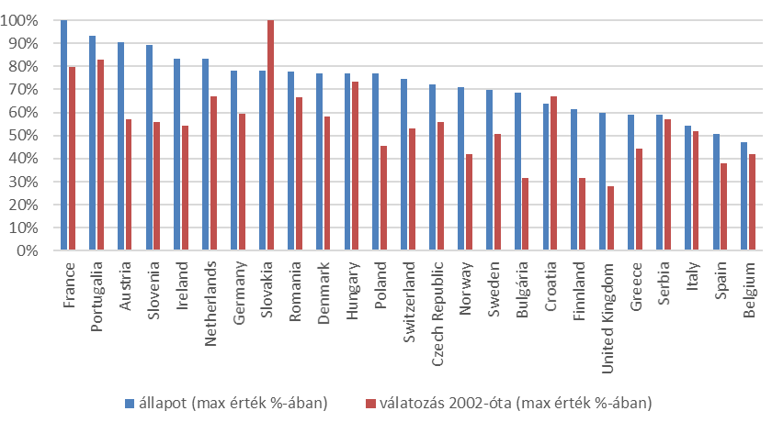
EU themes and priorities in domestic spatial/urban plans
(Status and change based on 5+4 indicators,
Source: Salamin 2018 key-expert questionnaire)
Status (percentage of max value)
Change from 2002 (percentage of max value)
Notes:
Spatial planning is not EU competence, however it influences national planning policies
The very first layer of this influence is when
Tematic objectives of 14-20 coh pol
EU basic concepts Growth, internat copetitiveness, territorial coh, ter capital
Priorities of TA
Reference to EU strategies (TA, LC EU2020)
In nat strategies
At the beggining of the row we see countries, which

Slide 11
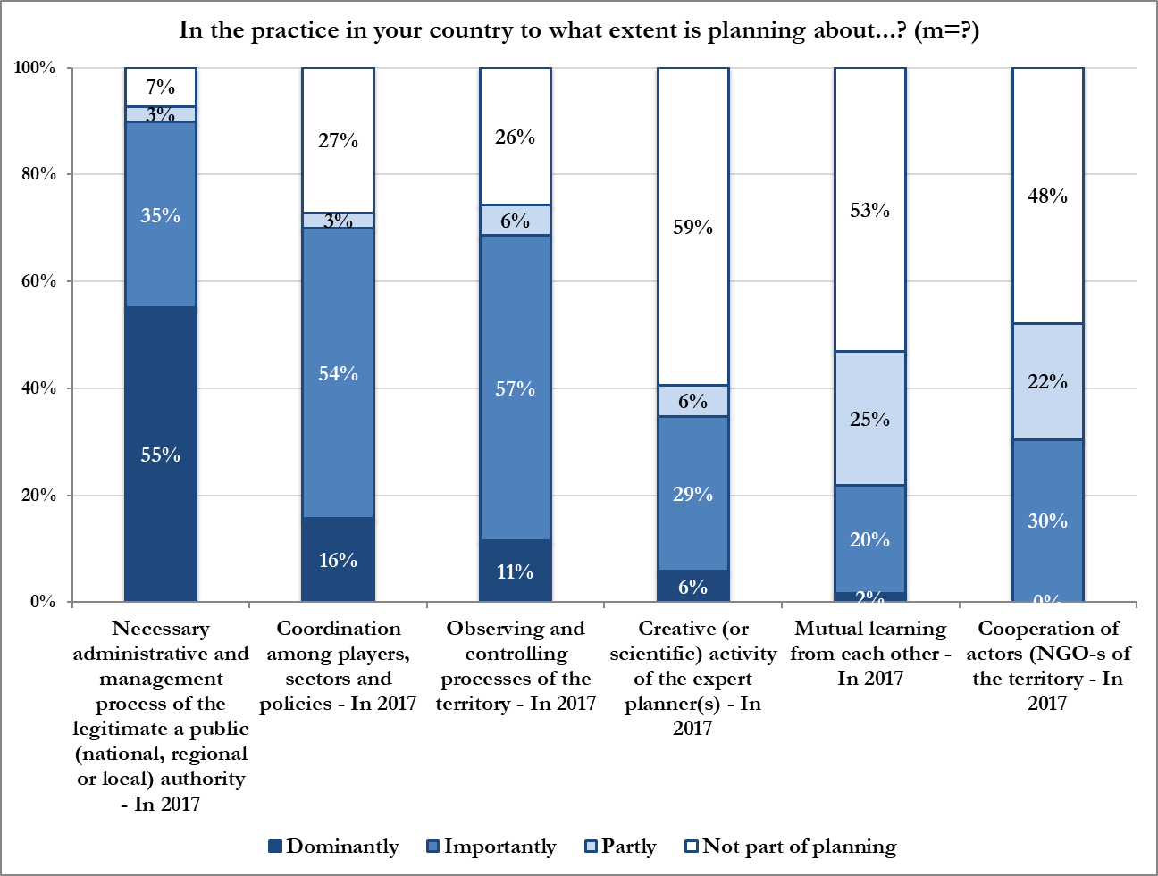
Why planning?
The basic nature of planning in 2017
(Source: Salamin 2018 (key-expert questionnaire, 2017)
Compulsory administrative and management process of legitim authority
Coordination of sectors, policies and actors
Territorial monitoring and controlling
Creative (or scientific) activity of expert planner
Mutual learning from each other
Cooperation between actors

Slide 12
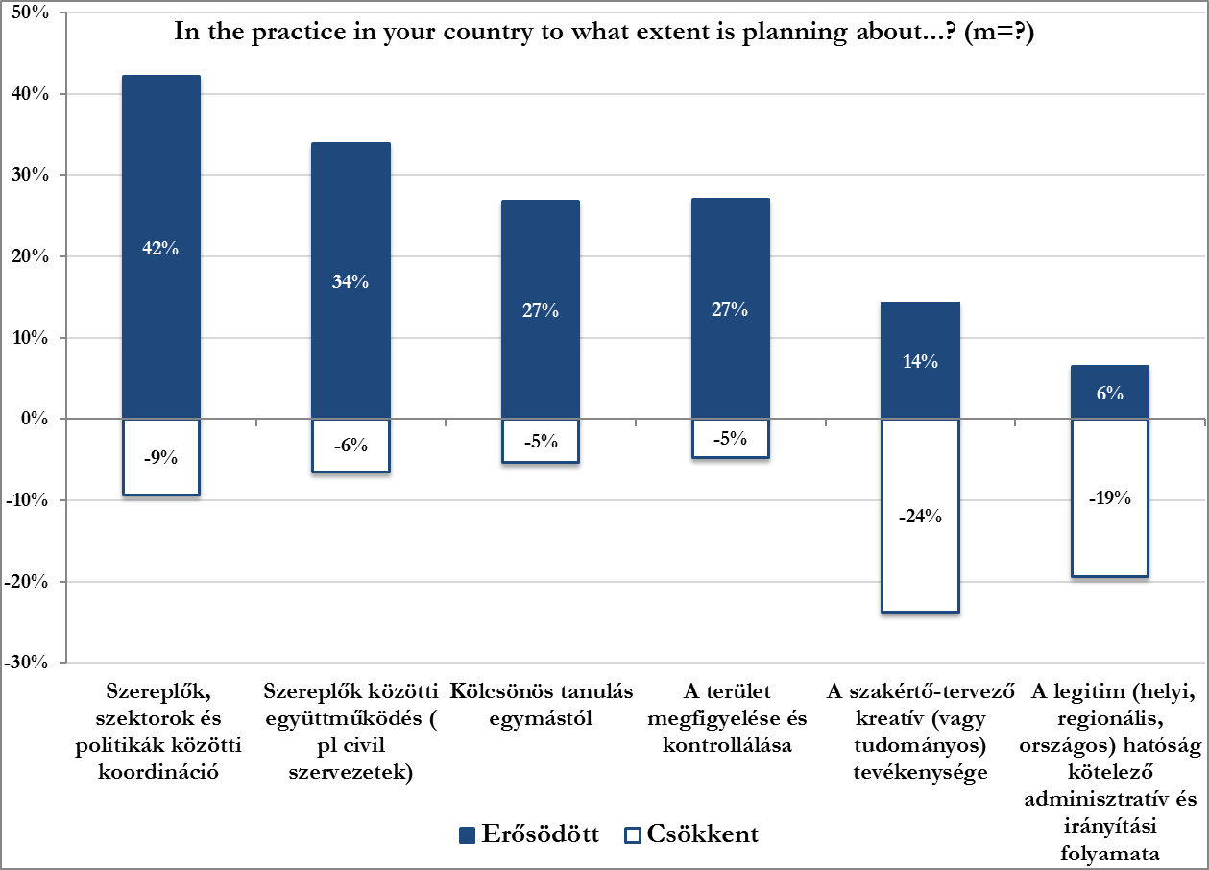
Why planning?
The basic nature of planning in 2017 change from 2002
(Source: Salamin 2018 (key-expert questionnaire, 2017)
Coordination of sectors, policies, actors
Cooperation between actors
Mutual learning from each other
Territorial monitoring and controlling
Creative (or scientific) activity of expert planner
Compulsory administrative and management process of legitim authority
Increased
Decreased

Slide 13
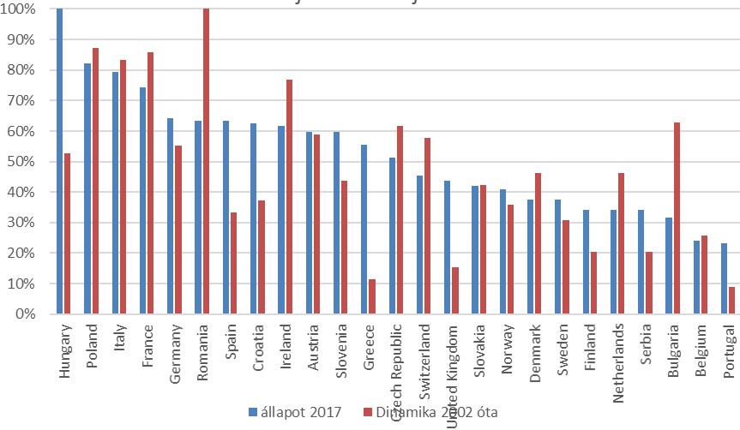
New spaces of planning
(Status and change based on 5+7 indicators)
Source: Salamin 2018 (key-expert questionnaire)
100=maximum value
Status (level)
in 2017
Dynamics (change)
Since 2002
Notes:
S first statemen I can confir, that yes, there are huge changes in relation to emegrence of new spaces.
However it does not mean that the formal ones disappear, rather a coexistance a complemntary nature of new spaces is tipical.
The new spaces are not all fuzzy spaces: e.g. in some CEE countries the NUTS2 level as beneficiary of cohesion policí emegre, but they also dissapeared, like in Hungary along with the microregional level, and the regional level here in England or the cityregions in th Netherlands.
The distrubution of emergence of new planning spaces is not in correlation with other pillars of the EMP.
Új szint 10 országban a NUTS 2, de háromban meg is szűnt ez alatt
Felértékelődik a határon tányúló, de ez ösztönzi is ETE
Abszolút nyerő a városrégió

Slide 14
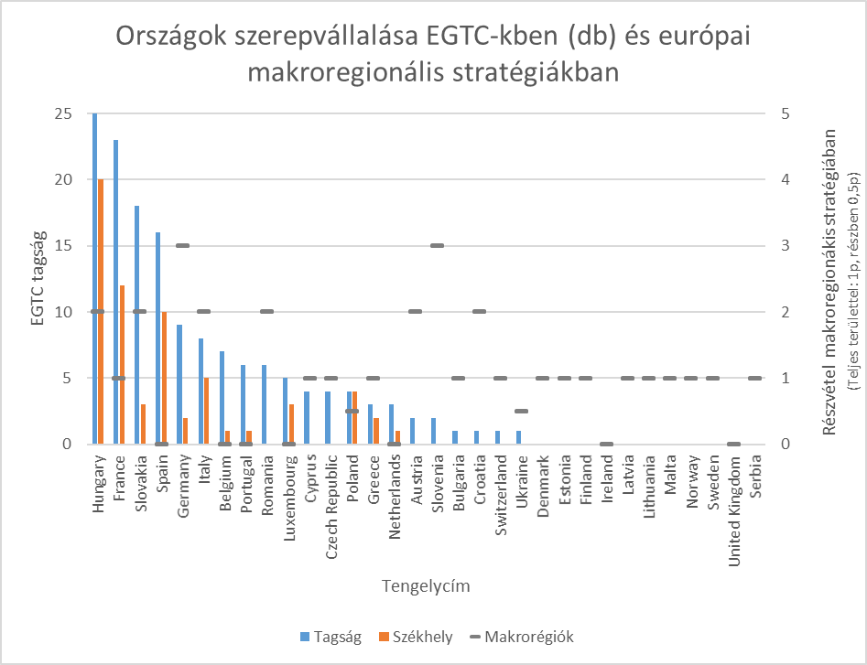
Countries’ participation in EGTC-s and EU Marco-regional strategies
Participation in macro-regional strategies (Total area: (fully: 1p, partly: 0,5p)
EGTC Membershipc
Member-ship
Head-quarters
Macroregions
Source: Based on European Committee of Regions and the register of the European Commission Salamin, G. 2018 (2018)
Notes:
skip

Slide 15
The most common new space: city region
The appearance of city regions in planning system (number of countries (out of the 26) mentioning the specific answer.)
 |  | No change |  | Change
 |  | Does not exist | Existed and exists | Existed | Appeared
 |  | Neither in 2017 nor in 2002 | In 2017-and also in 2002 | In 2002 but not in 2017 | In 2017 but not in 2002 | In which countries it appeared
Városrégió | Spatial perspective/concept/strategy | 10 | 10 | 2 | 8 | IE, IT, LT, NL, PL, SI, CH, NO
 | Physical/land use plan (zoning) | 17 | 11 | 0 | 2 | IT, PL
 | Building control | 24 | 6 | 0 | 0
 | Integrated development strategy | 13 | 4 | 1 | 12 | AT, HR, CZ, DK, FR, DE, IE, IT, LU, PL, RO, CH
Source: Salamin 2018 (key-expert questionnaire)
Notes:
nemcsak a tér értelmezése és jelentései, hanem lényegi módon a tervezés által konstruálódó beavatkozások és irányítás területének valós földrajzi kiterjedése és a részvételre jogosult és az érintett szereplőinek köre is átszabásra kerül.
Allmendinger és Haughton (2015) a földrajztudományi szakirodalomban a territoriális vs. viszonyítási (relációs) terek körül zajló vita alapján (Vö. LEFEBRE 1991) azt hangsúlyozzák, hogy míg a formalizált tervezésnek szabályozott, egyértelmű határokra van szüksége, addig az olyan a tervezésnek, amelyik a térbeli viszonyok összetettebb viszonyítási világára kíván reagálni, puha tereken keresztül is működnie kell.

Slide 16
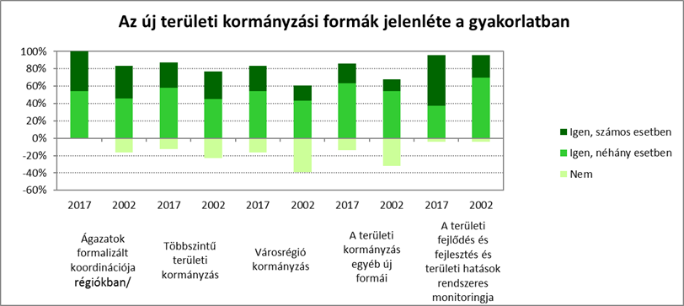
The presence of the new forms of territorial governance in European countries and its change (Answers aggregated to 26 countries)
Source: Salamin 2018 (based on key-expert questionnaire)
Yes in many cases
Yes in few cases
No
Formalised horizontal coordination of sectors
Multilevel governance of territories
City region governance
Other new forms of territorial governance
Monitoring of spatial development and spatial impacts

Slide 17
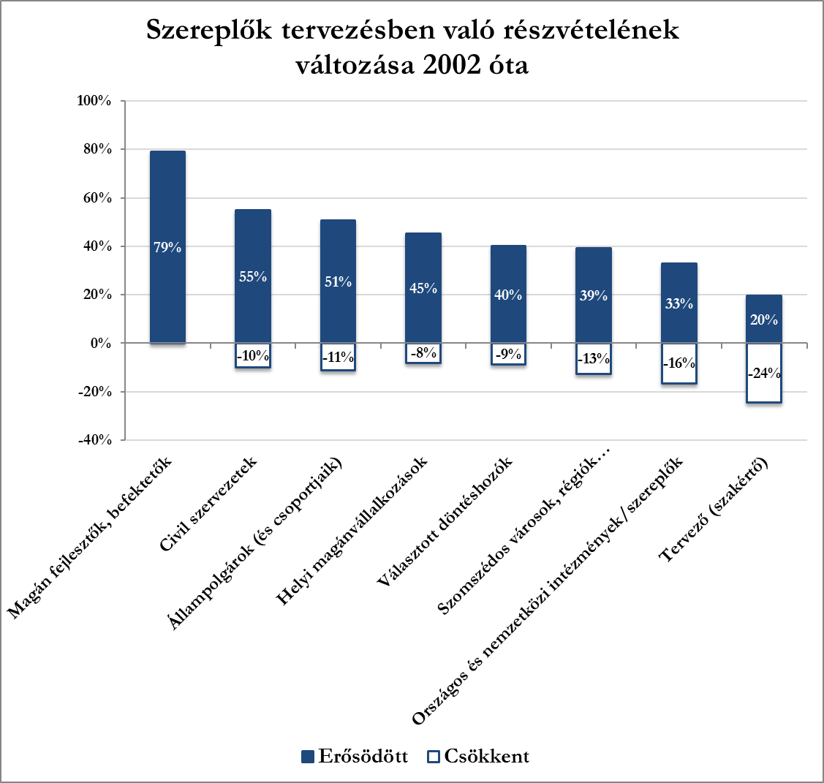
The changes of the role of various actors in planning from 2002
Source: Salamin 2018 (key-expert questionnaire, 2017)
Local private contractor
Neighboring cities, regions
Planners (experts)
Citizens and their groups
NGOs
Elected decision makers
Private developers, investors
National and international institutions
Strengthened
Decreased

Slide 18
The changes of participation of various actors in planning
Source: Salamin 2018 (key-expert questionnaire)
Trad. actors
stakeholders
The presence of stakeholder actors from 2002 and in the future
Planner
Elected decision makers
NGOs
Local businesses
Private developer
Local citizens
Local authority
(int.)national authority
Countries
2002
2030
2002
2030
2002
2030
2002
2030
2002
2030
2002
2030
2002
2030
2002
2030
2030
2030
A-Northwestern countries
Increased/will increase
Change from 2002
B-Eastern eur. countries
Remained/will remain
Expected change in future
C- Southern countries
Decreased/will decrease
No data

Slide 19
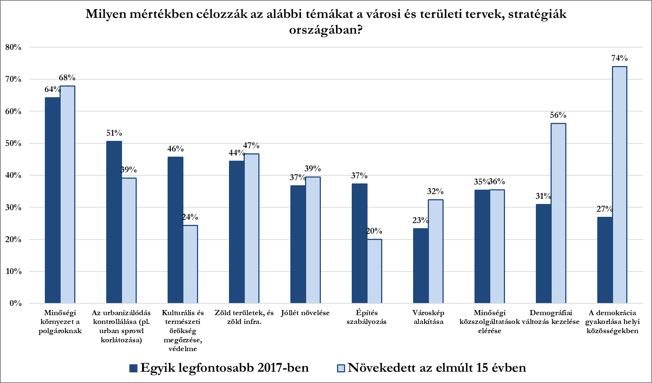
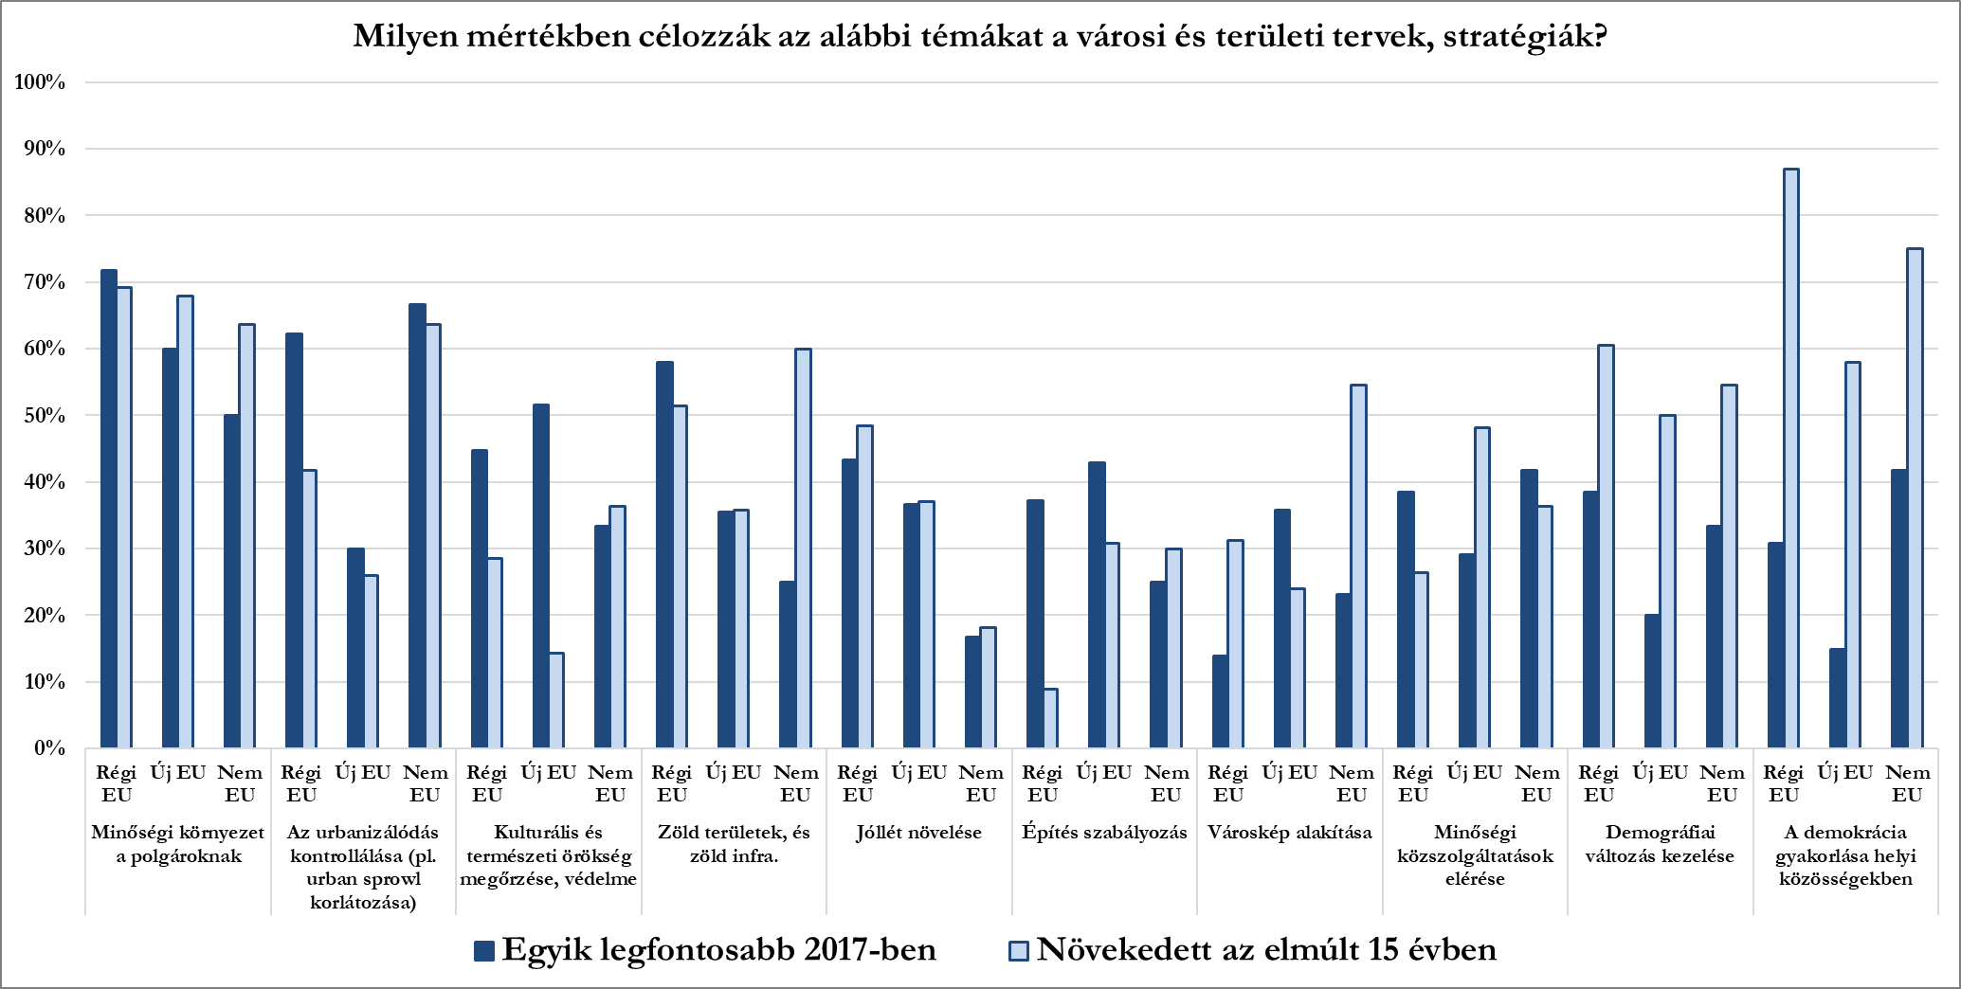
Focus of planning
Source: Salamin 2018 (key-expert questionnaire, 2017)
To what extent these following themes are addressed in territorial/urban/spatial plans, strategies in your country! (Number of answers)
Old EU
New EU
Non EU
Access of qualit publ services
Tackling demographic change
Practicing democracy in local communities
High quality environment
Control the urbanisation
Conserving, protecting cult./en. heritage
Green spaces, green infra.
Increase wellbeing
Regulating, controlling constructions
Shaping townscape
Practicing democracy in local communities
One of the most important in 2017
Increased over the last 15 years

Slide 20
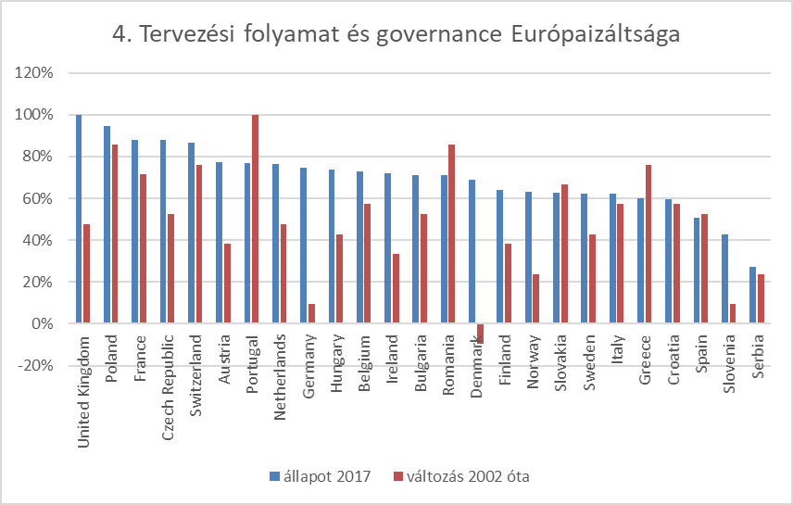
Emergence of new governance forms and change of process in national spatial planning systems
(Status and change composits based on 4+4 indicators)
Source: Salamin 2018 (key-expert questionnaire)
Status (percentage of max value)
Change from 2002 (percentage of max value)
Notes:
a tervezési folyamat jellegének átalakulása és a szereplői kör kibővülése Európa legtöbb vizsgált országában jól beazonosíthatóan jelen van, míg a területi governance szintén jelentősen mértékben kibontakozott, de látszódnak megjelenésében korlátai is (8/22. ábra).
A tervezési folyamat átalakulása és a governance tervezést érintő kiteljesedése alapján az országok rangsorában a nagyhagyományú tervezési kultúrával rendelkező országok mellett elöl szerepel az új területi integrációs fejlesztési eszközök bevezetésében élenjáró Lengyelország és Csehország, de a Mediterrán tervezési kultúrkörből láthatóan erőteljesen elmozduló Portugália tervezési rendszere is.

Slide 21
More and more instruments..
Existance of different types plans on different scales (Number of countries)
Level /space | Type of planning |  |  |  |  |  |  |  | Total change by levels
 | Spatial strategy/vision/concept |  | Physical/land use plan (zoning) |  | Integrated development strategy (addressing more policies) |  | Building control (regulation)
 | introduced | abolished | introduced | abolished | introduced | abolished | introduced | abolished | introduced | abolished
Federal |  | 1 |  | 1 |  | 1 |  | 1 |  | 4
State | 4 | 1 | 2 | 2 | 7 | 4 | 1 |  | 14 | 7
Regional (NUTS2) | 5 | 2 | 5 | 3 | 5 | 1 | 1 |  | 16 | 6
Regional (NUTS3, subregion) | 5 |  | 2 | 3 | 7 | 1 | 1 | 1 | 15 | 5
Local-municipal | 2 |  |  |  | 8 |  |  |  | 10
Part of city (Sub-local) | 3 | 1 | 2 |  | 4 |  |  |  | 9 | 1
Border crossing | 7 | 3 | 2 | 1 | 8 | 1 |  | 1 | 17 | 6
Transnational | 7 | 2 |  | 1 | 5 | 1 |  | 1 | 12 | 5
Cityregion, FUA | 8 | 2 | 3 | 1 | 11 | 1 |  |  | 22 | 4
Other functional | 1 | 1 |  |  | 2 |  |  |  | 3 | 1
Total change | 42 | 13 | 16 | 12 | 57 | 10 | 3 | 4 | 118 | 39
Source: Salamin 2018 (key-expert questionnaire)
Notes:
Numbers indicates the number of countries, where this change happened. (the more experts opinion were aggregated)
nemcsak a tér értelmezése és jelentései, hanem lényegi módon a tervezés által konstruálódó beavatkozások és irányítás területének valós földrajzi kiterjedése és a részvételre jogosult és az érintett szereplőinek köre is átszabásra kerül.
Allmendinger és Haughton (2015) a földrajztudományi szakirodalomban a territoriális vs. viszonyítási (relációs) terek körül zajló vita alapján (Vö. LEFEBRE 1991) azt hangsúlyozzák, hogy míg a formalizált tervezésnek szabályozott, egyértelmű határokra van szüksége, addig az olyan a tervezésnek, amelyik a térbeli viszonyok összetettebb viszonyítási világára kíván reagálni, puha tereken keresztül is működnie kell.

Slide 22
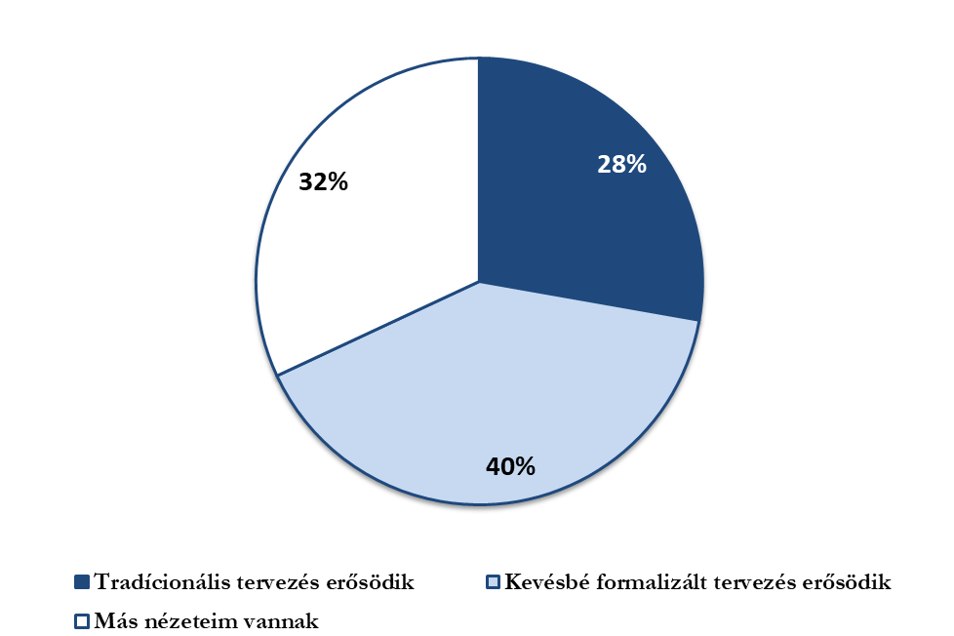
Towards soft instuments?
Source: Salamin 2018 (key-expert questionnaire, 2017)
What are the trends of traditional and less formalized planning?
Experiences in 30 countries
Traditioanl planning strengtheneing
Less formalised planning strengthening
Other opinion

Slide 23
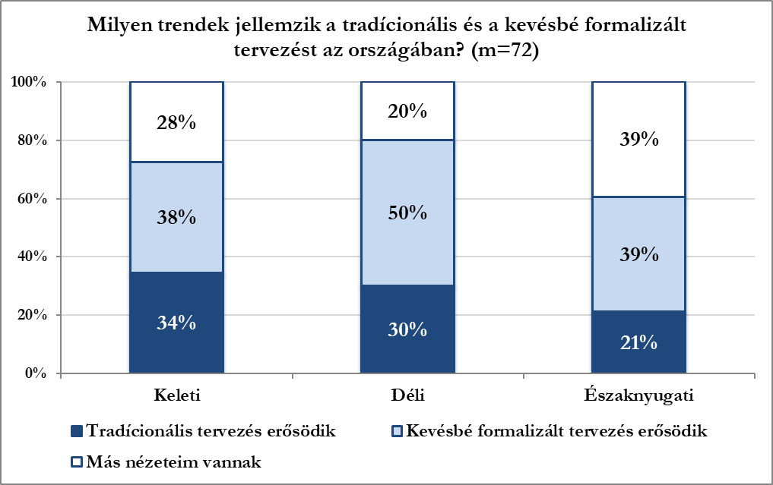
Towards soft instuments?
Source: Salamin 2018 (key-expert questionnaire, 2017)
What are the trends of traditional and less formalized planning?
Experiences in 30 countries
Eastern
Southern
North-western
Traditioanl planning strengtheneing
Less formalised planning strengthening
Other opinion

Slide 24
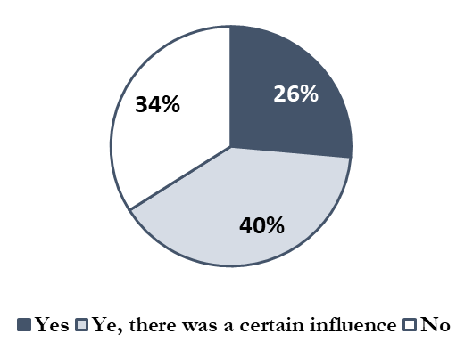
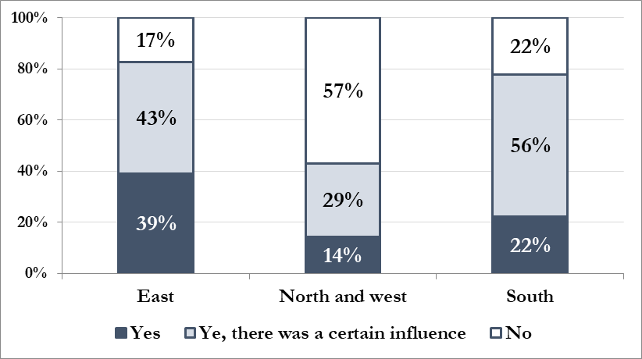
Have new types of plans or new planning activities emerged by the motivation of EU cohesion (regional) policy or its sources since 2002?
Source: Questionnaire survey Salamin G 2017 (M:120)
East: PL, HU, CZ, SK, SL, HR, SRB, RO, EE, LV, LT
North and West: AT, FR, UK, IE, SE, NO, FI, DK, DE, LU, BE, NL, CH,
South: IT, PT, MT, CY, GR, ES

Slide 25
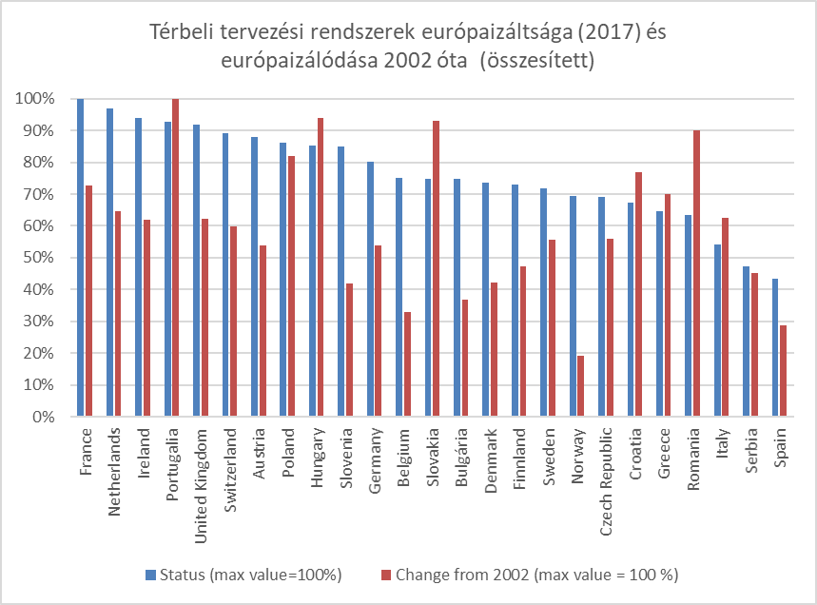
Level and dynamics of Europeanization of spatial planning in countries
Composite based on dimension 1,2,4,5 of EMP
Status (percentage of max value)
Change from 2002 (percentage of max value)
Notes:
sorrend

Slide 26
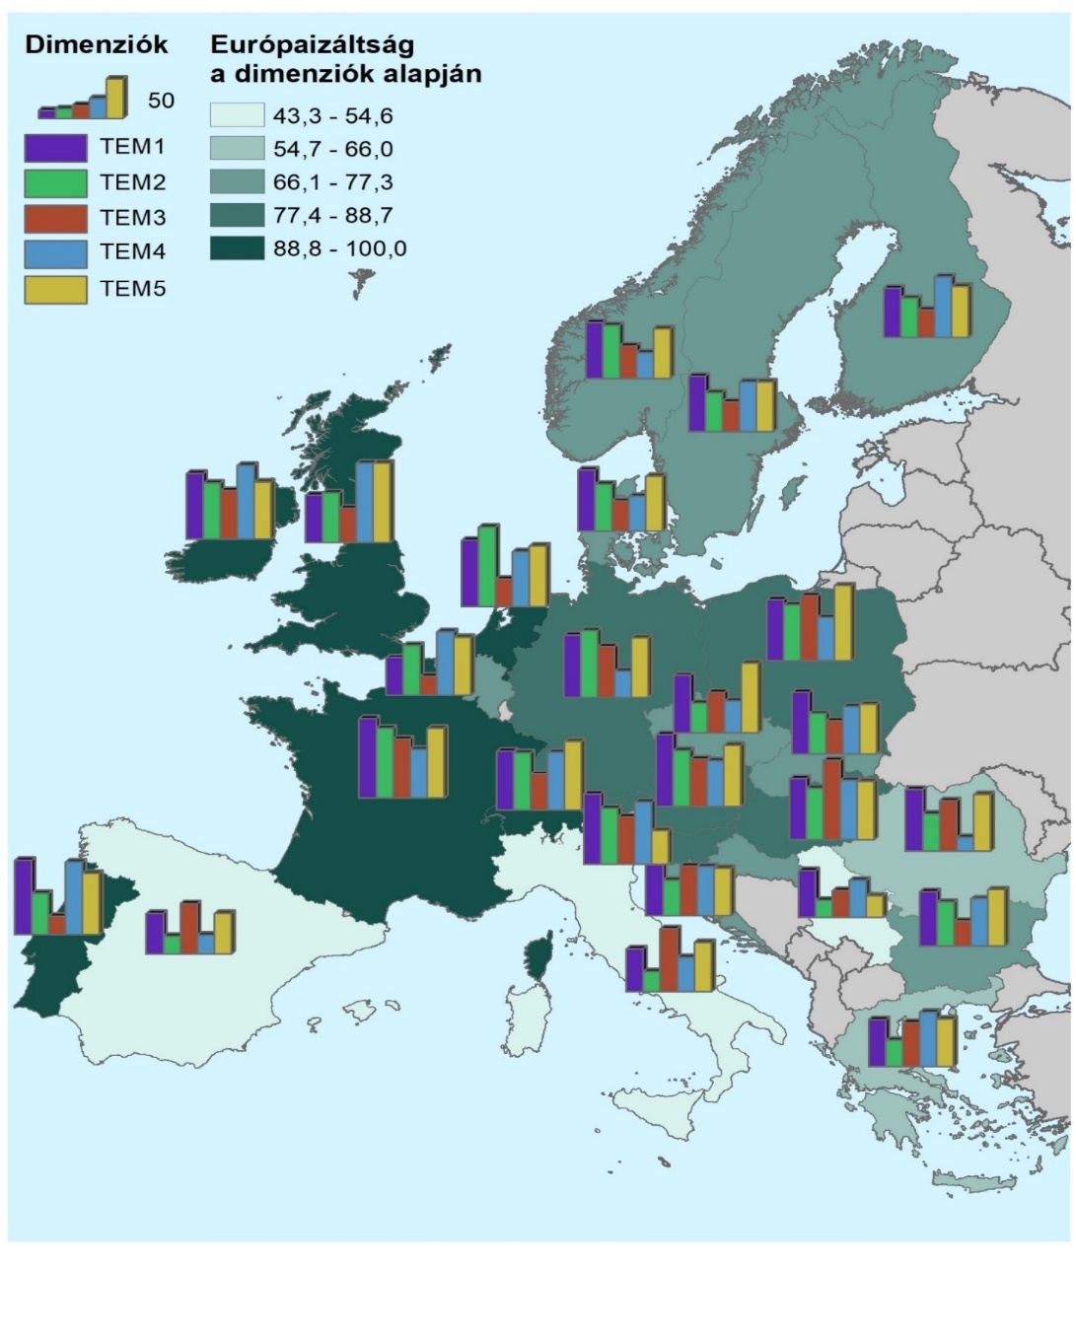
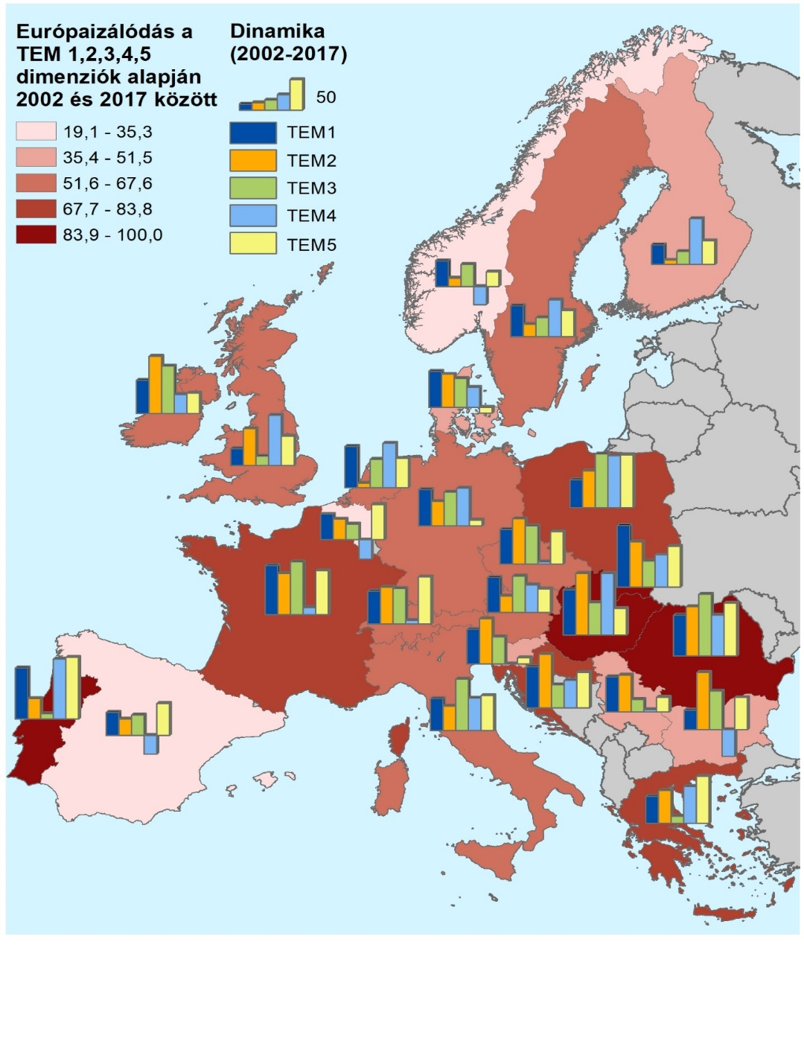
--
SPATIAL PLANNING’S
Level of Europeanization (2017) Dynamics of Europeanization (2002-2017)
Based on EMP Dimension 1,2,4,5
Level in EMP dimenisons
Synthetized Level of Europeanization
Synthetized Europeanization
Dynamics in EMP dimenisons
EMP1
EMP2
EMP3
EMP4
EMP5
EMP1
EMP2
EMP3
EMP4
EMP5
100=maximum value
Notes:
változás

Slide 27
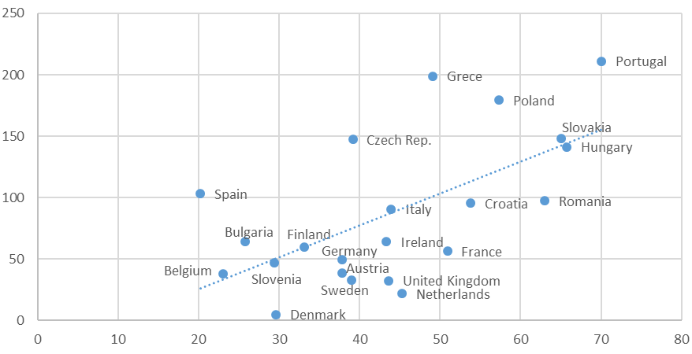
Sources of Cohesion Policy implemented in ‚territorial type’ programmes and the Europeanization of spatial planning between 2002-2017
Sources of territorial type operational programmes per a head (with cofinance)
Europeanization of planning (2002-2017)

Slide 28
Possible forms of spatail planning as umbrella term
Traditional and rather new forms
Trends
Changes according to my results
Source: Salamin - Péti 2019
Notes:
In a very recent paper we tryed to include all possible forms of planning and development policies into asingle figure, which can fall uinder the European umbrella cathegory of spatial planning (which is actually in a significant ovwrlap with the term territorial governance). For identification we used four dimensiond by which we can describe planning system of a certain country.
Accordint to the EMP there is a shift in the meaning od spatial planning – towards a territorial governance approach.
On the figure we indicated the more traditional lanning forms in each dime nsion near the centre and the new formsnear to the edge of the round.
And the trend ins what the red arrows are indicating.
I have to enphasize that this statement is based on , what the literature is saying, what the EU documents are encoureging.
This is what I tryed to measure in a comparative way.

Slide 29

Thank you for your attention!
Géza Salamin
geza.salamin@uni-corvinus.hu
president@mut.hu
Notes:
1. A spatial planning, azaz térbeli tervezés tudományos koncepciójának a fogalom készletét használom és elsősorban e terület széleskörű nemzetközi szakirodalmára építkeztem, amely többé kevésbé önálló diszciplináris területet is jelent, elsősorban a tervezéselmélet, és részben az integrációs irodalom keretében. Az európai szintű térbeli tervezésről és a tervezés európaizálódásáról a 90-es évek vége óta megélénkülő, rendkívül aktív tudományos diskurzus zajlik Európában, melyhez munkám csatlakozni kíván.
Bő 1,5 évtizede fogl ter-i és várostervezéssel, ebből jelentős részben európaival. Ezek tapasztalataira építek, de egy az elmúlt 1,5 évben megvalósított konkrét kutatásom adja dolgozatomat.

Slide 30
The presence of the new forms of territorial governance in European countries and its change
Source: Salamin 2018 (key-expert questionnaire)
The presence of new forms of territorial governance
in practice
Yes, in many cases
Yes, in few cases
No
Formalized horizontal coordination of sectors
Multilevel governance of territories
Cityregion governance
Other new forms of territorial governance
Monitoring of spatial development and spatial impacts

Slide 31
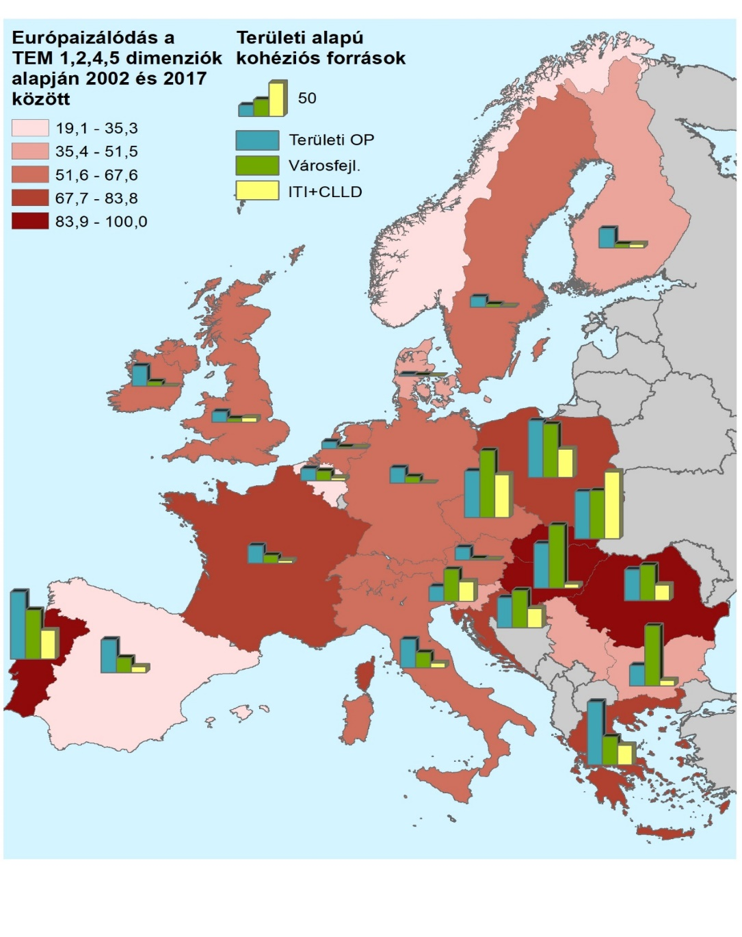
1. Sources allocated through territorial type operationall propgrammes between 2000-2020. Includes regional operational programmes, multiregional operational programmes with primary focus on territoriald evelopment and/or urban development
2. Sources used under integrated urban development cathegory in period 2014-2020
3. Sources used throgh the instuments of Integtrated Teriitorial Investment (ITI) and Community Lead Local Development (CLLD) in period 2014-2020
Europeanization of spatial plannning based on EMP dimension 1,2,4,5 (2002-2017)
Cohesion policy sources
used in territorrial way
1 Territorial type OP-s
2 Integr. Urban development
3 ITI+CLLD
Europeanization of spatial planning and the territorial related use of Cohesion Policy funds

Slide 32
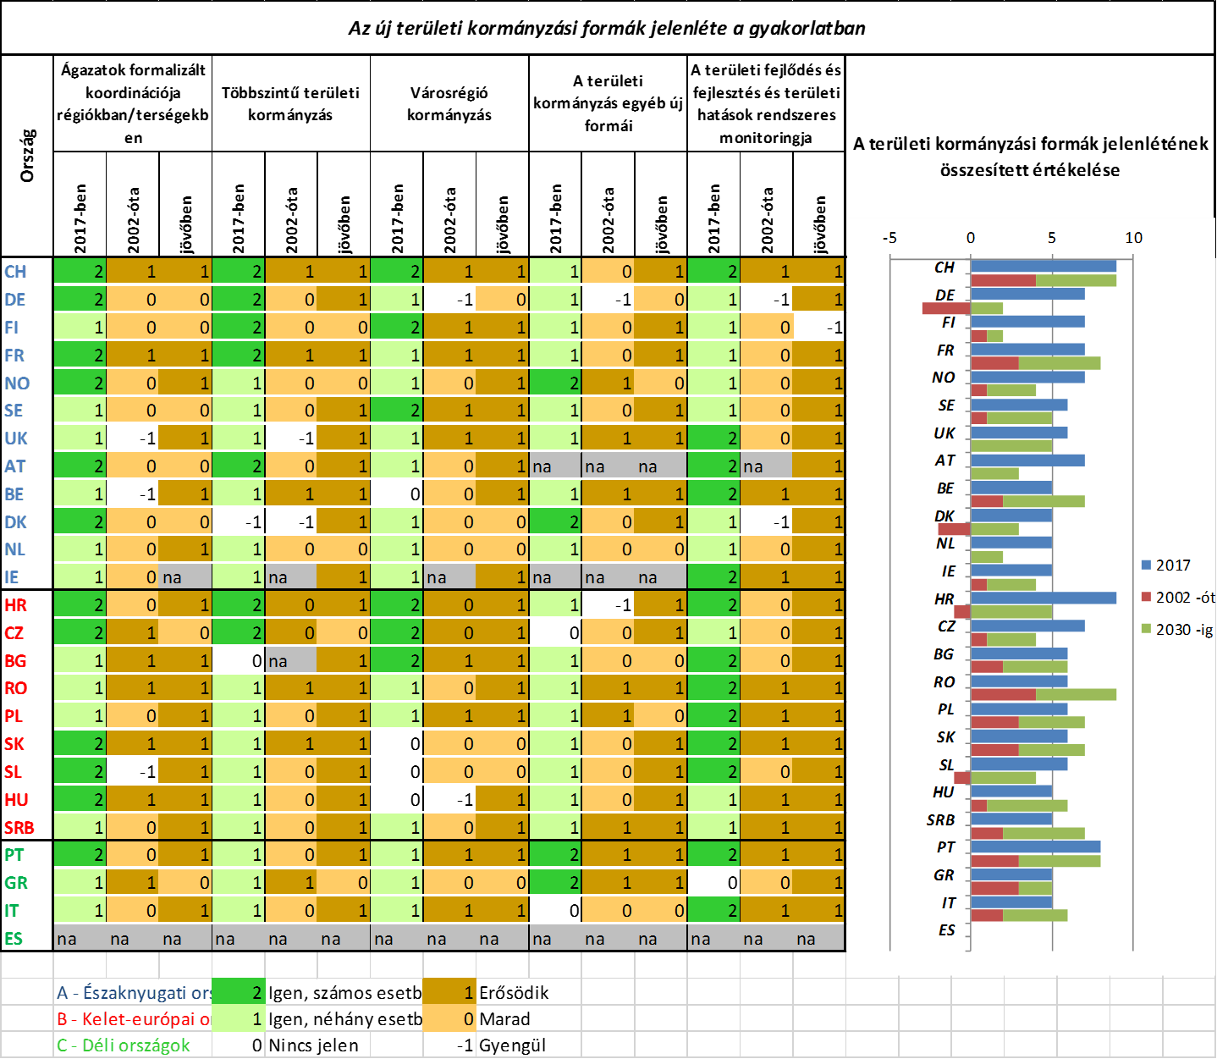
The presence of new forms of governance in practice and the change of these change
Source: Salamin 2018 (key-expert questionnaire)
Countries
Formalized horizontal coordination of sectors
Multilevel governance of territories
City region governance
Other new forms of territorial governance
Monitoring of spatial development and spatial impacts
The presence of territorial governance
2017
2002
Futu.
2017
2002
Futu.
2017
2002
Futu.
2017
2002
Futu.
2017
2002
Futu.
A-Northwestern countries
Yes, in many cases
Strengthen
B-Eastern eur. countries
Yes, in some cases
Remain
C – Southern countries
Not presents
Weaken

Slide 33
Sources
ALLMENDINGER, P. - HAUGHTON, G. (2009): Soft spaces, fuzzy boundaries, and metagovernance: The new spatial planning in the Thames Gateway. Environment and Planning A 41 617–633
Bevir, Mark (2012). Governance: A very short introduction. Oxford, UK: Oxford University Press.
CEMAT (2007): Spatial development glossary. European Conference of Ministers responsible for Spatial/Regional Planning (https://www.coe.int/en/web/conference-ministers-spatial-planning/publications)
FARINÓS DASI, J. (Szerk.) (2006): Governance of Territorial and Urban Policies from EU to Local Level. (ESPON project 2.3.2)
FÜRST, D. (2009) Planning Cultures on route to a better comprehension of 'planniong process'? In. KNIELING, J. – OTHENGRAFEN, F. (Szerk.): Planning cultures in Europe: Decoding Cultural Phenomena in Urban and Regional Planning. Rarnham: Ashgate. p. 23-38
GETIMIS, P. (2012) Comparing Spatial Planning Systems and Planning Cultures in Europe. The Need for a Multi-scalar Approach. In: Planning Practice and Research, Vol. 27, No. 1, p. 25–40,
HAUGHTON, G. - ALLMENDINGER, P. - COUNSELL, D. - VIGAR, G. (2010) The new spatial planning – territorial management with soft spaces and fuzzy boundaries, London: Routledge
Hufty, Marc (2011). "Investigating Policy Processes: The Governance Analytical Framework (GAF). In: Wiesmann, U., Hurni, H., et al. eds. Research for Sustainable Development: Foundations, Experiences, and Perspectives". Bern: Geographica Bernensia: 403–24.

Slide 34
Indicators of measuring governance shift in planning processes
Source: Salamin 2018
Status indicators 2017:
Presence of territorial governance forms
Emergence of new territorial governance forms in national plans/strategies
Formalized sectoral coordination of implementation their policies in regions, cities
The proportion of non-technical graduates among planning professionals
Indicator for change since 2002
Change of the role of stakeholders
Change in presence of territorial governance forms from 2002 and in the future
Change in presence of territorial governance forms from 2002
Apply of integrated development policy instruments in the implementation of cohesion policy 2014-2020
Notes:
a tervezési folyamat jellegének átalakulása és a szereplői kör kibővülése Európa legtöbb vizsgált országában jól beazonosíthatóan jelen van, míg a területi governance szintén jelentősen mértékben kibontakozott, de látszódnak megjelenésében korlátai is (8/22. ábra). A tervezési folyamat átalakulása és a governance tervezést érintő kiteljesedése alapján az országok rangsorában a nagyhagyományú tervezési kultúrával rendelkező országok mellett elöl szerepel az új területi integrációs fejlesztési eszközök bevezetésében élenjáró Lengyelország és Csehország, de a Mediterrán tervezési kultúrkörből láthatóan erőteljesen elmozduló Portugália tervezési rendszere is.

Slide 35
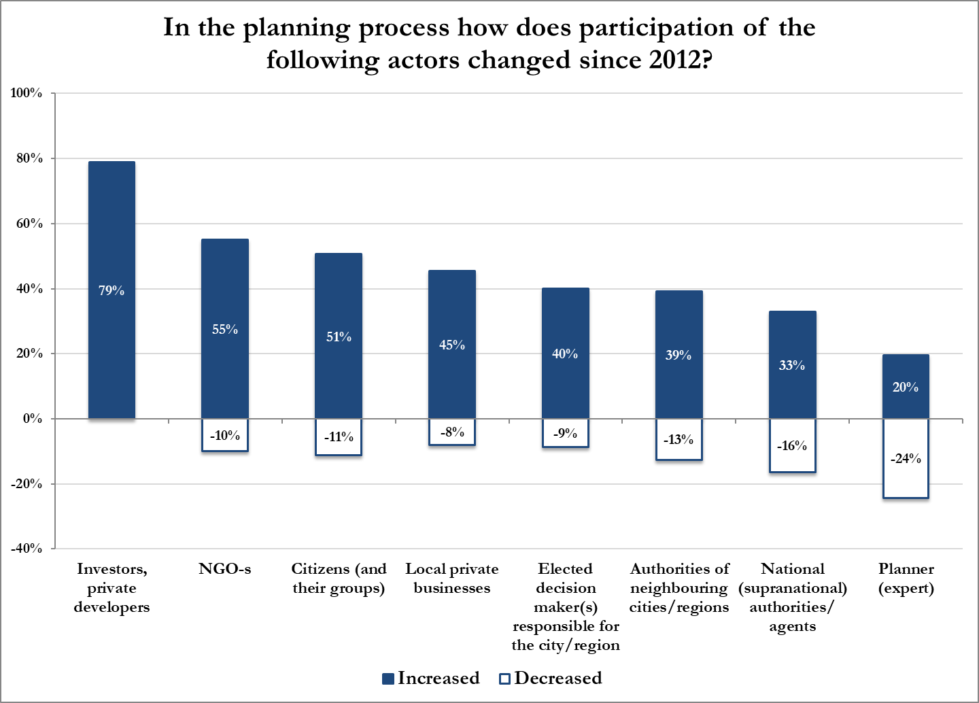
The role of actors in planning. Changes from 2002

Slide 36
Indicators of measuring emergence of new spaces in national planning systems
Source: Salamin 2018
Status indicators 2017:
Number of EGTS memberships
Emergence of new spaces in national strategies
Participation in european macro-regional strategies (EMS)
Presence of city region planning
Presence of planning other functional spaces
Indicator for change since 2002
Number of EGTC-s, in which was involved in creation
Strengthening/weakening of border-crossing planning
Participation in european macro-regional strategies (EMS)
Strengthening/weakening of planning in macro-regional level
Change in presence of city region planning from 2002 to 2017
Change in presence of planning other functional spaces from 2002 to 2017
Appearance of new planning level
Notes:
a tervezési folyamat jellegének átalakulása és a szereplői kör kibővülése Európa legtöbb vizsgált országában jól beazonosíthatóan jelen van, míg a területi governance szintén jelentősen mértékben kibontakozott, de látszódnak megjelenésében korlátai is (8/22. ábra). A tervezési folyamat átalakulása és a governance tervezést érintő kiteljesedése alapján az országok rangsorában a nagyhagyományú tervezési kultúrával rendelkező országok mellett elöl szerepel az új területi integrációs fejlesztési eszközök bevezetésében élenjáró Lengyelország és Csehország, de a Mediterrán tervezési kultúrkörből láthatóan erőteljesen elmozduló Portugália tervezési rendszere is.

Slide 37
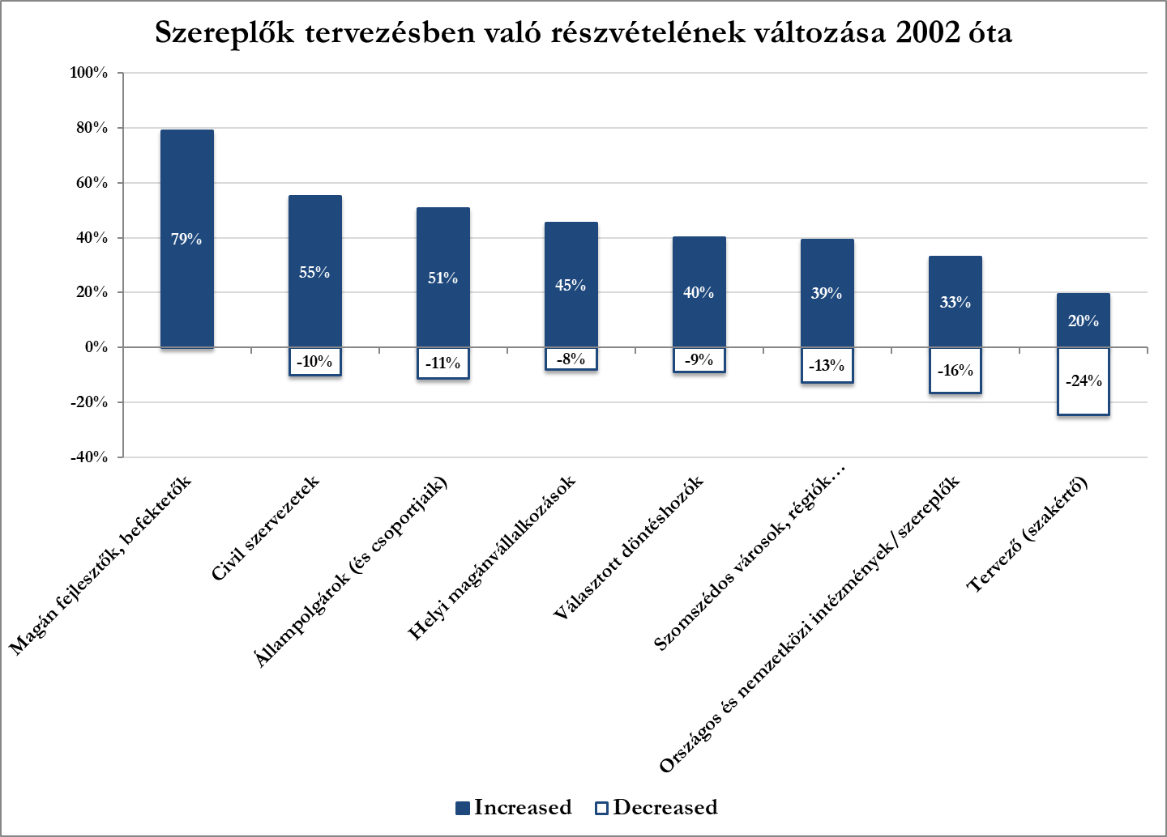
TEM 5. dimenzió: Tervezési folyamat és területi governance új formái
100=maximum érték
Notes:
AZ EU is ezt támogatja
Látszódnak korlátai
- holl városrégiók, BAFT, kistérségi társulások, UK reg

Slide 38
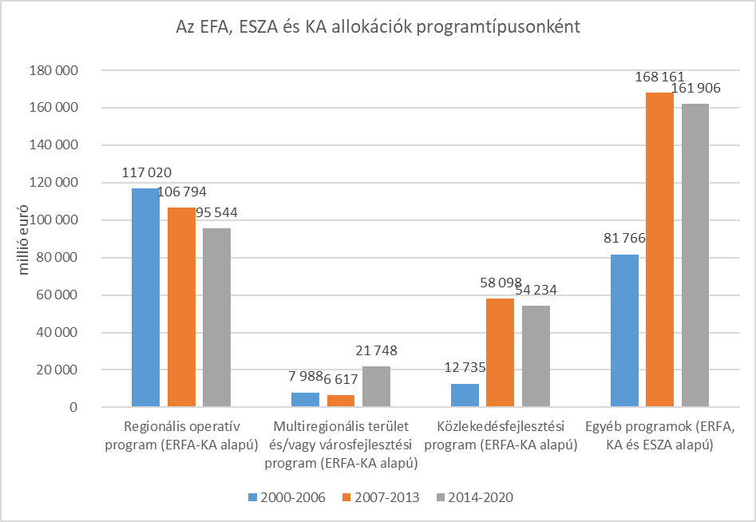
A Kohéziós politika területi dimenziója és a térbeli tervezés európaizálódása
A regionális szintre telepített programok súlya csökken
A térbeli dimenzió (városi és területi is) új formában jelenik meg a területi kohézió jegyében.

Slide 39
What planning is about?
Changes in the essence of planning since 2002
Source: Salamin 2018 (key-expert questionnaire, 2017)
Coordination between actors, sectors and policies
Coopertaion between actors (e.g NGOs)
Mutual learning from each other
Territorial monitoring and controlling
Creative (or scientific) activity of expert planner
Compulsory administrative and management process of legitim authority
Increased
Decreased

Slide 40
