Slide 1
PLYMOUTH’S PLANNING STORY:
A philosophy of planning?
JONATHAN BELL
Head of Development Planning
Plymouth City Council

Slide 2
PLYMOUTH’S PLANNING STORY:
A philosophy of planning?

Slide 3

PLYMOUTH’S PLANNING STORY:
A philosophy of planning?
Notes:
We have some long term problems
Historically Plymouth has been off the radar when it comes to funding – resulting in poor transport infrastructure, low levels of funding for public health etc.
Our economy has historically been over-reliant on the public sector jobs, and previously on construction led housing – and is relatively weak in the higher value financial and professional and business services. The recession was deeper and more enduring in Plymouth than elsewhere and overall GVA growth has been lower than the national and regional averages
We have a relatively low wage economy
There are long term issues of under-employment
One in five children are living in poverty
Plymouth under performs on productivity and its drivers, particularly business stock and start ups
Plymouth is consistently below the national average for educational attainment
There are some very significant health inequalities – the life expectancy gap between the most and least deprived areas of the city is 7 years and 9 months. (A city of two halves?)
30 per cent of private rented housing stock is considered to be non-decent
We suffer along with our neighbours in the South West Peninsula from outdated and slow rail infrastructure due to many years of under-investment by the Government. The result of this was at its most stark when the main line to London was washed away at Dawlish by storms a few years ago.

Slide 4
PLYMOUTH’S PLANNING STORY:
A philosophy of planning?

Slide 5
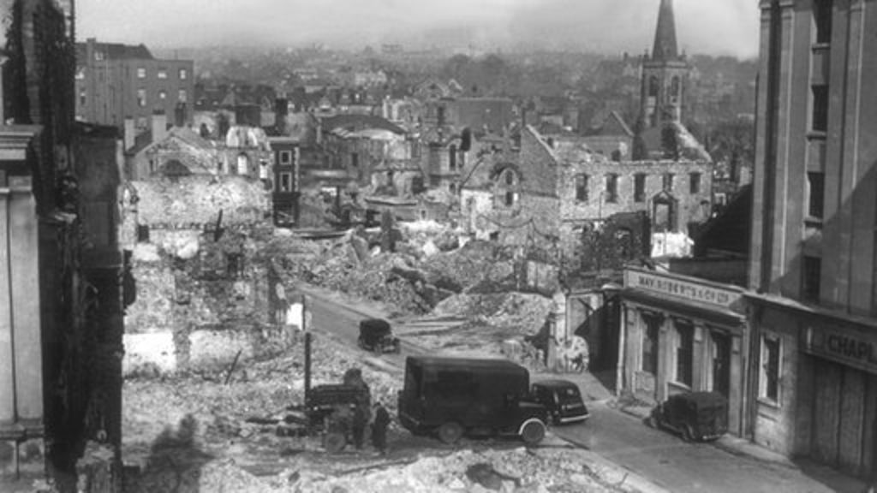
PLYMOUTH’S PLANNING STORY:
A philosophy of planning?
Plymouth 1941

Slide 6
PLYMOUTH’S PLANNING STORY:
A philosophy of planning?

Slide 7
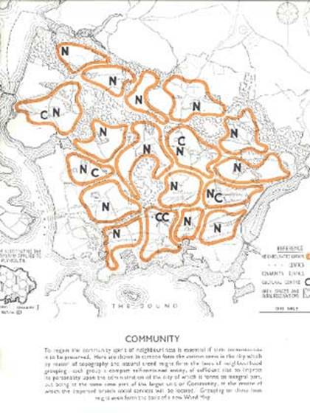
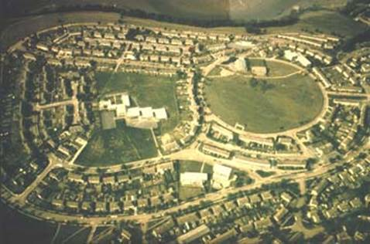
PLYMOUTH’S PLANNING STORY:
A philosophy of planning?
Plan for Plymouth 1943

Slide 8

PLYMOUTH’S PLANNING STORY:
A philosophy of planning?

Slide 9
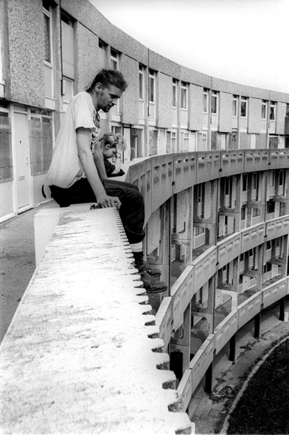
PLYMOUTH’S PLANNING STORY:
A philosophy of planning?

Slide 10
PLYMOUTH’S PLANNING STORY:
A philosophy of planning?

Slide 11
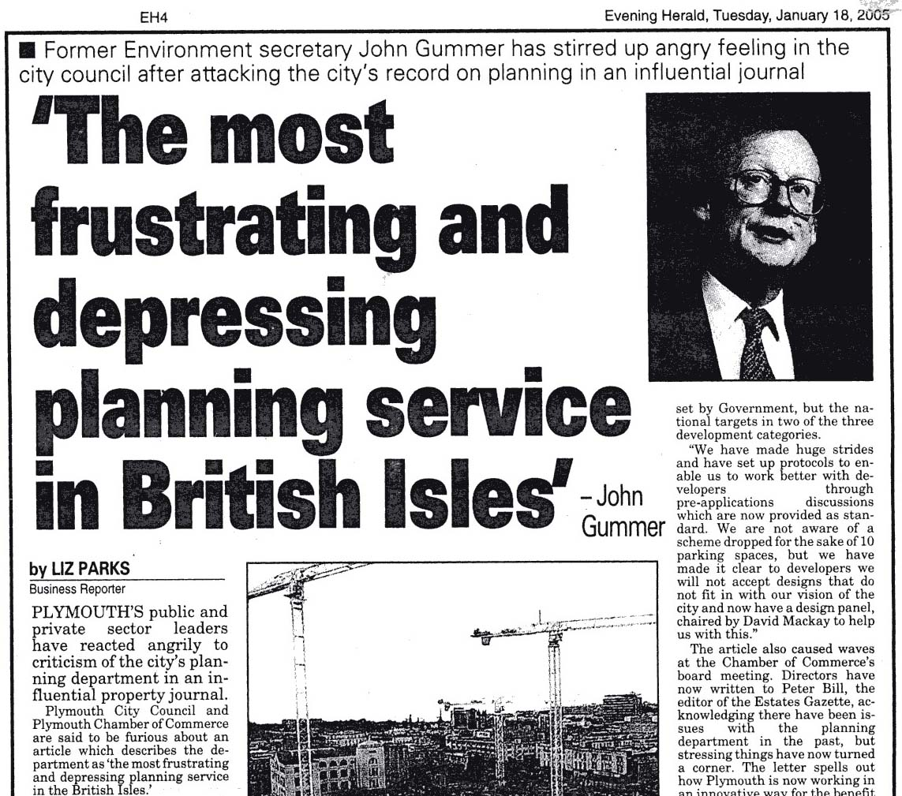
PLYMOUTH’S PLANNING STORY:
A philosophy of planning?

Slide 12
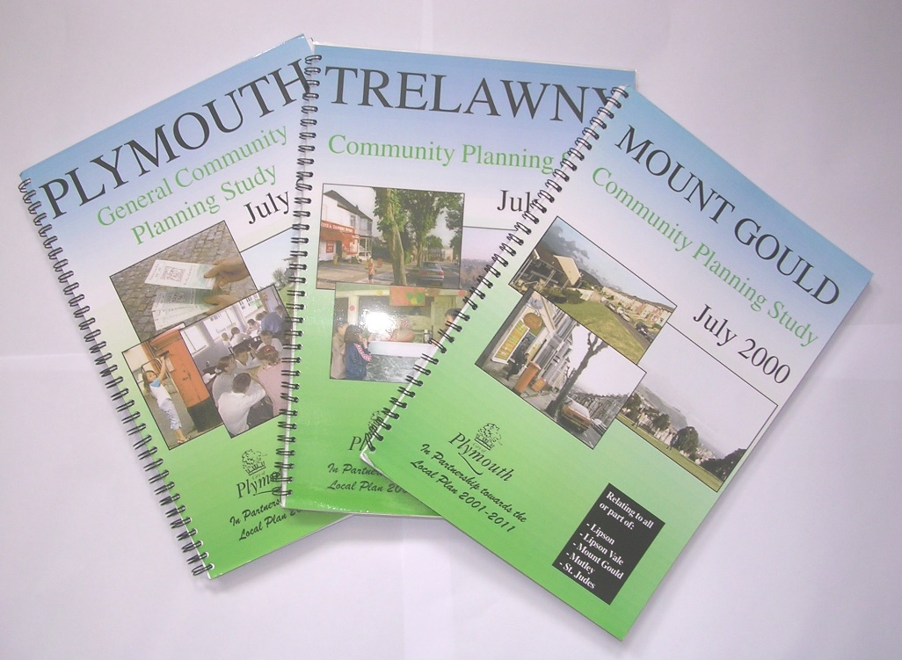
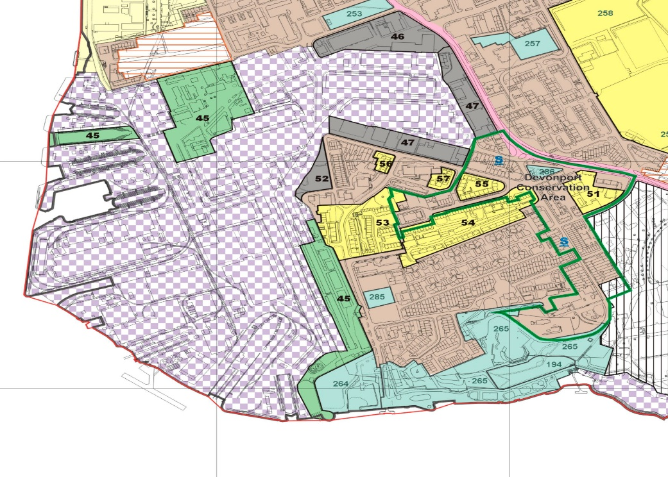
PLYMOUTH’S PLANNING STORY:
A philosophy of planning?
Community planning studies and the 2001 Local Plan

Slide 13
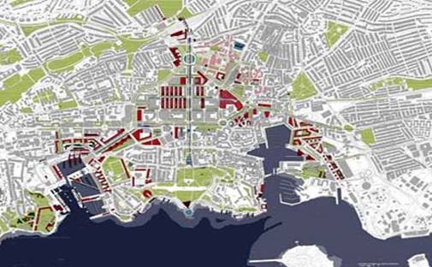

PLYMOUTH’S PLANNING STORY:
A philosophy of planning?
‘Mackay’ Vision, 2003

Slide 14

PLYMOUTH’S PLANNING STORY:
A philosophy of planning?
OFFICIAL

Slide 15
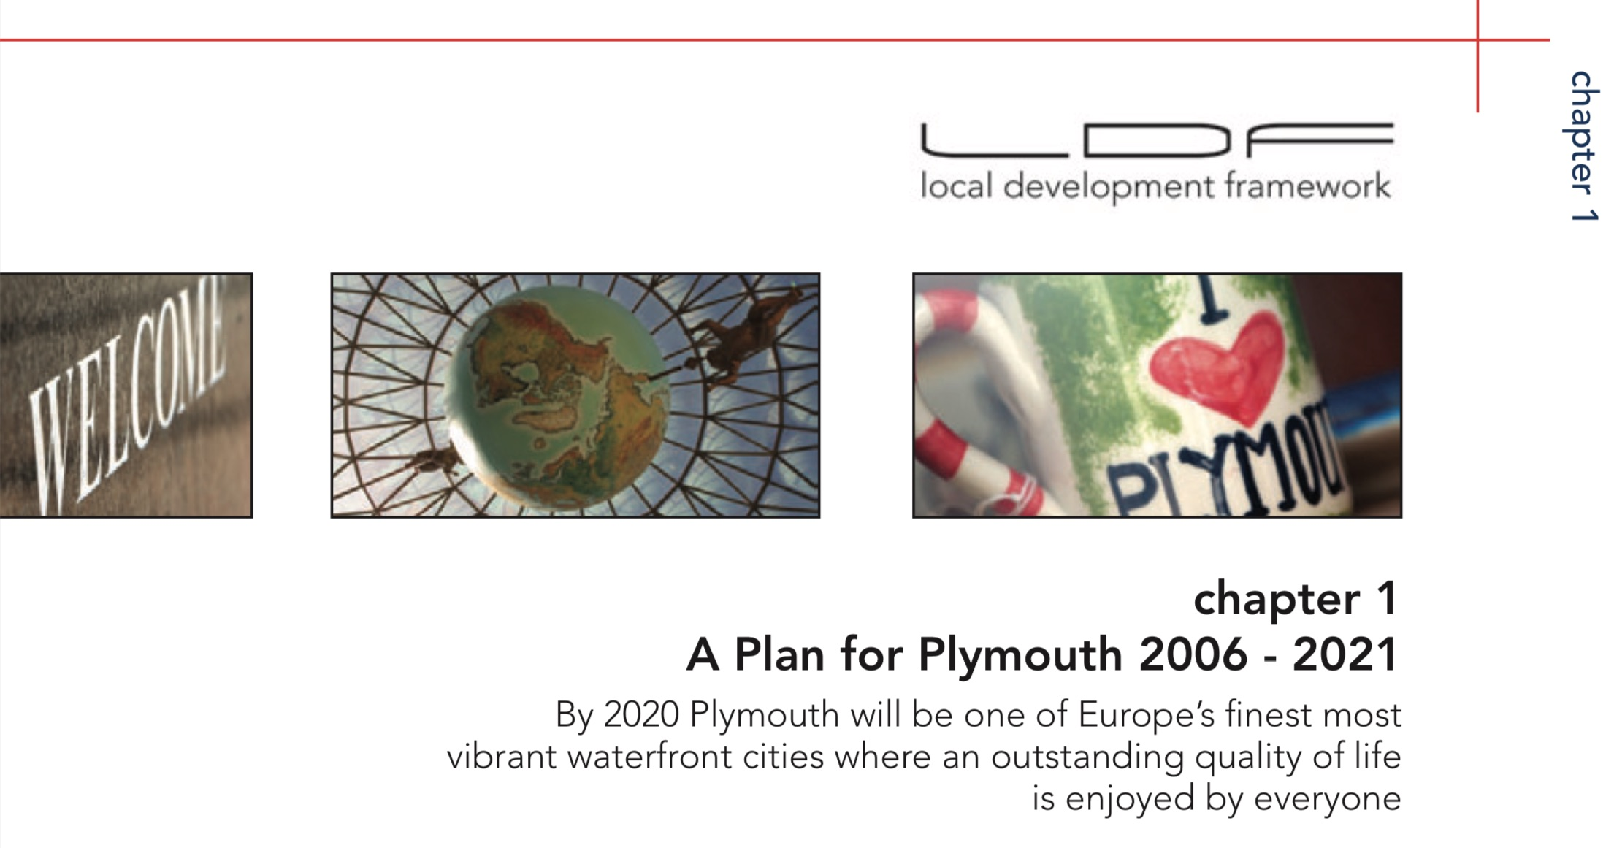
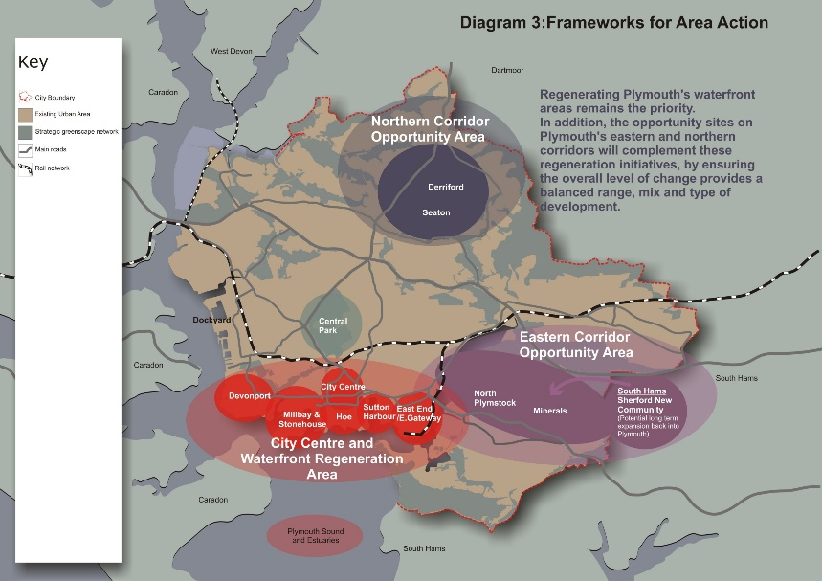
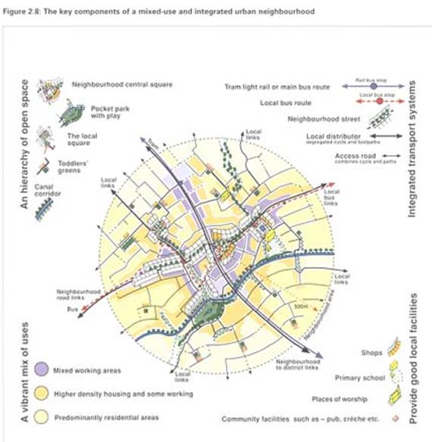
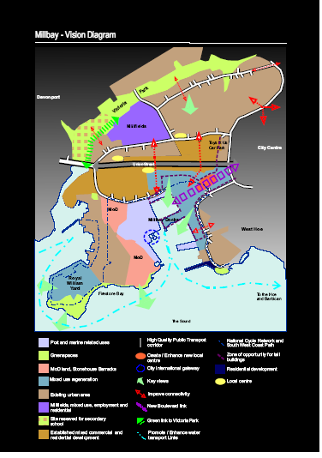
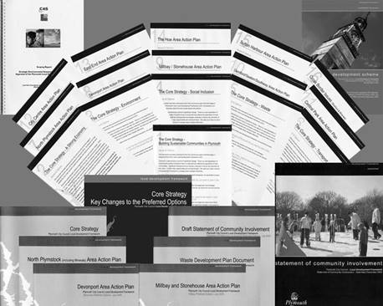
PLYMOUTH’S PLANNING STORY:
A philosophy of planning?

Slide 16


PLYMOUTH’S PLANNING STORY:
A philosophy of planning?

Slide 17
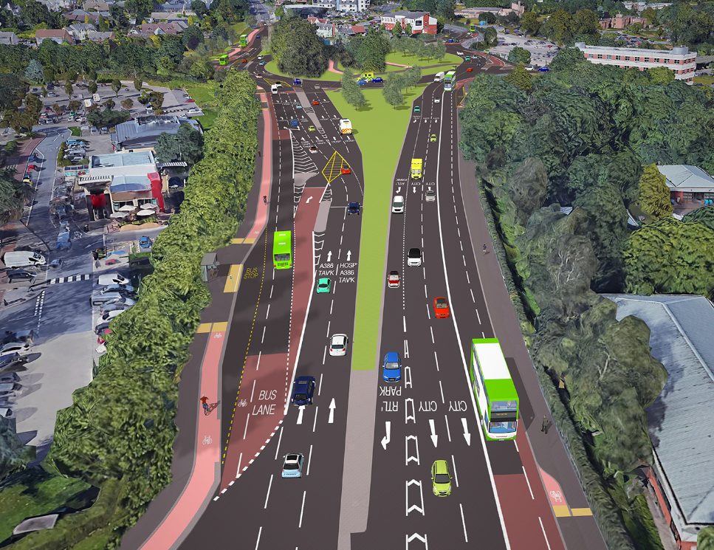
PLYMOUTH’S PLANNING STORY:
A philosophy of planning?
Derriford Transport Scheme – completed 2018

Slide 18
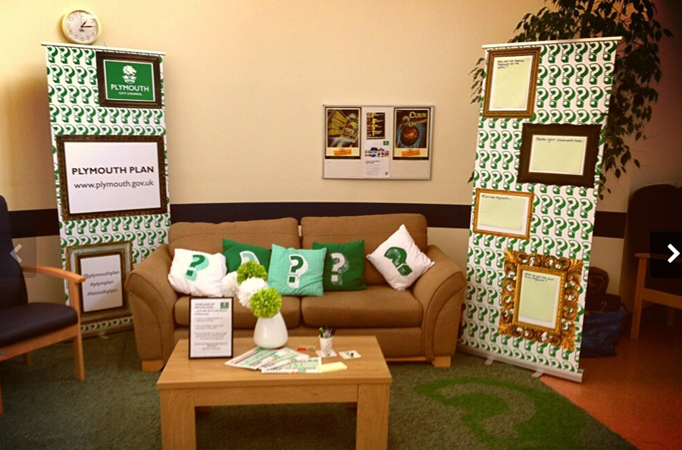
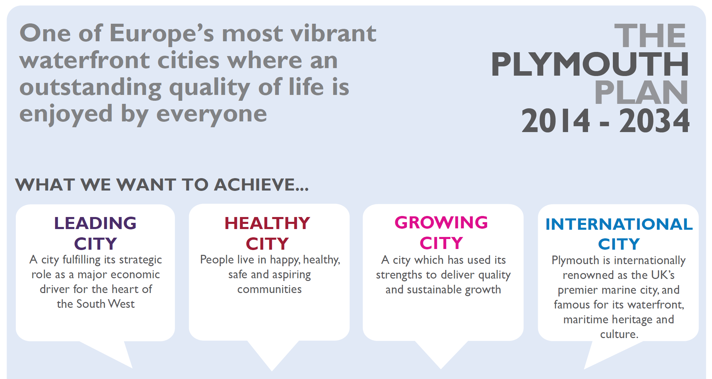
PLYMOUTH’S PLANNING STORY:
A philosophy of planning?

Slide 19
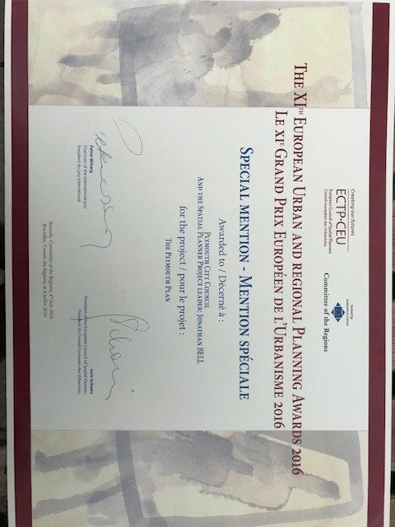
PLYMOUTH’S PLANNING STORY:
A philosophy of planning?

Slide 20

PLYMOUTH’S PLANNING STORY:
A philosophy of planning?

Slide 21
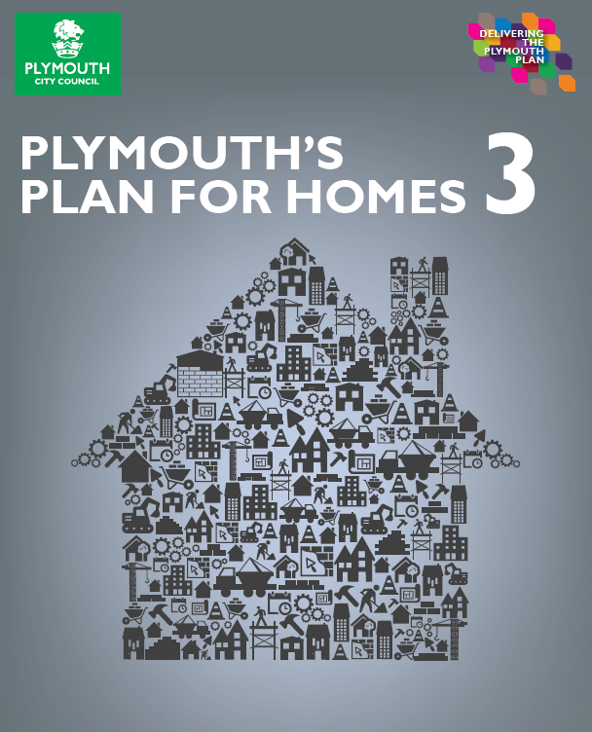
PLYMOUTH’S PLANNING STORY:
A philosophy of planning?
5,563 homes completed in 5 years; 1,656 under construction as at April 2019 (more than 40% above the previous 5 years)
Of these 1,529 are affordable homes (27.5%)
In 2018/19, 1,075 new homes completed, of which 421 are affordable (39%) – the highest affordable number this century.
Plymouth is first in its Housing Family Group for affordable housing delivery (2013 to 2018), outperforming a number of major cities.
New Homes Bonus yield of nearly £40m over 5 years
OFFICIAL

Slide 22
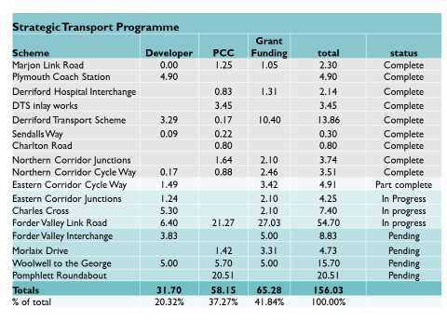
PLYMOUTH’S PLANNING STORY:
A philosophy of planning?

Slide 23
PLYMOUTH’S PLANNING STORY:
A philosophy of planning?

Slide 24

PLYMOUTH’S PLANNING STORY:
A philosophy of planning?
RTPI Awards 2018

