Slide 1
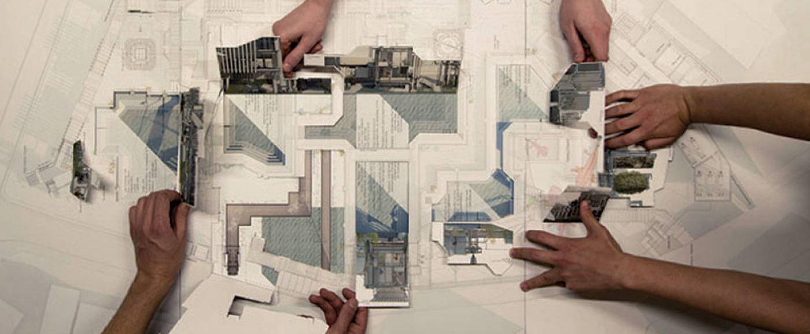
I EUROPEAN SEMINAR INAP AETU
CIRCULAR ECONOMY AND
URBAN AND REGIONAL METABOLISM
Spatial Planning’s new paradigms
JOÃO TEIXEIRA
Madrid 2019 05 10

Slide 2


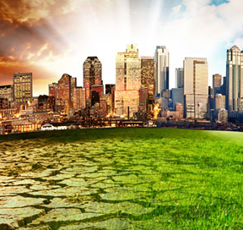
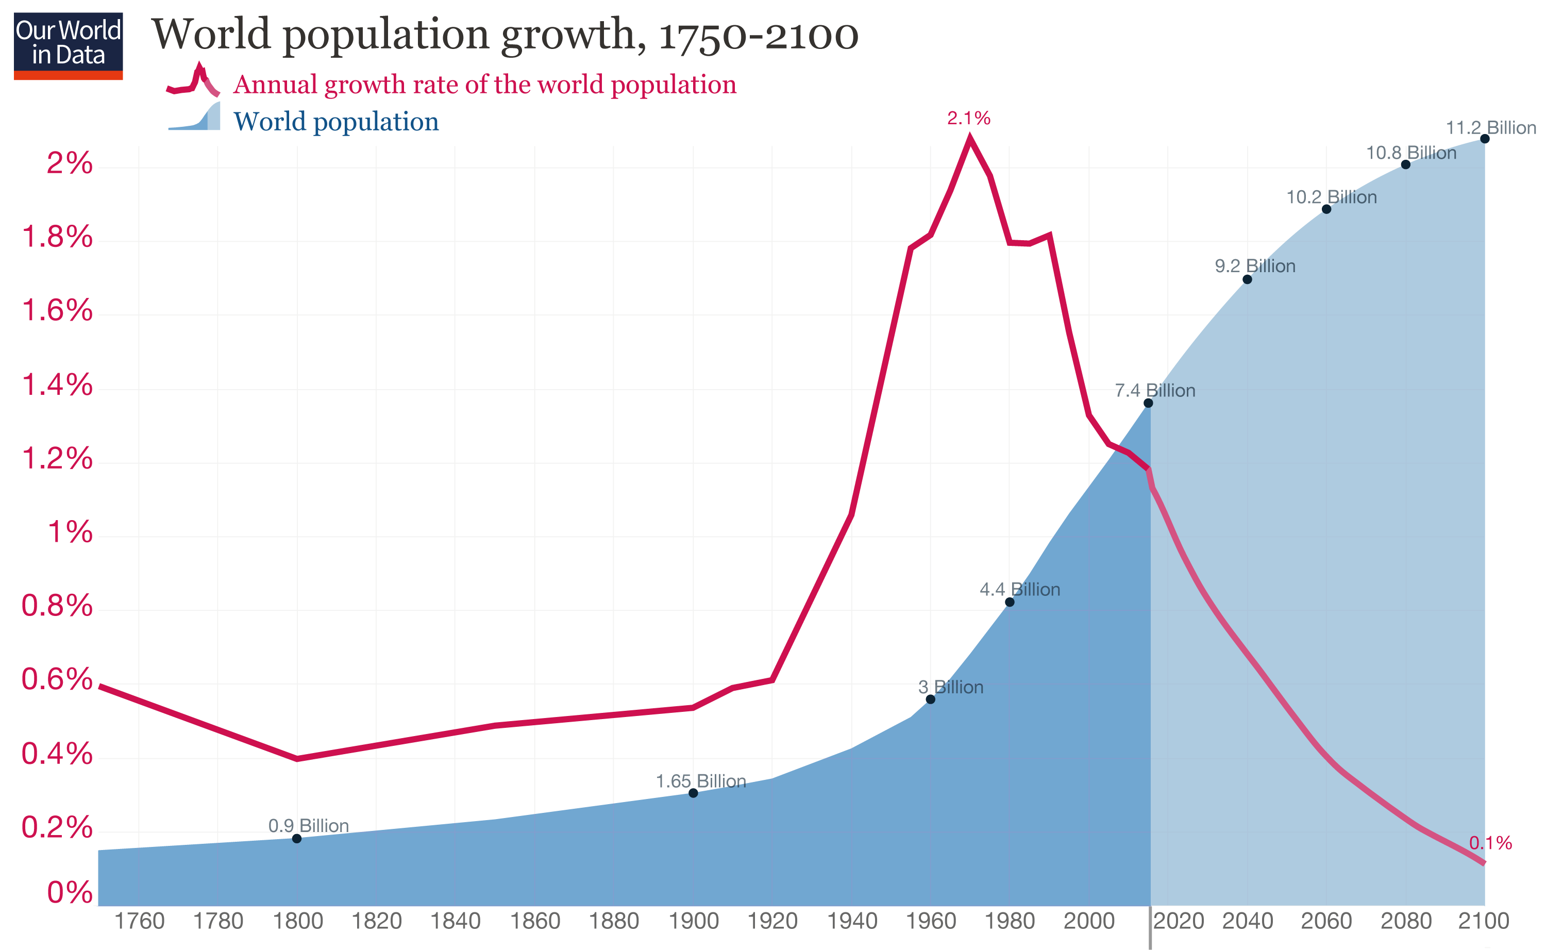
global frammework
1.
Never in the history of mankind as now:
has the world population experienced such an exponential growth;
has human activity been of as much consequence to climate change;
has scientific and technological evolution contributed so much to development;
has life expectancy been so high;
network society, velocity of information, quantity of data, assumed the impacts that occur;
have networks driven capital, goods, information movements with as much intensity and speed;
have global enterprises gathered such large concentration of capital, technology and human resources;
has the world seen as many growing numbers of increasing populated megalopolises.

Slide 3

global frammework
1.
network society, information velocity, quantity of data
increasing populated megalopolises

Slide 4
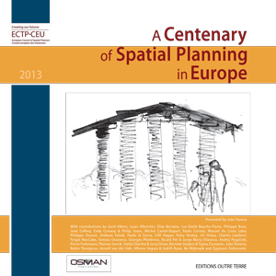
spatial planning throughout history
2.
Spatial planning has contributed to several solutions to urban issues, such as:
integrating water supply and sewerage networks:
integrating railway systems in cities and regions;
contributing to public health;
promoting public parks;
promoting housing;
promoting heritage buildings and cultural sites;
promoting New Towns;
integrating bike, cars and tram’s networks;
promoting high-rise buildings;
promoting public and social equipments;
promoting modernism in urbanism;
promoting regional planning;
integrating new airports and ports;
promoting strategic planning;
integrating real estate’s new products ;

Slide 5
spatial planning throughout history
2.
Spatial planning has contributed to several solutions to urban issues, such as:
… (continue)
promoting European landscape;
promoting urban regeneration:
promoting design with nature;
promoting European Spatial Planning;
promoting sustainability and resilience;
promoting eco-buildings, eco-quarters and eco-cities;
promoting smart cities and regions.
promoting community involvement, citizen’s empowerment and participatory democracy;
promoting urban and regional parks;
promoting science, businesses and technology incubation and innovation centers;

Slide 6


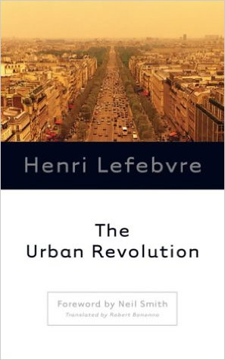
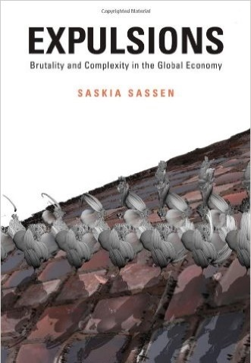
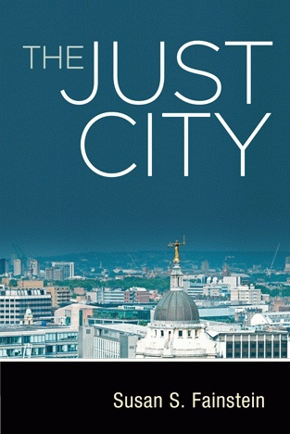
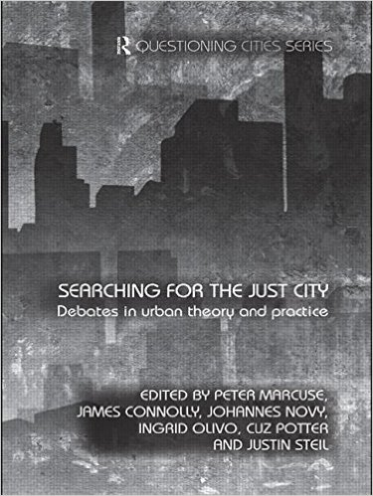
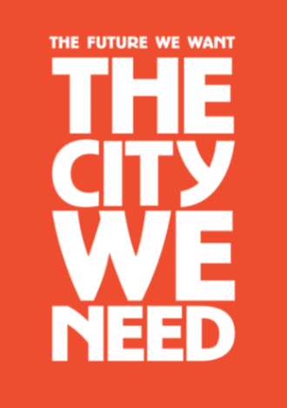
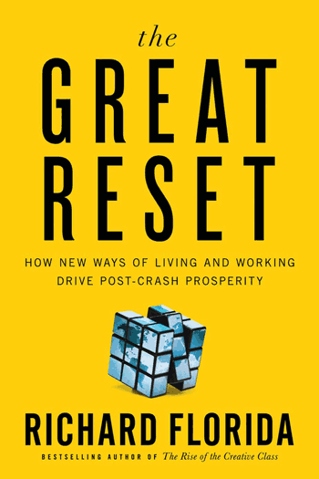
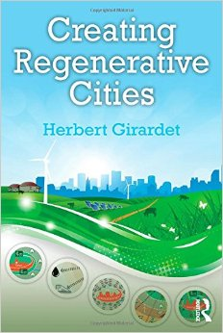
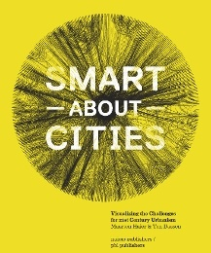


spatial planning dedicated to several subjects
3.
such as: sustainable city; resilient city; eco city; green city; compact city; healthy city; liveable city; human city; happy city; slow city; walkable city; just city; global city; fast city; competitive city; creative city; spectacle city; cool city; smart city; innovative city; ciber city e future city.

Slide 7
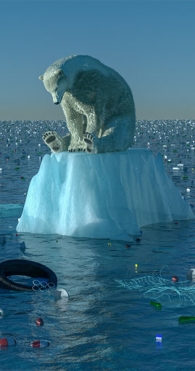
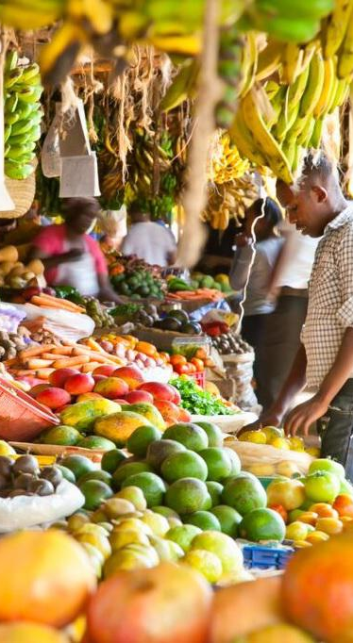
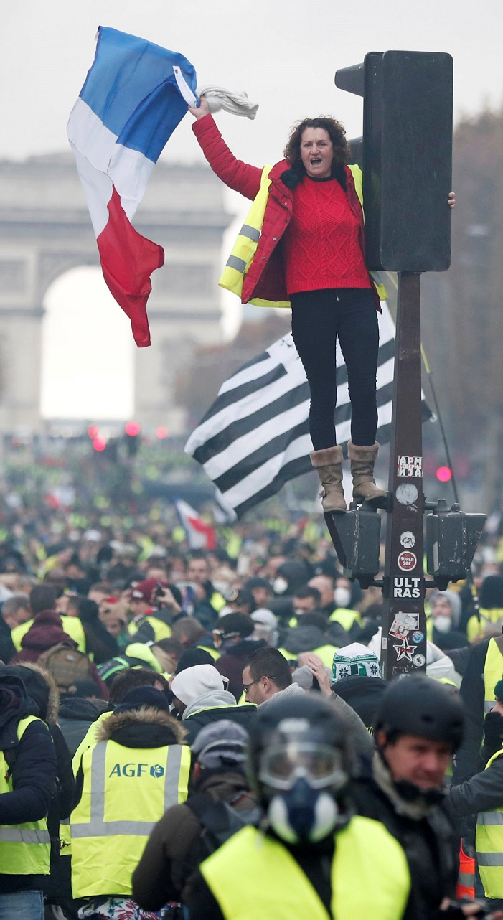
spatial planning main challenges
4.
climate change mitigation and adaptation;
carbon dioxide emissions and others green house gases reduction;
biodiversity improvement and losses prevention;
ensuring food security;
public space promotion;
spatial planning upgrade through networking systems;
social tensions prevention;
social inclusion promotion;
participatory democracy support;

Slide 8
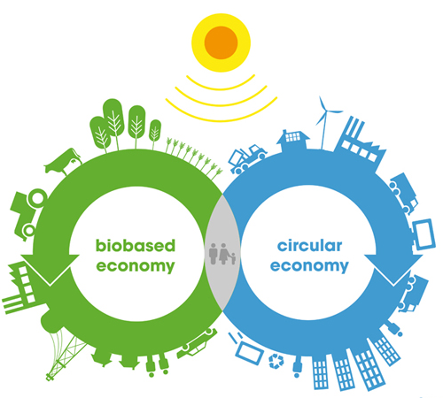
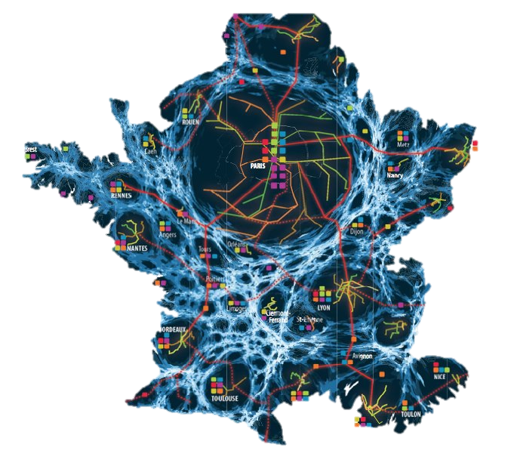
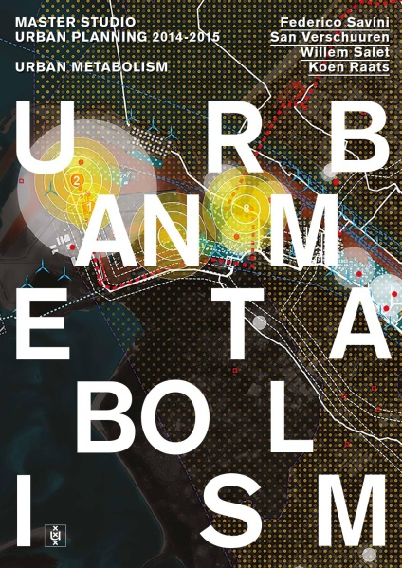
spatial planning main challenges
4.
circular economy
urban metabolism
Circular Economy and Urban and Regional Metabolism are mandatory in order to meet these challenges, particularly the first six.

Slide 9




2050: 9.8 billions
ecological overshoot
5.
+70%
+36%
+45%
+40%
We are now living in ecological overshoot:
By 2030 the world will be 14 % more populated, will need 50 % more food, 45 % more energy and 30% more water.
The resources consumption rate is higher than the planet's ability to replenish resources and absorb waste. The depletion of natural resources stock is closer than ever.
By 2030 two planets will not be sufficient to satisfy the current consumption patterns.
THAT IS WHY “BUSINESS AS USUAL” MODELS PRESENT SEVERAL GLOBAL RISKS THAT CAN SEVERELY THREATEN HUMAN SOCIETY.

Slide 10
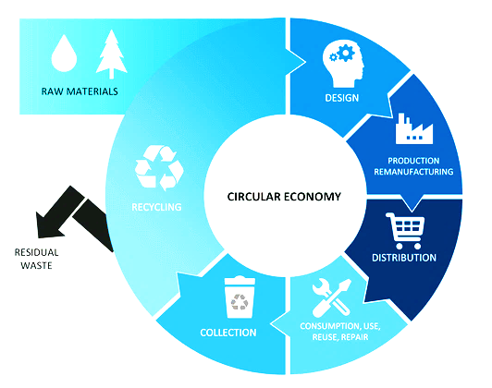
circular economy objectives
6.
the “3R”
(reduce, reuse and recycle)
“6R”
(repair, remake, refuse, remember, respect, restore);
CIRCULAR ECONOMY’S MAIN OBJECTIVES ARE THE REDUCTION OF RESOURCE CONSUMPTION, WASTE AND EFFLUENTS.
In order to achieve these objectives it is important to:
extend the life cycle of products, equipment's, materials, infrastructures and energy; change consumption habits, reducing excessive consumption;
turn waste and effluents into resources, using the “3R” (reduce, reuse and recycle);
ensure that waste and final effluent are benign, being neither toxic nor polluting;
apply circular economy principles in the design of products and processes; design and apply policies and taxes that promote circular economy;

Slide 11
circular economy objectives
6.
the “3R”
(reduce, reuse and recycle)
“6R”
(repair, remake, refuse, remember, respect, restore);
dematerialize, producing more with less and substituting products for services or electronic solutions; ensure the separation of products’ components, insuring that they can be mounted separately;
rethink the design of products and processes; intensify research, investment, information and civic education.
CIRCULAR ECONOMY IS AN IMPORTANT COMPONENT OF SUSTAINABLE DEVELOPMENT AND WILL THUS CREATE NEW BUSINESS OPPORTUNITIES AND JOBS.

Slide 12
urban and regional metabolism
7.
URBAN AND REGIONAL METABOLISM FOCUSES ON MAPPING FLOWS AND CREATING FORECAST MODELS
The study of circular economy at the urban and regional level requires the appliance of urban metabolism.
Urban and regional metabolism focuses on flows of people, food, water, biota, goods, solid waste, effluents, sediments, carbon components, energy and data, within cities and regions, in order build representation and forecast models that contribute to the achievement of the circular economy objectives.

Slide 13
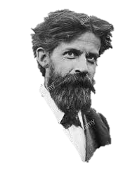
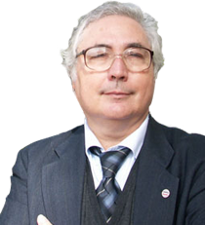
urban and regional metabolism
7.
“a city is more than a place in space,
it is a drama in time”
Patrick Geddes
“the idea of a contemporary city as a space of flows”
Manuel Castells

Slide 14
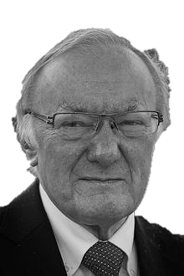
urban and regional metabolism
7.
“In short, our argument for a new science is based on the notion that to understand place, we must understand flows, and to understand flows we must understand networks. In turn, networks suggest relations between people and places, and thus the central principles of our new science depends on defining relations between the objects that comprise our system of interest.”
Michael Batty

Slide 15
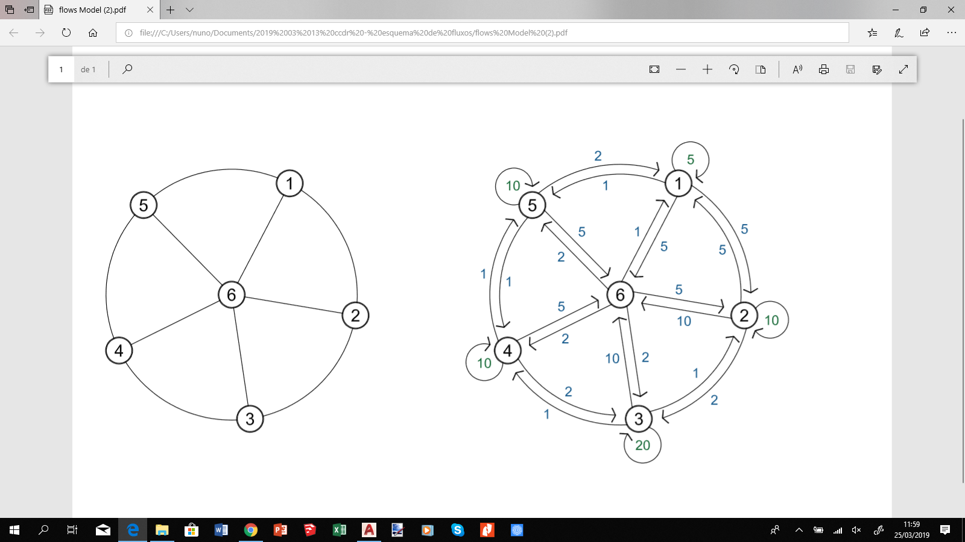
urban and regional metabolism
7.
Urban and regional metabolism is represented by networks that:
are constituted by nodes, links and flows. Nodes are connections points that can receive, create, store and send products, energy or data distributed by links, in the network. Flows can have two directions;
have flows that change their intensity within time and space;
show hinterland limits by the difference in flows’ intensity ;
combines regional hierarchy with the nodes relevance ;
illustrates the flows’ physical supports and infrastructures or digital presence (cyberspace);
are “open”, with external links and nodes, thus integrating global impacts.

Slide 16
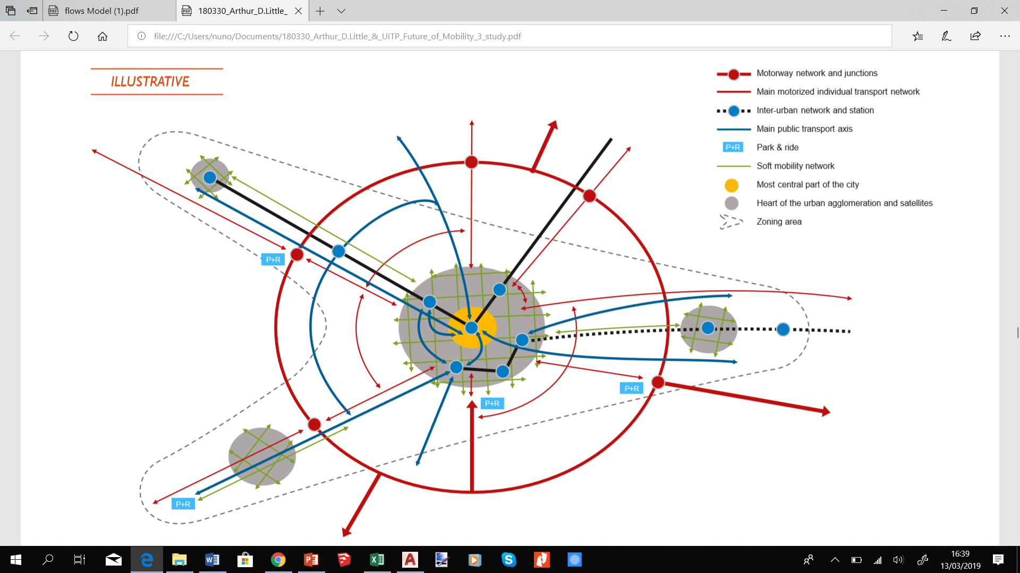
urban and regional metabolism
7.
The potential of urban and regional metabolism is of great importance, for it allows to:
identify and forecast flows;
analyze and forecast the chain of relations of production, transformation, distribution and consumption ;
analyze dynamics;
show opportunities for improvement and intervention;
the study can be made with zooms;
show the urban or/and regional structure in the territory through networks.
Figure 40: Towards multimodal transport master plans at city, region or even national level. Source: Direction générale de la mobilité, Etat de Genève, “Mobilités 2030, stratégie multimodale pour Genève”, 2013
VAN AUDENHOVE, François-Joseph. The Future of Mobility 3.0 - Reinventing mobility in the era of disruption and creativity (2018). Arthur D. Little, p61.

Slide 17
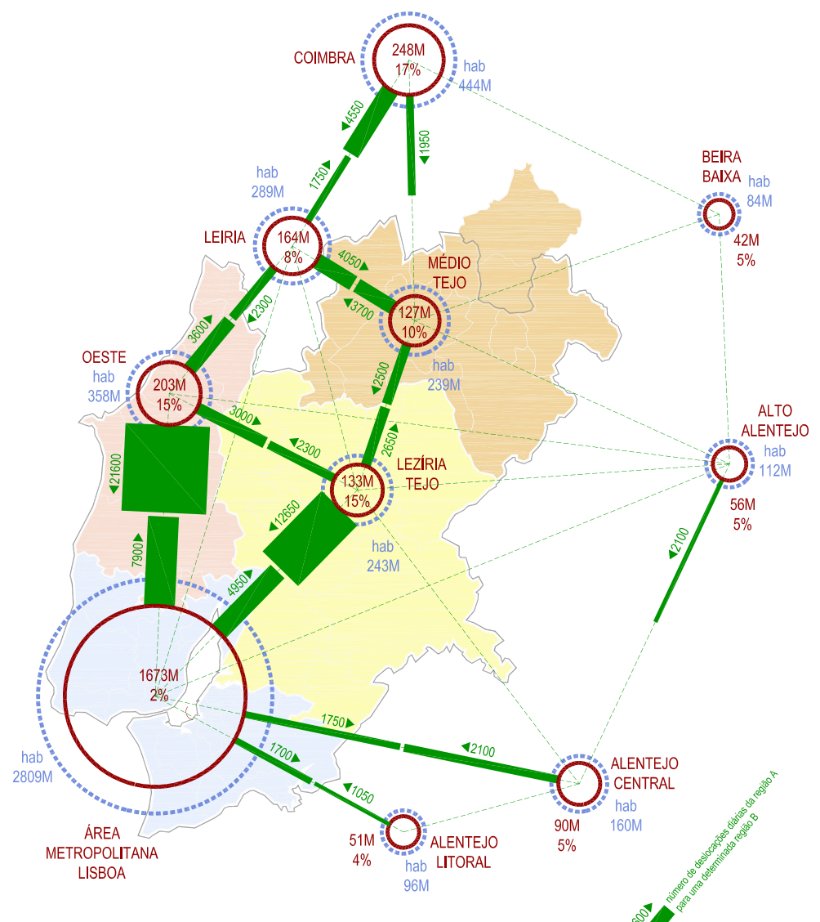
urban and regional metabolism
7.
By the analysis of urban metabolism in several cities, we can conclude that:
flows are very different depending on cities’ specialization: logistical, transportation, industrial, touristic, etc.)
different chain of flows must be studied, in order to optimize those that have an effect on the quality of life and that actively contribute to achieve circular economy objectives;
the application of each of the “9R” (reduce, reuse, recycle, repair, remake, refuse, remember, respect and restore) can be achieved through various appropriate intervention strategies;
it is always possible to find resources in waste and effluents;
It is possible to reduce consumption without damaging the quality of life.

Slide 18
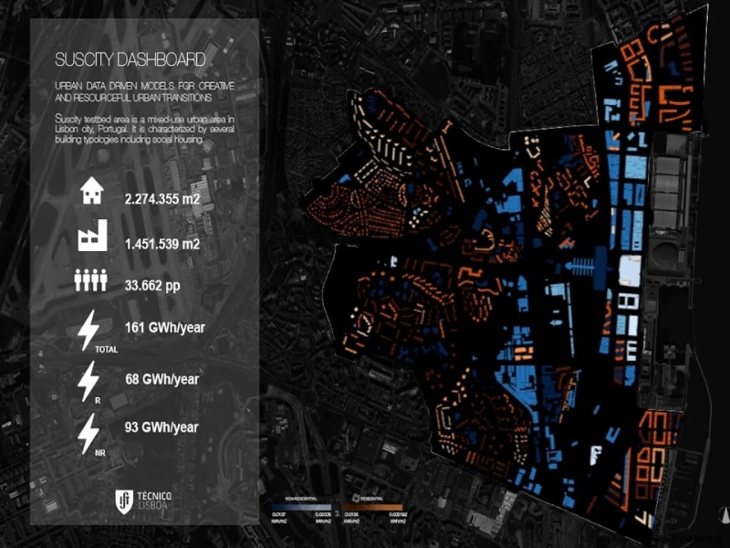
examples
8.
Here are shown some examples of spatial planning interventions (through infrastructures, equipments and design models) that can save resources and minimize Green House Gases (GHGs) emissions.

Slide 19
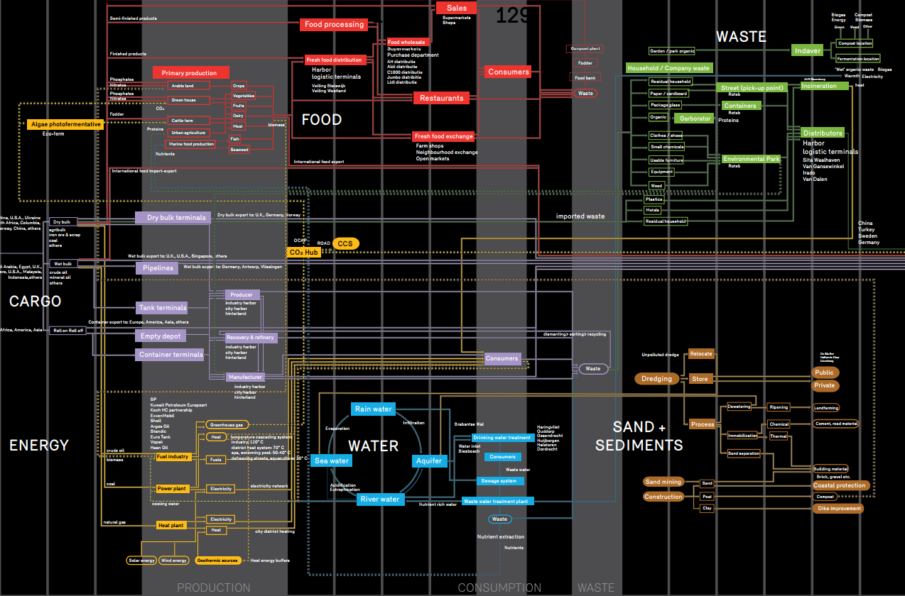
urban form and compactivity
9.
Urban form and compactivity can optimize urban resources consumption if used in a strategic way. It presents the ability of saving Land and energy;
It also prevents:
the production of construction material of building and infrastructures, as well as construction and demolition waste;
costs of use and maintenance;
costs of demolition, recycling and re-use.
Compactivity is related to urban components closely fitted together.
In that sense, urban forms and commuter lines minimize walking and travel distances and times in public transport systems.
THE COMPACT CITY NEEDS THUS LESS RESOURCES FOR CONSTRUCTION, MAINTENANCE AND OPERATION OF INFRASTRUCTURES

Slide 20
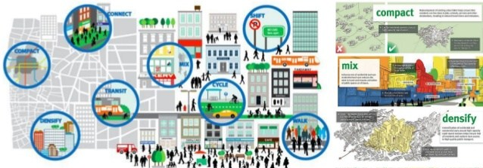
urban form and compactivity
8.
Urban form and compactivity can be optimized with:
high densities, strategic nodes, and well-articulated networks, with mixed uses, and with a good balance between residents, jobs and equipments, and urban designs to promote walking and cycling;
well-articulated networks such as:
  soft mobility networks (such as walking and cycling routes);
  mass transit systems in the strategic nodes (TOD-Transit-Oriented Development).

Slide 21
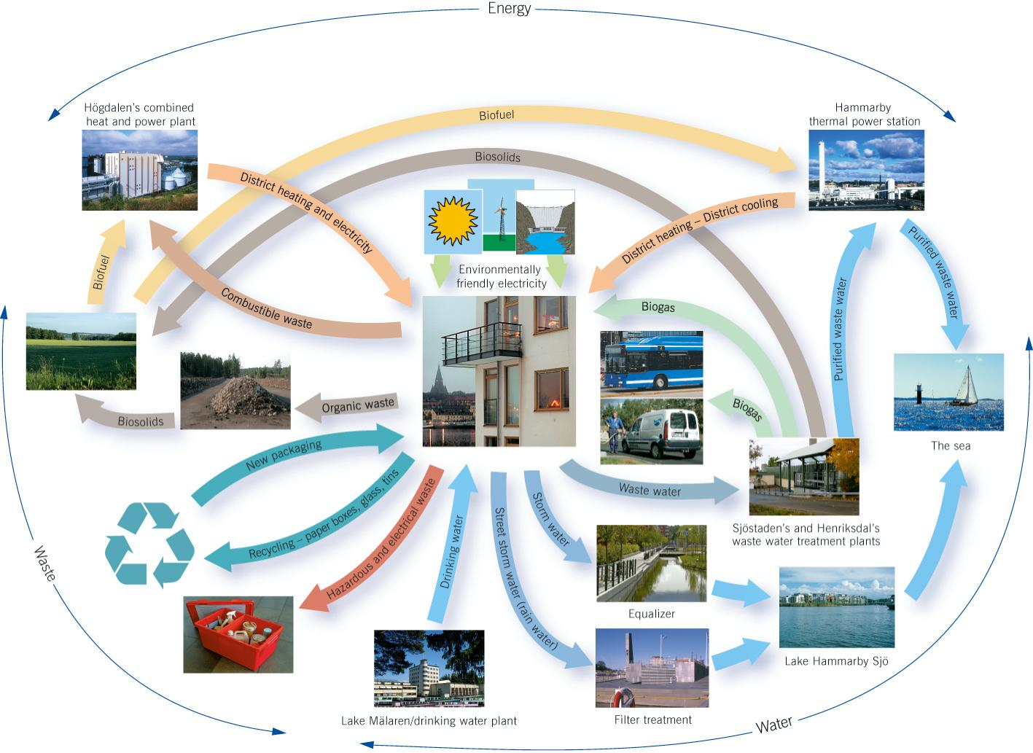
ECO-NEIGHBORHOOD
urban form and compactivity
8.
thermal power stations, district heating and industry networks;
waste water treatment plants and biogas networks for cars and houses;
waste water treatment plants and biosolids, to land to produce biofuel, to the heat and power plant;
stormwater, watering gardens, street cleaning and toilet flushing networks;

Slide 22
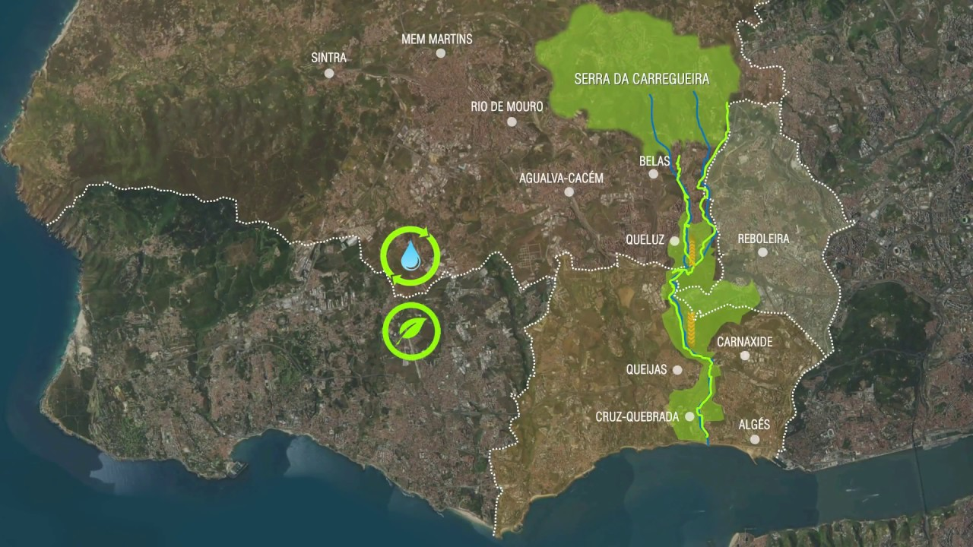
green and blue networks
urban form and compactivity
8.
Green and blue networks for a better climate balance, sustainable drainage system and protected drinking water supplies;
Green and urban food production networks and biodiversity systems;
Energy efficient buildings, quarters, neighborhoods and public space;

Slide 23
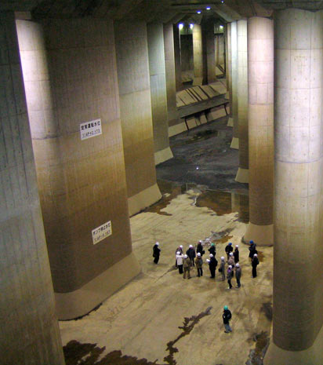
water tank of the Tokyo Metropolitan Area
urban form and compactivity
8.
Main water tank of the Tokyo Metropolitan Area Outer Underground Discharge Channel facility, 19 miles north of Tokyo, built to protect Tokyo megalopolis from flooding of heavy storms or typhoons. 177 meters long, 78 meters wide and 25 meters high. The water can be used to clean streets, water gardens and parks, and fire-fighting;
The Sumo-wrestling arena in Sumida City uses the 8400 m² of roof tops to catch rainwater into a 1000m³ underground storage. The water is used for toilet flushing and air conditioning. More than 1000 private and public building are using these systems;

Slide 24
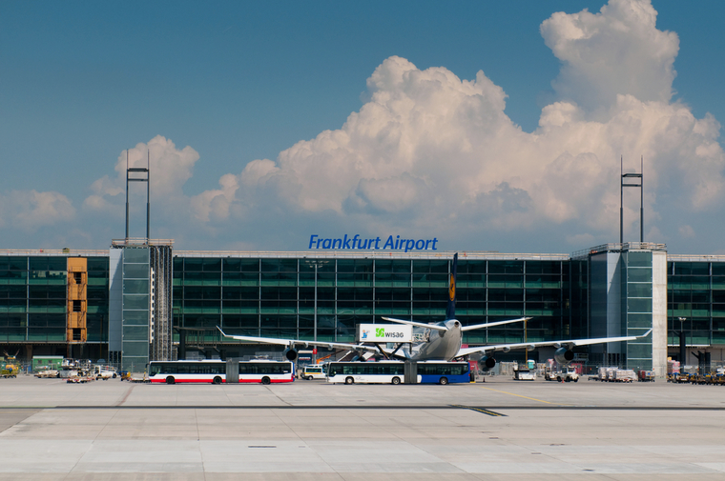
rainwater harvesting at Frankfurt Airport
urban form and compactivity
8.
The rainwater harvesting at Frankfurt Airport saves 1 million m³ of water per year. The water is collected from 26800 m² of roofs and stored in six tanks, with a capacity of 100 m³ each;
The Singapore system of rainwater harvesting includes the utilization of: big roofs; high rise buildings; urban residential areas; and capturing urban runoff;
Industrial Symbiosis is a model in which resources and energy are recycled and recovered instead of going linear. It turns the output (whether it’s products, energy, water, food, waste or effluents) of one enterprise into inputs of another;

Slide 25
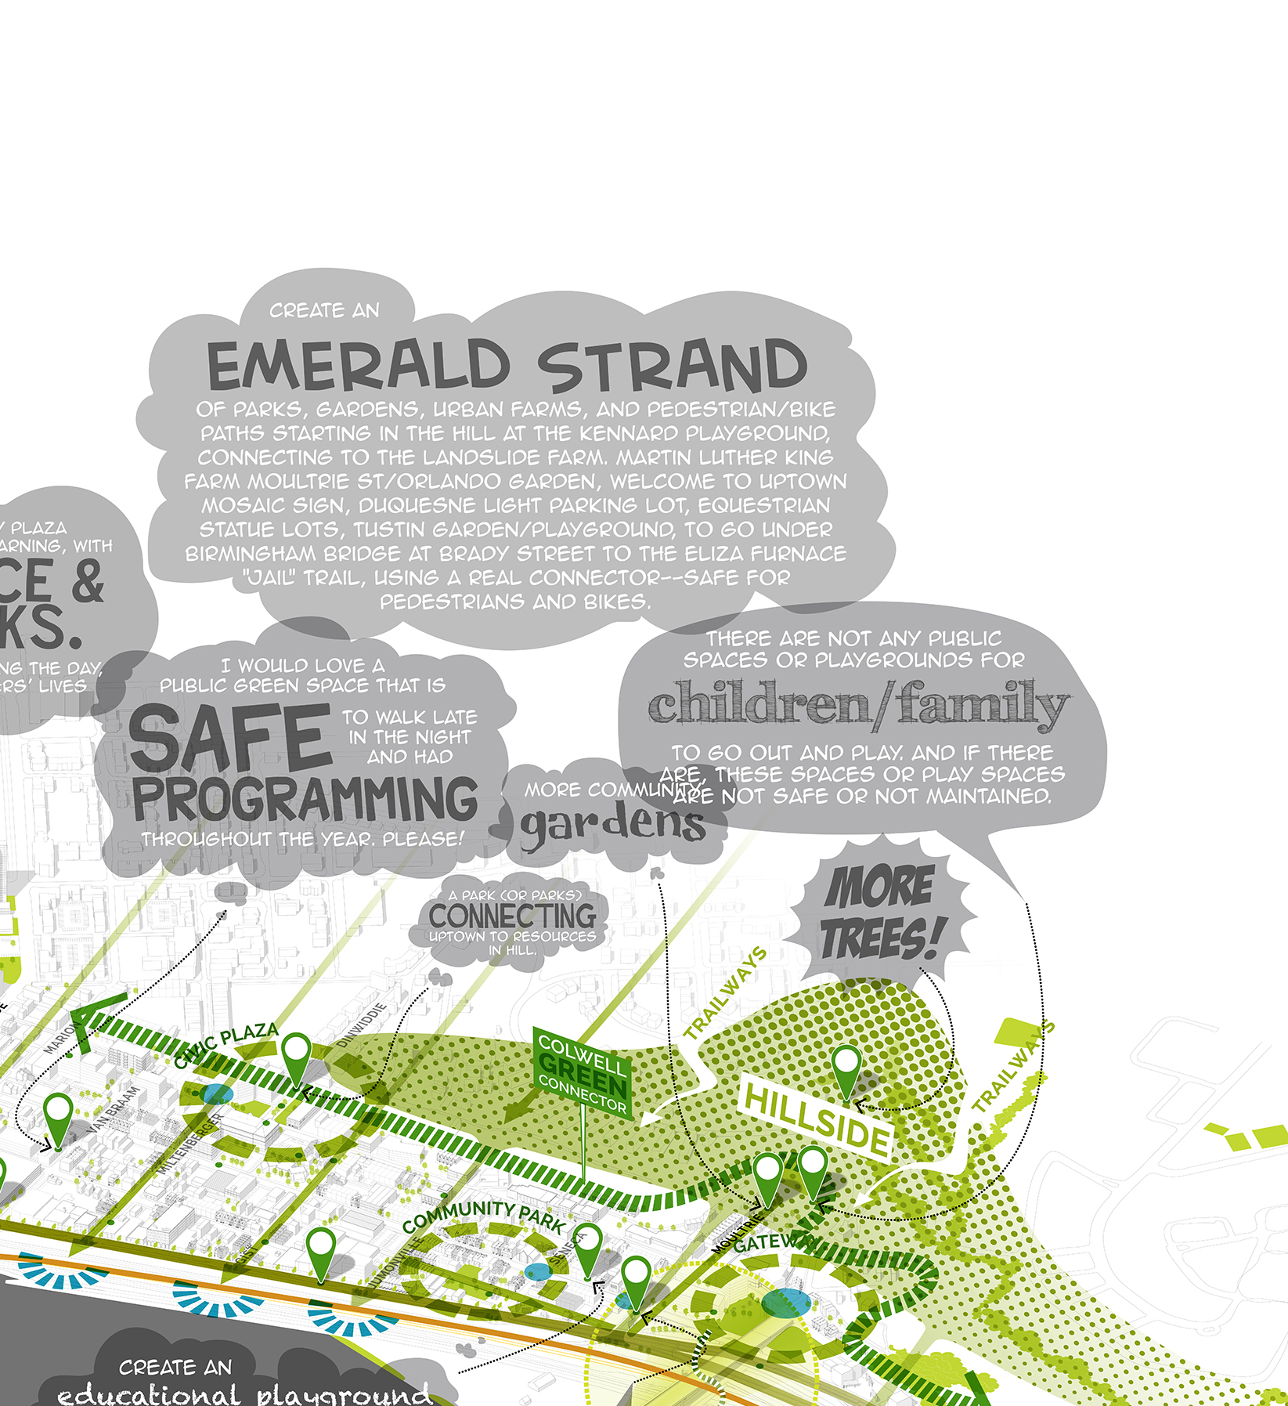
Eco-innovation parks
Pittsburgh
urban form and compactivity
8.
Eco-innovation parks promote various strategic objectives: waste management; energy efficiency; water management; flow of materials; renewable energy and industrial symbiosis;
“Park and Ride” is an important component of TOD. Parking lots are located near cities rings and local transportation system (trams, buses) are, whenever possible, near big attraction parks, arenas, stadiums, etc;
The parking lots shall have a big capacity and be almost free of charge during one to three days, so that people feel encouraged to use the public transport system;

Slide 26
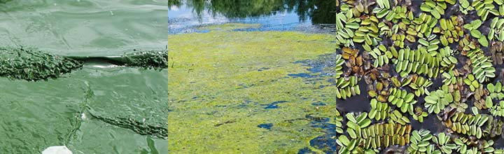
Catch the irrigation waters
take phosphates
to produce algae
urban form and compactivity
8.
Carbon dioxide capture and utilization: process of capture and utilization of carbon dioxide to recycling purposes such as upcycling (turning waste into products of higher value such as bio-plastics, bio-alcohols, concrete and biofuel). It presents a true potential for mitigating fossil fuel emissions;
Surpluses of phosphors and nitrogen nutrients of agriculture can be re-used in aquaculture and algae production in the health and cosmetic products industry;
Dry sewage systems can save fresh water;

Slide 27
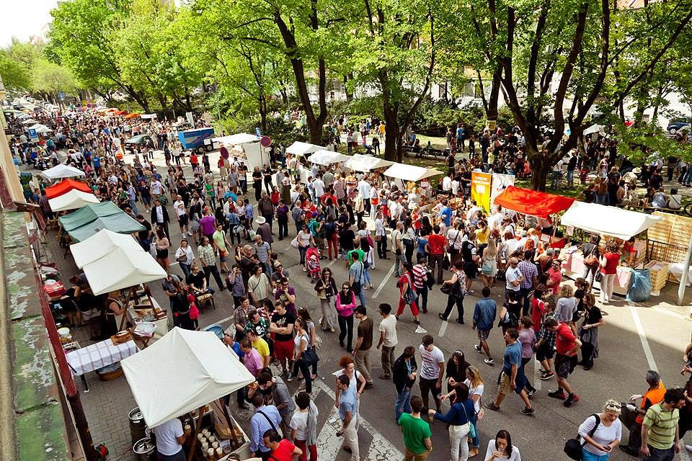
Flea markets and second hand markets
Bratislava
urban form and compactivity
8.
Flea markets and second hand markets provide the opportunity to buy household items, clothes, jewelry, bicycles, etc. These items can be sold by the owner or by a reseller, thus applying the principles of “reuse” and life cycle of products extension. It is important that Municipalities support these markets.
Misfit markets deliver ugly but edible fruits and vegetables One fifth of production is trashed because it is not attractive to the eye, although presenting the same quality. Ugly fruits and vegetables are generally sold 30 to 50 percent cheaper than “normal” retail prices.

Slide 28
Flea markets and second hand markets
Bratislava
urban form and compactivity
8.
It is necessary to promote these misfit markets and delivery companies in order to reduce food waste.
It is necessary to overcome five operational challenges:
  the systematic destructions;
  the efficient distribution;
  the liability;
  the profitability;
  the location.

Slide 29
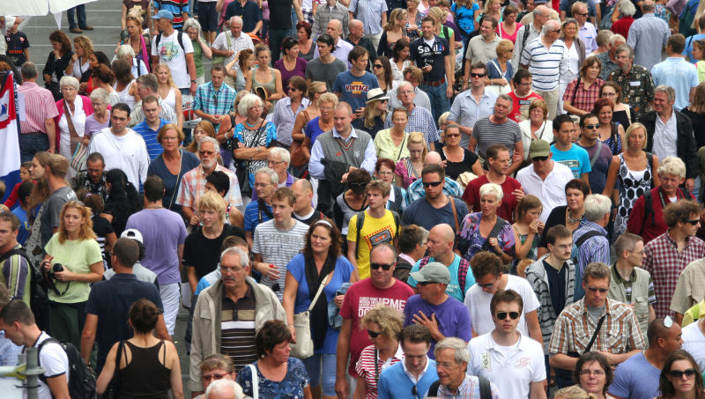


conclusion
Megalopolises, cities and regions’ evolution is challenged by the drivers of global change: demographic evolution, climate change, ecological overshoot, science technologies, digital revolution, networks, and concentration of capital and people.
THESE MAIN DRIVERS HAVE CHANGED SPATIAL PLANNING’S PARADIGMS.

Slide 30

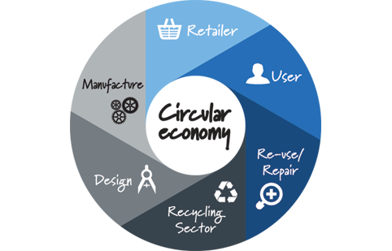
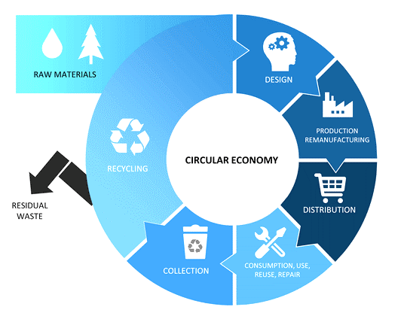
Historically, faced with the problems of public health and sanitation, the spatial planning presented zoning as a response. The zoning allowed the balance of uses, with structures, organization and densities compatible with the territories. At present time, current democracies, markets, and global economies, main problems are climate change, inequality and resources limits. the spatial planning presents circular economy as a response.
CIRCULAR ECONOMY IS ESSENTIAL TO TACKLE NEW PARADIGMS.
At the urban and regional levels, urban & regional metabolism is the methodology that puts into practice circular economy objectives, replacing zoning, former methodology of urbanism.

Slide 31

THANK YOU
João Pereira Teixeira
joao.pereira.teixeira@hotmail.com

